Slide 1

The Multiethnic Study of Atherosclerosis
Introduction to PSG Training

Slide 2
Outline
Review of Sleep
  Appreciate why and what we are doing
  Understand the reports generated
Overview of the PSG Visit
  Pre, During, Post
Working in the home
Alerts

Slide 3
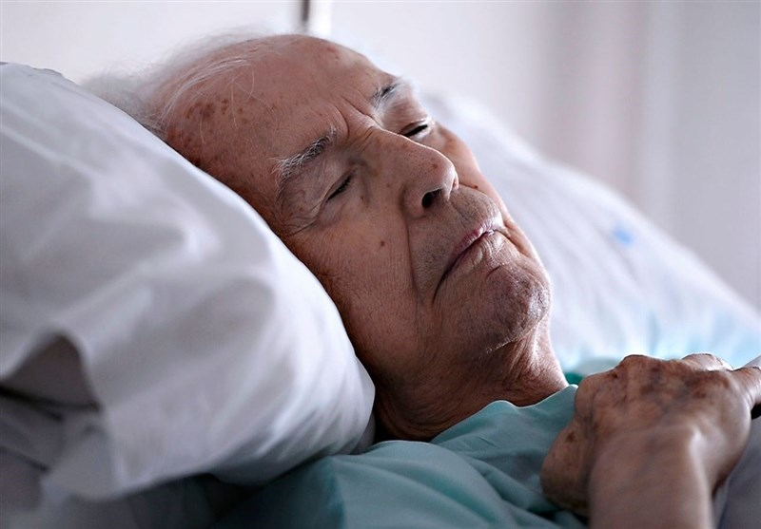

Brief Background on Sleep

Slide 4
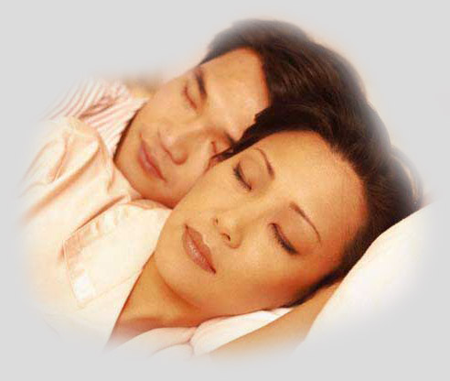
We need consolidated, restorative sleep for:
Functioning in a safe, efficient and effective way
Cognitive, social and physical performance
Learning and memory consolidation
Prevention of health problems and optimal health
  Cardiovascular Health
  Metabolic Health

Slide 5
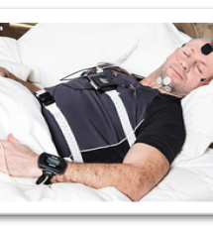
Measuring Sleep: Polysomnography
Considered “gold standard”
Precise neurophysiological monitoring of multiple channels of data
EEG, oximetry, airflow, effort,
ECG, legs

Slide 6
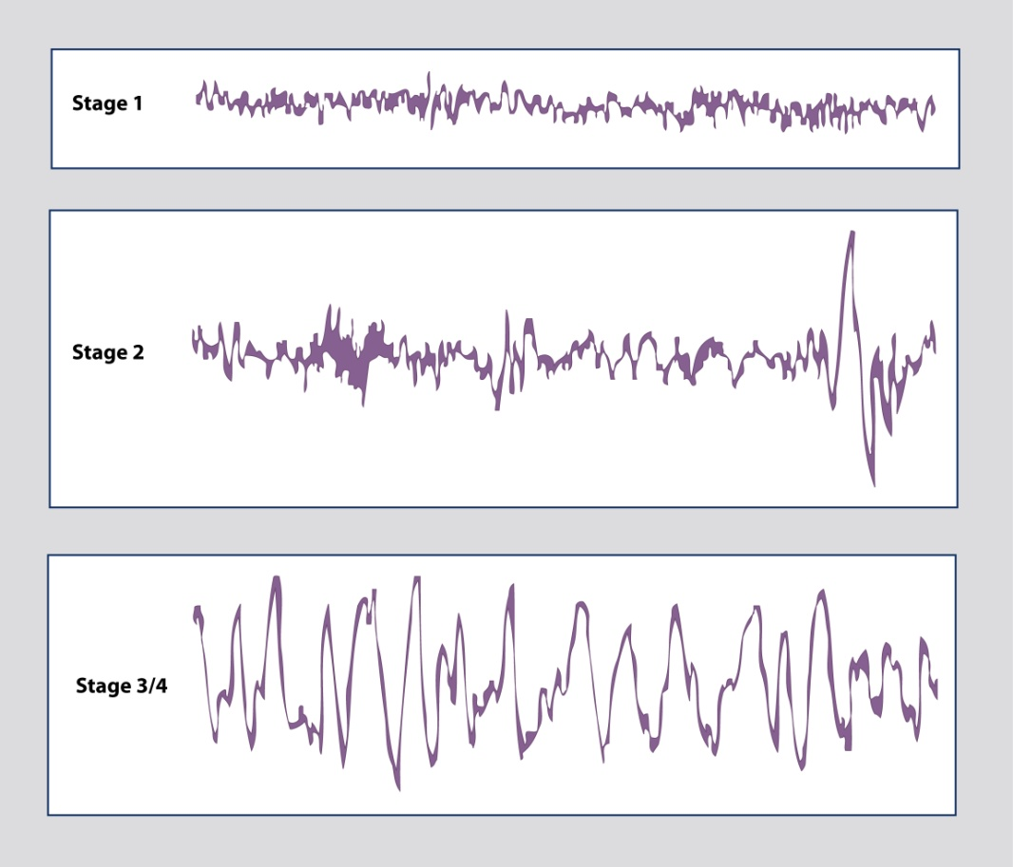
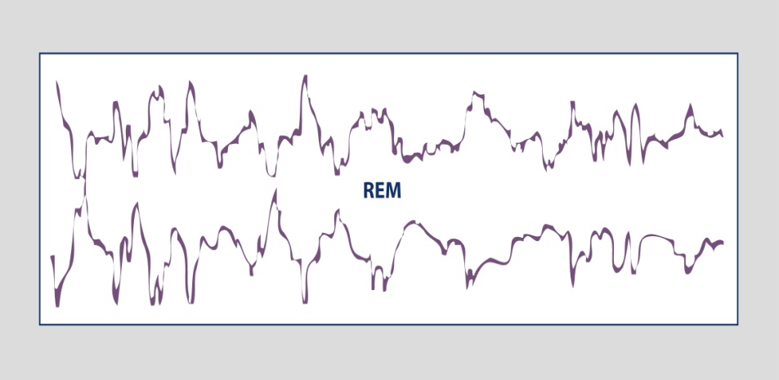
During the Sleep Cycle
Brain waves represent different stages of sleep.
NREM Stages of Sleep
REM Sleep

Slide 7
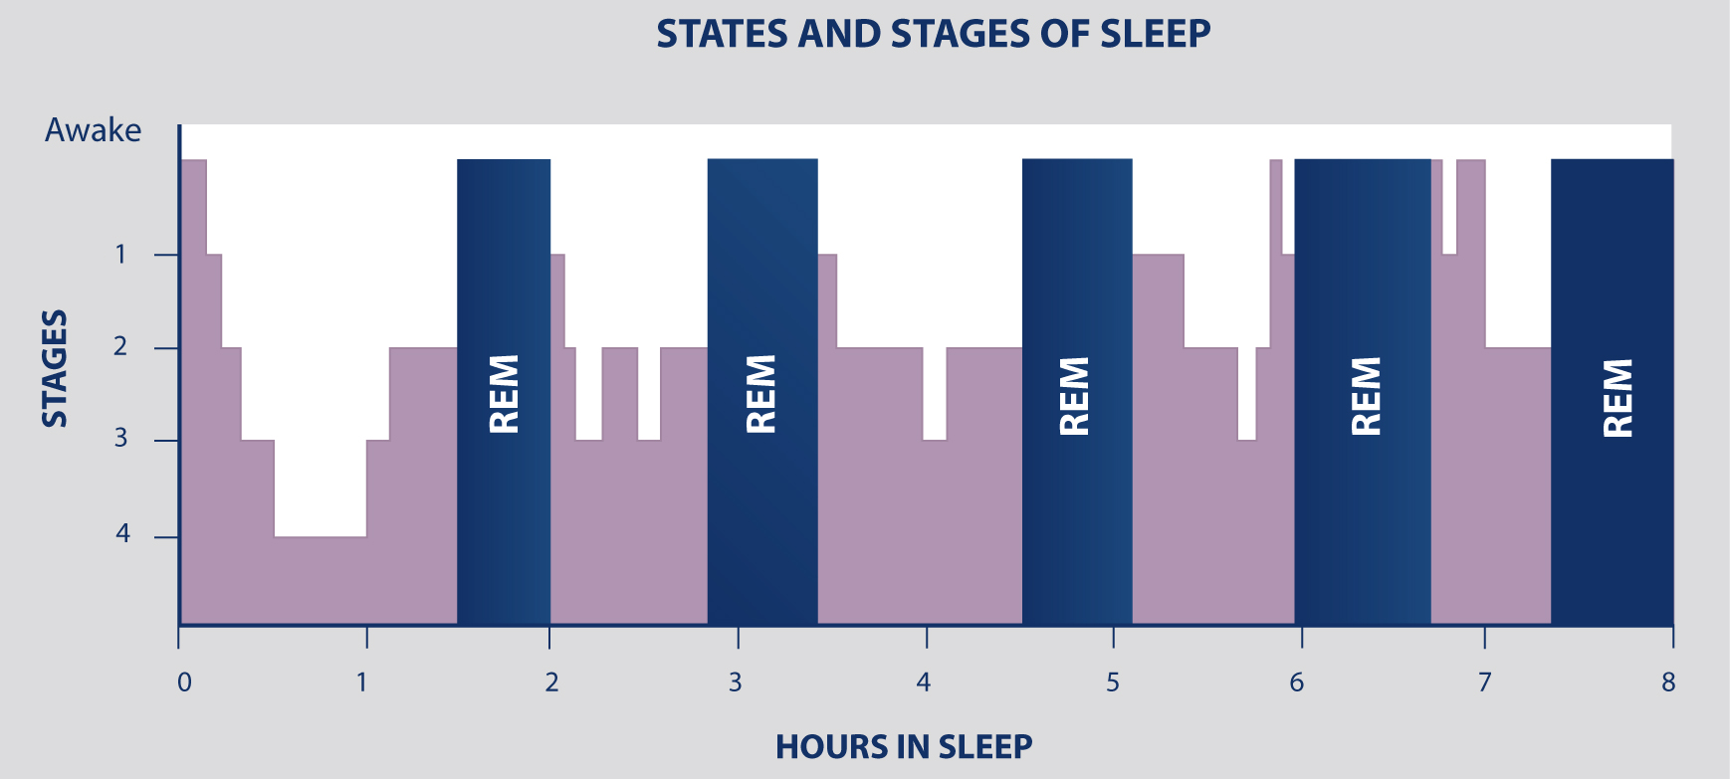
The Sleep Cycle
Alternating states and stages of sleep that occur over an 8-hour time period:
  NREM: Non-Rapid Eye Movement; Stages 1-4; 75% of the night
  REM: Rapid Eye Movement; Dreams occur; 25% of the night

Slide 8
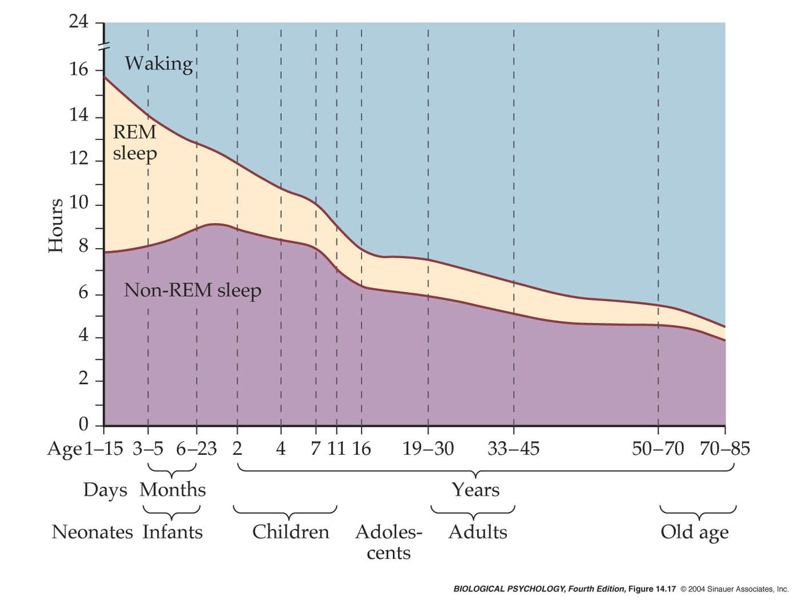
Change in Sleep States with Age
Notes:
biopsych4e-fig-14-17-0.jpg

Slide 9
Common Sleep Disorders In Older Adults
Insomnia
  Problems initiating or maintaining sleep
  Hyperarousability, abnormal cortisol, sympathetic activation
Sleep Apnea
  Recurrent breathing pauses
  Hypoxemia, sleep fragmentation, breathing swings
Restless legs Syndrome / Periodic Limb Movements
  Recurrent leg jerks during sleep
  Arousals, sympathetic surges
REM-Behavioral Disorder

Slide 10
Insomnia: The Most Common Cause of Sleepless Nights
Difficulty falling asleep, staying asleep, early morning awakenings, resulting in daytime impairment
  Affects at least 1/3 of the adult population occasionally and 10–15% on a chronic basis
  Can be acute in response to a life event
  Can become chronic

Slide 11
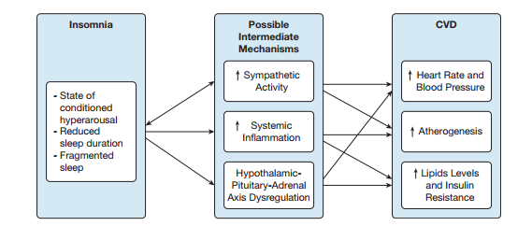
Insomnia and CVD
                Javaheri, Redline CHEST 2017

Slide 12
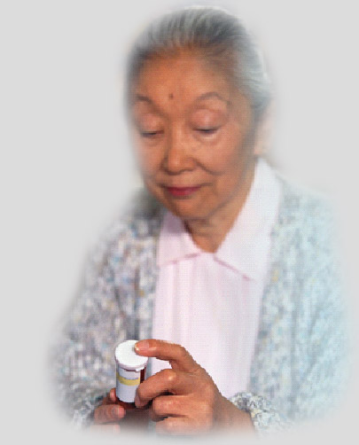
Treatment of Insomnia
Pharmacological Treatment
  Over-the-Counter (OTC’s)
  Prescription Medications
Behavioral Management
  Stimulus Response
  Sleep Restriction
  Cognitive Behavioral Therapy
  Relaxation Training

Slide 13
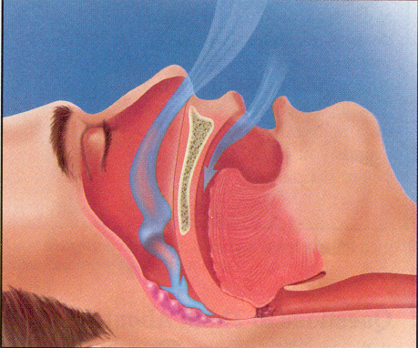
Sleep Disordered Breathing (Sleep Apnea, OSA)
Repetitive episodes of partial or complete upper airway obstruction during sleep, associated with hypoxemia, snoring, daytime sleepiness

Slide 14
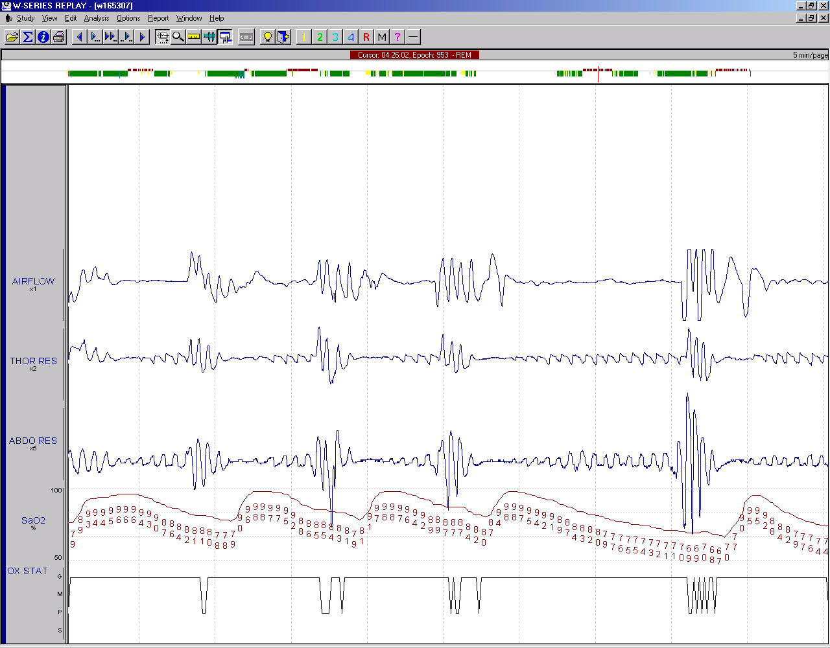
Sleep Disordered Breathing

Slide 15

What are the Symptoms of
Sleep Apnea?
Snoring
Pauses in breathing
  snorting/gasping
Frequent awakenings
Unrefreshed sleep
Excessive daytime sleepiness
Morning headaches/dry mouth

Slide 16
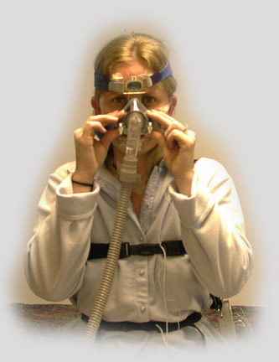
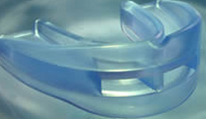
Treatment of Sleep Apnea
Behavioral Therapy
  Avoid alcohol, nicotine and sleep medications
  Lose weight if overweight
Physical or Mechanical Treatment
  CPAP (Continuous Positive Airway Pressure)
  Dental appliance
Surgery

Slide 17
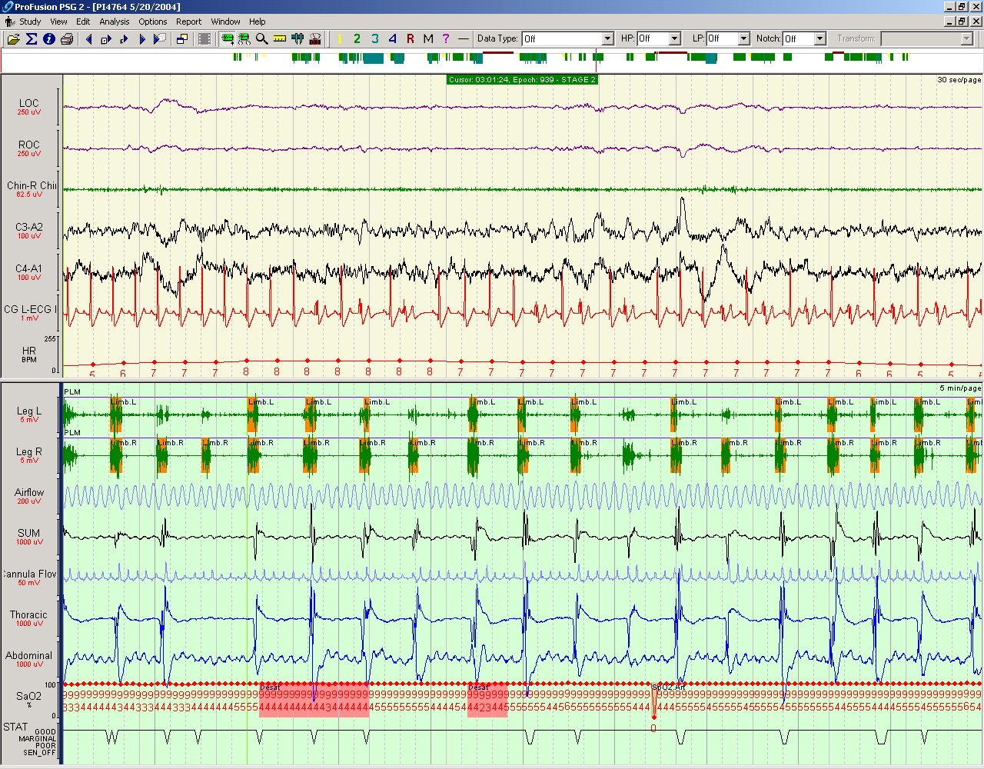
Restless Leg Syndrome
10% to 35% of older individuals
Creeping sensation in lower extremities
Tingling, cramping or even very painful sensations usually in the lower extremities
Intense urge to move or massage legs usually occurs when patients go to bed and cause sleep onset insomnia
Often associated with periodic limb movements
Periodic Limb Movements:
Repetitive/continuous leg jerks
every 20-40 seconds during sleep

Slide 18
REM Behavioral Sleep Disorder
Loss of normal muscle atonia in REM sleep
During REM sleep: dream enactment, trashing limbs, complex activity
Precursor/marker for neurodegenerative diseases (Parkinson Disease)

Slide 19
Why Perform Polysomnography in MESA?
Objective and quantitative evaluation of:
Sleep apnea (sleep disordered breathing)
  Central and Obstructive
Overnight oxygenation
Sleep depth, continuity and duration
Periodic limb movements
Overnight heart rate and rhythm
EEG markers of brain function
  Spindles, slow waves, etc

Slide 20
Key PSG Measurements
Abnormal
  AHI > 15 (moderate)
  AHI >50 (Urgent Alert)
  <85% > 10% (Urg Alert)
  ArI > 30*
  Sleep Efficiency <85%*
  PLMI >15*
  %REM < 15%*
  %N3 < 15%*
AHI (Apnea Hypopnea Index)
Apnea—no breathing for > 10 sec
Hypopnea- partial breathing for > 10 sec
Obstructive- with effort
Central- with no effort
AHI: Average number of Hypopneas and Apneas per hr of sleep
Measures of oxygenation
Arousal Index
Brief (3-29 sec) awakening from sleep
ArI: Average number of Arousals per hr of sleep
Sleep Efficiency
% of total time in bed spent asleep
PLM (Periodic Limb Movement Index)
Number of limb movements per hour
Sleep Stages
% REM; %N3 (Deep, Slow Wave)
* Thresholds vary by age

Slide 21
MESA Exam 5 Polysomnography
Completed over 2100 in-home PSGs
High quality data and well-tolerated
Published over 50 articles
Prevalence in a multi-ethnic cohort
Unique characteristics/mechanisms for sleep apnea in different groups
Associations with a wide variety of health outcomes

Slide 22
MESA Exam 5 PSG: Key Findings
  Gender and race/ethnic differences
    Sleep disorders under-recognized, especially in minorities
    Unique characteristics of sleep apnea in men vs women, by age, etc
  Sleep disturbances associated with
    Glucose impairment
    Stress reactivity
    Cardiac function
    Coronary artery calcium
    Atrial fibrillation
  Genetic analyses of sleep
    Accelerated biological aging
    Genetic markers of sleep apnea

Slide 23
Sleep Disparities
Odds of Having the Disorder By Race/Ethnicity
 | Black vs White |  | Hispanic vs White |  | Chinese vs White
 | Age & sex adjusted |  | Age & sex adjusted |  | Age & sex adjusted
 | OR (95% CI) |  | OR (95% CI) |  | OR (95% CI)
Diagnosed sleep apnea | 0.92 (0.65, 1.30) |  | 0.71 (0.48, 1.04) |  | 0.28 (0.14, 0.57)
Habitual snoring | 1.02 (0.82, 1.27) |  | 1.76 (1.40, 2.21) |  | 1.29 (0.97, 1.73)
Severe Sleep Apnea
AHI >=30 | 1.25 (0.87, 1.78) |  | 1.91 (1.32, 2.77) |  | 1.60 (1.02, 2.53)
Sleep duration
<6 hours | 5.01 (3.67, 6.84) |  | 2.27 (1.66, 3.10) |  | 2.42 (1.65, 3.56)
Poor sleep quality | 1.78 (1.15, 2.75) |  | 1.35 (0.84, 2.19) |  | 1.37 (0.74, 2.53)
Daytime sleepiness | 1.82 (1.35, 2.45) |  | 1.23 (0.88, 1.71) |  | 0.95 (0.61, 1.47)
Chen, X Sleep 2015
Hispanic and Chinese with most severe OSA
Majority were undiagnosed!

Slide 24
Sleep Apnea May A Different Disease in Men vs Women: Treatment Implications
Older men
More collapsible airway
May be most susceptible to residual sleep apnea with therapies that only address anatomy
Women
Shorter apneas, awake more easily
May be less tolerant of CPAP
May benefit from hypnotics

Slide 25
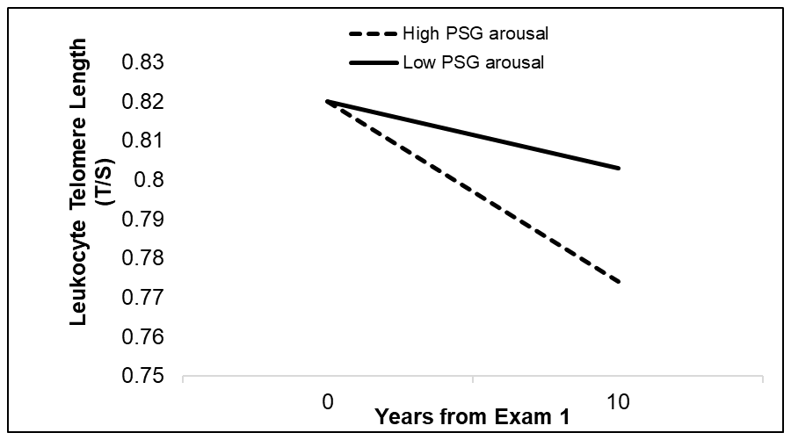
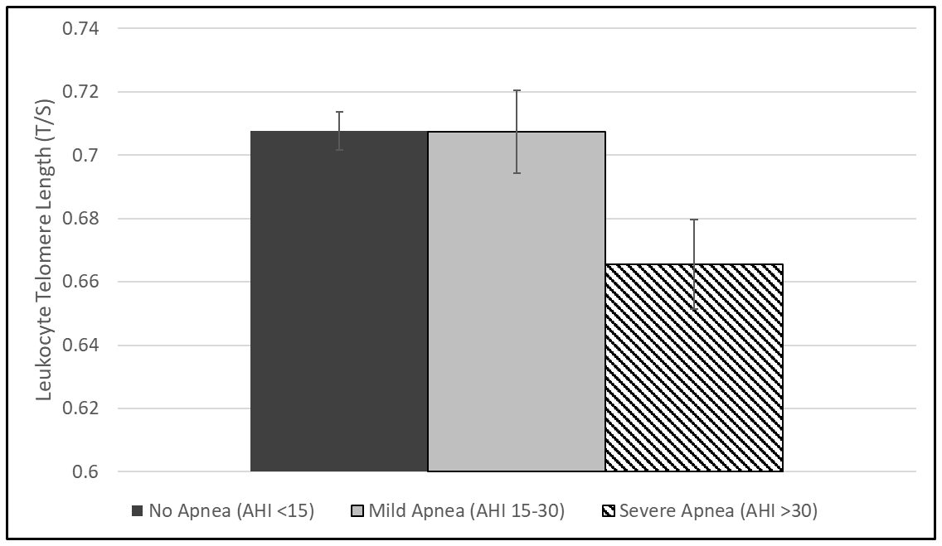
Estimated mean and standard error of leukocyte telomere length by AHI
Accelerated Telomere Shortening
(Biological Aging) With Sleep Disturbance
Estimated mean leukocyte telomere length at year 0 and 10 by Arousal Index (top quartile vs. bottom 3 quartiles)
AHI>30: beta -0.042 (.016); p=.002
Adjusted for age, sex, ethnicity, BMI, smoking, PA
Carroll, Sleep, 2019

Slide 26
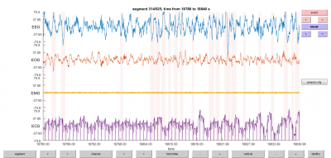

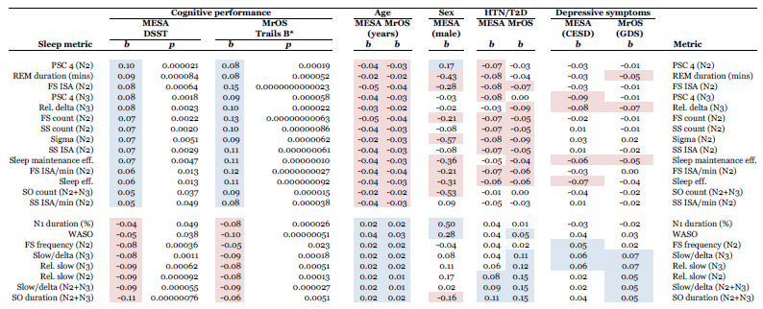
Sleep Architecture Linked to Age and Cognition
(Opposing Directions)
This Photo by Unknown Author is licensed under CC BY-SA
Djongalic….Purcell, Nat Hum Beh; 2020

Slide 27
Why Repeat A PSG Study In Exam 7?
Very little data on longitudinal relationships between sleep and cardiovascular and brain health
  How do changes in sleep over time influence risk of developing cardiac disease and cognitive impairment?
    Quantify risk over time
Understand associations of sleep with new brain markers of cognition, cognitive aging, and AD-related risk
Link sleep to overnight BP to vascular and brain outcomes

Slide 28

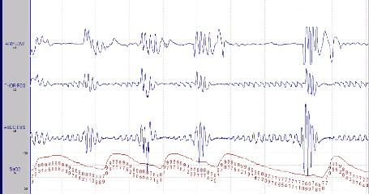
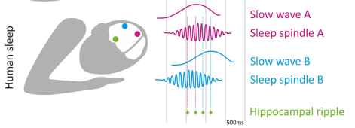

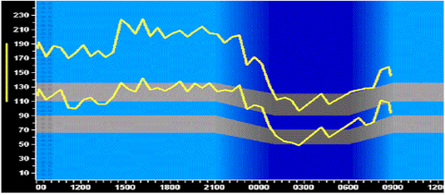
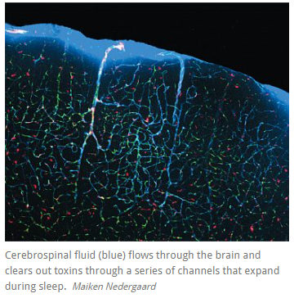
MESA-MIND-Sleep: Rationale
Impaired drainage in the glymphatic system, oxidative stress, inflammation, vascular stiffness, nocturnal surges in BP, altered cerebral blood flow, circadian misalignment
Accumulation of toxins (Aß, tau)
Neurodegeneration, reduced brain volumes, disturbed anatomic microstructure, and impaired synaptic plasticity
Sleep → Cognitive Decline/AD
Hypoxemia/OSA Macro/Micro Architecture Circadian Sleep duration, depth and fragmentation
        Electrophysiological oscillations
Geva-Sagiv, Nir. Front Neuro, 2019
Cognitive impairment, cognitive decline, AD/ADRD

Slide 29
Participant Feedback/Medical Alerts
Studies scored within 2 business days of receipt.
Similar to Sleep Exam 5, participants will receive a feedback letter summarizing key results of their sleep studies and ABPM results, including an explanation of typical ranges and general health recommendations.
Urgent alerts (or other abnormalities) be reviewed by Drs. Redline or Bertisch, who update the Alert forms in REDCap. The FC PI reviews this information, including information on known conditions and treatment, and then contacts the participant (and their physician) as indicated to expedite referral.
Proposed medical alerts:
  PSG:
    AHI > 50 (and not currently being treated for OSA)
    > 10 % of the recording time at an oxygen saturation < 85%
    > 2 continuous minutes in which heart rate is < 30 or > 150 BPM
    Atrial fibrillation of any rate not previously noted or known atrial fibrillation with ventricular rates <50 or > 120
    second or third degree AV block
  ABPM:
    24 hour SBP > 180/110
    Immediate Alert: At placement: If >180/>110, BP will be rechecked after 15 mins (assuming asymptomatic. If still elevated but < 210/<120 the participant will be advised to call their physician within the next 24 hrs (if none, referred for the ER). If >210/>120 (after repeat measurement) or symptomatic, the participant will be advised to contact their physician immediately or go to the ER.

Slide 30
MESA-Sleep Protocol Pre-Visit
At the clinic visit (if possible)
  Consent for the PSG
  Try to schedule the night after the ABPM if possible, and within the 8 days of in-home monitoring
    Ascertain best time to visit
      Late afternoon, early evening
    Obtain directions
  Provide participant instruction forms (prepare for visit)
Within 2 days of the home visit, confirm visit and ascertain that no acute medical illnesses occurred.
  Obtain directions (if not already done)
  Remind participant on key preparations

Slide 31
Day of the Study
Prepare equipment and supplies:
  Check that all equipment is clean
    Fresh batteries
  Ensure that all supplies are present
  Check PSG supply kit
  Detailed sleep questionnaire
  Verify correct participant ID on paper forms
  Set time and configure software
  Enter equipment information on equipment log

Slide 32
Morning of the Study
Make a reminder call to the Participant:
  Instruct the participant to be dressed for bed, have clean hair and face
  Ascertain participants usual bedtime so Nox device can be configured to start 1 hour before
  Ask the participant to prepare a surface where you can complete PSG hook-up
  Confirm directions to participant’s home
  Provide your number (cell) should plans change
  Ascertain absence of acute medical/psychological stresses
  Provide the participant with technician names, who to expect

Slide 33
Evening of the Study
Explain study
Informed Consent (if not done)
PSG Hook-up
Review Sensor Placement with ppt
  Use mirrors if needed
Participant Instructions
  Checking placement before bed
  Removal of equipment
    Use instruction form
Complete Questionnaires and Data Tracking Form
Arrange for monitor retrieval

Slide 34


Slide 35
Evening of the Study
Arrival:
  Be punctual
  Introduce yourself and provide identification to the participant
  Determine a suitable workplace (usually a kitchen table)
  Arrange your materials quickly
  Use a chuck or towel to prevent damage to furniture
  Explain what you are doing and answer any questions the participant may have

Slide 36
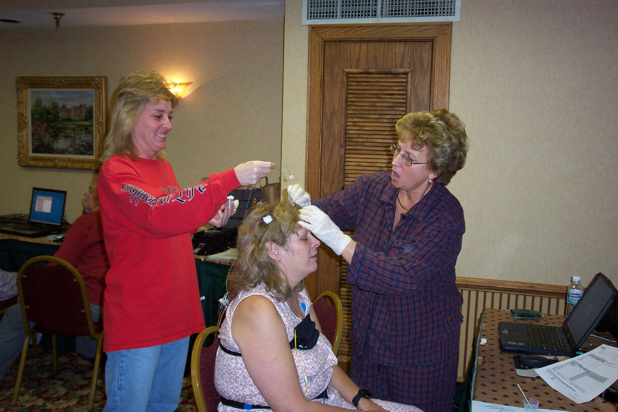

Slide 37
Evening of the Study
REMEMBER:
You are a guest in someone else’s home. Be considerate of the participant’s feelings and belongings, this is their turf.
Ask permission before moving chairs, etc.
Be careful that the equipment or supplies do not damage or harm the participant’s property.
Clean up after yourself.
Treat participant pets with caution and respect.

Slide 38
“Would it be OK for
your wife to hold “FLUFFY” while I do the hook-up?”

Slide 39
Evening of the Study
Departure:
  Pack all equipment and supplies and take all rubbish with you
  Ask the participant about any final questions that they may have
  Provide a phone number for emergency contact
  Wish the participant a good night!

Slide 40
MESA-Sleep After PSG Return
Post-PSG (in-clinic):
  Clean Electrodes and Sensors
  Update equipment inventory log
  Upload PSG studies to the CC Cloud
  Complete PSG Data Tracking Form and transmit data to the Reading Center
  Verify Sleep Questionnaire is complete and accurate, phone participant if necessary to complete
Generate feedback letter
  Communicate alerts, if identified, with PI

Slide 41
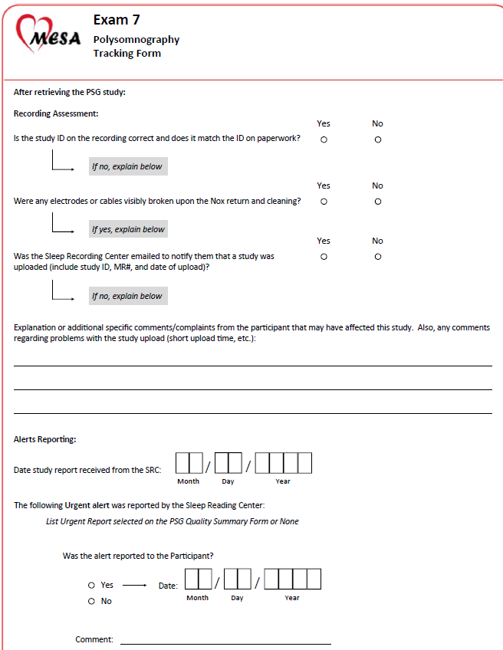

Slide 42
Quality Assurance
  Training and Certification
  Defined protocol
  Monitoring/feedback of adherence to protocol and performance
    Quality grade for each signal
    Quality grade for study interpretability
  Team work!
    Coordinator/Sleep calls

Slide 43
Obtaining Certification
Attendance at Central Training
If trained at site, the On-Site Training Check Sheet completed by the instructor and submitted to the Reading Center.
Submission of the PSG practical exam.
The evaluator must be a member of the training staff or a certified tech that attended Central Training.
Submission of the PSG written exam.
Submission of an acceptable practice (non-subject) PSG recordings.

Slide 44
Acceptable Sleep Study
Overnight recording on non-study volunteer
Good quality on each channel
All electrodes must work
Signals must be relatively free of artifact
Reflect MESA PSG protocol and procedure
Completed paperwork and transmission

Slide 45
Maintaining Certification
Frequency of actual field work
  Minimum 2 studies/month
  Hook-up only on a volunteer may substitute for actual field work.
Quality of studies
Scorer assigns a quality grade to each recording (poor, fair, good, excellent, outstanding)
Must maintain average grade of 85% of work in the very good (or above) range
Low grades?
SRC looks for cause (participant, equipment malfunction, poor tech performance)
May need to retrain and work under 1:1 supervision of certified tech in good standing

Slide 46
In the home….
2 person team
  Stay together
Inappropriate behavior
  Leave immediately

Slide 47
In the home….
Concern about medical safety
  You may suggest ppt call his doctor
  Call your MD on call
  Call 911

Slide 48

Never leave equipment in the car
  Theft, heat, cold

Slide 49
Additional “safety” issues
Certain neighborhoods
  Consider escort
Your safety comes first
Might consider alternative location
  hotels

Slide 50
Successful PSG Field Collection for a Large Research Study
Remove the Unknown
  Standardized Equipment and Procedure
  Study-wide Quality Assurance
  Feedback and Quality Grading
  PSG Technician Calls
  Resource People
  Call the Reading Center for help
Notes:
In addition to good application techniques during the hook-up other factors contribute to successful field collection

Slide 51
Additional Information on PSG Setup
To Be Covered in more detail in Central Training

Slide 52
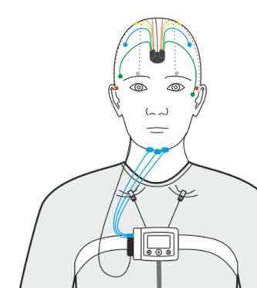
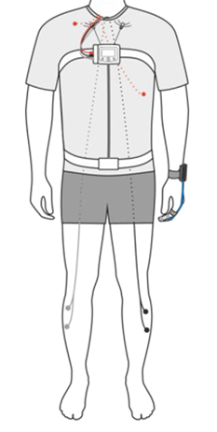

Slide 53
Introduction to the PSG Hook-up
Successful Monitoring
Key Points for Successful Monitoring of Physiological Data
  Place electrodes and sensors in areas expected to generate the desired signal.
  Place sensors in a fashion known to maximize the desired signal.
  Remove physical barriers for the electrode to work efficiently
    Part hair, clean skin, etc
  Place the electrode using good application techniques.
Notes:
To re-cap:
All those wires mean something , each has a job that the other cannot do, each is important to quality research.
Because the study is not attended you have 1 chance to get it right.
We will practice getting it right for the next 2 days

Slide 54
Introduction to the PSG Hook-up
Successful Monitoring
Use Good Application Techniques
  Movement and perspiration weaken the electrode’s bond with the placement site.
  An electrode fails to work once it has lost contact with its proper site.
  Electrodes must be applied securely with the expectation that the participant will move and sweat.
Notes:
We will be here to help you and give you tips during your practice.

Slide 55
Signal Details
Introduction to the PSG Hook-up
Why is EEG Important?
  Changes in brain waves help determine wakefulness from sleep.
  Changes in brain waves help distinguish between different levels of sleep.
  Changes in brain waves identify features associated with brain function.
Notes:
Collecting EEG is important to determine if sleep is occurring and about the level of sleep

Slide 56
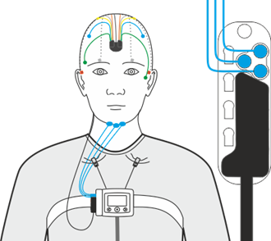
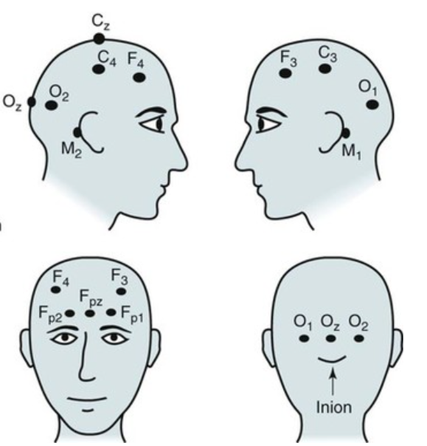
Head Electrodes (EEG)
E: Eye
F: Frontal
C: Central (mid head)
O: Occipital (back)
M: Mastoid (behind ear)
1,3: Left
2,4: Right
Z: central

Slide 57
Signal Details
Introduction to the PSG Hook-up
Why is EOG Important?
  Eye movement patterns change in wakefulness, drowsiness, and REM.
  Brain waves during REM resemble those in wakefulness, so EOG helps confirm the stage of sleep and distinguish wakefulness from REM.
Notes:
Electrodes near the eyes help determine wake from sleep and identify REM sleep

Slide 58
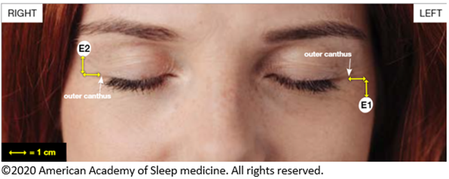
Introduction to the PSG Hook-up
Successful Monitoring
Sensor Placement
  EOG: On the face near the eyes.

Slide 59
Signal Details
Introduction to the PSG Hook-up
Why is Chin EMG Important?
  Chin EMG helps distinguish wakefulness from REM. Facial muscles remain toned in wakefulness, but muscle tone drops out in REM.
Notes:
Facial muscles relax in sleep and during REM lose their tone. This is best seen with the strong muscles of the chin.

Slide 60
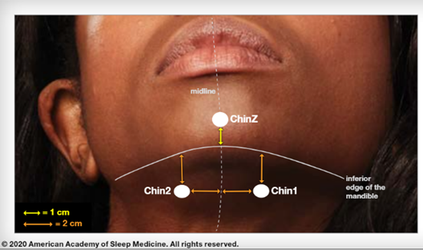

Introduction to the PSG Hook-up
Successful Monitoring
Sensor Placement
  EMG to record muscle tone of the chin
  Avoid hairy areas (above or below beard if needed)

Slide 61
Signal Details
Introduction to the PSG Hook-up
Why is ECG Important?
  Heart rate fluctuates in wakefulness and stages of sleep, but the rhythm should be normal.
  Abnormal rates and rhythms are seen in chronic severe Sleep Apnea.
  ECG helps determine if heart rate and rhythm changes are normal or abnormal.
Notes:
Recent research is showing that many cardiac rhythm abnormalities are related to sleep disordered breathing.
Some of these occur only at night and can be missed on a routine EKG test.

Slide 62
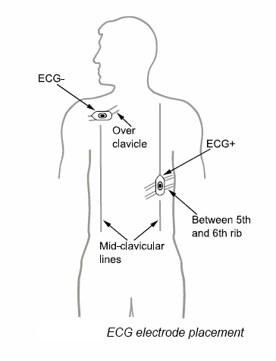
Introduction to the PSG Hook-up
ECG Place
  On the chest near the heart

Slide 63
Respiratory (Breathing) Monitoring
Respiratory Inductance Bands – measure breathing effort by chest or abdomen movement.
Finger oximeter– measures oxygen levels (saturation)
Nasal Pressure Cannular- Pressure (flow) from nose--breaths
Notes:
Show electrodes: These are other types of electrodes thermistor… IP bands….the Limb sensor…..are transducers
Transducers transform non-electric signals into a signal that can be displayed:
Respiration and other types of movement

Slide 64
Introduction to the PSG Hook-up
Signal Details
Why is Respiratory Monitoring Important?
  Short pauses in respiration during sleep are normal. Respiratory Monitors help determine if the pauses are normal or are abnormally long or frequent as associated with Sleep Apnea.
  Hypopnea – reduction in airflow associated with oxygen desaturation or EEG arousal.
  Apnea – cessation of airflow usually associated with desaturation or arousal.
    Obstructive Apnea – due to closing of the airway, so effort is observed though airflow is ceased.
    Central Apnea – due to brain signal, so neither effort nor airflow are observed.
Notes:
Respiratory Monitoring is important because its ALL ABOUT sleep disordered breathing

Slide 65
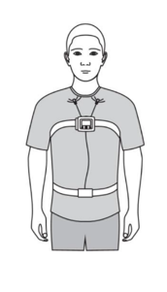
Introduction to the PSG Hook-up
Successful Monitoring
Sensor Placement
  Respiratory Bands: at areas of expansion / contraction on chest and abdomen
Notes:
Respiration is driven by the movement of the body when the lungs work… expansion and contraction of the chest and abdomen

Slide 66
Introduction to the PSG Hook-up
Signal Details
Why is Oximetry Important?
  Blood oxygen levels drop during long pauses in respiration.
  Oxygenation of organs is affected during repeated breathing pauses and may lead to severe medical consequences.
  Oximetry provides quantitative measurement of oxygen saturation and desaturation events during sleep and provide a baseline prior to sleep.
Notes:
Oxygen levels in the blood should remain fairly stable in wake or sleep but if there is trouble with breathing there will be a drop in the oxygen level.

Slide 67
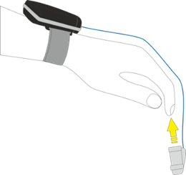
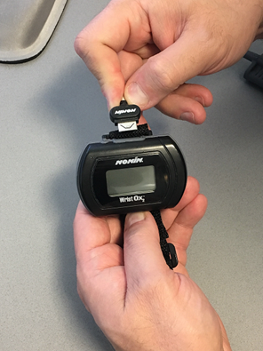
Oximetry
Snug placement on finger on non-dominant hand
  Ring or middle finger
Raised area of probe over the base of the finger nail
Avoid dark nail polish
No acrylic nails!
Use tape to secure cord on hand and around tip
Remind ppt not to get wet- show how to remove and replace if need to (bathroom)

Slide 68
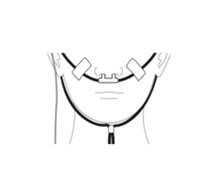
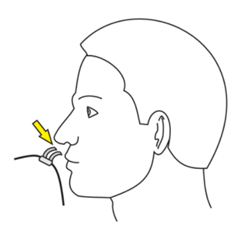
Introduction to the PSG Hook-up
Successful Monitoring
Sensor Placement
  Respiratory Signals: nasal cannula just inside the nostrils
  Use a small piece of tape on each cheek to secure tubing
  Can use a mirror to instruct participant on how to reposition
Notes:
2 ways to measure flow:
thermal sensor driven by the warmth of the expired breath
Flow measured by pressure changes through a tube (cannula).
+ and - Pressure changes with inspiration/expiration…similar to sucking through vs blowing through a straw

Slide 69
Introduction to the PSG hook-up
Signal Details
Why is Limb movement Important?
  Limb sensors help confirm movement disorders specifically associated with sleep (Periodic Limb Movement Disorder)
Notes:
Much research has been done on restless leg syndrome and Periodic Limb Movement Disorder.
The public is becoming very aware of restless leg syndrome due to pharmaceutical ads in the media

Slide 70
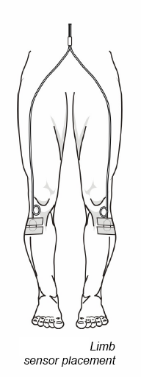
Introduction to the PSG Hook-up
Successful Monitoring
Sensor Placement
  EMG: Over muscles on the legs.

Slide 71
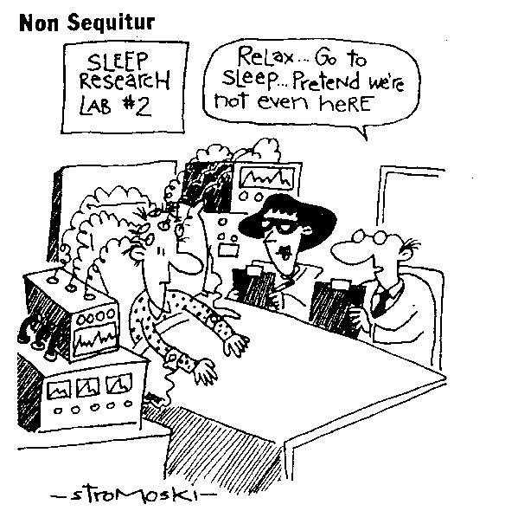
Introduction to the PSG Hook-up
How to Measure Sleep

