Slide 1
Coronary Artery Calcium Score For Primary Cardiovascular Event Risk Assessment in 2014: Role and Future
Joseph Yeboah MD, MS, FACC
9/18/14
Disclosure: None

Slide 2
Content
CAC for CHD/CVD Prediction and risk assessment
  General Population ( Framingham risk score)
    Intermediate FRS
  Chronic Kidney Disease-CKD (None?)
  Type 2 diabetes mellitus (FRS, UKDPS..)
CAC for stroke Prediction and Risk Assessment
  Framingham stroke risk score
Role of CVD risk prediction
Who is recommended statins -2014
  ASCVD risk estimator(PCE) and CAC
    CAC and clinical decision making as recommended
    Epidemiologic ( Improvement in discrimination)
Conclude

Slide 3
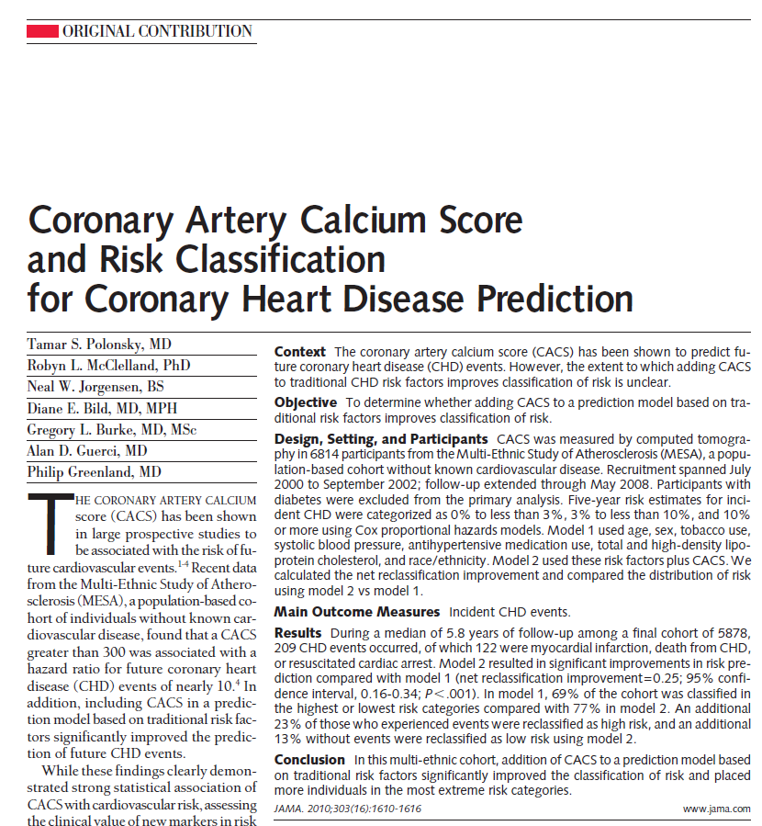

Slide 4
CAC and CHD Events-Intermediate FRS
Yeboah et al. JAMA. 2012; 308(8):788-795

Slide 5
CAC and CVD Events-Intermediate FRS
Yeboah et al. JAMA. 2012; 308(8):788-795

Slide 6
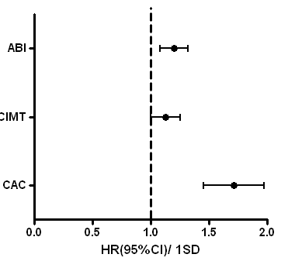
CAC and CVD Events- CKD
Delta C-statistics for CAC 0.03(0.01-0.06) for CKD and 0.04(0.02-0.06) for non-CKD
Matsushita et al JASN 2014;26:000-000

Slide 7
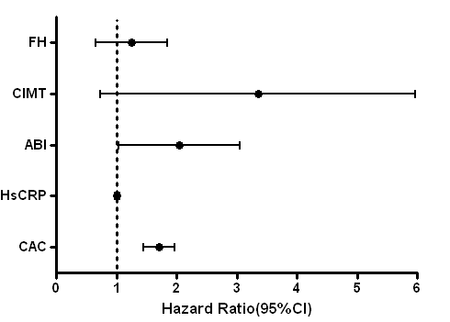
Independent Predictors of CHD-T2DM
MESA-HNR
Yeboah et al. Atherosclerosis. 2014; 236:411-417

Slide 8
CAC and CHD Events- Type II Diabetes
Yeboah et al. Atherosclerosis. 2014; 236:411-417

Slide 9
CAC and CHD Events- T2DM
Yeboah et al. Atherosclerosis. 2014; 236:411-417

Slide 10
MESA-HNR T2DM CHD Risk Score
8 Year Risk: Add points from the 5 categories
 | Age:
 | >=65 years | +4 points
 | Sex:
 | Male | +4 points
 | Systolic bp:
 | >=135 | +2 points
 | Duration of Diabetes:
 | >0 years | +3 points
 | CAC:
 | <25 | -2 points
 | 25 to <125 | 0 points
 | 125 to <400 | +4 points
 | >=400 | +16 points
*less than 1 point indicates less than 1% risk, otherwise 1 point is ~ 1% risk of 8 year coronary heart disease event
Yeboah et al. Atherosclerosis. 2014; 236:411-417

Slide 11
CAC and Strokes
(AUC = 0.744)
(AUC = 0.755)
(AUC= 0.0.664)
(AUC = 0.706 )
Yeboah et al . JACC Imaging In press

Slide 12
CAC and Strokes
Yeboah et al . JACC Imaging In press

Slide 13
Role of Primary CVD Risk Assessment
Modifiable CV risk factors
  Blood pressure
  Cigarette smoking
  Hyperlipidemia
  Obesity
  ? Physical activity
Recommend treatment of BP, cigarette smoking, diet and physical activity irrespective of individuals global CV risk!
Only hyperlipidemia Rx depends partially on global CV risk
  Rx: only statins have proven to be effective in reducing CVD events

Slide 14
Bottom-line – Risk Assessment
Primary CVD risk assessment: Indentifying asymptomatic individuals in whom the benefit of statins >>>>> risks for treatment
  Goal is to reduce CVD events in the population

Slide 15
Old Has Given Way to New Guidelines
Nov 2013: New ACC/AHA cholesterol guidelines and new CVD risk prediction tool
  FRS, FSRS, UKDPS New ASCVD risk estimator(Pooled Cohort Equations)
  NCEP/ATP III cholesterol guidelines(2001) New ACC/AHA Cholesterol guidelines(2013)
Data shown important but have unclear relevance today
  Bcos we are not using FRS, UKDPS, NCEP/ATPIII anymore!

Slide 16
Who is Recommended Statins-2014
New ACC/AHA guidelines
  Secondary prevention: All individuals with h/o of ASCVD( MI or strokes)
  Primary prevention : All type 2 DM (40-75yr), individuals with LDLc >/= 190 mg/dl and individuals with 10 yr ASCVD >/= 7.5%
  Note that CKD is not mentioned here
    Statin benefits CKD but not those with ESRD on dialysis
Critics – too many people will be on statins?

Slide 17
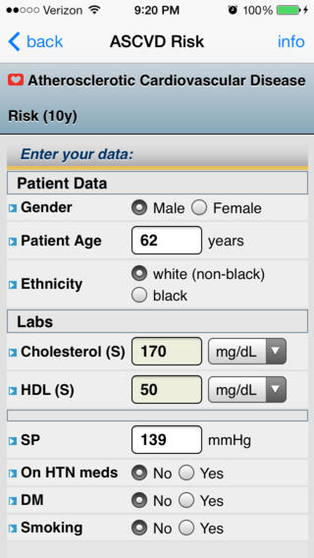
ASCVD Risk Estimator(PCEs)

Slide 18
Same 2013 ACC/AHA Cholesterol Guidelines
“In selected individuals who are not in 1 of the 4 statin benefit groups, and for whom a decision to initiate statin therapy is otherwise unclear, additional factors may be considered to inform treatment decision making”
These additional factors include primary LDL–C ≥160 mg/dL, other evidence of genetic hyperlipidemias, family history of premature ASCVD, high-sensitivity C-reactive Protein ≥2 mg/L, CAC score ≥300 Agatston units or ≥75 percentile for age, sex, and ethnicity, ankle-brachial index <0.9, or elevated lifetime risk of ASCVD

Slide 19
Question?
Does CAC and other subclinical CVD markers :
  Improve discrimination over and beyond the new ASCVD risk estimator( PCE)?- Epidemiology
  At the recommended cut offs in the ACC/AHA guidelines useful in those not recommended statins?

Slide 20
MESA
5185 out of 6814 had complete data and were not on statins during the baseline exam
  3882 had ASCVD risk <7.5% and did not have T2DM
10 years of follow up
  320 (6.2%)ASCVD events adjudicated
    139 non fatal MI
    132 fatal and non fatal strokes
    49 CHD Deaths

Slide 21
Demographics( Not on statins)
Variable | Total Cohort (n=5185)
Age, yrs (Mean + SD) | 61.2 ±10.3
Females, n (%) | 2751(53.1)
Race/Ethnicity (%) Whites Chinese Black Hispanic | 1969(38) 626(12.1) 1402(27.0) 1189(22.9)
Diabetes mellitus, n (%) | 506(9.8)
Cholesterol, mg/dl (Mean + SD ) Total LDL HDL Triglycerides | 196.4 ±35.7 119.7± 31.4 51.0 ±15.0 129.7 ±87.7
BMI, Kg/m2 (Mean + SD) | 28.2 ±5.5
Blood Pressure, mmHg (Mean + SD) Systolic Diastolic | 125.6± 21.4 72.1 ±10.4
Cigarette smoking, n (%) Never Former Current | 2624(50.6) 1854(35.8) 707(13.6)
Antihypertensive medication use, n (%) | 1683(32.5)
CAC, median(IQR),Agatston | 0(0 – 63.6)
Hs-CRP, median(IQR),mg/l | 1.9(0.8-4.3)
Family History of ASCVD, n (%) | 2121(40.9)
ABI, median (IQR) | 1.1(0.7-1.0)

Slide 22
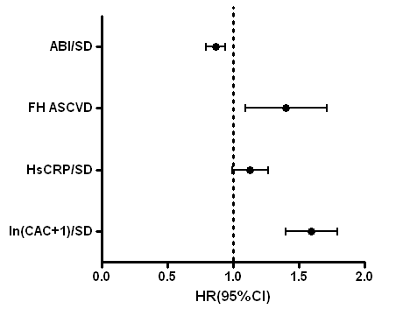
Independent Predictors of ASCVD?
Multivariable Model adjusted for age, gender, race, T2DM, tchol, HDL, BMI, SBP, smoking, bp meds use
Unpublished Data

Slide 23
Improve Discrimination Over and Beyond Pooled Cohort Equation
Model | Harrell's C | P value
Total (N=5185)
ASCVD Alone | 0.74 |  | --
ASCVD + CAC | 0.76 |  | 0.041
ASCVD + hsCRP | 0.74 |  | 0.245
ASCVD + FH | 0.74 |  | 0.987
ASCVD + ABI | 0.75 |  | 0.550
Unpublished Data

Slide 24
Improve Discrimination Over and Beyond Pooled Cohort Equation
 | ASCVD Alone
ASCVD + Marker | < 7.5% | ≥ 7.5 % | Row Total (%) | NRI(95%CI)
ASCVD + CAC
Event( n=320)
< 7.5% | 107 | 19 | 126(39.4) | 0.178(0.080,0.256)
≥ 7.5% | 76 | 118 | 194(60.6)
Column Total (%) | 183(57.2) | 137(42.8)
Non – Event(n=4865)
< 7.5% | 3506 | 202 | 3708(76.2) | -0.059(-0.075,-0.030)
≥ 7.5% | 496 | 661 | 1157(23.8)
Column Total (%) | 4002(82.3) | 863(17.7)
ASCVD + hsCRP
Event(n=320)
<7.5% | 165 | 9 | 174(54.4) | 0.028(-0.013, 0.077)
≥ 7.5% | 18 | 128 | 146(45.6)
Column Total (%) | 183(57.2) | 137(42.8)
Non-Event( n=4865)
<7.5% | 3882 | 98 | 3980(81.8) | -0.005(-0.015,0.003)
≥ 7.5% | 120 | 765 | 885(18.2)
Column Total (%) | 4002(82.3) | 863(17.7)
Unpublished Data

Slide 25
Improve Discrimination Over and Beyond Pooled Cohort Equation
 | ASCVD Alone
ASCVD + FH | < 7.5% | ≥ 7.5%
Event (n=320)
< 7.5% | 153 | 12 | 175(54.6) | 0.056(0.007,0.118)
≥ 7.5% | 30 | 125 | 155(48.4)
Column Total (%) | 183(57.2) | 137(42.8)
Non-Event (n=4865)
<7.5% | 3832 | 140 | 3972(81.6) | -0.006(-0.019,0.003)
≥ 7.5% | 170 | 723 | 893(18.4)
Column Total (%) | 4002(82.3) | 863(17.7)
ASCVD + ABI
Event(n=320)
<7.5% | 166 | 13 | 179(55.9) | 0.013(-0.034,0.051)
≥ 7.5% | 17 | 124 | 141(44.1)
Column Total (%) | 183(57.2) | 137(42.8)
Non-Event(n=4865)
<7.5% | 3910 | 113 | 4023(82.7) | 0.004(-0.004,0.011)
≥ 7.5% | 92 | 750 | 842(17.3)
Column Total (%) | 4002(82.3) | 863(17.7)
Unpublished Data

Slide 26
Clinically Useful?
New ACC/AHA Cholesterol Guidelines:
  primary LDL–C ≥160 mg/dL, other evidence of genetic hyperlipidemias, family history of premature ASCVD, high-sensitivity C-reactive Protein ≥2 mg/L, CAC score ≥300 Agatston units or ≥75 percentile for age, sex, and ethnicity, ankle-brachial index <0.9, or elevated lifetime risk of ASCVD
< 7.5% 10 year ASCVD risk score

Slide 27
Clinically Useful at the New Cholesterol Guideline Cut Offs?
Total Sample Without Type 2 Diabetics and ASCVD <7.5% (N=3882) | ASCVD Risk < 7.5% | Percent Reclassified to ASCVD ≥ 7.5% | Number Needed to Screen
ASCVD + Marker
ASCVD + CAC >/= 300 or >/= 75 percentile for age, race, and sex |  | 6.8 | 110.9
Event(n=156)
<7.5% | 121
≥ 7.5% | 35
Column Total (%) | 156(59.5)
Non Event(n=3726)
< 7.5% | 3497
≥ 7.5% | 229
Column Total (%) | 3726(84.4)
ASCVD + hsCRP >/= 2.0 |  | 2.6 | 388.2
Event(n=156)
<7.5% | 146
≥ 7.5% | 10
Column Total (%) | 156(59.5)
Non Event(n=3726)
<7.5% | 3637
≥ 7.5% | 89
Column Total (%) | 3726(84.4)
Unpublished Data

Slide 28
Clinically Useful at the New Cholesterol Guideline Cut Offs?
Total Sample Without Type 2 Diabetics and ASCVD <7.5% (N=3882) | ASCVD Risk < 7.5% | Percent Reclassified to ASCVD ≥ 7.5% | Number Needed to Screen
ASCVD + ABI < 0.9 |  | 0.6 | 1941
Event(n=156)
<7.5% | 154
≥ 7.5% | 2
Column Total (%) | 156(59.5)
Non Event(n=3726)
<7.5% | 3706
≥ 7.5% | 20
Column Total (%) | 3726(84.4)
ASCVD + Family history of ASCVD |  | 4.6 | 143.8
Event(n=262)
<7.5% | 129
≥ 7.5% | 27
Column Total (%) | 156(59.5)
Non Event(n=4417)
<7.5% | 3575
≥ 7.5% | 151
Column Total (%) | 3726(84.4)
Unpublished Data

Slide 29
Conclusions
CAC was superior for improving CVD risk assessment during the era of the FRS/FSRS/UKDPS or NCEP/ATP III
CAC may be superior for improving ASCVD risk assessment
  ASCVD risk estimator/Pooled cohort equations
  New ACC/AHA cholesterol guidelines
  Need a cost effectiveness analysis
    Improvement in discrimination afforded not as large
    More data needed to conclusively define CAC role today.
Subgroups to be well explore: CKD etc

Slide 30
Thanks!
NIH/NHLBI
MESA participants and investigators
Mentors and collaborators
  David Herrington
  Gregory Burke
  Philip Greenland, Robyn McClelland, Joseph Delaney, etc .

