Slide 1
Metabolomics in MESA
COMBI-BIO & COMBI-LIFE
Outline
  Description of COMBI-BIO
  Preliminary COMBI-BIO data
  Description of COMBI-LIFE
  What is “metabolomics”?

Slide 2



COMBI-BIO
Development of COMBInatorial
BIOmarkers for subclinical atherosclerosis
PI: Paul Elliott, MD, PhD
Professor Epidemiology & Public Health Imperial College, London
FUNDED BY EUROPEAN UNION

Slide 3
COMBInatorial BIOmarkers for subclinical atherosclerosis (COMBI-BIO)
Our Research
COMBI-BIO is a consortium, funded by the EU's research framework programme, that brings together leading groups in systems medicine, biomarker discovery, epidemiology, critical evaluation and development of coronary heart and cardiovascular disease risk functions, and computational medicine.
Our Partners
Imperial College of Science, Technology and Medicine
Metabometrix Ltd
University of Ioannina School of Medicine
Erasmus Universitair Medisch Centrum Rotterdam
Helmholtz Zentrum München (HMGU)
Northwestern University
  Wake Forest University
  University of Vermont
www.combi-bio.eu

Slide 5














Outline of the research activities, WPs and partners
We’re somewhere around here
ICL
(WP1)
Management and Coordination
ICL, MBX, UoI, EMC, HMGU, NWU
(WP2)
Sharing of resources: Data integration and
ICL, MBX
(WP3)
Biomarker discovery and identification
ICL, MBX
(WP4)
Biomarker
validation
ICL, MBX, EMC, HMGU, NWU
(WP5)
ICL, MBX, UoI, EMC, NWU
(WP6)
Predictive combinatorial biomarkers
Cross-platform and multi- omics analyses
harmonization
Improve subclinical atherosclerosis prediction, prevention and treatment
ICL: Imperial College London, MBX: Metabometrix Ltd, UoI: University of Ioannina, EMC:Erasmus Universiteit Rotterdam, HMGU: Helmholtz Zentrum, Munich, NWU: Northwestern University

Slide 6
Metabolomics in MESA
COMBI-BIO & COMBI-LIFE
Outline
  Description of COMBI-BIO
  Preliminary COMBI-BIO data
  Description of COMBI-LIFE
  What is “metabolomics”?

Slide 7
COMBI-BIO Preliminary data general epidemiology
¹H NMR spectroscopy in 3 cohorts (N=4,000 MESA; N=2000 Rotterdam Study; N=2,000 Lolipop)
randomly split per cohort in two equal sized phases (discovery and validation)
generalized regression models for CAC, adj for age, sex, cohort, ethnicity (model 1) plus CVD risk factors (model 2)
Metabolome Wide Significance Level (MWSL=4.14x10⁻⁵) in Discovery; Bonferroni in Validation

Slide 8
COMBI-BIO Preliminary data general epidemiology
total of 30,590 NMR features;
3,208 reached MWSL in discovery phase using model 1;
2,368 (74%) replicated in clustered regions across the metabolome;
23 features reached MWSL in the discovery phase using model 2;
10 (44%) replicated;

Slide 9
COMBI-BIO: preliminary associations with CAC

Slide 10
COMBI-BIO: GWAS
Take some preliminary CAC-associated findings and apply genomic analyses
Proof of principle, not definitive

Slide 11
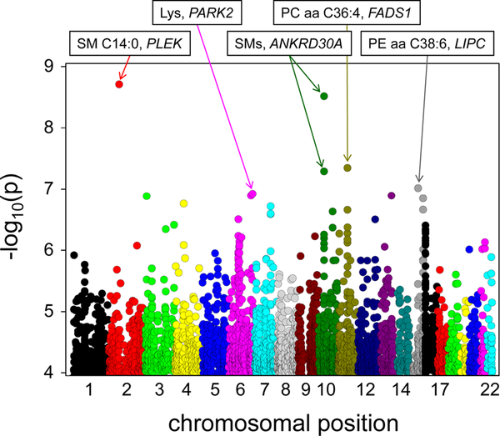

Figure 2. P-values of association assuming an additive genetic model, superposing the results obtained from all genome-wide tested metabolic traits.
Gieger C, Geistlinger L, Altmaier E, Hrabé de Angelis M, et al. (2008) Genetics Meets Metabolomics: A Genome-Wide Association Study of Metabolite Profiles in Human Serum. PLoS Genet 4(11): e1000282. doi:10.1371/journal.pgen.1000282
http://www.plosgenetics.org/article/info:doi/10.1371/journal.pgen.1000282

Slide 12
MESA Metabolomics
Sex distribution within each ethnicity is ~50%
Preliminary analysis only looked at EA and
AA samples

Slide 13
11 Initial Phenotypes from COMBI-BIO
UK ID | UVM ID | Compound
7.0715 | a | methlylistidine
2.917375 | b
2.957375 | c
2.47325 | d | glutamine
3.0415 | e | putrescine
3.10625 | f
7.822125 | g
5.133625 | h
5.156 | i
5.145875 | j
5.11875 | k

Slide 14
Results in EAs
There were no statistically significant findings for any of the phenotypes

Slide 15
Findings in AAs
There were several significant findings in AAs that appear to be robust to outlier analysis

Slide 16
AA Phenotype d (Glutamine)
summarize d, detail
-------------------------------------------------------------
Percentiles Smallest
1% .1888858 .1217605
5% .2223271 .1510181
10% .2434152 .1803253 Obs 480
25% .2741231 .1868353 Sum of Wgt. 480
50% .3003032 Mean .3018045
Largest Std. Dev. .0464573
75% .3316551 .4254486
90% .3566962 .4325068 Variance .0021583
95% .3746319 .4523227 Skewness -.0204826
99% .4165625 .4547997 Kurtosis 3.591294

Slide 17
AA Phenotype d Glutamine
CHR | SNP | Gene | A1 | A2 | FRQ | INFO | BETA | SE | P
1 | rs2997977 | RYR2 | A | G | 0.4872 | 0.9306 | 0.0147 | 0.003 | 1.89E-06
7 | rs10224073 | intergenic | C | T | 0.407 | 0.4784 | 0.0198 | 0.0043 | 6.18E-06
1 | rs3766840 | RYR2 | A | G | 0.6929 | 0.9624 | 0.0143 | 0.0033 | 1.33E-05
19 | rs11083725 |  | C | T | 0.4173 | 0.4679 | 0.0188 | 0.0044 | 2.10E-05
1 | rs6664907 |  | C | T | 0.1775 | 1.0692 | -0.016 | 0.0037 | 2.31E-05
17 | rs2854327 |  | C | G | 0.3784 | 0.9015 | -0.0135 | 0.0032 | 3.38E-05
17 | rs2285893 |  | C | G | 0.3201 | 0.8251 | -0.0146 | 0.0035 | 3.42E-05
17 | rs11867465 |  | A | G | 0.3553 | 1.0153 | -0.0128 | 0.0031 | 3.73E-05
6 | rs6915612 |  | A | G | 0.0731 | 0.7365 | 0.0275 | 0.0066 | 4.00E-05
17 | rs8078423 |  | A | G | 0.3163 | 0.8443 | -0.0144 | 0.0035 | 4.18E-05
Ryanodine receptor 2 (RYR2) is a protein found primarily in cardiac muscle; functions as a component of a calcium channel that supplies ions to the cardiac muscle.

Slide 18
AA Phenotype l: h, i, j, and k combined
summarize l, detail
-------------------------------------------------------------
Percentiles Smallest
1% .1679567 .1612863
5% .1747367 .1663296
10% .1775162 .1665104 Obs 477
25% .1836087 .1667834 Sum of Wgt. 477
50% .1900646 Mean .19147
Largest Std. Dev. .0117362
75% .1982072 .2256052
90% .2055684 .2272422 Variance .0001377
95% .2158724 .2277204 Skewness .6274575
99% .2244589 .233862 Kurtosis 3.618943

Slide 19
AA Phenotype l
CHR | SNP | Gene | A1 | A2 | FRQ | INFO | BETA | SE | P
5 | rs97713 | intergenic | A | G | 0.6047 | 0.4814 | -0.0057 | 0.0011 | 7.48E-07
5 | rs3776455 | intergenic | C | T | 0.5073 | 1.0983 | 0.0036 | 0.0007 | 1.35E-06
5 | rs10475399 | intergenic | A | G | 0.5081 | 1.0975 | 0.0036 | 0.0007 | 1.39E-06
5 | rs8659 | MTRR | A | T | 0.4903 | 1.0982 | -0.0036 | 0.0007 | 1.49E-06
5 | rs13166314 | intergenic | A | T | 0.5097 | 1.0824 | 0.0036 | 0.0007 | 1.50E-06
5 | rs1046014 | FASTKD3 | C | T | 0.3341 | 0.9 | 0.0042 | 0.0009 | 1.64E-06
5 | rs3733784 | FASTKD3 | C | T | 0.3459 | 0.9514 | -0.004 | 0.0008 | 2.34E-06
5 | rs11134265 | FASTKD3 | C | T | 0.3459 | 0.9494 | -0.004 | 0.0008 | 2.35E-06
5 | rs162026 | FASTKD3 | G | T | 0.6132 | 0.9678 | -0.0039 | 0.0008 | 2.79E-06
5 | rs326210 | FASTKD3 | C | G | 0.3882 | 0.953 | 0.0039 | 0.0008 | 2.85E-06
MTRR - methionine synthase reductase.
FASTKD3 – FAST kinase domains 3. The members of this family are ubiquitously expressed and are generally most abundant in mitochondria-enriched tissues such as heart, skeletal muscle and brown-adipose tissue.

Slide 20
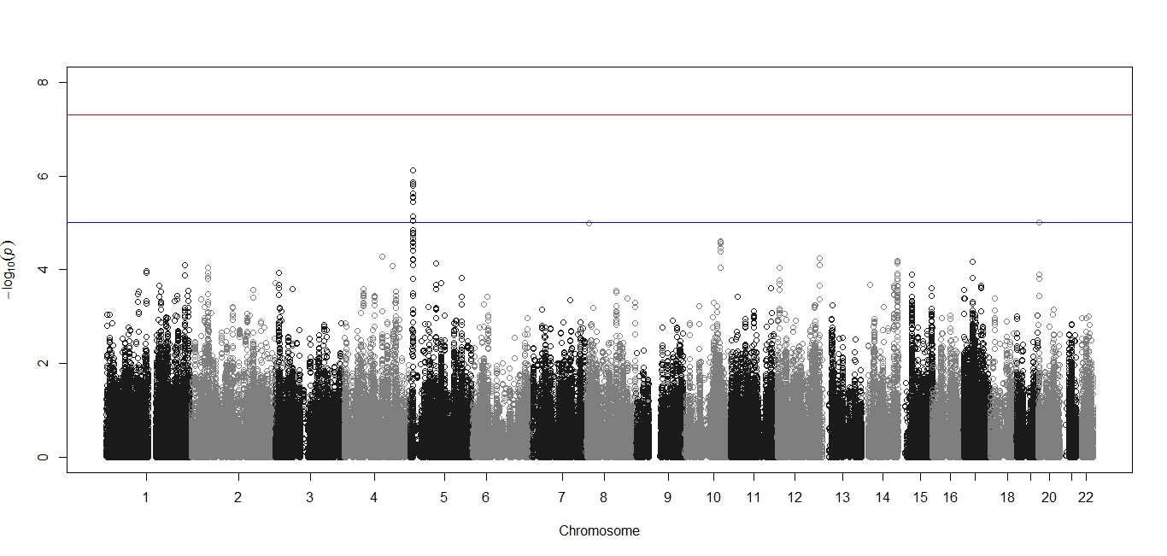
AA Phenotype l Manhattan Plot

Slide 21
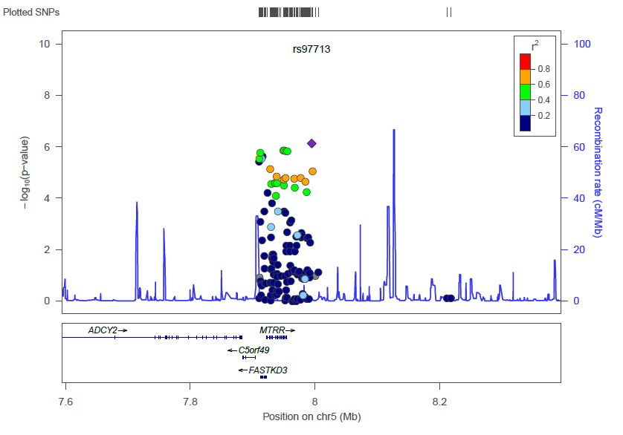
AA Phenotype l LocusZoom Plot

Slide 22
Summary AAs (1)
Phenotype b: GSK3B
  Glycogen synthase kinase 3 beta, also known as GSK3B;
  proline-directed serine-threonine kinase, an inactivating agent of glycogen synthase; involved in energy metabolism, neuronal cell development, and body pattern formation; also, apoptotic cascade.
  Interactions include: AKAP11, AXIN1, AXIN2, AR, CTNNB1, DNM1L, MACF1, MUC1, SMAD3, NOTCH1, NOTCH2, P53, PRKAR2A, SGK3, TSC2

Slide 23
Summary AAs (2)
Phenotype d: RYR2
  Ryanodine receptor 2 (RYR2) is a protein found primarily in cardiac muscle; functions as a component of a calcium channel that supplies ions to the cardiac muscle;
  Mutations in the RYR2 gene are associated with catecholaminergic polymorphic ventricular tachycardia, stress-induced polymorphic ventricular tachycardia, and arrhythmogenic right ventricular dysplasia;
  Mice with genetically reduced Ryr2 exhibit a lower basal heart rate and fatal arrythmias;

Slide 24
Summary AA’s (3)
Phenotypes h, i, j, and k represent same parent molecule;
CWAS-significant results on CHR 5 around MTRR and FASTKD3;
Combined into a new phenotype (l), results are similar;
MTRR - methionine synthase reductase;
FASTKD3 – FAST kinase domains 3; member of a small family of Fas-activated serine/threonine kinase domain- (FASTKD) containing proteins; ubiquitously expressed and most abundant in mitochondria-enriched tissues such as heart, skeletal muscle and brown-adipose tissue.

Slide 25
Metabolomics in MESA
COMBI-BIO & COMBI-LIFE
Outline
  Description of COMBI-BIO
  Preliminary COMBI-BIO data
  Description of COMBI-LIFE
  What is “metabolomics”?

Slide 26
COMBI-LIFE
A Consortium Proposal
characterize the ‘healthy’ metabolome across the lifecourse, with reference to cardiovascular healthy ageing as defined by arterial and cardiac function and structure.
metabolic profiling to provide a picture of the human serum metabolome representative of healthy ageing processes across the lifecourse .
uncover underlying biochemical pathways and mechanisms associated with the healthy metabolome through an integrative omics approach.
identify the environmental, demographic, social, lifestyle, and genetic determinants of the healthy metabolome, and their interactions, including by gender.
identify opportunities for early screening and disease prevention, health preservation, promotion of healthy ageing, early environmental/lifestyle interventions, potential new drug targets and therapeutic options.
translate and facilitate the dissemination of our findings to policy makers and society for the improvement of health. Ultimately the aim is to improve prevention, care, health and quality of life of individuals, populations and society.

Slide 27
COMBI-LIFE: Overall Idea
The global aim is to map the topology of the human metabolome over the lifecourse and identify metabolic features and their molecular, cellular, and environmental correlates, and their interactions associated with healthy ageing in both men and women.

Slide 28
COMBI-LIFE: Synthetic Cohort

Slide 29
COMBI-LIFE: Defining Healthy CV Aging Across the Lifespan

Slide 30
COMBI-BIO: Metabolomes Differ by Healthy CV Status

Slide 31
COMBI-LIFE: Longitudinality

Slide 32
COMBI-LIFE:

Slide 33
Metabolomics in MESA
COMBI-BIO & COMBI-LIFE
Outline
  Description of COMBI-BIO
  Preliminary COMBI-BIO data
  Description of COMBI-LIFE
  What is “metabolomics”?

Slide 34
What is metabolomics?
Comprehensive characterization of small low molecular-weight metabolites in biological samples
The ‘metabolome’ refers to the complete array of metabolites found within an organism; analogous to the ‘genome’ or ‘proteome’ ; no platform actually achieves this
Metabolomics may offer an inclusive approach to assess relationships between genetics, environmental exposures and metabolism

Slide 35
Metabolomics: Instrumentation
NMR is highly reproducible, requires little sample preparation, is not destructive and is good for structure elucidation
  NMR has low sensitivity, and is orders of magnitude less sensitive than MS
MS is very sensitive, and platforms allow variety in types of metabolites detected (lipids, proteins, carbohydrates, etc)
  MS less reproducible, very platform-dependent, destructive to the sample, lower throughput, and produces data which are more complex than NMR data and more difficult to analyze

Slide 36
Metabolic profiling can run in either targeted or untargeted modes
Targeted profiling (ARIC, Framingham, others) separates a limited number of specific metabolites of known identity, is optimized for these metabolites, and is based on a priori hypotheses
Untargeted profiling (MESA in COMBI-BIO) involves multiple assays (NMR, MS) to measure as many metabolites as possible. The chemical identity of the peaks are not known a priori (with a few exceptions) and post hoc analyses are required for identification
Untargeted profiling is used for novel metabolic biomarker discovery. Data output is high and metabolite identification is not guaranteed.

Slide 37
COMBI-BIO-MESA
COMBI-BIO: Includes London-based LOLLIPOP study, and the Rotterdam Study, totalling ~ 4,000 samples
MESA: 4,000 random serum samples from Exam 1
Analytical Platforms (6x):
¹H NMR: CPMG and NOESY
HPLC-MS: HILIC (+) and (-)
LIPID (+) and (-)
Operating in untargeted mode; samples analysed in 2 ‘phases’
Gender distribution within
each ethnicity is ~50%

Slide 38
Preprocessing: Data Reduction– “binning”
Benefits of binning as a primary data reduction:
Assigning a single identifier to a group of “features” that are similar in how the analysis reports them, and highly correlated
Reduces data complexity and therefore reduces amount of computer power, data storage, and statistical tests
Partially compensates for variation among spectra
Disadvantages:
Loss of sensitivity in biomarker elucidation
Requires subjective assessment of size and positioning of bins
Blaise, BJ. Anal. Chem. 2009.

Slide 39
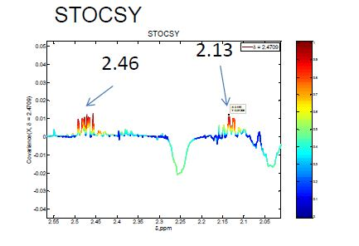
Metabolite identification: molecular assignment
How to identify feature “2.46”?
Claire Boulange, COMBI-BIO

Slide 40
Some NMR Spectral Prediction Software
MestreLab (“MNova NMRPredict Desktop”)
  http://mestrelab.com/ (commercial only)
CambridgeSoft
  e.g. integrated with ChemDraw Ultra 11.0 (commercial only)
ACD Labs
  integrated with ChemSketch (free since late 2009)
  http://www.acdlabs.com/resources/freeware/nmr_proc/index.php
  also free via Chemical Database Service, Daresbury http://cds.dl.ac.uk/cds/download/ftp/pdf/CDS_Users_Guide.pdf
Perch (Finland) – acquired by Bruker, but now independent again
  http://www.perchsolutions.com/
iNMR (Mac platform only; incorporates some MestreLab functionality)
  http://www.inmr.net/feat.html#SIMULATION
Slide courtesy of Richard H. Barton, Imperial College London

Slide 41
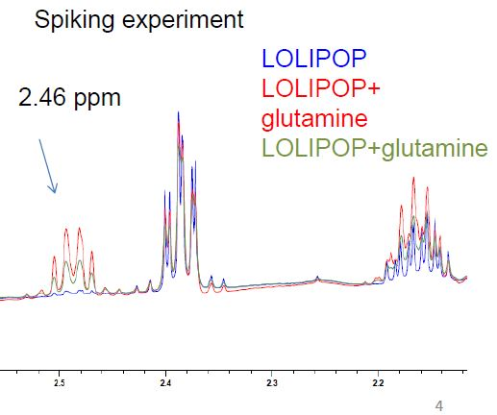
Metabolite identification: absolute ID
Glutamine?
Claire Boulange, COMBI-BIO

