Slide 1
Chronic Obstructive Pulmonary Disease in Non-Smokers
The MESA Lung Non-Smoker Study
Benjamin M Smith
Columbia University
R01-HL130506

Slide 2
Chronic obstructive pulmonary disease
Despite a 50% decline in smoking over 5 decades, COPD deaths continue to increase “without explanation”
25-30% of COPD occurs in non-smokers
Non-smokers have been largely excluded from COPD studies with lung imaging
- Thun MJ, et al. New Eng J Med 2013.
Lamprecht B, et al. Chest 2011.
Tan W, et al. Thorax 2015.

Slide 3
Chronic obstructive pulmonary disease
COPD in non-smokers
  CanCOLD: Population-based, 40 years and older
    9 urban centers
    Standardized spirometry
    COPD defined by spirometry using standard criteria
    Questionnaire
    CT and cardiopulmonary exercise testing in subsample
Tan W, et al. Thorax 2015.

Slide 4
Chronic obstructive pulmonary disease
CanCOLD | Non-smokers 2,295 | Ever-smokers 2,598
Age – years | 56±11 | 58±11
Male – % | 39 | 46
Caucasian – % | 88 | 95
BMI – kg/m² | 28±6 | 28±6
Education – years | 16±4 | 15±3
Mean ± SD
Tan W, et al. Thorax 2015.

Slide 5
Chronic obstructive pulmonary disease
COPD prevalence
Women
Men
Non-smokers
Ever-smokers
29% of COPD observed
in non-smokers
Tan W, et al. Thorax 2015.

Slide 6
Chronic obstructive pulmonary disease
Non-smokers
NoCOPD
COPD
Tan W, et al. Thorax 2015.

Slide 7
Chronic obstructive pulmonary disease
Factors associated with COPD
  Passive cigarette smoke; non-cigarette smoke
  Indoor biomass cooking / heating
    13% prevalence of 10+ years of cooking with biomass
    17% prevalence of 10+ years of heating with biomass
  Occupational exposure vapor, gas, dust fumes
  Outdoor air pollution
  Asthma, tuberculosis, pre-term birth, childhood hospitalization for respiratory illness
  α₁ anti-trypsin deficiency
Rodriguez J, et al. Ann Int Med 2010; Lovasi GS, et al. Am J Epi 2010;
Adar SD, et al. Envir Health Persp 2015; Doney B, et al. COPD 2014;
Manichaikul A, et al. Am J Resp Crit Care Med 2014; Tan W, et al. Thorax 2015.
Notes:
Biomass cooking:
Has an indoor open fire with coal, wood, crop residues, dung, or coke been used in your home as a primary means of cooking for more than 6 months in your life?
For how many years was this used for cooking in your home?
Biomass heating:
Have you used an open fire with wood, coal, crop residues, dung, or coke as a primary means of heating your home for more than 6 months in your life?
For how many years have you used this as a primary means of heating your home?

Slide 8
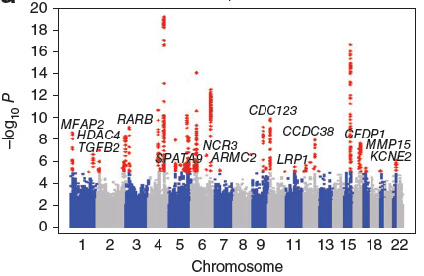
Chronic obstructive pulmonary disease
Genome-wide association studies have identified genetic variants that are associated with COPD
Several of the genetic variants occur within genes that regulate development of the tracheobronchial tree
Artigas MS, et al. Nat Gen 2010; 1
Pillai S, et al. PLoS Genetics 2009; 5
Cardoso WV, et al. Development. 2006; 133
Cardoso WV, et al. Proc Am Thorac Soc. 2009; 6

Slide 9
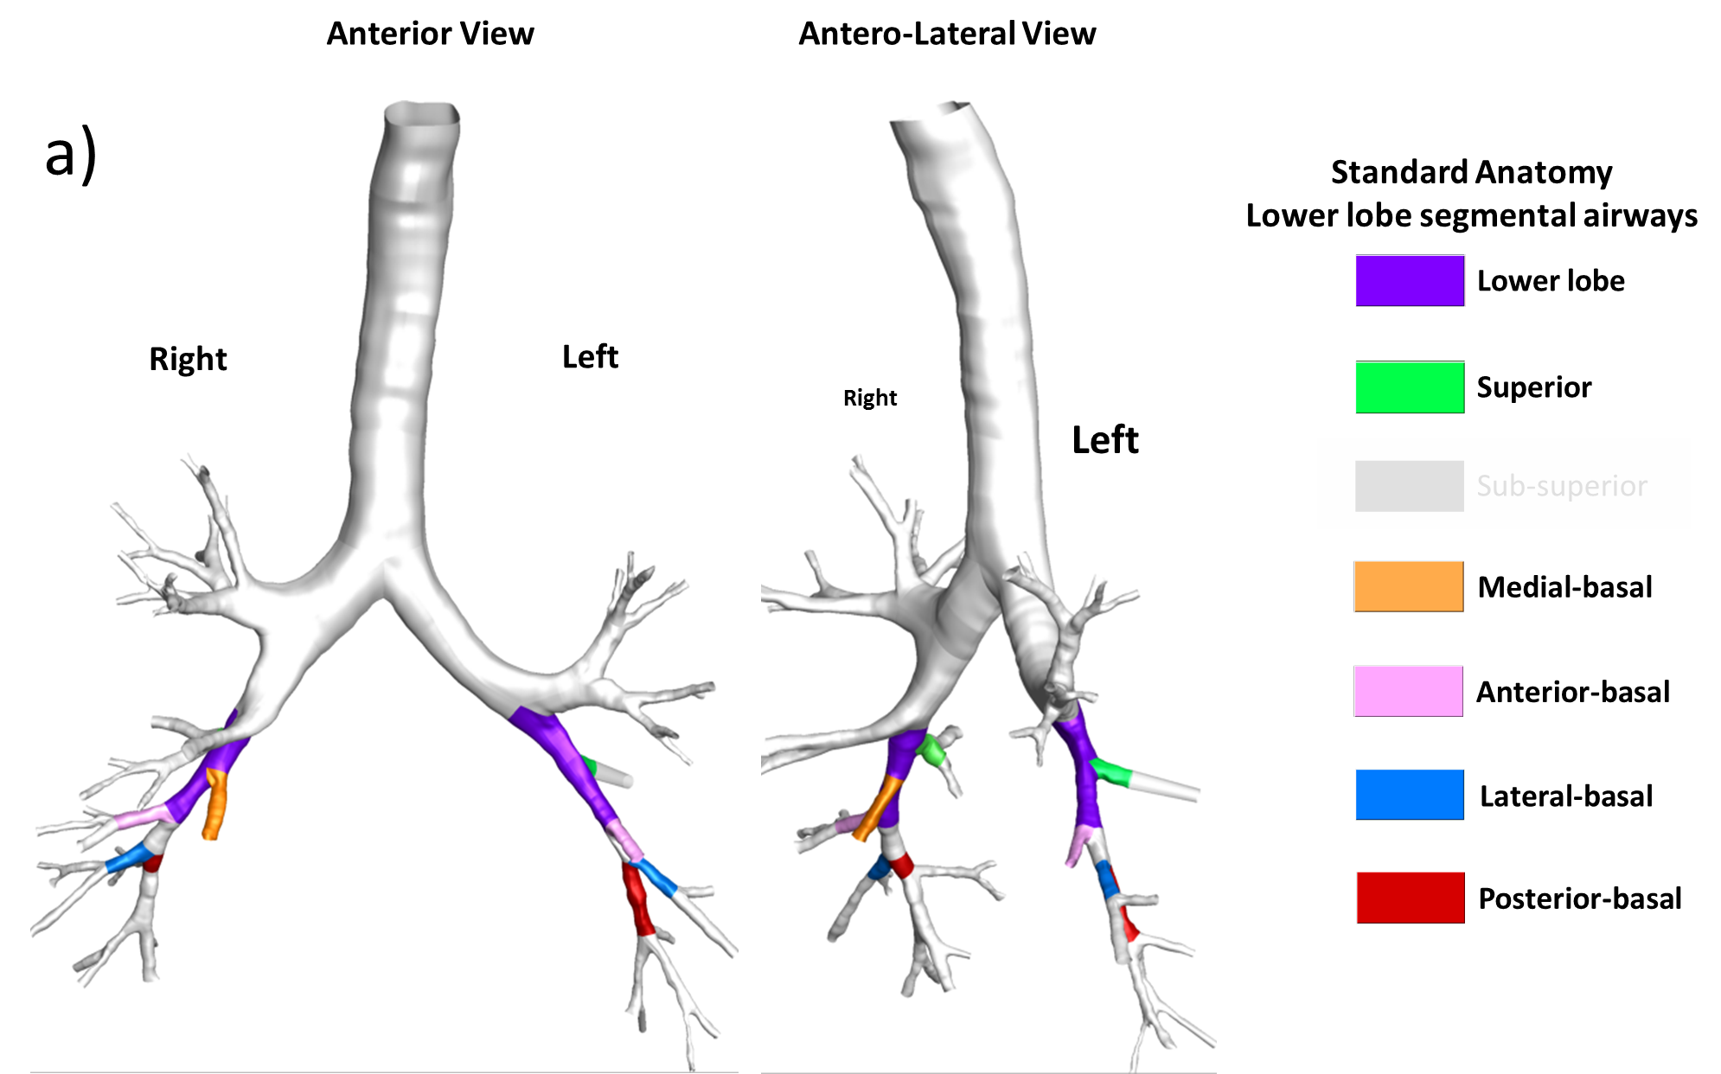
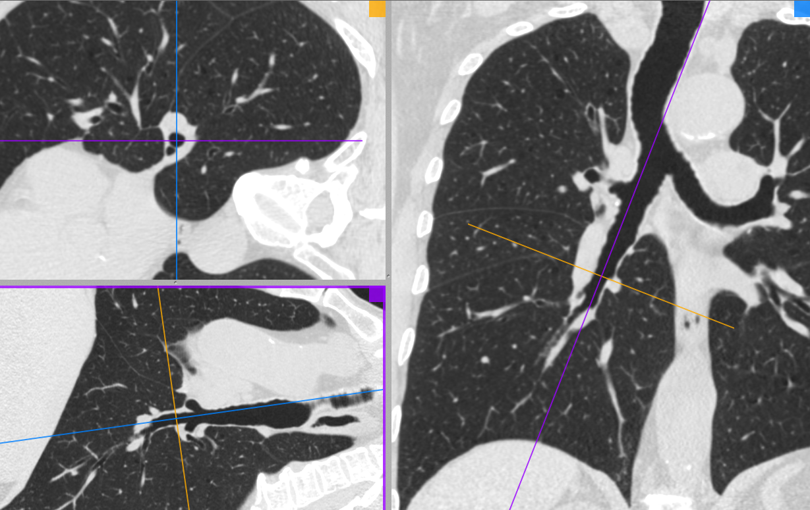
A novel susceptibility factor
Airway anatomy
  Forms in utero
  The conduit for gas exchange
  Filter of particulate matter
  Visible on CT scan

Slide 10
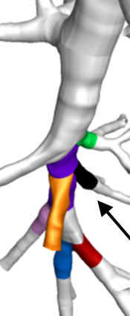
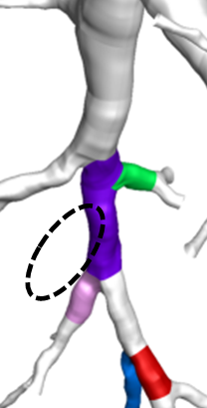
Variant airway anatomy is common
Accessory
subsuperior airway (16%)
Absent right medial
basal airway (6%)
Standard
anatomy (73%)
Accessory left medial basal: 4%
Other: <0.5%
MESA Lung
N=3,169

Slide 11
Common airway anatomy variants
Higher COPD prevalence
 | Standard Anatomy | Accessory sub-superior airway | Absent right medial-basal airway
MESA Lung E5 Smokers
COPD prevalence | 128/912 (14%) | 41/208 (20%) | 16/64 (25%)
PR for COPD (95% CI)§ | Reference | 1·5 (1·0 to 1·9) | 2·0 (1·3 to 3·1)
SPIROMICS Smokers
COPD prevalence (%) | 444/677 (66%) | 191/267 (72%) | 61/76 (80%)
OR for COPD (95% CI)§ | Reference | 1·3 (0·9 to 1·8) | 2·1 (1·1 to 3·9)
MESA Lung E5 Non-smokers
COPD prevalence (%) | 37/801 (4·6%) | 12/148 (8·1%) | 0/72 (0%)
PR for COPD (95% CI) § | Reference | 2·0 (1·0 to 3·7) | No convergence
§Adjusted models include terms for age, gender, height, weight, smoking status, and race-ethnicity. MRC denotes Medical Research Council: scale 1 to 5, >1 abnormal. CAT denotes COPD Assessment Test: scale 0 to 40, MCID 2

Slide 12
Common airway anatomy variants
Higher COPD prevalence
 | Standard Anatomy | Accessory sub-superior airway | Absent right medial-basal airway
MESA Lung E5 Smokers
COPD prevalence | 128/912 (14%) | 41/208 (20%) | 16/64 (25%)
PR for COPD (95% CI)§ | Reference | 1·5 (1·0 to 1·9) | 2·0 (1·3 to 3·1)
SPIROMICS Smokers
COPD prevalence (%) | 444/677 (66%) | 191/267 (72%) | 61/76 (80%)
OR for COPD (95% CI)§ | Reference | 1·3 (0·9 to 1·8) | 2·1 (1·1 to 3·9)
MESA Lung E5 Non-smokers
COPD prevalence (%) | 37/801 (4·6%) | 12/148 (8·1%) | 0/72 (0%)
PR for COPD (95% CI) § | Reference | 2·0 (1·0 to 3·7) | No convergence
§Adjusted models include terms for age, gender, height, weight, smoking status, and race-ethnicity. MRC denotes Medical Research Council: scale 1 to 5, >1 abnormal. CAT denotes COPD Assessment Test: scale 0 to 40, MCID 2

Slide 13
Common airway anatomy variants
Higher respiratory symptoms
 | Standard Anatomy | Accessory sub-superior airway | Absent right medial-basal airway
SPIROMICS Smokers
MRC breathlessness score > 1 | 442/664 (66%) | 179/262 (68%) | 57/74 (77%)
PR for COPD (95% CI)§ | Reference | 1·2 (0·9 to 1·6) | 2·0 (1·1 to 3·6)
SPIROMICS Smokers
CAT score (25th, 75th %ile) | 13.5 (7, 19) | 14.0 (7, 20) | 15.5 (9, 21)
OR for COPD (95% CI)§ | Reference | 0·7 (-0·4 to 1·8) | 2·2 (0·4 to 3·9)
§Adjusted models include terms for age, gender, height, weight, smoking status, and race-ethnicity. MRC denotes Medical Research Council: scale 1 to 5, >1 abnormal. CAT denotes COPD Assessment Test: scale 0 to 40, MCID 2

Slide 14
Common airway anatomy variants
Altered particle deposition
STANDARD
ANATOMY (n=1)
ABSENT
RIGHT MEDIAL-BASAL AIRWAY (n=1)

Slide 15
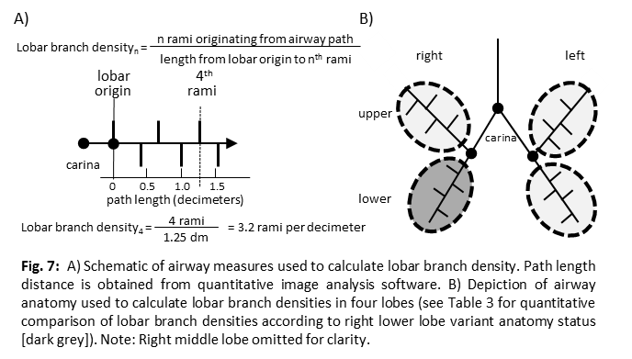
Common airway anatomy variants
Biomarker of globally altered airway anatomy

Slide 16
Common airway anatomy variants
Biomarker of globally altered airway anatomy
MESA COPD | Lobar branch density₄ - rami per decimeter | Mean difference in lobar branch density₄ compared with standard right lower lobe anatomy
 | Participants with standard right lower lobe anatomy | Participants with an accessory right lower lobe airway | Participants with an absent right lower lobe airway
Right lower lobe | 10.9 (10.8 to 11.0) | +2.14 (+1.80 to +2.49) P<0.0001 | -1.37 (-1.61 to –1.13) P<0.0001
Right upper lobe | 8.8 (8.7 to 8.8) | +0.21 (+0.18 to +0.25) P<0.0001 | 0.00 (-0.02 to +0.02) P=0.831
Left lower lobe | 8.3 (8.2 to 8.4) | +0.14 (+0.03 to +0.26) P=0.014 | -0.01 (-0.03 to +0.01) P=0.470
Left upper lobe | 9.3 (9.3 to 9.4) | +0.15 (+0.01 to +0.03) p=0.005 | 0.01 (-0.01 to +0.03) P=0.156

Slide 17
Common airway anatomy variants
Biomarker of globally altered airway anatomy
MESA COPD | Lobar branch density₄ - rami per decimeter | Mean difference in lobar branch density₄ compared with standard right lower lobe anatomy
 | Participants with standard right lower lobe anatomy | Participants with an accessory right lower lobe airway | Participants with an absent right lower lobe airway
Right lower lobe | 10.9 (10.8 to 11.0) | +2.14 (+1.80 to +2.49) P<0.0001 | -1.37 (-1.61 to –1.13) P<0.0001
Right upper lobe | 8.8 (8.7 to 8.8) | +0.21 (+0.18 to +0.25) P<0.0001 | 0.00 (-0.02 to +0.02) P=0.831
Left lower lobe | 8.3 (8.2 to 8.4) | +0.14 (+0.03 to +0.26) P=0.014 | -0.01 (-0.03 to +0.01) P=0.470
Left upper lobe | 9.3 (9.3 to 9.4) | +0.15 (+0.01 to +0.03) p=0.005 | 0.01 (-0.01 to +0.03) P=0.156
Mean differences adjusted for age, gender, height, weight, race-ethnicity, lung volume.

Slide 18
Common airway anatomy variants
Biomarker of globally altered airway anatomy
MESA COPD | Lobar branch density₄ - rami per decimeter | Mean difference in lobar branch density₄ compared with standard right lower lobe anatomy
 | Participants with standard right lower lobe anatomy | Participants with an accessory right lower lobe airway | Participants with an absent right lower lobe airway
Right lower lobe | 10.9 (10.8 to 11.0) | +2.14 (+1.80 to +2.49) P<0.0001 | -1.37 (-1.61 to –1.13) P<0.0001
Right upper lobe | 8.8 (8.7 to 8.8) | +0.21 (+0.18 to +0.25) P<0.0001 | 0.00 (-0.02 to +0.02) P=0.831
Left lower lobe | 8.3 (8.2 to 8.4) | +0.14 (+0.03 to +0.26) P=0.014 | -0.01 (-0.03 to +0.01) P=0.470
Left upper lobe | 9.3 (9.3 to 9.4) | +0.15 (+0.01 to +0.03) p=0.005 | 0.01 (-0.01 to +0.03) P=0.156
Mean differences adjusted for age, gender, height, weight, race-ethnicity, lung volume.

Slide 19
Common airway anatomy variants
Familial clustering
16 sibships in MESA Family (n=64) | Accessory subsuperior airway variant | Absent right medial-basal airway variant
Expected prevalence | 0.16 | 0.06
Observed prevalence | 0.46 | 0.31
P-value | 0.002 | 0.02

Slide 20
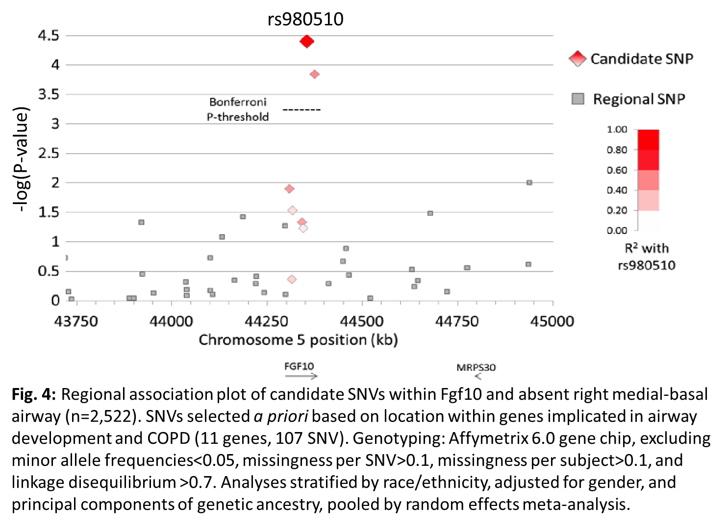
Common airway anatomy variants
Fibroblast growth factor 10

Slide 21
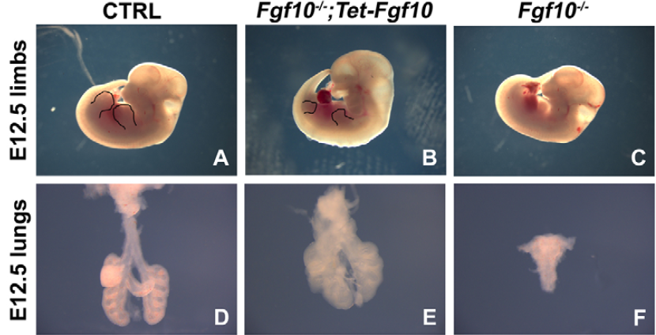
Fibroblast Growth Factor 10
Critical for embryonic airway morphogenesis
Knockout: lung agenesis
Expression: rescues branching phenotype in vitro and in vivo
Volckaert T, et al. Devel 2013.
Notes:
Fgf10 overexpression partially rescues lung and limb agenesis.
Dox-induced Fgf10 expression at E9.5.

Slide 22
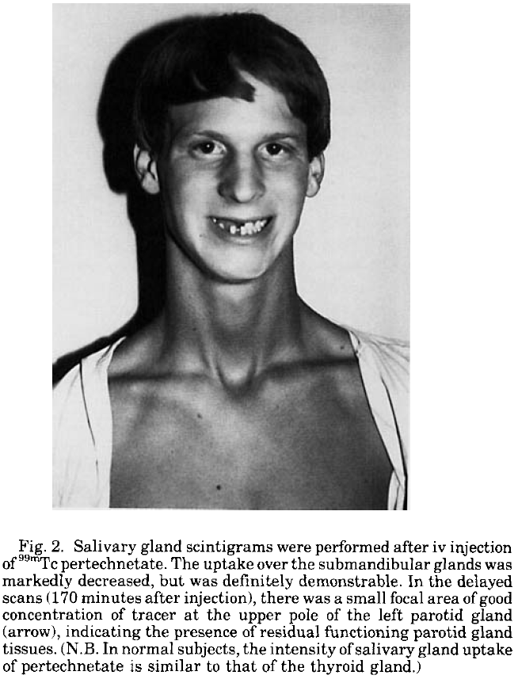
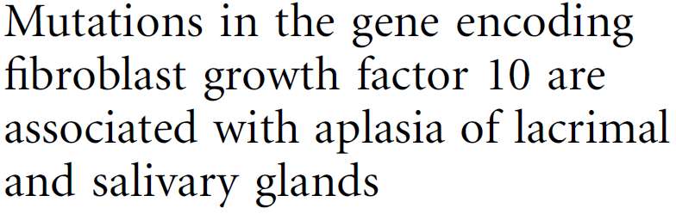
Fibroblast Growth Factor 10
Altered branching in other organs…
ALSG Syndrome
  Aplasia or hypoplasia of the lacrimal, salivary, and parotid glands
  Irritable eyes, recurrent eye infections, epiphora, xerostomia, dental carries, oral infections.
Milunsky A, et al. Am J Med 1990.
Entesarian M, et al. Nat Gen 2005.

Slide 23
Fibroblast Growth Factor 10
ALSG syndrome
  Sporadic and familial forms
  Rare, no prevalence estimates
  60 patients published literature
Entesarian M, et al. Nat Gen 2005.

Slide 24
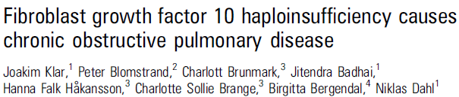

Fibroblast Growth Factor 10 and COPD
ALSG-affected individuals vs unaffected siblings
Klar J, et al. J Med Gen 2011.

Slide 25

Fibroblast Growth Factor 10 and COPD
FGF+/- versus FGF+/+ mice
Klar J, et al. J Med Gen 2011.

Slide 26
Aim 1
1. Variant airway anatomy is associated with COPD and respiratory symptoms cross-sectionally among 2,635 non-smokers and with incident COPD and decline in lung function among 2,000 non-smokers followed for a median of 10 years
1a. Associations are consistent among strata of gender and race/ethnicity
  MESA E6: 650 MESA E5: 1,445 CanCOLD: 540
  Full-lung CT Spirometry Respiratory questionnaire

Slide 27
Aim 2
2. The mechanisms of COPD risk differ by common airway variant among non-smokers and smokers:
  2a. The accessory airway variant reduces regional airflow in a CFD model of participant-specific geometry, whereas the absent airway variant increases particulate transfer to the distal lung
    SPIROMICS: 45
    Inspiratory and expiratory full-lung CT
  2b. The accessory airway variant is associated with globally altered branching, whereas the absent segmental airway variant represents lobe-specific altered airway branching
    MESA E6: 650 MESA E5: 3,204 CanCOLD: 1,417
    Full-lung CT VIDA airway dimensions

Slide 28
Aim 3
3. Genome wide association analysis will discover genetic variants underlying the common airway variants in MESA, MESA Family, and SPIROMICS, with replication in an independent cohort (CanCOLD)
  Discovery N=9,900
  Replication N=1,417
Notes:
Accessory: Combined race-ethnicities, OR 1.5, MAF 0.1: 0.98
Absent: Combined race-ethnicities, OR 1.5, MAF 0.3: 0.86

Slide 29
Exam 6 components
Participants
    Non-smokers who did not perform full-lung CT at Exam 5
    Same exclusion as MESA Lung III (except no contrast/ no eGFR)
Procedures
    Core MESA components
    Full-lung, non-contrast inspiratory CT, spirometry, urine (cotinine) identical to MESA Lung Exam 5 Protocol
    Respiratory questionnaire
      MRC breathlessness questionnaire (4)*
      MRC chronic bronchitis questionnaire (2)*
      Childhood respiratory events (1)*
      Exacerbation-like respiratory events (2)*
      COPD Assessment Test (8)
      Indoor biomass heating/cooking exposure (2)
Notes:
MRC:
Do you get short of breath when hurrying on the level or walking up a slight hill?
Do you walk slower than people of the same age on the level because of breathlessness or have to stop for breath when walking at your own pace on the level?
Do you stop for breath after walking about 100 yards or after a few minutes of the level?
Are you too breathless to leave the house or breathless when dressing?
Exacerbation-like respiratory symptoms:
Have you ever had a period when you had breathing problems that got so bad that the interfere with your usual daily activities?
If yes, how many episodes have you had in the past 12 months?
CAT:
1. I never cough / I always cough
2. I have no phlegm / My chest is completely full of phlegm
3. My chest doesn’t feel tight at all / My chest feels very tight
4. When I walk up a hill or one flight of stairs I am not breathless / I am not at all confident leaving my home because of my lung condition.
5. I am not limited doing any activities at home / I am very limited doing activities at home
6. I am confident leaving my home despite my lung condition / I am not at all confident leaving my home because of my lung condition
7. I sleep soundly / I don’t sleep soundly because of my lung condition
8. I have lots of energy / I have no energy at all
Biomass:
2 questions

Slide 30
Exam 6 components
Target enrollment (650 non-smokers)
  Non-smokers alive and followed at last events report without full-lung CT at Exam 5: 986

Slide 31
Impact
The largest structure-function evaluation of COPD among non-smokers to define risk factors and preventative strategies.
Establish airway anatomy as a novel developmental risk factor for clinically significant COPD among non-smokers that would allow personalization of treatments.
Advance our genetic understanding of airway tree structure to expose actionable mechanisms of COPD pathogenesis and progression.

Slide 32
Thanks / Questions
MESA Steering Committee MESA investigators & staff
R. Graham Barr Richard Kronmal
Dan Rabinowitz Karen Hinckley-Stukovsky
John Austin Greg Burke
Steve Shea Aaron Folsom
Wellington Cardoso David Jacobs Jr
Ani Manichaikul Eric Hoffman
Steve Rich Ching-Long Lin
Karol Watson Shinjiro Miyawaki
Kiang Liu John Hankinson
Erin Michos Jean Bourbeau
Wendy Post Wan Tan
SPIROMICS investigators CanCOLD investigators
NIH-NHLBI

