Slide 1

Overview from the
NHLBI Project Office
Lorraine Silsbee, M.H.S.
Project Officer
Division of Cardiovascular Sciences
National Heart, Lung, and Blood Institute
MESA Exam 6 Central Training
July 25, 2016

Slide 2

National Institutes of Health
Much of the biomedical and biobehavioral research in the United States is supported by
the Federal Government, primarily the National Institutes of Health (NIH)

Slide 3
NIH: 27 Institutes and Centers
NIAID
NINR
Office of the NIH Director
NCI
NIAMS
NCCAM
NIEHS
NEI
NIMH
CIT
NIDA
NLM
NINDS
CC
NIDDK
NIBIB
NCMHD
NHLBI
NHGRI
NIDCR
NIA
NIDCD
NIAAA
NICHD
NIGMS
FIC
CSR
NCATS
= Extramural only
Notes:
From NIH 101 slide deck

Slide 4
The National Heart, Lung, and Blood Institute
Third largest Institute at NIH
Supports independent research and career training of new and established researchers through research awards in heart, lung, blood and sleep disorders.

Slide 5
Mission of NHLBI Epidemiology Branch
Identify distributions and trends in heart, lung, blood, and sleep diseases and their risk factors in the U.S.
Identify new risk factors for HLBS disorders
Apply findings from bench research to population settings and vice versa
Identify potential interventions

Slide 6
Original MESA Objectives
Identify and measure early CVD
Characterize subclinical CVD before it causes symptoms or illness (clinical CVD)
Study progression of subclinical disease and progression of subclinical to clinical CVD
The ultimate goal is to find treatments that will disrupt the natural history of CVD and improve health.

Slide 7
MESA Study Cohort
N= 6,814 original cohort
45-84 years at baseline exam (2000-2002)
38% white; 28 % African American; 22% Hispanic; 12% Asian
6 Field Centers

Slide 8
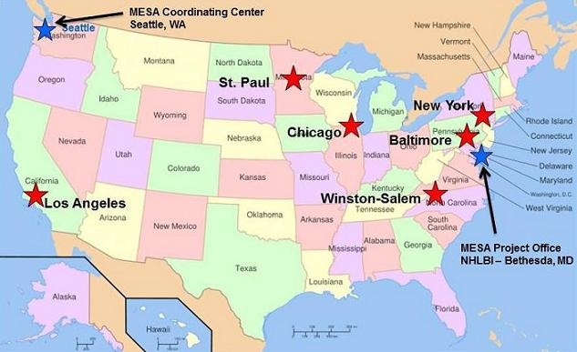
MESA Sites

Slide 9
MESA Examinations
Baseline
Exam
2000-2002
Exam 2
2002-2004
Exam 3
2004-2005
Exam 4
2005-2007
VIII
Exam 5
2010-2011
Exam 6
2016-2018
N= 6,814
N= 6,232
N= 5,939
N= 5,704
N= 4,651
N= 4,000
Regular participant follow-up for:
-Updating contact information
-Determining vital status
-Event ascertainment

Slide 10
Some key MESA findings
Coronary artery calcium (CAC) is an important independent predictor of coronary events in all 4 race/ethnic groups.
A healthy lifestyle predicted a lower incidence and progression of CAC.
Many genetic associations have been observed for many variables including blood pressure, lung function, airflow obstruction, aortic stenosis, CAC, lipids, glucose balance, body mass index, etc.
Early emphysema detected by CT is associated with dyspnea, reduced exercise tolerance, and increased all-cause mortality.
Obesity was associated with neighborhood characteristics (lack of health promoting resources and unfavorable food environments)
Incident diabetes was associated with obesity, inflammation, unfavorable dietary patterns, and lack of neighborhood resources for physical activity.

Slide 11
Current MESA Objectives
Scientific
  Study the progression of subclinical CVD to CVD
  Identify new risk factors and interactions among risk factors
Operational
  Conduct cohort follow-up for vital status and events
  Ascertain clinical events to improve statistical power for analyses
  Conduct Exam 6

Slide 12
Exam 6 Funding Model
Previously: full exam supported via contracts; several ancillary studies
Current Funding Model
  Contract support for follow-up and a basic exam, e.g. blood pressure, anthropometry, phlebotomy, medical history, etc.
  Ancillary studies support many components e.g. heart monitor patch, cognitive function testing, spirometry, 6-minute walk, etc.
Notes:
Previously MESA was supported via contracts with NHLBI. Many ancillary studies.
Now – new model - limited support for a basic follow-up examination during the contract cycle only if independent ancillary study grants to the examination were funded. This is important to note because some ancillary studies may be funded after the exam begins. Under a full contract, the entire protocol is set up front. Under this model, there is the possibility of adding components later on.

Slide 13
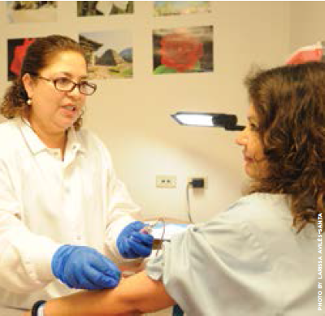
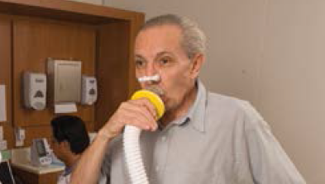
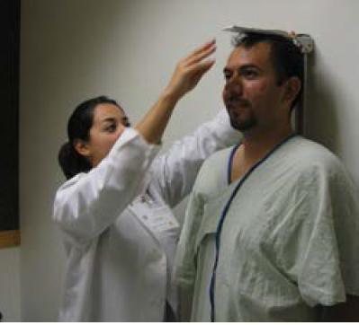
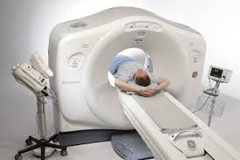
Your role is critical!
Notes:
MESA has been so successful and scientifically productive because of the of the high quality of the data you have collected and continue to collect.

Slide 14

MESA Publications
Number
of
manuscripts
published
(n=1057)*
* From MESA website as of 7/21/2016
Notes:
Publications are the primary way we communicate study findings to other scientists. MESA now has over 1,000 publications

Slide 15
NHLBI MESA Team
Project Office
  Lorraine Silsbee, M.H.S. – Project Officer
  Pothur Srinivas, Ph.D. - Project Scientist
  George Papanicolaou, Ph.D. – Genomics Scientist
  Jean Olson, M.D. – Former Project Officer, Consultant
Contracting Office
  Roxane Burkett – Contracting Officer
  Mark Brady – Contracting Specialist

Slide 16
You are a valuable member of the MESA TEAM !!!
THANK YOU !!!

