Slide 1
MESA P&P REPORT 9/17/14
Steve Shea
Moyses Szklo
Robyn McClelland

Slide 2
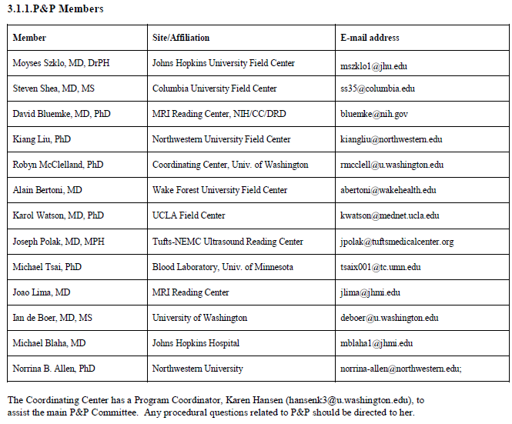

Slide 4
Approved Paper Proposals (n=1284)
Cumulative by Year
Data Cumulative Through August 12, 2014 Slide courtesy of Robyn McClelland

Slide 5
Publications (n=665)
Cumulative by Year
Data Cumulative Through August 12, 2014 Slide courtesy of Robyn McClelland
Notes:
This does not include Genetics or Air Publications (as they are not reviewed by our committee).

Slide 6
Abstracts (n=965)
Cumulative by Year
Data Cumulative Through August 12, 2014 Slide courtesy of Robyn McClelland

Slide 7
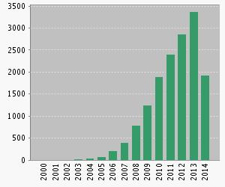
Citations by Year (with Multi-Ethnic Study of Atherosclerosis in “topic”—Web of Science search)
Sum of times cited: 15307 (up from 12373 last Fall)
Without self citation: 12967 (up from 10339 last Fall)
Average citations per article: 15.25 (up from 13.5 last Fall)
h-index: 58 (up from 53 last Fall)
Slide courtesy of Robyn McClelland

