Slide 1
MESA-PET
Grant #: 1R01HL127637-01A1
Title: HDL-Mediated Cholesterol Efflux and Plaque Inflammation in MESA
Goal: To test the hypotheses that HDL-mediated cholesterol efflux is associated with incident CVD, plaque progression, and plaque inflammation and morphology as assessed by 18-FDG PET-MRI of the carotid arteries in the Multi-Ethnic Study of Atherosclerosis (MESA)
PI: Steven Shea, MD, MS
Dates: 07/01/16 - 04/30/20
Sites: Columbia only
NGA: Received
Subawards: Pending
Subjects: N=350; estimate 50% MESA, 50% from Neurovascular Lab
Eligibility: Presence of carotid atherosclerosis at Exam 5 or carotid Doppler
Components: Questionnaires, blood draw, PET-MRI of carotids (FDG PET)¹
Efflux Assay: Dr. Alan Tall’s laboratory (Columbia)²
PET-MRI Dr. Zahi Fayed (Mt. Sinai)³
  1. ¹⁸F-fluorodeoxyglucose
  2. Cell Metab 2008;7:365-75. Circulation 2012;125:1905-19. NEJM 2011;364:127-35.
  3. JACC 2006;48:1818-24.

Slide 2
 | Year 1 |  | Year 2 |  | Year 3 |  | Year 4
 | 7/1/16 | 1/1/17 | 7/1/17 | 1/1/18 | 7/1/18 | 1/1/19 | 7/1/19 | 1/1/20
Start of project | x
Aim 1 | x | x | x | x | x | x
Aim 2: n=enrolled |  | 75 | 50 | 50 | 50 | 50 | 75
Exploratory Aim |  |  |  |  | 30 | 30
Analysis/ reporting |  |  |  |  |  | x | x | x

Slide 3
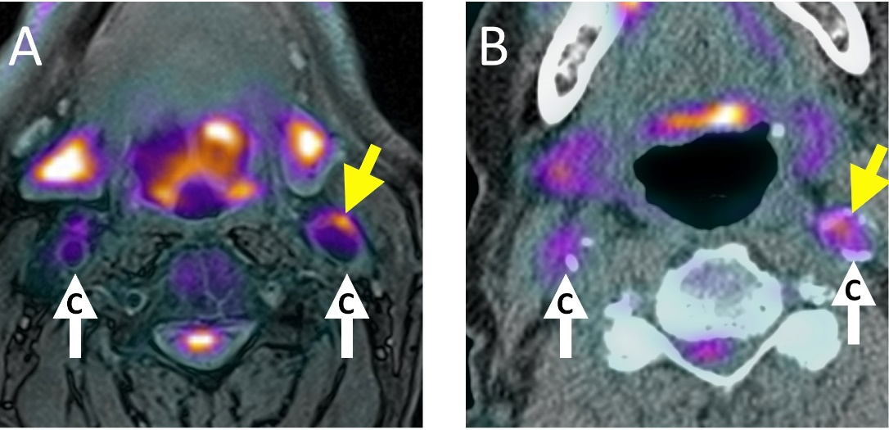
(A) PET/MRI and (B) PET/CT images after the administration of 18F-FDG of an atherosclerotic patient’s carotid arteries. Vessel wall delineation and soft tissue contrast are far better on PET/MR than PET/CT images. White arrows point to the carotid arteries, yellow arrow indicates area of high 18F-FDG uptake in the vessel wall.

Slide 4
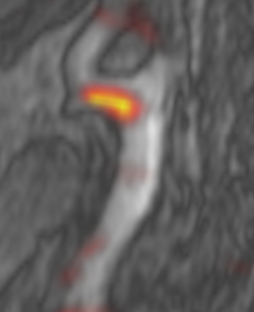
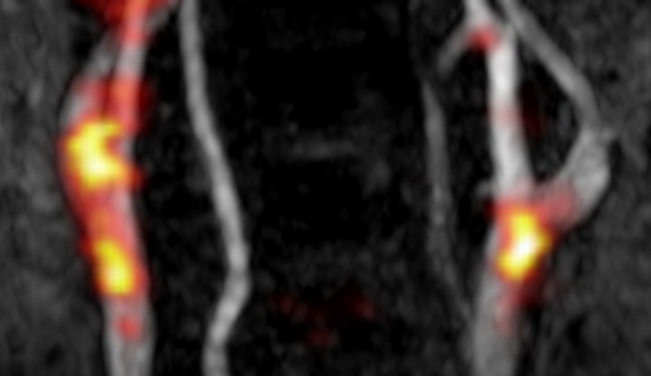
Carotid FDG-PET/MR
IC
CC
Bright areas indicate inflammation(arrows), CC: Common Carotid, IC:Internal carotid

Slide 5
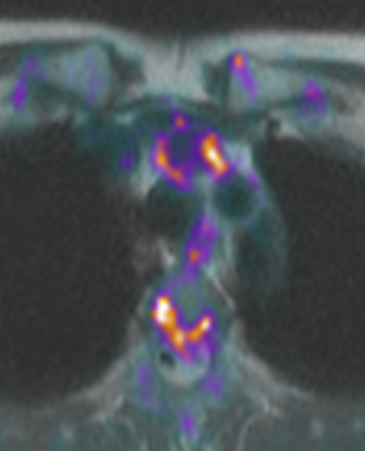
Quantitative Analysis
Right Carotid
Left Carotid
Aorta
PET signal analyzed 1 cm above and below carotid bifurcation in internal and common carotid artery. Regions of interest drawn on axial slices from MR angiogram
PET signal analyzed in ascending aorta in a segment spanning 1 cm above aortic root. Regions of interest drawn on axial MR anatomical imaging.

