Slide 1
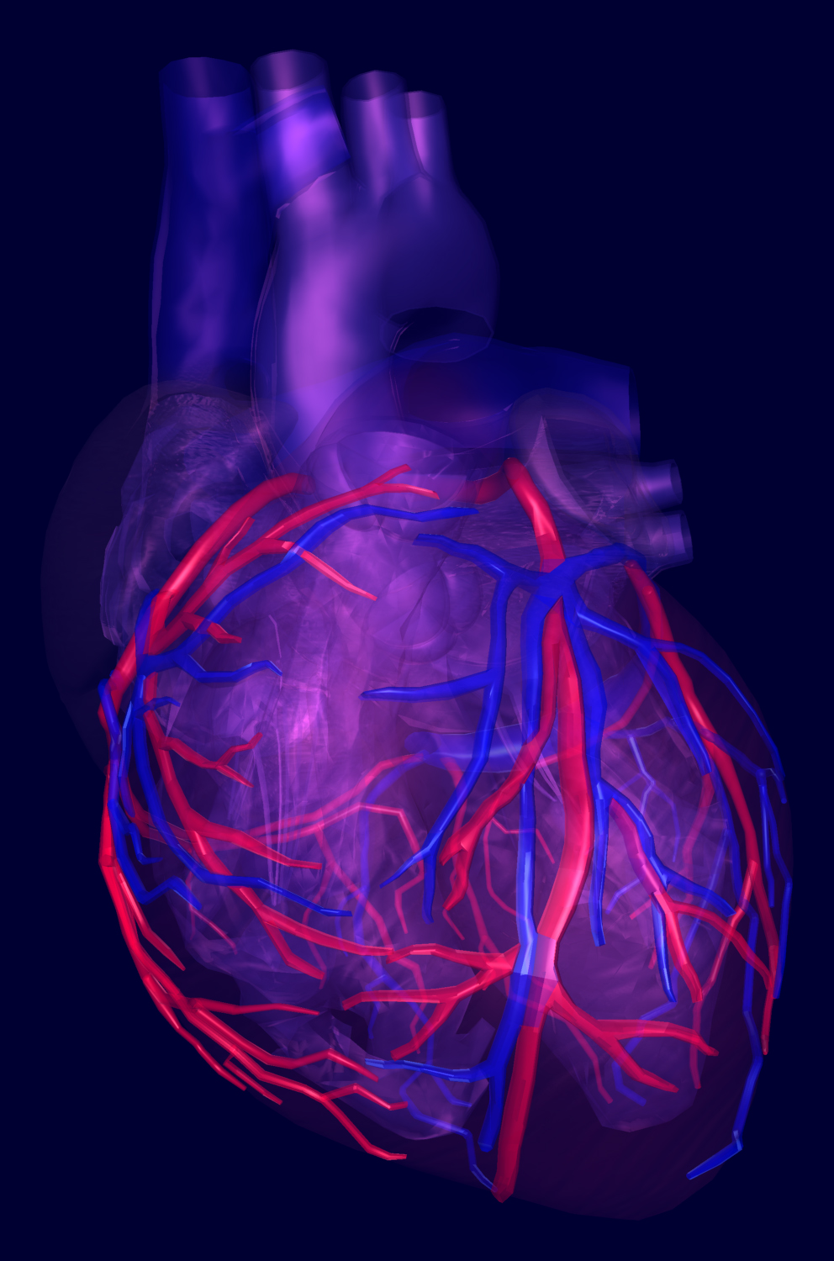

MESA STEERING COMMITTEE MEETING 2016
Risk Prediction of Heart Failure with Preserved Versus Reduced Ejection Fraction
An Opportunity for
“Precision Prevention”?
MARCH 22, 2016
Sanjiv J. Shah, MD
Associate Professor of Medicine
Director, Northwestern HFpEF Program
Division of Cardiology, Department of Medicine
N O R T H W E S T E R N U N I V E R S I T Y F E I N B E R G S C H O O L O F M E D I C I N E
Notes:
Talk about the clinic

Slide 2
Risk prediction for incident HF
Several models exist (MESA, Health ABC, FHS, ARIC, CHS)
Limitations:
  Generally based on diagnosed HF (mostly hospitalized HF, some outpatient HF diagnoses)
  External validation limited
  Clinical use unclear
  None focus on HF subtypes
  HFpEF and HFrEF are distinct
  Within HFpEF and HFrEF, there are clearly sub-phenotypes

Slide 3
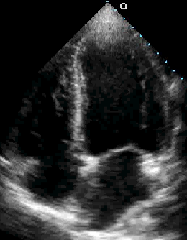
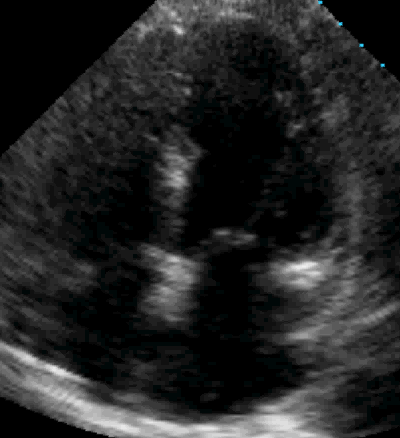
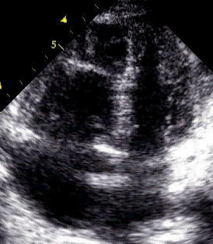
HFpEF pheno-groups: echo + invasive
Pheno-group #1
PCWP 20±6 mmHg
Least cardiac remodeling/dysfunction
Pheno-group #2
PCWP 25±8 mmHg
Lowest e’ velocity
Pheno-group #3
PCWP 24±9 mmHg
Most cardiac remodeling/dysfunction (especially RV dysfunction)

Slide 4
HF can be prevented!
HYVET trial indapamide resulted in
64% reduction
in HF hospitalization compared to placebo
P<0.0001
Cumulative incidence
Follow-up time (years)
Beckett NS, et al. NEJM 2008

Slide 5
HF can be prevented!
HYVET trial indapamide resulted in
64% reduction
in HF hospitalization compared to placebo
Can we do better than a one-size-fits-all paradigm for HF prevention?
P<0.0001
Cumulative incidence
Follow-up time (years)
Beckett NS, et al. NEJM 2008

Slide 6




Discriminating Risks for Heart Failure with Preserved and Reduced Ejection Fraction
The International Collaboration on Heart Failure Subtypes
Jennifer E. Ho*, Danielle Enserro*, Frank P. Brouwers*, Jorge R. Kizer*,
Sanjiv J. Shah, Bruce M. Psaty, Traci M. Bartz, Rajalakshmi Santhanakrishnan, Douglas S. Lee, Cheeling Chan, Kiang Liu, Michael J. Blaha, Hans L. Hillege,
Pim van der Harst, Wiek H. van Gilst, Willem J. Kop, Ron T. Gansevoort, Ramachandran S. Vasan, Julius M. Gardin, Daniel Levy, John S. Gottdiener*, Rudolf A. de Boer*, and Martin G. Larson*

Slide 7
Specific Aim and Hypothesis
To develop/validate separate risk prediction models for incident HFpEF and HFrEF
Hypothesis: risk factor profiles differ for HFpEF and HFrEF
Considerations:
  Sample size
  Imaging at time of HF to adjudicate HF subtype
  Multiple competing risks

Slide 8
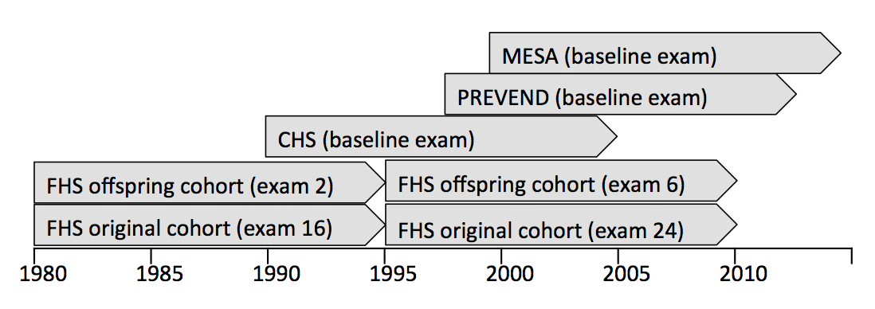
Participating cohorts
CHS: Cardiovascular Health Study
FHS: Framingham Heart Study
MESA: Multi-Ethnic Study of Atherosclerosis
PREVEND: Prevention of Renal and Vascular End-stage Disease

Slide 9
Work flow
Harmonized variables and outcomes
Central database
HFpEF vs. HFrEF defined using LVEF 45% cut-off

Slide 10
Statistical methods
Derivation and validation sets:
  CHS, FHS, PREVEND pooled for 2:1 random split
  MESA external validation
Fine-Gray models
  Proportional sub-distribution hazards model
  Multiple competing risks (death, other HF subtype, unclassified HF)
  Fitted separately for HFpEF and HFrEF
Stepwise model
  Forced in age and sex
  Entry: covariates with P<0.1 in age-/sex-adj. analyses
  Retention: Bonferroni-corrected P-value threshold

Slide 11
Baseline characteristics
Characteristic | CHS n=5277 | FHS n=9496 | MESA n=6678 | PREVEND n=7369
Age, years | 73 (6) | 58 (14) | 62 (10) | 49 (12)
Women, % | 57 | 55 | 53 | 50
Race: White, % | 85 | 100 | 38 | 96
Black, % | 15 | 0 | 28 | 1
Other, % | 0.6 | 0 | 34 | 3
Systolic BP, mmHg | 136 (21) | 130 (20) | 127 (21) | 129 (20)
BMI, kg/m² | 27 (5) | 27 (5) | 28 (6) | 26 (4)
Anti-HTN Rx, % | 45 | 26 | 37 | 14
Diabetes, % | 16 | 6 | 13 | 4
Current smoker, % | 12 | 24 | 13 | 34
Previous MI, % | 8 | 3 | 0 | 6

Slide 12
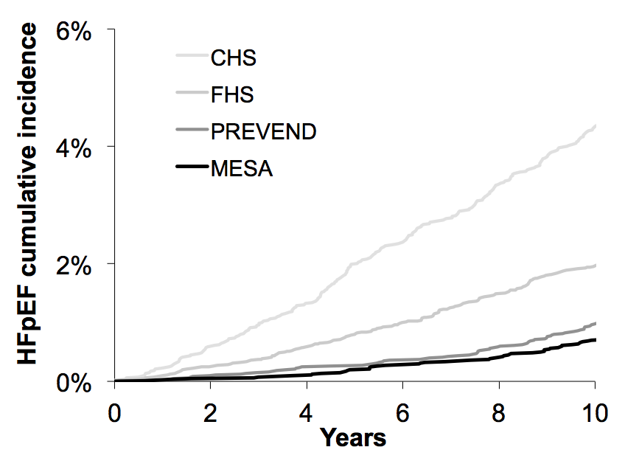
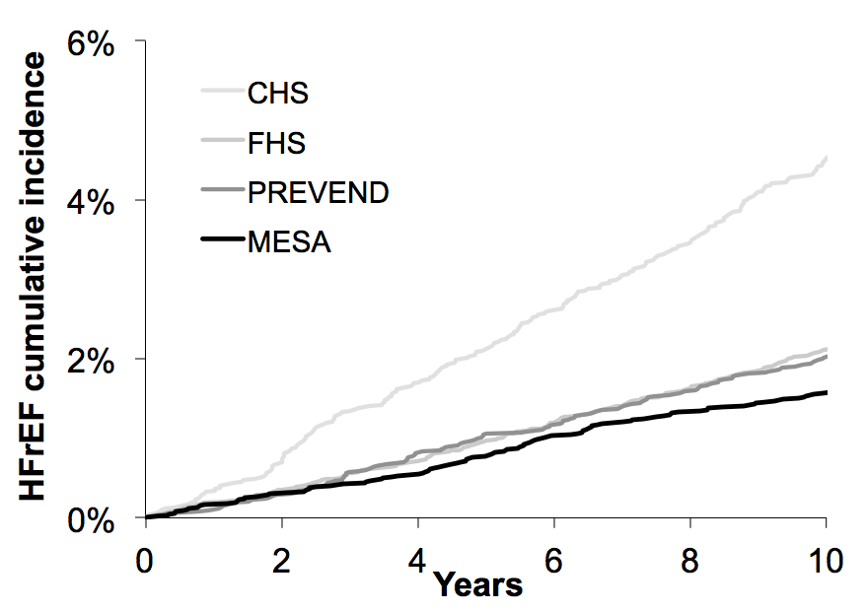
Results
28,820 participants:
  Median follow-up of 12 years; 7,733 deaths
2,579 incident HF events, 73% classified
HFpEF: 982 events, HFrEF: 909 events

Slide 13
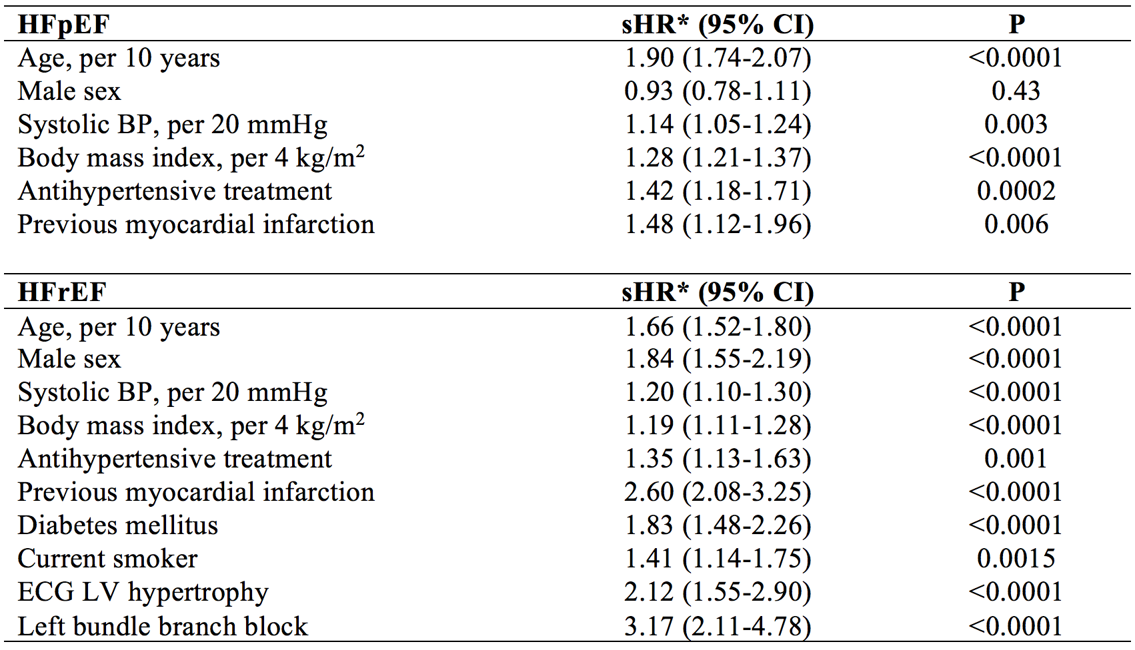
Risk prediction models for
HFpEF and HFrEF
Stepwise models for HFpEF: 8 variables eligible, HFrEF: 11 variables eligible
Covariates considered: age, sex, BP, heart rate, BMI, antihypertensive treatment, diabetes, smoking, modest alcohol use, previous MI, coronary heart disease, stroke, total and HDL cholesterol, LVH, LBBB, RBBB

Slide 14
Validation of HF subtype-specific models
Discrimination | HFpEF C-statistic (95% CI) | HFrEF C-statistic (95% CI)
Derivation | 0.80 (0.78-0.82) | 0.82 (0.80-0.84)
Internal validation | 0.79 (0.77-0.82) | 0.80 (0.78-0.83)
External validation | 0.76 (0.71-0.80) | 0.76 (0.71-0.80)
Calibration | HFpEF X² (p-value) | HFrEF X² (p-value)
Derivation | 5.29 (0.73) | 13.35 (0.10)
Internal validation | 9.02 (0.34) | 14.19 (0.08)
External validation | 4.54 (0.81) | 7.56 (0.48)
Internal validation: CHS, FHS, PREVEND sample with 2:1 random split
External validation: MESA

Slide 15
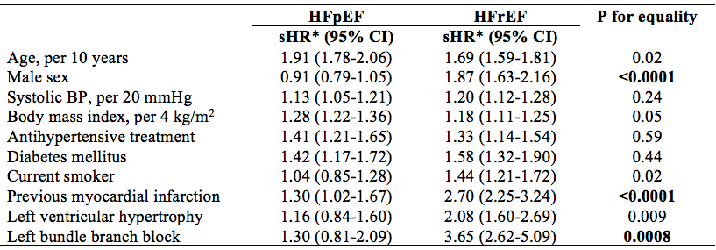
Differential effects of predictors on HF subtype
Lunn M, Biometrics 1995

Slide 16
Differential effects of predictors on HF subtype
Lunn M, Biometrics 1995

Slide 17
Conclusions
Developed/validated separate risk prediction models for HFpEF and HFrEF using 4 longitudinal community-based cohorts
There is considerable overlap in risk factors for HFpEF and HFrEF, but there are some interesting differences
Male sex, previous MI, and LBBB are stronger risk factors for HFrEF

Slide 18
Strengths/limitations
Strengths
  Multi-center, broad age distribution, >900 events for each HF subtype
  Internal and external validation
Limitations
  Models focused on readily available clinical characteristics
  27% unclassified HF
Future directions
  Potential benefit of imaging and biomarkers
  Clinical utility in HF prevention

Slide 19
Biomarker analysis
Characteristic | FHS | CHS | PREVEND | MESA
BNP | X | X | X | X
CRP | X | X | X | X
Troponin | X | X | X
Renin | X |  | X
UACR | X |  | X | X
D-dimer | X | X |  | X
Fibrinogen | X | X |  | X
Aldosterone | X |  | X
ST2 | X | X
Cystatin C | X | X | X | X
Galectin-3 | X | X | X
PAI-1 | X |  | X | X
IL-6 |  | X |  | X

Slide 20
Biomarker analysis
Characteristic | FHS | CHS | PREVEND | MESA
BNP | X | X | X | X
CRP | X | X | X | X
Troponin | X | X | X
Renin | X |  | X
UACR | X |  | X | X
D-dimer | X | X |  | X
Fibrinogen | X | X |  | X
Aldosterone | X |  | X
ST2 | X | X
Cystatin C | X | X | X | X
Galectin-3 | X | X | X
PAI-1 | X |  | X | X
IL-6 |  | X |  | X

Slide 21
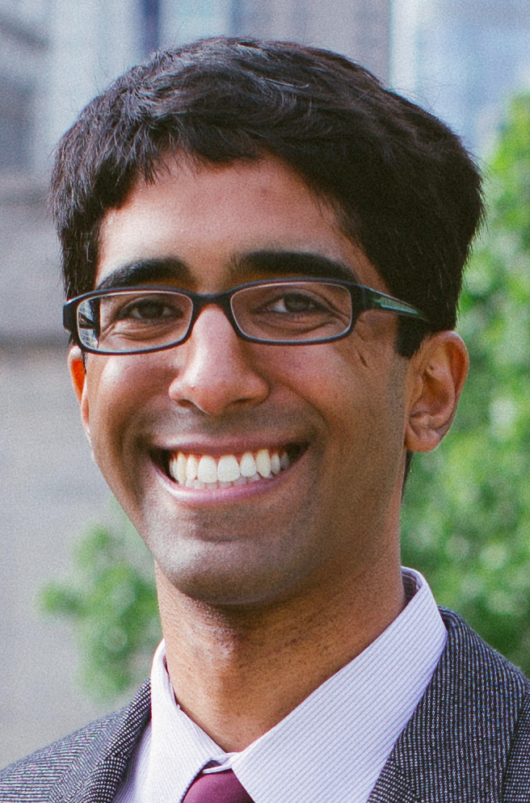

Machine learning for the prediction of HF subtypes in MESA
Aim 1: Machine learning of MESA data (comprising multiple domains) to define risk factor phenotype signatures (pheno-groups) and relate these pheno-groups to incident HF, HFpEF, and HFrEF
Aim 2: Compare the discrimination of HF risk models generated using machine learning techniques to HF risk models using traditional cardiovascular disease risk factors and statistical methods
Faraz Ahmad, MD
Yuan Luo, PhD

Slide 22
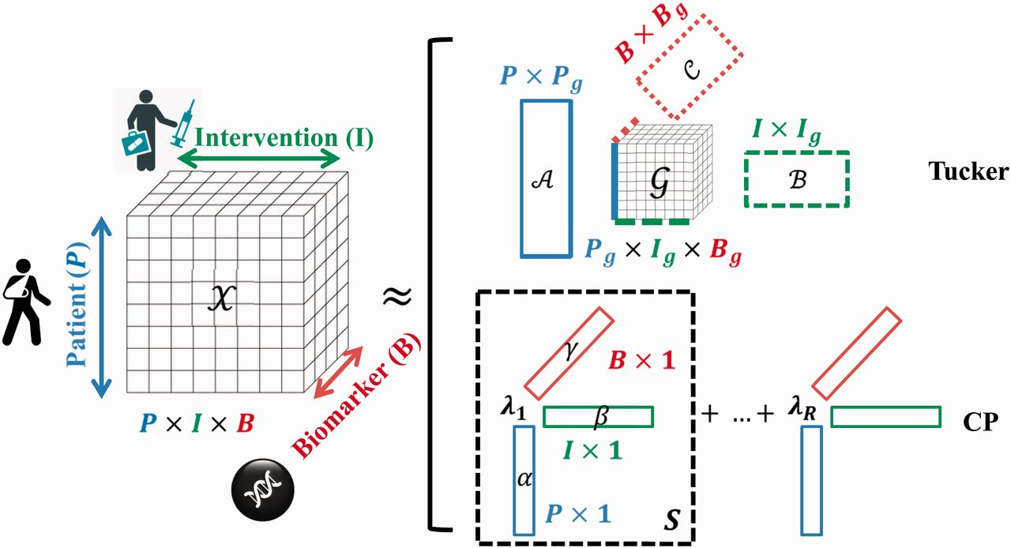
Tensor factorization
Luo Y, et al. Briefings in Bioinformatics, 2016, 1–4

Slide 23

Text mining the EHR via natural language processing (NLP)
Translation of findings from population-based studies to the population
Large amounts of data in the EHR is not “structured”; need a solution for “unstructured” data (free text reports)
Solution: NLP
  Pilot studies for automated identification of patients who meet inclusion/exclusion criteria for HF clinical trials
  High sensitivity/specificity
Sid Jonnalagadda, PhD

Slide 24
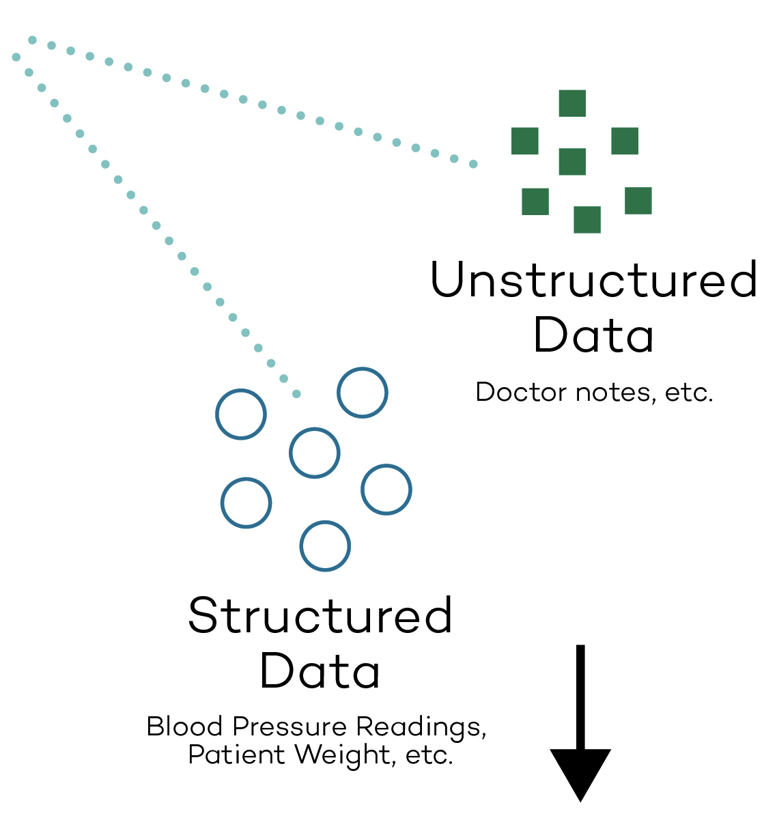

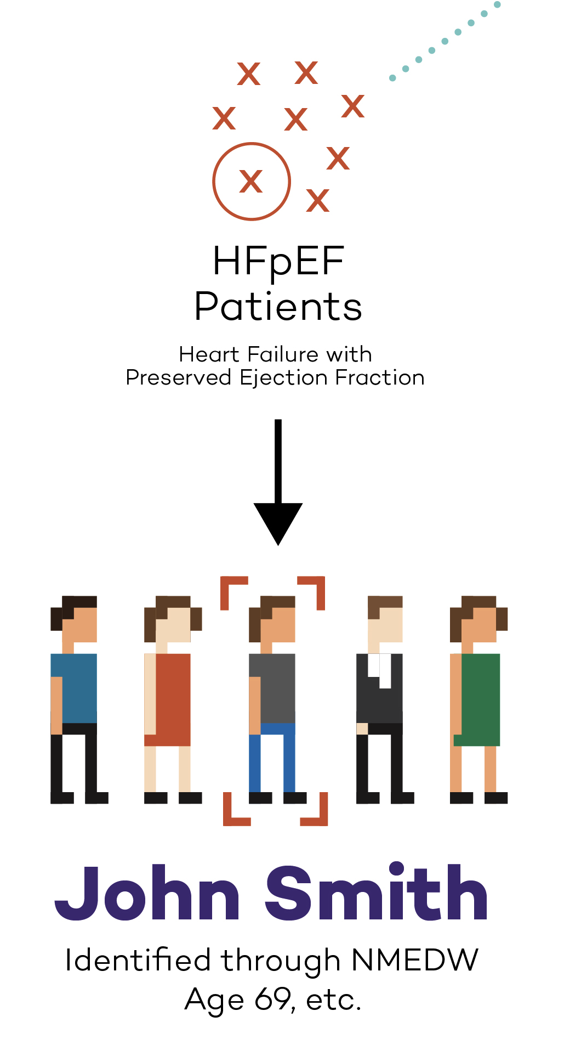
NLP to identify at-risk patients
Patients at risk
for HF
Machine learning
Natural language processing

Slide 25
NLP to identify at-risk patients
Patient Records Data
IC: Age ≥ 55 y, EC: BMI > 40 kg/m²
IC: Number of HF terms ≥1
Encounter Progress Notes
Age
BMI
Hb
GFR
BP
IC: LVEF value ≥45%
EC: Number of angioedema or pancreatitis or bilateral renal artery stenosis terms ≥1
Encounter Diagnosis Names
Structured data normalizer
Problem List
Structured data extractor
EC: Number of “transplant” or “ICD” terms ≥1
Lab Report
LVEF
Echo Report
Unstructured data extractor
EC: Sentences with “malignant” term and absence of “basal” and “prostrate” terms ≥1
Medication List
a. Heart failure
b. Angioedema
c. Pancreatitis
d. Organ transplant
e. ICD
f. Malignant cancer
g. Valvular heart disease
h. Pericardial constriction. Cardiomyopathy
EC: Hb < 10 g/dl, GFR < 30
EC: SBP value > 150 mm Hg and number of antihypertensive drugs > 3
EC: Number of “pericardial constriction” or “genetic hypertrophic cardiomyopathy” or “infiltrative cardiomyopathy” terms ≥ 1

Slide 26
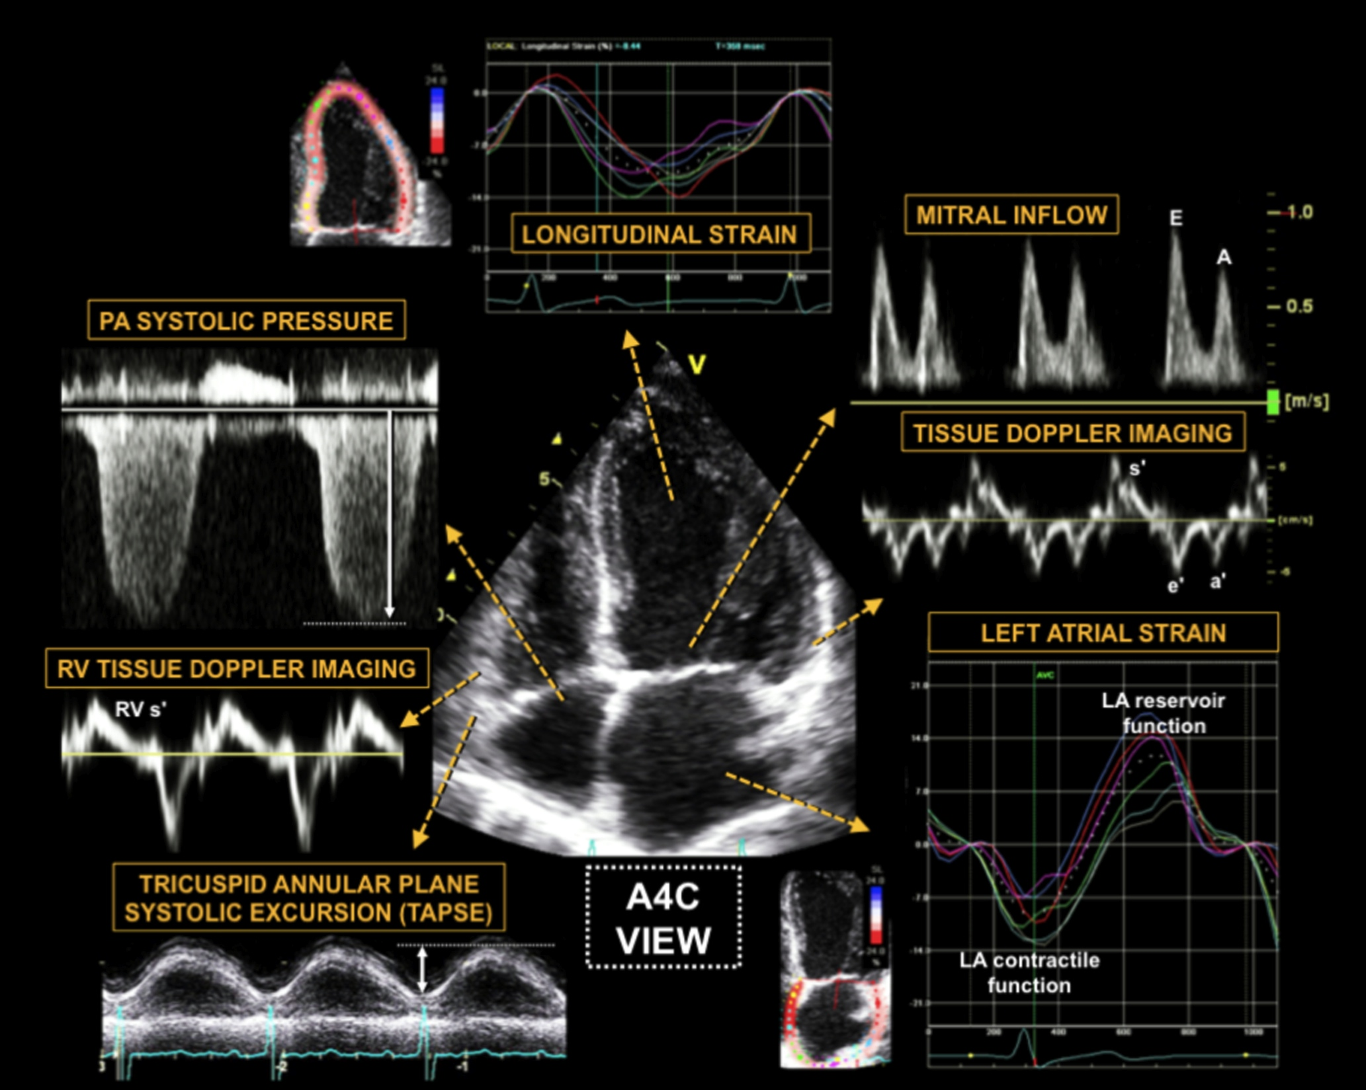

Slide 27
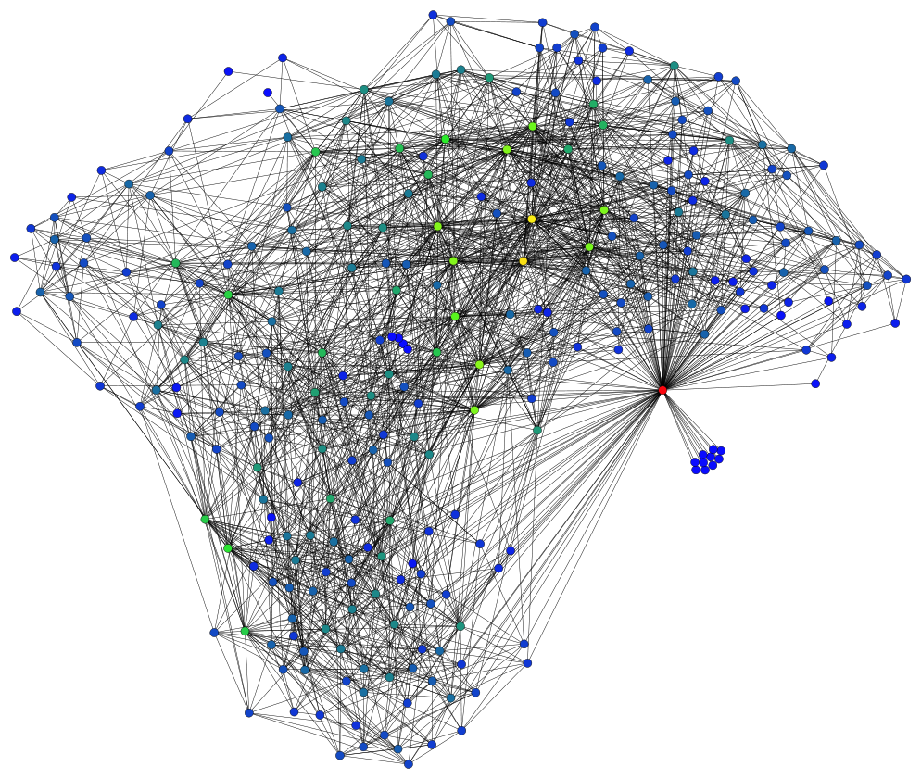
Future directions
Deep learning: neural network with multiple layers of nodes (feature identification and feature learning; processing in stages)

Slide 28
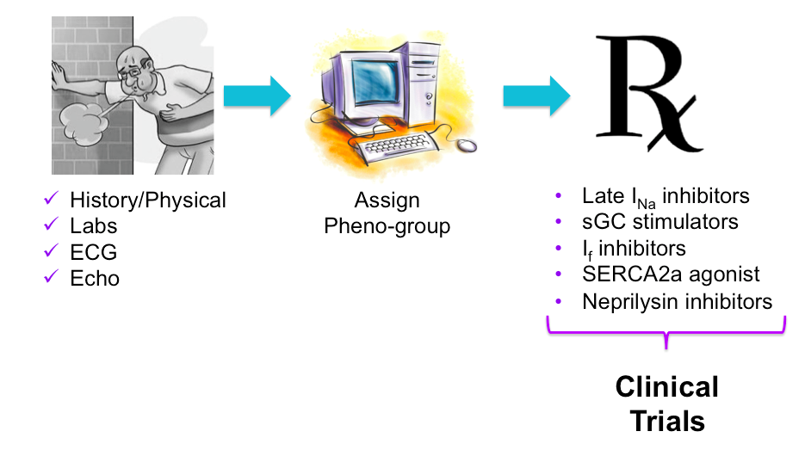
Future directions
Traditional therapies
Non-Rx prevention
Neprilysin inhibition
sGC stimulators
Inorganic nitrates
Late I_{Na+} inhibitors
NLP to collect features from EHR (phenotypes)
Deep learning to identify features (phenotypes)
Statistical learning to assign pheno-groups
Personalized preventive medicine

Slide 29

thank you!

