Slide 1
Introduction to VaSera for Use in the MESA Study
Christopher Broadbridge
Phone: (425) 241-7396
Clinical Development & Marketing, VaSera
Fukuda Denshi USA
Redmond, WA
Notes:
Good afternoon, everyone, and thank you very much for this opportunity to formally introduce myself and the VaSera product, on behalf of Fukuda Denshi USA. Fukuda Denshi is proud to be a sponsor of this meeting, and hopes to become more involved with the progression of learning around vascular physiology and testing.

Slide 2
Fukuda Denshi
3,000+ employees worldwide (including 300 engineers)
Celebrated 75th Year Anniversary
ECG leader in Japan
First ECG producer in Japan (1939)
Reputation for quality engineering
Oldest bedside monitoring manufacturer in the world
Makes 300+ medical device products
Notes:
Fukuda Denshi is 3,000 employees strong worldwide, though our US office is still modest in size. The company in the USA is growing, both in terms of number of employees and in its recognition.
This year will be Fukuda Denshi’s 75th anniversary as a company. It is the oldest bedside monitoring manufacturer in the world, with a reputation for quality, and experience in manufacturing a wide range of products.

Slide 3
Fukuda Denshi’s History in Vascular Function Measurement
Notes:
Along the history of the VaSera product line are several devices designed to measure arterial compliance, pulse wave velocity, and vascular function—dating back to the 1970’s.

Slide 4
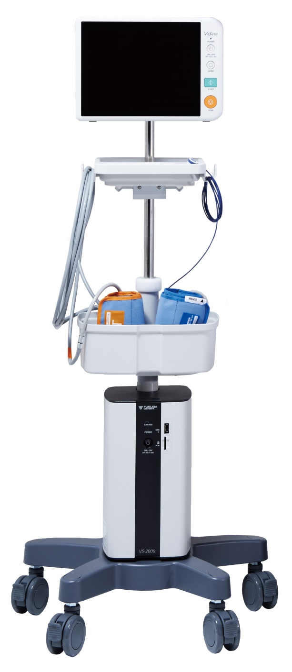
Rolling cart
Touch screen
Data transfer: Removable USB
Data storage: 2 USB, 1 SD, internal

Slide 5
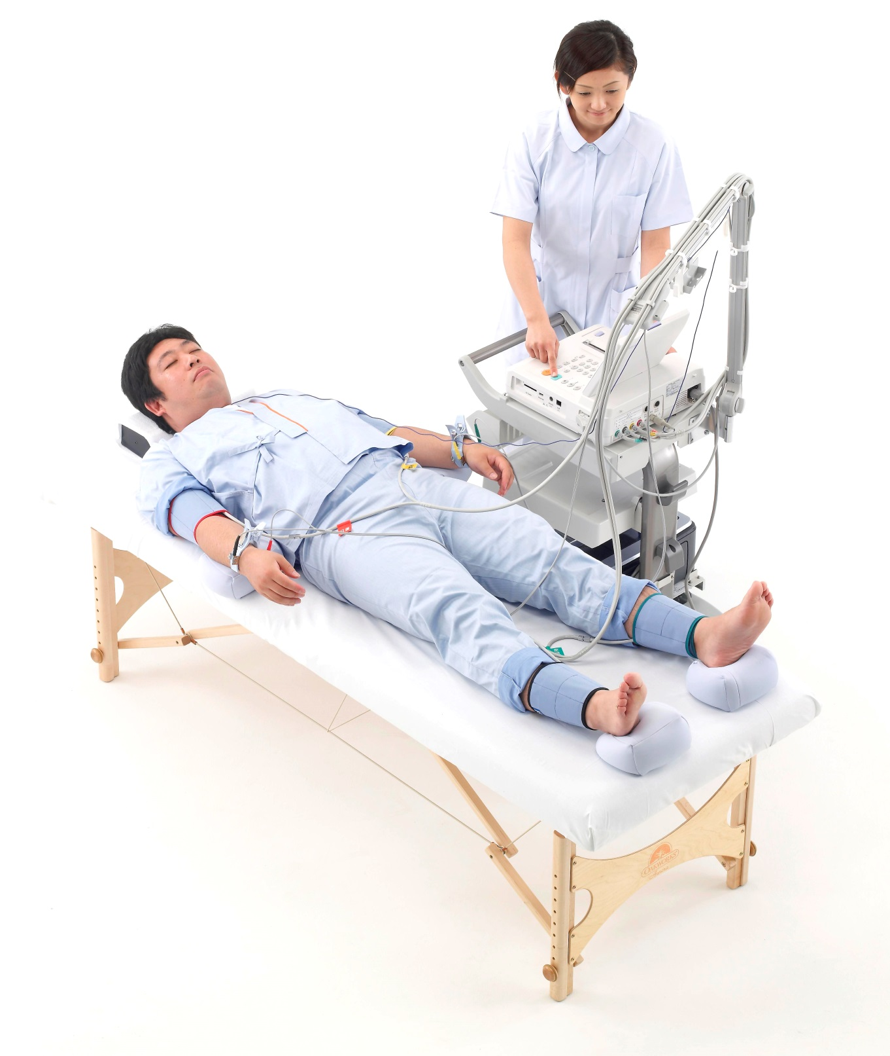
6 ultra-sensitive cuffs (brachia, thighs, ankles)
1 heart-sensitive microphone
Ankle cushions and wrist cushions
Notes:
Our very sensitive brachial and ankle cuffs measure arterial pulses, while a phonocardiograph placed on the chest listens for the second heart sound.

Slide 6
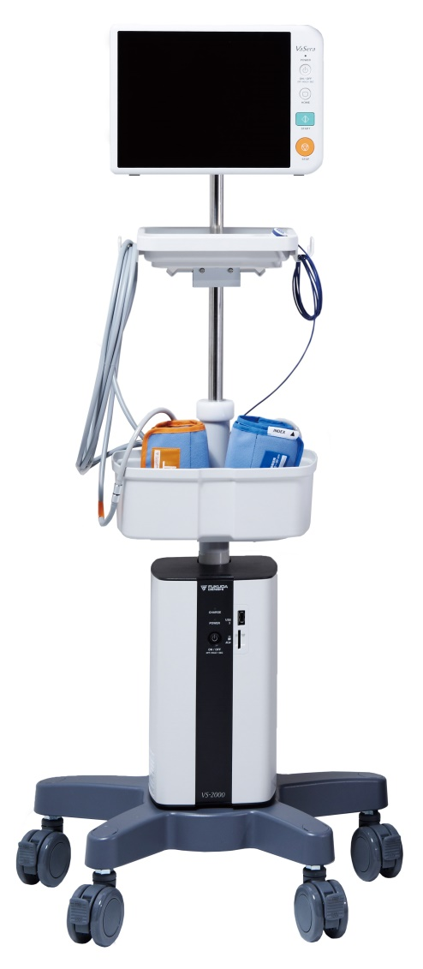
Characteristics of VaSera Tests
Diagnostic
Non-invasive
Validated
Reproducible
Sensitive to CV risk
Reimbursed in USA
FDA approved
Notes:
VaSera has all the hallmarks of a great medical instrument

Slide 7
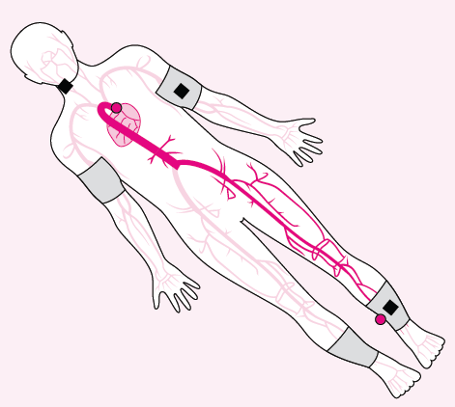
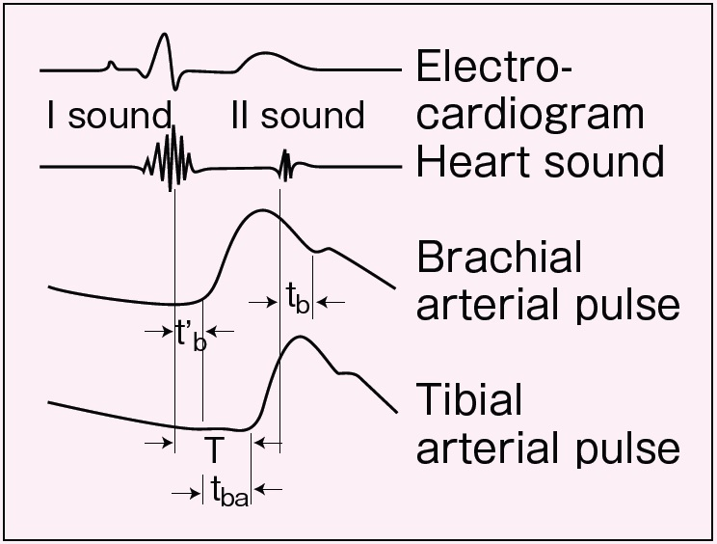
CAVI
A heart-to-ankle measurement:
Direct, single-path from the point of origin
Includes the whole aorta
Notes:
When the second heart sound is detected, we have the time of closure of the aortic valve. A high quality brachial pulse waveform will show, with its dichrotic notch, when that closure’s effect occurs in the pulse. Using the same durations for the valve’s closing—sound-to-notch—as for its opening, we take the closing duration, and extrapolate it back from the foot of the brachial pulse. Thus, with the time from valve opening being taken as time zero, we can easily measure the pulse’s total transit time to the ankle. Transit distance is estimated using the subject’s height, or can be done more exactly from manual measurements.
So, the CAVI measurement is that of a pulse movement along a single path, and includes the whole aorta.

Slide 8
VaSera tests to perform
CAVI test (Cardio-Ankle Vascular Index):
For arterial stiffness diagnosis ( → atherosclerosis; CAD)
Thigh-cuff test (Cardio-Thigh Vascular Index):
For arterial stiffness diagnosis ( → atherosclerosis; CAD)
ABI test:
For peripheral artery disease diagnosis (PAD)

Slide 9
Why do the measurement?
CAVI is a possible predictor of coronary risk; fully automatic.
Cardio-thigh stiffness measurements may be as effective as well-measured cfPWV.
VaSera ABI’s are automated; easier for clinics to perform.
“Clean” brachial waveforms from VaSera may provide data to predict HF
Notes:
The inclusion of the lower extremities to measure CAVI has led to some debate, but it’s value as a clinical and research tool will have to been tested empirically. Many studies already published on CAVI have suggested that it correlates well and independently to several medical risk factors.
In the same study by Wohlfahrt and company, it was found that when measurements included the lower extremity arteries, they were more strongly associated with LVH, and were similar to carotid-femoral measures in their associations with CV mortality and CHD. The researchers also suggested that inclusion of the muscular arteries may make stiffness measurements a better reflection of structural changes than is traditional pulse wave velocity.

Slide 10
For adults, CAVI is an independent risk marker for:
Coronary artery disease
Future cardiovascular events in people with CAD
Atherosclerosis in HTN patients
Renal dysfunction (eGFR) / Chronic Kidney Disease (CKD)
REFS:
Yingchoncharoen T, Limpijankit T, Jongjirasiri S, Laothamatas J, Yamwong S, Sritara P. Arterial stiffness contributes to coronary artery disease risk prediction beyond the traditional risk score (RAMA-EGAT score). Heart Asia. 2012 Feb 21;4(1):77-82. Print 2012.
Otsuka K, Fukuda S, Shimada K, Suzuki K, Nakanishi K, Yoshiyama M, Yoshikawa J. Serial assessment of arterial stiffness by cardio-ankle vascular index for prediction of future cardiovascular events in patients with coronary artery disease. Hypertens Res. 2014 Jul [Epub ahead of print]
Okura, T; Watanabe, S; Kurata, M; Manabe, S; Koresawa, M; Irita, J; Miyoshi, K; Fukuoka, T. Relationship between Cardio-Ankle Vascular Index (CAVI) and Carotid Atherosclerosis in Patients with Essential Hypertension. Hypertens Res; 2007; (30): 335-340
Takuro K, Masaaki M, Kiyo U, Aya N, Shuichi H, Ken K, Osamu K, and Chuwa T. Association between Arterial Stiffness and Estimated Glomerular Filtration Rate in the Japanese General Population. J Atheroscler Thromb, 2009; 16:840-845.
Notes:
Some of the many journal publications on CAVI studies show correlations between CAVI and several disease states.
CAVI has been shown to be an independent risk marker for:
Coronary artery disease
Future cardiovascular events in people with CAD
Atherosclerosis in HTN patients
And eGFR slash CKD
ROC curve for the presence of CAD: Using ROC curve analysis, a CAVI of ≥8 (area under the curve 0.87 (95% CI 0.852 to 0.896); p<0.001; sensitivity 92%; specificity 73%; accuracy 79%) was identified as the best cut-off value associated with the presence of CAD.
Multivariate analysis: After adjustment for age, gender, hypertension, smoking, diabetes, total cholesterol, waist circumference and high density
lipoprotein (HDL) cholesterol, the association between CAVI and CAD remained significant (OR 3.3, p<0.001).
Coronary segments were analyzed by the American Heart Association classification. Significant coronary stenosis was defined as ≥50% of mean luminal diameter reduction in two orthogonal projections.
Moderate coronary stenosis was classified as 50-75% coronary stenosis and severe coronary stenosis as ≥75% coronary stenosis.

Slide 11
CAVI Health Subject Data
Notes:
Shown here are data for over 6,000 healthy Japanese subjects have been collected to characterize the effect of aging. CAVI has been shown to increase with age, with men tending towards higher values than women.

Slide 12
VaSera: Become an Expert!
(Tips on testing)
MESA version

Slide 13
Background
What is CAVI?
How is it measured?

Slide 14
4 ultra-sensitive cuffs
1 heart-sensitive microphone
ECG for gating signals
Notes:
Our very sensitive brachial and ankle cuffs measure arterial pulses, while a phonocardiograph placed on the chest listens for the second heart sound.

Slide 15
CAVI
A heart-to-ankle measurement:
Direct, single-path from the point of origin
Includes the whole aorta
Notes:
When the second heart sound is detected, we have the time of closure of the aortic valve. A high quality brachial pulse waveform will show, with its dichrotic notch, when that closure’s effect occurs in the brachial pulse. Using the same duration for the detection of the valve’s closing—sound-to-notch—as for detection, in the brachial pulse of its opening (the point of onset of the pulse), we take the closing duration, and extrapolate it back from the foot of the brachial pulse. Thus, with the time from valve opening being taken as time zero, we can easily measure the pulse’s total transit time to the ankle. Transit distance is estimated using the subject’s height, or can be done more exactly from manual measurements.
So, the CAVI measurement is that of a pulse movement along a single path, and includes the whole aorta.
Calculation of the pulse wave velocity portion of CAVI is essentially a distance/time (ratio) with units in meters/second. The distance of the transit is from the aortic valve to the measured ankle, and is estimated either by direct measurement from sternal notch to ankle, or by using a scale factor applied to the subject’s vertical height (more commonly used for clinical settings).
CAVI is then calculated by applying the beta-stiffness index to the PWV, and cancelling out some of the BP components. Two constants are also factored into the equation to normalize the result to be closer to the scale of cfPWV measurements. In adding the beta stiffness index, CAVI losses its units, and so is simply expressed as a number to the nearest one decimal place.

Slide 16
When VaSera detects the second heart sound, we have the time of closure of the aortic valve. A high quality brachial pulse waveform will show, with its dichrotic notch, when that closure’s effect occurs in the brachium. Time of the second heart sound to dichrotic notch represents, then, a “lag time”. Applying that lag time to the start of the rise of the brachial pulse wave (the foot of the brachial wave), the time of expulsion of blood at the level of the aortic valve (valve opening time) is extrapolated. Thus, with aortic valve-opening time being time zero, we can easily measure the pulse’s total transit time to the ankle, where it is measured until the “foot” of the ankle wave. Transit distance is estimated using the subject’s height, or can be done more exactly from manual measurements. Dividing this distance by transit time gives the pulse wave velocity (PWV).
The beta stiffness index and scale adjustments are added to give CAVI more independence from blood pressure and make it comparable to heart-to-femoral PWV.
The CAVI measurement is that of a pulse movement along a single path, and includes the whole aorta.

Slide 17
Performing the Measurement
Before pressing START button:
Quiet room
Ensure cuffs correctly wrapped and positioned
Patient: Supine, Still, Relaxed
Ensure that…
PCG = distinct 2nd heart sound
Brachials = dichrotic notch
Ankles = defined starting point to each pulse
Thighs = clean, smooth, regular signals
Supine, Still, Relaxed

Slide 18
Clean Waveforms and Signals
Up-going R-wave; In sinus rhythm
Distinct 2nd heart sound; flatter baseline
Noticeable dichrotic notch; no disruptive artifacts on the downslope
Sharp and consistent “foot”, marking the up-slope, with no disruptive artifacts

Slide 19
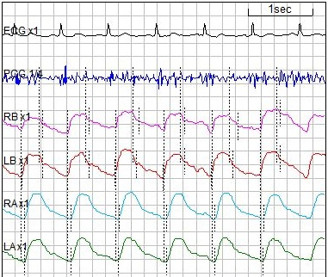
Always check your PCG signal
If you can’t distinguish the 2nd heart sound, VaSera probably can’t either.

Slide 20
Look at the Brachial Waveforms
Can you distinguish the dichrotic notch from the artifact?

Slide 21
Good Ankle Signal (“foot”/ trough)?
No
Yes
Are the troughs or “feet” of the ankle waveforms at the ends of consistent and regular up-slopes?

Slide 22
Movement Artifact Effect
Movement, beyond relaxed breaths, can disrupt signals

Slide 23
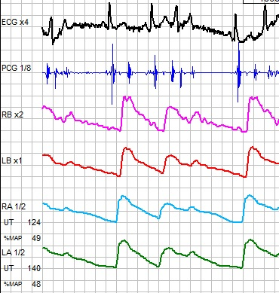
Arrhythmia Effect
Arrhythmic heart beats result in irregular pulse waveforms

Slide 24
Measurement Review
AFTER CAVI measurement period:
Ensure that…
Blue, data quality-check screen shows pluses “+” for both sides (R and L)
If a minus “—” is shown, press STOP button, and start the test over by adjusting where necessary and pressing START button
If there is a minus sign “—” for either side, do not use this test result

Slide 25
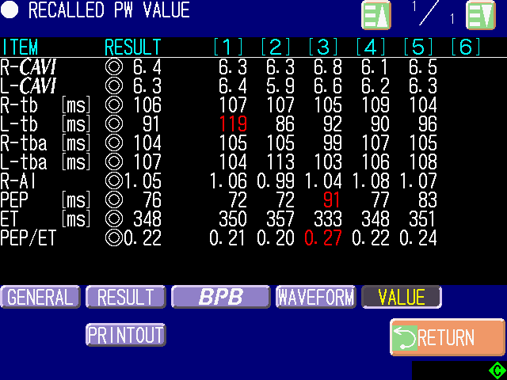
You may also review calculation results via the “VALUE” screen. One column per heartbeat (1-6).
These symbols are quality measures: ◎ is the same as “++”, ○ = “+”, △ = “—”, ×= “——”. Red values (outliers) are not used in the reported results.

Slide 26
Performing Tests with Thigh Cuffs
(See the “Thigh Cuff Protocol” document)
Thigh cuffs are used in this study in order to assess measurements with a heart-to-femur transit (more purely aortic in nature than measurements using a heart-to-ankle transit)
Thigh cuffs must be applied as carefully as brachial and ankle cuffs are applied

Slide 27
VaSera Data Management for the MESA Study
(From the VaSera collection device to MESA central data repository)

Slide 28
Please use these site # assignments
Site# | Site Name
1 | Northwestern University Clinic
2 | Columbia University Clinic
3 | Johns Hopkins University Field Center
4 | University of Minnesota (Epidemiol. Clin.Res. Cntr)
5 | UCLA Clinic
6 | Wake Forest University Clinic

Slide 29
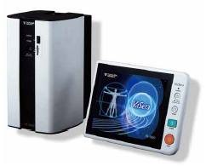
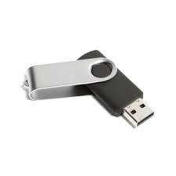
At each site…
Zip Files
ZIPPED
VaSera USB data stick
For all VaSera data, create consistent, date-sortable, folder-naming format:
e.g., 20160915-UCLA
Remove USB drive/Stick from front of VaSera.
Use File Manager to copy files from USB drive to a folder you designate for VaSera data on your PC.
Name that folder “MESA Study VaSera Data”.
Zip/compress the files in your PC folder to make them ready for transfer.
Upload the zipped folder to your MESA central data storage location.
Repeat the above steps, on a regular basis, keeping all historical data.
MESA Study VaSera Data
20160915-UCLA
Send to Center

Slide 30
MESA Central Data Storage Location
UCLA-5
ZIPPED
20160915-UCLA
Unzipped
20160915-UCLA
upload
ZIPPED
20161030-UCLA
Unzipped
20161030-UCLA
ZIPPED
20161013-JHU
NWU-1
CU-2
ZIPPED
20161104-UCLA
CU-2
Unzipped
20161116-CU
ZIPPED
20161028-WFU
JHU-3
ZIPPED
20161116-CU
WFU-6

Slide 31
VSS-50 management
UCLA-5
20160915-UCLA
Aug5 2016_Pennsylvania
Import with VSS-50 software
JHU-3
Review, Print, or Export in various data formats
20161224-JHU
“Inspection Data” spreadsheet
“Wave Data” files
“Graphic files”

Slide 32
Some Extra Tips
Sites not using the AUTO-TRANSFER of data from VaSera to PC:
Remove auto transfer option from the system settings
Change Site ID # for each site according to table above:
MENU → SETTINGS → PATIENT INFO →
For Thigh-cuff measurements, make sure to measure to/from the middle of the thigh cuff
BP VESSEL LENGTH setting
Make sure to input the correct subject HEIGHT information; this is critical to the test result
PAUSE the test at the CAVI DATA CHECK SCREEN (“SUMMARY SCREEN”); this will enable an opportunity to review data quality and decide if to stop and restart the test after adjustments, or to continue with the test to completion.
Preview the PDF file Report to see if the CAVI result is reported with a circle (signifying “clean data”) or no circle (questionable data quality).
Data will be saved to USB1, USB3, SD card, and to the VaSera internal memory.
A good VaSera test time for each subject is 8 (CAVI test) + 2 (rest between measurements) + 8 (thigh cuff test) = 18 minutes

Slide 33
Let us support you
Please pose your questions to your local Fukuda Denshi USA representative:
Christopher Broadbridge
FUKUDA DENSHI USA, Inc.
Tel: (425) 241-7396
Fax: (425) 556-3213
CBroadbridge@fukuda.com
Or contact our customer service at:
Toll Free : 1-800-365-6668
Local : 425-881-7737
Hours: 8:00 AM to 5:00 PM (PST)

