Slide 1
Mesa exam 6 echocardiography and arterial stiffness training
Lauren Nelson, MS, RDCS, FASE
Technical director, Northwestern University Echocardiography Core Laboratory
July 27, 2016
Notes:
Hi everyone, thank you so much for coming to the training! My name is Lauren Nelson and I am the technical director of the core lab here at Northwestern. What that means is that I will be receiving and analyzing all of the echos performed for the MESA study, and I will be your primary contact here as well. My presentation will cover the more technical aspects of the MESA Heart Failure study, including a full review of the echo protocol.

Slide 2
Outline for Today
Introductions
Role of echo and NUECL in MESA
Basic echo protocol
Imaging pitfalls to avoid
Site certification process
Electronic transfer instructions
Echo submission and medical alerts
Questions

Slide 3
Northwestern University Echocardiography Core Laboratory (NUECL)
Located in downtown Chicago, Illinois USA
Experienced sonographers perform echo analysis using GE EchoPAC, FujiFilm Synapse, and Tomtec 2D Cardiac Performance Analysis software
All measurements over-read by core lab PI, Dr. Sanjiv Shah

Slide 4
Study-Wide Process Overview
Site Preparation and Training
Transfer of studies to NUECL
Attend central echocardiography training in July 2016
Echo Manual of Operations distributed to all sites
Submission of certification echo
Secure electronic transfer via Heart IT WebPAX
Submission of Echo Transmittal Form via email
Study tracking and image storage at NUECL
All images over-read by NUECL PI
All studies reviewed for quality, completeness
NUECL Image Analysis
Feedback on image quality provided to each site
Ongoing assessments of variability and temporal drift
Image analysis performed by NUECL

Slide 5
Role of the NUECL
Train and certify each site sonographer
Perform QA of all study echos with feedback
Provide accurate and reproducible quantitation of echos
Serve as a resource for sites for all echo related questions

Slide 6
Site/Sonographer Responsibilities
Know the image acquisition protocol
Submit required certification echocardiogram(s)
Perform complete, high quality echos
Submit echos to the core lab in proper format, in a timely fashion

Slide 7
Basic Echo Protocol

Slide 8
T8 Machine – Features and Limitations
Scaled-down, more affordable version of GE vivid systems
Advanced cardiac imaging capabilities
Minor processing limitations

Slide 9
General Tips for 2D Echo Acquisition
Ensure that high quality ECG signals (with a clearly identifiable QRS complex) are recorded on all images
Record at least 3 beats of each view (10 beats if atrial fibrillation or another arrhythmia is present)
Adjust gain, TGC, dynamic range, and compression to optimize endocardial definition and minimize artifacts
Avoid foreshortening of the ventricle and maximize ventricular length in all views
Stabilize the image before recording (minimize translational motion)
Frame rate between 50-80 fps when noted

Slide 10
General Tips for Color Doppler Acquisition
The Nyquist limit should be set near 60 cm/s throughout the exam
Make sure not to overgain color Doppler
Evaluate all valves with color Doppler to look for stenosis or regurgitation
Perform further quantification if greater than moderate valvular disease is present

Slide 11
General Tips for Spectral Doppler and M-mode Acquisition
Keep line of interrogation parallel to flow
Optimize baseline shift and velocity scale so that the waveform of interest occupies approximately ¾ of the screen
A velocity scale of + 20 cm/s is recommended for recording Tissue Doppler velocities
Adjust gain, compress, and reject levels to generate a clear, well-defined waveform
Minimize wall filter
Sweep speed should be set at 100 mm/s for all Doppler and M-mode clips
Capture multiple clips if necessary – at least three complete cardiac cycles are required for each view

Slide 12
Prior to Examination
All echos should be de-identified using the following labeling system:
Last name field: MESA 6
First name field: Acrostic ID
ID field: 7 digit study ID
Record the patient’s height (cm), weight (kg), blood pressure, heart rate, and rhythm on the echo transmittal form

Slide 13
Parasternal Long Axis (PLAX) View

Slide 14
PLAX View – Color on the mitral and aortic valves

Slide 15
Parasternal Short Axis (PSAX) View – Papillary muscle level

Slide 16
PSAX View – Basal (aortic valve) level

Slide 17
PSAX View – Color on the tricuspid valve

Slide 18
PSAX View – CW Doppler on the tricuspid valve

Slide 19
Apical Four Chamber (A4C) View

Slide 20
A4C View – Focused on the left ventricle

Slide 21
A4C View – Focused on the left atrium

Slide 22
A4C View – Color on the mitral valve

Slide 23
A4C View – Color M-mode of mitral inflow

Slide 24
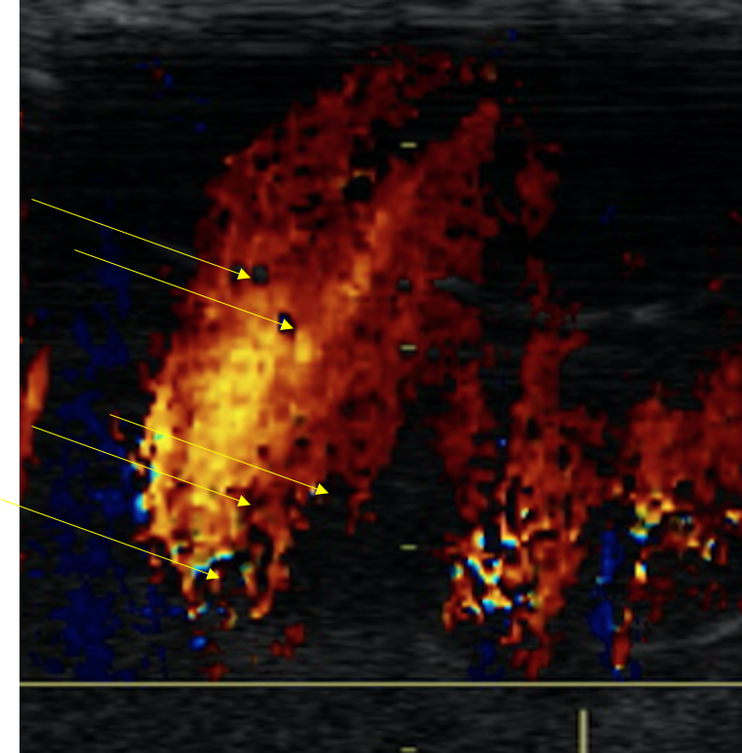

Slide 25
A4C View – PW Doppler at mitral leaflet tips

Slide 26
A4C View – PW Tissue Doppler at the septal annulus

Slide 27
A4C View – PW Tissue Doppler at the lateral annulus

Slide 28
A4C View – Focused on the right ventricle

Slide 29
A4C View – Color on the tricuspid valve

Slide 30
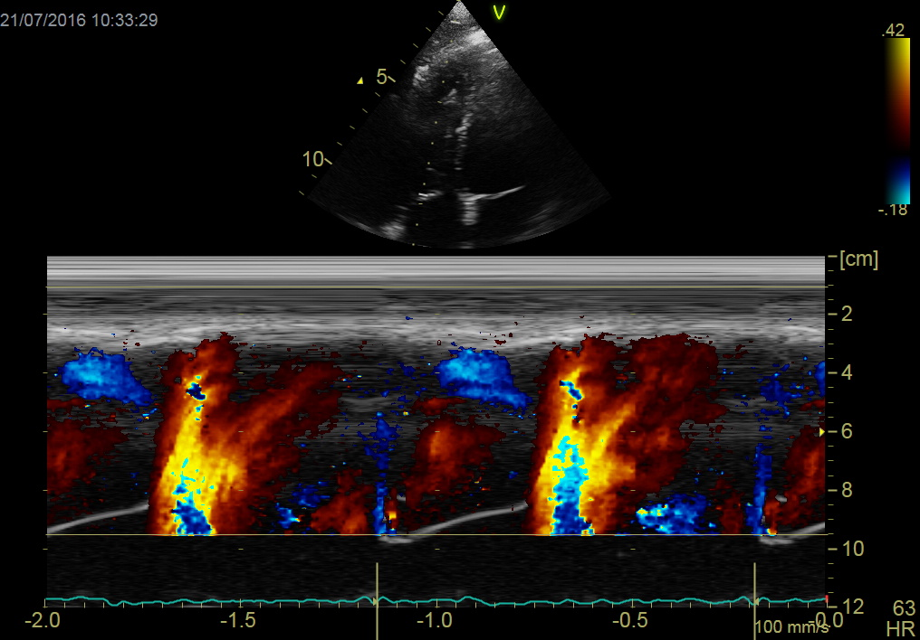
A4C View – Color M-mode of tricuspid inflow

Slide 31
A4C View – PW Doppler at tricuspid leaflet tips

Slide 32
A4C View – CW Doppler on the tricuspid valve

Slide 33
A4C View – PW Tissue Doppler at the lateral tricuspid annulus

Slide 34
Apical Five Chamber (A5C) View – Color on the aortic valve

Slide 35
A5C View – PW Doppler at the LVOT

Slide 36
A5C View – CW Doppler on the aortic valve

Slide 37
Apical Two Chamber (A2C) View

Slide 38
Apical Three Chamber (A3C) View

Slide 39
Subcostal View – IVC with sniff

Slide 40
Subcostal View – PW Doppler of abdominal aorta at level of diaphragm

Slide 41
Subcostal View – PW Doppler of abdominal aorta at level of diaphragm

Slide 42
Suprasternal View – PW Doppler of descending thoracic aorta

Slide 43
Suprasternal View – PW Doppler of descending thoracic aorta

Slide 44
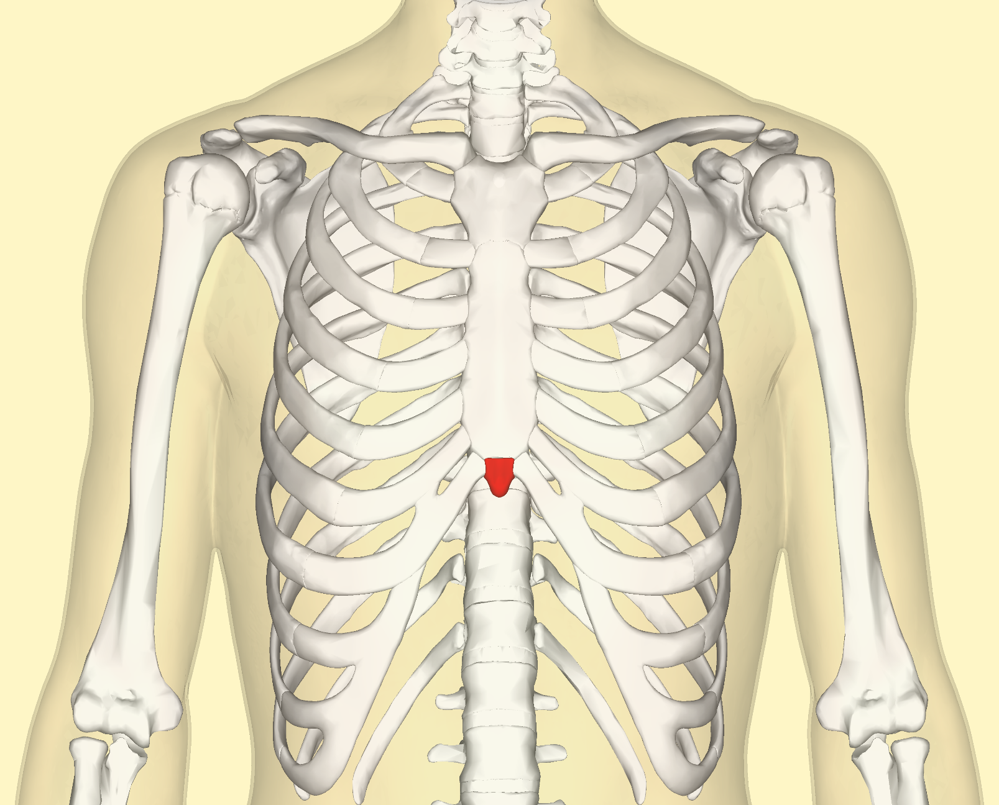

Slide 45
Passive Leg Raise
With the patient in the supine position, prop the legs up using a large wedge-shaped pillow
Instruct the patient to keep the legs straight and relaxed to facilitate venous return to the heart (and increase preload)

Slide 46
Passive Leg Raise
A4C view, focused on the left ventricle (FR = 50-80 fps)
A4C view, focused on the left atrium (FR = 50-80 fps)
A4C view, focused on the right ventricle (FR = 50-80 fps)
PW Doppler at mitral leaflet tips
PW Tissue Doppler at the septal annulus
PW Tissue Doppler at the lateral annulus
PW Doppler at the LVOT
CW Doppler on the tricuspid valve

Slide 47
Passive Leg Raise – Remember to annotate!

Slide 48
Imaging Pitfalls to Avoid

Slide 49
Foreshortened Left Ventricle

Slide 50
Off-Axis Image

Slide 51
Translational Motion

Slide 52
Poor Endocardial Definition

Slide 53
Incorrect Sweep Speed

Slide 54
Incorrect Doppler Scale

Slide 55
Electronic transfer instructions

Slide 56
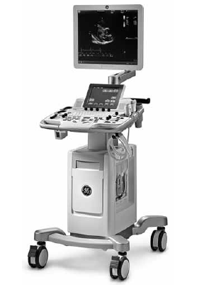
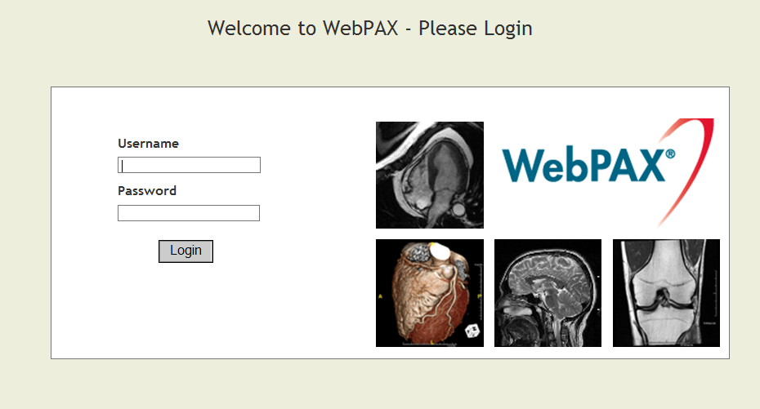
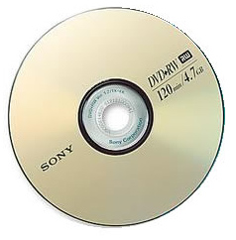
Image Storage and Transfer
Before submitting any echos for the MESA study, a modification must be made to the DICOM CD/DVD settings on the T8 machine
Detailed instructions on page 6 of the Echo Manual of Operations
All study echos must be copied to DVD in DICOM format
Copy the echo directly to DVD from the machine, and not a PACS system
Only one study should be saved on each DVD
The NUECL uses Heart Imaging Technologies (IT) WebPAX for the secure and efficient submission of de-identified echo studies from MESA field sites to the NUECL

Slide 57
WebPAX How-To
The NUECL uses Heart Imaging Technologies (IT) WebPAX for the secure and efficient submission of de-identified echo studies from PROMIS HFpEF field sites to the NUECL for review
Heart IT WebPAX can be accessed at: https://webpax.northwestern.edu/

Slide 58
WebPAX How-To
1. Heart IT WebPAX can be accessed at: https://webpax.northwestern.edu/. Enter username and password provided by NUECL
2. Click “Upload”

Slide 59
WebPAX How-To
3. Select the appropriate Patient ID and Scan Description from the drop-down menus (leave the “Patient Initials” field blank). Click “Continue.”

Slide 60
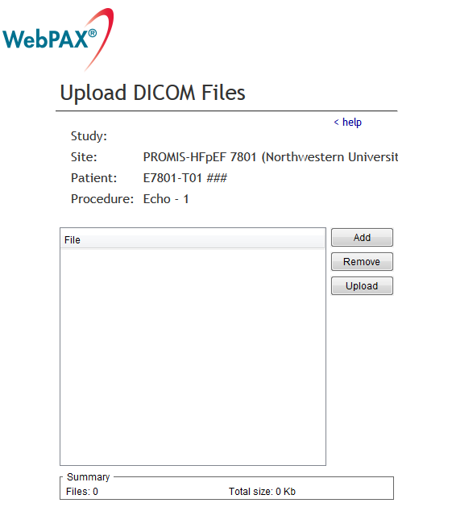
WebPAX How-To
4. Click “Add” and choose the drive location containing the de-identified DICOM images you would like to send. Click “Upload.”

Slide 61
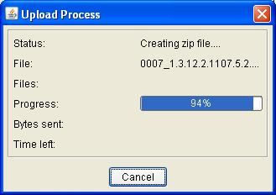
WebPAX How-To
5. Heart IT WebPAX will send the images from the local directory to the online archive.
6. After the upload is complete, the text under “Scan Description” for the given study will change from “Upload” to “Uploaded.”
7. A confirmation email will be sent to the site sonographer.

Slide 62
Site Certification process

Slide 63
Site Certification Overview
Each site must:
Participate in central training
Review Echo Manual of Operations
Provide at least one certification echo to become certified prior to beginning enrollment
What do we look for in certification echo?
Demonstrates understanding of study protocol
Quality echo image acquisition
Successful digital upload to WebPAX for analysis at NUECL

Slide 64
Site Certification Overview
Echo may be performed at any time on a non-study patient
Include all required protocol views
Burn the study to DVD from echo machine in DICOM format, then use WebPAX to transmit to NUECL
Use one of the patient identification numbers beginning with ‘T’ for WebPAX upload (for example, E7801-T01)
Images will be reviewed by the NUECL
If images are acceptable, certification will be granted
If images are unacceptable, detailed feedback will be sent to the site sonographer and a new certification echo must be submitted
Sonographer training at Site
Perform certification echo
Review of images
Transfer echo via WebPAX
Certification granted

Slide 65
Echo submission and medical alerts

Slide 66
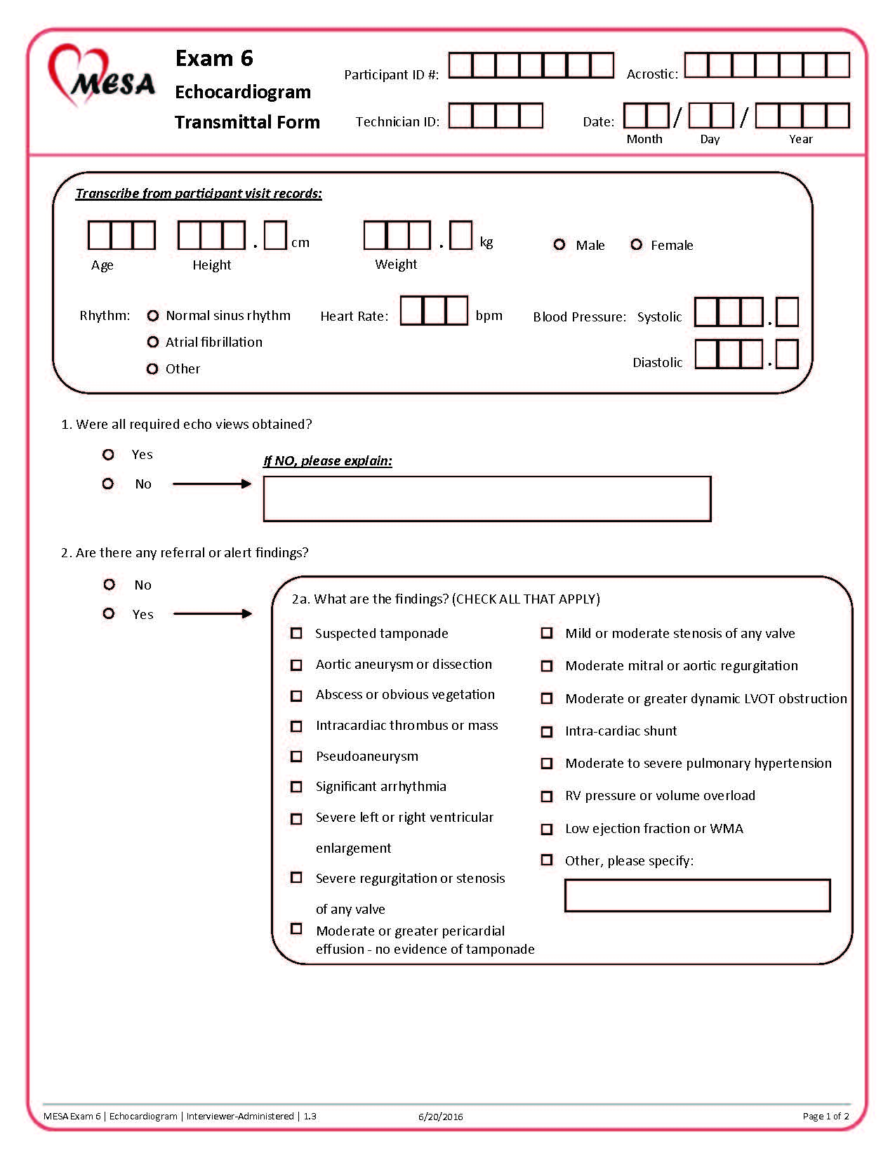
Echo Transmittal Form
Each echo submitted to the NUECL must be accompanied by an Echo Transmittal Form (ETF)
Fill out an ETF for each study patient and submit to the NUECL via email (lauren.nelson@northwestern.edu)

Slide 67
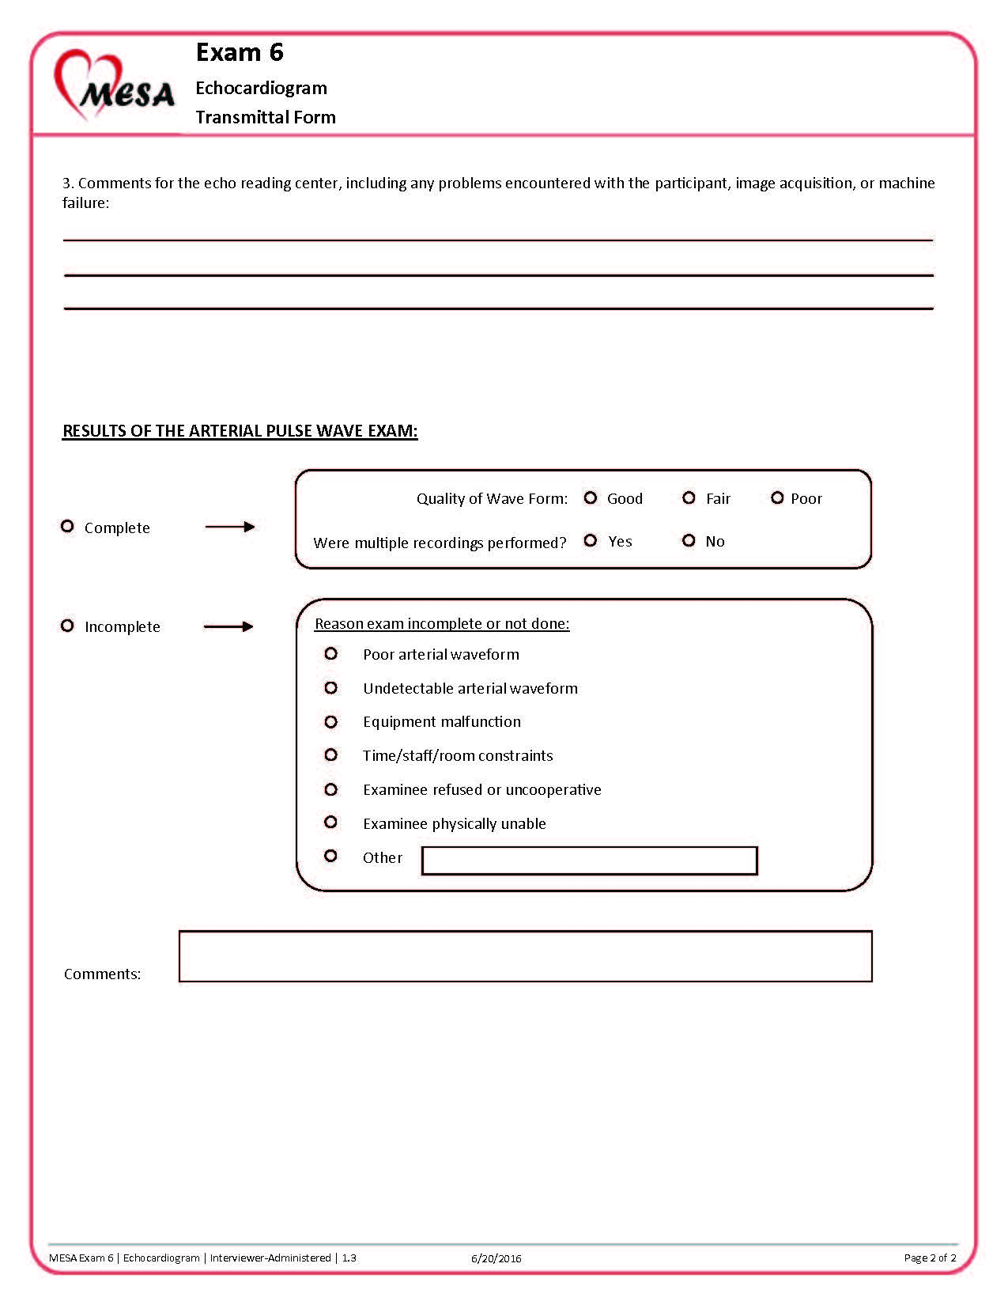

Slide 68
Reporting and Medical Alerts
For routine studies, a qualitative echo report will be provided to the site within 6-8 weeks of study receipt
These reports are provided as a courtesy to MESA participants, and should not be considered a substitute for a full echocardiogram
Because routine studies may not be analyzed for 6-8 weeks, it is important that the site sonographer take note of any abnormalities on the echo and follow the appropriate procedure depending on the findings:
Immediate referral
Urgent referral
Alert
Notes:
Echo has not been performed as part of MESA, so you may end up being the one to diagnose a significant finding

Slide 69
Medical Alerts
The purpose of the alert system is to make sure that the participant and his/her physician are aware of any significant medical findings noted during the MESA exam
If any of the qualifying abnormalities are noted, the sonographer should acquire additional echo images as needed and notify the site PI or cardiologist at the time of the echo
Each site is responsible for coordinating local echo review and follow up for any patient with an abnormal finding noted on the echo
The NUECL is not responsible for detecting abnormal echo findings

Slide 70
Immediate Referrals
Medical emergencies that require immediate notification of both the participant and his/her primary physician
Immediately notify both the site PI and the NUECL
Site PI will review images, verify the findings, and determine whether urgent or emergent care is required
Results should be communicated to the participant and his/her physician at the time of the echo
Immediate referral is indicated on the ETF, and the study is transmitted to the NUECL
A detailed report will be emailed to the site within 24-48 hours
Immediate referral abnormalities:
Suspected tamponade
Aortic aneurysm (>5.0 cm) or dissection
Intracardiac abscess or vegetation
Intracardiac thrombus or mass
Pseudoaneurysm
Significant arrhythmia
Atrial fibrillation with HR>110 bpm
Sustained ventricular arrhythmia
Nonsustained ventricular tachycardia > 10 beats

Slide 71
Urgent Referrals
Abnormalities that require medical attention, but not on an emergency basis
Notify the site PI at the time of the echocardiogram
Site PI will review images and verify the findings
Results should be communicated to the participant at the time of the visit; the site PI should also communicate results to the participant’s physician within one week of the visit
Urgent referral is indicated on the ETF, and the study is transmitted to the NUECL
A detailed report will be emailed to the site within 48-96 hours
Urgent referral abnormalities:
Severe left or right ventricular enlargement
Severe stenosis of any valve
Severe regurgitation of any valve
Moderate or greater pericardial effusion without evidence of tamponade

Slide 72
Alerts
Medical findings that may have adverse health consequences to the participant if left untreated
Notify the site PI at the time of the echocardiogram
Site PI will review images and verify the findings
Results should be communicated to the participant at the time of the visit
Alert is indicated on the ETF, and the study is transmitted to the NUECL
A detailed report will be emailed to the site within 6-8 weeks
Alert abnormalities:
Mild or moderate stenosis of any valve
Moderate mitral or aortic regurgitation
Moderate or greater dynamic LVOT obstruction
Gradient at rest or with Valsalva > 40 mmHg
Intra-cardiac shunt
Moderate to severe pulmonary hypertension
RSVP>45 mmHg
Evidence of RV pressure or volume overload
Low ejection fraction (< 40%) or wall motion abnormality

Slide 73
Site sonographer completes a study
Immediate Referral
Urgent Referral
Routine Study (No Referral or Alert)
Site PI/cardiologist and NUECL are notified
Site PI/cardiologist is notified
Study is sent with Echo Transmittal Form
Site PI determines if emergency medical referral is needed
Site PI communicates results to participant at time of exam and notifies the participant's physician within one week
Detailed report available within 6-8 weeks
Site PI communicates results to participant and participant's physician at time of exam
Study is sent with Echo Transmittal Form
Study is sent with Echo Transmittal Form
Detailed report available within 48-96 hours
Alert
Site PI/cardiologist is notified
Site PI communicates results to participant at time of exam
Study is sent with Echo Transmittal Form
Detailed report available within 6-8 weeks
Detailed report available within 24-48 hours
Notes:
That was a lot of information – it is all summarized here on the flow chart, which can also be found in your echo manual. The structure for reporting referrals and alerts for the MESA study is complicated, do not hesitate to reach out to us if you have any questions about the process.

Slide 74
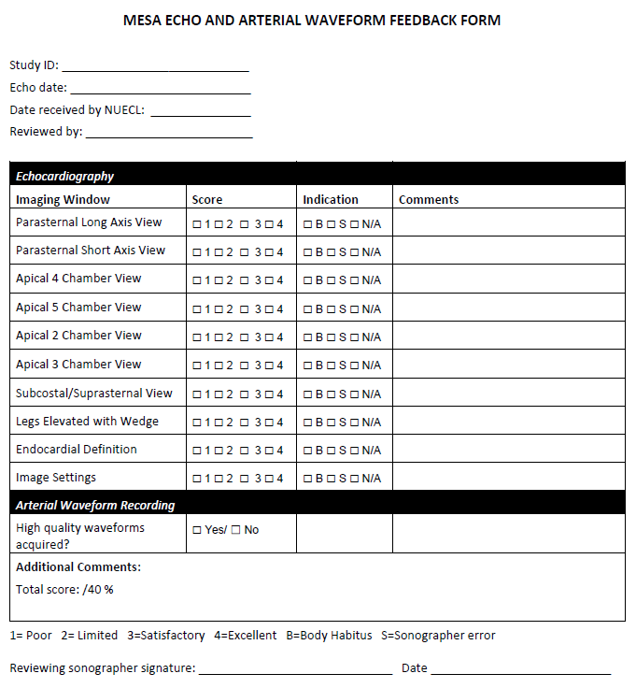
Echo Quality Assessment
All echos will be evaluated for adequacy
Sonographers are expected to maintain 90% adherence to items listed on the form
If a study receives a score of less than 90%, a copy of the completed form will be sent to the site via e-mail
Comments and technical tips will be provided to improve future image quality and protocol compliance

Slide 75
Echo Quality Assessment
Quarterly report cards
Report cards will be sent to each site to provide a comparison of how the quality of studies submitted compares to other sites
Sent out monthly for the first six months, then quarterly for the remainder of the exam
Ongoing phone conferences
Phone conferences will be held monthly for the first six months, then quarterly for the remainder of the exam
Image quality issues, protocol review, technical assistance, and questions from site sonographers will be discussed

Slide 76
Quality Control of NUECL
Intra- and Inter-observer Variability
Evaluated on a quarterly basis
5% sample of echocardiograms will be randomly selected for assessment of variability
Key echo parameters will be read in a blinded fashion
Each study will be re-read by the original reader (intra-observer), as well as a second reader (inter-observer)
Temporal Drift
Blind re-reads will be performed on the same set of 10 studies every six months for the duration of the study

Slide 77
Contact Information
Lauren Nelson, MS, RDCS, FASE
Technical Director, Northwestern University Echocardiography Core Laboratory
645 N Michigan Ave, Suite 1040
Chicago, IL 60611
(312) 926-7065
lauren.nelson@northwestern.edu

Slide 78
Thank You!

