Slide 1
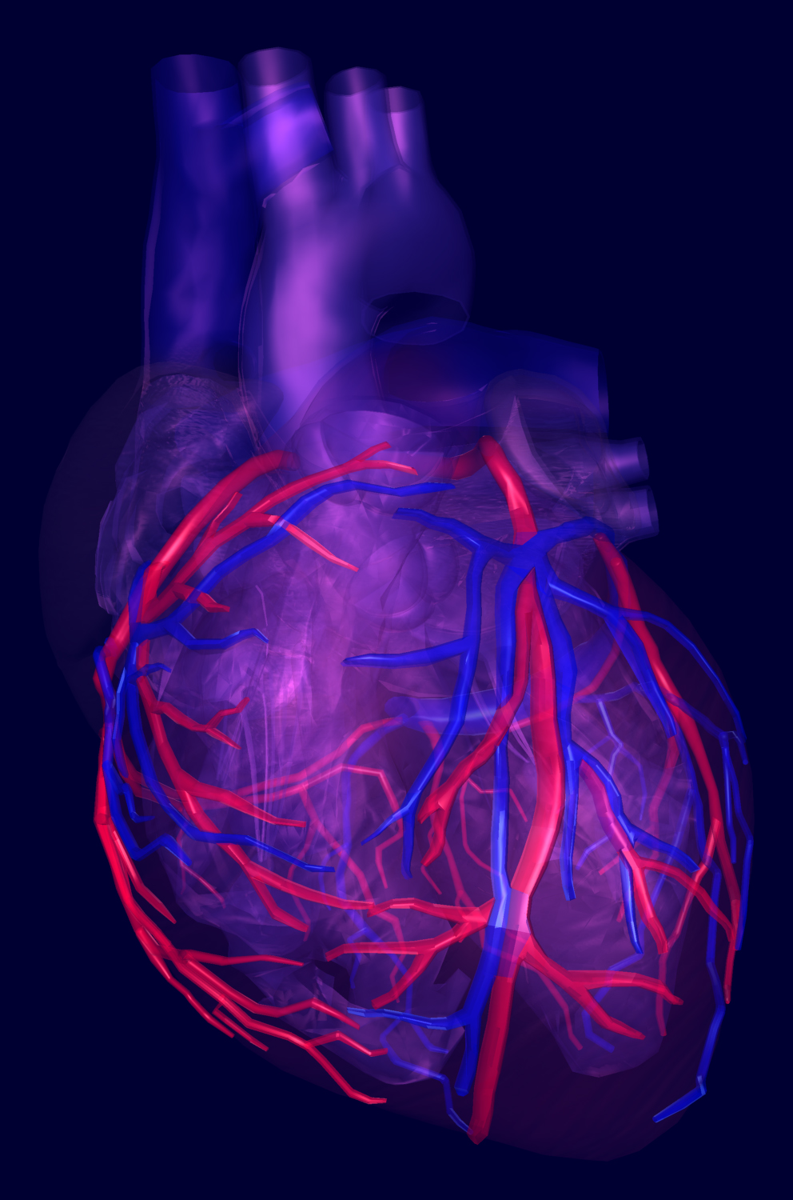
MESA CENTRAL TRAINING 2016
MESA Early HF Study
Sonographer Training
JULY 27, 2016
Sanjiv J. Shah, MD, FAHA, FACC, FASE
Associate Professor of Medicine
Director, Northwestern HFpEF Program
Division of Cardiology, Department of Medicine
Northwestern University Feinberg School of Medicine

Slide 2
Original MESA Objectives
Identify and measure early CVD
Characterize subclinical CVD before it causes symptoms or illness (clinical CVD)
Study progression of subclinical disease and progression of subclinical to clinical CVD
The ultimate goal is to find treatments that will disrupt the natural history of CVD and improve health.
(MESA overview slides courtesy of Lorraine Silsbee, MHS)

Slide 3
MESA Study Cohort
MESA started in the year 2000
N= 6,814 original cohort
45-84 years old at baseline exam (2000-2002)
Multi-ethnic: 38% white; 28% African American; 22% Hispanic; 12% Chinese
6 Field Centers (Chicago, Minneapolis, Los Angeles, Baltimore, Winston-Salem, New York City)

Slide 4
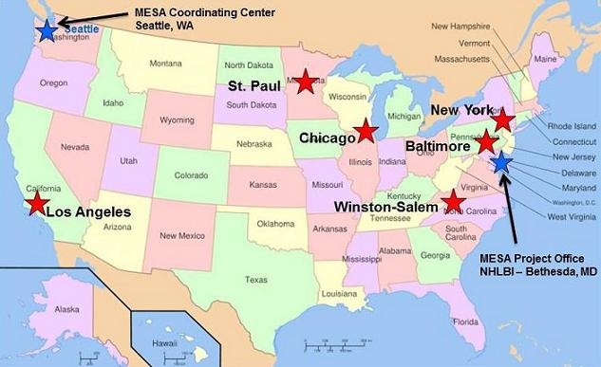
MESA Sites

Slide 5
MESA Examinations
Baseline
Exam
2000-2002
Exam 2
2002-2004
Exam 3
2004-2005
Exam 4
2005-2007
Exam 5
2010-2011
VIII
Exam 6
2016-2018
N=6,814
N=6,232
N=5,939
N=5,704
N=4,651
N=4,000
Regular participant follow-up for:
-Updating contact information
-Determining vital status
-Event ascertainment

Slide 6
Current MESA Objectives
Scientific
  Study the progression of subclinical CVD to CVD
  Identify new risk factors and interactions among risk factors
Operational
  Conduct cohort follow-up for vital status and events
  Ascertain clinical events to improve statistical power for analyses
  Conduct Exam 6

Slide 7
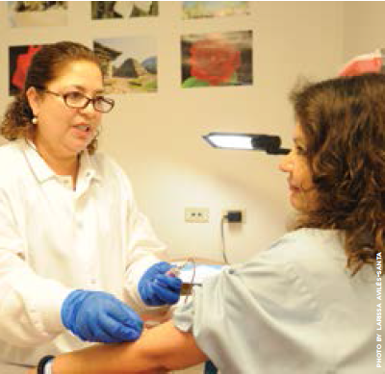

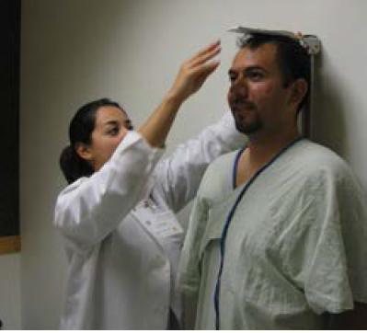
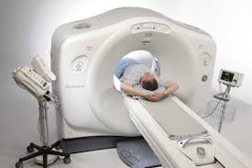
Your role is critical!
Notes:
MESA has been so successful and scientifically productive because of the of the high quality of the data you have collected and continue to collect.

Slide 8

MESA Publications
Number
of
manuscripts
published
(n=1057)*
* From MESA website as of 7/21/2016
Notes:
Publications are the primary way we communicate study findings to other scientists. MESA now has over 1,000 publications

Slide 9

Transition from Risk Factors to Heart Failure: Prevalence, Pathogenesis, and Phenomics
Co-PIs: Alain Bertoni MD MPH and Sanjiv Shah MD
Other key personnel:
C Rodriquez, J Yeboah, S Rosas, H Chen, A Folsom, S Shea, K Watson, W Post, K Liu, R Kronmal, R Tracy, B Freed, R Deo, and J Chirinos

Slide 10
BACKGROUND
Heart failure (HF): common, costly, and ultimately fatal form of CVD
NHANES-based estimated prevalence of HF in adults 60+ is 8% but this misses early HF
Gender and race/ethnic differences in incidence, subtype and mortality
HF not decreasing despite declines in ischemic heart disease

Slide 11
Overall goal:
Prevention of Stage C HF
Stage B→C: Critical transition point but poorly understood. What defines the development of symptomatic HF?
Stage A
High risk for development of HF
(HTN, CAD, DM, obesity, CKD, etc)
★
Stage B
Asymptomatic HF (abnormal cardiac structure/function)
Most elderly are at risk (Stage A) and many are in Stage B HF
Stage C
Symptomatic HF
Stage D
End-stage, refractory HF

Slide 12
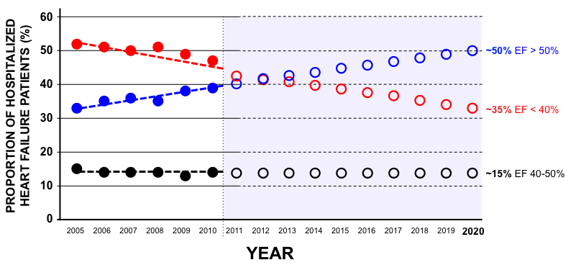
Hospitalized HFpEF: prevalence increasing
GWTG-HF: N=110,621 patients hospitalized with HF
P<0.0001 for trend of increased HFpEF prevalence
Oktay AA, Rich JD, Shah SJ. Curr Heart Fail Rep 2013
Based on Steinberg et al. Circulation 2012

Slide 13
Types of HFpEF
ENVIRONMENT, DIET
COMORBIDITIES
GENETIC SUSCEPTIBILITY
VULNERABLE HEART,
VULNERABLE PATIENT
HFpEF
EXERCISE INTOLERANCE
HFpEF
(Early HF)
VOLUME
OVERLOAD
HFpEF
PULMONARY HTN,
RV FAILURE
HFpEF
By 2020, 65% of hospitalized HF will have EF>40%
Shah SJ. JACC 2013

Slide 14
What is early HF?
Dyspnea and/or exercise intolerance due to underlying cardiac problem
No or minimal overt volume overload
Majority have a normal or near-normal LVEF
May have a normal BNP
Elevated LV filling pressure at rest or with volume loading, hand-grip, or exercise
Borlaug BA, et al. Circ Heart Fail 2010
Penicka M, et al. JACC 2010
Shah SJ. JACC 2013

Slide 15
How common is early HF in MESA?
28% of MESA ppt’s reported pedal edema at baseline
Pedal edema not associated with LV or RV systolic dysfunction on cardiac MRI
Pedal edema was associated with:
  Orthopnea (OR 1.66 [95% CI 1.30-2.12])
  PND (OR 1.95 [95% CI 1.21-2.68])
  Elevated NTproBNP (OR 1.80 [95% CI 1.21-2.68])
  Incident HF (adj. HR 1.43 [95% CI 1.02-1.99])
Yeboah J, et al. (unpublished data)

Slide 16
RATIONALE
This project addresses research gaps identified by 2011 NHLBI Working Group on HF Prevention:
  Determine the prevalence of early HF (i.e., transition from risk factors to HF)
  Elucidate the pathophysiology of early HF, particularly HFpEF
  Delineate the key antecedent risk factors and risk factor patterns associated with the transition from Stage B to Stage C HF
Notes:
Here’s where you can summarize the background and identify the key question(s) you are going to address;
It would be good state “impact”; also remember we have a final slide on impact where you can really reinforce it;

Slide 17
AIM 1
Prevalence of early HF
To determine the prevalence/subtype of early HF by assessing functional status (6MWT), physical activity (survey), symptoms, NTproBNP, echocardiography, arterial stiffness measures, and in a Wake Forest sub-sample, cardiopulmonary exercise testing.

Slide 18
CLINICAL, SYMPTOMATIC HF IS A SPECTRUM
Depends on: (1) type of clinical presentation; (2) MD threshold to hospitalize the patient vs. outpatient treatment
OUTPATIENT
Dyspnea on exertion due to myocardial problem with evidence of ⬇CO and/or
⬆PCWP at rest or with exertion
INPATIENT
CHF hospitalization due to overt volume overload and/or low output state
CLINICAL SPECTRUM
Traditional HF endpoint in epidemiology studies
HYPOTHESES:1) HF, when defined broadly to include exercise intolerance due to ⬇CO and/or ⬆LV filling pressure, is more common than previously recognized;
2) There are significant gender and race/ethnic differences in prevalence/subtype of early and all HF

Slide 19
AIM 2
Pathogenesis of early HF
To measure key physiologic parameters, risk factors, and novel biomarkers (ST2, gal-3, FGF23) concurrent to the assessment of HF status, and use the data from prior MESA exams to examine the associations between ideal CV health, risk factors, biomarkers, and changes in risk factors with all HF and early HFpEF specifically

Slide 20
Early HF pathogenesis
RISK FACTORS
CORONARY ENDOTHELIAL DYSFUNCTION
T-TUBULE
DISRUPTION
ARTERIAL STIFFENING
ABNORMAL
CARDIAC
MECHANICS
HFpEF
Paulus and Tschoppe. JACC 2013
Shah SJ, et al. Am J Physiol 2014

Slide 21
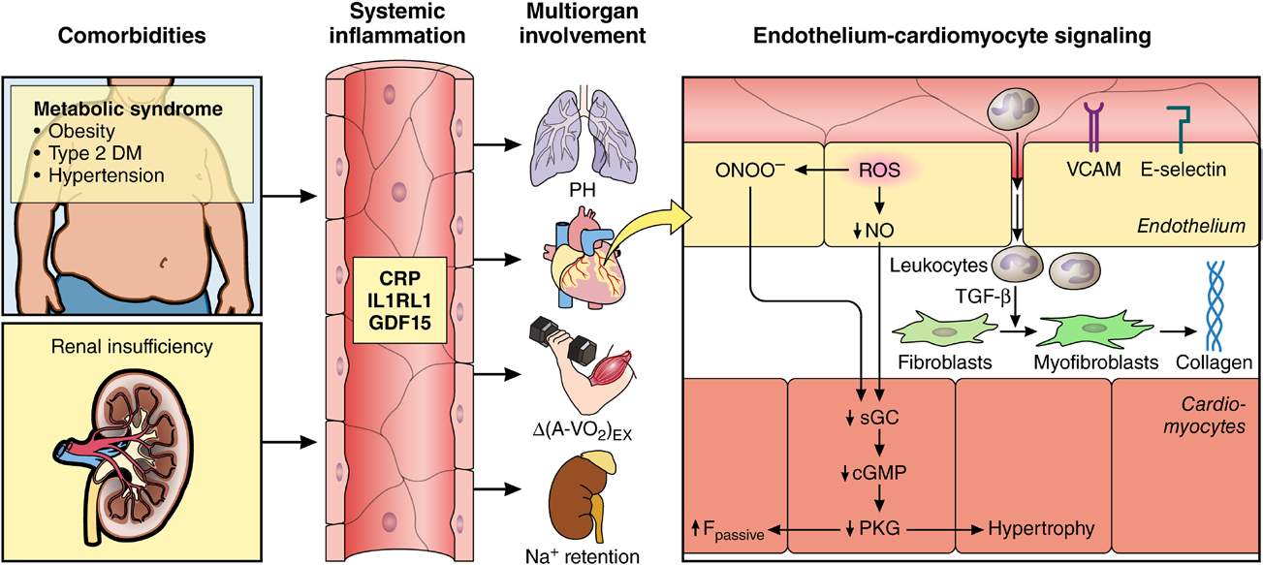
Pathophysiology of HFpEF
Shah SJ…Paulus WJ. Circulation 2016

Slide 22
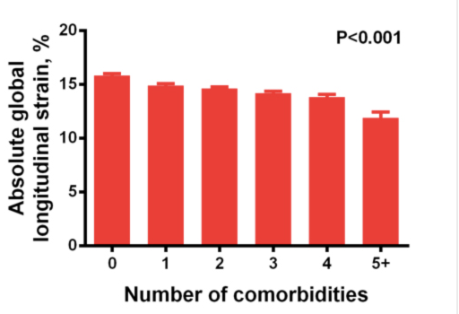
Risk factors and cardiac mechanics (HyperGEN, N=2150)
Longitudinal systolic function worsens
with increasing number
of risk factors
Diastolic function worsens
with increasing number
of risk factors
Number of risk factors
Number of risk factors
Selvaraj S…Shah SJ, et al. JAHA 2014

Slide 23
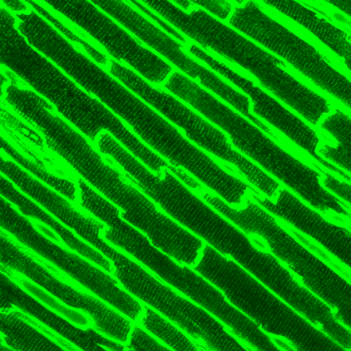
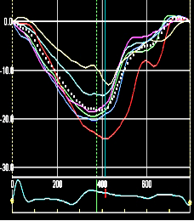
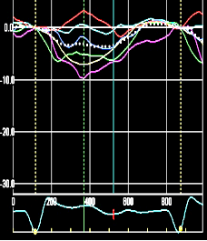
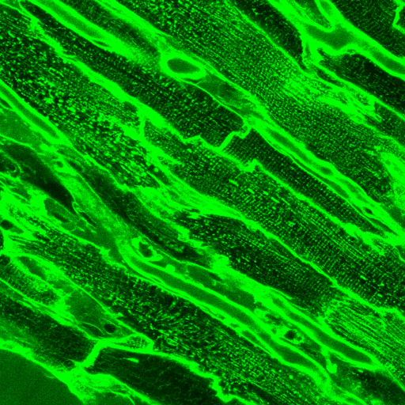
Ventricular-arterial interactions
Central aortic
waveform
Time-varying
wall stress
Confocal microscopy
(T-tubule staining)
Cardiac mechanics
(speckle-tracking echo)
NORMAL
Pressure
Systolic wall stress
Longitudinal strain
P_{f}
P_{b}
Time
Time
Time
aortic stiffness
reflected wave
time to peak
wall stress
T-tubule disruption
Abnormal Ca2+ cycling
Abnormal mechanics
HFpEF
Pressure
Systolic wall stress
Longitudinal strain
P_{f}
P_{b}
Time
Time
Time
Shah SJ, et al. Am J Physiol 2014; Shah SJ, et al. JACC 2012; Chirinos J, et al. JACC 2012

Slide 24
Ventricular-arterial interactions
Central aortic
waveform
Time-varying
wall stress
Confocal microscopy
(T-tubule staining)
Cardiac mechanics
(speckle-tracking echo)
NORMAL
Pressure
Systolic wall stress
Longitudinal strain
HYPOTHESIS: Risk factors (alone and in combination) have differential effects on cardiac mechanics, arterial stiffening, and the deleterious interplay between heart and arteries
P_{f}
P_{b}
Time
Time
Time
aortic stiffness
reflected wave
time to peak
wall stress
T-tubule disruption
Abnormal Ca2+ cycling
Abnormal mechanics
HFpEF
Pressure
Systolic wall stress
Longitudinal strain
P_{f}
P_{b}
Time
Time
Time
Shah SJ, et al. Am J Physiol 2014; Shah SJ, et al. JACC 2012; Chirinos J, et al. JACC 2012

Slide 25
Pathophysiologic contributors to HFpEF
Longitudinal systolic dysfunction
Diastolic dysfunction
Chronotropic incompetence
Extra-cardiac causes of volume overload
Autonomic dysfunction
HFpEF
Arterial stiffness
Endothelial dysfunction
Inflammation
Pulmonary hypertension / RV failure
Abnormal V-A coupling
Skeletal muscle abnormalities
Shah SJ, et al. Heart Fail Clin 2014

Slide 26
Pathophysiologic contributors to HFpEF
Longitudinal systolic dysfunction
Diastolic dysfunction
Chronotropic incompetence
Extra-cardiac causes of volume overload
Autonomic dysfunction
HFpEF
Arterial stiffness
Endothelial dysfunction
Inflammation
Pulmonary hypertension / RV failure
Abnormal V-A coupling
Skeletal muscle abnormalities
Shah SJ, et al. Heart Fail Clin 2014

Slide 27
AIM 3
Phenomics of early HF
To perform phenomics (machine learning analysis) of previously ascertained quantitative MESA data to define differential phenotype signatures (pheno-groups) and relate these pheno-groups to cardiac structure/function at Y15 and the prevalence and type of HF (e.g., early or overt HFpEF or HFrEF)

Slide 28
Traditional epidemiology of HF
1 OR 2 RISK FACTORS
or
RISK FACTOR SCORE
HEART FAILURE
Assumes HF is a homogenous syndrome
Ignores complex interactions between risk factors
Does not take advantage of wealth of high-density, quantitative phenotypic data

Slide 29
Multiple different risk factors, combinations of risk factors lead to abnormal myocardial structure/function
HFpEF
Multiple different (heterogeneous) clinical presentations / pathophysiologic phenotypes
Shah SJ, et al. Heart Fail Clin 2014

Slide 30


HEART FAILURE
RISK FACTOR
COMBINATIONS
HEART FAILURE
PATHOPHYSIOLOGIC
SUBTYPES
HYPOTHESIS: Specific HF risk factor phenotypic signatures are associated with specific
HF pathophysiologic subtypes
Shah SJ, et al. Heart Fail Clin 2014

Slide 31
MESA existing quantitative phenotype domains (pre-Y15)
Anthropomorphic data
Environmental data
  Diet, geocoding, pollution
Sleep questionnaire data
Biomarkers, laboratory data
Spirometry (lung function)
Electrocardiography
Arterial tonometry
Coronary CT
Cardiac MRI
Phenomics
analysis
Unique phenotype
signatures

Slide 32
METHODS (1)
All participants (N=3500) will undergo contract exam, PLUS
  6-minute walk test
  Kansas City Cardiomyopathy Questionnaire (KCCQ12)
  PROMIS Dyspnea Questionnaire
  Physical Activity Survey (MESA TWPAS)

Slide 33
METHODS (2)
Laboratory Testing
  All: Serum NTproBNP, glucose, creatinine, urine microalbumin
  Case-cohort approach: novel biomarkers (ST2, galectin-3, FGF23) to be performed after exam 6
    Budgeted to run 1000 assays for each biomarker

Slide 34
METHODS (3)
Echocardiography with Doppler, tissue Doppler and speckle-tracking
  At rest
  Passive leg raise (preload)
Arterial stiffness (Fukuda VaSera)
Microsoft Aurora “smart watch”
Cardiopulmonary exercise testing in a subset (n=300) to validate early HF dx, as CPEX is gold standard for evaluating exercise intolerance

Slide 35
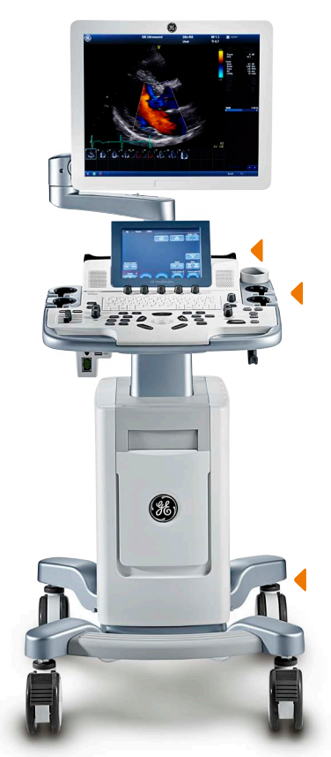
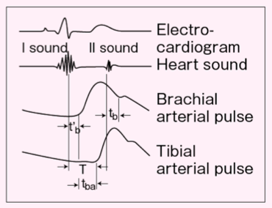
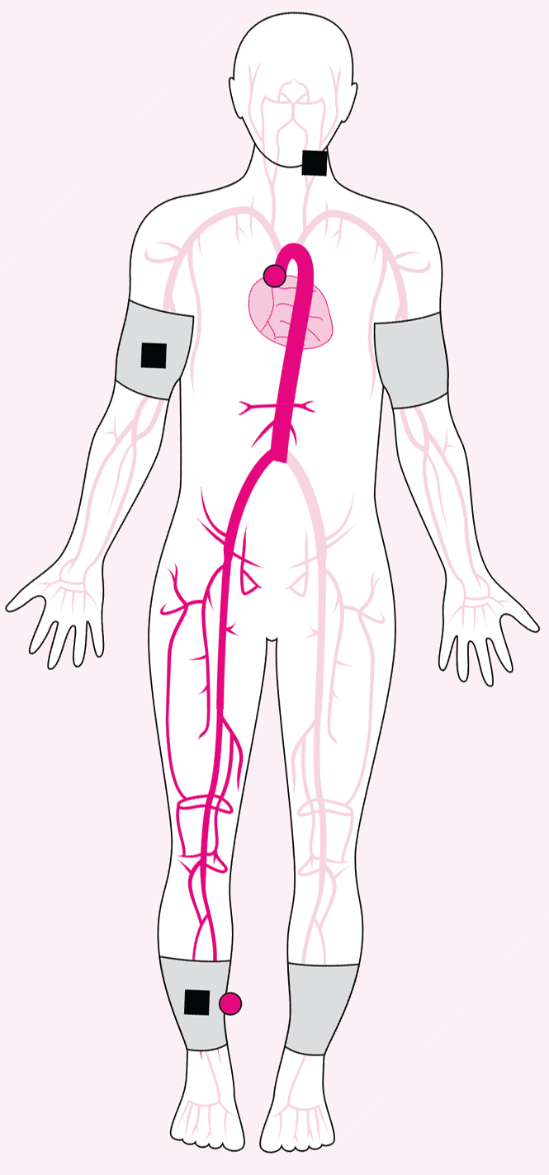
Fukuda
VaSera
(automated
PWV, ABI, HRV)
Vivid T8 cardiac ultrasound system
(tissue Doppler, speckle-tracking)

Slide 36
METHODS (3)
Definition of early HF:
  No prior HF hospitalization and
  Presence of HF symptoms or functional limitation suggestive of HF and
  NTproBNP or echo evidence of elevated LV filling pressure (at rest or with passive leg raise or bilateral cuff occlusion)
Notes:
Definition of early HF: We will define early HF based on the combination of: (1) symptoms and signs of HF and (2) objective abnormalities of cardiac structure and/or function on echocardiography. We will use a HF symptom survey to identify symptoms of HF in study participants. Signs of HF will include 6MWT distance significantly below age- and gender-specific norms; elevated NT-proBNP; and echocardiographic signs of HF, including elevated left atrial pressure (E/e’ ratio) or right atrial pressure (size and collapsibility of the inferior vena cava); increased pulmonary artery systolic pressure; and/or reduced cardiac output (estimated using the LV outflow tract velocity-time integral). Abnormalities in cardiac structure and function on echocardiography will include cardiac chamber dilation, LV or RV systolic dysfunction, LV hypertrophy, LV diastolic dysfunction, and/or overt LV systolic dysfunction (i.e,. reduced LVEF). We anticipate that participants with early HF have reduced physical activity (measured objectively using accelerometry) compared to those without early HF. The CPEX will be performed in 400 participants unselected for early HF (only excluding those with prior hospitalization for HF or ischemic heart disease in prior 6 months), and will be used to verify the diagnosis of early HF. This will allow us to determine the sensitivity and specificity of our symptom/NTproBNP/6MWT/echo-based early HF definition.

Slide 37
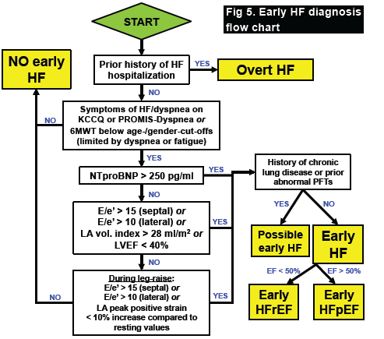
Approach to Early HF Classification

Slide 38
IMPACT
Clinical impact within the next 5 years:
  Characterization of the early HF syndrome, including prevalence data, diagnostic criteria, and clinical characteristics will help inform design of prevention and intervention trials
  Identification of patients at highest risk for transitioning from Stage B→C (early) HF

Slide 39
Why do echo instead of MRI in MESA?
Echo can be done in virtually all participants
Assessment of response to preload
Assessment of valvular disease
Assessment of diastolic dysfunction
Low cost, high feasibility

Slide 40
Cardiac MRI in MESA
Characteristic | MRI (N=5090) | No MRI (N=1615) | P-value
Age (years) ✓ | 61.2 (10.0) | 63.5 (10.4) | <0.001
Male (%) | 47.1 | 45.0 | 0.153
African-American (%) ✓ | 25.1 | 32.4 | <0.001
BMI (kg/m²) ✓ | 27.7 (4.9) | 30.1 (6.5) | <0.001
SBP (mmHg) ✓ | 125.3 (21.2) | 129.3 (21.8) | <0.001
HR (bpm) ✓ | 62.8 (9.3) | 63.9 (10.1) | <0.001
Diabetes (%) ✓ | 11.5 | 15.5 | <0.001
CRP (mg/L) ✓ | 1.8 (0.8 to 4.0) | 2.2 (1.0 to 4.9) | <0.001
CAC score > 10 (%) ✓ | 40.2 | 45.0 | 0.001
✓RISK FACTOR FOR HEART FAILURE

Slide 41
Incident HF by MRI completion status
No MRI
MRI
Log-rank P<0.0001
Model | MRI (N=5090) | No MRI (N=1615) | p-value
Unadjusted | reference | 1.73 (1.28 to 2.33) | <0.001
Age-, race-, and sex-adjusted | reference | 1.44 (1.06 to 1.94) | 0.011

Slide 42
Goals of the echo core lab (1)
QA of echos with rapid feedback
Provide accurate and reproducible quantitation of echos
Determine cardiac structure/function characteristics of the study cohort (assist with the diagnosis of early HF)
Compare cardiac structure/function among MESA sites

Slide 43
Goals of the echo core lab (2)
Determine echo characteristics associated with risk for early HF: are there echo parameters that are associated with risk factors for HF?
Provide novel echo data for future research: cardiac mechanics, dynamic maneuvers (leg raise), echo PWV, phenomapping, and more…

Slide 44
Novel aspects of MESA Exam 6 echo
Speckle-tracking of all cardiac chambers
Dynamic echo (passive leg raise)
LA strain with leg raise
Time-varying pressure-stress analyses
  Integration of echo + arterial waveform
Echo/Doppler-based pulse wave velocity
Color M-mode for intraventricular pressure gradients

Slide 45
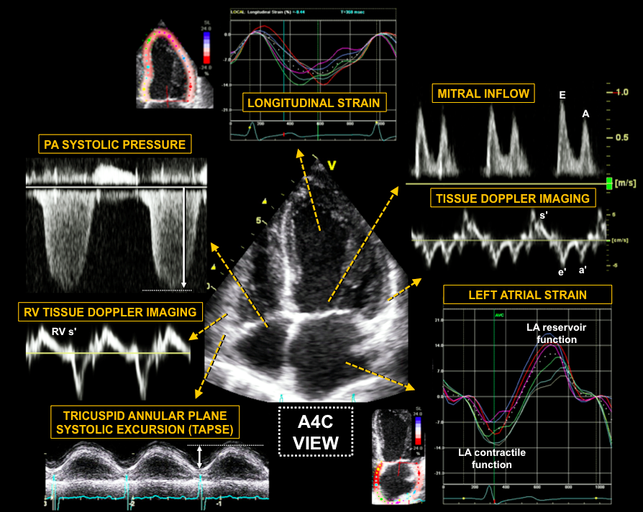

Slide 46
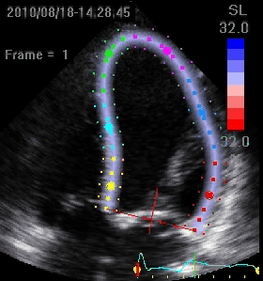
What is strain?
Strain is a tool used to characterize myocardial deformation
Enhances assessment of systolic and diastolic function
Not affected by translational motion or tethering

Slide 47
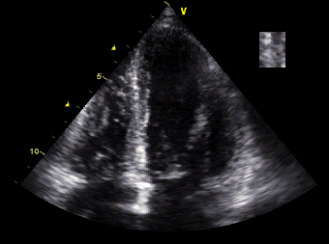
Speckle (tissue) tracking

Slide 48
Strain imaging
Displacement
(distance)
e.g., TAPSE

Slide 49
Strain imaging
Displacement
(distance)
e.g., TAPSE
Velocity
(distance/time)
e.g., TDI s’
systole
diastole

Slide 50
Strain imaging
Displacement
(distance)
e.g., TAPSE
Velocity
(distance/time)
e.g., TDI s’
systole
diastole

Slide 51
Strain imaging
Displacement
(distance)
e.g., TAPSE
Velocity
(distance/time)
e.g., TDI s’
Strain
(%Δ length)
e.g., RVFWS
systole
diastole

Slide 52
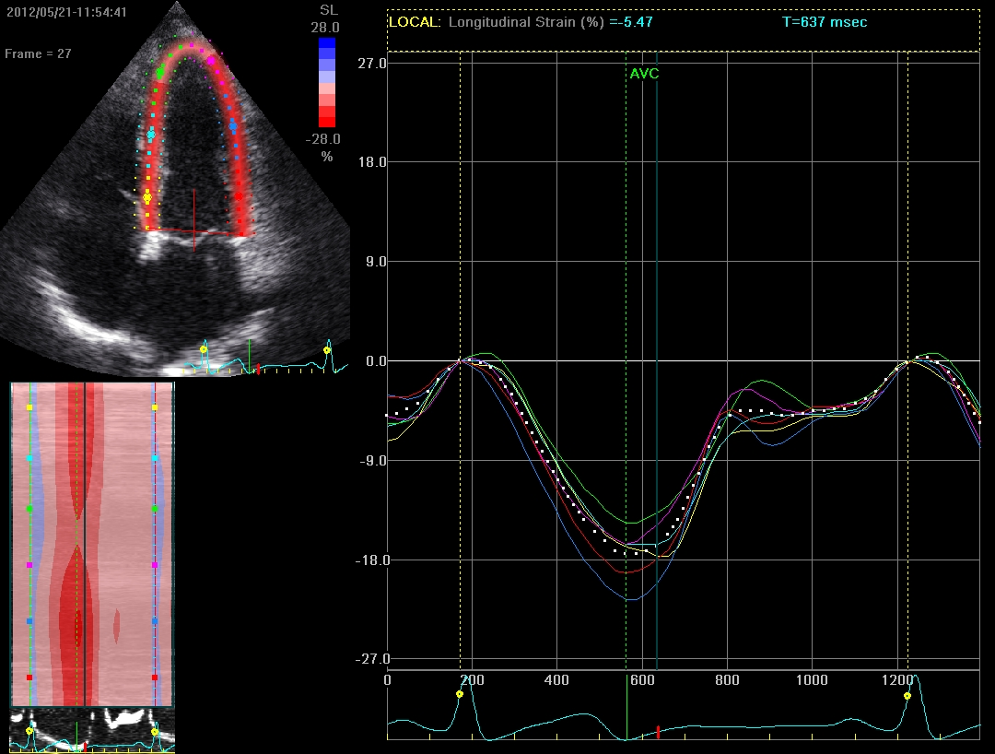
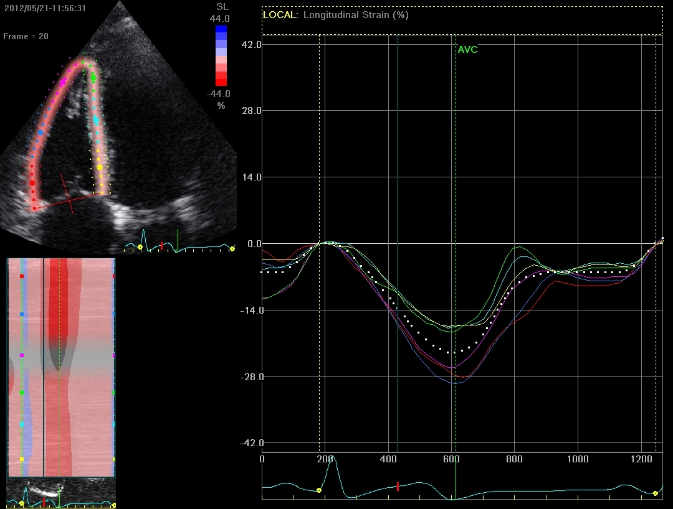
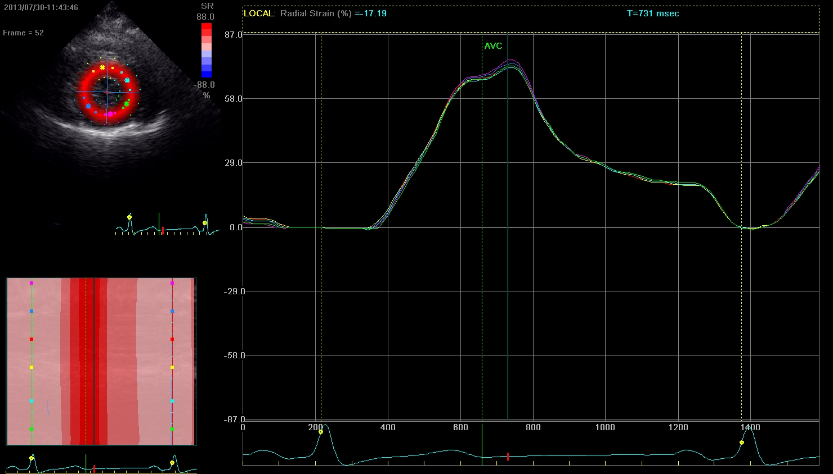
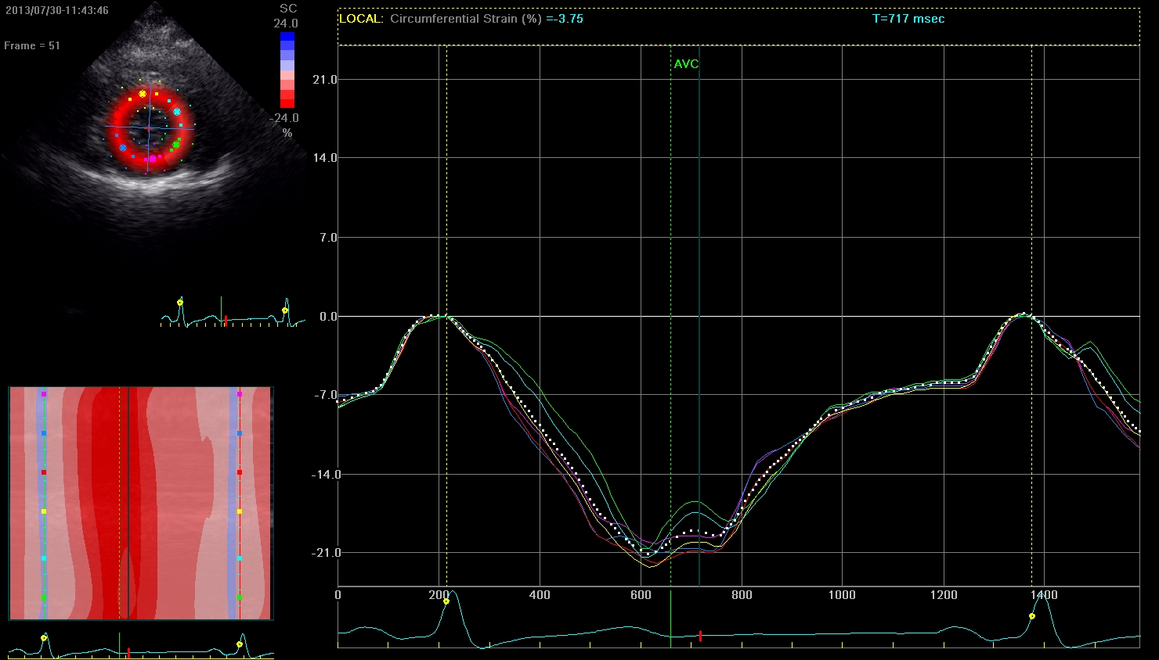
LV global
longitudinal strain
RV free wall
longitudinal strain
LV global
circumferential strain
LV global
radial strain

Slide 53
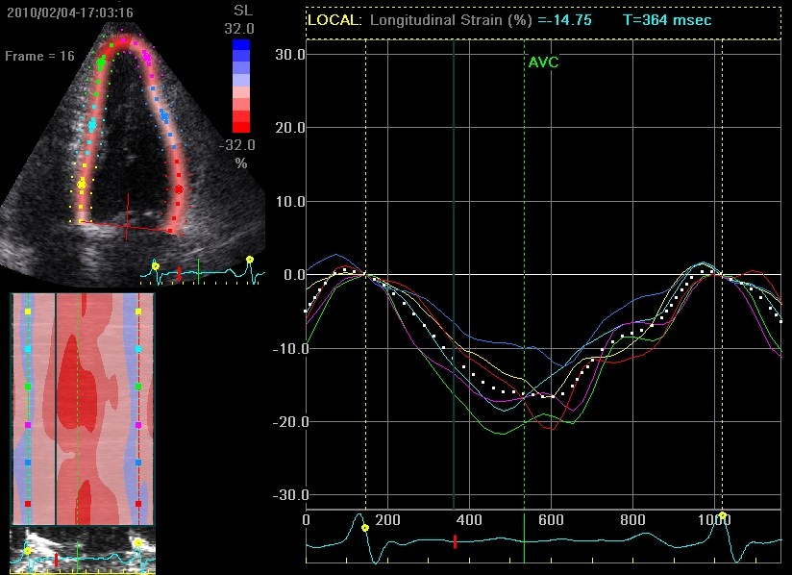
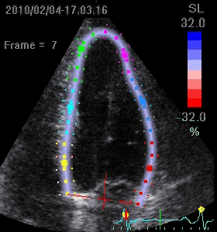

Slide 54
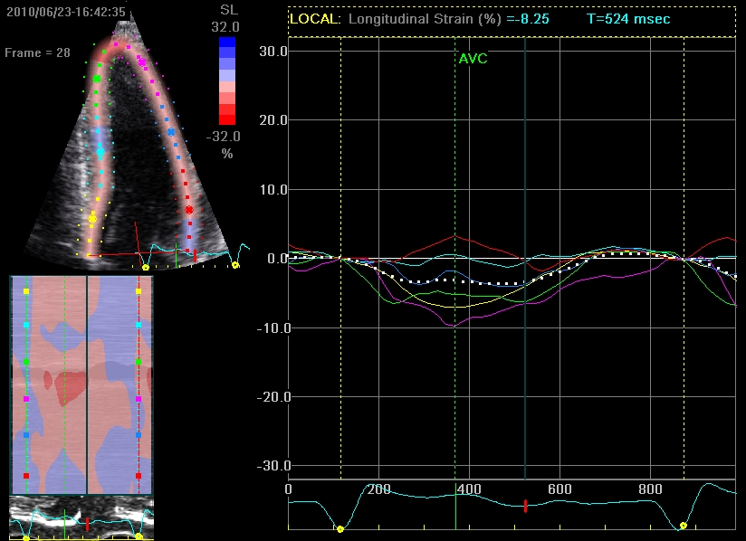
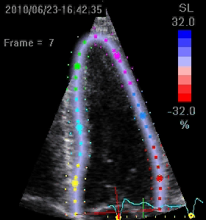

Slide 55
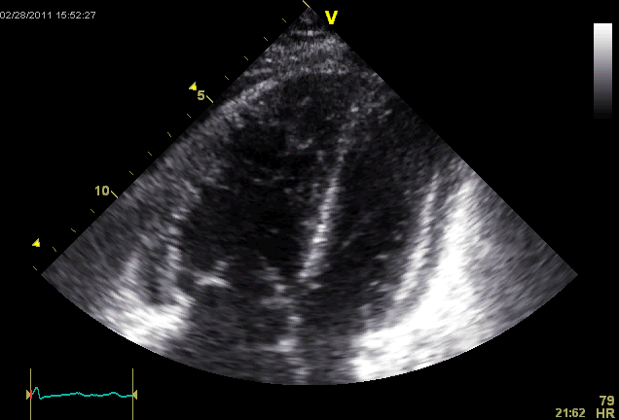
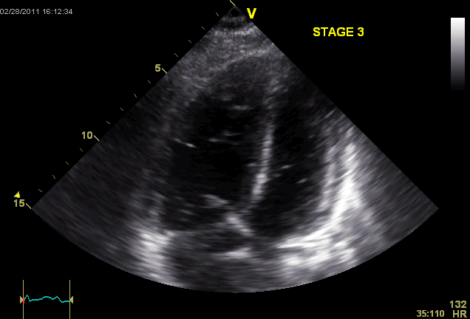
Bicycle stress echocardiography in a
68-year-old woman with pulmonary hypertension
Baseline (rest)
Peak (45W)

Slide 56
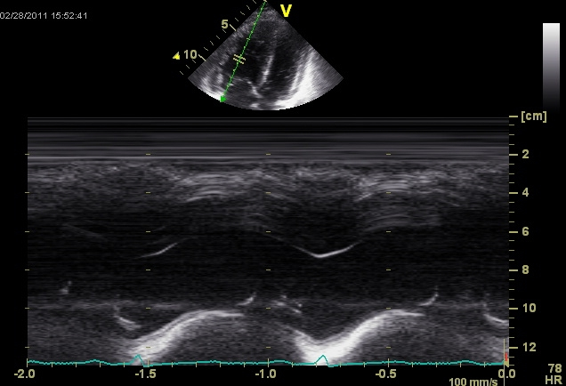
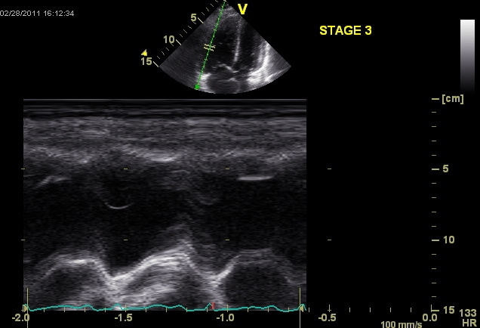
Tricuspid annular plane systolic excursion (TAPSE):
Increases with exercise
1.8 cm
2.5 cm
Baseline (rest)
Peak (45W)

Slide 57
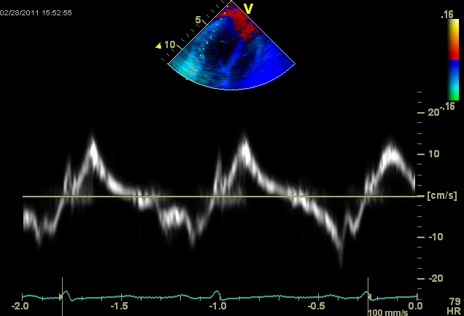
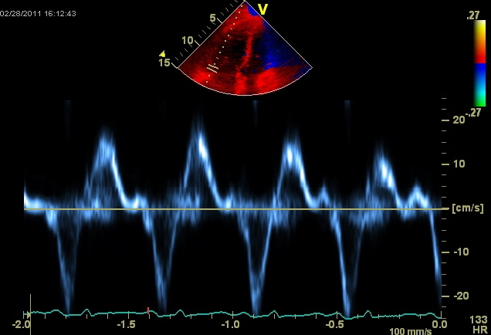
RV free wall peak tissue Doppler S’ velocity:
Increases with exercise
13 cm/s
19 cm/s
Baseline (rest)
Peak (45W)

Slide 58
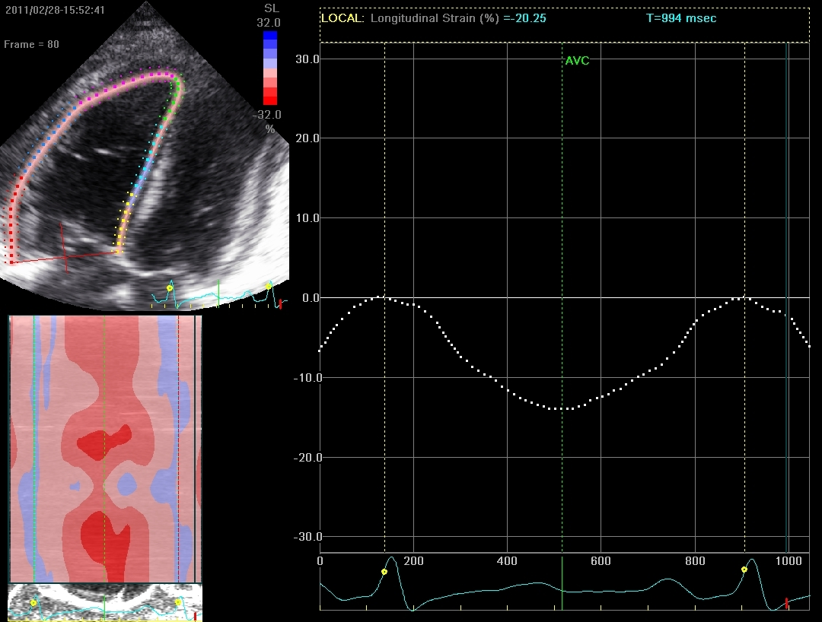
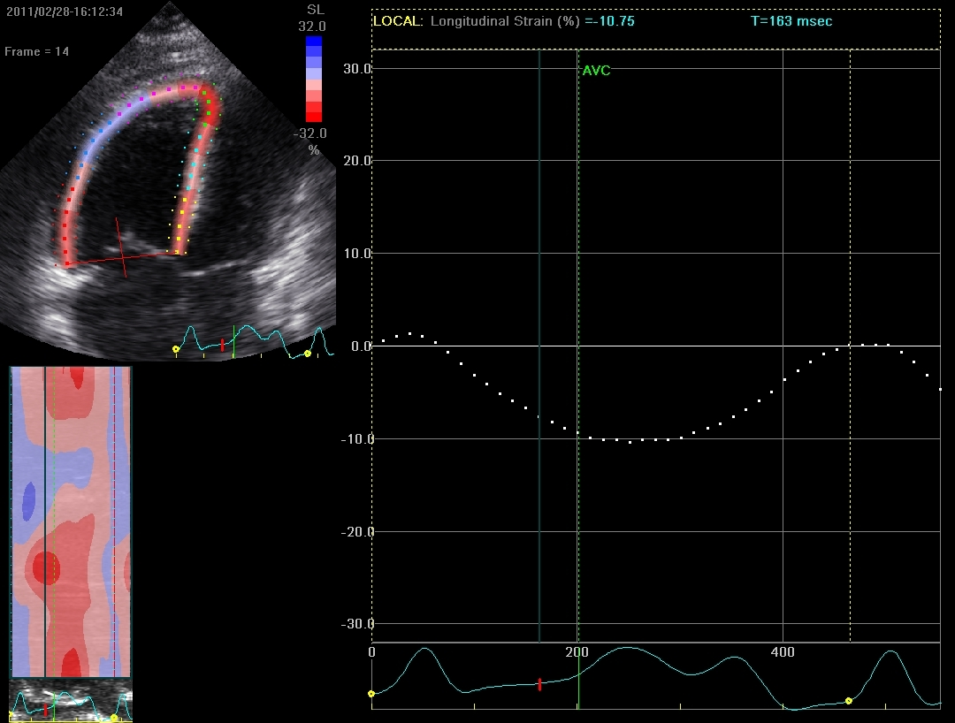
RV free wall peak strain (local deformation):
Decreases with exercise on speckle-tracking echo
-14%
-10%
Baseline (rest)
Peak (45W)
ONLY SPECKLE-TRACKING STRAIN IMAGING SHOWS TRUE
DECREASE IN RV SYSTOLIC FUNCTION WITH EXERCISE

Slide 59
Cardiomyocyte T-tubule disorganization = worse cardiac mechanics
SHR R² = 0.56, P<0.001
WKY R² = 0.14, P=0.10
Global longitudinal strain (%)
T-tubule organizational index
(~efficiency of myocyte Ca²⁺ handling)
Shah SJ, et al. Am J Physiol Heart Circ Physiol 2014

Slide 60
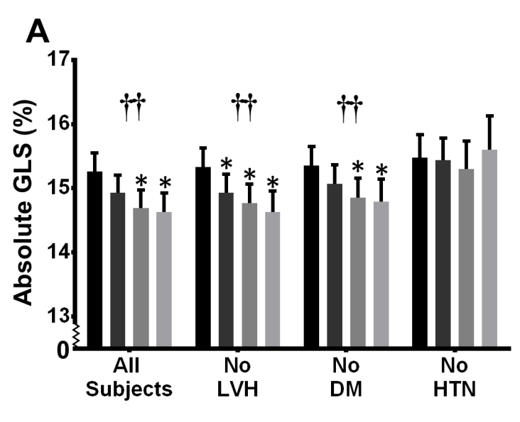
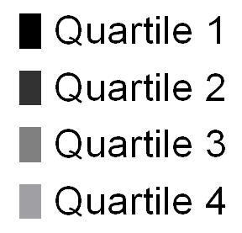
Endothelial dysfunction and cardiac mechanics (HyperGEN)
Quartile of albuminuria
Katz DH….Shah SJ.
Circulation 2014

Slide 61
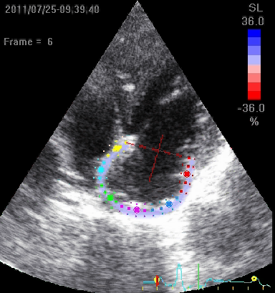
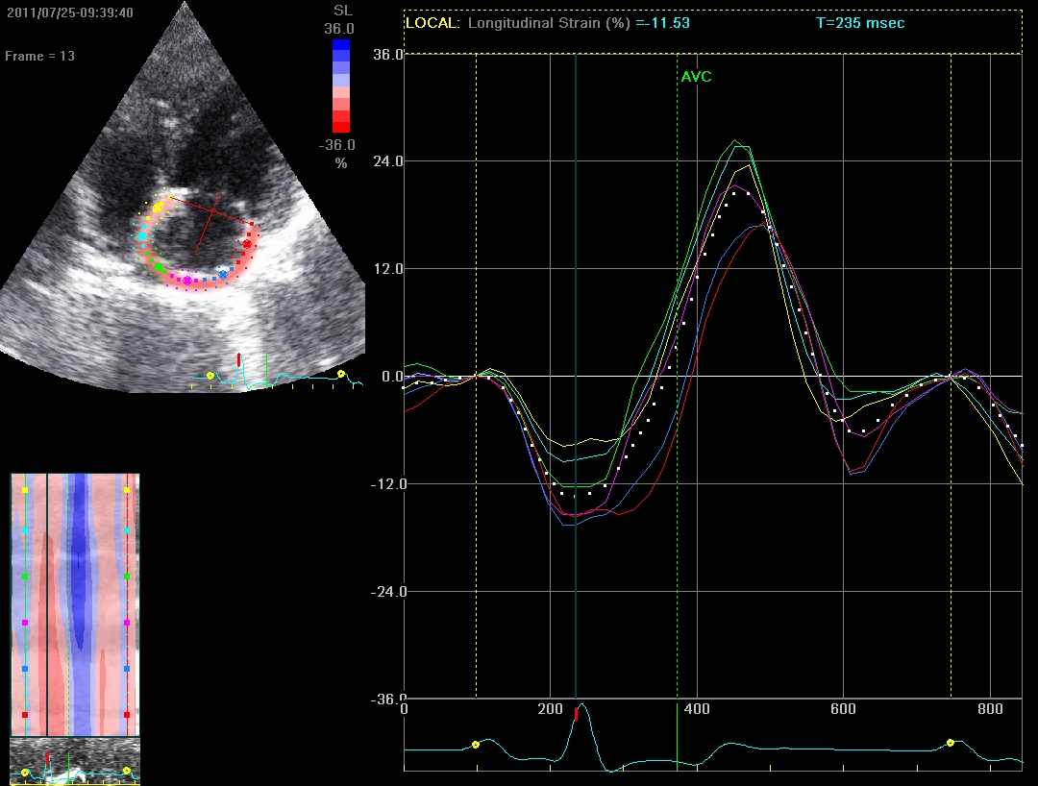
Atrial
relaxation
Passive
emptying
Diastasis
Atrial
contraction
Atrial
filling

Slide 62
RESERVOIR
CONDUIT
BOOSTER

Slide 63
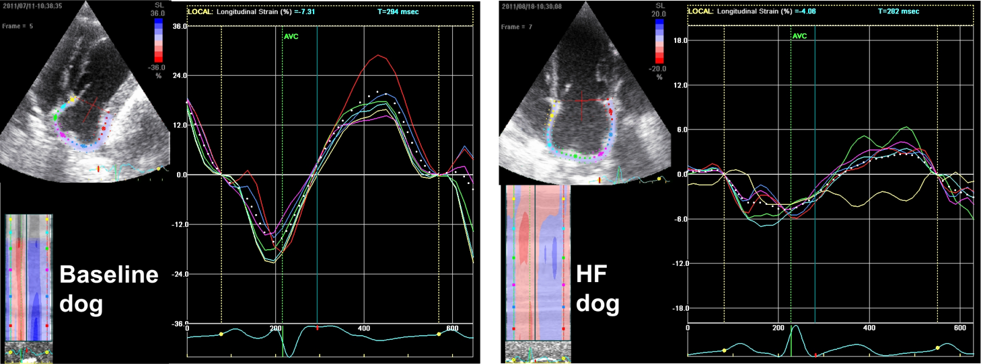
LA strain in a canine model of HF

Slide 64
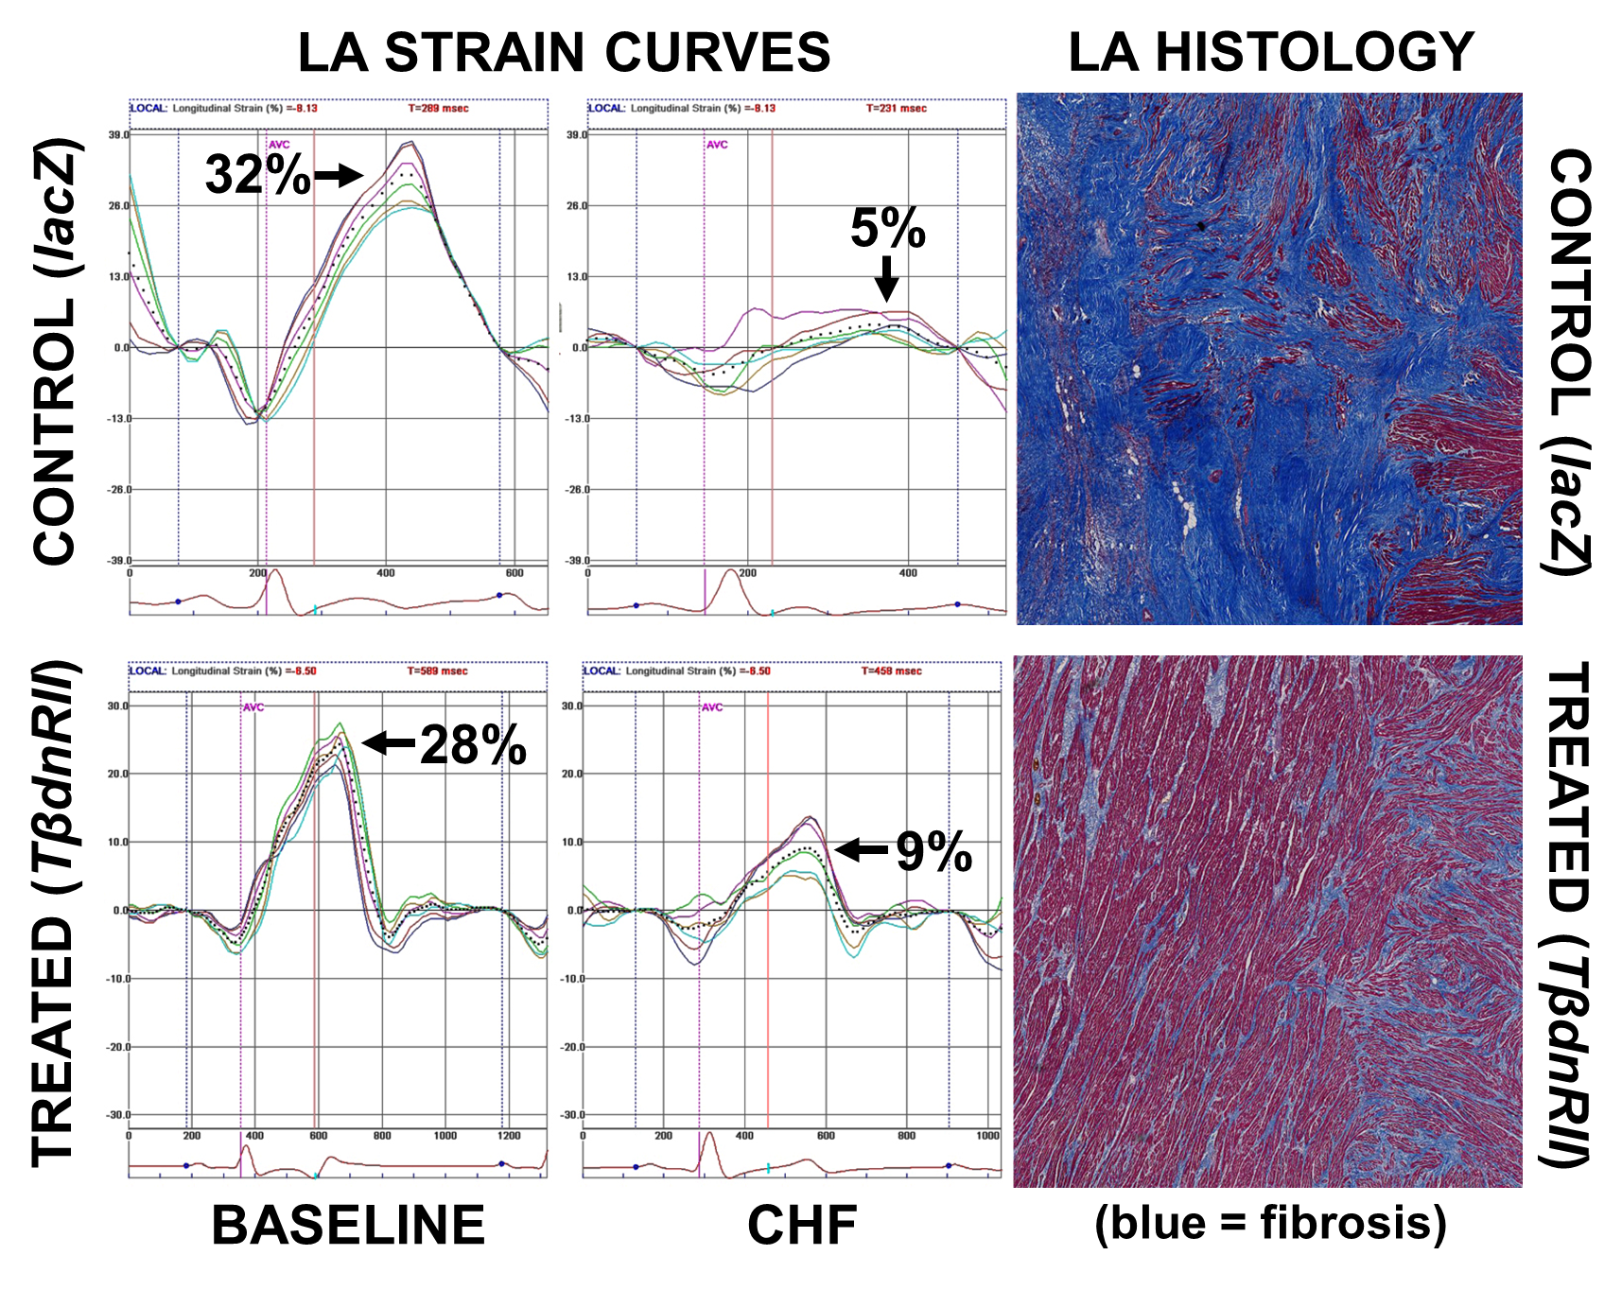

Slide 65
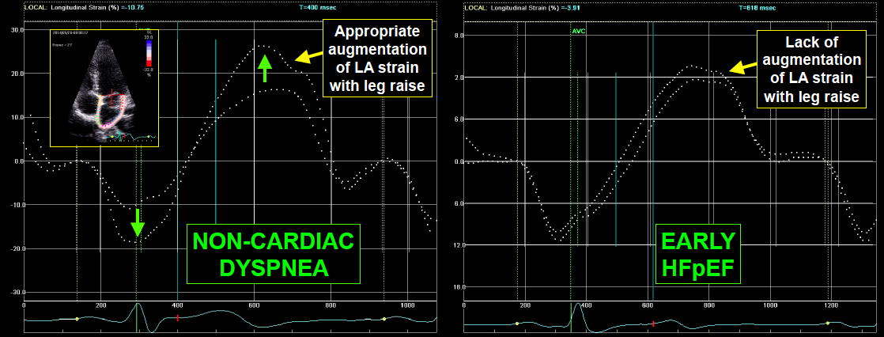
Effect of preload on LA strain
HFpEF vs. non-cardiac dyspnea

Slide 66
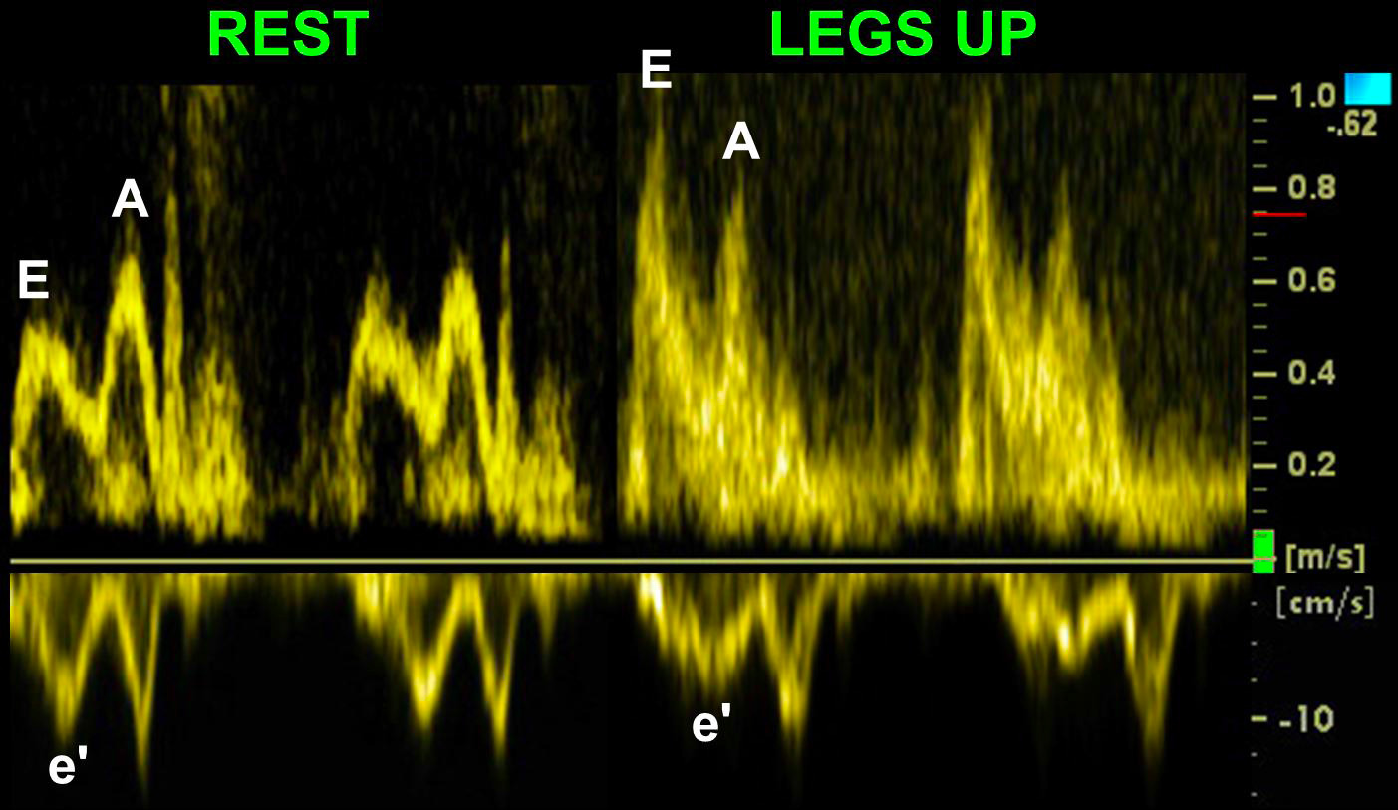

Slide 67
Abnormal LA mechanics in HFpEF
P=0.001
P=0.0009
LA reservoir strain > 31.2%
LA reservoir strain < 31.2%

Slide 68

Abnormal LA mechanics in HFpEF
LV diastolic dysfunction
LA
fibrosis
Atrial
fibrillation
Atrial myopathy
Chronic
LA pressure and volume overload
Pulmonary venous congestion
Pulmonary vasoconstriction
RV afterload
RV failure
Reduced atrial emptying
Decreased LV filling
Decreased cardiac output
Decreased peak VO₂
ABNORMAL LA MECHANICS
CONDUIT
RESERVOIR
BOOSTER
EXERCISE INTOLERANCE
ADVERSE OUTCOMES

Slide 69
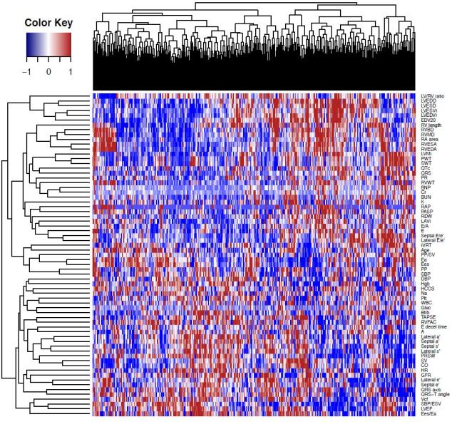
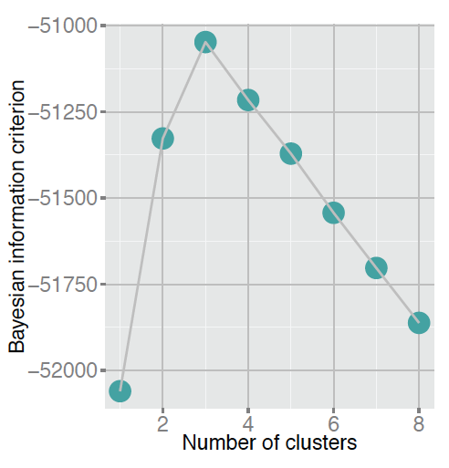
Phenomapping of HFpEF: identified 3 distinct pheno-groups
PEX, lab, ECG, echo data
Shah SJ, et al. Circulation 2015
Notes:
Phenomapping analysis used 67 continuous quantitative phenotypes to classify patients into 3 distinct groups

Slide 70
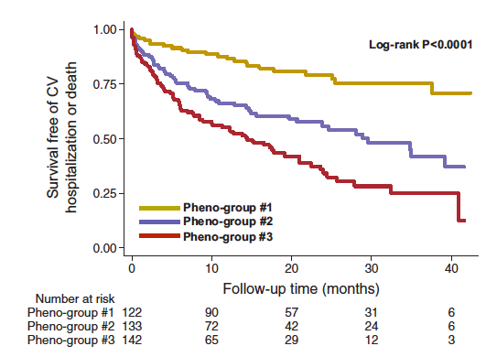
Phenomapping of HFpEF: identified 3 distinct pheno-groups
Shah SJ, et al. Circulation 2015
Notes:
Phenomapping analysis used 67 continuous quantitative phenotypes to classify patients into 3 distinct groups

Slide 71
Indices of cardiac mechanics
by HFpEF pheno-group
**
**
*
**
**
*P<0.05
**P<0.001
GLS = LV global longitudinal strain
GCS = LV global circumferential strain
GRS = LV global radial strain
RVFW = RV free wall strain
Notes:
This is from my 6-month thesis presentation

Slide 72
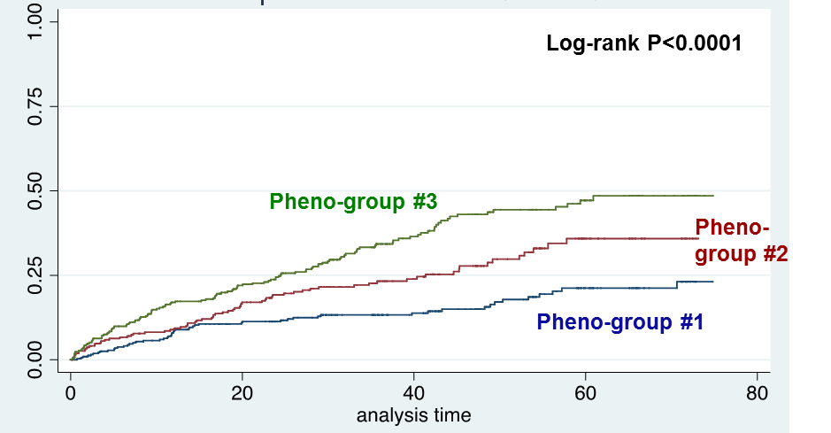
TOPCAT: Cumulative survival by pheno-group
Pheno-group #1: referent group
Pheno-group #2: HR 1.8 (95% CI 1.2-2.5); P=0.002
Pheno-group #3: HR 2.7 (95% CI 1.9-3.7); P=0.001
Proportion with 1° outcome
Follow-up time (months)
Notes:
Do you have the number of patients remained at each time point?

Slide 73

You are a valuable member of the MESA TEAM !!!
THANK YOU !!!

Slide 74

thank you

