Slide 1
Heart Failure
Alain Bertoni/ Sanjiv Shah
MESA Exam 6 Training, Chicago
July 2016

Slide 2
Introduction to the HF problem
Heart failure (HF) is a complex clinical syndrome (not a single disease entity)
Very common (#1 reason for hospitalization after age 65)
The end result of virtually every type of heart disease / heart problem
Fundamental problem:
  Not enough output from the heart to the body and/or
  Pressures in the heart very high (fluid back-up)
2 types of HF: “preserved” vs. “reduced” pumping function (ejection fraction [EF])

Slide 3
Introduction to the HF problem
HF: end-result of almost every cardiovascular disease
There are many causes of heart failure:
  Ischemic heart disease (heart attacks)
  Hypertension (high blood pressure), diabetes
  Valve diseases (leaking or blocked up valves)
  Heart muscle diseases (genetic, drug-induced, infections, toxins, or “idiopathic” [cause unknown])
  Congenital heart diseases, pericardial disease, heart rhythm problems, and more…

Slide 4
Introduction to the HF problem
HF has been variably defined as…
  A kidney problem: Na⁺ and fluid retention
  Forward failure vs backward failure
  Right-sided failure vs left-sided failure
  Systolic HF vs diastolic HF
  A neurohormonal problem
  An electromechanical problem
The truth: most cases of HF are a combination of several of these problems

Slide 5
Why is HF so important?
HF: major medical problem
#1 cause of hospitalization if age > 65y
  1.1 million hospitalizations per year
Prevalence ~7 million (2% of US population)
Incidence > 550,000 new cases/year
Costs more than all cancers combined
  $35 billion/year and rising
Although many treatments exist, once hospitalized for HF, prognosis is poor…
AHA Heart Disease and Stroke Statistics 2015 Update

Slide 6
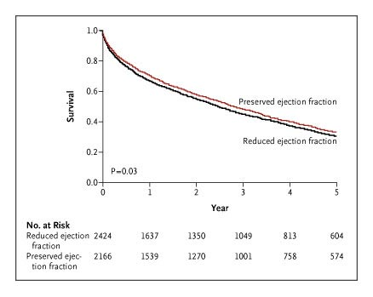
Epidemiology of HF
5-year survival after HF hospitalization
Only 30-35% (dismal)
Owan T et al. N Engl J Med 2006;355:251-259

Slide 7
Epidemiology of HF
Survival similar to advanced non-small cell lung cancer…
T4 NSCLC
(Stage 3B or worse)
HF can be prevented!
HF can be prevented!
Owan T et al. N Engl J Med 2006;355:251-259
Yang H-X et al. Ann Thoracic Surg 2009.

Slide 8
The rising prevalence of HF…
HTN, diabetes, obesity epidemics on the rise
Better treatment of heart attacks
Effective but not curative Rx for HF
Aging population
Prevalence of HF by age and gender
(United States: 1999-2004)
Source: NHANES (1999-2004), CDC/NCHS and the American Heart Association

Slide 9
Heart failure staging system
Stage A
High risk for development of HF
HTN, CAD, DM
Stage B
Asymptomatic HF (LV remodeling)
MI, LVH
Stage C
Symptomatic HF
HFpEF
HFrEF
Stage D
End-stage, refractory HF
HFrEF
ACC/AHA Heart Failure Practice Guidelines (HFpEF = HF with preserved EF; HFrEF = HF with reduced EF)

Slide 10
Heart failure staging system
Stage A
High risk for development of HF
HTN, CAD, DM
CURRENT FOCUS OF DIAGNOSIS AND TRAETMENT
Stage B
Asymptomatic HF (LV remodeling)
MI, LVH
Stage C
Symptomatic HF
HFpEF
HFrEF
FUTURE FOCUS OF DIAGNOSIS
AND TREATMENT
Stage D
End-stage, refractory HF
HFrEF
ACC/AHA Heart Failure Practice Guidelines (HFpEF = HF with preserved EF; HFrEF = HF with reduced EF)

Slide 11
PATHOPHYSIOLOGY OF HEART FAILURE

Slide 12
Decreased cardiac output and/or
Elevated cardiac filling pressures!
1
2

Slide 13
DECREASED CARDIAC OUTPUT

Slide 14
Key pathophysiology of HF#1: ↓CO
Symptoms:
  Fatigue, dyspnea, exercise intolerance, end-organ failure (e.g., ↓urine output, confusion)
Signs:
  Hypotension, hypothermia
  Cool extremities, weak carotid upstroke

Slide 15
ELEVATED
CARDIAC FILLING PRESSURES

Slide 16
Key pathophysiology of HF#2: ↑FP
↑LV filling pressures:
  Pulmonary venous congestion
  Symptoms: shortness of breath, waking up short of breath in middle of night
  Signs: pulmonary rales
↑RV filling pressures:
  Systemic venous congestion
  Symptoms: leg swelling, abdominal bloating
  Signs: elevated neck veins, edema in legs

Slide 17
What causes ↑filling pressures?
Impaired LV or RV relaxation
Reduced LV or RV compliance (↑stiffness of the heart)
Fluid overload (e.g., kidney failure)

Slide 18
SYSTOLIC vs.
DIASTOLIC
HEART FAILURE

Slide 19
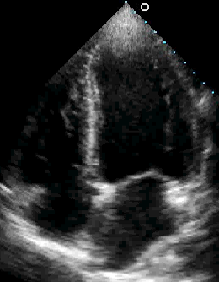
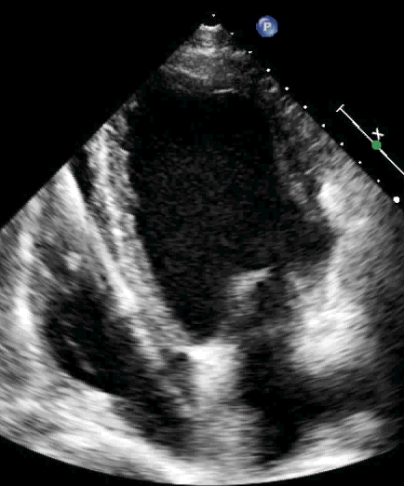
HFpEF vs. HFrEF
HFpEF
Heart failure with preserved ejection fraction
“Diastolic HF”
HFrEF
Heart failure with reduced ejection fraction
“Systolic HF”
Left
ventricle
Left
ventricle

Slide 20
HFpEF vs. HFrEF
HFpEF
Heart failure with preserved ejection fraction
“Diastolic HF”
HFrEF
Heart failure with reduced ejection fraction
“Systolic HF”
Poorly understood
Increasing in prevalence
No definitive treatments
High morbidity/mortality
Well studied
Decreasing in prevalence
Many proven treatments
Decreasing morbidity
Decreasing mortality

Slide 21
HFpEF vs. HFrEF
HFpEF
Heart failure with preserved ejection fraction
“Diastolic HF”
HFrEF
Heart failure with reduced ejection fraction
“Systolic HF”
Poorly understood
Increasing in prevalence
No definitive treatments
High morbidity/mortality
Well studied
Decreasing in prevalence
Many proven treatments
Decreasing morbidity
Decreasing mortality

Slide 22
Systolic vs diastolic HF
Traditional thinking…
  Systolic HF ≈ squeezing problem ≈ ↓output
  Diastolic HF ≈ relaxation problem ≈ ↑filling pressures
We now know that heart failure is more complex:
  Systolic HF now called “HFrEF”
  Diastolic HF now called “HFpEF”

Slide 23
The bottom line…
HF is a syndrome and main differences between systolic and diastolic HF
(HFrEF and HFpEF) = anatomic structure and function of heart muscle and heart muscle cells

Slide 24
Differentiating types of HF
Characteristic | HFpEF | HFrEF
Clinical features Symptoms (e.g., dyspnea, orthopnea) Congestive state (e.g., edema) Neurohormonal activation (↑BNP, ↑SNS, ↑RAAS) | YES YES YES | YES YES YES
LV structure and function LV ejection fraction LV mass Relative wall thickness (i.e., mass/volume ratio) LV end-diastolic volume LV end-diastolic pressure, left atrial size | Normal ↑ ↑ Normal ↑ | ↓ ↑ ↓ ↑ ↑
Exercise Exercise capacity Cardiac output augmentation End-diastolic pressure | ↓ ↓ ↑ | ↓ ↓ ↑

Slide 25
Differentiating types of HF
Characteristic | HFpEF | HFrEF
Clinical features Symptoms (e.g., dyspnea, orthopnea) Congestive state (e.g., edema) Neurohormonal activation (↑BNP, ↑SNS, ↑RAAS) | YES YES YES | YES YES YES
LV structure and function LV ejection fraction LV mass Relative wall thickness (i.e., mass/volume ratio) LV end-diastolic volume LV end-diastolic pressure, left atrial size | Normal ↑ ↑ Normal ↑ | ↓ ↑ ↓ ↑ ↑
Exercise Exercise capacity Cardiac output augmentation End-diastolic pressure | ↓ ↓ ↑ | ↓ ↓ ↑

Slide 26
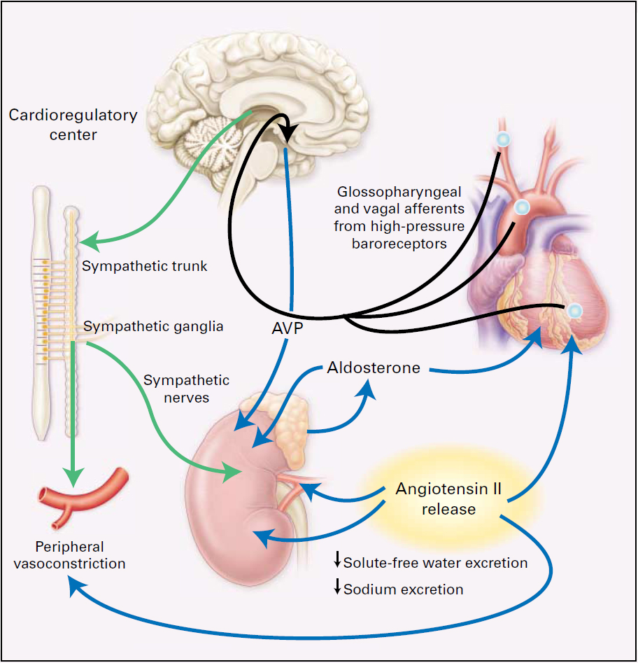
Neurohormonal activation in HF

Slide 27
Sympathetic nervous system
↓Cardiac output leads to decreased perfusion pressure sensed by carotid baroreceptors
Results in increased sympathetic outflow
Initially a good thing:
  The body is trying to preserve BP
  ↑Sympathetic nervous system = increases HR, contractility, vasoconstriction
But long term it’s a bad thing: heart function gets worse

Slide 28
Natriuretic peptides (NPs)
NPs are released into the circulation when the myocardium is under stress
These hormones are beneficial and counteract the ill-effects of SNS, RAAS, and AVP activation
Elevated levels of BNP:
  Used to diagnose HF
  Associated with worse outcomes

Slide 29
Why is neurohormonal activation bad?
Natriuretic peptides are good
Sympathetic nervous system, renin-angiotensin-aldosterone system, vasopressin system: all bad
Initially they are compensatory
They very quickly worsen the HF syndrome
  Sodium and water retention: ↑congestion
  Vasoconstriction: ↑afterload = ↓output
  Angiotensin II, aldosterone: ↑cardiac fibrosis (hardening of the heart tissue)

Slide 30
Overview of HF staging system
Hunt SA et al. J Am Coll Cardiol. 2001;38:2101–2113.
Refractory
End-Stage HF
Marked symptoms at rest
despite maximal
medical therapy
D
Symptomatic HF
Known structural heart disease
Shortness of breath and fatigue
Reduced exercise tolerance
C
Asymptomatic HF
Previous MI
LV systolic dysfunction
Asymptomatic valvular disease
B
High Risk for Developing HF
Hypertension
CAD
Diabetes mellitus
Family history of cardiomyopathy
A

Slide 31
Overview of HF treatment
Goal #1:
  Prevent patients from ever getting symptomatic (Stage C or D) HF
  Focus on Stage A and B HF for prevention
Goal #2:
  Once symptomatic (Stage C) HF develops, prevent hospitalization
Goal #3:
  Prevent progression to Stage D HF

Slide 32

NYHA functional classification
NYHA class I:
  No limitation
NYHA class II:
  Slight limitation; dyspnea and fatigue with moderate exertion
NYHA class III:
  Marked limitation; dyspnea with minimal activity
NYHA class IV:
  Severe limitation; symptoms at rest

Slide 33
Classification of Severity
ACC/AHA HF Stage
NYHA Functional Class
A At high risk for heart failure but without
structural heart disease or symptoms
of heart failure (eg, patients with
hypertension or coronary artery disease)
None
B Structural heart disease but without
symptoms of heart failure
I Asymptomatic
C Structural heart disease with prior or
current symptoms of heart failure
II Symptomatic with moderate exertion
III Symptomatic with minimal exertion
IV Symptomatic at rest
D Refractory heart failure requiring
specialized interventions
Hunt SA et al. J Am Coll Cardiol. 2001;38:2101–2113.
New York Heart Association/Little Brown and Company, 1964.
Adapted from: Farrell MH et al. JAMA. 2002;287:890–897.
Notes:
The New York Heart Association (NYHA) classification system is based largely on the assessment of symptoms.¹
The new American College of Cardiology and American Heart Association (ACC/AHA) classification guidelines were designed to compliment the NYHA classification system. These new guidelines focus more on underlying disease and the need to treat early in the disease process, even before overt symptoms of heart failure are present.²
¹The Criteria Committee of the New York Heart Association. Diseases of the Heart and Blood Vessels: Nomenclature and Criteria for Diagnosis. 6th ed. Boston, Mass: Little Brown; 1964.
²Hunt SA, Baker DW, Chin MH, et al. ACC/AHA guidelines for the evaluation and management of chronic heart failure in the adult: executive summary. A report of the American College of Cardiology/American Heart Association Task Force on Practice Guidelines (Committee to revise the 1995 Guidelines for the Evaluation and Management of Heart Failure). J Am Coll Cardiol 2001;38:2101-2113.

Slide 34
Mortality rate by NYHA class
Class IV
Class II-III
Class I-II
The CONSENSUS Trial Study Group, N. Engl. J. Med., 1987
The SOLVD investigators, N. Engl. J. Med., 1991
The SOLVD investigators, N. Engl. J. Med., 1992

Slide 35
Mortality rate by NYHA class
Class IV
Class II-III
Once symptomatic HF
occurs prognosis is bad
Class I-II
The CONSENSUS Trial Study Group, N. Engl. J. Med., 1987
The SOLVD investigators, N. Engl. J. Med., 1991
The SOLVD investigators, N. Engl. J. Med., 1992

Slide 36
Symptoms are Important
  Symptoms decrease quality of life and are highly relevant to patients
  Symptoms generally define the severity of the disease
    Disease severity is one of the strongest predictors of death in heart failure.
  Symptoms often determine therapy

Slide 37
Health Status and Hospitalizations
Heidenreich, PA et al. JACC 2006; 47:752-6

Slide 38
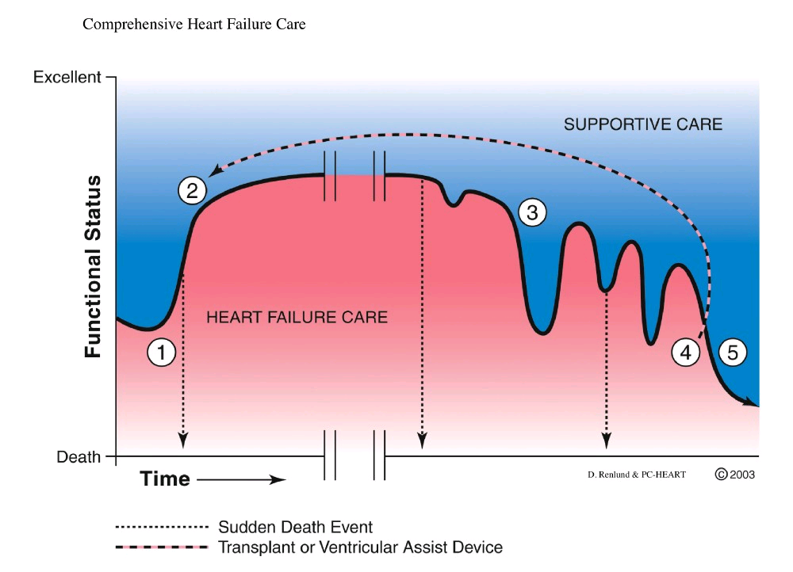
Non-Linear Course of Heart Failure
Allen et al. Circ 2012;March 5

Slide 39
Heart failure: unanswered questions
Why do some people with risk factors develop heart failure while others do not?
How common is early heart failure (i.e., symptoms prior to hospitalization)?
What is the best way to diagnose early heart failure?
What are the mechanisms behind early heart failure?

Slide 40
Cohorts/ Trials/ Outcomes studies investigating HF
Have primarily focused on HF with reduced ejection fraction (HFrEF),
Or have not differentiated HF with reduced vs. preserved EF
Diagnosis of HF based on hospitalizations, primarily
The diagnosis of early heart failure is missing in these studies

Slide 41
CLINICAL, SYMPTOMATIC HF IS A SPECTRUM
Depends on: (1) type of clinical presentation; (2) MD threshold to hospitalize the patient vs. outpatient treatment
OUTPATIENT
Dyspnea on exertion due to myocardial problem with evidence of ⬇CO and/or
⬆PCWP at rest or with exertion
INPATIENT
CHF hospitalization due to overt volume overload and/or low output state
CLINICAL SPECTRUM
Traditional HF endpoint in epidemiology studies
Heart failure may have insidious onset, characterized by poor exercise capacity, dyspnea/ pulmonary signs, but not recognized until severe/ decompensated

Slide 42
HF Stages
Modified from Hunt et al, ACC/AHA Guidelines for the Evaluation and Management of Chronic Heart Failure in the Adult. 2005
Stage B→C: Critical transition point but poorly understood. What defines the development of symptomatic HF?
Stage A
High risk for development of HF
(HTN, CAD, DM, obesity, CKD, etc)
★
Stage B
Asymptomatic HF (abnormal cardiac structure/function)
Most elderly are at risk (Stage A) and many are in Stage B HF
Stage C
Symptomatic HF
Stage D
End-stage, refractory HF

Slide 43
Types of HFpEF
ENVIRONMENT, DIET
COMORBIDITIES
GENETIC SUSCEPTIBILITY
VULNERABLE HEART,
VULNERABLE PATIENT
HFpEF
EXERCISE INTOLERANCE
HFpEF
(Early HF)
VOLUME
OVERLOAD
HFpEF
PULMONARY HTN,
RV FAILURE
HFpEF
By 2020, 65% of hospitalized HF will have EF>40%
Shah SJ. JACC 2013

Slide 44
Framingham Criteria for HF
Diagnosis requires the simultaneous presence of at least 2 major criteria or 1 major criterion and 2 minor criteria
Minor criteria are acceptable only if they can not be attributed to another medical condition (i.e. pulmonary hypertension, chronic lung, liver, or kidney diseases)

Slide 45
Major/Minor Framingham Criteria
Paroxysmal nocturnal dyspnea
Neck vein distention; Rales (lung sounds); S3 gallop
Incr heart size on chest Xray; Acute Pulm Edema
Increased central venous pressure
Hepatojugular reflux
Weight loss >4.5 kg in 5 days in response to Rx
Bilateral ankle edema
Dyspnea on ordinary exertion; nocturnal cough
Hepatomegaly; Pleural effusion
Decrease in vital capacity by one third from maximum recorded
Tachycardia (heart rate>120 beats/min)

Slide 46
Other Schemes for defining HF
Several Other Formulations
  Gothenberg
  NHANES
  Boston
All these criteria predate the availability of biomarkers or the inclusion of structural assessments
Different “definitions” influence epidemiology!

Slide 47
Transthoracic Echocardiography
(heart ultrasound)
Provides measures of heart structure and function
  Left ventricular ejection fraction (squeezing function)
  Chamber size (is the heart enlarged?)
  LV wall thickness (hypertrophy)
  Measures of chamber relaxation (diastology)
  Valvular anatomy and function
Advantages
  Real time, Non-invasive, No radiation
  Relatively “inexpensive”
Disadvantages
  Not as precise as MRI for some measures

Slide 48
Brain Natriuretic Peptides
Secreted as proBNP by heart cells, cleaved into BNP and NTproBNP
  In response to atrial/ventricular stretch
  BNP is active component, signals to kidney to produce diuresis
Shown to be markedly elevated in acute HF, can differentiate between cardiac and non cardiac causes of dyspnea
  Also elevated by renal failure
Within “normal” ranges, higher levels are predictive of future risk of HF

Slide 49

Transition from Risk Factors to Heart Failure: Prevalence, Pathogenesis, and Phenomics
Co-PIs: Alain Bertoni MD MPH and Sanjiv Shah MD
Other key personnel:
C Rodriquez, J Yeboah, S Rosas, H Chen, A Folsom, S Shea, K Watson, W Post, K Liu, R Kronmal, R Tracy, B Freed, R Deo, and J Chirinos

Slide 50
What is early HF?
Dyspnea and/or exercise intolerance due to underlying cardiac problem
No or minimal overt volume overload
Majority have a normal or near-normal LVEF
May have a normal BNP
Elevated LV filling pressure at rest or with volume loading, hand-grip, or exercise
Borlaug BA, et al. Circ Heart Fail 2010
Penicka M, et al. JACC 2010
Shah SJ. JACC 2013

Slide 51
How common is early HF in MESA?
28% of MESA ppt’s reported pedal edema at baseline
Pedal edema not associated with LV or RV systolic dysfunction on cardiac MRI
Pedal edema was associated with:
  Orthopnea (OR 1.66 [95% CI 1.30-2.12])
  PND (OR 1.95 [95% CI 1.21-2.68])
  Elevated NTproBNP (OR 1.80 [95% CI 1.21-2.68])
  Incident HF (adj. HR 1.43 [95% CI 1.02-1.99])
Yeboah J, et al. (unpublished data)

Slide 52
AIM 1
Prevalence of early HF
To determine the prevalence/subtype of early HF by assessing functional status (6MWT), physical activity (survey), symptoms, NTproBNP, echocardiography, arterial stiffness measures, and in a Wake Forest sub-sample, cardiopulmonary exercise testing.

Slide 53
AIM 2
Pathogenesis of early HF
To measure key physiologic parameters, risk factors, and novel biomarkers (ST2, gal-3, FGF23) concurrent to the assessment of HF status, and use the data from prior MESA exams to examine the associations between ideal CV health, risk factors, biomarkers, and changes in risk factors with all HF and early HFpEF specifically

Slide 54
AIM 3
Phenomics of early HF
To perform phenomics (machine learning analysis) of previously ascertained quantitative MESA data to define differential phenotype signatures (pheno-groups) and relate these pheno-groups to cardiac structure/function at Y15 and the prevalence and type of HF (e.g., early or overt HFpEF or HFrEF)

Slide 55


HEART FAILURE
RISK FACTOR
COMBINATIONS
HEART FAILURE
PATHOPHYSIOLOGIC
SUBTYPES
HYPOTHESIS: Specific HF risk factor phenotypic signatures are associated with specific
HF pathophysiologic subtypes
Shah SJ, et al. Heart Fail Clin 2014

Slide 56
MESA existing quantitative phenotype domains (pre-Y15)
Anthropomorphic data
Environmental data
  Diet, geocoding, pollution
Sleep questionnaire data
Biomarkers, laboratory data
Spirometry (lung function)
Electrocardiography
Arterial tonometry
Coronary CT
Cardiac MRI
Phenomics
analysis
Unique phenotype
signatures

Slide 57
METHODS (1)
All participants (N=3500) will undergo contract exam, PLUS
  6-minute walk test
  Kansas City Cardiomyopathy Questionnaire (KCCQ12)
  Dyspnea Questionnaire (MESA Lung)
  Physical Activity Survey (MESA TWPAS)

Slide 58
METHODS (2)
Laboratory Testing
  All: Serum NTproBNP, glucose, creatinine, urine microalbumin
  Case-cohort approach: novel biomarkers (ST2, galectin-3, FGF23) to be performed after exam 6
    Budgeted to run 1000 assays for each biomarker

Slide 59
METHODS (3)
Echocardiography with Doppler, tissue Doppler and speckle-tracking
  At rest
  Passive leg raise (preload)
Arterial stiffness (Fukuda VaSera)
Cardiopulmonary exercise testing in a subset (n=300) to validate early HF dx, as CPEX is gold standard for evaluating exercise intolerance

Slide 60
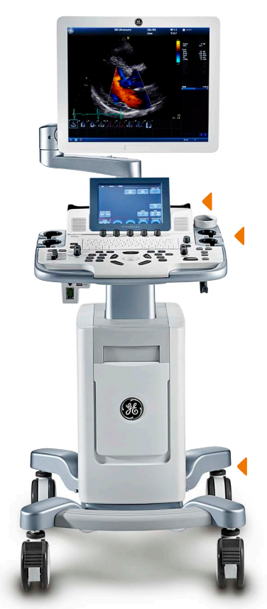
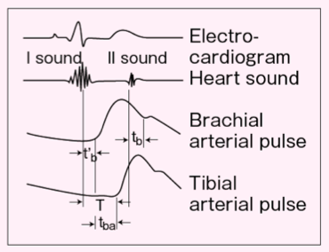
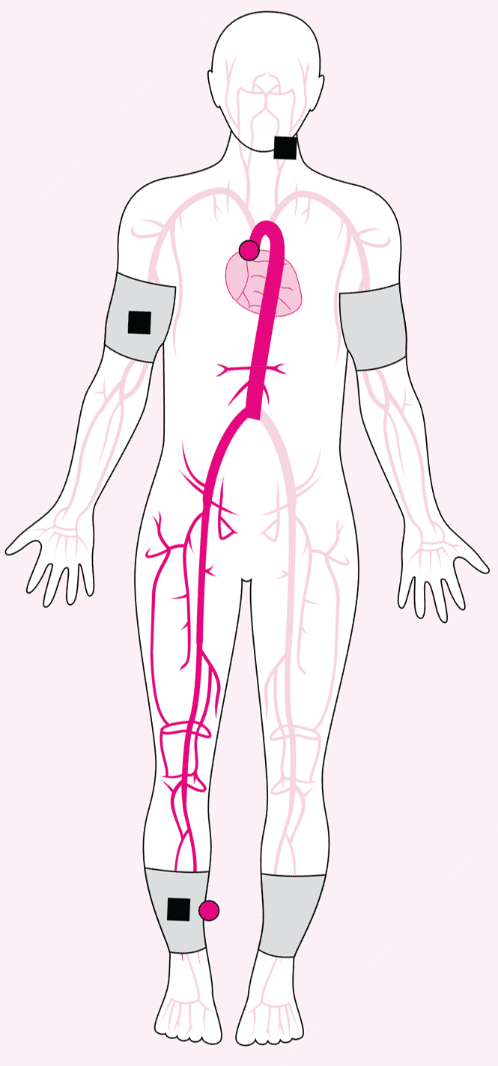
Fukuda
VaSera
(automated
PWV, ABI, HRV)
Vivid T8 cardiac ultrasound system
(tissue Doppler, speckle-tracking)

Slide 61
METHODS (4)
Definition of early HF:
  No prior HF hospitalization and
  Presence of HF symptoms or functional limitation suggestive of HF and
  NTproBNP or echo evidence of elevated LV filling pressure (at rest or with passive leg raise or bilateral cuff occlusion)
Notes:
Definition of early HF: We will define early HF based on the combination of: (1) symptoms and signs of HF and (2) objective abnormalities of cardiac structure and/or function on echocardiography. We will use a HF symptom survey to identify symptoms of HF in study participants. Signs of HF will include 6MWT distance significantly below age- and gender-specific norms; elevated NT-proBNP; and echocardiographic signs of HF, including elevated left atrial pressure (E/e’ ratio) or right atrial pressure (size and collapsibility of the inferior vena cava); increased pulmonary artery systolic pressure; and/or reduced cardiac output (estimated using the LV outflow tract velocity-time integral). Abnormalities in cardiac structure and function on echocardiography will include cardiac chamber dilation, LV or RV systolic dysfunction, LV hypertrophy, LV diastolic dysfunction, and/or overt LV systolic dysfunction (i.e,. reduced LVEF). We anticipate that participants with early HF have reduced physical activity (measured objectively using accelerometry) compared to those without early HF. The CPEX will be performed in 400 participants unselected for early HF (only excluding those with prior hospitalization for HF or ischemic heart disease in prior 6 months), and will be used to verify the diagnosis of early HF. This will allow us to determine the sensitivity and specificity of our symptom/NTproBNP/6MWT/echo-based early HF definition.

Slide 62
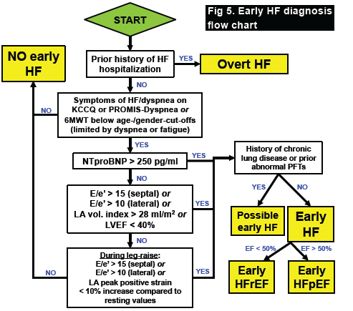
Approach to Early HF Classification

Slide 63
IMPACT
Clinical impact within the next 5 years:
  Characterization of the early HF syndrome, including prevalence data, diagnostic criteria, and clinical characteristics will help inform design of prevention and intervention trials
  Identification of patients at highest risk for transitioning from Stage B→C (early) HF

Slide 64

thank you!

