Slide 1
Updates from the MESA-Kidney Study
September 17, 2014
MESA Steering Committee Meeting
Tariq Shafi, MBBS, MHS
Johns Hopkins University
On behalf of the MESA-Kidney Investigators
(Levey, Inker, Shlipak, Coresh)
Notes:
Blue: 51 51 178

Slide 2
Background
Glomerular Filtration Rate (GFR)
Best overall index of kidney function
Presence of low GFR:
Detection of chronic kidney disease (CKD)
Classification of CKD
Detection and monitoring of CKD complications (anemia, hyperparathyroidism, drug dosing)
Risk factor for death, end-stage renal disease and acute kidney injury

Slide 3
Background
Variations in burden of CKD
Burden of CKD in the US population varies by age, sex and race

Slide 4
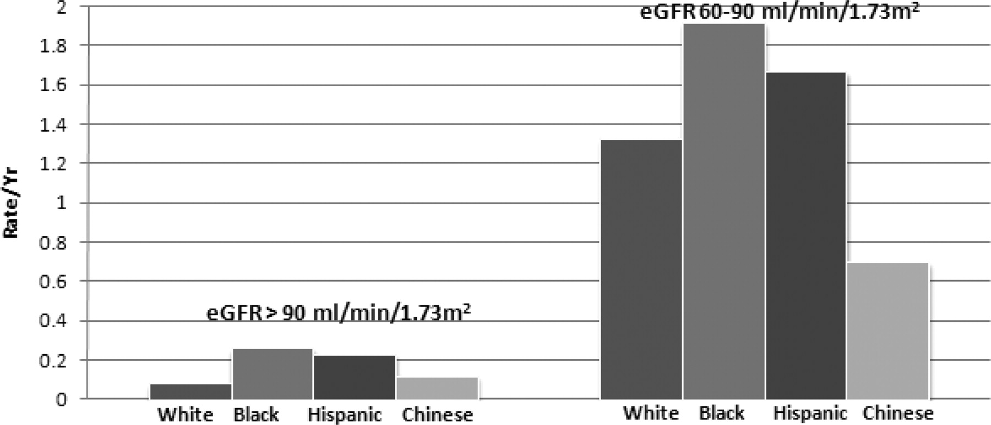
Age- and sex-adjusted rates of incident chronic kidney disease are higher among blacks and Hispanics in MESA.
Visits 1 to 4 (N=4,214)
Incident CKD: eGFR_{CYS} <60 ml/min + eGFR_{CYS} decline > 1 ml/min/yr
x3
x2
Peralta C A et al. JASN 2011;22:1327-1334
©2011 by American Society of Nephrology
Notes:
Age- and sex-adjusted rates of incident chronic kidney disease are higher among blacks and Hispanics in MESA.
>90 group (3 fold higher in blacks and 2 fold higher in whites) – statistically sig
60-90 group – not stat sig

Slide 5
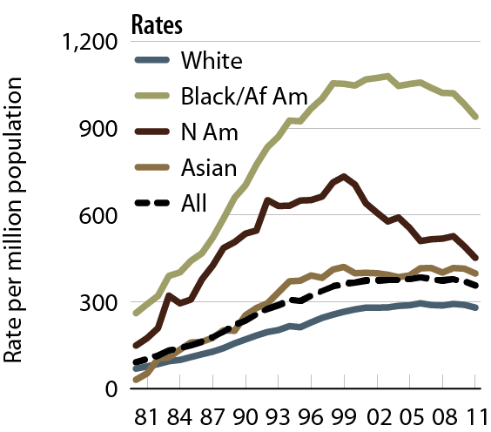
Incident rates of ESRD, by race Figure 1.5 (Volume 2)
Black
Blacks have
>3-fold higher incidence of ESRD
White
Incident ESRD patients. Adj: age/gender; ref: 2010 ESRD patients.

Slide 6
Normal GFR: Age-Related Decline
N: 347
N:140
1.3 ml/min/1.73 m² per year
Age≥55: N=42
Age≥55: N=12
Data from 27 cross-sectional studies. Wesson LG, ed. Physiology of the Human Kidney 1969: 96-108.
Notes:
age-related decline in mGFR
1.3ml per year after 40-50 years
GFR higher in men than women
Age >55: 42 men; 12 women

Slide 7
Background
Variations in burden of CKD
Burden of CKD in the US population varies by age, sex and race
Due to:
Comorbid disease burden?
GFR estimation equations performance?
Difference in GFR between race/ethnic groups?

Slide 8
Objective
To measure GFR across a broad age-range of adults within a representative, community-based population and to determine the impact of race on age-related GFR differences.
Hypothesis:
Measured GFR levels will be significantly lower in Blacks than in Whites, independent of age and sex.

Slide 9
Study Organization
PIs: Shlipak, Levey, Inker, Coresh
Funding: NIDDK R01 and JHU ICTR
Study Coordinating Center: Tufts Medical Center
MESA Field Center: Johns Hopkins University (PI: Wendy Post)
Study Visits: Johns Hopkins Bayview – Clinical Research Unit
Data Coordinating Center: University of Washington, Seattle
Laboratory: University of Minnesota (PI: John Eckfeldt)

Slide 10
Study Protocol
Participants | All MESA 5 Participants → (Visit 3 &4)
Location | Johns Hopkins Bayview CRU
Duration | Approximately 6 hours
GFR Protocol
Iohexol | 5 ml over 2 min
Flush | 30 cc
Timed Blood, min | 0, 10, 30, 120, 240, 360 (if eGFR <30)
Storage | -80° C within 30 min
Shipping | Dry Ice; monthly batches
Measurements | (5% QC Samples)
Plasma Iohexol | HPLC
Serum Cys C, Creat, Urine albumin/creat | BN Prospec/Roche
Ancillary Studies | DXA Scan (whole body and hip/spine), PWV
Data Entry | EDC
Notes:
Briefly mention advantages of iohexol
Carotid femoral pulse wave velocity
Augmentation index
Radial tonometry – using the standard tonometer (sphygmacor) and MESA tonometer (goose neck clamp)

Slide 11
Study Flow Diagram
Study Visits (May 2012 to April 2014)
Eligible Participants: 746
Exam 5: 604
Exam 4: 124
Exam 3: 18
Not Approached | 76
Cognitive impairment | 8
Deceased | 15
Out of State | 37
Do not contact | 12
Study drop out | 4
Ineligible (Excluded) | 27
Allergy CT contrast/iodine | 17
Liver disease | 2
Cancer | 3
Limb amputation | 1
Dementia diagnosis | 4
Approached: 670
Not Enrolled | 336
Did not keep appointment | 46
No reason provided | 13
Other reason provided | 259
Nursing home | 2
Did not show up | 16
Eligible: 643
Enrolled: 307
Problem with venous access | 10
Other | 3
Complete GFR Data: 294
Notes:
1st ppt.: 5/2/12
Last ppt.: 4/25/14
a) Inclusion criteria:
All participants who completed the MESA exam 5 study visit at Johns Hopkins.
b) Exclusion criteria:
o Persons presently on dialysis or have received dialysis within the past three months
o Persons taking medications that affect creatinine levels (e.g. Bactrim, cimetidine)
o Inability to maintain a stable regimen of anti-inflammatory agents and angiotensin converting enzyme inhibitors for one week prior to study visit
o Inadequate venous access
o End stage conditions such as cirrhosis; active treatment for cancer; or progressive neurological diseases with life expectancy < 6 months
o Known allergy to CT contrast or iodine
o Multinodular goiter, Graves’ disease or autoimmune thyroiditis
o Women who are either pregnant, lactating or intending to get pregnant in the next 6 weeks

Slide 12
Results: Participant Characteristics
Number | 294
Mean Age, years (SD) | 70.7 (8.6)
Sex, % female | 48
Race, % black | 47
Mean Weight, kg (SD) | 84.6 (17.1)
Diabetes, % | 25
Hypertension, % | 64
Measured GFR, ml/min/1.73 m²
Mean (SD) | 72.6 (18.8)
Median (25th, 75th percentiles) | 72 (61, 84)

Slide 13
Preliminary Results
Effects of Race and Sex on Measured GFR in the Elderly: Multi-Ethnic Study of Atherosclerosis
American Society of Nephrology Annual Meeting
Philadelphia, PA
November 15, 2014; SA-PO826

Slide 14
Results: Measured GFR
GFR was higher in men versus women
 | Men vs. Women | Blacks vs. Whites
 | Mean Difference (95% CI) | Mean Difference (95% CI)
Unadjusted | 9.2 (5.0, 13.4) | 3.0 (-1.3, 7.3)
Adjusted for age, sex or race | 10.4 (6.7, 14.1) | 1.2 (-2.5, 4.9)
Adjusted for age, sex or race, DM, HTN | 11.0 (7.2, 14.8) | 2.3 (-1.6, 6.2)
DM: Diabetes at exam 5 defined as history of diabetes or treatment with insulin/oral hypoglycemic medications or fasting glucose ≥ 126 mg/dL. HTN: Hypertension at exam 5 defined as history of hypertension or antihypertensive medication us or SBP ≥ 140 mm Hg or DBP ≥ 90 mm Hg.

Slide 15
Results: Measured GFR
GFR was higher in men versus women
There was no difference in GFR between Blacks and Whites
 | Men vs. Women | Blacks vs. Whites
 | Mean Difference (95% CI) | Mean Difference (95% CI)
Unadjusted | 9.2 (5.0, 13.4) | 3.0 (-1.3, 7.3)
Adjusted for age, sex or race | 10.4 (6.7, 14.1) | 1.2 (-2.5, 4.9)
Adjusted for age, sex or race, DM, HTN | 11.0 (7.2, 14.8) | 2.3 (-1.6, 6.2)
DM: Diabetes at exam 5 defined as history of diabetes or treatment with insulin/oral hypoglycemic medications or fasting glucose ≥ 126 mg/dL. HTN: Hypertension at exam 5 defined as history of hypertension or antihypertensive medication use or SBP ≥ 140 mm Hg or DBP ≥ 90 mm Hg.

Slide 16
Measured GFR: Sex and Race
Black Men
White Men
150
Intercept @ mean age 71 years (95% CI):
78.1 (73.6, 82.7)
150
Intercept @ mean age 71 years (95% CI):
77.1 (73.7, 80.4)
2
2
m
m
100
100
mL/min/1.73
mL/min/1.73
GFR,
GFR,
50
50
Slope per year (95% CI): -1.24 (-1.79, -0.70)
Slope per year (95% CI): -1.10 (-1.49, -0.71)
55
60
65
70
75
80
85
90
55
60
65
70
75
80
85
90
Age, years
Age, years

Slide 17
Measured GFR: Sex and Race
Relationship of GFR to age does not differ between races or between sexes
Black Men
White Men
150
Intercept @ mean age 71 years (95% CI):
78.1 (73.6, 82.7)
150
Intercept @ mean age 71 years (95% CI):
77.1 (73.7, 80.4)
2
2
m
m
100
100
mL/min/1.73
mL/min/1.73
GFR,
GFR,
50
50
Slope per year (95% CI): -1.24 (-1.79, -0.70)
Slope per year (95% CI): -1.10 (-1.49, -0.71)
55
60
65
70
75
80
85
90
55
60
65
70
75
80
85
90
Age, years
Age, years
Black Women
150
Intercept @ mean age 71 years (95% CI):
68.0 (64.3, 71.7)
2
m
100
mL/min/1.73
GFR,
50
Slope per year (95% CI): -0.91 (-1.32, -0.50)
55
60
65
70
75
80
85
90
Age, years

Slide 18
Preliminary Results
Conclusions:
Measured GFR is higher in men versus women.
Measured GFR is similar in blacks and whites.
Higher incidence of ESRD in blacks and men is not explained by:
The level of average measured GFR in the population
Age-related differences in GFR
Notes:
ESRD not simply due to the effect of lower GFR
Age related cross sectional differences
Selection bias

Slide 19
Planned Analyses
Determinants of measured GFR
Determinants of GFR markers
GFR modeling – 1 compartment vs. 2 compartment model
Extracellular volume and cross-sectional associations
Association of GFR with bone mineral density and hip geometry
Association between lean body mass and serum creatinine-based GFR estimation
Association between BP and PWV between mGFR strata
Association between ECG R-wave to Arterial Pulse Delay with Subclinical CVD and Risk Factors
Relationship of arterial elasticity and PWV to renal function
Comparison of arterial elasticity and PWV

Slide 20
Acknowledgements
Johns Hopkins University
Josef Coresh
Wendy Post
Tariq Shafi
Seamus Whelton (PWV)
Kendall Moseley (DXA)
JHU-MESA Field Center
Imene Benayache
Ann Martz
Carol Christman
Sheila Odum
Diane Weiss
JHU Nephrology/CRU
Zarqa Tariq
Chloe Knight
Patricia Endicott
Nadejda Sokhieva
Marium Jamil
Jim Monolakis
Tufts Medical Center
Andrew Levey
Lesley Inker
Aghogho Okparavero
University of California San Francisco
Michael Shlipak
University of Washington
Norma Dermond
Ronit Katz
Craig Johnson
Kayleen Williams
Sandi Shrager
University of Minnesota
John Eckfeldt,
Catherine Foster
Julie Idzorek
University of Minnesota
David Jacobs (PWV)
Daniel Duprez (PWV)
MESA Participants & Investigators

