Slide 1
MESA Steering Committee Genetics Committee Update
March 22, 2016
Jerome I. Rotter, MD and Stephen S. Rich, PhD

Slide 2
MESA Genetics Overview
Update on Genetics P&P
Recognition of the Committee members
Progress to date
Return of Results
NHLBI TOPMed program
Overview and Structure
Manuscript and grant opportunities
Additional ‘omics interest
Analytic Commons
Description and Rationale
MESA as a member of the Commons
Analytic Commons
MESA Genetics Committee, tonight at 7:30pm

Slide 3
Genetics Dataset Availability
Genetic dataset | Available w/MESA ID from CC | Available w/SHARe ID from CC | Available w/SHARe ID from dbGaP
Affy 6.0 | No | Yes | Yes
Candidate Gene 1&2 | Yes | No | No
CARe IBC iSelect | Yes | Yes | Yes
96 SNP | Yes | Yes | No
Metabochip | Yes | No | No
Exome Chip | Yes | Yes | Yes
Exome Sequence | Yes | Yes | Yes
Epigenomics methylation | Yes | No | No
Epigenomics expression | Yes | No | No
SHARe Principal Components | Yes | Yes | No
1000 G Imputation | No | Yes | No
Phenotype Updates | Yes | Yes | Yes
Whole Genome Sequence | In progress

Slide 4
MESA Genetics P&P
Continued outstanding leadership and work
Wendy Post (Chair), Xiaohui Li, Nancy Jenny, Ani Manichaikul, Jim Pankow, Christina Wassel, Lekki Frazier-Wood, Steve Rich (as needed)
Thanks to Xiuqing Guo who has recently stepped down from the committee.
Review of MESA-specific and consortia manuscripts (proposals and pen-drafts)
Manuscript proposals
Manuscript submissions
Manuscript acceptance

Slide 5
MESA Genetics P&P Summary
 | All | SHARe
Proposals approved | 478 | 354
Pen Draft Pending (Proposals approved; pen draft not yet approved) | 283 | 213
Withdrawn | 11 | 2
Pen Draft approved | 184 | 139
Published | 127 | 96
Pen Draft approved; not yet published | 58 | 44
 | Pending Pen Draft | Pen Drafts not published
0-3 months | 24 | 16
3-6 months | 14 | 18
6-9 months | 11 | 6
9-12 months | 25 | 9
12+ months | 209 | 9

Slide 6
MESA Return of Results
Aim: confirm and return actionable IFs to qualified MESA participants
Project status:
Completed | To Do
Protocol drafted | Finalizing protocol and MOP
MOP drafted | Create genetic contact script
Field Center Script | Develop result letter
Specific questionnaires | Create test kits
Variant annotation
Secured testing in CLIA lab
Failed contact letter
Initial Decline letter

Slide 7
NHLBI TOPMed Project
Initiated in late 2014 to develop deep “omics” datasets (genomics, metabolomics, proteomics, lipidomics/inflammatory mediators) in NHLBI cohorts, focused on heart, lung, and blood diseases
Initial (Phase 1) cohorts were chosen through an RFI (describing cohort characteristics and capabilities) and an RFA for whole genome sequencing (WGS) through R01 supplements.

Slide 8
Rationale for Whole Genomes
Thousands of significant SNP-trait associations have been identified but the functional impact for most remain unknown
In a 2009 analysis of GWAS index SNPs, a large proportion were intronic (45%) or intergenic (43%)*
Relatively few trait-associated SNPs (<5%) are in coding regions
Approximately 80% of trait-associated SNPs are in strong LD (r² ≥ 0.8) with a SNP with predicted functional, regulatory impact (e.g., DNase I site/footprint, ChIP-seq peak, in at least one cell line)**
Many trait-associated SNPs identified in CHARGE have been convincingly annotated to lncRNAs
*Hindorff et al, PNAS 106:9362, 2009.
**Schaub et al, Genome Research 22:1748, 2012.

Slide 9
TOPMed Structure
Participating projects (11 in Phase 1)
Data Coordinating Center (University of Washington – Cathy Laurie, Bruce Weir, Bruce Psaty)
Informatics Resource Center (University of Michigan – Goncalo Abecasis, Mike Boehnke)
Sequencing Centers
Broad Institute (Stacey Gabriel)
University of Washington/Macrogen (Debbie Nickerson)
New York Genome Center (Soren Germer, Mike Zody)
Illumina Sequencing Service (Tonya McSherry, Karine Viaud)

Slide 10
TOPMed Projects Phase 1
Project | Design | Sample Size
MA Families, San Antonio | Large Pedigrees | (1,142)
Genetic Epi of COPD | Case-Control | 2,130
Minority Children with Asthma | Case only (AA-PR-MA) | 1,484
Old Order Amish | Large Pedigrees | 1,178
Asthma, African ancestry-Barbados | High prevalence population | 1,261
Genetics of AF, PR interval | Cases (Eur-Am) | 3,413
Gen-Epi Asthma, Costa Rica | High prevalence, Hispanic | 1,533
Samoan Adiposity Study | High prevalence (obesity) | 444
Cleveland Family Study | Pedigrees, Sleep Measures | 1,178
Framingham Heart Study (EA) | Population-based, observational | 4,097
Jackson Heart Study (AA) | Population-based, observational | 3,461
Total |  | 21,321

Slide 11
Data Access and Publication
Each project (cohort) will receive its own variant calls as soon as these are available from the sequencing center
Any sequence or phenotype data used in a publication will be submitted to dbGaP (if not already there, or by waiver from NHLBI)
All WGS for initial Phase 1 projects is expected to be completed by February, 2016
Joint variant calling will be conducted at the University of Michigan and placed with harmonized phenotypes in a dbGaP Exchange Area to facilitate rapid analysis
Prompt release to the broader community is expected

Slide 12
Data Access and Publication
Data access and publication policy is intended to minimize obstacles to analysis and publication, ensure transparency, enable productivity tracking, and promote synergy across the TOPMed projects
~ 2 page online manuscript proposal form
Rapid review with simultaneous cohort review as required
Abstracts and manuscripts will be reviewed with a similar, rapid timeline
Same basic process for other cohorts (e.g., MESA) and consortia (e.g., NHLBI ESP)

Slide 13
Vv Extending the Scope of TOPMed
Expanding to additional cohorts & populations
Targeted phenotypes (e.g., MI case-control)
Increasing sample sizes in non-Caucasian populations
Additional ethnicities (East Asian, South Asian)
Additional phenotyping / phenotype access
Biological samples: metabolomics, proteomics, lipidomics / inflammatory mediators, environmental measures
Clinical phenotypes from EMR (lung conditions, heart failure, blood disorders)

Slide 14
Advantages & Contributions
Experience with whole genome sequence data
Integrating mutiple forms of ‘omics data
Existing consortium and working groups with harmonized phenotypes
Developing models for Centralized and cloud computing
Potential to analyze individual-level data without downloading
Analytic methods that don’t require individual-level data

Slide 15
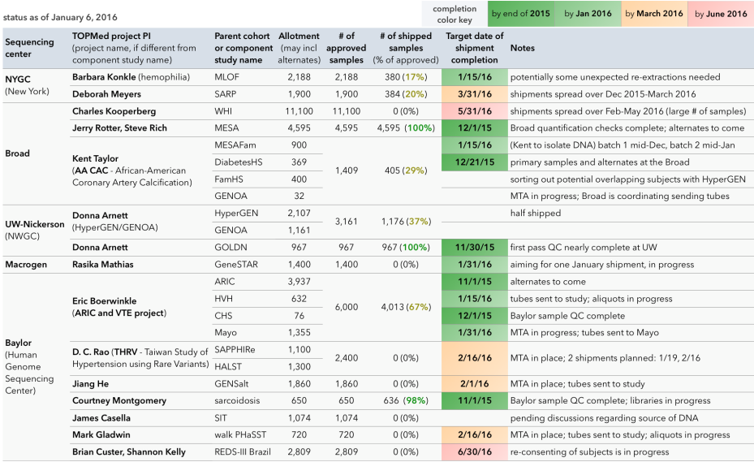
Phase 2 schedule of sample shipments

Slide 16
TOPMed WGS Overview
Study
DNA samples
Sequencing Center
sequence data
IRC
Michigan
study-specific call sets
joint genotype call sets
harmonized sequence data
NCBI
Study Coordinating Center
phenotypes
DCC UW
phenotypes
dbGaP
SRA
harmonized phenotypes
phenotypes,
genotypes,
sequence data
Scientific Community
Working Group
COPD
Working Group
atherosclerosis
Working Group
asthma
Study A analysis team
Study B analysis team
etc...
etc...
Cross study publications
Study-focused publications
Personalized Medicine

Slide 17
Manuscript & Grant Opportunities
Recall that each cohort (e.g., MESA) will receive VCFs/BAMs from dbGaP to be maintained in its own DCC
Each cohort has many more phenotypes than the harmonized list (~150) for TOPMed
Within TOPMed, there are Working Groups
Within and across cohorts, there can be collaborations, and grant applications related to TOPMed and specific phenotypes
A few R21 applications made already; R01s needed
TOPMed provides support for transport of DNA to sequencing centers, and sequencing – but not analysis

Slide 18
Analytic Commons
CHARGE investigators, led by Eric Boerwinkle (ARIC), Bruce Psaty (CHS) and Adrienne Cupples (Framingham), recognized the need for a site that could provide support, curation, analytic framework, and security, for next-gen sequence data coupled with phenotypes
Consideration of low cost of data storage, secure individual-level data, and ability to design and implement analytic tools
Cloud-computing based resource for analysis & discovery – Analytic Commons (where multiple cohorts can contribute data and analysis)

Slide 19
Implementation of the Analytic Commons
Established relationship with DNANexus (www.DNAnexus.com), a company supporting a cloud-based platform, optimized for ‘big data’ and computational biology
Initiated with exome sequence data from CHARGE-S and ESP; extended to low-pass whole genome sequence data from CHARGE-S
Initial activities (with significant support from DNAnexus technical staff) to establish work-flows, analysis pipelines, and developing/modifying existing analytic procedures

Slide 20
Opportunities
NHLBI TOPMed will require protocols for analysis of the 100,000 whole genomes being generated
Multiple possibilities from academia, NCBI, etc
Analytic COMMONS currently the only ‘working’ model
With ARIC, CHS, Framingham working in the Commons, opportunity for MESA to join (with Jackson Heart Study)

