Slide 1
MESA-Sleep Aims
Perform polysomnography and 7 day wrist actigraphy and supplemental sleep questionnaires (n=2200-2500)
Link sleep data to MESA CVD data to quantify the associations of SDB, sleep duration, sleep fragmentation, slow wave sleep and sleep timing/rhythms with:
CVD risk factors
Subclinical CVD
Clinical CVD
Identify ethnic, gender and SES differences in the distribution of measures of sleep disturbances
Evaluate whether such differences explain ethnic/race and gender differences in subclinical and clinical CVD.

Slide 2
Sleep Reading Center Activities
21 certified field staff (17 active)
3 certified scorers
Regular reliability; AHI ICC >.97
Problem with PLMs-corrected
Quality reports-reviewed monthly
More intense trouble shooting as needed/re-training for new staff
Weekly transmission to CC; monthly calls

Slide 3
Sleep Data Received
1297 PSGs and actigraph studies received
PSGs:
77% PSGs “very good or better”
4.8% failure
Actigraphs
Mean days with good data: 7 +/- .5 days
3% failure
Site equipment, battery, supply updates

Slide 4
PSG Study Quality by Site
Site | Total N |  | % Fail |  | Very Good Excellent
3-WakeForest | 195 |  | 5.1% |  | 78.5%
4-Columbia | 239 |  | 4.2% |  | 67.8%
5-Johns Hopkins | 228 |  | 2.6% |  | 80.3%
6-Minneapolis | 230 |  | 2.6% |  | 77.4%
7-Northwestern | 194 |  | 3.1% |  | 80.9%
8-UCLA | 158 |  | 13.9% |  | 75.9%
Totals | 1244 |  | 4.8% |  | 76.6%

Slide 5
PSG Failure Causes

Slide 6
Change in Sleep Quality (% >Very Good) Q1 2011 to 2012

Slide 7
MESA-Sleep Recent Milestones

Slide 8
PSG Findings and SDB In MESA
1.8% Urgent Referral (A Fib, NSVT, low oxygen)
1.8% Cheyne Stoke Respiration
43% with moderate-severe SDB (AHI>15)
10x rate of doctor diagnosed SDB in MESA

Slide 9
Analyses and Extensions
Minority supplement funded
Dennis Dean
HTN analyses
Arterial stiffness derived from the oximetry pleth waveform (with D Jacobs)
Pollution, weather and sleep
Sleep Informatics and Data Sharing Resource (R24 pending)
Genetics project-rare variants (pending)

Slide 10
Paper Proposal Possibilities
Linking sleep to:
Indices of RV/Pulm HTN
COPD-OSA
HTN, LVM, cardiac function
Stress, socioeconomic, environment
HF, CSB, BNP—outcomes
Qol
Inflammatory, metabolic and cardiac biomarkers
Inter-relationship with health behaviors
Genetics……
Etc etc etc

Slide 11
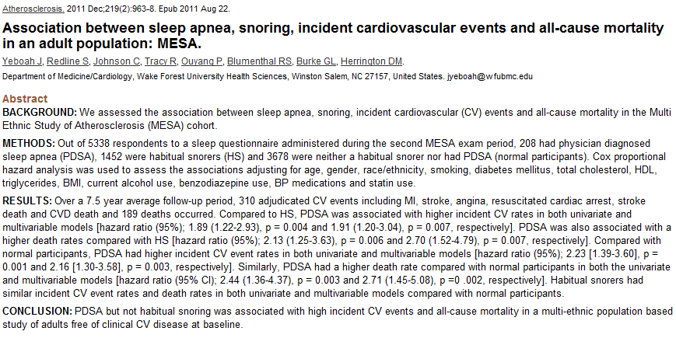

Slide 12
Plans:
Initiate monthly “sleep scientific” calls
(N Punjubi (JHU), P Lutsy (UMN), P Zee (NU))
Nominate your representative(s)

