Slide 1
METABOLOMICS IN MESA
Waqas Qureshi MD
PGY 5 Cardiology Fellow
Wake Forest University School of Medicine

Slide 2
BACKGROUND
Conventional risk factors:
Are imperfect for prediction
Incompletely informative about pathophysiologic mechanisms
The goal for biomarkers is to:
Improve prediction, and
Generate new insights that lead to novel therapies or preventive interventions
New biomarkers that are orthogonal to each other and conventional risk factors would be especially helpful

Slide 3
METABOLOMICS – THE NEXT STEP
Environment
Genome
Transcriptome
Metabolome
Clinical
Phenotype
Proteome
BNP, troponin, MMP, adiponectin
Fatty acids, sterols, products of gut microbes, bile acids, carbohydrates, medicines
Notes:
In the last decade major work has been performed in the field of genomics trying to find new risk factors and newer biomarkers. Transcriptomics and proteomics have also developed. Metabolomics has risen as a field that comprehensively evaluates the breakdown products as a result of metabolism. It is at the intersection of where genome, diet and environment meet. Many of the steps in evaluating metabolome and proteome are similar. Examples of proteome would be troponin, BNP, MMP (known markers) while examples of metabolites would be fatty acids, pyruvate, hippuric acid, bile acids, sterols etc.

Slide 4
COMBI-BIO METABOLOMIC PIPELINE
SAMPLES
SEPARATION
DETECTION
DATA PREPROCESSING
DATA ANALYSIS
MESA LOLLIPOP ROTTERDAM
COMBI-BIO
X3
Storage
Notes:
There are several steps in a metabolomic study. The individual metabolites are first separated by chromatography. A detection tool like NMR or MS is used after that to detect these individual metabolites.

Slide 5
COMBI-BIO METABOLOMIC PIPELINE
SAMPLES
SEPARATION
DETECTION
DATA PREPROCESSING
DATA ANALYSIS
MESA LOLLIPOP ROTTERDAM
UPLC
HILIC
RPLC
RPLC
COMBI-BIO
X3
HILIC
Notes:
There are several steps in a metabolomic study. The individual metabolites are first separated by chromatography. A detection tool like NMR or MS is used after that to detect these individual metabolites.

Slide 6
ULTRA PERFORMANCE LIQUID CHROMATOGRAPHY (UPLC)
Hydrophilic Interaction Liquid Chromatography (HILIC)
Polar
Glycoproteins, fatty acids, sterols, bile acids
Reverse Phase Liquid Chromatography (RPLC)
Non Polar
Proteins, gut microbial metabolites, medication metabolites
Notes:
Many types of chromatography. Two separate stages. Optimized for different kinds of molecules based on their polarity

Slide 7
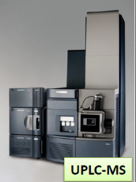
COMBI-BIO METABOLOMIC PIPELINE
SAMPLES
SEPARATION
DETECTION
DATA PREPROCESSING
DATA ANALYSIS
MESA LOLLIPOP ROTTERDAM
UPLC
HILIC
RPLC
ESI+
RPLC
COMBI-BIO
ESI-
X3
NOESY
HILIC
CPMG
Notes:
There are several steps in a metabolomic study. The individual metabolites are first separated by chromatography. A detection tool like NMR or MS is used after that to detect these individual metabolites.

Slide 8
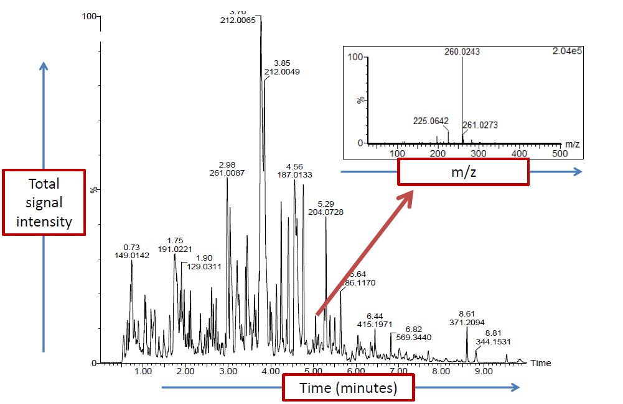
Mass Spectroscopy

Slide 9
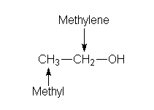
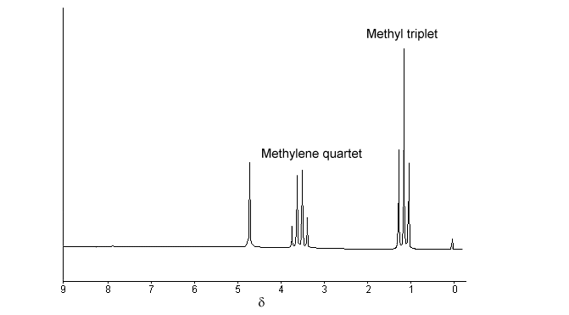
NMR
ppm = Hz/MHz

Slide 10
COMBI-BIO METABOLOMIC PIPELINE
SAMPLES
SEPARATION
DETECTION
DATA PREPROCESSING
DATA ANALYSIS
Technical checks
Internal Standards
Quality Control
Peak Alignment
Binning
Peak Annotation
MESA LOLLIPOP ROTTERDAM
UPLC
HILIC
RPLC
ESI+
RPLC
COMBI-BIO
ESI-
X3
NOESY
HILIC
CPMG
Notes:
There are several steps in a metabolomic study. The individual metabolites are first separated by chromatography. A detection tool like NMR or MS is used after that to detect these individual metabolites.

Slide 11
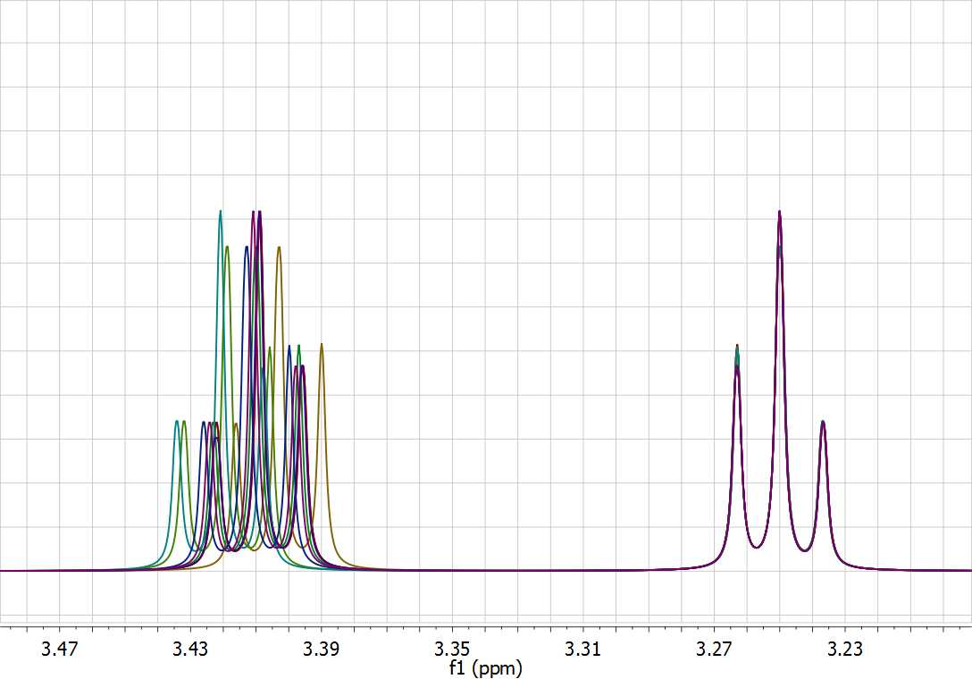
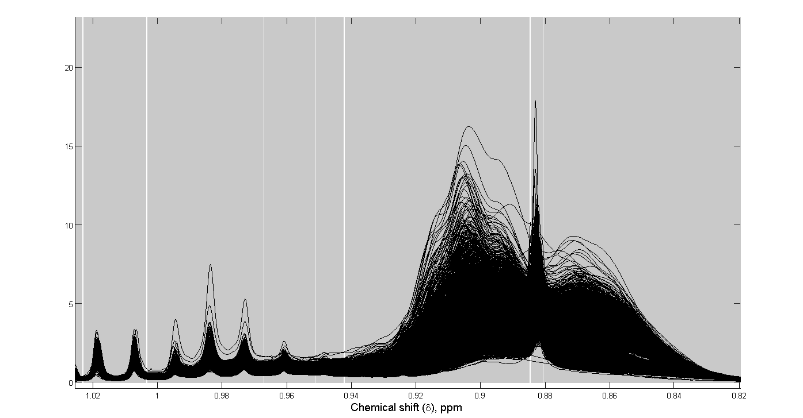
DATA PROCESSING
Binning
Peak Alignment
Notes:
In reality, the spectrum is not as simple as I showed you. It would look more like this. This is after binning and cleaning the data. Several peaks are obtained and they are all aligned together as in this figure. Please make a note of ppm which is also called chemical shift

Slide 12
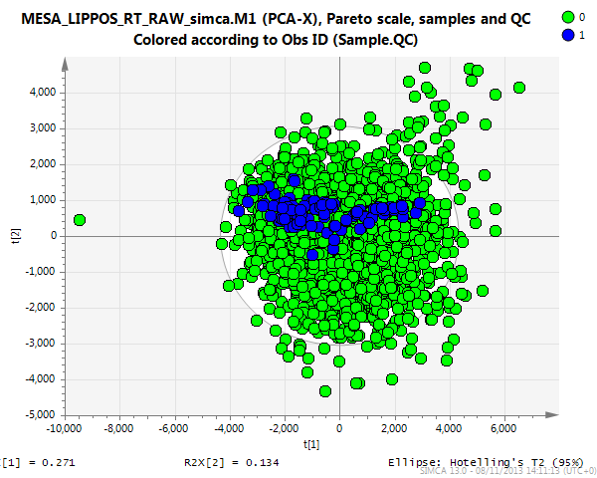
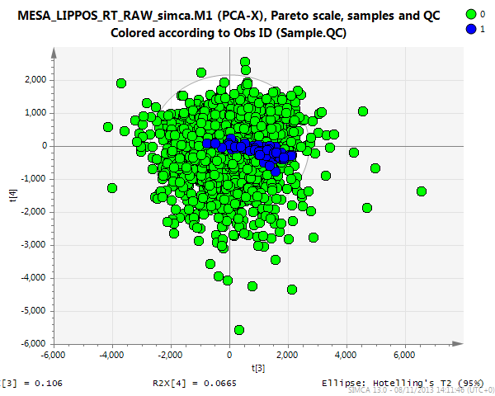
DATA PROCESSING
NMR - QC
MS - QC
PCA: 0=samples, 1=QCs
PCA: 0=samples, 1=QCs

Slide 13
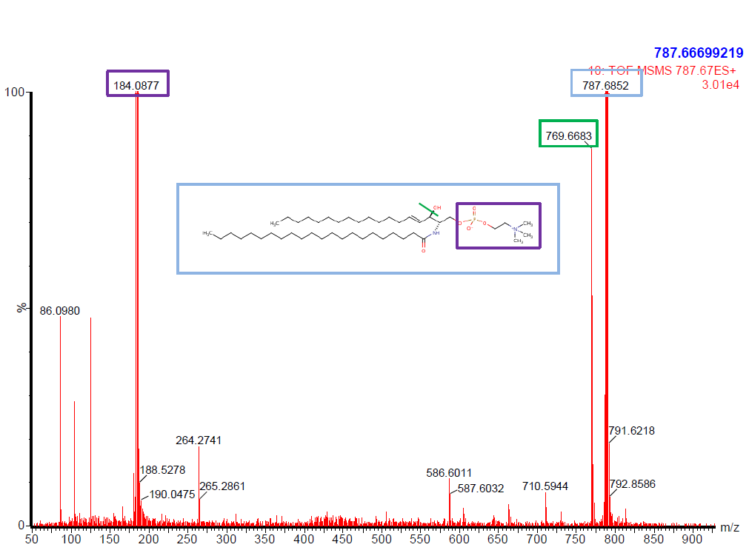
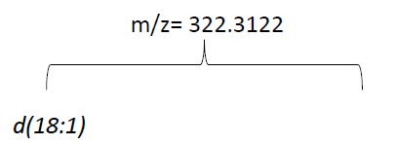
PEAK ANNOTATION

Slide 14
COMBI-BIO METABOLOMIC PIPELINE
SAMPLES
SEPARATION
DETECTION
DATA PREPROCESSING
DATA ANALYSIS
Technical checks
Internal Standards
Quality Control
Peak Alignment
Binning
Peak Annotation
Unsupervised
- Data Cleaning
- Validation
Supervised Analyses
- Interpretation
- association studies
MESA LOLLIPOP ROTTERDAM
UPLC
HILIC
RPLC
Ionization
ESI -
ESI +
ESI+
RPLC
COMBI-BIO
ESI-
X3
NOESY
HILIC
CPMG
Notes:
There are several steps in a metabolomic study. The individual metabolites are first separated by chromatography. A detection tool like NMR or MS is used after that to detect these individual metabolites.

Slide 15
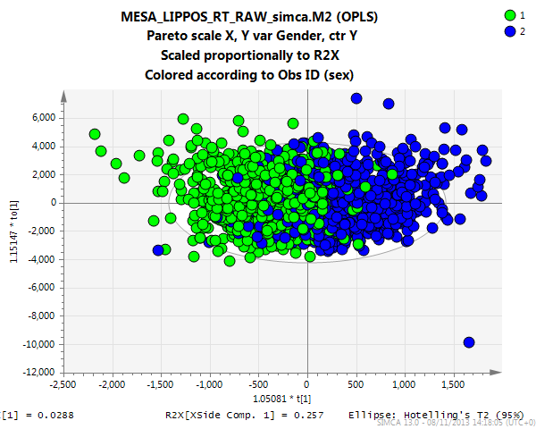
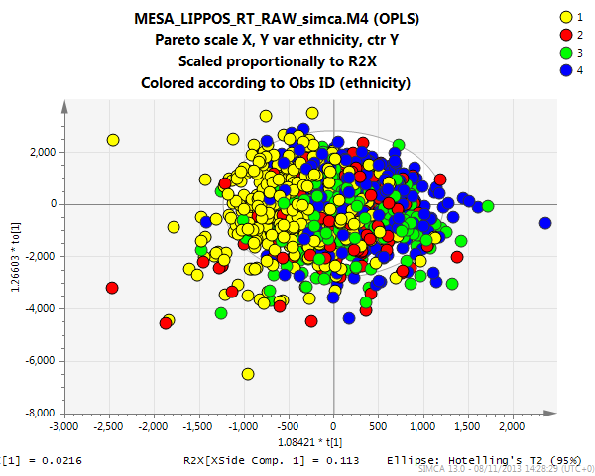
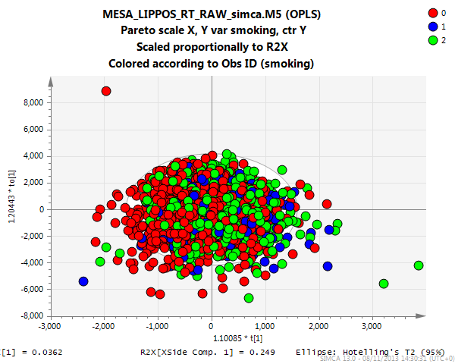
GENDER
Q2:0.428
ETHNIC GROUPS
SMOKERS
Q2:0.19
Q2:0.0109

Slide 16
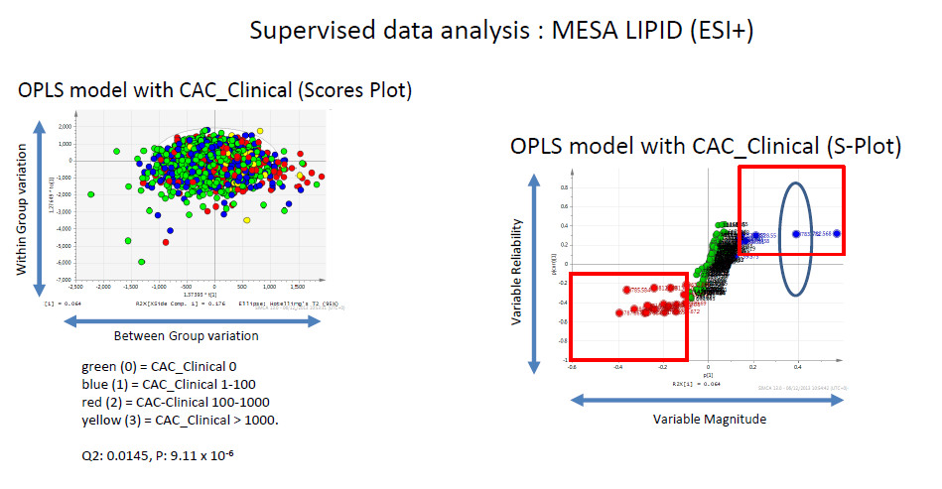
Coronary Calcium Score
SAMPLES
METABOLITES

Slide 17
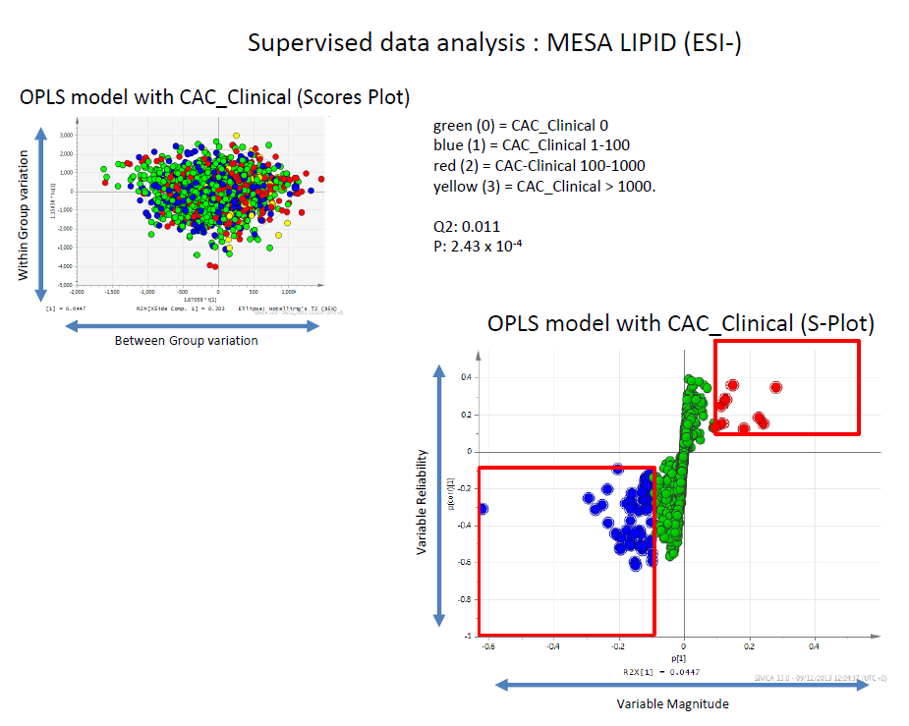
SAMPLES
METABOLITES

Slide 18
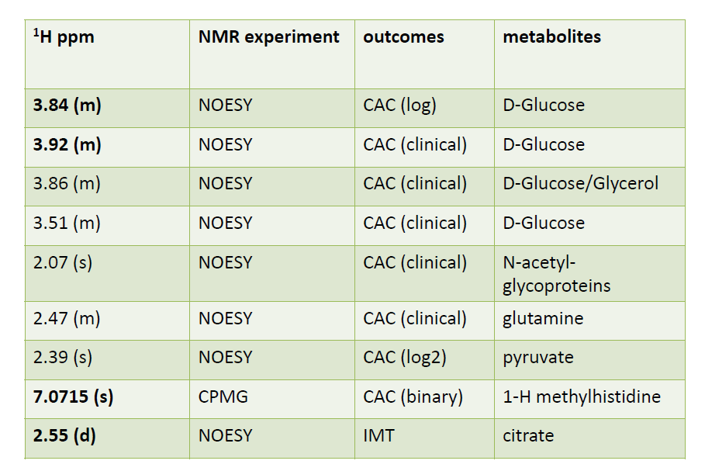

Slide 19
CONCLUSION
RPLC
ESI +
ESI –
HILIC
ESI +
ESI –
NMR
HILIC
RPLC
Association studies

Slide 20
THANK YOU

Slide 21
Extra slides
NOESY
Provides 2 dimensional data and cross relates nuclei through space to provide structural information
CPMG – echo train acquisition NMR
Has higher S/N ratio than others. Provides better resolution of smaller molecules

Slide 22
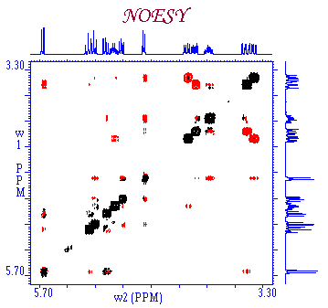
ROESY

Slide 23
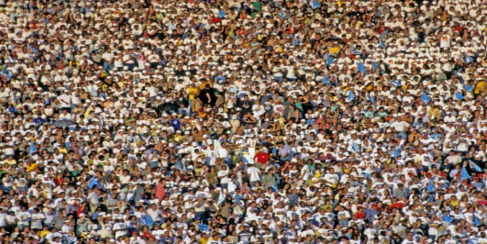
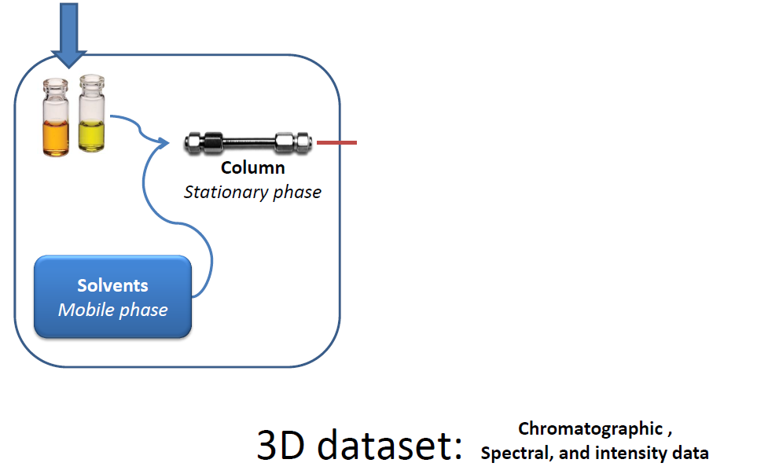
SEPARATION

Slide 24
TIME OF FLIGHT MASS SPECTROSCOPY
Utilizes time to fly and reach the detector to measure mass/charge values of each particle
Sample
+
_
Ionizer
Mass Analyzer
Detector

Slide 25
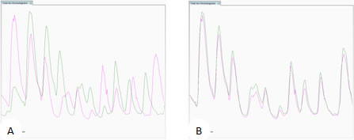
PEAK ALIGNMENT
LC – MS
NMR

