Slide 1
Genome Wide Association Studies of Aortic Valve and Mitral Annular Calcification in the CHARGE Consortium
Wendy Post, MD
On behalf of the co-authors
Notes:
Today I am going to talk about GWAS of valvular and aortic calcification in the CHARGE Consortium.

Slide 2
CHARGE
GWAS require very large sample sizes in order to have adequate power to detect significant associations
CHARGE is a collaborative effort across multiple cohorts with genome-wide SNP genotyping developed to increase the power to detect significant associations
Cohorts for Heart and Aging Research in Genomic Epidemiology
Notes:
Genome wide association studies require very large sample sizes in order to have adequate power to detect significant associations. The CHARGE Consortium is a collaborative effort across multiple cohorts with genome-wide SNP genotyping that was developed to increase the power to detect significant associations in GWAS.

Slide 3
Valvular and Aortic Calcification GWAS
Aortic Valve Calcium: Complete
Mitral Annular Calcium: Complete- with ongoing replication efforts
Descending Thoracic Aortic Calcium: In Progress
Abdominal Aortic Calcium: In Progress
Notes:
The work I am presenting today represents a collaborative effort involving all my colleagues in the CHARGE Extra-Coronary Calcium Working Group. These colleagues are from multiple cohorts, including MESA, Framingham, AGES, Heinz Nixdorf Recall Study, Malmo Diet and Cancer Study, the Copenhagen City Heart Study, and the Family Heart Study. Wendy Post and I are investigators within the MESA cohort.

Slide 4
Valvular Calcification
Valvular calcification is a marker for generalized atherosclerosis and a precursor for clinical valve disease.
Risk factors for valvular calcification include hypercholesterolemia, smoking, hypertension, age, male sex, obesity, and diabetes.
There is limited information regarding genetic associations with valvular calcification.
The purpose of our study is to identify common genetic variants associated with aortic valve calcium, mitral annular calcium, and clinical valve disease.

Slide 5
Methods (Valve Calcium): Discovery Cohorts
Two-stage analysis to discover and replicate genome-wide associations with presence of aortic valve calcium (AVC, n=6942) and mitral annular calcium (MAC, n=3795).
Discovery cohorts included White European participants from three cohorts:
Framingham Heart Study
AGES
MESA

Slide 6
Methods: Replication
Significant findings from discovery meta-analysis were tested in additional cohorts:
White European participants from the Heinz-Nixdorf Recall Study
African-, Chinese-, and Hispanic-American participants from the MESA and MESA-Family studies
Swedish participants with clinical aortic stenosis data from the Malmo Diet and Cancer Study (MDCS).
Danish participants with clinical aortic stenosis data from the Copenhagen City Heart Study (CCHS).

Slide 7
Methods: Valve Calcium
Calcium quantified from non-contrast computed tomography (CT) scans using Agatston method.
Presence of AVC or MAC defined as an Agatston score > 0.
AVC defined as calcium on the aortic valve leaflets or commissures, excluding annular and coronary artery calcium.
MAC defined as calcium along the mitral annulus exclusive of the mitral leaflets (except in FHS which included calcium along the mitral annulus and the mitral leaflets).

Slide 8
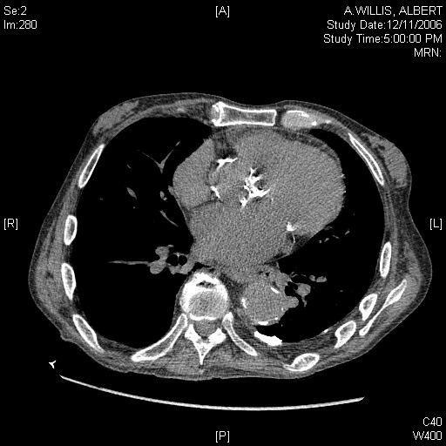
Mitral Annular Calcium and Aortic Valve Calcium
AVC
MAC
MAC

Slide 9
Methods: Statistical Analysis
Performed logistic regression for the presence of AVC or MAC adjusting for age, sex and ancestry information (as necessary) and field center, stratified by cohort.
Results were filtered to remove SNPs with minor allele frequency <1% and imputation ratio < 0.3.
Individual study results were combined using fixed effects meta-analysis.
Study specific results were genomic control corrected before meta-analysis.
Results were filtered to ensure that > 2 studies contributed to statistics for each SNP.

Slide 10
Baseline Characteristics: Discovery Cohorts
Study | FHS | AGES | MESA
Genotyping Platform | Affymetrix 5.0 | Illumina Hu370CNV | Affymetrix 6.0
Country of Origin | USA | Iceland | USA
N | 1298 | 3120 | 2527
Age, mean (SD), years | 60 (9) | 76 (5) | 63 (10)
Women, No. (%) | 616 (47) | 1811 (58) | 1321 (52)
AVC present, No. (%) | 510 (39) | 1338 (43) | 397 (16)
MAC present, No. (%) | 259 (20) | NA | 309 (12)
FHS, Framingham Heart Study; AGES-RS, Age, Gene-Environment Susceptibility-Reykjavik Study; MESA, Multi-Ethnic Study of Atherosclerosis; AVC, aortic valve calcium; MAC, mitral annular calcium
Notes:
This slide shows the baseline characteristics of our discovery cohorts: Framingham, AGES, and MESA. The mean age was higher in the AGES cohort than in Framingham or MESA. The prevalence of aortic valve calcium and mitral annular calcium was lower in MESA than in the other cohorts. This is likely because MESA was a primary prevention population, and because of the younger age of the MESA participants as compared to the AGES participants. Mitral annular calcium was not measured in the AGES cohort.
Overall prevalence of AVC= 35%
Overall prevalence of MAC=15%

Slide 11
Baseline Characteristics: Discovery Cohorts
Study | FHS | AGES | MESA
Genotyping Platform | Affymetrix 5.0 | Illumina Hu370CNV | Affymetrix 6.0
Country of Origin | USA | Iceland | USA
N | 1298 | 3120 | 2527
Age, mean (SD), years | 60 (9) | 76 (5) | 63 (10)
Women, No. (%) | 616 (47) | 1811 (58) | 1321 (52)
AVC present, No. (%) | 510 (39) | 1338 (43) | 397 (16)
MAC present, No. (%) | 259 (20) | NA | 309 (12)
FHS, Framingham Heart Study; AGES-RS, Age, Gene-Environment Susceptibility-Reykjavik Study; MESA, Multi-Ethnic Study of Atherosclerosis; AVC, aortic valve calcium; MAC, mitral annular calcium

Slide 12
Baseline Characteristics: Discovery Cohorts
Study | FHS | AGES | MESA
Genotyping Platform | Affymetrix 5.0 | Illumina Hu370CNV | Affymetrix 6.0
Country of Origin | USA | Iceland | USA
N | 1298 | 3120 | 2527
Age, mean (SD), years | 60 (9) | 76 (5) | 63 (10)
Women, No. (%) | 616 (47) | 1811 (58) | 1321 (52)
AVC present, No. (%) | 510 (39) | 1338 (43) | 397 (16)
MAC present, No. (%) | 259 (20) | NA | 309 (12)
FHS, Framingham Heart Study; AGES-RS, Age, Gene-Environment Susceptibility-Reykjavik Study; MESA, Multi-Ethnic Study of Atherosclerosis; AVC, aortic valve calcium; MAC, mitral annular calcium

Slide 13
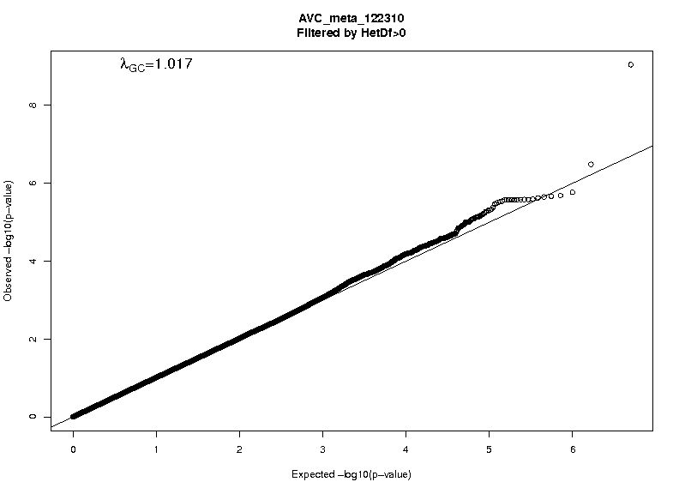
Q-Q plot AVC Meta-analysis
Notes:
Genome-wide analysis involves millions of statistical tests, and even modest levels of bias can considerably influence the results. To search for evidence of systematic bias (from unrecognized population structure, analytical approach, genotyping artifacts, etc.), a quantile-quantile (Q-Q) plot is used to characterize the extent to which the observed distribution of the p values follows the distribution you would expect if there is no association between the SNPs and your disease of interest. In the Q-Q plot, the calculated P values for each SNP are ranked in order from largest to smallest and plotted against the values expected had they been sampled from a null distribution. Deviations from the diagonal identity line suggest that either the assumed distribution is incorrect or that the sample contains values arising in some other manner, as by a true association.

Slide 14
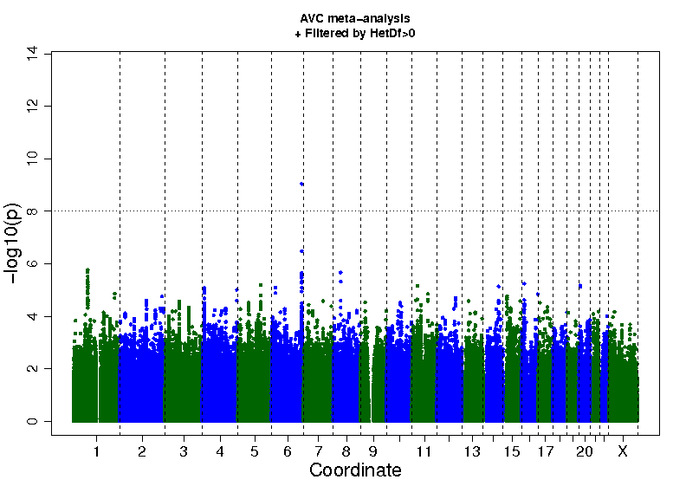
Aortic Valve Calcium Manhattan Plot
Chromosomal Position
Notes:
This genome-wide significant SNP is located within intron 25 of the apolipoprotein(a) LPA gene on chromosome 6. It is the same SNP that has been found to be associated with cerebrovascular disease and coronary artery disease in other studies.

Slide 15
Aortic Valve Calcium Manhattan Plot
LPA
Chromosomal Position

Slide 16
Regional Association Plot for AVC of LPA region

Slide 17
Results from Discovery and Replication Stages for SNP rs10455872 in LPA in White Europeans
Study | MAF | N | OR (95% CI) | P-value
Discovery Cohort Results
FHS | 0.07 | 1298 | 2.33 (1.42-3.81) | 7.9 x 10⁻⁴
AGES-RS | 0.06 | 3117 | 2.04 (1.52-2.74) | 1.9 x 10⁻⁶
MESA | 0.06 | 2527 | 1.80 (1.09-2.97) | 0.022
Discovery Meta-analysis (FHS, AGES-RS, and MESA)* | 0.07 | 6942 | 2.05 (1.63-2.57) | 9.0 x 10⁻¹⁰
*Genomic control correction

Slide 18
Results from Discovery and Replication Stages for SNP rs10455872 in LPA in White Europeans
Study | MAF | N | OR (95% CI) | P-value
Discovery Cohort Results
FHS | 0.07 | 1298 | 2.33 (1.42-3.81) | 7.9 x 10⁻⁴
AGES-RS | 0.06 | 3117 | 2.04 (1.52-2.74) | 1.9 x 10⁻⁶
MESA | 0.06 | 2527 | 1.80 (1.09-2.97) | 0.022
Discovery Meta-analysis (FHS, AGES-RS, and MESA)* | 0.07 | 6942 | 2.05 (1.63-2.57) | 9.0 x 10⁻¹⁰
Replication (HNR) | 0.06 | 745 | 2.04 (1.13-3.67) | 0.018
Combined Meta-analysis (FHS, AGES-RS, MESA, and HNR)† | 0.07 | 7687 | 2.05 (1.66-2.53) | 2.8 x 10⁻¹¹
*Genomic control correction †No genomic control correction

Slide 19
Cross-ethnicity Replication in MESA of rs10455872 and Aortic Valve Calcium
Ethnicity (cohort) | N | MAF | OR (95% CI) | P-value
African-American | 2497 | 0.02 | 3.57 (1.42-8.99) | 0.0068
Hispanic-American | 2026 | 0.02 | 2.75 (1.39-5.45) | 0.0037
Chinese-American | 774 | 0.005 | 1.13 | 0.96
Notes:
.005*774=4

Slide 20
Association between rs10455872 and aortic valve calcium using directly genotyped SNP
Cohort | Genotyping Platform | Imputation Software | Imputation Ratio | N | HR | P-value
FHS | Affymetrix 5.0 | MACH | 0.50 | 1298 | 2.33 | 7.9 x 10⁻⁴
FHS | IBC | directly genotyped |  | 1162 | 2.27 | 1.8*10⁻⁵
MESA | Affymetrix 6.0 | IMPUTE 2.1.1 | 0.47 | 2527 | 1.80 | 0.022
MESA | IBC | directly genotyped |  | 2527 | 1.93 | 2.6*10⁻⁴
AGES | Illumina Hu370CNV | MACH 1.0.16 | 0.53 | 2886 | 2.16 | 7.8*10⁻⁷

Slide 21
Association between rs10455872 and aortic valve calcium: Exclusion of participants with baseline MI
Cohort | Exclusions | N | OR | P-value
FHS | None | 1298 | 2.33 | 7.9 x 10⁻⁴
FHS | Baseline MI | 1245 | 2.27 | 9.5*10⁻⁵
AGES | None | 3117 | 2.04 | 1.9 x 10⁻⁶
AGES | Baseline MI | 2886 | 2.16 | 7.8*10⁻⁷

Slide 22
Additional analyses for the association between rs10455872 and AVC and CAC phenotypes
 |  |  | FHS |  |  |  | AGES |  |  |  | MESA
Phenotype | Covariates |  | Cases/N | OR (95% CI) | P-value |  | N | OR (95% CI) | P- value |  | N | OR (95% CI) | P-value
CAC >0 | Age, sex* |  | 749/ 1085 | 1.37 (0.87-2.16) | 0.17 |  | 1365/ 3144 | 1.51 (0.92-2.48) | 0.10 |  | 1405/2480 | 1.07 (0.79-1.46) | 0.67
AVC > 0 in participants with low CAC† | Age, sex* |  | 72/ 377 | 2.22 (1.45-3.39) | 0.007 |  | 221/ 786 | 1.98 (1.48-2.66) | 0.13 |  | 78/ 1171 | 1.95 (1.37-2.78) | 0.0001
AVC >0 | Age, sex, CAC>0* |  | 407/ 1085 | 3.06 (1.36-6.92) | 0.0002 |  | 1334/ 3113 | 1.77 (0.85-3.7) | 5.5x10⁻⁶ |  | 393/ 2480 | 3.39 (1.81-6.36) | 0.0002
† low CAC: CAC=0 or CAC<25th percentile for age and gender
Notes:
Additional analyses for the association between rs10455872 and AVC and CAC phenotypes

Slide 23
Additional analyses for the association between rs10455872 and AVC and CAC phenotypes
 |  |  | FHS |  |  |  | AGES |  |  |  | MESA
Phenotype | Covariates |  | N | OR (95% CI) | P-value |  | N | OR (95% CI) | P- value |  | N | OR (95% CI) | P-value
CAC >0 | Age, sex* |  | 1085 | 1.37 (0.87-2.16) | 0.17 |  | 3144 | 1.51 (0.92-2.48) | 0.10 |  | 2480 | 1.07 (0.79-1.46) | 0.67
AVC > 0 in participants with low CAC† | Age, sex* |  | 377 | 2.22 (1.45-3.39) | 0.007 |  | 786 | 1.98 (1.48-2.66) | 0.13 |  | 1171 | 1.95 (1.37-2.78) | 0.0001
AVC >0 | Age, sex, CAC>0* |  | 1085 | 3.06 (1.36-6.92) | 0.0002 |  | 3113 | 1.77 (0.85-3.7) | 5.5x10⁻⁶ |  | 2480 | 3.39 (1.81-6.36) | 0.0002
† low CAC: CAC=0 or CAC<25th percentile for age and gender
Notes:
Additional analyses for the association between rs10455872 and AVC and CAC phenotypes

Slide 24
Additional analyses for the association between rs10455872 and AVC and CAC phenotypes
 |  |  | FHS |  |  |  | AGES |  |  |  | MESA
Phenotype | Covariates |  | N | OR (95% CI) | P-value |  | N | OR (95% CI) | P- value |  | N | OR (95% CI) | P-value
CAC >0 | Age, sex* |  | 1085 | 1.37 (0.87-2.16) | 0.17 |  | 3144 | 1.51 (0.92-2.48) | 0.10 |  | 2480 | 1.07 (0.79-1.46) | 0.67
AVC > 0 in participants with low CAC† | Age, sex* |  | 377 | 2.22 (1.45-3.39) | 0.007 |  | 786 | 1.98 (1.48-2.66) | 0.13 |  | 1171 | 1.95 (1.37-2.78) | 0.0001
AVC >0 | Age, sex, CAC>0* |  | 1085 | 3.06 (1.36-6.92) | 0.0002 |  | 3113 | 1.77 (0.85-3.7) | 5.5x10⁻⁶ |  | 2480 | 3.39 (1.81-6.36) | 0.0002
† low CAC: CAC=0 or CAC<25th percentile for age and gender
Notes:
Additional analyses for the association between rs10455872 and AVC and CAC phenotypes

Slide 25
Instrumental Variable Analysis
If all of the effect of rs10455872 on AVC is through Lp(a), then can estimate causal effect of Lp(a) on AVC by the ratio of coefficients for regression of AVC on rs10455872 and Lp(a) on rs10455872
Associations between AVC, plasma Lp(a), and rs10455872 were performed in FHS and AGES, separately
Instrumental variable analysis performed
Results were meta-analyzed using random effects meta-analysis
SNP
A
Lp(a)
B
C (causal effect of Lp(a) on AVC) = B / A
C
AVC
Notes:
To support the hypothesis of a causal association between our LPA SNP and AVC, an instrumental variable analysis was performed.
In our analyses, genetically elevated Lp(a) concentrations (predicted by SNP data) were regressed against AVC presence.
[A 2-stage Murphy-Topel variance estimator was used to compute 95% confidence intervals (CI). Individual study results were then combined using a random effects meta-analysis with inverse variance weighting, due to heterogeneity across cohorts.]

Slide 26
Instrumental Variable Analysis of Lp(a) and Presence of Aortic Valve Calcium
 | Meta-analysis
Association with plasma Lp(a)* | b (95% CI) | p-value
rs10455872 | 1.58 (1.21-1.94) | <0.0001
Associations with AVC | OR (95% CI) | p-value
rs10455872 | 2.17 (1.66-2.83) | <0.0001
rs10455872, adjusted for Lp(a) | 1.62 (0.94-2.81) | 0.085
Plasma Lp(a)* | 1.29 (1.18-1.42) | <0.0001
Genetically-elevated Lp(a) | 1.62 (1.27-2.06) | <0.0001
* Plasma Lp(a) levels were non-normally distributed and log-transformed.
Notes:
This table shows the results of our instrumental variable analysis of lipoprotein a and presence of aortic valve calcium.
In FHS and AGES-RS, where Lp(a) concentrations were available, our top SNP was strongly associated with Lp(a) levels and Lp(a) was associated with presence of AVC . After adjustment for Lp(a), the association between rs10455872 SNP and AVC was attenuated in both cohorts and became non-significant when cohorts were pooled (meta-analytic p=0.09). Genetically elevated Lp(a) levels are the plasma Lp(a) levels predicted based on the genotype. Based on pooled data across both cohorts, the “causal” effect of genetically elevated Lp(a) levels was estimated as a 62% increase in the prevalence of AVC per log-unit increase in plasma Lp(a) (p=1x10⁻⁴; meta-analytic OR, 1.62).

Slide 27
rs10455872 is associated with incident aortic stenosis in the Malmo Diet and Cancer Study
Phenotype | Exclusions | N (cases) | HR (95% CI) | P-value
Incident aortic stenosis (AS) | None | 28193 (308) | 1.68 (1.32-2.15) | 3x10⁻⁵
Median follow-up: 12 years
HR: Hazard Ratio per copy of risk allele
Adjusted for age, sex, BMI, current smoking

Slide 28
rs10455872 is associated with incident aortic stenosis in the Malmo Diet and Cancer Study
Phenotype | Exclusions | N (cases) | HR (95% CI) | P-value
Incident aortic stenosis (AS) | None | 28193 (308) | 1.68 (1.32-2.15) | 3x10⁻⁵
AS, requiring aortic valve replacement | None | 28193 (133) | 1.54 (1.05-2.27) | 0.03
Incident aortic stenosis | MI at baseline or during follow-up | 28126 (241) | 1.69 (1.28-2.22) | 0.0002
AS, requiring aortic valve replacement | MI at baseline or during follow-up | 28126 (111) | 1.82 (1.22-2.69) | 0.003
Median follow-up: 12 years
HR: Hazard Ratio per copy of risk allele
Adjusted for age, sex, BMI, current smoking

Slide 29
rs10455872 is associated with Incident Aortic Stenosis in the Copenhagen City Heart Study Cohort
Phenotype | Exclusions | N (cases) | HR (95% CI) | P-value
Incident aortic stenosis (AS) | None | 10291 (191) | 1.60 (1.12-2.28) | 0.010
Median follow-up: 17 years
HR: Hazard Ratio for presence of at least one risk allele
Adjusted for Framingham risk factors
Notes:
Age, sex, systolic blood pressure, total cholesterol, HDL, diabetes

Slide 30
rs10455872 is associated with Incident Aortic Stenosis in the Copenhagen City Heart Study Cohort
Phenotype | Exclusions | N (cases) | HR (95% CI) | P-value
Incident aortic stenosis (AS) | None | 10291 (191) | 1.60 (1.12-2.28) | 0.010
AS, requiring aortic valve replacement | None | 10154 (54) | 1.64 (0.84-3.18) | 0.145
Incident aortic stenosis | MI at baseline | 9995 (184) | 1.55 (1.08-2.23) | 0.018
Median follow-up: 17 years
HR: Hazard Ratio for presence of at least one risk allele
Adjusted for Framingham risk factors
Notes:
Covariates: Age, sex, systolic blood pressure, total cholesterol, HDL, diabetes

Slide 31
Conclusions: AVC
Genetic variation in the LPA locus is associated with AVC across multiple ethnicities and with incident aortic stenosis.
These associations remain significant in analyses that exclude those with a history of myocardial infarction and in analyses that adjust for coronary artery calcium.
The Mendelian randomization analysis results are consistent with Lp(a) being a causal factor for AVC.
These are the first strong and replicated findings for a genetic variant associated with either AVC or aortic stenosis in the community

Slide 32
Q-Q plot MAC Meta-analysis

Slide 33
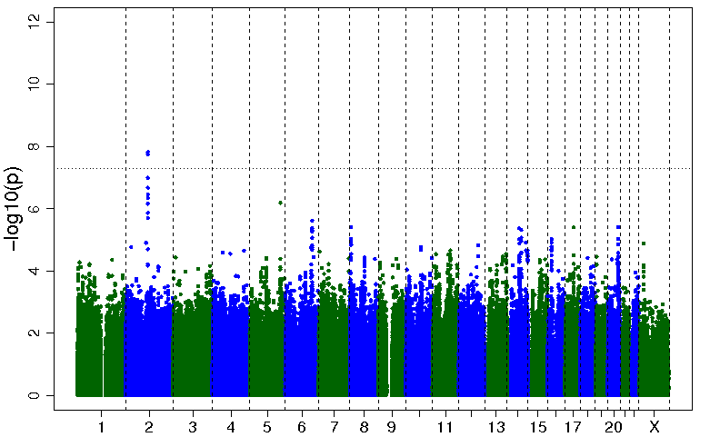
Mitral Annular Calcium Manhattan Plot
Chromosomal Position
Notes:
In our GWAS of mitral annular calcium, we identified a strong signal in the interleukin 1 family 9 (IL1F9) gene on chromosome 2; this is a proinflammatory gene. In addition to inflammation, IL-1 factors are also markers for bone metabolism. IL-1 factors have previously found to be associated with osteoarthritis and rheumatologic diseases as rheumatoid arthritis, but not with coronary artery disease or valve disease. One of the top SNPs in a recent CRP GWAS is in the IL1F9 locus about 120,000bp away from our top SNPs.

Slide 34
Mitral Annular Calcium Manhattan Plot
IL1F9
Chromosomal Position

Slide 35
MAC Regional Association Plot

Slide 36
Top SNPs Ranked by P-value MAC
SNP | Chromosome | MAF | OR (95%CI) | P-value | Direction of effect | Nearest genes
rs17659543 | 2 | 0.16 | 1.66 (1.39-1.98) | 1.5 x 10⁻⁸ | + + | IL1F9
rs13415097 | 2 | 0.16 | 1.66 (1.39-1.98) | 1.8 x 10⁻⁸ | - - | IL1F9
Notes:
Two SNPs in the IL1F9 gene reached genome wide significance; these SNPs are in strong linkage disequilibrium in Caucasians. The p value for the top SNP was 1.5*10-8. This top SNP is located near the IL1F9 gene. 5’ region of the gene. 20kb away.

Slide 37
Cross-ethnicity Replication in MESA of rs17659543 and Mitral Annular Calcium
Ethnicity (cohort) | N | MAF | OR (95% CI) | P-value
African-American | 2495 | 0.23 | 1.15 (0.88-1.50) | 0.30
Hispanic-American | 2025 | 0.14 | 1.44 (1.02-2.02) | 0.04
Chinese-American | 774 | 0.01 | n/a | n/a
Notes:
We evaluated the association between our top SNP and mitral annular calcium in other racial/ethnic groups in MESA. This SNP was associated with mitral annular calcium in Hispanics in MESA (p=0.04) with a similar direction of effect. The association between our SNP and mitral annular calcium was not significant in African-Americans, though the direction of effect was similar. The minor allele frequency was very low in Chinese and the model did not converge.
We also evaluated the association between our top SNP and mitral annular calcium in White European participants from the Heinz-Nixdorf Recall Study and found no significant association in this cohort, though the sample size was small.

Slide 38
No significant association for rs17659543 and Mitral Annular Calcium in Heinz-Nixdorf Recall Study
Cohort | N | MAC present, No. (%) | MAF | OR (95% CI) | P-value
HNR | 745 | 18 (2) | 0.16 | 0.66(0.22-1.93) | 0.42
Notes:
[In contrast, there was no significant association between rs17659643 and MAC (p=0.42) in White European participants from the HNR (total n=745, MAC prevalence 2.4%, 18 cases). However, the combined effect estimate of the discovery and replication samples remained genome-wide significant (p=3.27 x10⁻⁸). ]

Slide 39
Conclusions: MAC
Top SNP for MAC lies near the IL1F9 locus and raises the hypothesis that inflammation may play a role in the etiology of MAC.
Further studies are needed to confirm the association between the IL1F9 locus and MAC.
AGES
Penn Cohort

Slide 40
Acknowledgments
Mentor: Wendy Post
Linda Kao, Mandy Li
Investigators and Participants of FHS, AGES, HNR, MDCS, CCHS, Family Heart Study
Cohorts for Heart and Aging Research in Genome Epidemiology (CHARGE) Consortium
Funding:
Catherine Campbell: NHLBI T32 training grant
FHS: NHLBI, Robert Dawson Evans Endowment
MESA: NHLBI
AGES: NHLBI, NIA, NEI, National Institute on Deafness and Other Communication Disorders; Hjartavernd; Althingi; British Heart Foundation
HNR: Heinz Nixdorf Foundation, German Foundation of Research
MDCS: Swedish Cancer Society, Swedish Medical Research Council, Swedish Dairy Association, Albert Påhlsson and Gunnar Nilsson Foundations, Malmö city council
CCHS: Danish Heart Foundation

Slide 41
CHARGE Extra-Coronary Calcium Working Group
Multi-Ethnic Study of Atherosclerosis (MESA): Catherine Y. Campbell, Kathleen F. Kerr, Quenna Wong, Jie Yao, Xiuqing Guo, Matthew J. Budoff, Matthew Allison, Michael H. Criqui, Susan R. Heckbert, Yongmei Liu, Jeffrey Carr, Jerome I. Rotter, Wendy S. Post
Framingham Heart Study (FHS): George Thanassoulis, Gina M. Peloso, Rajeev Malhotra, Charles White, Shih-Jen Hwang, L. Adrienne Cupples, Sekar Kathiresan, Christopher J. O’Donnell
Age, Gene-Environment Susceptibility (AGES): David S. Owens, Albert V. Smith, Tamara B. Harris, Kevin D. O’Brien, Muriel Caslake, Emanuele Di Angelantonio, John Danesh, Sigurdur Sigurdsson, Villi Gudnason
Heinz Nixdorf Recall Study (HNR): Sonali Pechlivanis, Hagen Kälsch, Thomas W. Mühleisen, Markus M. Nöthen, Raimund Erbel
Malmö Diet and Cancer Study (MDCS): J. Gustav Smith, Marketa Sjogren, Jesper van der Pals, Olle Melander
Copenhagen City Heart Study (CCHS): Pia R. Kamstrup, Børge G. Nordestgaard, Anne Tybjærg-Hansen
Family Heart Study: Mary Feitosa, Ingrid Borecki
Notes:
The work I am presenting today represents a collaborative effort involving all my colleagues in the CHARGE Extra-Coronary Calcium Working Group. These colleagues are from multiple cohorts, including MESA, Framingham, AGES, Heinz Nixdorf Recall Study, Malmo Diet and Cancer Study, the Copenhagen City Heart Study, and the Family Heart Study. Wendy Post and I are investigators within the MESA cohort.

Slide 42
Additional Slides

Slide 43
Baseline Characteristics: Replication Cohorts
Study | MESA: African American | MESA: Hispanic | MESA: Chinese | HNR | MDCS | CCHS
Race | African American | Hispanic American | Chinese American | European | European | European
Genotyping Platform | Affymetrix 6.0 | Affymetrix 6.0 | Affymetrix 6.0 | Illumina HumanOmni1-Quad | Life Technologies ABI 7900HT | Applied Biosystems ABI 7900HT
Country of Origin | USA | USA | USA | Germany | Sweden | Denmark
N | 2497 | 2027 | 774 | 745 | 28193 | 10400
Age, mean (SD), years | 61 (10) | 61 (10) | 62 (10) | 60 (8) | 58 (8) | 56 (16)
Women, No. (%) | 1395 (56) | 1094 (54) | 394 (51) | 379 (51) | 17008 (60) | 5796 (56)
AVC present, No. (%) | 263 (11) | 243 (12) | 67 (9) | 91 (12) | 308 (1)* | 192 (2)*
MAC present, No. (%) | 175 (7) | 197 (10) | 37 (5) | 18 (2) | N/A | N/A
* Number (%) of participants with incident aortic stenosis.
HNR, Heinz Nixdorf Recall Study; MDCS: Malmo Diet and Cancer Study; AVC, aortic valve calcium; MAC, mitral annular calcium

Slide 44
Cross-trait analyses in discovery cohorts
 |  | Aortic Valve Calcium |  | Mitral Annular Calcium
SNP | MAF | OR | P-value | OR | P-value
rs10455872 | 0.07 | 2.05 | 9.0*10⁻¹⁰ | 1.59 | 0.025
rs17659543 | 0.16 | 1.13 | 0.03 | 1.66 | 1.5*10⁻⁸

Slide 45
Prevalence of rs10455872 SNP in subgroups of participants with and without AVC and CAC
Cohort | Subgroup | N | MAF | P-value (compared to AVC=0 and CAC=0)
FHS | AVC>0 and CAC>0 | 360 | 0.08 | 0.04
 | AVC >0 and CAC =0 | 52 | 0.09 | 0.12
 | AVC =0 and CAC > 0 | 401 | 0.05 | 0.41
 | AVC = 0 and CAC = 0 | 286 | 0.05 | reference
AGES | AVC>0 and CAC>0 | 1262 | 0.08 | 0.02
 | AVC >0 and CAC =0 | 72 | 0.08 | 0.26
 | AVC =0 and CAC > 0 | 1485 | 0.06 | 0.46
 | AVC = 0 and CAC = 0 | 294 | 0.05 | reference
MESA | AVC>0 and CAC>0 | 342 | 0.06 | 0.42
 | AVC >0 and CAC =0 | 51 | 0.12 | 0.01
 | AVC =0 and CAC > 0 | 1063 | 0.05 | 0.26
 | AVC = 0 and CAC = 0 | 1024 | 0.05 | reference
Notes:
Prevalence of the rs10455872 SNP in subgroups of participants with and without aortic valve calcium and coronary artery calcium.

Slide 46
Kappa statistic and correlation coefficient: AVC and CAC
 | FHS | AGES-RS | MESA
AVC prevalence (%) | 37.7 | 42.8 | 15.7
CAC prevalence (%) | 69.4 | 88.2 | 56.7
Kappa statistic for dichotomous AVC and CAC agreement | 0.25 | 0.10 | 0.18
Correlation coefficient for AVC and CAC as continuous variables | 0.27 | 0.19 | 0.18

