Slide 1
Sustained Pre–hypertensive Blood Pressure and Incident Atrial Fibrillation: the Multi–Ethnic Study of Atherosclerosis
Wesley T. O’Neal, MD, MPH
Department of Internal Medicine
Wake Forest School of Medicine
March 23, 2016

Slide 2
Conflicts of Interest/Disclosures
None

Slide 3
Atrial Fibrillation (AF)
Irregularly Irregular Rhythm Disorder

Slide 4
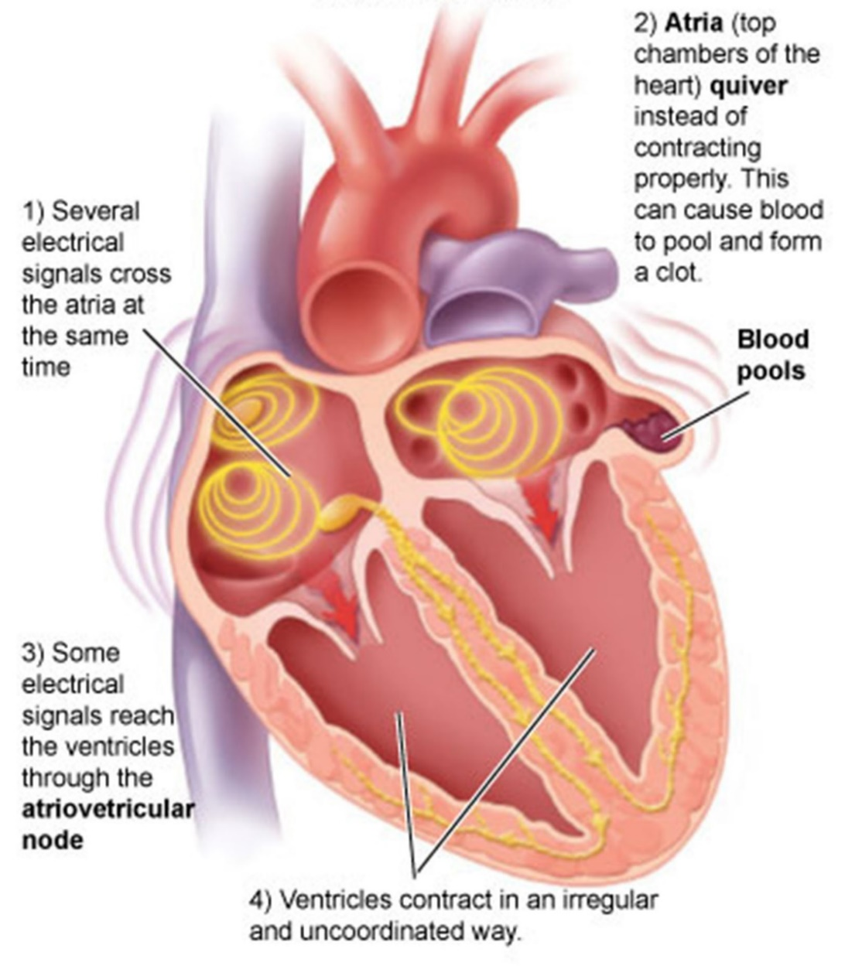
AF: Pathogenesis

Slide 5
AF: Epidemiology
Affects ~3 million Americans
Increased risk of stroke, heart failure, and MI
Risk factors
Hypertension, diabetes, smoking, etc.
National costs between $6 and $26 billion
Heart Disease and Stroke Statistics—2015 Update. Circulation. 2015;131:e29-322
Kim et al. Estimation of total incremental health care costs in patients with atrial fibrillation in the United States. Circ Cardiovasc Qual Outcomes. 2011;4(3):313-320

Slide 6
AF: Blood Pressure (BP)
Clearly associated with AF
Including pre-hypertension (e.g., 120-139/80-89)
Single BP measurements
Measurement error/temporal variation
Misclassification
Sustained BP exposure over time
Mitigate against measurement/biologic variability?
Grundvold I, et al. Upper normal blood pressures predict incident atrial fibrillation in healthy middle-aged men: a 35-year follow-up study. Hypertension. 2012;59(2):198-204
Conen D, et al. Influence of systolic and diastolic blood pressure on the risk of incident atrial fibrillation in women. Circulation. 2009;119(16):2146-2152

Slide 7
Methods: Study Population
5,311 MESA Participants
Complete BP measurements visits 1, 2, and 3
62 ± 10 years
53% female
57% White, 6% Chinese, 20% Black, 17% Hispanic
Exclusion Criteria
AF events before visit 3
Missing baseline covariates or follow-up data

Slide 8
Methods: BP Categorization
BP measured for visits 1, 2, and 3
Optimal: <120/80 mm Hg and no med
Pre-hypertension: 120-139/80-89 mm Hg and no med
Hypertension: ≥140/90 mm Hg or med
Sustained exposure
2 or more consecutive visits in same category
163 with different categories at all visits
Pre-hypertensive based on the average across 3 visits

Slide 9
Methods: AF Ascertainment
Study-scheduled electrocardiogram
Analyzed and interpreted at Wake Forest University
Medical records
Discharge diagnoses, ICD-9 Codes
Medicare Claims Data
65 years or older enrolled in fee-for-service Medicare
Inpatient and outpatient settings
Follow-up through December 31, 2010

Slide 10
Methods: Statistics
Cox regression
Time 0=Visit 3
BP category and incident AF
Multivariable model with visit 1 covariates:
age, sex, race/ethnicity, income, education, smoking
status, diabetes, body mass index, total cholesterol,
HDL-cholesterol, lipid-lowering medications, aspirin
use, and ECG-left ventricular hypertrophy
Sensitivity analysis
Visit 3 covariates

Slide 11
Results: BP Categorization
BP Categories
Optimal: 1,612 (30%)
Pre-hypertension: 1,122 (21%)
Hypertension: 2,577 (49%)
Mean time between study visit 1 and 3
3.2 ± 0.30 years

Slide 12
Results: BP Categorization

Slide 13
Results: Risk of AF
Median follow-up=5.3 years
182 (3.4%) AF events
Log-rank: p<0.0001

Slide 14
Results: Risk of AF
BP Group | Events/ #At risk | Adjusted* HR (95%CI)
Optimal | 18/1,612 | 1.0
Pre-hypertension | 33/1,122 | 1.8 (1.01, 3.2)
Hypertension | 131/2,577 | 2.6 (1.6, 4.4)
*Visit 1 covariates: age, sex, race/ethnicity, income, education, smoking status, diabetes, body mass index, total cholesterol, HDL-cholesterol, lipid-lowering medications, aspirin use, and ECG-left ventricular hypertrophy

Slide 15
Results: Sensitivity Analysis
BP Group | Events/ #At risk | Adjusted* HR (95%CI)
Optimal | 18/1,612 | 1.0
Pre-hypertension | 33/1,122 | 2.0 (1.1, 3.6)
Hypertension | 131/2,577 | 2.8 (1.6, 4.7)
*Visit 3 covariates: age, sex, race/ethnicity, income, education, smoking status, diabetes, body mass index, total cholesterol, HDL-cholesterol, lipid-lowering medications, aspirin use, and ECG-left ventricular hypertrophy

Slide 16
Key Findings/Implications
Sustained pre-hypertension increases AF risk
Attempt to group BP categories over time
More accurate AF risk associated with BP?
BP guidelines based on:
Overall mortality, CVD-related mortality, CVD (e.g., MI,
heart failure), kidney function
Role in AF prevention?
Ignored in BP guidelines

Slide 18
Acknowledgements
Thanks to my mentors and coauthors:
Elsayed Z. Soliman (Wake Forest School of Medicine)
Waqas Qureshi (Wake Forest School of Medicine)
Alvaro Alonso (University of Minnesota)
Susan R. Heckbert (University of Washington)
David Herrington (Wake Forest School of Medicine)

Slide 19
Questions?

