Slide 1
MESA Project Officer Report
Jean Olson, MD, MPH
MESA Project Officer
Epidemiology Branch
Prevention and Population Sciences Program
Division of Cardiovascular Sciences
National Heart, Lung, and Blood Institute
MESA Steering Committee
March 22-23, 2016

Slide 2
Topics
NIH News
Funding Opportunities
NHLBI 2016 Funding Guidelines
Other NHLBI Happenings
MESA

Slide 3
NIH Precision Medicine Initiative
Infrastructure for the PMI Cohort Program being developed
Near-term goal: enroll 79,000 participants in 2016
Direct Volunteers Pilot Program awarded to Vanderbilt in collaboration with Verily (formerly Google Life Sciences)
“Sync for Science” pilot to enable patients to contribute EHR data to research
Working with HRSA to engage Federally Qualified Health Centers
Establishing a Central IRB

Slide 4
NIH Notice NOT-OD-16-011
“Implementing Rigor and Transparency in NIH & AHRQ Research Grant Applications”
Grant application instructions and reviewer questions revised to “enhance reproducibility of research findings through increased scientific rigor and transparency”
Effective for grant applications received on or after January 25, 2016
Research strategy section page limits unchanged
Also applies to annual progress reports (RPPRs)
Parallel requirements for research contracts
http://grants.nih.gov/grants/guide/notice-files/NOT-OD-16-011.html

Slide 5
NIH Funding Opportunities
NHLBI FOA: Secondary Dataset Analyses in Heart, Lung, and Blood Diseases and Sleep Disorders (R21),
PAR-13-009; Expired but possible renewal in FY17
NIDDK FOA: Secondary Analyses in Obesity, Diabetes and Digestive and Kidney Diseases (R21)
PA-15-169; standard receipt dates; expires May 18, 2018
http://grants.nih.gov/grants/guide/pa-files/PA-15-169.html
NHLBI FOA: NHLBI TOPMed: Omics Phenotypes of Heart, Lung, and Blood Disorders
X01 – Resource access award to provide biospecimens for whole genome sequencing or other omics assays)
PAR-16-021; Receipt dates: Jan 19, 2017; 2018; 2019
http://grants.nih.gov/grants/guide/pa-files/PAR-16-021.html

Slide 6
NIH Funding Opportunities (cont’d)
NIH FOA: Diet and Physical Activity Assessment Methodology
To enhance the quality of measurements of dietary intake and physical activity
PAR-15-170 (R01) http://grants.nih.gov/grants/guide/pa-files/PAR-15-170.html
PAR-15-071 (R21) http://grants.nih.gov/grants/guide/pa-files/PAR-15-171.html
Standard receipt dates through June 5, 2018
NIH FOA: Administrative Supplements for Research on Dietary Supplements (Administrative Supplement; many activity codes eligible)
Investigate the role of dietary supplements and/or their ingredients in health maintenance and disease prevention
Parent award need not be focused on dietary supplements
Maximum award $100,000 total, 1 year, within project period of parent award
PA-15-258; due dates vary by awarding IC
http://grants.nih.gov/grants/guide/pa-files/PA-15-258.html

Slide 7
NIH Funding Opportunities (cont’d)
NIH FOA: Research Supplements to Promote Diversity in Health-Related Research (Administrative Supplement)
Many activity codes eligible
Awards up to $100,000, vary by candidate level (HS – junior investigator)
PA-15-322; due dates and award amounts vary by awarding IC
http://grants.nih.gov/grants/guide/pa-files/PA-15-322.html
Example: NHLBI Diversity Supplements
Available for grants and contracts
Awards made in each month except November and December
http://www.nhlbi.nih.gov/research/training/application-guidelines

Slide 8
NIH Funding Opportunities (cont’d)
NHLBI FOA: Small Grant Program for NHLBI K01/K08/K23 Recipients ((R03)
Eligibility: Current or recently completed K01/K08/K23 awardees
Must start within 2 years of end date of K award
Expand current research or branch out to a study resulting from research conducted under the K award
Pilot and feasibility studies, secondary analysis of existing data, small research projects, development of new research methodology
Awards up to $50,000 per year for 2 years
RFA-HL-16-020
Receipt dates: three per year through June 15, 2018; see RFA for specifics
http://grants.nih.gov/grants/guide/rfa-files/RFA-HL-16-020.html

Slide 9
New Salary Cap for NHLBI Career Development (K) Awards
Base salary support for all NHLBI K awards
Increased from $75,000 to $100,000
Must be consistent with Institution’s polices on compensation
Minimum level of effort 9 person-months (75% FTE)
Effective for Type 1 (new) and Type 5 (noncompetitive renewal) applications submitted in FY16 and beyond

Slide 10
NHLBI FY 2016 Funding Strategy
Two methods, depending on grant type
Designed to provide greater flexibility to consider meritorious applications
Payline + Selective Pay
All applications equal to or less than the percentile or priority score are funded
Some applications above the payline may also be funded via selective pay
Zone Of Consideration
Range of priority scores within which competing applications are considered for funding
http://www.nhlbi.nih.gov/research/funding/general/current-operating-guidelines

Slide 11
NHLBI Funding Paylines FY 2016
Grant Program | Percentile | Priority Score | Description
R01 | 14 |  | Research Project Grant
ESI R01 | 24* |  | Early Stage Investigators
K awards |  | 30 | Career Development Awards
F30 |  | 20 | Pre-Doctoral NRSA
F31, F32, F33 | 36 |  | Pre- and Post-Doctoral NRSA
*Summary Statement issues must be satisfactorily resolved on applications >19th percentile.
http://www.nhlbi.nih.gov/research/funding/general/current-operating-guidelines

Slide 12
NHLBI FY 2016 Zones of Consideration
Grant Program | Grant Program Description | Zone of Consideration (Priority Score Range)
R21 | Innovative Research Grants | 10 - 33
P01 | Program Project Grant | 10 - 30
T32, T35 | Institutional NRSA Training | 10 - 40
R41, R42 | Small Business Technology Transfer (STRR) Grants | 10 - 40
http://www.nhlbi.nih.gov/research/funding/general/current-operating-guidelines

Slide 13
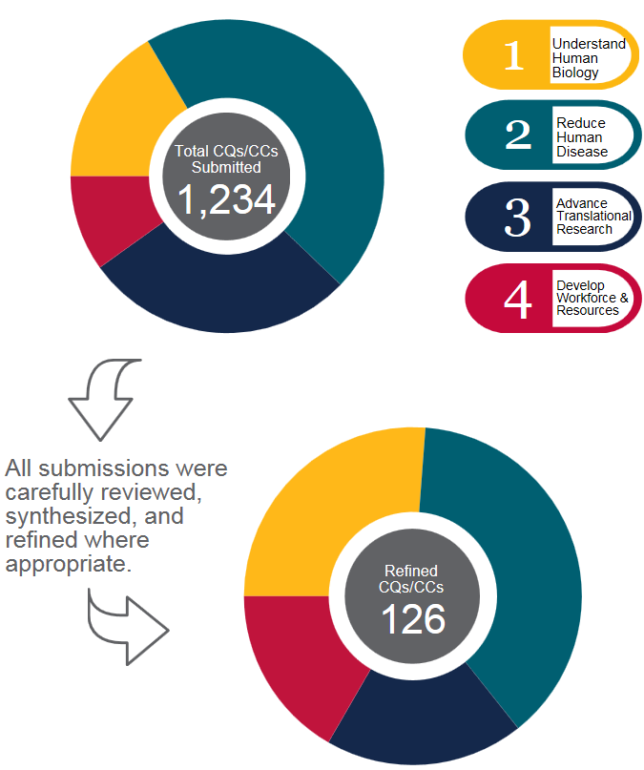
NHLBI Strategic Visioning Process
Aim: help guide NHLBI’s future research directions over next 5-10 years
Community input was actively sought to identify compelling questions and critical challenges
Final report to be published this spring
See draft report at: https://www.nhlbi.nih.gov/about/documents/strategic-visioning/public-comment-period

Slide 14
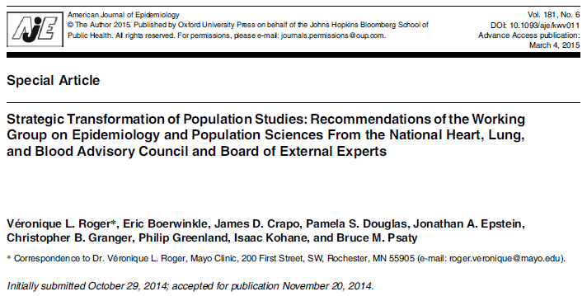
NHLBI Advisory Council/BEE Epidemiology Working Group
NHLBI Institute-wide committee has presented strategies for implementation
Implementation committee(s) being assembled

Slide 15
NHLBI MESA Team
Project Office:
Jean Olson – Project Officer
Lorraine Silsbee – Deputy Project Officer
Pothur Srinivas – Program Scientist
George Papanicolaou – Genomics
Colin Wu – Biostatistics
Mollie Minear – AAAS Fellow
Contracts Office:
Roxane Burkett – Contracting Officer
Mark Brady – Contract Specialist
Cheryl Jennings – Contracts Team Lead

Slide 16
MESA Publications
Number
of
manuscripts
published
through
12/31/2015
(n=990)

Slide 17
Renewal Timeline for MESA Grants and Contracts

Slide 18
Renewal Timeline for MESA Grants and Contracts

Slide 20
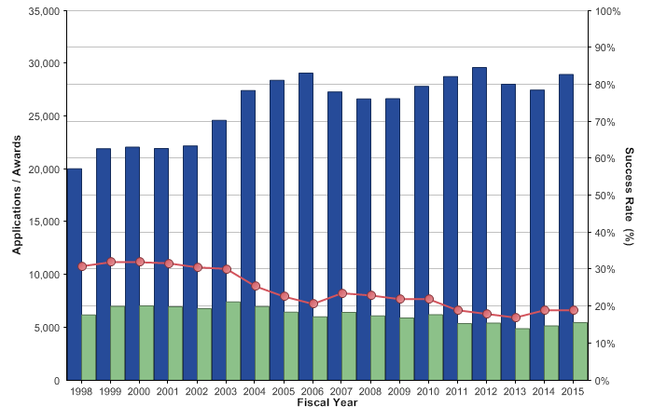
R01-Equivalent Grants: Competing Applications, Awards, and Success Rates
http://report.nih.gov/NIHDatabook/Charts/Default.aspx?showm=Y&chartId=126&catId=13

Slide 21
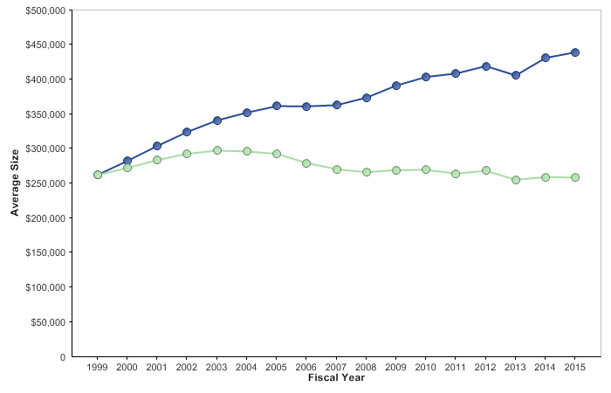
R01-Equivalent Grants: Average Size
$435,525
http://report.nih.gov/NIHDatabook/Charts/Default.aspx?showm=Y&chartId=158&catId=2

