Slide 1
MESA Project Officer Report
Jean Olson, MD, MPH
Deputy Chief, Epidemiology Branch
MESA Project Officer
Prevention and Population Sciences Program
Division of Cardiovascular Sciences
National Heart, Lung, and Blood Institute
MESA Steering Committee
September 17, 2014

Slide 2
Topics
NIH News
NHLBI News
Funding Opportunities
MESA renewal

Slide 3
NIH Genomic Data Sharing Policy
Replaces NIH GWAS policy
Applies to
Grant applications or contract proposals submitted for Jan 25, 2015 or later receipt dates
All research conducted with NIH support
Two-tiered data access (open, controlled)
Studies initiated after effective date of policy should include consent stating
That a participant’s genomic and phenotypic data may be shared broadly for future research purposes
Whether the data will be shared via unrestricted or controlled access
Consent also required for studies using cell lines or clinical specimens, even if de-identified

Slide 4
Key Distinctions
 | GWAS Policy | GDS Policy
Scope | Applies to human GWAS data | Applies to all genomic data types, human and non-human
Consent Standard - Existing* Collections *Before the effective date of the GDS policy | If research consent, IRB reviews for consistency If no research consent exists, data may still be submitted to NIH databases | Same
Consent Standard – Future* Collections *After the effective date of the GDS policy | Policy is silent but the preamble states “the NIH expects specific discussion within the informed consent process and documentation that participants’ genotype and phenotype data will be shared for research purposes through the NIH GWAS data repository” | Samples or cell lines should be consented for future research purposes and broad data sharing Exceptions from consent can be requested for compelling scientific reasons
Data Submission | Data submitted as soon as quality control procedures are completed | Human: Timelines vary by level of data processing, but generally as soon quality control procedures are complete Non-Human: generally, no later than time of publication
Data Release | Immediate data release 12 month publication embargo | Human: 6 month deferral of data release; no publication embargo Non-human: No later than time of publication

Slide 5
NIH Genomic Data Sharing Policy (cont’d)
Applicants to state in cover letter if proposed research will generate large-scale human or non-human genomic data
If yes
Genomic data sharing plan to be included in resource sharing plan section of applications and proposals
Resources necessary to support sharing to be included in budget section
Peer reviewers will comment on plan
Will not factor into overall impact score unless specified in FOA
Plan will be referenced as a Special Term or Condition in grant or contract award
Human data to be submitted to dbGaP; non-human data to be submitted to appropriate NIH-designated data repository
http://gds.nih.gov/

Slide 6
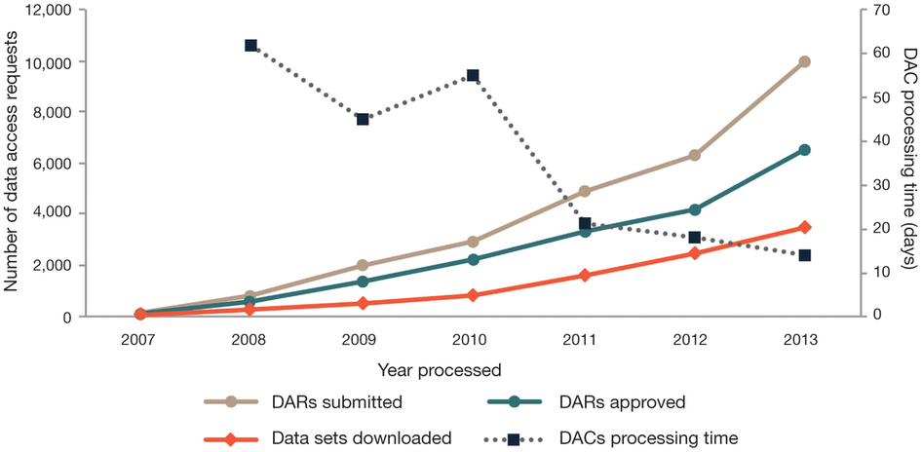
dbGaP Data Access Activity from April 2007 to 1 December 2013
Paltoo et al. Data use under the NIH GWAS Data Sharing Policy and future directions. Nat Genet 2014;46:934-938.

Slide 7
New NIH Policy for Application Submission
Following an unsuccessful resubmission (A1) application, applicants may submit the same idea as a new (A0) application for any future appropriate due date.
Similarity of the science in the new (A0) application to any previously reviewed submission will not be assessed
Applies to all application types
http://grants.nih.gov/grants/guide/notice-files/NOT-OD-14-074.html; http://grants.nih.gov/grants/guide/notice-files/NOT-OD-14-082.html

Slide 8
CASE-EPIC Combined Study Sections: Pilot
Problem
Extensive collaborations and conflicts of interest
Opportunity
Scientific overlap in cancer, CV, and sleep epidemiology
Possible Solution
Twin study sections, each with cancer, CV, and sleep expertise
Pilot Duration
Began with apps submitted in Feb/March 2014
Expected to continue 1-2 additional rounds

Slide 9
NIH Public Access Policy
A reminder: all manuscripts using MESA data must be submitted to PubMed Central upon acceptance for publication.
Remind your colleagues!
http://www.ncbi.nlm.nih.gov/pmc/

Slide 10
NHLBI Funding Paylines
Grant Program | Percentile | Priority Score | Description
R01 | 12.0 |  | Research Project Grant
ESI | 22.0* |  | Early Stage Investigators
AIDS | 22.0 |  | HIV/AIDS Grants
K awards |  | 25 | Career Dev’t Awards
T32/35 |  | 25 | Institutional NRSA Training
*Summary Statement issues must be satisfactorily resolved on applications >17th percentile.
http://www.nhlbi.nih.gov/research/funding/general/current-operating-guidelines/index.htm

Slide 11
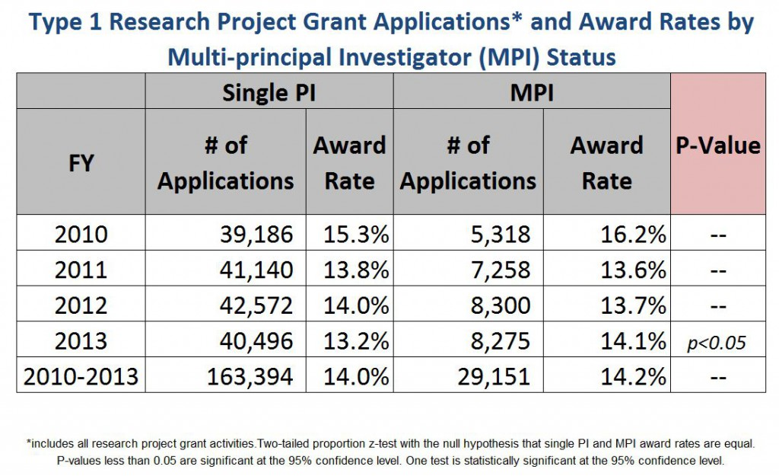
Success Rates of Single- vs Multiple PI R01 Applications
Rock Talk 7-11-14: http://nexus.od.nih.gov/all/2014/07/11/how-do-multi-pi-applications-fare/

Slide 12
R56 Grant Mechanism at NHLBI
High Priority, Short-Term Project Award
Provides one year of research support for eligible <$500K investigator-initiated R01 –A1 applications
Competing renewal (Type 2) R01s < 10%ile points above payline
New (Type 1) R01 ESI applications < 5%ile points above ESI payline
Intentions
Provide interim funding to sustain meritorious programs seeking R01 renewals
Enable collection of preliminary data to support a new (Type 1 A0) R01 application

Slide 13
R56 Grant Mechanism at NHLBI (cont’d)
Investigators may not apply for and need not request these awards
Eligibility and selection done by NHLBI
Eligible investigators may not have other “substantial” NIH support
No-cost extensions are allowed
Subject to availability of funds
http://www.nhlbi.nih.gov/funding/policies/operguid.htm; http://grants.nih.gov/grants/guide/notice-files/NOT-OD-04-047.html

Slide 14
NHLBI Strategic Visioning Process
Aim: help guide NHLBI’s future
research directions over next 5-10
years
Compelling questions and critical challenges to be identified in multi-stage process
Stay tuned for an opportunity to provide input via an online crowdsourcing platform
Report of NHLBI Advisory Council/Board of Extramural Experts Epidemiology Working Group
Report, recommendations due late October 2014

Slide 15
AHA FOA: Cardiovascular Genome Phenome Study (CVGPS)
“Combines the power of long-term population studies with the precision of molecular analysis to unravel key distinctions between and within subgroups of patients” to find “better-targeted, safer, and more effective treatments”
Pathway grants
$250K/yr for 2 yrs
Total of 40 awards over 5 years
Challenge grants
$500K/yr for 4 yrs
One award each in 2014-15, 2016-17, 2018-19
Letters of intent due October 1
Applications due December 2
http://my.americanheart.org/professional/Research/CardiovascularGenomePhenomeStudyCVGPS/AHA-Cardiovascular-Genome-Phenome-Study-CVGPS_UCM_461668_SubHomePage.jsp

Slide 16
AHA FOA: Strategically Focused Research Network (SFRN) on Disparities in CVD
Awards to four Disparities Research Centers to constitute the Network
Each center to have basic, clinical, and population teams
Centers may be intra- or inter-institutional
“For the purposes of this RFA, the use of data from existing longitudinal cohort studies is encouraged for the clinical and/or population portion of the Center proposal. Examples of appropriate cohort studies include, but are not limited to: MESA, IC3, REGARD, FHS and JHS.”
Total $15M over four years
Letters of intent due 10/30
Applications due 1/30/15 (?)
http://click.heartemail.org/?qs=4ee53fe9d9be75d9e06edb7c809e192d626ae128f8248b64b01241861a93920c

Slide 17
NIH Funding Opportunities
NHLBI FOA: Secondary Dataset Analyses in Heart, Lung, and Blood Diseases and Sleep Disorders (R21),
PAR-13-009; Receipt dates: Oct 21of 2014 and 2015
http://grants.nih.gov/grants/guide/pa-files/PAR-13-009.html
NIDDK FOA: Small Grants for New Investigators to Promote Diversity in Health-Related Research (R03)
PAR-13-074; Receipt date: June 16, 2015
http://grants.nih.gov/grants/guide/pa-files/PAR-13-074.html
NIA FOA: Secondary Analyses of Existing Data Sets and Stored Biospecimens to Address Clinical Aging Research Questions (R01)
PA-13-168; Standard receipt dates; expires May 8, 2016
http://grants.nih.gov/grants/guide/pa-files/PA-13-168.html

Slide 18
MESA Publications
Number
of
manuscripts
published or
in press
(n= 738)*
* From the MESA public website, accessed 9/15/14.

Slide 19
MESA Contract Renewal
Scientific goals
Enhance statistical power to perform analyses of predictors of clinical events, particularly in informative subgroups
Study the progression of subclinical to clinical CVD
Identify new risk factors or interactions among factors that inform disease pathophysiology

Slide 20
MESA Contract Renewal (cont’d)
Operational goals
Support continued cohort follow-up and data collection on clinical events
Continue to foster scientific collaborations
Conduct a limited clinical examination of the MESA participants as a platform for ancillary study examination components

Slide 21
MESA Contract Renewal (cont’d)
Five-year duration
Anticipated start 8/15/2015
Anticipated end 8/14/2020
Single contract
Exam-related tasks, if done, span 28 months
Exam preparation 1/01/16 - 8/31/16
Exam and closeout 9/01/16-4/30/18

Slide 22
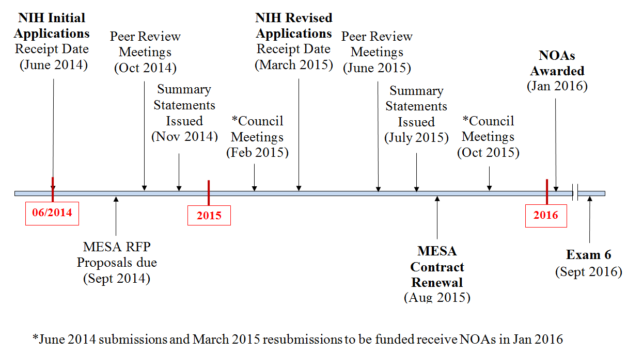
Renewal Timeline for MESA Grants and Contracts

Slide 23
Exam 6 Grant Applications
Submitted in June/July
Allison: MESA Mobility
Barr: MESA Lung III
Bertoni: Transition from risk factors to early HF
Budoff: Coronary atherosclerosis and the effects of intestinal microbiota, diet and genetics in MESA
Ding: Age-related mitochondrial dysfunction and cognitive decline
Heckbert: Atrial fibrillation burden, vascular disease of the brain and cardiac MRI in MESA
Kramer: Urinary KNOWledge study (U-KNOW)
Shea: HDL-mediated cholesterol efflux and plaque inflammation in MESA

Slide 24
Exam 6 Grant Applications (cont’d)
To be submitted in October
de Boer: Phosphorus and vitamin D metabolism and cardiovascular outcomes in MESA
Goodarzi: Insulin axis and diabetes risk: effects of microbiome diversity and host genome in a multiethnic cohort
Needham: Socioeconomic disadvantage, life course stress exposure, and CVD

