Slide 1
MESA Project Officer Report
Jean Olson, MD, MPH
Deputy Chief, Epidemiology Branch
MESA Project Officer
Prevention and Population Sciences Program
Division of Cardiovascular Sciences
National Heart, Lung, and Blood Institute
MESA Steering Committee
February 6, 2014

Slide 2
Topics
NIH and NHLBI
Budget
Other
MESA
Current status
Future

Slide 3
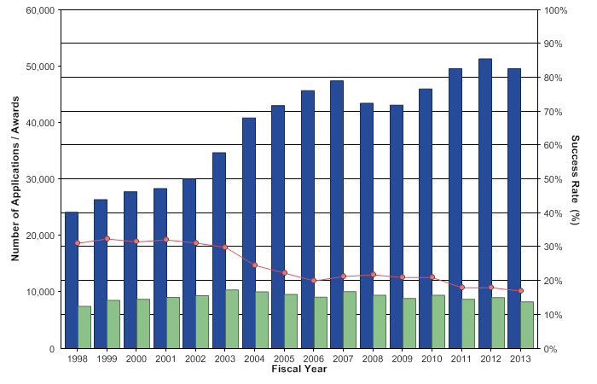
NIH Budget: FY 2013 Impact
Source: FY 2013 NIH Data Book

Slide 4
Budget Issues
FY 2014 NIH allocation: $29.9 billion
$1 billion more than FY 2013
$714 million less than FY 2013 pre-sequestration allocation
Implications for NHLBI
Current R01 payline: 10th percentile
Grant duration limited to 4 years except
Awards made to early stage investigators
Awards for studies requiring longer pt accrual & F/U
Awards for AIDS-related research

Slide 5
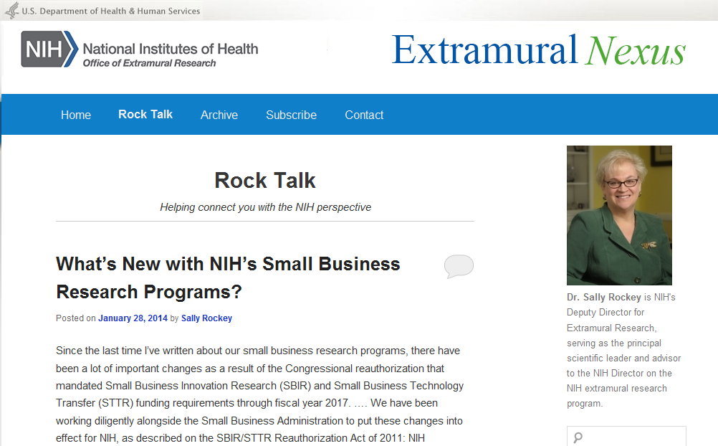
For NIH funding info
http://nexus.od.nih.gov/all/category/blog/

Slide 6
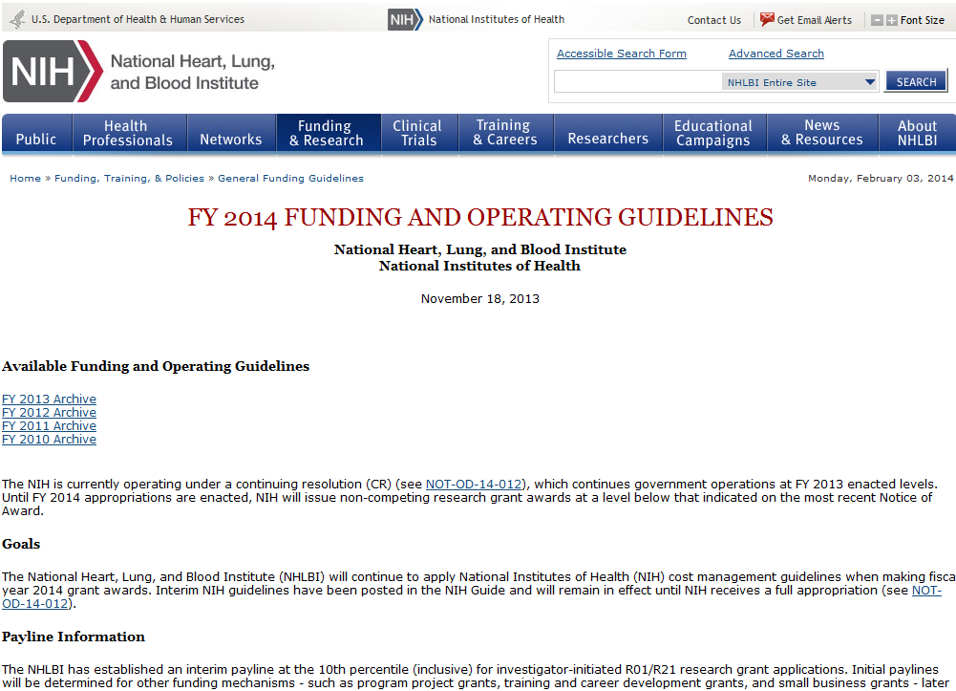
For NHLBI funding info
http://www.nhlbi.nih.gov/funding/policies/operguid.htm

Slide 7
Big Data To Knowledge Initiative (BD2K)
Mission: enable researchers to capitalize more fully on biomedical Big Data
Areas of focus
Facilitate broad use of biomedical data
Develop and disseminate analysis methods and software
Enhance training for biomedical big data (3 FOAs)
Discover and disseminate advances in data science
http://bd2k.nih.gov/funding_opportunities.html#sthash.8gZiioUQ.dpbs

Slide 8
PAR: Secondary Dataset Analyses in HLBS
Goal: Support early-stage exploratory studies by analysis of existing data sets
Intent is for applicants to generate new research hypotheses from previously collected data distinct from the original research
Requires patient-oriented or epi research
http://grants.nih.gov/grants/guide/pa-files/PAR-13-009.html

Slide 9
Towards a Creative Transformation of Epidemiology
NHLBI Council/BEE Working Group on Epidemiology and Population Science
Goal “to define how Epidemiology and Population Science research can be optimized by taking advantage of new tools/methods.”
Report anticipated late spring or early summer
Charge and roster available on NHLBI Epidemiology Digital Forum
http://nhlbiepi.wordpress.com/?p=444&preview=true

Slide 10
Other NHLBI News
New Consortium Data Use Agreement template available
David Gordon, MD, PhD new DCVS Associate Director for Prevention and Population Sciences
NHLBI travel funds greatly reduced
Future meetings to take place in Federal government facilities wherever possible

Slide 11
MESA--Current Status

Slide 12
MESA Publications
Number
of
Manuscripts
(n= 645)*
* Published as of December 31, 2013.

Slide 13
Follow-up Retention
2014 MESA Steering Committee Report, Sec. 1.2.1

Slide 14
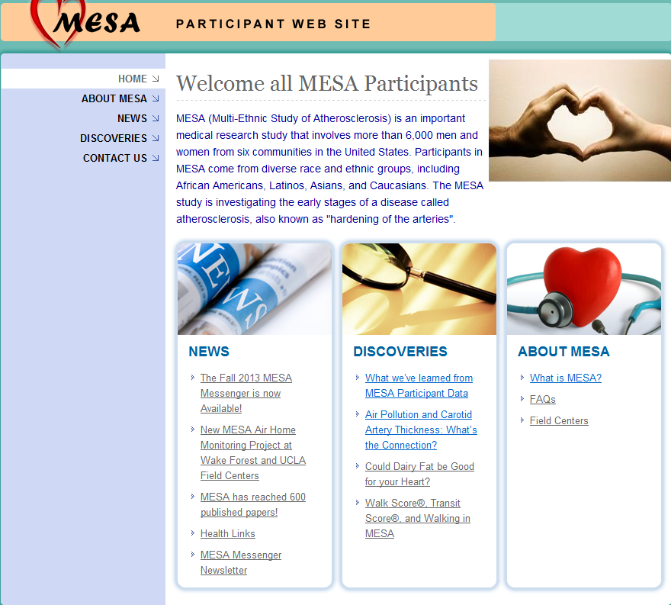
MESA Participant Website

Slide 15
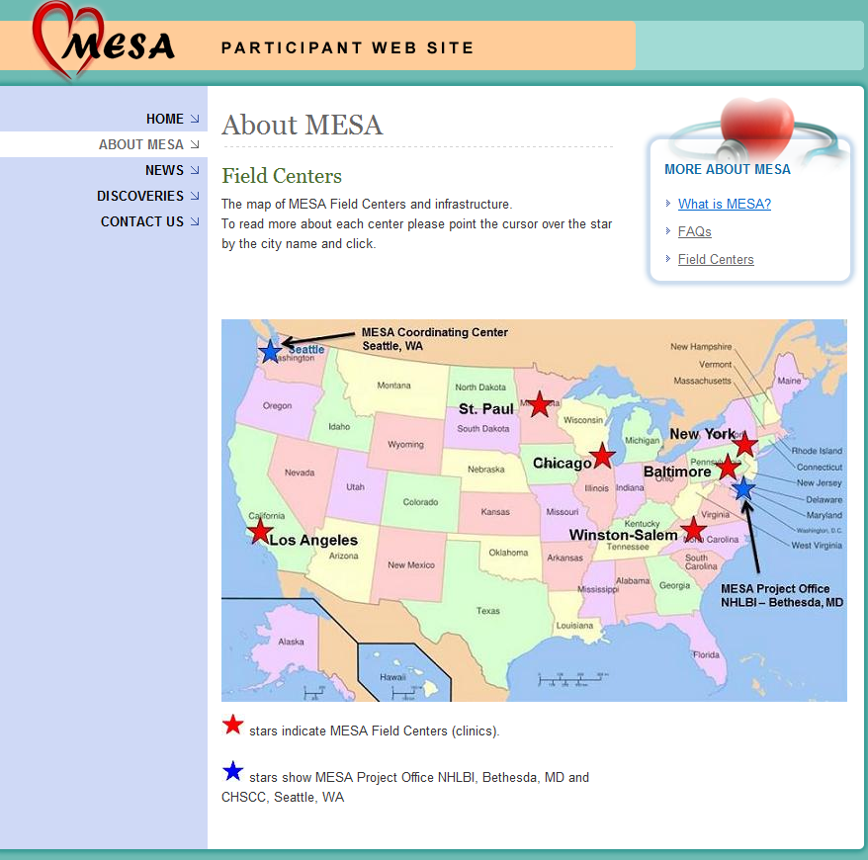
MESA Participant Website

Slide 16
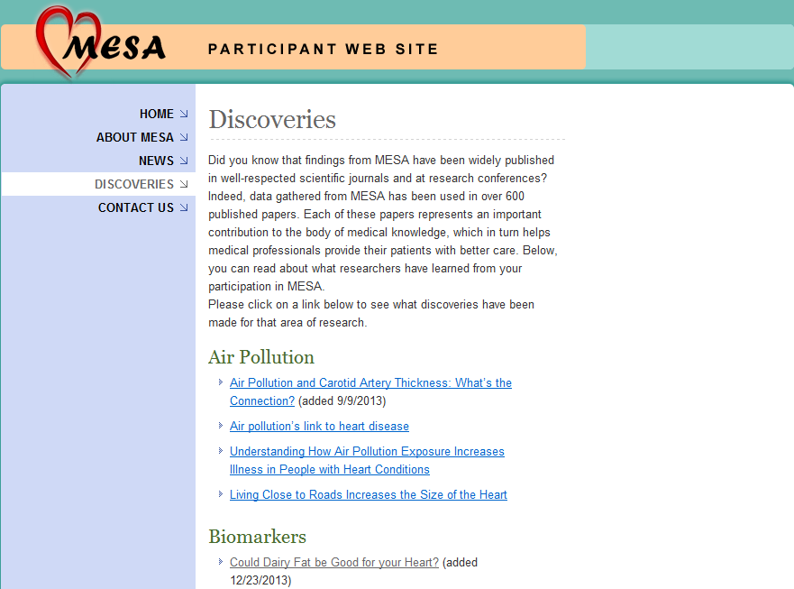
MESA Participant Website

Slide 17
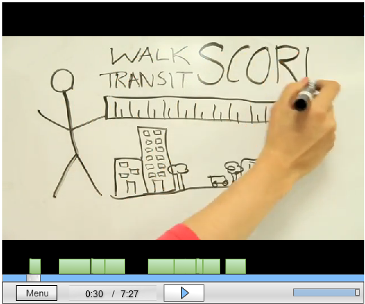
MESA Participant Website

Slide 18
MESA’s Future

Slide 19
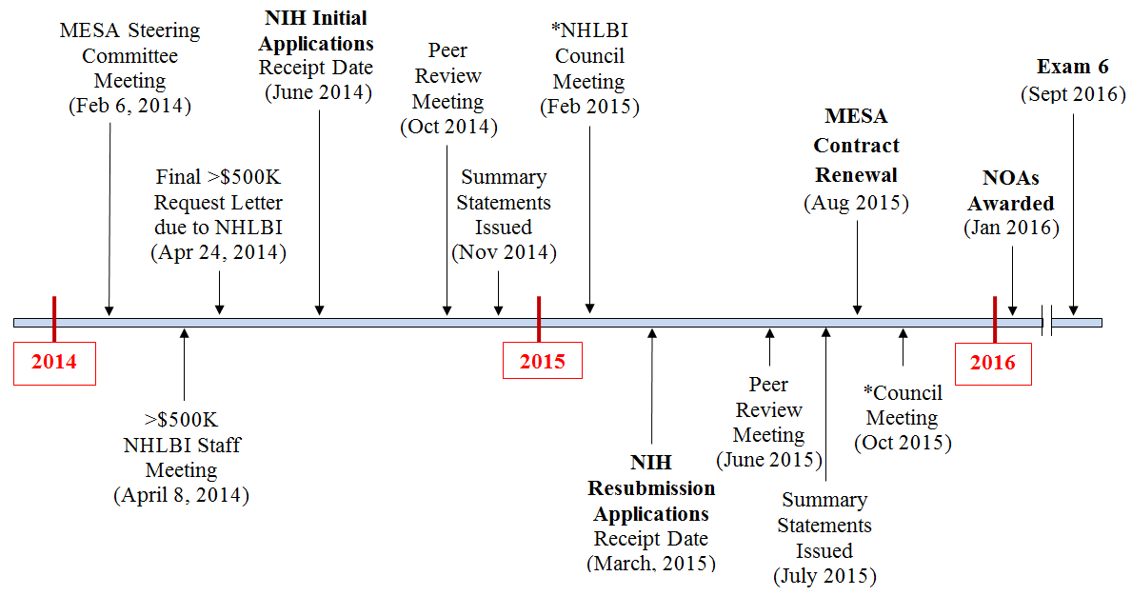
MESA Ancillary Studies Applications Timeline
*Note: June 2014 submissions and March 2015 resubmissions to be funded receive NOAs in Jan 2016

Slide 20
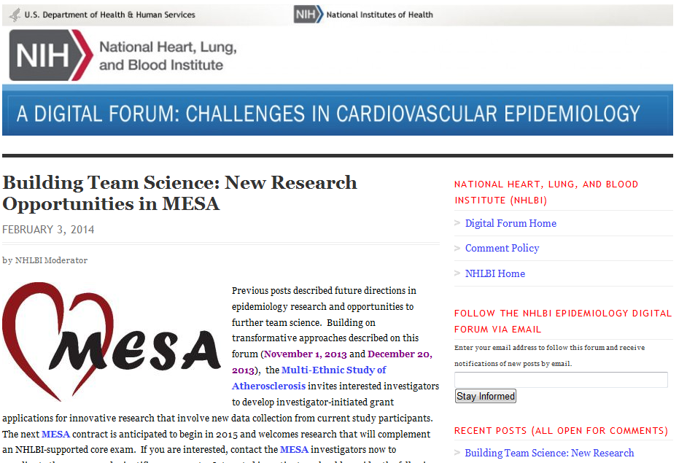
Exam 6 Announced on NHLBI Epi Forum
http://www.nhlbi.nih.gov/resources/epidemiology-forum/

