Slide 1

David A. Bluemke, MD, PhD, FAHA
CV Magnetic Resonance Imaging: The MESA Study
Director, Radiology and Imaging Sciences
Senior Investigator, NIBIB, NHLBI, NIDDK
National Institutes of Health
Bethesda, MD, USA
Professor, Medicine And Radiology
Johns Hopkins Hospital, Baltimore

Slide 2
David A. Bluemke, MD, PhD, FAHA
Integrated Imaging: Insights from Recent Clinical Trials:
The MESA Study
Director, Radiology and Imaging Sciences
Senior Investigator, NIBIB, NHLBI, NIDDK
National Institutes of Health
Bethesda, MD, USA
Professor, Medicine And Radiology
Johns Hopkins Hospital, Baltimore

Slide 3
Collaborating Centers in MESA
Univ of Washington
Univ of MN
U of Vermont
Univ of WI – Madison ●
New Engl Med C
Northwestern
Columbia
Johns Hopkins
UCLA
Wake Forest
Chinese 12%, African-American 28%, Hispanic 22%, White 38%; 53% women
Mean age 62 yrs at study entry

Slide 4
Acknowledgements
MESA participants
NIH: National Heart, Lung, and Blood Institute.
OSMB
MESA CC Center: Richard Kronmal, PhD
MESA PI’s, Field Center coordinators /staff

Slide 5
MESA Investigators
● Wake Forest University – G. Burke, G. Hundley, J. Carr
● U. of Minnesota – A. Folsom and David Jacobs
● Northwestern University – Kiang Liu and Philip Greenland
● UCLA – A. Gomes, K. Watson, M Budoff, J. Rotter
● Columbia University – S. Shea, G. Bahr and M. Prince
● NHLBI – Diane Bild MD and Jean Olson MD
● U. of Washington – R. Kronmal and R. McClelland
● University of Vermont – Russell Tracy and M. Cushman
● Johns Hopkins – David Bluemke and Wendy Post
● Tufts – D. O’Leary and J. Polak

Slide 6
Collaboration in MESA
1330 staff members/ potential authors
350 manuscripts
195 manuscripts involving imaging
NHLBI Project officer: Diane Bild MD, MPH, (Terry Manoli MD, MHS)
Head of Steering committee: Greg Burke MD MS
Notes:
In review of the data by the coordinating center, the event follow up at 2.45 yrs was incomplete.
The data presented in this presentation will focus on the first 1.5 yrs of event follow up.

Slide 7
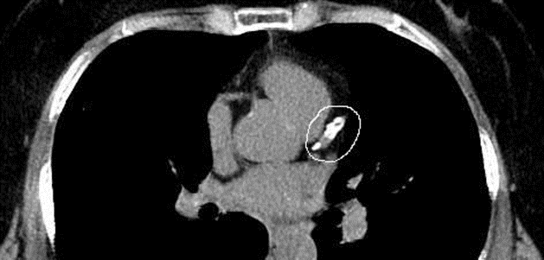
Coronary Calcium by EBCT

Slide 8
LV mass size and structure
Cardiac MRI evaluation
MRI Reading Center: João Lima, MD, PI; David Bluemke, MD, PhD Johns Hopkins
Notes:
In review of the data by the coordinating center, the event follow up at 2.45 yrs was incomplete.
The data presented in this presentation will focus on the first 1.5 yrs of event follow up.

Slide 9
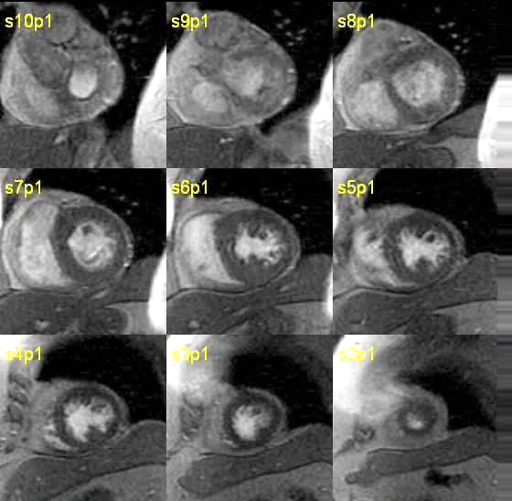
LV mass by MRI measured in 5004 participants in MESA

Slide 10
Normal LV mass: 10% difference by ethnicity
Natori, Lima, Bluemke, et al. AJR 2006; 186(6)
Chinese, p<0.05, vs. all other groups

Slide 11
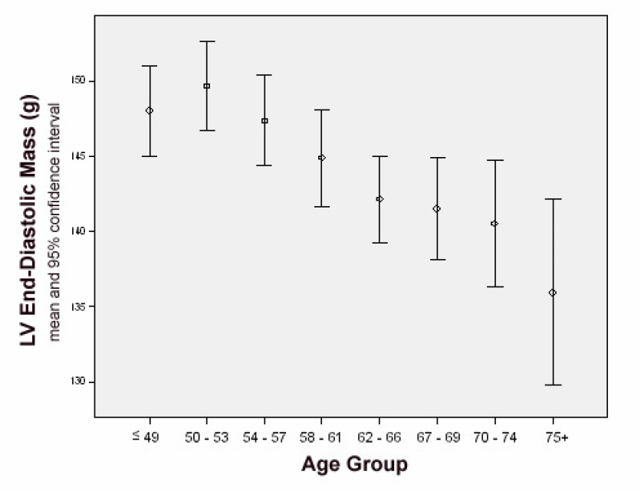
LV Mass vs. age
LV Mass (grams)
Age group
Cheng, Bluemke, Lima et al, Circulation Imaging 2009: 2(3)

Slide 12
LV Geometry vs. age
1.8
1.4
1.0
LV Mass-to-volume ratio
Cheng, Bluemke, Lima et al AHA 2007
Age group

Slide 13
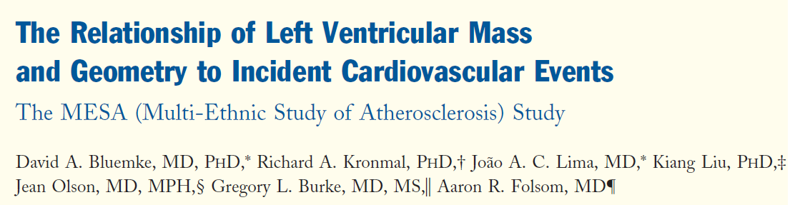
JACC 2008: 52(25)
4948 participants
216 incident events, 4 yr follow-up
Angina (71), HF (48), MI (45), stroke (39) and CHD death (13)
Notes:
In review of the data by the coordinating center, the event follow up at 2.45 yrs was incomplete.
The data presented in this presentation will focus on the first 1.5 yrs of event follow up.

Slide 14
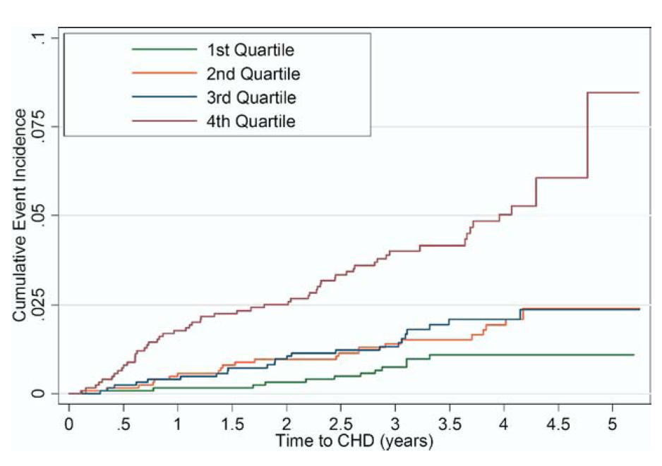
Cumulative CHD Event Rate
Model | Adjusted HR | P value
LV mass (per 10%) | 1.0 | 0.39
LV volume (per 10%) | 0.9 | 0.09
LV mass/ volume (g/ml) | 2.1 | 0.02

Slide 15
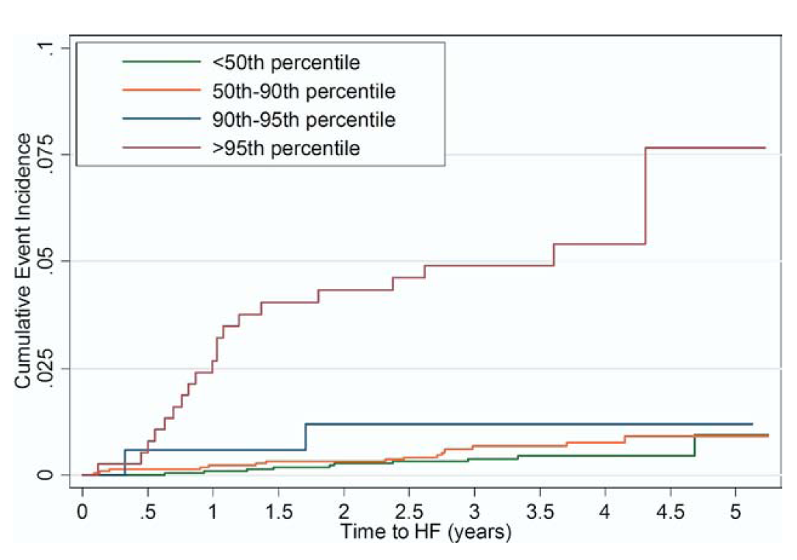
Cumulative Heart Failure Event Rate
Model | Adjusted HR | P value
LV mass (per 10%) | 1.4 | <0.0001
LV volume (per 10%) | 1.3 | <0.0001
≥ 95th %tile LV mass | 8.6 | <0.0001

Slide 16

Median f/u: 5.8 years
297 CVD events: 187 CHD, 65 strokes, 91 heart failure

Slide 17
Results: All CHD (n=187)
Model 1: Traditional risk factors + one imaging measure at a time
Model 2: Traditional risk factors + all imaging measures together
*p< 0.001; †p< 0.01; ‡p< 0.05

Slide 18
Results: HF (n=91)
Model 1: Traditional risk factors + one imaging measure at a time
Model 2: Traditional risk factors + all imaging measures together
*p< 0.001; †p< 0.01; ‡p< 0.05

Slide 19
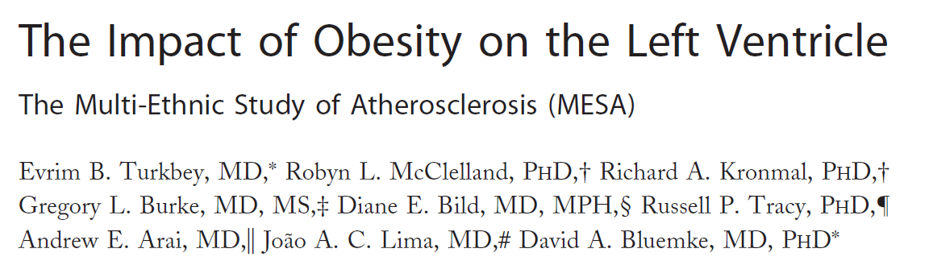
JACC Cardiovascular imaging 2010: 3(3)
5098 participants
LV size and structure vs. BMI, WC, WHR and fat free mass
Notes:
In review of the data by the coordinating center, the event follow up at 2.45 yrs was incomplete.
The data presented in this presentation will focus on the first 1.5 yrs of event follow up.

Slide 20
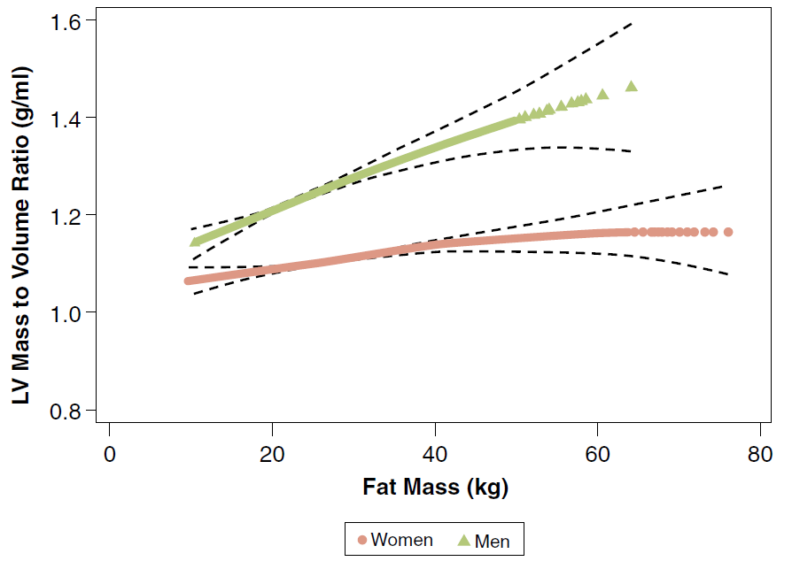
JACC Cardiovascular imaging 2010: 3(3)
Turkbey, McClelland, Bluemke, et al, MESA
*Adjusted for CV risk factors

Slide 21
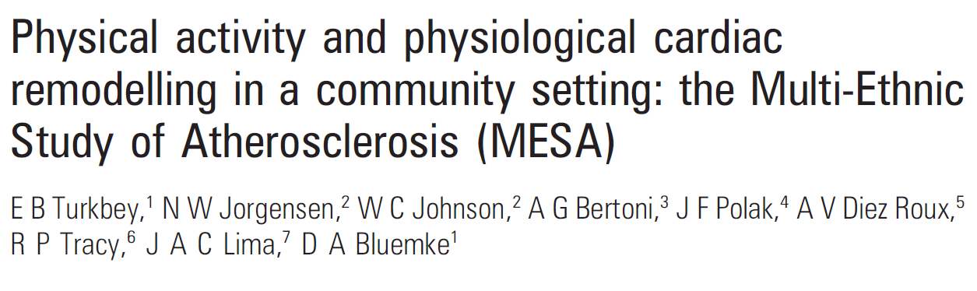


4992 participants
physical activity questionnaire, intentional exercise survey
Notes:
In review of the data by the coordinating center, the event follow up at 2.45 yrs was incomplete.
The data presented in this presentation will focus on the first 1.5 yrs of event follow up.

Slide 22
LV mass
LV volume
Standardized units
Proportional, physiologic change in mass and volume related to exercise level
Physical Activity (MET/min/day)

Slide 23

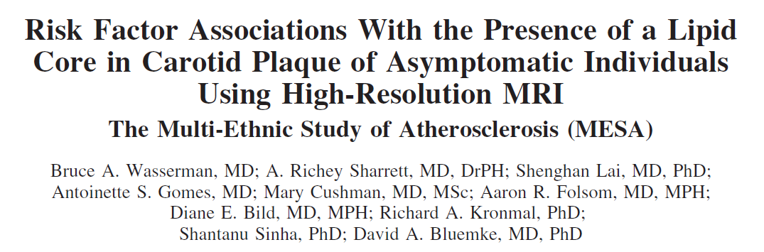
2008: 39:329
214 participants with >1.5 mm wall thickness
70% had plaques with lipid core

Slide 24
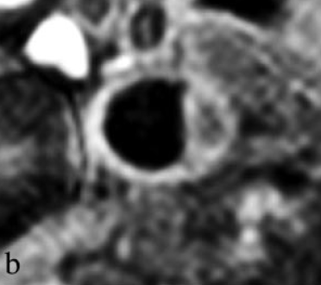
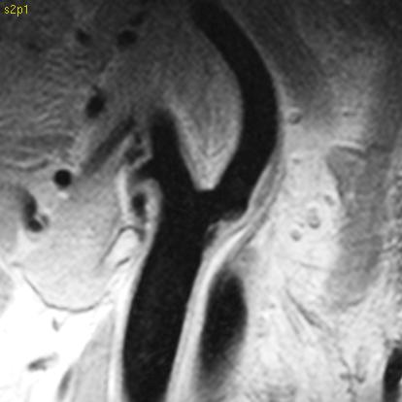
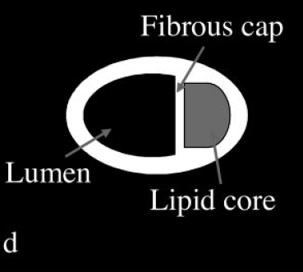
Stroke 2008: 39:329
Presence of lipid core correlated with cholesterol level > 200 mg/dl (OR 2.9), but not other CV risk factors (including CRP).
Carotid MRI

Slide 25
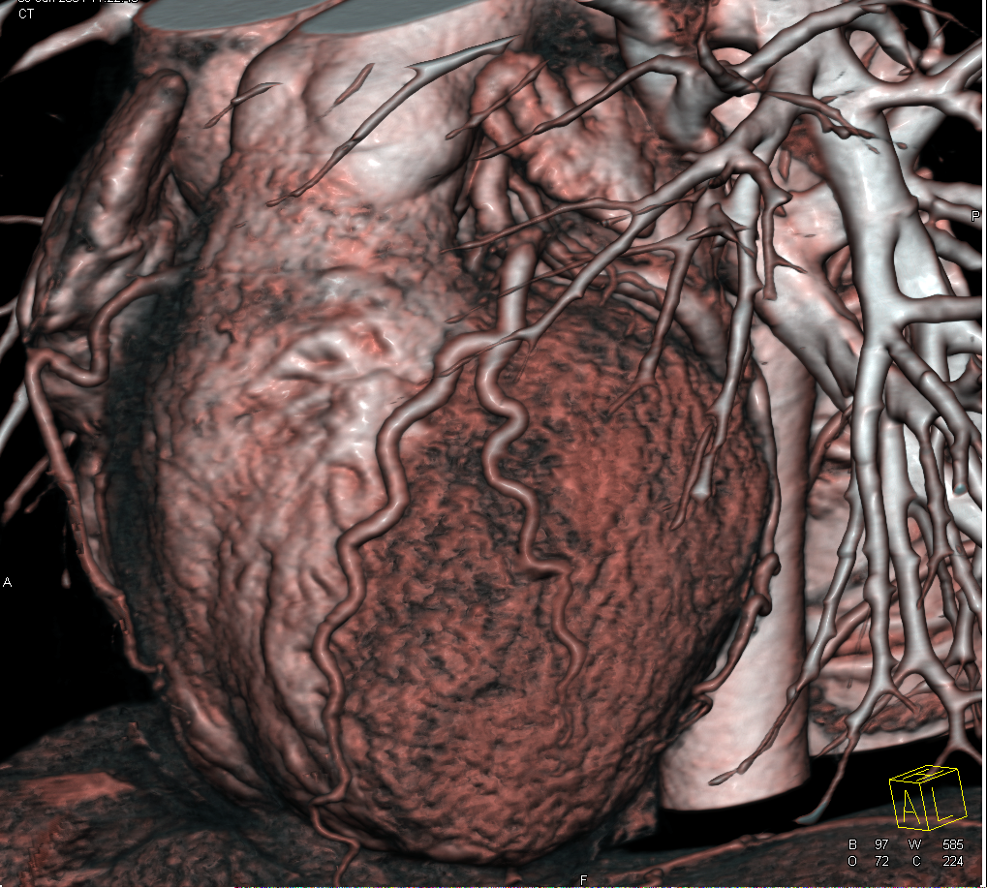
MESA Coronary MRI
Routine by CT
Challenging by MRI, but no radiation: helpful for research studies
Notes:
For coronary imaging, there are significant challenges, with diameter of 2-4 mm, wall thickness that is submillimeter

Slide 26
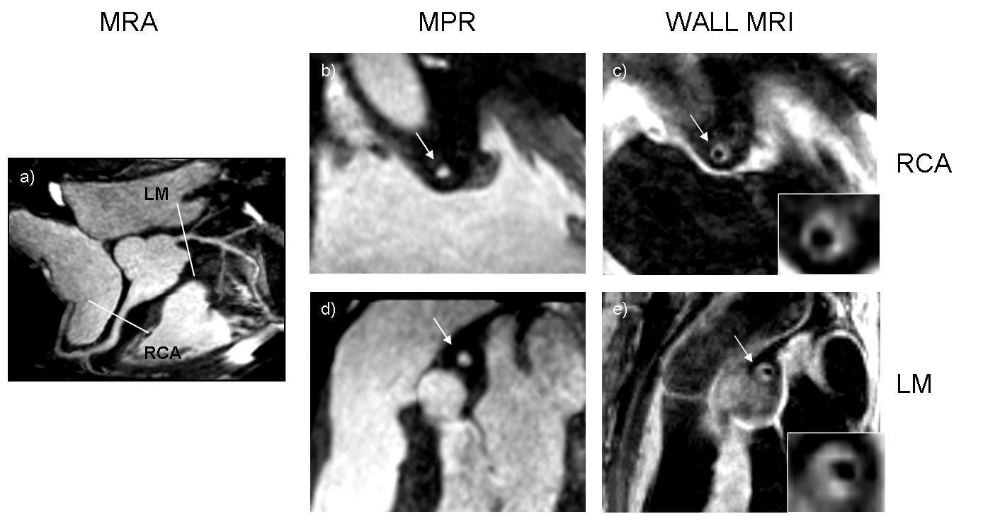
73 yo male, eccentric wall thickening, no coronary stenosis
RCA
LM

Slide 27
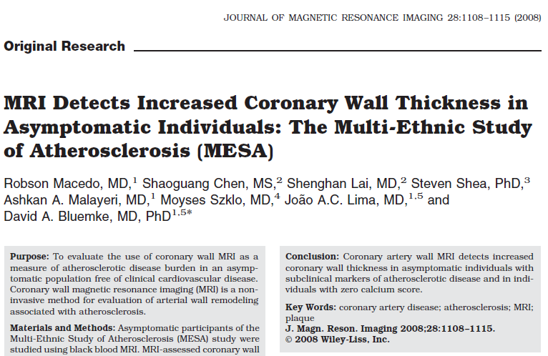
Macedo, Bluemke et al J Magn Reson Imaging. 2008 Oct

Slide 28
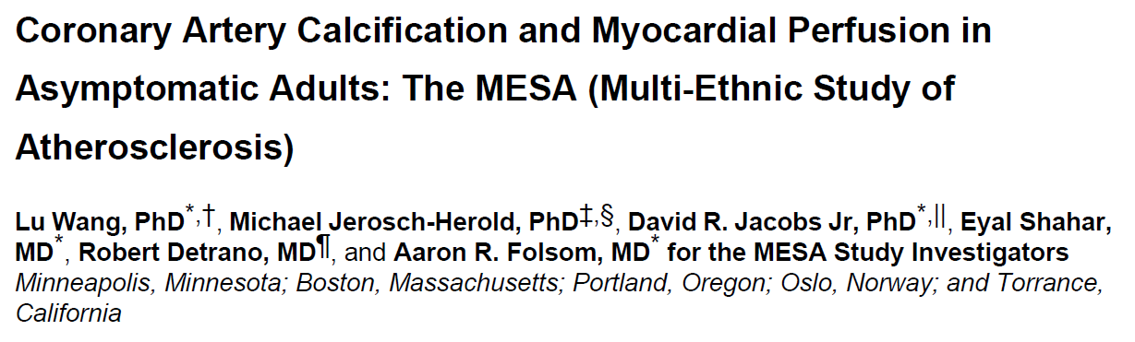
222 men and women undergoing stress MRI perfusion evaluation
Notes:
In review of the data by the coordinating center, the event follow up at 2.45 yrs was incomplete.
The data presented in this presentation will focus on the first 1.5 yrs of event follow up.

Slide 29
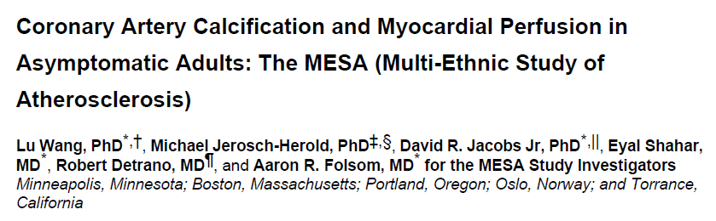
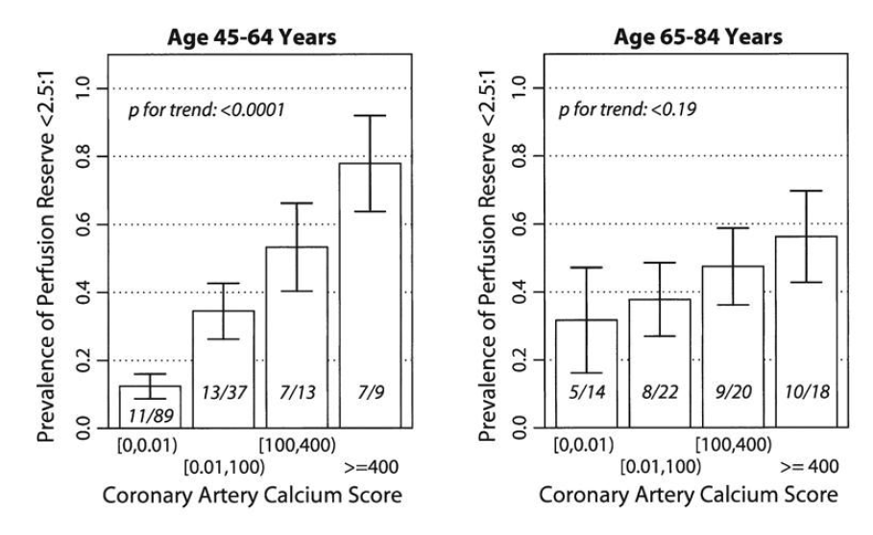
Notes:
In review of the data by the coordinating center, the event follow up at 2.45 yrs was incomplete.
The data presented in this presentation will focus on the first 1.5 yrs of event follow up.

Slide 30
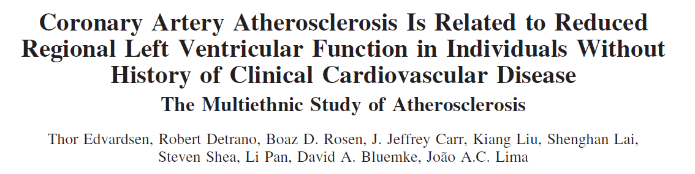
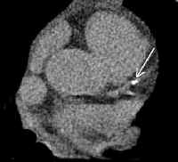
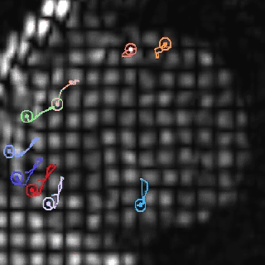
Atherosclerosis (Coronary Calcification) and Local Myocardial Function
Notes:
I’d like to give you just one example of the myriad of results that have come from this analysis.
For example, we have evaluated the relationship between atherosclerosis (measured by calcium) and regional myocardial strain

Slide 31
Edvardsen T, Bluemke, DA, Lima, J et al. ATVB 2006;26(1):206-211
250
200
150
100
50
0
LAD calcium score
-0.79 – -1.13
-1.13 – -1.33
-1.33 – -1.67
-1.69 – -3.86
Strain rate (s⁻¹)
Worse LV function
Notes:
We looked at calcification in each territory – and then used MR tagging to look at function in that coronary territory
When atherosclerosis load was low – low calcium score, the regional strain rate in that territory was normal.
But as calcium score increased, strain rate decreased. This indicates the surprising result that subclinical atherosclerosis is interacting on a regional basis with myocardial function.

Slide 32
Conclusions: MESA
Success: implementation of advanced imaging, collaborations
Weakness: fewer events than anticipated, thus, some limits on role of ethnicity
Challenges: cohort retention
MESA II: Heart failure: myocardial scar, genetics, many ancillary studies

Slide 33
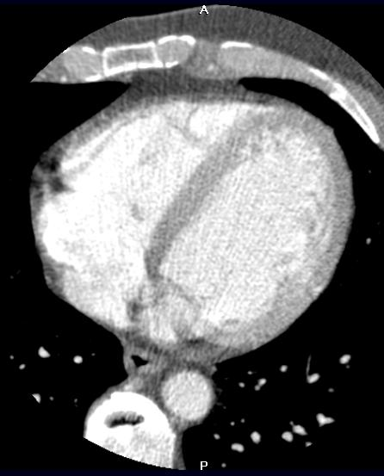
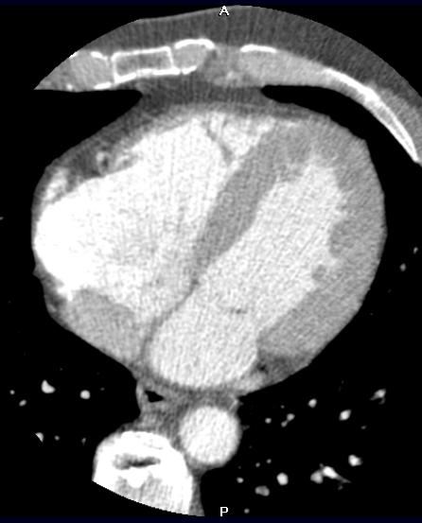
Analysis for LV mass and function

Slide 34
Calibration of Longitudinal Measurements of
Cardiac Anatomy and Function in the
Multiethnic Study of Atherosclerosis
Sources of variability
participant
physiological variability (5%)
heart rate
respiratory motion
positioning
images
technical variability
pulse sequence (5–15%)
scanner type (1.5–3%)
technologist
(field strength)
measurements
reading variability
inter-reader (6%)
intra-reader (6%)
analysis software
image display
site (2–12%)
Adjustment for systematic differences
corrected
(MESA II)
=
uncorrected
(MESA I)
+
technical correction
(MESA II – I)
+
reading correction
(MESA II – I)
human phantom studies
SSFP–FGRE
Siemens, GE
MESA II reader training
MESA I re-readings

Slide 35
The Metabolic Syndrome and CHF Risk
0.03
Metabolic Syndrome
0.02
0.01
Cumulative Hazard of CHF (%)
0.01
No Metabolic Syndrome
0.01
0.00
0
1
2
3
4
5
Follow-up Time (years)
Log-rank test p-value: 0.001
Bahrami H. et al, JACC March 2008

Slide 36
Background
Race x CHF in MESA
AA
HP
CC
CA
Bahrami H. et al., Archives of Internal Medicine, Nov. 2008
Notes:
,

Slide 37
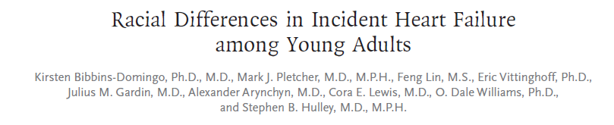
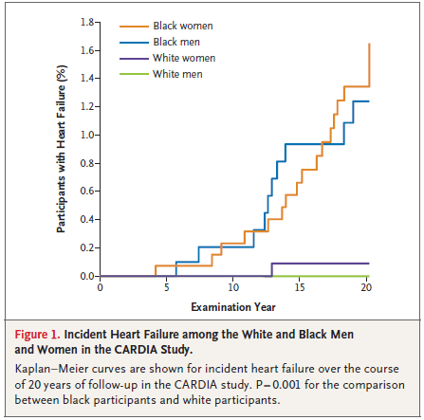
5115 Participants
20 year follow-up
27 new cases of heart failure
26 in black patients

Slide 38
0.02
Above 75th Percentile
0.01
CRP and CHF Risk
Cumulative Hazard of CHF (%)
0.01
Below 75th Percentile
0.01
0.00
Log-rank test p-value: 0.02
0
1
2
3
4
5
0.02
Follow-up Time (years)
CRP ≥ 5 mg/dL
0.01
Cumulative Hazard of CHF (%)
0.01
CRP < 5 mg/dL
0.01
Log-rank test p-value: 0.009
0.00
Bahrami H., JACC March 2008
0
1
2
3
4
5
Follow-up Time (years)

Slide 39
Albuminuria and CHF Risk
0.08
Macroalbuminuria
0.06
Cumulative Hazard of CHF (%)
Microalbuminuria
0.04
0.02
Normal
Log-rank test p < 0.001
0.00
0
1
2
3
4
5
Follow-up Time (years)
Bahrami H., JACC March 2008

Slide 40
Adjusted Mean Differences (95% CI) of Systolic Strain Rates (s⁻¹) among individuals with renal insufficiency compared to Normal renal Function (Nasir K. et al. AHJ 2007)
Age, gender, race, hypertension, diabetes, cholesterol/HDL ratio, LV mass index, CRPand homocysteine were included in the multiple linear regression models as covariates.
By convention systolic strain rates are negative. Positive coefficients indicate reduced systolic function.
LAD
LCX
RCA
Adjusted mean differences of Ecc (%)

Slide 41
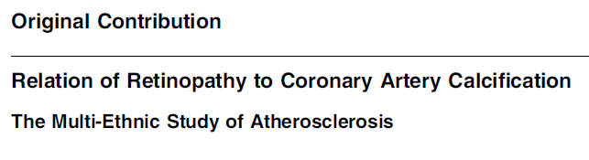
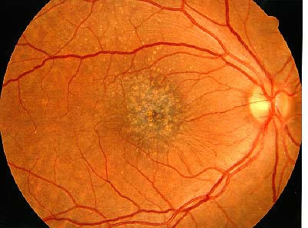

Relationship of microvascular disease to CAC
CAC > 100 was associated with retinopathy (odds ratio: 1.4) after adjustment for CV risk factors, in both men and women
Notes:
In review of the data by the coordinating center, the event follow up at 2.45 yrs was incomplete.
The data presented in this presentation will focus on the first 1.5 yrs of event follow up.

Slide 42
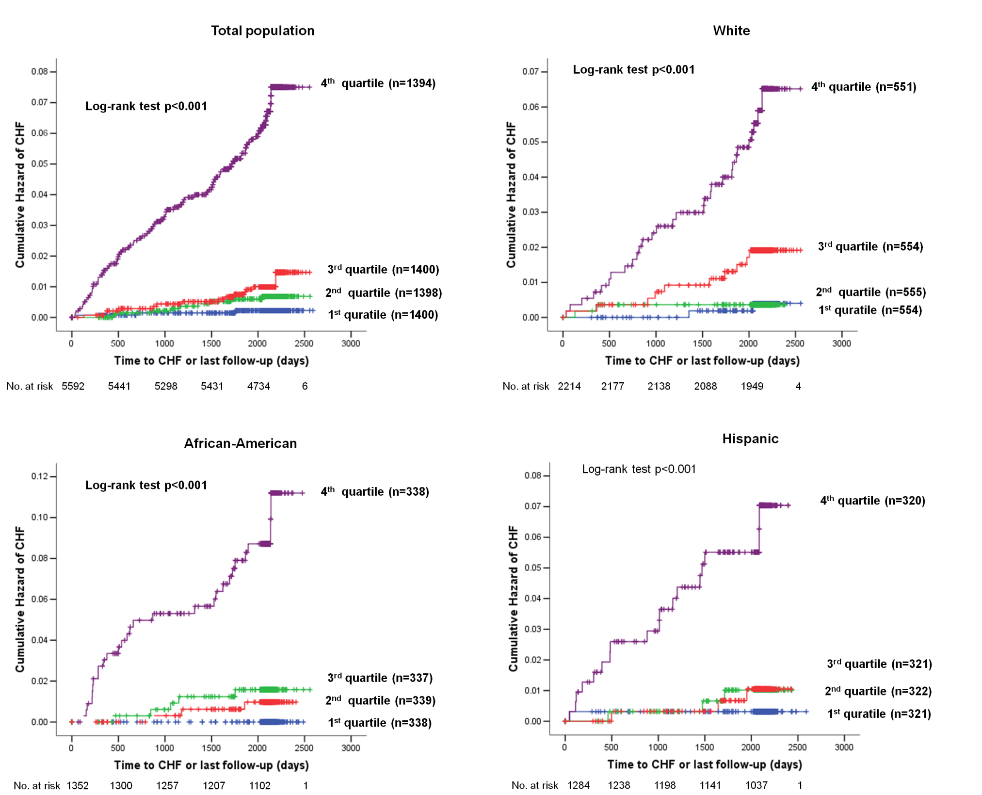

Slide 43
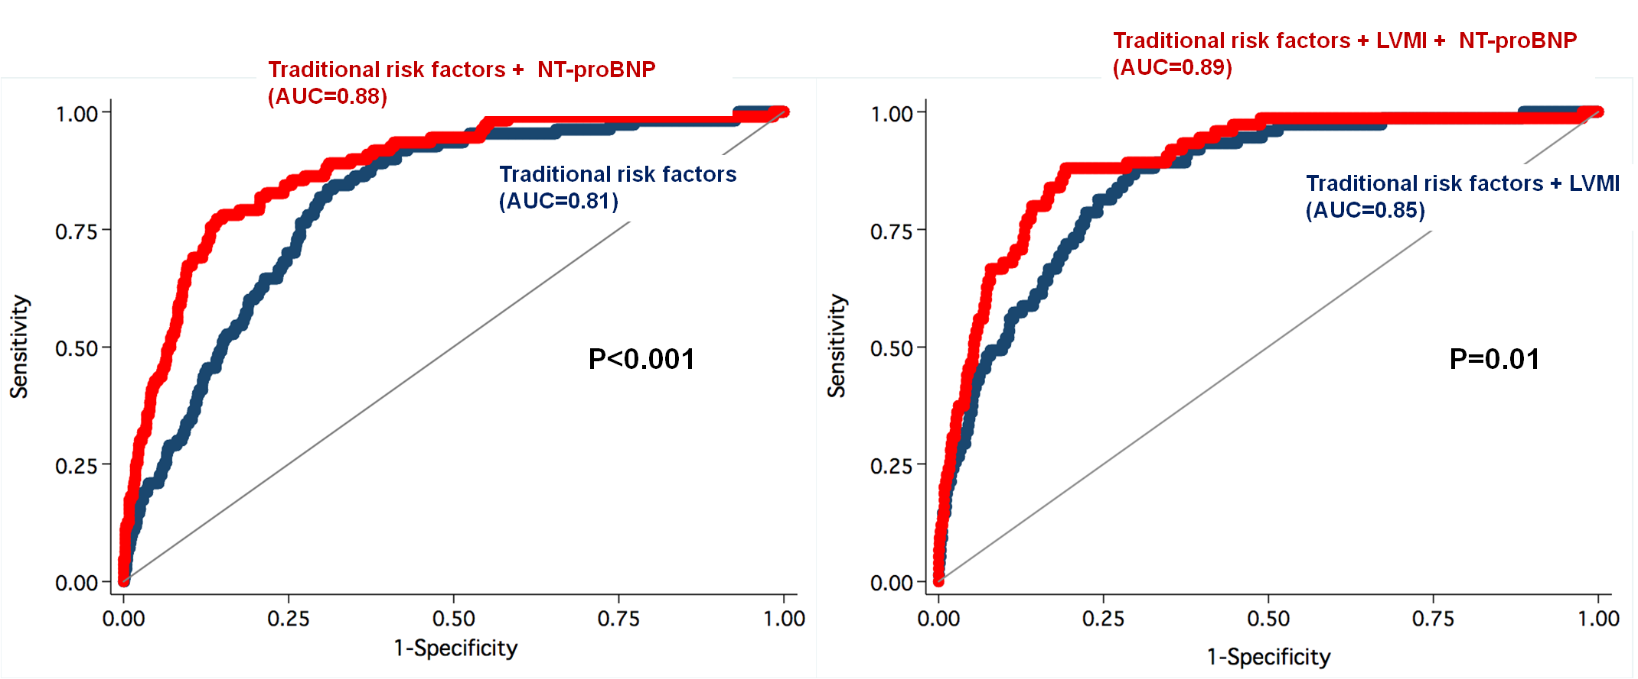
Discrimination
Comparison of model with C-index
95% CI (0.85-0.91)
95% CI (0.86-0.93)
95% CI (0.77-0.84)
95% CI (0.82-0.89)

Slide 45
Sugroup analysis for incident HF in lower NT-proBNP
(<112.5 pg/mL, n=4169) population with Model 3 covariates
Variables | HR | 95% CI | P-value
Age, per year | 1.08 | 1.02-1.14 | 0.013
Male | 1.06 | 0.30-3.77 | 0.93
Diabetes | 4.52 | 1.65-13.38 | 0.003
Current Smoking | 2.21 | 0.67-7.28 | 0.19
Systolic blood pressure, per mmHg | 1.01 | 0.98-1.03 | 0.67
GFR, per mLl/min | 1.00 | 0.97-1.02 | 0.86
Antihypertensive medication use | 1.48 | 0.54-4.09 | 0.45
Statin use | 0.53 | 0.12-2.38 | 0.53
LDL-cholesterol, per mg/dl | 1.01 | 0.99-1.03 | 0.28
HDL-cholesterol, per mg/dl | 0.98 | 0.94-1.03 | 0.43
LV mass index, per 1SD | 2.04 | 1.36-3.06 | 0.001
Log NT-proBNP, per 1SD | 1.46 | 0.77-2.75 | 0.24
Cox proportional hazard regression analysis

Slide 46
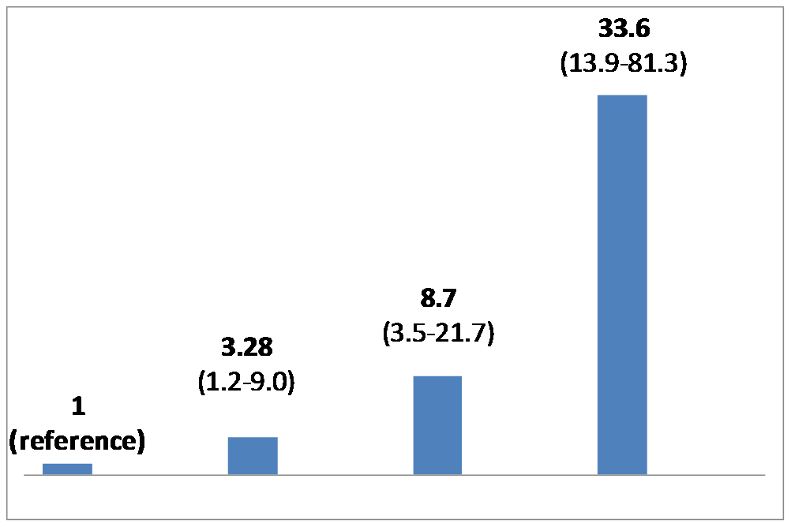
Hazard Ratio (95% CI) of Subgroup for Incident HF According to 4th Quartiles of LV mass index (>86.8 g/m2) and NT-proBNP (<112.5 pg/ml)
BNP <4th Q
LVMI <4th Q
(8/2412)
BNP <4th Q
LVMI =4th Q
(11/769)
BNP =4th Q
LVMI <4th Q
(22/710)
BNP =4th Q
LVMI =4th Q
(35/268)
(HF no./participants no)
Cox regression analysis (model 2)

Slide 47
N-terminal Pro-B-type Natriuretic Peptide, Left Ventricular Mass, and Incident Heart Failure: the Multi-Ethnic Study of Atherosclerosis
Eui-Young Choi, Hossein Bahrami, Colin O. Wu, Andre L.C. Almeida, Aditya Jain, Kihei Yoneyama, Anders Opdahl, Lori B. Daniels, Michael H. Criqui, Mary Cushman, Philip Greenland, Alan Maisel, David Siscovick, Christine Darwin, David A. Bluemke, Joao A.C. Lima

Slide 48
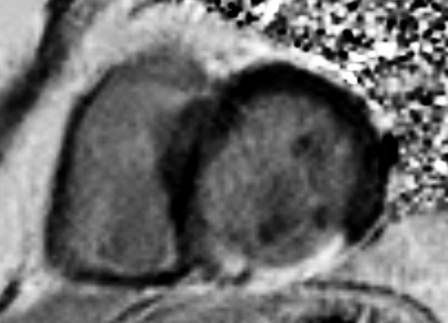
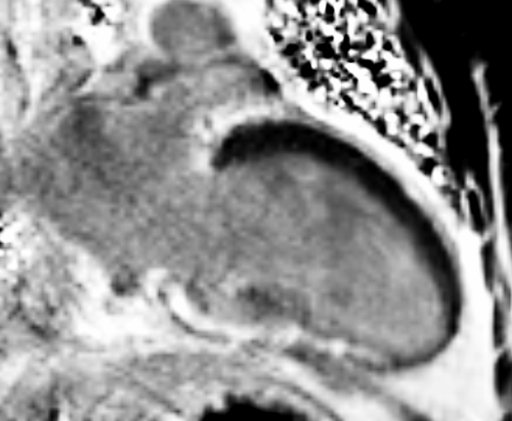
Transmural Infarct
Notes:
Inferior and inferolateral wall

Slide 49
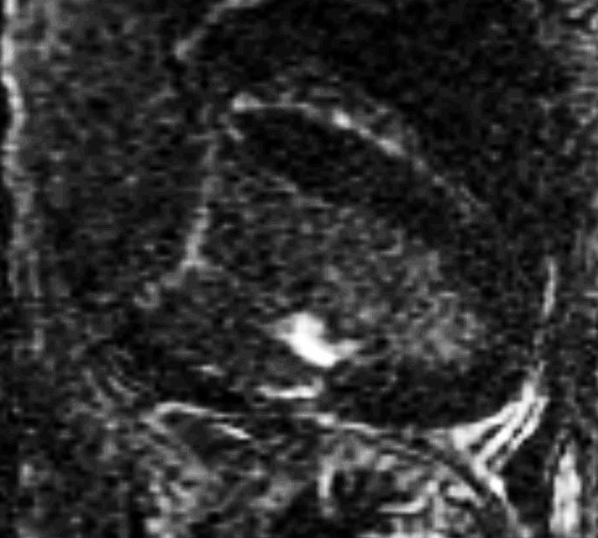
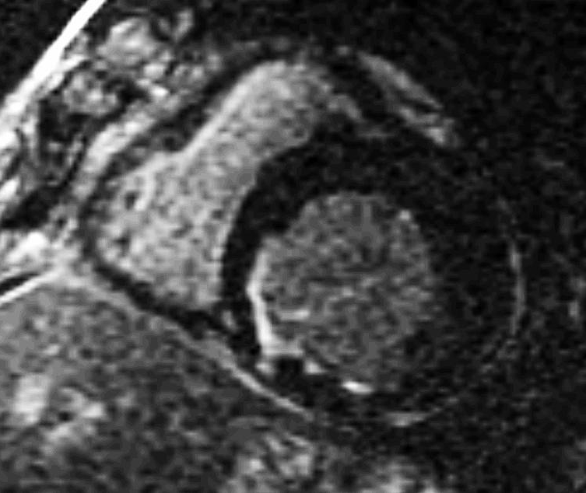
Subendocardial Infarct
Notes:
Inferoseptal and inferior

Slide 50
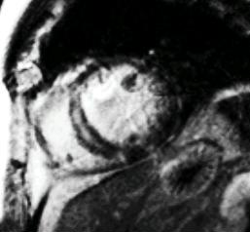
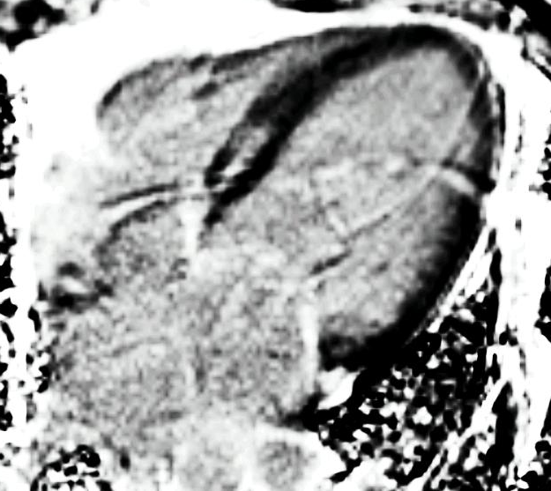
Mid-wall Hyperenhancement
Notes:
Antero and inferoseptal

Slide 51
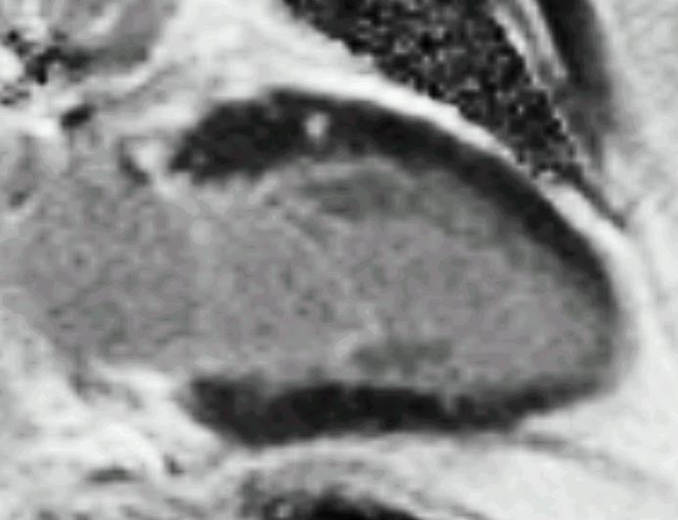
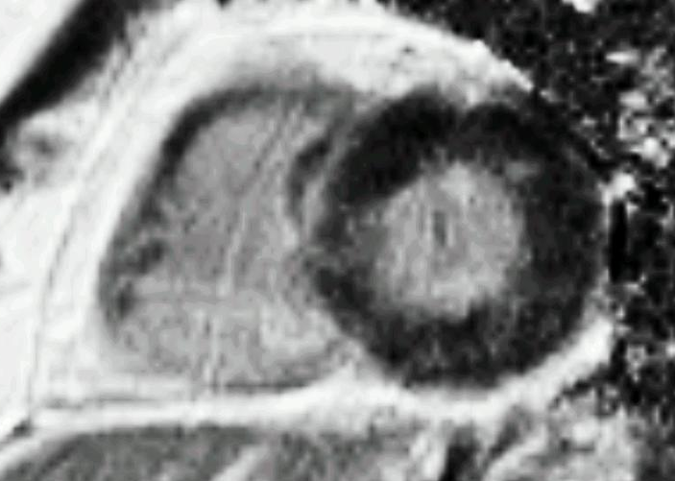
Localized Myocardial Scar
Notes:
Anterolateral wall

Slide 52

Cardiac Structure and Function
in Type 1 Diabetes
Evrim B. Turkbey⁴, Chia-Ying Liu³, Cuilian Miao³, Saul Genuth¹, Patricia A. Cleary², Jye-Yu C. Backlund²,
João A. C. Lima³, David A. Bluemke⁴
¹ Case Western Reserve University, Cleveland, OH
² The George Washington University, Washington, DC
³ Johns Hopkins University, Baltimore, MD
⁴ National Institutes of Health, Bethesda, MD
Circulation, 2011 (In Press)

Slide 53
Ancillary Studies - Ongoing
Aortic structure and function
MESA COPD
MESA fibrosis (T1 mapping)
CAP (Atlas project)
EDIC/MESA comparison
MESA SHARe (LV structure and function working group)

Slide 54
Cardiomyocyte (75% of myocardial structural space)
Reactive interstitial fibrosis:
-hypertension
-diabetes
-aging
-valvular disorders
-genetic
Blood vessel
(capillary, arteriole)
Collagen (type I and type III=2-4% of structural space)
Endothelial cell
Myofibroblast: synthesis & degradation of collagen
Vascular smooth muscle cell
Cardiac Interstitium
(25% of myocardial structural space)
Macrophage and mast cells (synthesis of metalloproteinases & pro-fibrotic factors)
Infiltrative interstitial fibrosis:
-amyloidosis
-Anderson-Fabry
Replacement/scarring fibrosis:
-acute/chronic ischemia, infarction
-myocarditis
-sarcoidosis
-renal insufficiency (chronic)
-miscellaneous inflammatory disease
-toxic
-genetic
Mewton N. et al JACC 2011

Slide 55
T1 Mapping – Normal Volunteers
Liu C. , Mewton N. et al

Slide 56
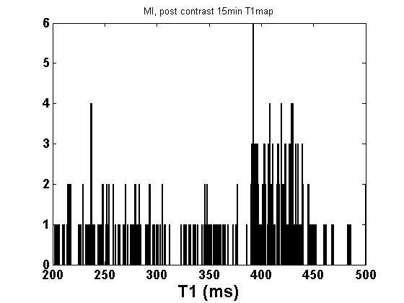
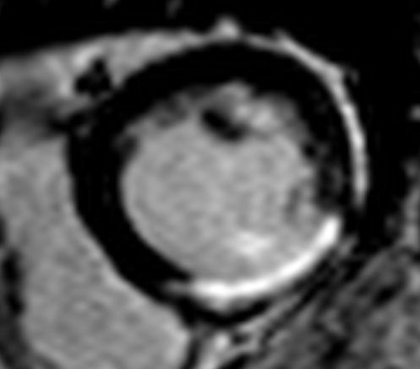
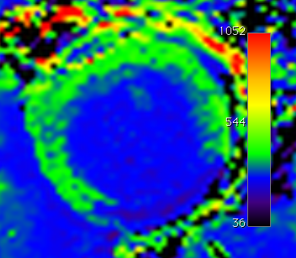
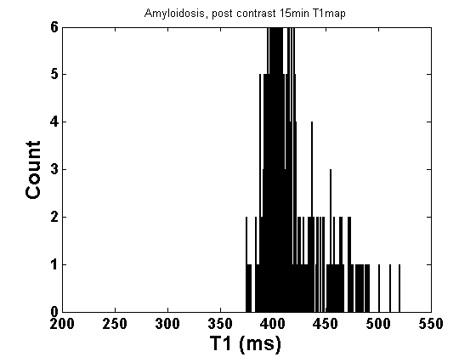
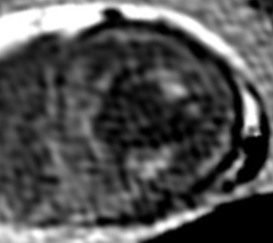
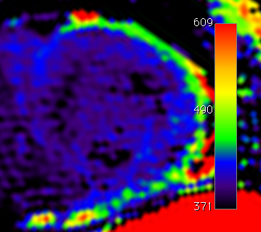
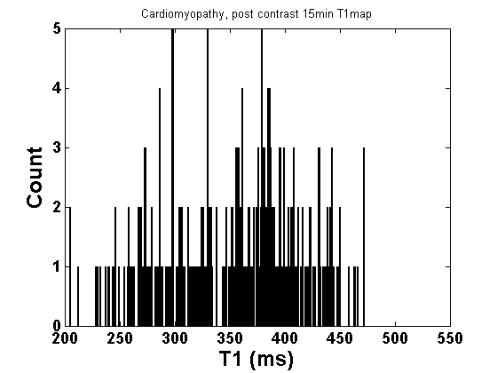
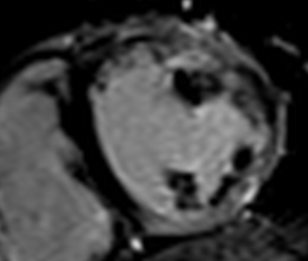
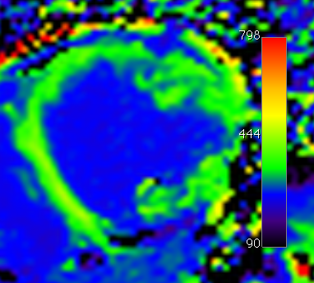
LGE CMR
T₁ Map (15’)
T₁ Distribution Histogram
LV T₁ = 355±80 ms
A
A1
A2
A3
LV T₁ = 418±27 ms
B
B1
B2
B3
LV T₁ = 352±62 ms
C
C1
C2
C3

Slide 57
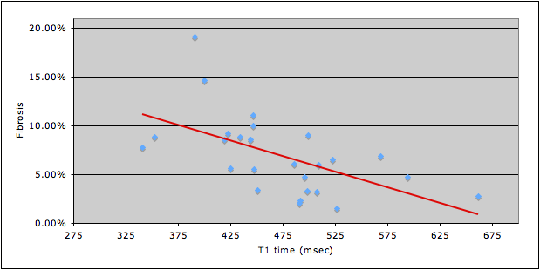
T1 time and myocardial fibrosis were inversely correlated
(r = -0.42, p = 0.03)
Sibley C, Bluemke D et al. AHA 2011

Slide 58


Quantitative Assessment of Myocardial Fibrosis with Magnetic Resonance T1 Mapping of the Heart in the Multi-ethnic Study of Atherosclerosis (MESA)*
Chia Liu, (R21) MESA MRI RC
Johns Hopkins School of Medicine and NIH Clinical Center
Baltimore, Maryland
* Ancillary study proposal approved

Slide 59
Myocardial T1 mapping
Delayed-enhancement (DE) method produces contrast between scar (bright, short T1) and normal area (dark, long T1) by selection of TI, which depends on underlying T1 difference.
T1 map: Directly measuring the tissue T1.

Slide 60
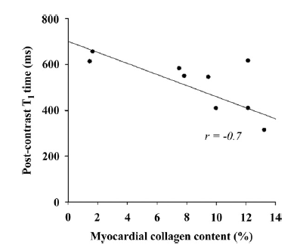
T1 Mapping – Collagen Content

Slide 61

Aortic Structure and Function
Mean aortic wall thickness
Max aortic wall thickness
Distensibility

Slide 62
Association of Aortic Size with Aging:
Longitudinal Analysis from Multi-Ethnic Study of Atherosclerosis
Gisela Teixido, Alban Redheuil, Gregory Hundley… MESA MRI RC

Slide 63

Aortic Distensibility and Aging
A. Redheuil, WC Yu, E Mousseaux, D. Bluemke, J Lima

Slide 64


Aortic Function Team Members
Alban Doris

Slide 65

Cardiac size and the environment
Air quality measured in conjunction with the EPA in 3827 MESA participants.
Traffic exposure (<50 m from major roadways) resulted in higher LV mass (equivalent to 6 mm increase in blood pressure) after adjustment
Van Hee et al Am J Resp Crit Care Med 2009

Slide 66

Cardiac size and genetic interaction
2882 candidate SNPs.
genes responsible for coagulation and myocardial repolarization modify associations between proximity to major roadways and LV mass.
Van Hee et al submitted

Slide 67


M E S A S H A R e M E E T I N G 2 0 1 0 – C H I C A G O , I L
MESA SHARe LV Structure/Function
Working Group:
LV Structure/Function
Preliminary Report
S E P T E M B E R 1 4 , 2 0 1 0
Sanjiv J. Shah, MD
Assistant Professor of Medicine
Division of Cardiology, Department of Medicine
Northwestern University Feinberg School of Medicine
M U L T I – E T H N I C S T U D Y O F A T H E R O S C L E R O S I S

Slide 68
Conclusions: MESA
Success: implementation of advanced imaging, collaborations
Weakness: fewer events than anticipated, thus, some limits on role of ethnicity
Challenges: cohort retention
MESA II: heart failure, myocardial scar, fibrosis, aortic structure and function, genetics, many ancillary studies

Slide 69
Thank you

