Slide 1
The NHLBI Exome Sequencing Project
Stephen S. Rich, PhD
September 30, 2013

Slide 2
NHLBI Exome Sequencing Project (ESP)
Three cohort-based groups
  Heart disease (HeartGO, S Rich)
  Lung disease (LungGO, M Bamshad)
  Women’s Health Initiative (WHISP, R Jackson)
Two sequencing centers
  Broad Institute (BroadGO, S Gabriel/D Altshuler)
  University of Washington (SeattleGO, D Nickerson)
Two additional GO components
  CHARGE-S (E Boerwinkle, targeted & exome sequencing)
  WashUGO (T Graubert, cancer focus, whole genome seq)

Slide 3
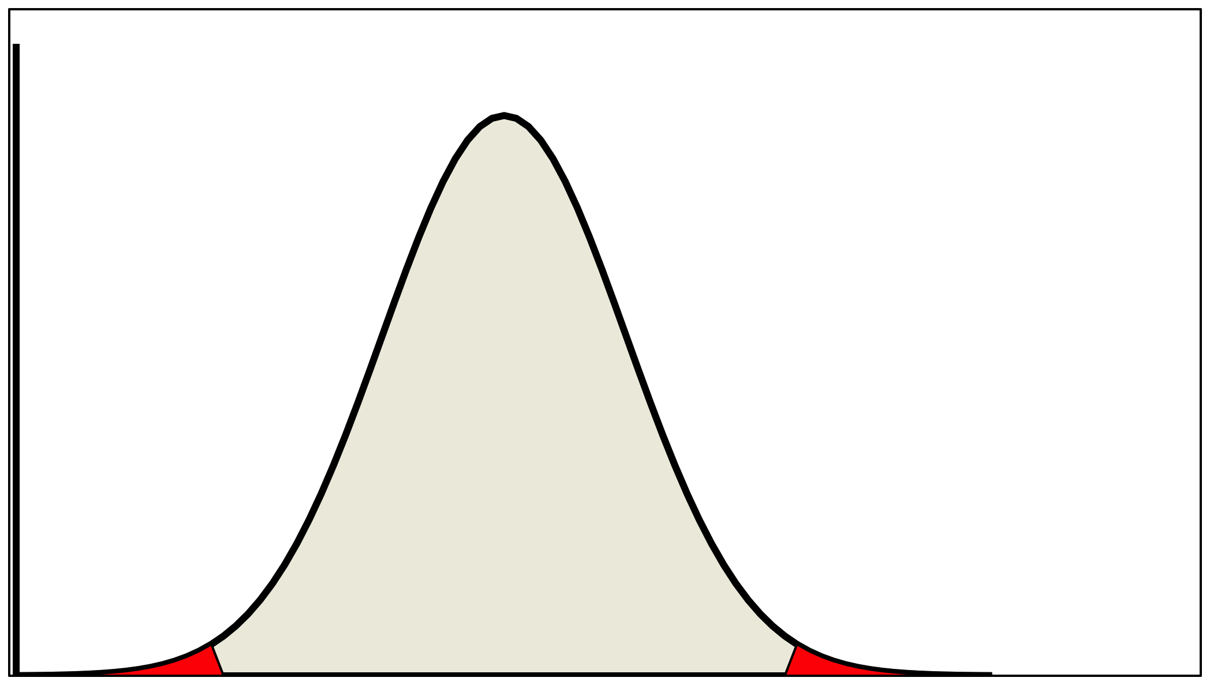
NHLBI Exome Sequencing Project
Established with ARRA funding
Extremes of cardiovascular and lung phenotypes to be analyzed to enrich for genetic effects
Early Onset Disease
“Mendel-ize” Traits-Compare
extremes of trait distribution
Rare, higher penetrant variants
Example of extreme
High FRS
no MI
Early-onset MI

Slide 4

Relatively small numbers in each tail x 2 ethnic groups
LOW LDL
HIGH LDL
LOW BP
HIGH BP

Slide 5
HeartGO
N>60,000
LungGO
N>19,000
WHISP
N>142,000
12 Primary Traits
Extremes of Quantitative Traits: BP, BMI & LDL
Disease Outcomes: EOMI, PAH & Stroke and Controls for EOMI & PAH
Severity of Disease: Asthma, COPD, ALI and Pseudomonas Infection and Pulmonary Function in CF patients
Deeply Phenotyped Reference Group
Secondary Traits
48 Quantitative & 11 Qualitative
~6700 exomes
sequenced at the Broad & University of Washington
European Americans
N=4420
African Americans
N=2312

Slide 6
HeartGO Structure
HeartGO Coordination
University of Virginia
(S Rich, PI)
ARIC
E Boerwinkle
A Morrison
CARDIA
M Gross
A Reiner
CHS
B Psaty
R Tracy
FHS
L Atwood
C O’Donnell
JHS
H Taylor
J Wilson
MESA
J Rotter
W Post
Requirements: IRB APPROVAL, 5ug DNA, GWAS guidelines
HeartGO supports Labs, Coordinating Centers, and Genetic Counseling

Slide 7
MESA Contributions (Sample & Data)
Seq Ctr | Trait | Samples Rec’d | Passed Q/C | Passed Seq(%) | dbGaP Release
Broad | BP | 46 | 46 | 44 (96%) | 3 (5400)
Broad | DPR | 50 | 50 | 50 (100%) | 4 (7000)
UW | Stroke | 12 | 12 | 12 (100%) | 3 (5400)
UW | DPR1/2 | 51/112 | 51/112 | 48/112 (94%/100%) | 4 (5400) 5 (7000)
UW | LDL | 124 | 124 | 117 (94%) | 5 (7000)
395 Samples Received
100% passed Sequencing Center Q/C (!!!)
383 (97%) passed sequencing

Slide 8
A Few Publications from ESP
Tennessen JA, Bigham AW, O’Connor TD, Fu W, Kenny EE, Gravel S et al. Evolution and functional impact of rare coding variation from deep sequencing of human exomes. Science 2012 Jul 6;337(6090) 64-9
Emond MJ, Louie T, Emerson J, Zhao W, Mathias RA, Knowles MR et al. Exome sequencing of extreme phenotypes identifies DCTN4 as a modifier of chronic Pseudomonas aeruginosa infection in cystic fibrosis. Nat Genet 2012 Jul 8;44(8):886-9
Auer PL, Johnsen JM, Johnson AD, Logsdon BA, Lange LA, Nalls MA et al. Imputation of exome sequence variants into population-based samples and blood-cell-trait-associated loci in African-Americans: NHLBI GO Exome Sequencing Project. Am J Hum Genet 2012 Nov 2;91(5):794-808
Fu W, O’Connor TD, Jun G, Kang HM, Abecasis GR, Leal SM et al. Analysis of 6,515 exomes reveals the recent origin of most human protein-coding variants. Nature 2013 Jan 10;493(7431):216-20
Johnsen JM, Auer PL, Morrison AC, Jiao S, Wei P, Haessler J et al. Common and rare von Willebrand factor (vWF) coding variants, VWF levels, and factor VIII levels in African Americans: the NHLBI Exome Sequencing Project. Blood 2103 Jul 25;122(4):590-7

Slide 9
Snippets of ESP Results - 1
EOMI
  Led by Sek Kathiresan and Chris O’Donnell
  Exome sequencing of
    1,207 cases of MI with early age at onset
    946 ‘controls’ with older age, high FRS, no MI
  Strongest single variant results in 9p21, LDLR, APOE, …
  Rare variants contribute to burden of risk in APOA5 (novel)
  Validation by re-sequencing 11,414 additional participants
  APOA5 carriers of rare variants had
    higher triglycerides than non-carriers
    Lower HDL levels than non-carriers
  Under review, N Engl J Med

Slide 11
Snippets of ESP Results - 2
LDL cholesterol levels
  Led by Cristen Willer and Leslie Lange
  Exome sequencing of 2,005 participants, including 554 selected for extremes of LDL (>98th or <2nd percentile)
  Strongest single variant results in APOE
  Rare variants contribute to burden of risk in PCSK9, LDLR, APOB and PNPLA5 (novel)
  Validation in GOT2D sequencing study of 2,084 participants
  Different genes exhibited different genetic architecture
    PCSK9 – loss of function variants (MAF < 5%)
    LDLR – rare missense, loss of function variants (MAF<0.1%)
  Under review, Am J Hum Genet (after a long tortuous path with Nat Genet)

Slide 12
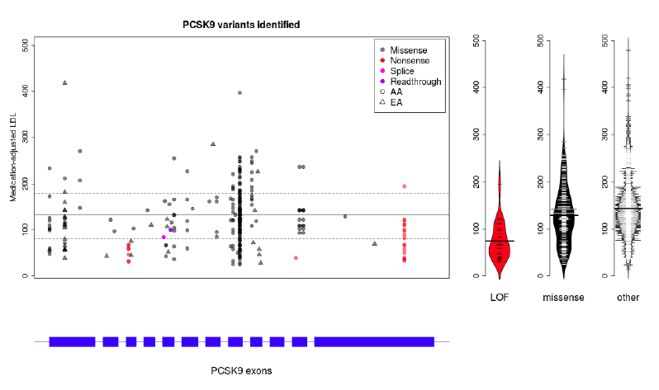

Slide 13
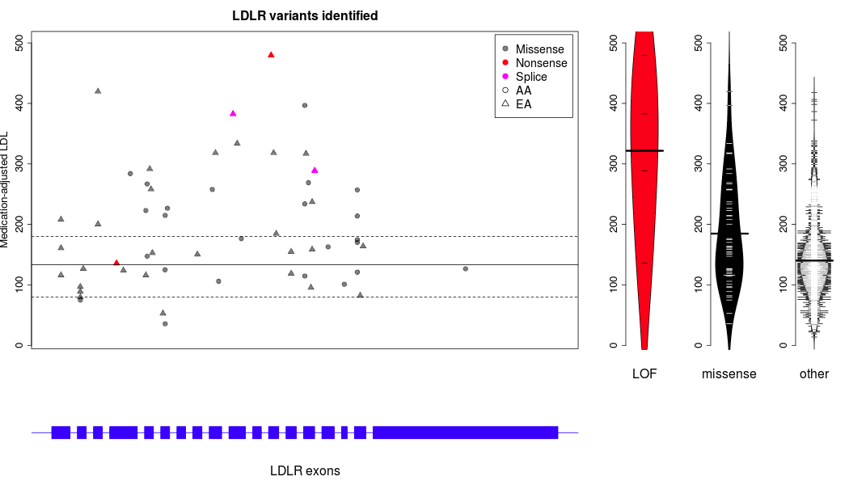

Slide 14
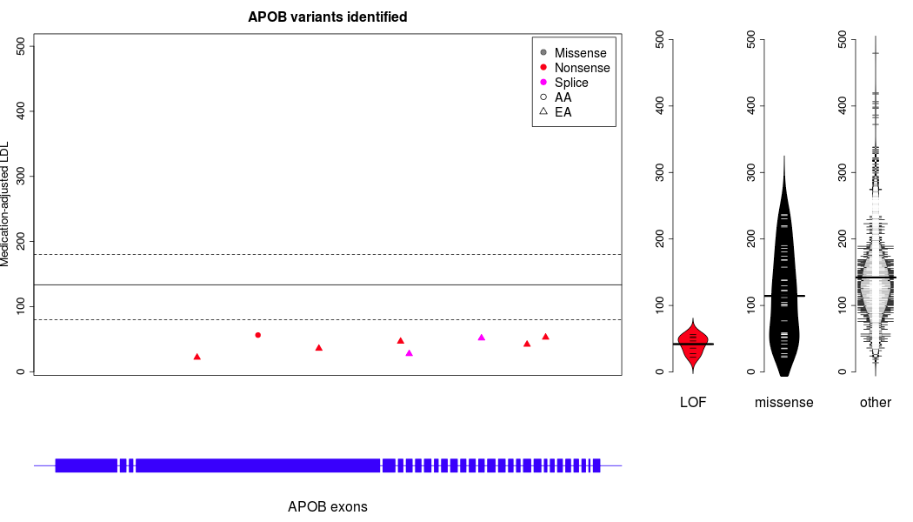

Slide 15
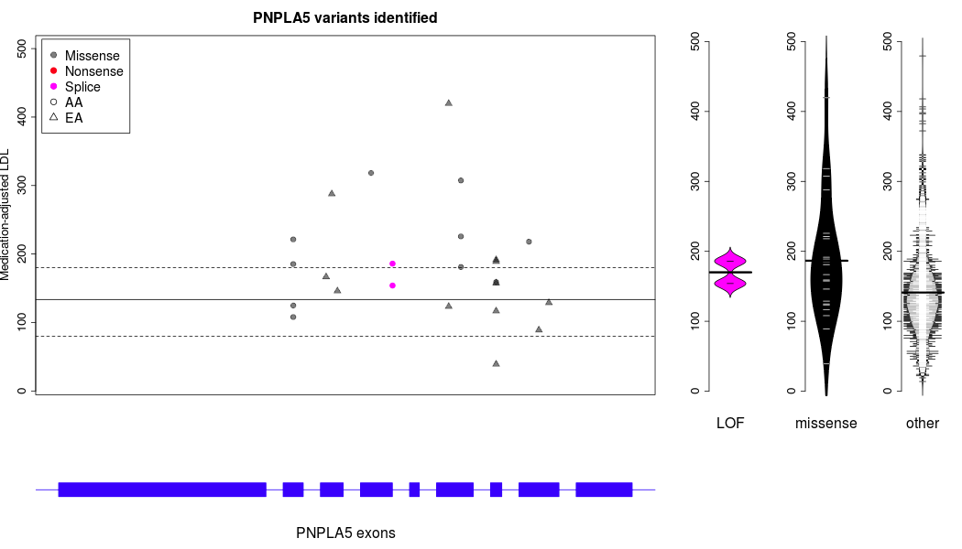

Slide 16
Snippets of ESP Results - 3
Pharmacogenomics
  Led by Adam Gordon (Nickerson lab)
  Exome sequencing of 2,203 African Americans and 4,300 Caucasians
  Survey of coding variation in 12 CYP450 genes
  Discovered 1,006 unique variants (275 known, 731 novel); 486 missense variants and 42 nonsense/splice or frameshift
  CYP2A6, CYP2B6, CYP2D6 contain most nonsynonymous variation (and are in the top 20% exome-wide)
  Predicted function -> drug metabolism?
    11.7% AA and 7.6% EA carry a predicted functional variant
    21.8% AA and 14.1% EA have variants in one of 12 CYP genes
  Under review, Hum Mol Genet

Slide 17
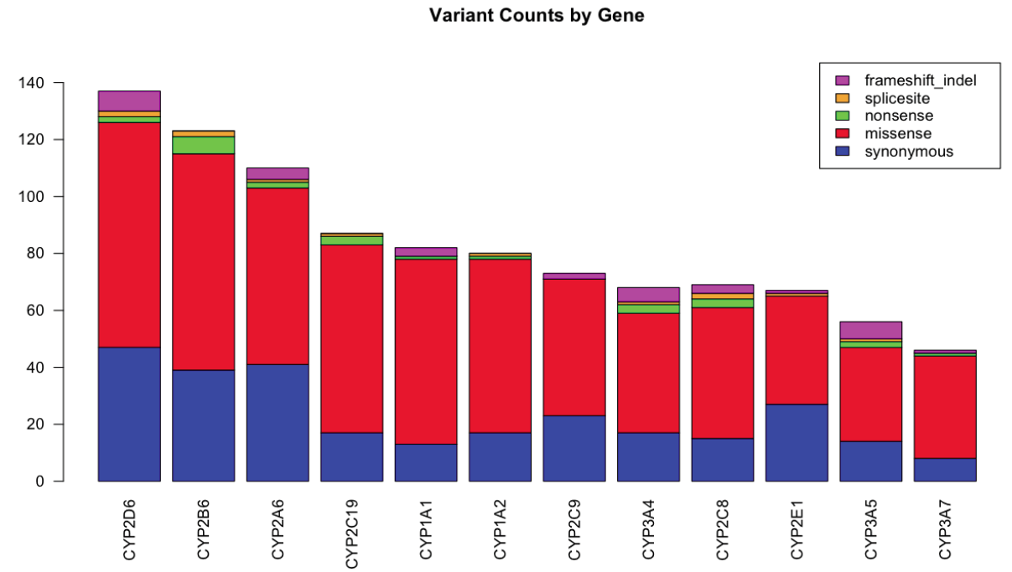

Slide 18
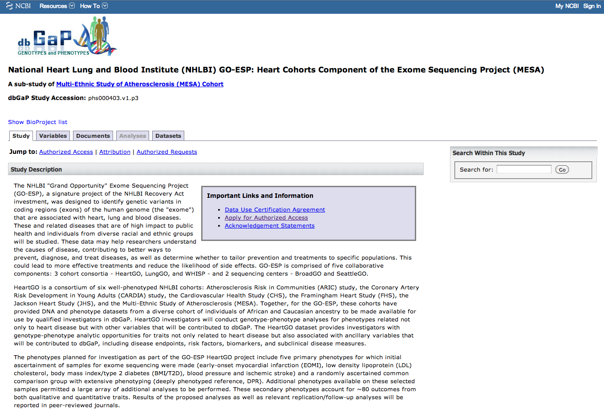
MESA ESP data in dbGaP

Slide 19
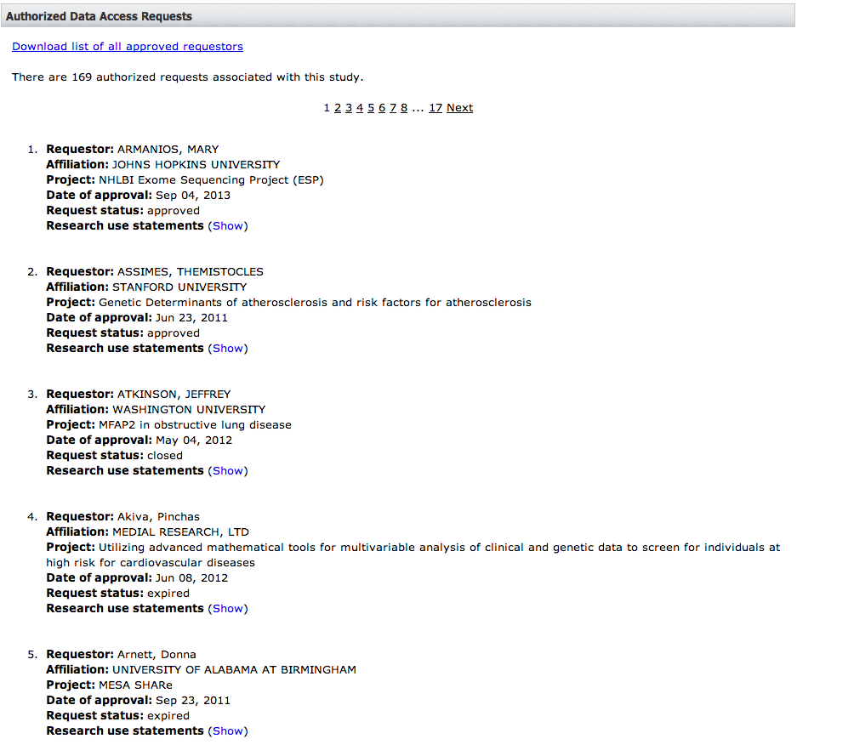
MESA ESP dbGaP access

Slide 20
The ExomeChip
Exome sequencing studies are likely well-powered to discover shared (MAF > 0.1%) variants that contribute to diseases of interest
Exome sequencing studies of (non-Mendelian) traits may be underpowered to demonstrate association to those variants
Array-based genotyping is less expensive per sample than exome sequencing

Slide 21
Samples Contributed to ExomeChip
Samples | # Samples | Phenotype | Samples | # Samples | Phenotype
Baylor Autism | 902 | Autism | Finn BMI | 46 | BMI
Broad Autism + DILI | 993 | Autism* | ESP BP | 613 | BP
STARD | 50 | Depression | Lipid extremes | 131 | Lipids
Broad SCZ | 525 | Schizophrenia | ESP AA | 1143 | Metabolic
Cancer Genome Atlas | 422 | Cancer | ESP EA | 1377 | Metabolic
HIV | 121 | HIV | Sardinia | 505 | Metabolic
Lausanne Sanger | 456 | Population | ESP AA (UW) | 144 | Metabolic
1KG Solid | 306 | Population | ESP EA (UW) | 983 | Metabolic
1KG Illumina | 822 | Population | GO T2D Genome | 602 | T2D
Chinese Exomes | 327 | Population | Pfizer T2D | 182 | T2D
 |  |  | GO T2D Exome | 1016 | T2D
 |  |  | T2D Exome | 362 | T2D
 | 4924 |  |  | 7104
Total: 12,028 samples

Slide 22
Coding Content (RefSeq Genes)
1,107,051 nonsynonymous variants
  646,888 with allele counts = 1
  163,044 with allele counts = 2
  297,119 with allele counts > 2
  260,054 seen in at least 2 studies
44,529 splice variants
  27,265 with allele counts = 1
  17,264 with allele counts > 1
  12,662 seen in at least 2 studies
31,003 stop gain/loss variants
  20,637 with allele counts = 1
  10,366 with allele counts > 1
  7,137 seen in at least 2 studies

Slide 23
MESA ExomeChip data
Genotyping of MESA (and MESA ancillary) samples conducted at CSMC (n=8,304)
Quality Control conducted at UVA
  SNP-level call rate (missing > 5%); 37 SNPs removed (1 Y SNP)
  Sample-level call rate (missing > 5%); 5 subjects (1m, 4f)
  Sample-level heterozygosity (1m, 7f)
  Sex mismatch (47 subjects removed)
  Cryptic relationships (23 pairs flagged as errors; 16 pairs of unintended first-degree relatives)
  Concordance with GWAS (3,064 overlapping SNPs); 78 samples do not match MESA SHARe GWAS data
  ExomeChip-GWAS concordance; reassign 79 ID, drop 6 ID
Data released March 2013 (v12 MESA SHARe update, June 2013)(n=8,239)

Slide 24
MESA ExomeChip activity
Take advantage of multi-ethnic structure and diverse phenotypes that would otherwise not be considered in large consortia
Phenotypes
  Lipids (levels and subfractions)
  Lung (PFT and CT measures of volume, COPD, emphysema)
  Hematology and blood count factors
  Inflammatory and endothelial biomarkers
  Imaging of the heart (cardiac MRI, LV/RV parameters)
  Fatty acid and lipid metabolism
Develop active collaboration with basic scientists

Slide 25
CHARGE-MESA ExomeChip activity
“best practices” manuscript
  Grove et al., Best practices and joint calling of the HumanExome BeadChip: the CHARGE Consortium. PLoS One 2013 Jul 12;8(7):e68095. PMID: 23874508
Lipids
  CHARGE (~60,000 participants [3/4 white, 1/4 black] with Total Cholesterol, LDL, HDL, triglycerides); Gina Peloso lead
Lung
  Pulmonary function tests (FEV1, FVC, FEV1/FVC)
  Stephanie London, CHARGE; Graham Barr, MESA
Ischemic Stroke
  116 MESA participants with stroke diagnosis
  Myriam Fornage, CHARGE; Stephen Rich, MESA

Slide 26
Future Directions
Exome Sequence Project
  MESA/HeartGO ESP with CHARGE-S
  Translating candidate genes with burden of rare variants into mechanisms of pathology
ExomeChip
  Leverage MESA ethnic-diversity and phenotypes into MESA-centric studies
  Continue MESA collaborations with CHARGE
  Initiate MESA as discovery cohort with PAGE (NHGRI)
Utilizing MESA expression/methylation data with genomic data into Systems Genetics
MESA serving as a foundation for functional studies with basic scientists

Slide 27
