Slide 1
Overview of Recent MESA Findings
Gregory Burke and Diane Bild
MESA OSMB meeting
September 21, 2011

Slide 2
Impaired fasting glucose was not independently associated with an increased risk of incident cardiovascular events over 7.5 years.

Slide 3
Yeboah, continued

Slide 4
Yeboah, continued

Slide 5
Yeboah, continued
IFG is not a risk factor for CVD, independent of age, sex, race/ethnicity, BMI, SBP, TC, HDL, TGs, smoking, BP medication and statins.
Diabetes was associated with a 1.9-fold independent risk.
IFG carried a 13-fold risk for the development of diabetes.

Slide 6
Higher left ventricular mass was significantly associated with higher incidence of hypertension.

Slide 7
Shimbo, continued

Slide 8
Shimbo, continued
LV mass is a well-documented consequence of long-standing hypertension.
This study demonstrated that LV mass predicted the development of hypertension after adjusting for confounders. This was previously shown in Framingham and the Strong Heart Study.
Quartile 4 of LV mass was associated with a 1.8-fold increased risk of hypertension over 4.8 years.

Slide 9
Regional wall motion abnormality was independently associated with incident heart failure.

Slide 10
Yan, continued
Baseline prevalence of regional myocardial dysfunction (RMD) was 25.6%.
After adjusting for risk factors, RMD was associated with a 2.6-fold increased risk of HF.

Slide 11
Homeostasis model of insulin resistance predicts coronary artery calcification incidence and progression.

Slide 12
Blaha, continued

Slide 13
Blaha, continued
The rate of incident CAC for the 1^{st—}4th quartiles of HOMA-IR - 4.4, 5.4, 6.8, and 7.8 per 100 person-yrs
Adjusted for age, sex, ethnicity, site, & years in between scans, participants in the 2nd–4th quartiles were 1.2, 1.5, and 1.8 times more likely to develop CAC than those in the 1st quartile.
However, HOMA-IR was no longer predictive after adjusting for metabolic syndrome components and other established risk factors

Slide 14
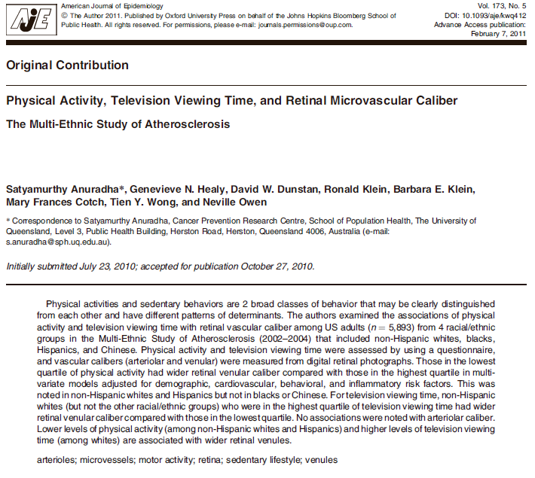
Lower levels of physical activity (among non-Hispanic whites and Hispanics) and higher levels of television viewing time (among whites) are associated with wider retinal venules.

Slide 15
Anuradha, continued
Microvascular changes in the retina of the eye are thought to represent a directly visible microvascular phenotype of endothelial dysfunction.
Lower levels of physical activity and higher levels of television viewing time are associated with wider retinal venules, independent of known sociodemographic, cardiovascular, and behavioral risk factors.

Slide 16
Anuradha, continued

Slide 17
Anuradha, continued

Slide 18
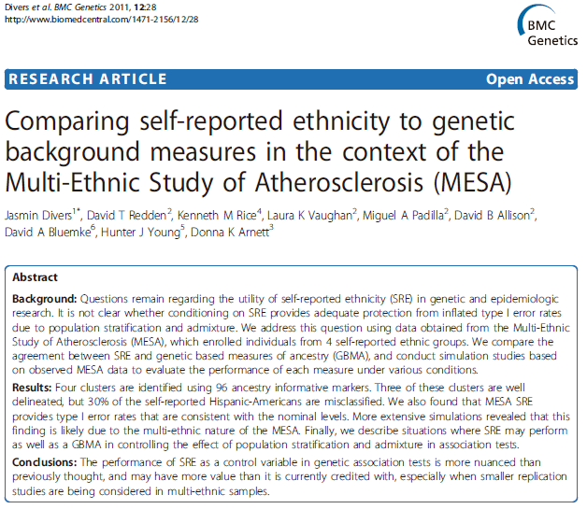
Self-reported ethnicity is strongly associated with AIMs.

Slide 19
Divers, continued
Some researchers have proposed banning use of self-reported race and ethnicity because they are poorly defined social constructs with weak biologic and genetic bases.
Some studies have found SRE to be closely related to an individual’s genetically estimated ancestry proportions.

Slide 20
Divers, continued

Slide 21
Divers, continued

Slide 22
Divers, continued
High degree of agreement between self-reported ethnicity and two genetic based measures of ancestry computed using genotyped ancestry informative markers.
Four clusters identified using 96 ancestry informative markers. Three of the clusters are well-delineated, but 30% of the self-reported Hispanic-Americans were misclassified.
Self-reported Hispanic-Americans were the most heterogeneous group.

Slide 23
For individuals with discordant LDL cholesterol levels and LDL particle number (LDL-P), the LDL attributable atherosclerotic risk is better indicated by LDL-P.

Slide 24
Otvos, continued
Low-density lipoprotein (LDL) is conventionally quantified in terms of the mass of cholesterol carried by these particles.
However, for the same cholesterol mass, people may have different particle numbers.

Slide 25
Otvos, continued

Slide 26
Otvos, continued

Slide 27
Otvos, continued

Slide 28
Reviews papers on relationships between air pollution and CRP, HRV, retinal vessel measures, SBP, arterial stiffness, urinary albumin, LV mass, coronary calcium, carotid IMT, & aortic calcification found in MESA. Red indicates signficiant association.

Slide 29
Gill, continued

Slide 30
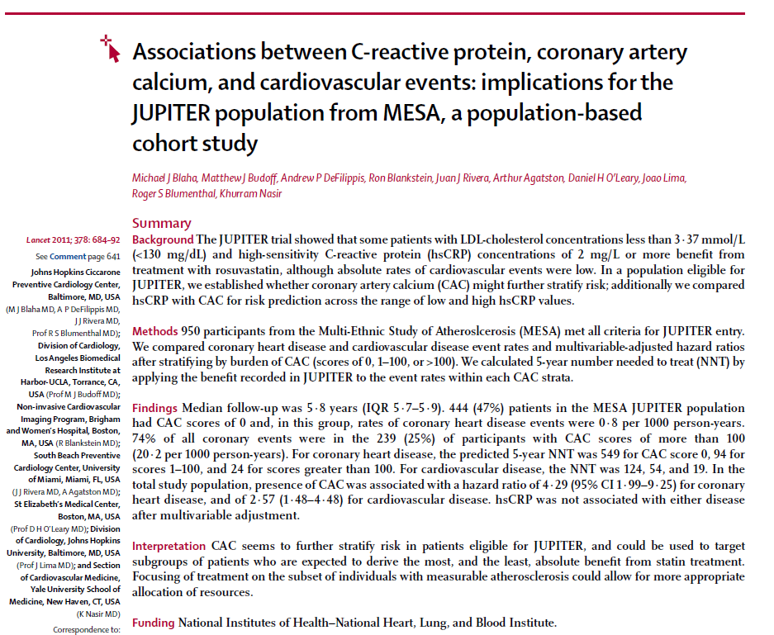
CAC was a stronger predictor of CVD than hsCRP. Among persons with high CRP and low LDL, CAC predicted CVD.

Slide 31
Liver attenuation and pericardial adipose tissue were associated with insulin resistance, independent of BMI and waist circumference. There were significant differences by ethnicity in the liver attenuation-insulin resistance relationships.

Slide 32
McAuley, continued
Insulin resistance was related to liver attenuation, pericardial adipose tissue, BMI, and waist circumference.

Slide 33
McAuley, continued
For liver attenuation and insulin resistance, regression coefficients per 1 SD increment in HOMA were 0.10 ± 0.01 for whites, 0.11 ± 0.02 for Chinese, 0.08 ± 0.2 for blacks, and 0.14 ± 0.01 for Hispanics.
HOMA – BMI relationships were strongest for Chinese and weakest for African Americans. HOMA – waist circumference relationships were strongest in African Americans.

Slide 34
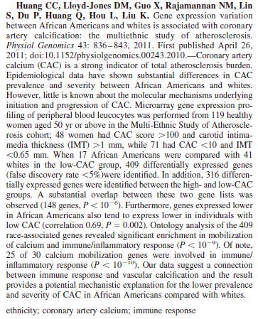

Slide 35
Huang, continued
African Americans have a lower prevalence of coronary calcification than whites.
We found a large number of differentially expressed genes between these two ethnic groups among those with low CAC scores. Investigation of the functional modules of the race-associated genes revealed enrichment and substantial overlap of two major functional axes: calcium mobilization and immune response.

Slide 36
Associations of occupation, job control and job demands with intima-media thickness: The Multi-Ethnic Study of Atherosclerosis
Kaori Fujishiro,¹ Ana V Diez Roux,² Paul Landsbergis,³ Sherry Baron,¹ R Graham Barr,⁴ Joel D Kaufman,⁵ Joseph F Polak,⁶ and Karen Hinckley Stukovsky⁷
Occup Environ Med. 2011 May;68(5):319-26. Epub 2010 Oct 8.
Blue-collar jobs and low levels of job control were associated with the development of subclinical atherosclerosis

Slide 37
Fujishiro et. al.
Blue-collar workers had greater internal carotid artery (ICA)-IMT than managers/professionals after adjustments were made for traditional cardiovascular disease risk factors and SES, suggesting that blue-collar jobs carry additional risk.
Occupational category was more strongly associated with ICA-IMT, whereas job control was more strongly associated with common carotid artery (CCA)-IMT.
Low job control was associated with greater CCA-IMT, with the association being stronger for those in high-demand jobs than in low-demand jobs.

Slide 38
These findings represent only a subset of MESA Publications over one year Much More is to Come!!!

