Slide 1

MESA Project Office Report
MESA OSMB meeting
September 2010
Diane Bild, MD, MPH
Prevention and Population Science Program
Division of Cardiovascular Sciences
NHLBI

Slide 2
Recent MESA OSMB meetings
Meeting, March 17, 2009
  Issues: Planned Exam 5 components, radiation exposure estimates, CT equipment comparability
Conference call, October 2, 2009
  Issues: Columbia CT scanner, length of past exams, radiation exposure estimates, ancillary study updates
Meeting, September 13, 2010

Slide 3
Project Office Report Items
Exam 5
OSMB notifications
Ancillary studies
Genetics (no separate slide)
  SHARe program – MESA data added to dbGaP in December; active working groups and papers (Rotter and Burke)
  Go-ESP -- RC2 grant – Exome Sequencing Project (Rich)
MESA publications activities

Slide 4
Exam 5
Exam started in April.
Clinic site were visits conducted in June and July.
  No major problems identified
  Three clinics needed to increase capacity
Clinic exams are well-received by participants.
Mean exam time is 6.51 hours (main exam + ancillary studies).
Retention is at 65% of expected.*
*As of September 8, 2010

Slide 5
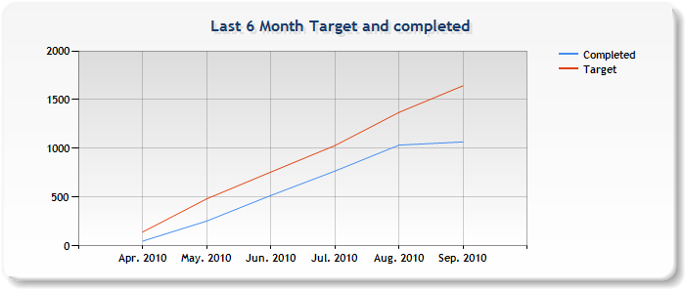
Exam 5 retention
Downloaded from MESA web site September 6, 2010

Slide 6
OSMB notifications
When an IRB is notified, we notify the OSMB
  Protocol violation that violates informed consent
  Adverse events
    Serious adverse events or unanticipated problem
    Other AEs

Slide 7
Exam 5 Ancillary studies
Ancillary studies
  We are operating under a moratorium for Exam 5
  Still actively receiving proposals to use samples and read scans

Slide 8
Exam 5 Ancillary Studies
Funded in last 12 months, studies without burden (or blood only)
  Allison – renal artery arteriosclerosis
  Nettleton – diet, genetics, and DM risk
  Liu – genetics of visceral adiposity
  Bradley – GGT and CVD risk
  Vedal – genes, air pollution, and CVD risk
  Carnethon – DM in normal weight adults
  Kestenbaum – vit D, Phos, CVD risk

Slide 9
Exam 5 Ancillary Studies
Funded (or pending) in last 12 months, studies with burden
  Barr – MESA Lung II (qq, spiromety, CT scan)
  Golden – adrenal size (ADA, pending)
  Diez Roux – MESA Stress II (salivary cortisol, urine, DNA)
  Redline – sleep (home polysomnography)
  Jacobs – arterial elasticity (tonometry)

Slide 10
Publications (n=297)
Cumulative by Year
Data Cumulative Through August 2010; prepared by MESA CC

Slide 11
Abstracts accepted to AHA Scientific Sessions, 2010
32 submitted
20 accepted
  14 oral presentations
  6 poster presentations

Slide 13
MESA Project Office Report
MESA Steering Committee meeting
September 2010
Diane Bild, MD, MPH
Prevention and Population Science Program
Division of Cardiovascular Sciences
NHLBI

Slide 14
Project Office Report Items
OSMB recommendations
Exam 5
Ancillary studies
MESA publications activities
DMDAs
Contract changes
NIH and NHLBI news

Slide 15
Exam 5
Exam started in April
Clinic site visits conducted in June and July
  No major problems identified
  Three clinics needed to increase capacity
Clinic exams are well-received by participants
Mean exam time is 6.51 hours (main exam + ancillary studies).
Retention is at 65% of expected*
*As of September 8, 2010

Slide 16
OSMB recommendations

Slide 17
Exam 5 Ancillary studies
Ancillary studies
  We are operating under a moratorium for Exam 5
  Still actively receiving proposals to use samples and read scans

Slide 18
Exam 5 Ancillary Studies
Funded in last 12 months, studies without burden (or blood only)
  Allison – renal artery arteriosclerosis
  Nettleton – diet, genetics, and DM risk
  Liu – genetics of visceral adiposity
  Bradley – GGT and CVD risk
  Vedal – genes, air pollution, and CVD risk
  Carnethon – DM in normal weight adults
  Kestenbaum – vit D, Phos, CVD risk

Slide 19
Exam 5 Ancillary Studies
Funded (or pending) in last 12 months, studies with burden
  Barr – MESA Lung II (qq, spiromety, CT scan)
  Golden – adrenal size (ADA, pending)
  Diez Roux – MESA Stress II (salivary cortisol, urine, DNA)
  Redline – sleep (home polysomnography)
  Jacobs – arterial elasticity (tonometry)

Slide 20
Publications (n=297)
Cumulative by Year
Data Cumulative Through August 2010; prepared by MESA CC

Slide 21
Abstracts accepted to AHA Scientific Session 2010
32 submitted
20 accepted
  14 oral presentations
  6 poster presentations

Slide 22
MESA DMDAs - changes
Requires IRB review rather than IRB approval from data/material requesters. IRB approval exemption is acceptable if de-identified data (variables) are requested. (Project Office will determine.)

Slide 23
MESA DMDAs – changes, cont.
Defines “Images” as Data instead of Materials
Adds definition of MESA investigator (on active contract or subcontract or consultant, NHLBI employee working on MESA)
If Material is requested:
  DMDA is needed for ancillary study PI
  DMDA is not needed for non-affiliated lab if not receiving data

Slide 24
MESA DMDAs – changes, cont.
Acknowledgements: ancillary study investigators can publish papers without MESA approval but must acknowledge the disapproval or non-collaboration
Indemnification: Exemption for the State and Federal government is added.
Adds the clauses in sections 4.2 and 12 that allow for NHLBI authorized distribution of data and/or materials by the Recipient, for cases such as fee-for-service assay work on behalf of the Recipient, or repackaging/processing/assaying of data and/or materials such as that ongoing within the HEART-GO/GO-ESP projects and similar consortia.
Adds the clauses in section 21 (a) that require the CMS data recipients to destroy all copies of all data received from the MESA study.

Slide 25
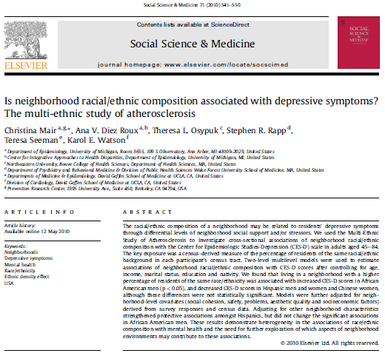
Continued productivity in area of neighborhood characteristics and CVD risk

Slide 26
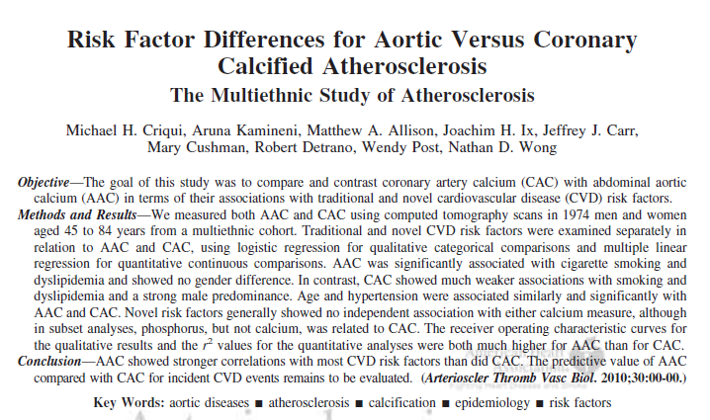
The correlations between CVD risk factors and aortic calcification were noted to be stronger than for CAC.

Slide 27
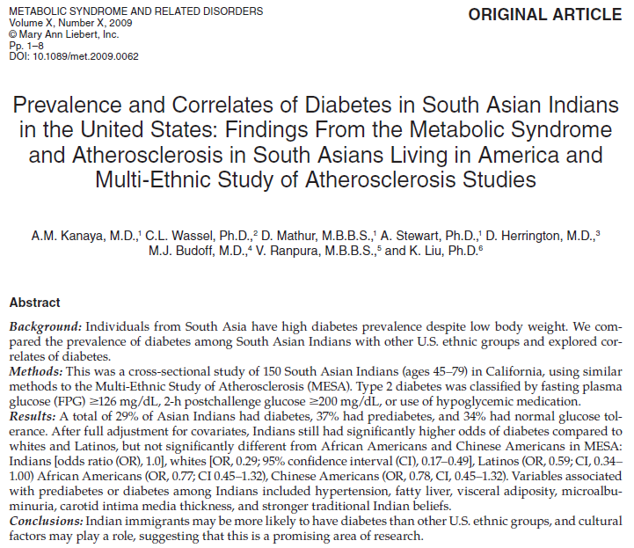
Comparison with another ethnic group

Slide 28
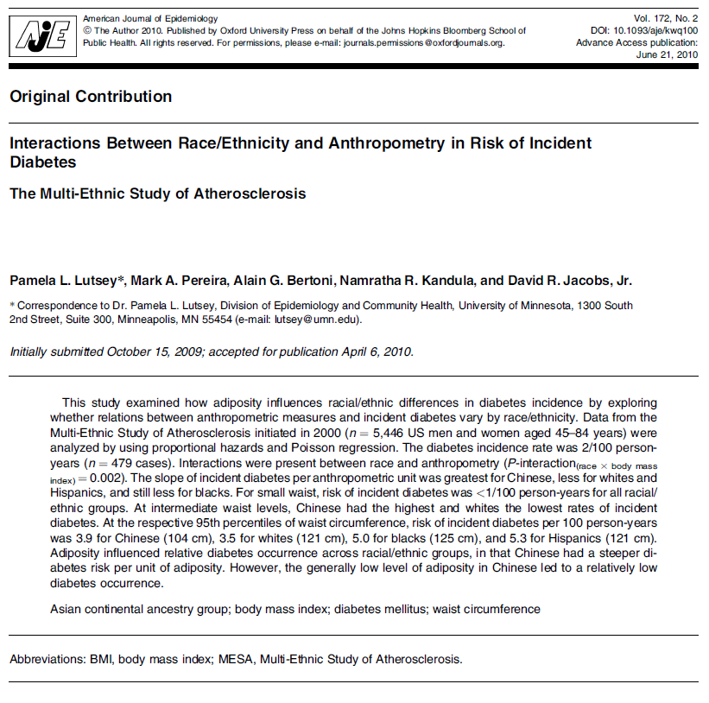
Further analysis of some of the interesting ethnic comparisons, particularly with the less well-studied Chinese subgroup

Slide 29
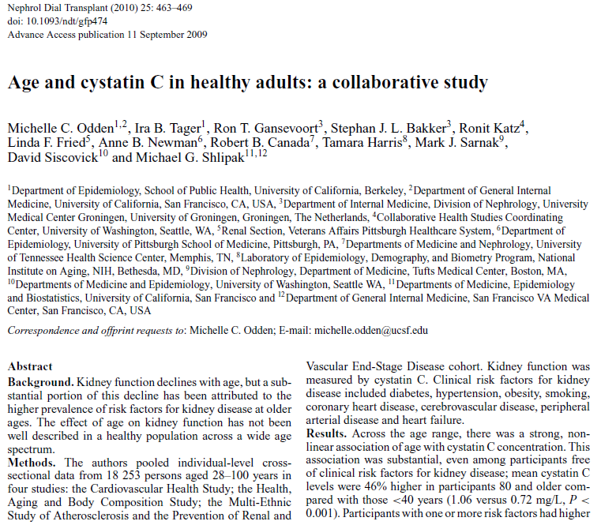
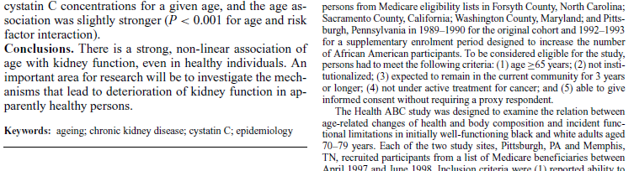
Collaboration with Health ABC, CHS, and the Prevention of Renal and Vascular End-Stage Disease cohorts.

Slide 30
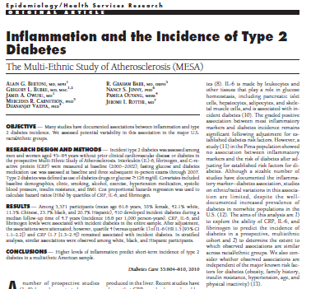

Slide 31
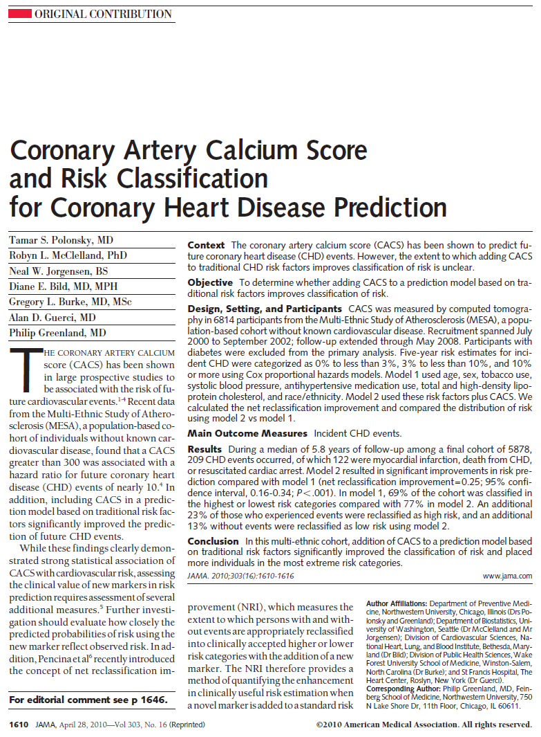

Slide 32
NIH and NHLBI news
New NHLBI Director to have been selected by the end of August . . .
Susan Shurin is Acting Director of NHLBI
Changes in contracting

Slide 33
Changes in contracting
Necessary due to a change in HHS’ interpretation of the appropriation laws for contracts exceeding 1 year.
MESA contracts exceed 5 years and are considered non-severable (the service cannot be considered complete in the middle of performance), so they will be structured as Options contracts. These contracts have a base period and annual options thereafter.
Each contractor’s base period will be determined. The OA (with you and your business offices) will calculate the amount of time your individual current obligations will cover. Thereafter you will have annual option periods.
The expiration date will not change nor should the negotiated amount of your current contract.

Slide 34
Questions?
Comments?

