Slide 1
MESA Project Office Report
Diane Bild, MD, MPH
Prevention and Population Sciences Program
Division of Cardiovascular Sciences NHLBI
MESA OSMB meeting September 2011

Slide 2
Project Office Report Items
Exam 5
Retention, results reports, protocol violations
Adverse events and OSMB notifications
Publications

Slide 3
Exam 5 retention
Goal for Exam 5 is 5200, which represents
87-88% of enrolled cohort (not deceased). (Exam 4 achieved 87%.)
The study has seen 4219 as if September 14 (out of 6178, which is 68% retention).
Exam 5 ends on November 30, 2011.
Follow up phone calls (Follow-up 10) somewhat behind, probably due to Exam 5 efforts; plan to make up in Follow-up 11.

Slide 4
Exam 5 results reporting
Overseen by the Participant Relations Committee.
Sending reports to participants was slow at the start of Exam 5 but picked up throughout (largely due to automating the process).
During the July – September period, first results were sent in a median of 23 days (maximum of 38 days). (This compares to a median of 108 days and a max of 326 during April – December 2010.)

Slide 5
Adverse events and protocol violations
Three cases of radiation that exceeded the informed consent since April 2011:
Case 69: Participant was not selected for and did not consent to a cardiac CT but received a cardiac CT scan in April (Columbia CT).
Case 76: Participant was not selected for and did not consent to a lung CT but received a lung CT in July (UCLA).
Case 78: Participant was scheduled twice for both the cardiac and lung CTs (UCLA) (7/19/2011 and 8/18/2011).
All reported to local IRBs.
No reports for inappropriate gadolinium administration (someone with low GFR)
Notes:
From Karol Watson on 9/16: Immediately after discovering these deviations, UCLA put several corrective measures in place, revised our SOPs and procedures and received additional training so that these occurrences do not happen again. The IRB agreed with our plans and our assessment and the final determination as voted on by the full IRB committee on Wednesday September 14, 2011 is that "no further action is required."

Slide 6
OSMB notification
Current directive to investigators:
When an IRB is notified, please notify the PO so we can notify the OSMB
Protocol violation that violates informed consent
Adverse events and unanticipated problems

Slide 7
Adverse Events and Unanticipated Problems
Any event or problem that is
Unexpected;
AND
Possibly, probably, or definitely related to study participation;
AND one of the following:
Is fatal, life-threatening, or serious (SAE + UP)
Report within 7 calendar days
Suggests greater risk of harm to study participant(s) than was previously known or recognized(UP)
Report within 30 calendar days
http://www.nhlbi.nih.gov/funding/policies/adverse.htm#formsandattachments

Slide 8
OSMB notification
Proposal:
Report only SAEs and UPs urgently; report others routinely. (They are still reported to IRBs.)

Slide 9
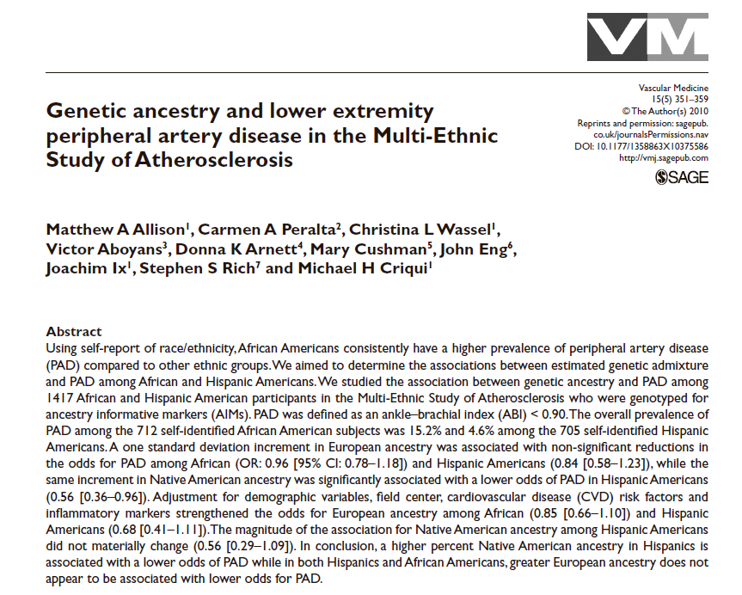
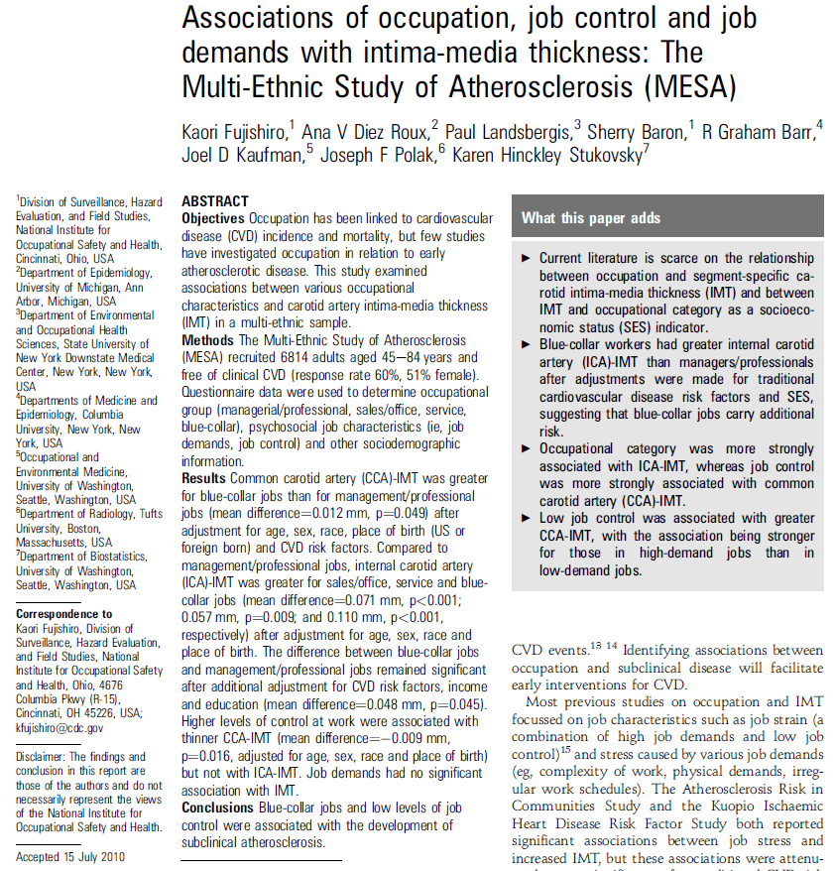
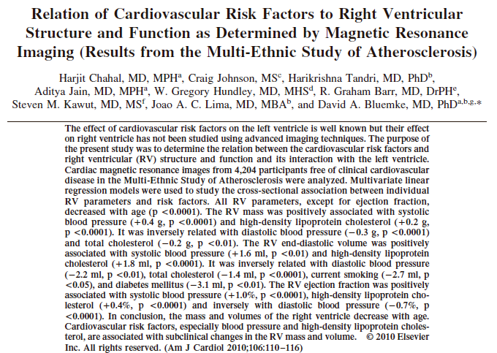
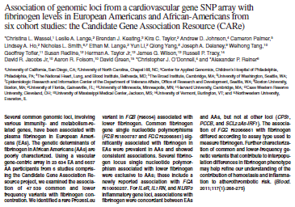
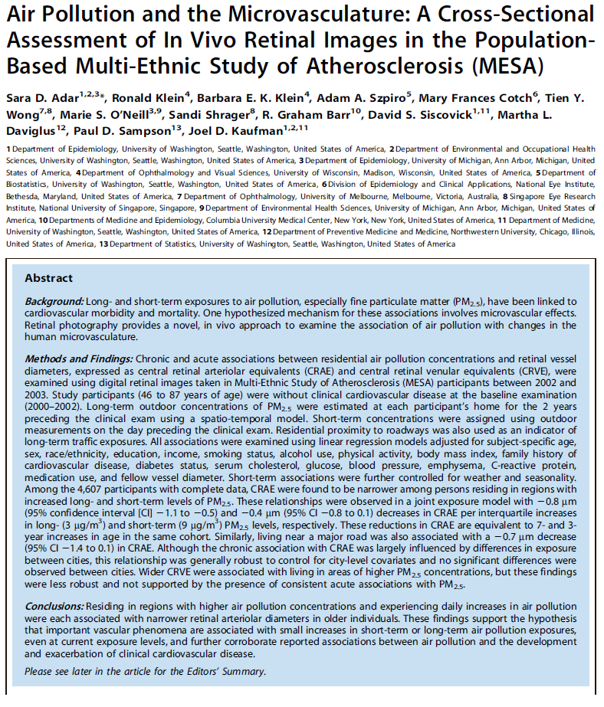
Publications

Slide 10
MESA Publications
*
Number
of
Manuscripts
(n=403)
Represents 235 unique first authors
* Published or in press as of September 8, 2011.

Slide 11
High profile publication

Slide 12
MESA Objectives and Publications
July 2011
Notes:
Papers fit into one main topic as 1. Secondary topic coded as 0.01 (but not exhaustively). Cross-sectional risk factor analyses coded in column G (screening methods). For ethnic differences, I looked for mention of ethnicity in the title. I tended into include all papers on LV function in the second group.

Slide 13
Questions?

Slide 14
Changes proposed to Common Rule
News Release
FOR IMMEDIATE RELEASE July 22, 2011
Contact: HHS Press Office (202) 690-6343
HHS announces proposal to improve rules protecting human research subjects
Changes under consideration would ensure the highest standards of protections for human subjects involved in research, while enhancing effectiveness of oversight
http://www.hhs.gov/news/press/2011pres/07/20110722a.html

