Slide 1
Type 2 Diabetes and: the Multi-Ethnic Study of Atherosclerosis (MESA)
Alain G Bertoni MD MPH
Public Health Sciences
Wake Forest School of Medicine
Presentation to OSMB

Slide 2
Background I
Diabetes (primarily type 2) prevalence has increased substantially in U.S. since 1980’s, linked to increasing obesity
Minority groups, and the elderly, have a higher burden of Type 2 diabetes

Slide 3
Age-adjusted Percentage of U.S. Adults Who Were Obese or Who Had Diagnosed Diabetes
Obesity (BMI ≥30 kg/m²)
1994
2000
2007
No Data <14.0% 14.0-17.9% 18.0-21.9% 22.0-25.9% >26.0%
Diabetes
1994
2000
2007
No Data <4.5% 4.5-5.9% 6.0-7.4% 7.5-8.9% >9.0%
CDC’s Division of Diabetes Translation. National Diabetes Surveillance System available at http://www.cdc.gov/diabetes/statistics

Slide 4
Background II
Diabetes is well established as a major risk factor for CVD including
Ischemic Heart Disease
Stroke
Heart Failure
Peripheral Vascular Disease

Slide 5
Diabetes and risk of vascular disease: A meta-analysis of 102 prospective studies/ 698K people Relative risk compared to non-diabetic persons
Emerging Risk Factors Collaboration Lancet 2010; 375: 2215–22

Slide 6
What is there left to study?
When MESA was designed, there was little information regarding
CAC in populations with diabetes
Relationship between DM, CAC and events
Could CAC be helpful for further risk stratification?
Few large U.S. prospective studies exist with incident diabetes endpoints
None designed for that purpose exclusively
Limited ethnic diversity
Genetics of DM, CVD

Slide 7
MESA and Diabetes
Active group of investigators
At least 38 published papers focusing primarily on diabetes and closely related topics (e.g. insulin resistance)
Important phenotype for ancillary studies
At least 2 funded ancillary studies related to DM incidence
R21 (Carnethon) pooling cohorts to study diabetes among non-obese participants
Industry (Bertoni) validation of risk prediction testing in multi-ethnic sample

Slide 8
DM related Data
Exams 1-5: Medication inventory
Subclasses including oral agents, insulins
Exams 1-5: fasting serum glucose
Exams 1,5: Serum Insulin
Exam 2: Family history of diabetes
Exam 2, 5: Hemoglobin A1c
Related phenotypes: weight, waist circumference, BP, lipids at each exam.

Slide 9
Baseline Characteristics, 2000-02
 | White | Chinese | African American | Hispanic
Characteristic | N=2614 | N=801 | N=1881 | N=1494
Age | 63 (10) | 62 (10) | 62 (10) | 61(10)
Female | 52% | 51% | 55% | 52%
Current Smoking | 12% | 6% | 18% | 14%
BMI (kg/m2) | 27.5 (5) | 24.0 (3) | 30.2 (6) | 29.4 (5)
Hypertension | 39% | 37% | 59% | 42%
SBP (mmHg) | 123 (20) | 125 (22) | 132 (22) | 127 (22)
Glucose (mg/dl) | 92 (21) | 99 (28) | 100 (32) | 104 (39)
Diabetes* | 6% | 13% | 18% | 18%
Impaired Fasting Glucose | 10% | 15% | 13% | 14%
* At baseline inquired regarding age at onset and first treatment; nearly all appear to by type 2 DM
Notes:
tab race1c

Slide 10
Coronary Artery Calcium (CAC)
The prevalence of any CAC among type 2 diabetes in MESA was high (62%)
Diabetes independently associated with significantly greater amount of CAC among those with CAC>0
Bild et al, Circulation 2005
Proportions with CAC differed by ethnicity
Carnethon et al. Diabetes Care 2005

Slide 11
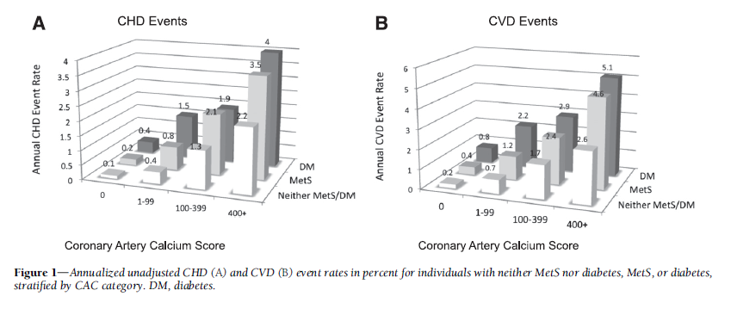
Low event rates even in DM participants if CAC is absent
Malik et al, Diabetes Care 2011

Slide 12
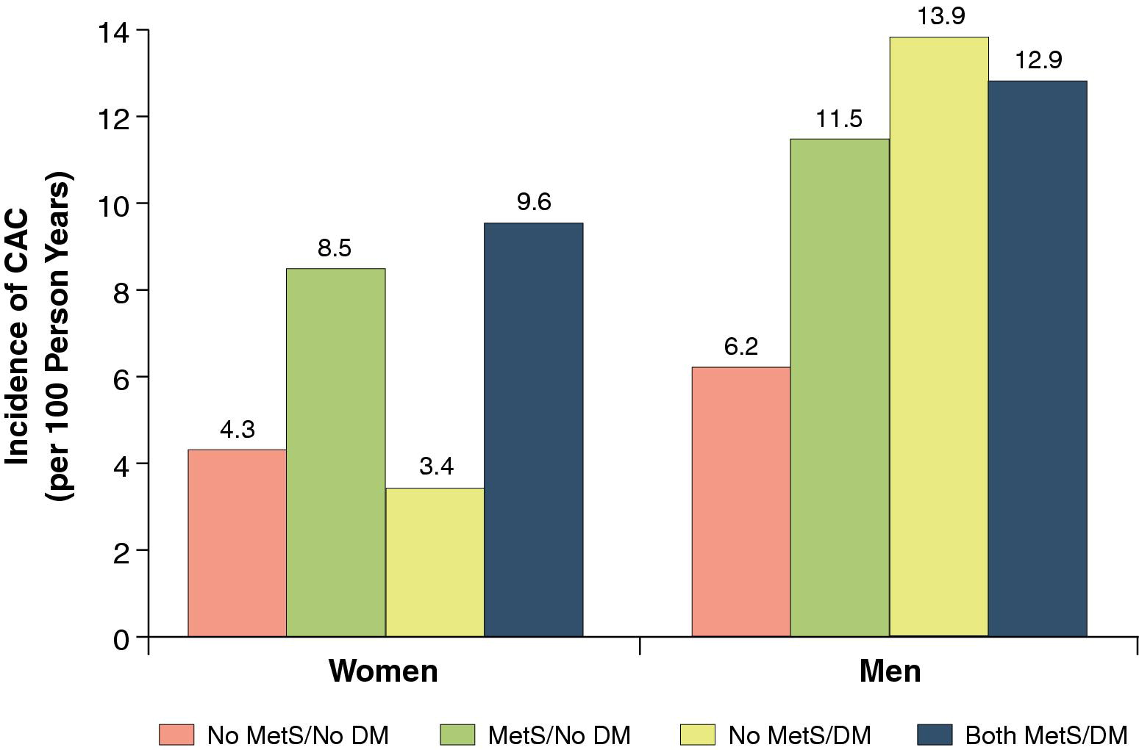
Wong ND, Nelson JC, et al. Metabolic Syndrome, Diabetes, and Incidence and Progression of Coronary Calcium : The Multiethnic Study of Atherosclerosis Study.
JACC: Cardiovascular Imaging 2012 Vol 5, Issue 4 ,358 - 366
Figure 1 Incidence of CAC (per 100 Person Years) According to MetS and DM Status, by Sex, Among Persons Without Baseline CAC CAC = coronary artery calcium; DM = diabetes mellitus; MetS = metabolic syndrome.

Slide 13
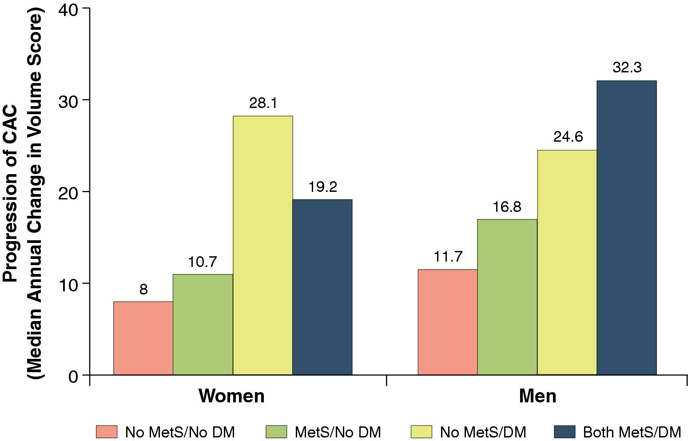
Figure 2 Progression of CAC (Mean Unadjusted Absolute Change in Volume Score) According to MetS and DM Status, by Sex, Among Persons Without Baseline CAC

Slide 14
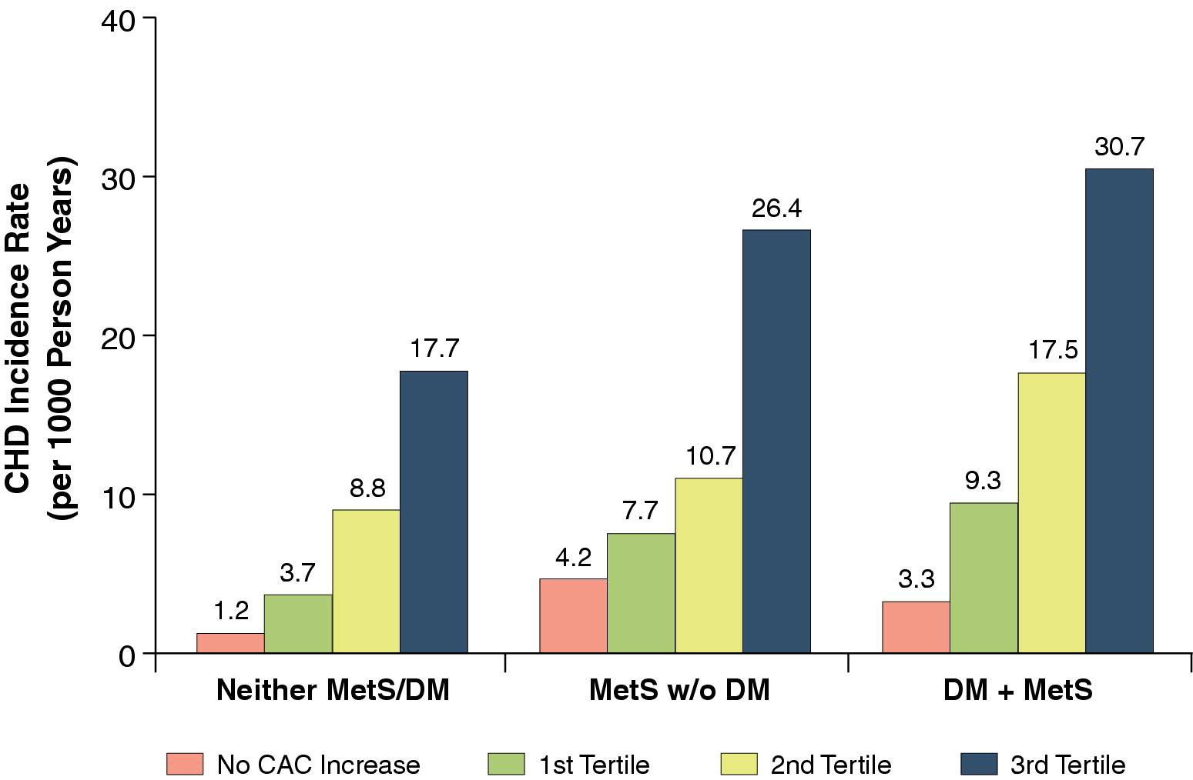
Figure 3 CHD Event Rates (per 1,000 Person Years) According to Tertile of CAC Progression by Presence of MetS and DM Data are not shown for persons with DM without MetS because of an insufficient number of coronary heart disease (CHD) events.

Slide 15
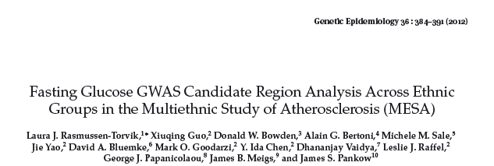
MESA GENETICS Working Groups/ Ancillary Studies
SNPs from 3 gene regions with the strongest associations to fasting glucose in previous Caucasian GWAS (MTNR1B / GCK /G6PC2) were examined in depth.
rs10830963 in MTNR1B and rs4607517 in GCK demonstrated consistent magnitude and direction of association with fasting glucose across ethnic groups
In conclusion, certain SNPs in MTNR1B and GCK demonstrate consistent effects across four racial and ethnic groups, narrowing the putative region for these causal variants.
Notes:
There was limited power to replicate associations in other ethnic groups due to smaller
allele frequencies and limited sample size; SNP associations may also have differed across ethnic groups due to differing
linkage disequilibrium patterns with causal variants..

Slide 16
Selected other publications
Depression and Diabetes
Neighborhood characteristics and insulin resistance
Diabetes and cardiomyopathy
Biomarkers associated with diabetic retinopathy
Sex Hormones and IFG/ Diabetes

Slide 17
Incident Diabetes
2003 ADA definition: use of hypoglycemic meds or insulin or glucose > 7.0mmol/l (126mg/dl)
Incidence at exam 2 (2003-04), 3 (2004-05), 4 (2005-07) and 5 (2010-11) defined among those who did not have diabetes at baseline (assume incident Type 2 DM)

Slide 18
Incident DM including exam 5 646 persons (15.1/1000 PY)
Notes:
Rate not markedly different by gender: Women 16.3/1000, Men 17.4/1000 , p=0.6

Slide 19
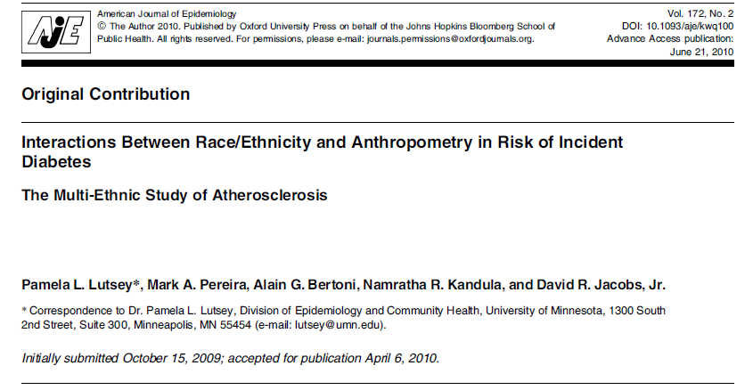

Slide 20
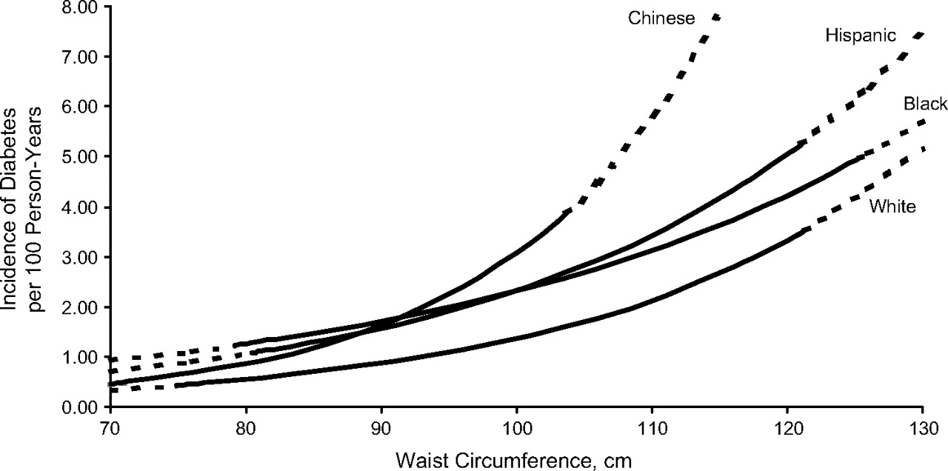
Absolute incidence rates of diabetes by waist circumference, stratified by race/ethnicity, The Multi-Ethnic Study of Atherosclerosis, United States, 2000–2007.
Lutsey P L et al. Am. J. Epidemiol. 2010;172:197-204
American Journal of Epidemiology © The Author 2010. Published by Oxford University Press on behalf of the Johns Hopkins Bloomberg School of Public Health. All rights reserved. For permissions, please e-mail: journals.permissions@oxfordjournals.org.
Notes:
Absolute incidence rates of diabetes by waist circumference, stratified by race/ethnicity, The Multi-Ethnic Study of Atherosclerosis, United States, 2000–2007. Solid lines pertain to values between the race-specific 5th and 95th percentiles of waist circumference. Dotted lines are extrapolated values outside the aforementioned race-specific ranges. Lines are curved because Poisson regression calculates incidence on the log scale. Adjusted for age, sex, education, and income.
The relation of adiposity to diabetes risk varied by race/ethnicity, with Chinese tending to be at greatest risk per anthropometric unit, followed by whites and Hispanics at lesser risk, and then blacks, who had the lowest risk per unit. Nevertheless, Chinese did not reach the same degree of obesity observed in other populations. Consequently, at the upper end of their race-/ethnic-specific adiposity distributions, the greatest absolute risk was observed for blacks and Hispanics.

Slide 21
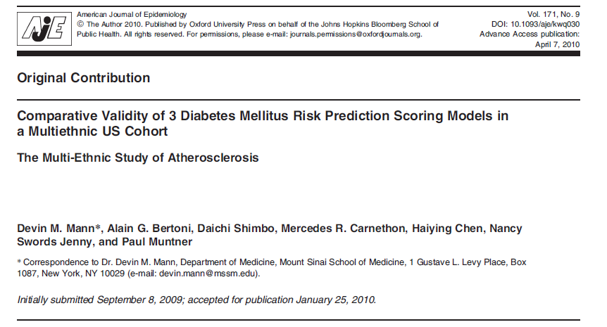

Slide 22
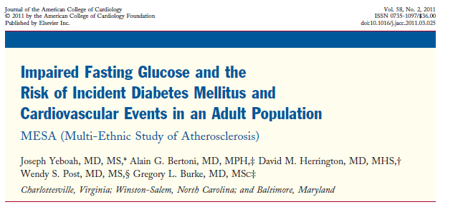

Slide 23
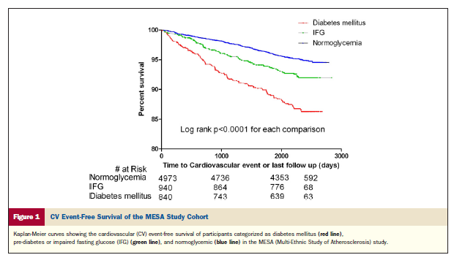
After adjustment for other risk factors, Diabetes associated with increased risk of CV events (HR 1.87, 95% CI 1.47-2.37)
Yeboah et al, JACC 2011

Slide 24
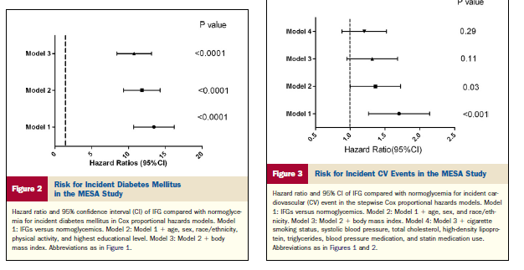
The increased rate of CV events in IFG is not independent of risk factors, however IFG is strongly predictive of future diabetes.
Suggests increased efforts at preventing DM among those with IFG are needed
Yeboah et al, JACC 2011

Slide 25
Diabetes Incidence by PA
p<0.001 by Log Rank Test
p<0.001 by Log Rank Test
Notes:
Updated 2012

Slide 26
Diabetes Incidence by PA
p<0.05 by Log Rank Test except Exercise: p<0.001
Notes:
Updated 2012

Slide 27
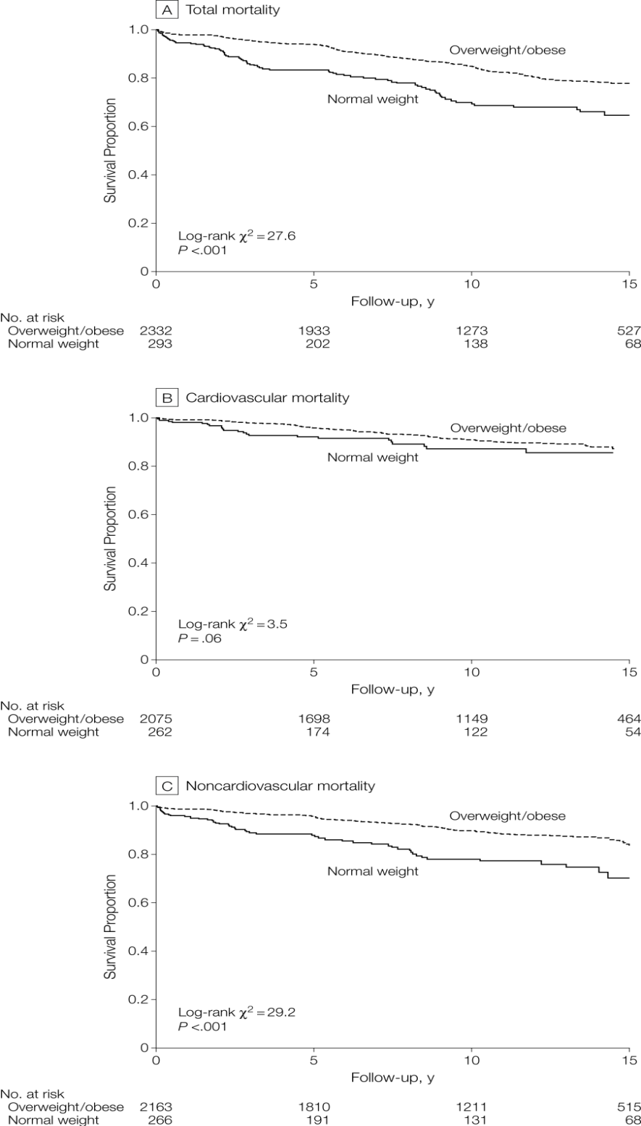
From: Carnethon et al, Association of Weight Status With Mortality in Adults With Incident Diabetes
JAMA. 2012;308(6):581-590. doi:10.1001/jama.2012.9282
Pooled analysis of MESA, ARIC, CARDIA, CHS and Framingham
Offspring Study
Figure Legend:
Body mass index (BMI) was calculated as weight in kilograms divided by height in meters squared. Normal weight was defined as a BMI of 18.5-24.9; those categorized as overweight/obese had a BMI of ≥25.
Date of download: 8/30/2012
Copyright © 2012 American Medical Association. All rights reserved.

Slide 28
Conclusions
MESA has, and will continue to contribute to further understanding the relationship between diabetes and CVD
Hastens coronary calcification
Subset of adults with DM but without CAC is at low risk for CVD
Important contributions regarding the epidemiology of type 2 diabetes in a contemporary, multi-ethnic sample

Slide 29
Further Directions/ Opportunities
Impact of Diabetes on heart structure/function and Heart Failure
Change from Exam 1 to Exam 5 in LV parameters
Investigation of “diabetic cardiomyopathy”
Correlates of progression from normal to IFG to Diabetes
By exam 5, 21% of the examined cohort has IFG and 20% diabetes.
Associations between glycemic status, subclinical athero, and cognition

