Slide 1

The Use of Coronary Artery Calcium Testing to Guide Aspirin Utilization for Primary Prevention: Estimates from the Multi-Ethnic Study of Atherosclerosis
Michael Miedema, MD MPH
MESA STEERING COMMITTEE MEETING
September 17, 2014

Slide 2
Disclosures
None

Slide 3
Introduction
The ideal role for aspirin in the primary prevention of cardiovascular disease is unclear
The primary prevention aspirin trials have resulted in a reduction in CVD events but with a near-equivalent increase in bleeding risk
Improved assessment of CVD risk could potentially identify patient with the most and least favorable risk/benefit profiles

Slide 4
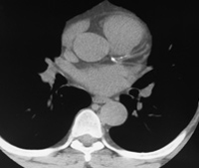
Introduction
Coronary Artery Calcium (CAC)
  Direct marker of coronary atherosclerosis
Predicts CHD (and CVD) events independent of traditional risk factors
The utility of CAC scoring in clinic practice is unclear

Slide 5
Aim/Hypothesis
Aim
  To evaluate the ability of CAC to provide improved risk stratification for individuals eligible for aspirin for the primary prevention of cardiovascular disease
Hypothesis #1
  Individuals with CAC > 100 would have favorable estimated risk/benefit profiles on aspirin regardless of baseline risk status
Hypothesis #2
  Individuals with CAC = 0 would have an unfavorable estimated risk/benefit profile with aspirin

Slide 6
Methods – Design and Participants
Prospective cohort (N=6,814 recruited 2000-2002)
45-84 years (mean age 62)
White, Black, Hispanic, and Chinese
53% women
No clinical CVD at baseline
Exam 5 (ended in 2011)
We excluded individuals on aspirin at baseline as well as those with diabetes

Slide 8
Methods – CAC Assessment
EBCT or multi-detector CT were used depending on the clinical site
All patients were scanned twice and the scores were averaged
All scans were interpreted by a cardiologist or radiologist at the MESA CT reading center (Los Angeles Biomedical Research Institute at Harbor-UCLA Medical Center)
Correlation coefficient between readers was 0.99

Slide 9
Methods – Outcomes
Events were adjudicated by the MESA morbidity and mortality committee
Hard CHD and CVD outcomes were assessed
  Hard CHD – Nonfatal MI, rescusitated cardiac arrest, and CHD death
  Hard CVD – Hard CHD and fatal and nonfatal stroke
Median Follow-up of 7.6 years

Slide 10
Methods - Analysis
Baseline characteristics were reports stratified by baseline aspirin use
Absolute CHD and CVD event rates were calculated stratified by CAC (0, 1-99, > 100)
  Multivariable hazard ratios were calculated using a Cox proportional hazards model

Slide 11
Methods - Analysis
For the total sample
  18% relative risk reduction in CHD was applied to individuals stratified by CAC and a Framingham risk of of > and < 10%
  We then calculated a 5-year number-needed to treat
  This was contrasted against the risk of major bleeding
    0.23% in major bleeding over 5-years (NNH 443)

Slide 12
Methods - Analysis
Gender stratified analysis
  We assumed a 32% relative risk reduction for CHD in men and a 17% CVD reduction in women
  This was contrasted against the risk of major bleeding
    0.26% in major bleeding for men over 5-years (NNH 388) and 0.20% for women (NNH 512)

Slide 13
Methods - Analysis
Age Stratified analysis
  18% relative risk reduction in CHD was applied to individuals stratified by CAC and a Framingham risk of of > and < 10% in 3 age categories (45-59, 60-69, 70-84)
  The risk of major bleeding adjusted for age-dependent risk according to the USTPTF guidelines

Slide 14
Table 1. Baseline Characteristics of MESA Participants Included in the Study Compared With Those Patients Excluded Because of Baseline Aspirin
Characteristic | No Aspirin Use at Baseline (n=4229) | Aspirin Use at Baseline (n=978) | P-Value
Age (years) | 60.6 (10.2) | 66.2 (9.2) | <0.0001
Female (%) | 56.0 | 45.4 | <0.0001
Race (%) |  |  | <0.0001
White | 36.7 | 58.6
Chinese | 13.1 | 7.2
African-American | 27.4 | 22.1
Hispanic | 22.8 | 12.1
Education Level (%) |  |  | <0.0001
College or Above | 35.7 | 45.3
BMI (kg/m²) | 28.0 (5.5) | 28.1 (4.9) | 0.77
Hypertension (%) | 38.3 | 55.6 | <0.0001
Current smoker (%) | 13.6 | 9.4 | <0.0001
HDL Cholesterol | 51.7 (14.8) | 51.4 (15.1) | 0.47
LDL Cholesterol | 118.9 (31.4) | 113.8 (29.1) | <0.0001
Family Hx of CHD (%) | 40.8 | 52.0 | <0.0001
10-Year Framingham CHD Risk Score (%) | 7.4 (7.0) | 10.3 (7.2) | <0.0001

Slide 15
Table 2. CHD and CVD Event Rates per 1000 Patient-Years and Hazard Ratios by CAC Burden in the MESA Population Not Using Aspirin
CAC Score | N (%) | CHD Event Rate | CHD H.R. (95% CI)* | CHD H.R. (95% CI)** | CVD Event Rate | CVD H.R. (95% CI)* | CVD H.R. (95% CI)**
0 | 2,361 (55.8%) | 1.3 | 1.00 (ref) | 1.00 (ref) | 2.30 | 1.00 (ref) | 1.00 (ref)
1-99 | 1,093 (25.8%) | 4.1 | 3.13 (1.82-5.41) | 2.09 (1.18-3.70) | 6.71 | 2.92 (1.93-4.43) | 1.88 (1.21-2.92)
> 100 | 775 (18.3%) | 11.6 | 9.03 (5.54-14.72) | 4.19 (2.36-7.43) | 15.02 | 6.57 (4.47-9.66) | 2.85 (1.81-4.50)
Model adjusted for age, sex, race/ethnicity, MESA site, cigarette status, cigarette pack-years, body mass index, low-density lipoprotein cholesterol, high-density lipoprotein cholesterol, lipid-lowering medication use, hypertension, antihypertensive medication use, family history of myocardial infarction, education level, and Framingham risk score

Slide 16
Table 3. Estimated Number Needed to Treat and Number Needed to Harm With Use of Aspirin in MESA Participants Stratified by 10-Year CHD Risk and Baseline CAC Assuming an 18% Reduction in CHD in Both Sexes
CHD risk < 10% | No. of participants | 5-yr CHD event rate | Estimated 5-yr NNT | 5-yr estimated absolute increase in bleeding rate | Estimated 5-yr NNH
CAC = 0 | 1907 | 0.27% | 2036 | 0.23% | 442
CAC 1-99 | 633 | 0.97% | 571
CAC > 100 | 289 | 3.22% | 173
CHD risk > 10%
CAC = 0 | 454 | 0.69% | 808 | 0.23% | 442
CAC 1-99 | 460 | 3.82% | 146
CAC > 100 | 486 | 6.07% | 92

Slide 17
Risk/Benefits of ASA According to CAC
Number Needed to Treat to Prevent a CHD event
*
* Represents number needed to harm for a major bleeding event
Miedema et al. ASA and CAC – Circ Quality 2014

Slide 18
Table 4. Estimated Number Needed to Treat to Prevent a CHD or CVD Event and Number Needed to Harm to Cause a Major Bleed With Aspirin in Men in MESA Stratified by Qualification for Aspirin by AHA Guidelines and CAC
10-year CHD risk < 10% | No. | 5-yr CHD event rate | Estimated 5-yr NNT | 5-yr estimated bleeding rate | Estimated 5-yr NNH
CAC = 0 | 461 | 0.23% | 1389 | 0.26% | 388
CAC 1-99 | 178 | 1.74% | 180
CAC > 100 | 71 | 5.68% | 56
CHD risk > 10%
CAC = 0 | 373 | 0.55% | 571 | 0.26% | 388
CAC 1-99 | 386 | 3.72% | 85
CAC > 100 | 392 | 6.42% | 49

Slide 19
Table 4. Estimated Number Needed to Treat to Prevent a CHD or CVD Event and Number Needed to Harm to Cause a Major Bleed With Aspirin in Women in MESA Stratified by Qualification for Aspirin by AHA Guidelines and CAC
Global CVD Risk < 10% | No. of participants | 5-yr CVD event rate | Estimated 5-yr NNT | 5-yr estimated absolute increase in major bleeding | Estimated 5-yr NNH
CAC = 0 | 1167 | 0.45% | 1322
CAC 1-99 | 299 | 1.37% | 430 | 0.20% | 512
CAC > 100 | 107 | 4.84% | 122
Global CVD Risk > 10%
CAC = 0 | 360 | 2.33% | 253
CAC 1-99 | 230 | 4.95% | 119 | 0.20% | 512
CAC > 100 | 205 | 4.68% | 126

Slide 20
Table 6. Estimated NNT and NNH With the Use of Aspirin in MESA Assuming an 18% Reduction in CHD Stratified by Age
Age 45-59 | No. of participants | 5-yr CHD event rate | Estimated 5-yr NNT |  | 5-yr estimated absolute increase in bleeding |  | Estimated 5-yr NNH
CAC = 0 | 1528 | 0.41% | 1,355
CAC 1-99 | 413 | 1.76% | 316 |  | 0.13% |  | 770
CAC > 100 | 141 | 7.18% | 78
Age 60-69
CAC = 0 | 584 | 0.17% | 3,268
CAC 1-99 | 375 | 1.14% | 488 |  | 0.46% |  | 218
CAC > 100 | 239 | 3.94% | 141
Age 70-84
CAC = 0 | 249 | 0.43% | 1,292
CAC 1-99 | 305 | 3.89% | 143 |  | 0.56% |  | 179
CAC > 100 | 395 | 4.83% | 115

Slide 21
Discussion
MESA Participants with CAC > 100 were estimated to be 2x to 4x more likely to prevent a CHD event with ASA than to have a major bleeding secondary to ASA use
Conversely, MESA Participants with CAC=0 were estimated to 2x to 4x more likely to suffer a major bleed secondary to ASA than to prevent a CHD event
These results were largely independent of age and traditional risk factors

Slide 22
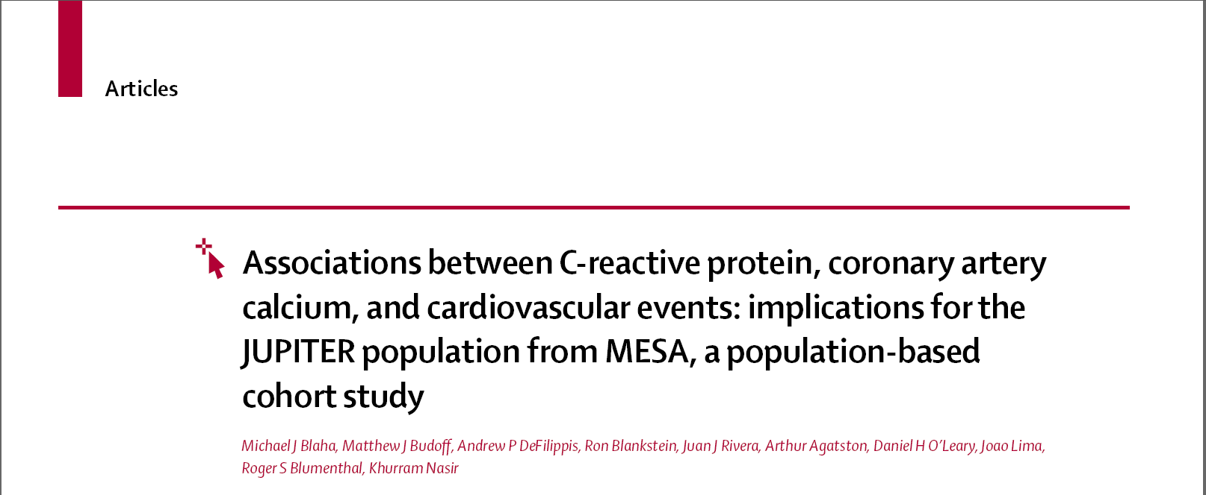
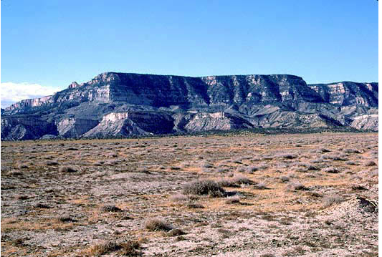


Slide 23
Blaha M, et al. MESA-JUPITER. Lancet. 2011

Slide 24
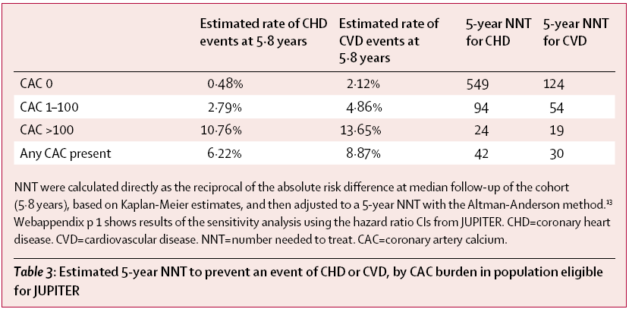
MESA-JUPITER
Blaha M, et al. MESA-JUPITER. Lancet. 2011

Slide 25
Limitations
Excluding patient’s on ASA created a healthier cohort
Applicability of MESA population
ASA has not performed as well in recent trials
Are bleeding and CVD equivalent events?

Slide 26
Conclusion
Further risk stratification with CAC scoring could potentially serve as a tool to guide use of aspirin therapy
Randomized trials are needed to determine the ability of CAC to change clinical decision-making and patient outcomes

Slide 27
