Slide 1



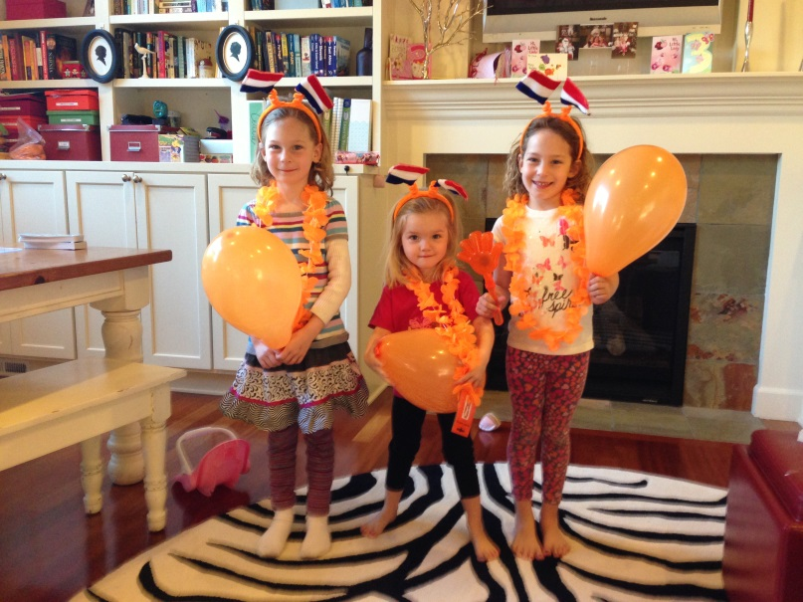
Vitamin D and cardiovascular disease
Ian de Boer, MD, MS
Associate Professor of Medicine
Adjunct Associate Professor of Epidemiology
Division of Nephrology & Kidney Research Institute
University of Washington

Slide 2
Many investigators have contributed to this work
AS Investigators
Young investigators
Bryan Kestenbaum (UW)
Ian de Boer (UW)
David Siscovick (UW)
Russ Tracy (Vermont)
Joe Ix (UCSD)
Andy Hoofnagle (UW)
Michael Sachs (UW)
Hanne Ballegooijen (Amsterdam)
Nisha Bansal (UCSF)
Marc Blondon (Geneva)
Cortney Bosworth (UW)
Robin Kremsdorf (UW)
Jehu Mathew (UW)
Cassy Robinson-Cohen (UW)
Anand Vaidya (BWH)

Slide 3
MESA Mineral Metabolism Working Group: additional participants
Matt Allison (UCSD)
Pallav Bhatnagar (Hopkins)
Michael Criqui (UCSD)
Karina Davidson (Columbia)
Temitope Foster (Emory)
Jeffrey Hsu (UCSF)
Nancy Jenny (Vermont)
Craig Johnson (CC)
Abigail Khan (Penn)
Erin Michos (Hopkins)
Carrie Nielson (OHSU)
Carmen Peralta (UCSF)
Sylvia Rosas (Penn)
Mike Shlipak (UCSF)
Jonathan Schaeffer (Columbia)
Abby Shoben (Ohio State)
Chistina Wassel (UCSD)
Open invitation!

Slide 4


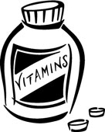
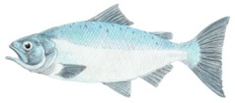
Cutaneous
Synthesis
Dietary intake
& Supplements
Cholecalciferol Ergocalciferol
(Vitamin D3) (Vitamin D2)
“Vitamin D”
25α-hydroxylase (CYP2R1)
25-hydroxy- 25-hydroxy-
vitamin D3 vitamin D2
25(OH)D
1α-hydroxylase (CYP27B1)
1,25(OH)₂D
1,25-dihydroxy-
vitamin D3
(calcitriol)
1,25-dihydroxy-
vitamin D2

Slide 5
Vitamin D metabolism is regulated by hormonal signalling
25(OH)D
1,25(OH)₂D
PTH
FGF-23

Slide 6
Vitamin D deficiency may promote CVD through multiple pathways
In animals, ↓1,25(OH)2D:
  ↑RAAS activation
  ↑Th1/↓Th2
  Impaired glucose homeostasis
  VSMC calcification
In (white) human populations, ↓25(OH)D is consistently associated with CVD
PVD
CHF
CHD

Slide 7
Pressing questions:
Vitamin D & CVD
Does vitamin D supplementation improve outcomes?
How do we ascertain vitamin D deficiency?
  Threshold 25(OH)D levels?
  Alternate/additional biomarkers?
Which CVD pathways are involved?
What populations are at risk?
  Non-white populations?
  Genetic susceptibility?

Slide 8
Mineral metabolism AS: Scope
Biomarkers Measured
Outcomes examined
25(OH)D
24,25(OH)2D
PTH
FGF-23
Serum calcium
Serum phosphate
Urine calcium
Urine phosphate
Other serum and urine electrolytes
Clinical events
  CHD
  CHF
Subclinical CVD:
  CAC
  LVM
  IMT
  Arterial stiffness
Other intermediates:
  Hypertension
  Kidney disease

Slide 9
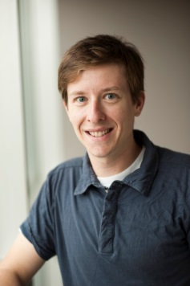




Current work on 25(OH)D
Analyses completed or published
Analyses planned or underway
Methods to account for seasonal variation
Carotid IMT
Arterial stiffness
Hypertension
Valve calcification
CHD events
CAC
LV mass, CHF
NAFLD
Diabetes
Change in kidney function

Slide 10
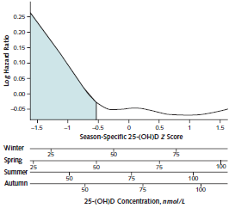
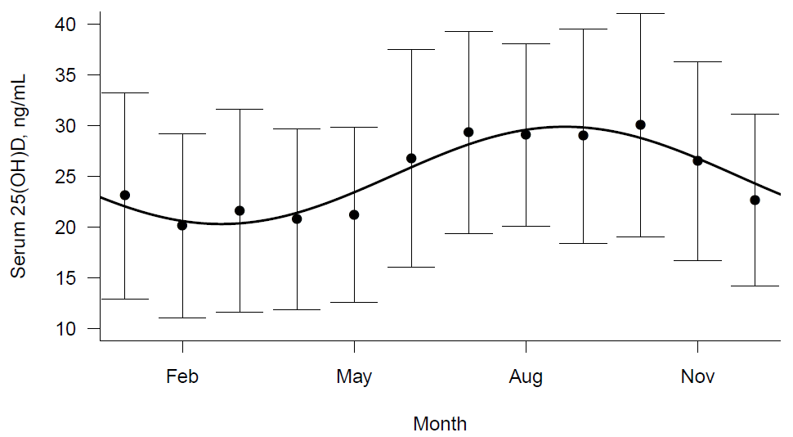
Seasonal variation complicates the analysis of 25(OH)D: CHS experience
Shoben AB et al, AJE 2011
de Boer IH et al, Annals Intern Med 2012

Slide 11
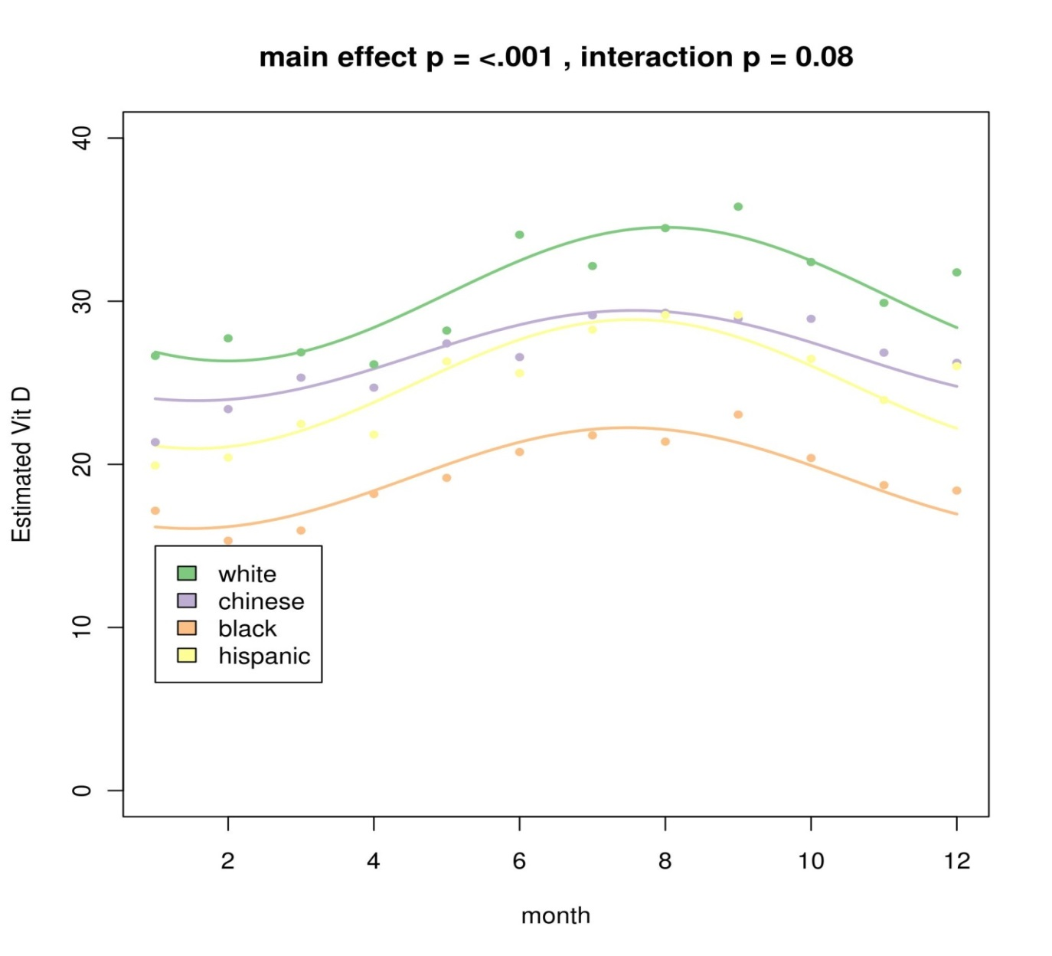
Seasonal variation in 25(OH)D is similar by race/ethnicity in MESA

Slide 12
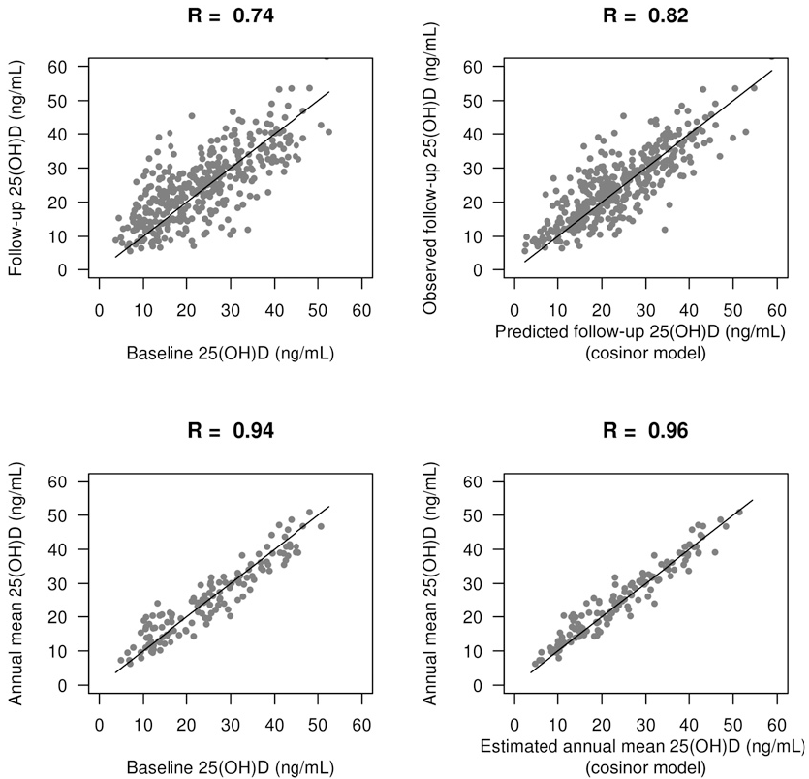
The cosinor model improves prediction of future 25(OH)D
Difference in RMSE = 1.3 ng/mL
P<0.001
Difference in RMSE = 1.0 ng/mL
P<0.001
Sachs MC et al, AJCN [in press]

Slide 13
25(OH)D & CHD events
Rationale
Insufficient vitamin D plausibly linked to atherosclerosis
Low 25(OH)D consistently associated CVD in white populations
Hypothesis
Low 25(OH)D is associated with increased risk of CHD in a multi-ethnic population, without heterogeneity by race/ethnicity
Strengths:
Population:
  Community-based
  Diverse (race, age)
  Free of clinical CVD
Exposure:
  Precisely measured
  Standardized to NIST
  Accounting for season
Outcome:
  Appropriate pathway
  Adjudicated
  10 years follow-up
Standardized covariates

Slide 14
25(OH)D and CHD events: Table 1
 | <20 ng/mL | 20-29 ng/mL | ≥30 ng/mL
N | 2131 | 2224 | 2081
Age (years) | 61 (10) | 62 (10) | 63 (10)
Female gender | 1191 (56%) | 1096 (49%) | 1142 (55%)
Race/ethnicity
White | 429 (20%) | 855 (38%) | 1217 (59%)
Chinese | 167 (8%) | 351 (16%) | 266 (13%)
Black | 1064 (50%) | 478 (24%) | 208 (10%)
Hispanic | 471 (22%) | 540 (24%) | 390 (19%)
Diabetes | 320 (15%) | 310 (14%) | 165 (8%)
BP med | 770 (36%) | 737 (33%) | 621 (30%)
Activity (MET-min/wk) | 630 [0,1680] | 810 [105,1890] | 1140 [330,2460]
BMI (kg/m²) | 30 (6) | 28 (5) | 27 (5)

Slide 15
25(OH)D and CHD events: unadjusted incidence rates
25(OH)D
(ng/mL)
No. events | 167 | 27 | 94 | 73

Slide 16
25(OH)D and CHD events: adjusted Cox models (whites, blacks)
 | Adjusted HR (95% CI)
 | Model 1 | Model 2 | Model 3
White
≥30 ng/mL | 1.0 | 1.0 | 1.0
20-29 ng/mL | 1.41 (0.99,2.00) | 1.33 (0.93,1.90) | 1.35 (0.94,1.94)
<20 ng/mL | 2.18 (1.46,3.25) | 1.84 (1.22, 2.78) | 1.85 (1.21, 2.81)
p-trend | 0.001 | 0.007 | 0.008
Black
≥30 ng/mL | 1.0 | 1.0 | 1.0
20-29 ng/mL | 1.00 (0.52,1.94) | 0.91 (0.46,1.78) | 0.83 (0.42,1.62)
<20 ng/mL | 0.89 (0.48,1.65) | 0.76 (0.41,1.44) | 0.75 (0.40,1.42)
p-trend | 0.863 | 0.466 | 0.586
M1: age, gender, site.
M2: adds income, education, self-reported health, smoking, physical activity, nutritional vitamin D intake, BMI.
M3: adds diabetes, CKD, BP, lipids, antihypertensive meds, lipid-lowering meds, PTH, CRP

Slide 17
25(OH)D and CHD: adjusted splines, with distributions of 25(OH)D

Slide 18
25(OH)D and CHD: adjusted splines, with distributions of 25(OH)D

Slide 19
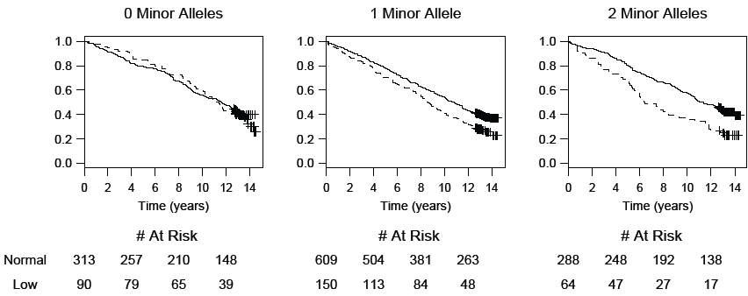
Similarity: 25(OH)D x VDR SNP interaction in CHS (whites only)
Levin G et al, JAMA 2012

Slide 20
25(OH)D & CHD: Summary
Significant racial heterogeneity
  Whites: consistent with prior literature
  Blacks: robustly null
  Chinese & Hispanics: low N
  Parallels heterogeneity for other outcomes
Requires replication:
  Other cohorts
  Subclinical disease
Raises questions:
  Racial differences in metabolic pathways?
  Genetic polymorphisms?

Slide 21
Other ancillary study findings
FGF-23
PTH
Strongly associated with:
  LV mass
  CHF events
  Atrial fibrillation
Less strongly associated with:
  Prevalent CAC
  CHD events
  Carotid plaque
Strongly associated with:
  LV mass
  CHF events
Less strongly associated with:
  Arterial stiffness
  Endothelial dysfunction

Slide 22
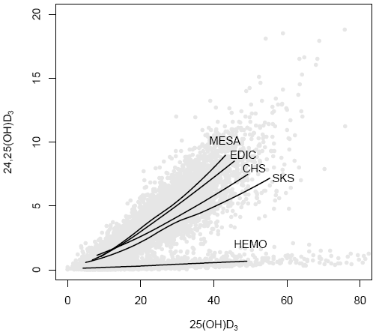
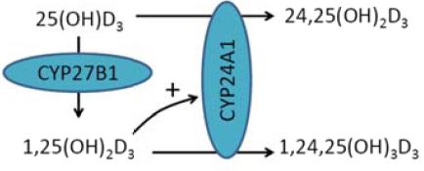
24,25(OH)2D3: a promising biomarker, but maybe not in MESA

Slide 23
Ongoing & planned work
Complete proposed work!
Collaborations
Finish & present ongoing analyses
Utilize urine calcium & phosphate
Address biomarker combinations
GWAS:
  25(OH)D
  PTH
  FGF-23
  24,25(OH)2D3
Change in CAC (Kaufman)
Carotid Distensibility (Stein)
Renal artery calcium (Allison)
Aorta calcium (Criqui)
Immune cell function (Tracy)
MESA Bone (Budoff)

Slide 24
Future directions?
Racial differences in vitamin D metabolism
  Additional biomarkers
  Kinetic studies
Focus on interactions in additional/combined cohorts
  Race x biomarker
  Gene x biomarker
Response to interventions
  Intermediate markers of mineral metabolism & subclinical CVD
  Clinical events
Open to collaboration!

Slide 25
Thank you
MESA investigators
MESA participants
Ancillary study investigators
Young investigators
MESA Mineral Metabolism Working Group
Collaborators
NHLBI

