Slide 1
Validity of the Surface Electrocardiogram Criteria for Right Ventricular Hypertrophy
Ziggy Whitman, MD
Cardiology Fellow
University of California, San Francisco
MESA Steering Committee Meeting
October 3-4, 2013
Silver Spring, MD
Whitman IR, et al. J Amer Coll Cardiol. In Press.

Slide 2
Background
Increased RV afterload – increased mass – RVH
pulmonary HTN, COPD, OSA, left-sided failure
Sequelae: heart failure, arrhythmia, increased mortality
RVH frequently a delayed diagnosis
Independent predictor of HF and CV death
Early detection could facilitate treatment
screening strategies in the general population are limited
Brown LM, et al. REVEAL. Chest 2011.
Kawut SM, et al. MESA-RV. Circulation 2012.
Benza RL, et al. REVEAL. Circulation 2010.
Notes:
RVH is the result of chronically increased afterload to the RV.
Similar to the LV, this can be from increased cavity size or from increased wall thickness, and results from various etiologies.
RVH increases patients’ morbidity and mortality, and unfortunately, the diagnosis is frequently delayed.
Early recognition would allow for earlier treatment, but there are no current screening strategies for the diagnosis of RVH.

Slide 3
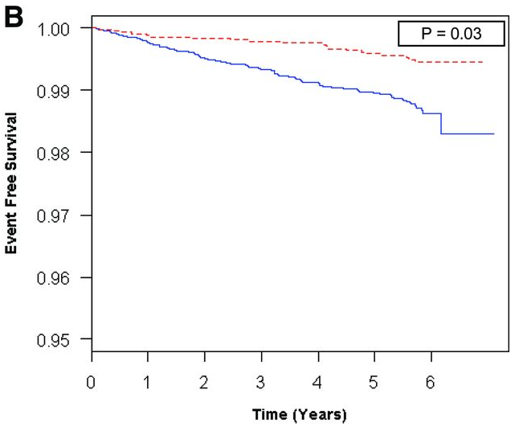
Outcomes in RVH
RV hypertrophy
normal RV mass
Survival curves for RVH vs normal (adjusted for LVH).
Copyright © American Heart Association
Kawut SM et al. Circulation 2012;126:1681-1688
Notes:
This Kaplan-Meier curve is from a study by SK, my mentor at Penn, published in Circ and derived from the MESA population.
Their analysis showed that RVH more than doubles the risk of death even after controlling for LVH.

Slide 4
AHA Recommended ECG Criteria for RVH
Lewis, 1914 | (R I + S III) – (S I + R III) < 15 mV
Myers, 1948 | Tall R V₁ > 6 mV Increased R:S ratio V₁ > 1.0 Deep S V₅ > 10 mV Deep S V₆ > 3 mV Small S V₁ < 2 mV Small R V_{5,6} < 3 mV Reduced R:S ratio V₅ < 0.75 Reduced R:S ratio V₆ < 0.4 R peak V₁ (QRS > 0.12 sec) > 0.035 sec Presence of QR V₁
Sokolow, 1949 | Tall R aVR > 4 mV Reduced R:S V₅ to R:S V₁ < 0.04 R V₁ + S V_{5,6} > 10 mV
Butler, 1986 | Max R V_{1,2} + max S I, aVL – S V₁ > 6 mV
Supportive Criteria | P in II ≤ 2.5 mV S > R in I S > R in II S > R in III R:S in V₁ > R:S in V_{3,4} Presence of RSR’ in V₁ (QRS > 0.12 sec) Presence of T-wave inversion in V₁-V₃ Presence of S in I and Q in III
Hancock EW, et al. AHA/ACCF/HRS recommendations for the standardization and interpretation of the electrocardiogram: part V: electrocardiogram changes associated with cardiac chamber hypertrophy. Circulation 2009.
Notes:
Recognizing the morbidity of this disease, the AHA recommends these ECG criteria for the screening of RVH in their 2009 recommendations for interpretation of the ECG.
These ECG criteria, for the most part, are different electrocardiographic ways to describe disproportionate anterior forces over posterolateral forces relative to normal.

Slide 5
Lewis, 1914
n = 33 with mitral stenosis
poor NPV
Myers, 1948
n = 40, with CP (24), mitral stenosis (13), ToF (2), or “AV aneurysm”
specificity was high, but not sensitivity
Sokolow, 1949
n = 60, 44 with cyanotic congenital heart disease
R-wave > 4 mV in aVR with PPV of > 30%
Butler, 1986
n = 50, all with MS vs 500 healthy controls
specificity of 94% and sensitivity of 66%
Lewis, 1914 | (R I + S III) – (S I + R III) < 15 mV
Myers, 1948 | Tall R V₁ > 6 mV Increased R:S ratio V₁ > 1.0 Deep S V₅ > 10 mV Deep S V₆ > 3 mV Small S V₁ < 2 mV Small R V_{5,6} < 3 mV Reduced R:S ratio V₅ < 0.75 Reduced R:S ratio V₆ < 0.4 R peak V₁ (QRS > 0.12 sec) > 0.035 sec Presence of QR V₁
Sokolow, 1949 | Tall R aVR > 4 mV Reduced R:S V₅ to R:S V₁ < 0.04 R V₁ + S V_{5,6} > 10 mV
Butler, 1986 | Max R V_{1,2} + max S I, aVL – S V₁ > 6 mV
Notes:
The recommended criteria are derived from 4 specific studies.
Most criteria are derived from a study by Myer’s. These patients…..
I want to highlight “Einthoven’s Sign”, named after the father of electrocardiography. His mentee, Sir Thomas Lewis, attempted to demonstrate his theory of anterior forces predominating on the surface ECG in 33 patients with MS. Both sensitivity and NPV were poor.
This posed an opportunity to improve the understanding of how well these criteria may perform in a larger, healthier population.
Sokolow looked at a group, the majority of which had cyanotic congenital heart disease. The PPV of a tall R in aVR was 30%.
Butler demonstrated a poor sensitivity to predominant rightward, anterior forces in 50 patients with MS.
You can see that these criteria for the screening of RVH lack validation.

Slide 6
Basis of AHA Criteria
Cadaveric dissection of selected patients without a uniform approach
Antiquated, small studies
Attempted to find ECG correlates of RV pathology in patients with previously-diagnosed, clinically advanced cardiopulmonary disease
Lewis T. Heart 1914.
Myers GB. Am Heart J 1947.
Myers GB. Am Heart J 1948.
Sokolow M. Am Heart J 1949.
Roman GT. Am J Cardiol 1961.
Murphy ML. Chest 1974.
Murphy ML. Am J Cardiol 1984.
Murphy ML. Am J Cardiol 1983.
Butler PM. Am J Cardiol 1986.
Notes:
These criteria for the screening of RVH have never been validated.
In fact, they are based on cadaveric dissection studies that were not uniform in methods, are old studies, and importantly, correlated ECG findings in patients with known risk factors for RVH.

Slide 7
Recommendation Statement
The ability of the ECG to detect RVH may be low, but is not known.
Ancillary clinical information is vital.
No set of criteria can be recommended for use exclusive of other validated criteria.
The effect of using larger numbers of criteria on sensitivity and specificity should be further studied.
Hancock EW, et al. Circulation 2009.
Notes:
These are the remarks in the AHA recommendation statement regarding using ECG to diagnose RVH.

Slide 8
Study Question
What is the predictive performance of ECG criteria for RVH in a large, population-based, multi-ethnic sample of adults in the community?

Slide 9
Methods
MESA
Prospective cohort study in a multi-ethnic population
6,814 subjects; 45 - 84 years; 6 cities
Exclusions: clinical CV disease, obesity, pregnancy
5,098 (75%) had cMRIs; 5,004 (73%) were interpretable for the LV
4,204 (62%) cMRIs were interpreted for the RV
Study Sample
Inclusion criteria: cMRI and ECG available
Exclusion criteria: IVCD, LBBB, WPW, high-grade AV block, poor quality ECG
Notes:
Of course, those here no the anatomy of MESA far better than I, but the study sample for this study was a subset of MESA, including those with MRIs and ECGs, excluding those with diagnoses that confound interpretation of the ECG.

Slide 10
Cardiac MRI
Image analysis was performed by 2 experienced readers.
Endocardial/epicardial borders of the RV traced manually in short-axis at end-systole and end-diastole
Papillary muscles and trabeculae
included in the RV volumes
excluded from RV mass
Intrareader intraclass correlation coeff. (n=229) = 0.94
Interreader intraclass correlation coeff. (n=240) = 0.89
Notes:
Each patient had a cardiac MRI, the gold standard in measuring RV mass.
The MRIs were interpreted using standard methodologies with high intra-reader reliability.

Slide 11
Electrocardiograms
Standard 12-lead ECGs
Measurements automated; analysis performed at the EPICARE reading center.
ECGs were visually inspected for technical errors and inadequate quality.
Notes:
ECGs were also interpreted by experts at Wake Forest.

Slide 12
Statistical Analysis
Sensitivity, specificity, PPV, and NPV of the 2009 AHA ECG criteria for RVH
Primary analysis:
Subjects without LVH or reduced LV EF
Sensitivity analysis including those with abnormal LV
Classification and regression tree (CART) analysis
Receiver operating characteristic curves
Allometric Equations used for % predicted RV mass*:
Men: RV mass / (10.59∙ Age^{-0.320}Ht^{1.135}Wt^{0.315})
Women: RV mass / (11.25∙ Age^{-0.320}Ht^{1.135}Wt^{0.315})
RVH: RV mass > 126% predicted (95%-ile)
Secondary analyses with RVH defined as RV mass > 99%-ile.
*Kawut SM, Lima JA, Barr RG, et al. Sex and race differences in right ventricular structure and function: the multi-ethnic study of atherosclerosis-right ventricle study. Circulation 2011.
Notes:
The statistics were not terribly sophisticated, which is perfect for me….
Sensitivity, Specificity, PPV, and NPV were determined for each criterion in patients with LVH, without it, and in the entire cohort.
CART analysis was also performed to probe the possibility of improved cut-offs or combinations of criteria, and then with a ROC analysis to look for optimal cut-offs.
RVH was defined as previously described in one of Dr. Kawuts prior MESA publications, and in our primary analysis, those with RV mass > 95th percentile were described as having RVH. A secondary analysis was performed with RVH described as the 99th percentile.

Slide 13
6814 MESA Baseline Exam
5098 had MRIs
5004 MRIs interpretable for LV
4634 MRIs reviewed for RV
430 MRIs unavailable or uninterpretable for RV
35 excluded for lack of ECG data
4204 MRIs interpretable for RV
4169 in study sample
6,814 MESA Baseline Exam
5,098 had MRIs (75%)
5,004 MRIs interpretable for LV (73%)
4,634 MRIs selected (68%)
4,484 MRIs attempted to be read (66%)
280 MRIs unavailable or uninterpretable for RV (4%)
4,204 MRIs interpretable for RV (62%)
35 with missing ECG data (<1%)
4,169 with RV and ECG data (61%)
107 with ECG exclusion criteria (2%):
93 – interventricular conduction delay (1%)
11 – left bundle branch block (<1%)
1 – Wolff-Parkinson-White (<1%)
1 – Advanced AV block (<1%)
32 – Poor quality (<1%)
4,062 in study sample (60%)
3,719 with normal LV (55%)
343 participants with LV hypertrophy or reduced LV ejection fraction (5%)
Percentages given relative to size of original MESA cohort, n = 6,814
Notes:
This figure details the composition of our study cohort, with absolute numbers and percentage of the entire MESA cohort is parentheses.

Slide 14
Characteristics of Study Sample
 |  | Normal LV | LVH or Reduced LVEF | All
Number |  | 3,719 | 343 | 4,062
Age, years |  | 61 | 63 | 61
Race, % | Caucasian | 40 | 29 | 39
 | Asian | 13 | 8 | 13
 | Afr-Amer | 26 | 37 | 26
 | Hispanic | 22 | 27 | 22
Hypertension, % |  | 40 | 67 | 43
Smoking Status, % | Never | 53 | 44 | 52
 | Former | 36 | 36 | 36
 | Current | 12 | 21 | 13
RV Mass, g |  | 21 | 23 | 21
RVH, % |  | 6 | 20 | 8
LV Mass, g |  | 140 | 197 | 145
LV EF, % |  | 70 | 63 | 69
Notes:
These next two slides detail “Table 1” from the study cohort, with those in our primary analysis in the first column, those with abnormal LV’s in the second column, and the entire cohort in the third column.
Those with abnormal LV’s were more African-American or Hispanic, and overall similarly educated.

Slide 15
Characteristics of Study Subjects with and without RVH
Normal LV
 |  | RVH | Normal RV | P-value
Number |  | 224 | 3,495
Age, years |  | 63 | 61 | 0.002
Male, % |  | 42 | 47 | 0.16
Race, % | Caucasian | 43 | 39 | 0.18
 | Asian | 10 | 13
 | Afr-Amer | 22 | 26
 | Hispanic | 25 | 22
Hypertension, % |  | 44 | 40 | 0.29
Diabetes | Normal | 77 | 76 | 0.38
 | IFG | 10 | 13
 | Diabetes | 13 | 11
Notes:
This table separates those with a normal LV in our primary analysis from the entire group.
Within each, the table shows the characteristics of patients with and without RVH.
As you can see, those patients with RVH are similar to those without with regard to their demographics.

Slide 16
Characteristics of Study Subjects with and without RVH
Normal LV
 |  | RVH | Normal RV | P-value
Smoking, % | Never | 56 | 53 | 0.55
 | Former | 35 | 36
 | Current | 10 | 12
Pack-years |  | 11 | 11 | 0.86
FVC (mL) |  | 3,141 | 3,231 | 0.31
FVC% |  | 97 | 96 | 0.7
FEV1/FVC ratio |  | 0.8 | 0.8 | 0.48
FEV1/FVC < 0.7, % |  | 20 | 21 | 0.7
Emphysema, % |  | 15 | 17 | 0.03
Asthma |  | 10 | 9 | 0.26
Notes:
Given that smoking is likely to cause lung injury, it is the breakdown of smoking and lung disease between subgroups that is particularly poignant.
Nonetheless, this clinically healthy group in MESA had similar pulmonary function between those with RVH and those without.
For example, taking a look at FEV1/FVC ratio, those patients with RVH and similar results as those without across both groups of patients

Slide 17
RVH in MESA
RVH: 6.4%
RVH: 7.7%
Normal LV | All Subjects
 | RVH | Normal RV | P-value | RVH | Normal RV | P-value
Number | 224 | 3,495 |  | 291 | 3,771
RV Measures
RV Mass, g | 27 | 21 | <0.001 | 27 | 21 | <0.001
RV Ejection Fraction, % | 69 | 71 | 0.01 | 70 | 71 | 0.02
LV Measures
LV Mass, g | 149 | 140 | <0.001 | 161 | 141 | <0.001
LV Ejection Fraction, % | 69 | 70 | 0.67 | 69 | 69 | 0.32
Notes:
This slide shows what one might expect – that RV mass is greater in the those with RVH, and LV mass is greater in those with RVH as well.
And very important to our sensitivity analysis, the incidence of RVH in the patients with normal LV was 6.4%. The group as a whole had a slightly higher incidence at nearly 8%, when RVH is defined as RV mass > 95th percentile.

Slide 18
RESULTS
Criterion | Sensitivity (95% CI) | Specificity (95% CI) | PPV (95% CI) | NPV (95% CI)
Lewis, 1914
(RI + SIII) – (SI + RIII) < 15 mV | 80 (75, 86) | 17 (16, 18) | 6 (5, 7) | 93 (91, 95)
Myers, 1948
RV1 > 6 mV | 2 (0, 4) | 99 (98, 99) | 9 (2, 20) | 94 (93, 95)
R:S V1 > 1 | 1 (0, 2) | 98 (97, 98) | 3 (0, 9) | 94 (93, 95)
SV5 > 10 mV | 1 (0, 1) | 100 (99, 100) | 6 (2, 30) | 94 (93, 95)
SV6 > 3 mV | 2 (0, 4) | 96 (96, 97) | 4 (1, 9) | 94 (93, 95)
SV1 < 2 mV | 8 (4, 12) | 91 (91, 92) | 5 (3, 8) | 94 (93, 95)
RV5 < 3 mV | -- | -- | -- | --
RV6 < 3 mV | 1 (0, 1) | 100 (99, 100) | 5 (0, 26) | 94 (93, 95)
R:S V5 < 0.75 | -- | -- | -- | --
R:S V6 < 0.4 | -- | -- | -- | --
R peak V1 > 35 msec (QRS > 120 msec) | 5 (2, 7) | 98 (97, 98) | 12 (6, 21) | 94 (93, 95)
QR V1 | 1 (0, 3) | 99 (99, 99) | 8 (2, 22) | 94 (93, 95)
Notes:
This table details the results of our sensitivity analysis.
Sensitivity is low, with the single outlier being Einthoven’s Sign – however, at the price of any specificity. In Lewis’ original study, the sensitivity was approximately 50%.
Specificity is misleading (i.e. mostly very high); however, due to low prevalence of RVH, despite high specificity, PPV was low.
NPV uniformly similar to the incidence of RVH-free subjects – i.e. a negative ECG does not further exclude RVH.

Slide 19
RESULTS
Criterion | Sensitivity (95% CI) | Specificity (95% CI) | PPV (95% CI) | NPV (95% CI)
Sokolow, 1949
R aVR > 4 mV | 1 (0, 1) | 100 (100, 100) | 11 (3, 48) | 94 (93, 95)
R:S V5 / R:S V1 < 0.04 | -- | -- | -- | --
R V1 + S V5 > 10.5 mV | 1 (0, 3) | 99 (98, 99) | 11 (3, 48) | 94 (93, 95)
R V1 + S V6 > 10.5 mV | 1 (0, 2) | 100 (99, 100) | 10 (1, 30) | 94 (93, 95)
Butler, 1986
(Max R V1,2) + (Max S I, aVL) – S V1 > 6 mV | 13 (8, 17) | 85 (84, 87) | 5 (4, 7) | 94 (93, 95)
Notes:
The criteria proposed by Sokolow and Butler followed these trends of low sensitivity and low PPV, and unhelpful NPV.

Slide 20
RESULTS
Failure to optimize criteria
Receiver Operating Characteristic curve
AUC < ~ 0.6 for each variable
Classification and Regression Tree analysis
Different groups/cut-offs did not improve prediction
Notes:
Our ROC analysis and CART analysis did not yield improved performance.
The AUC for our ROCs was < 0.6 for each criterion.
In our CART analysis, we looked at continuous variables and examined whether there were different cutpoints to better discriminate between groups.

Slide 21
Summary
AHA-recommended ECG criteria for RVH:
Sensitivity is uniformly low
PPV is uniformly low
NPV are similar to the underlying prevalence of RVH in the population
Most criteria indicated ~10% chance of having RVH
Notes:
In summary, the AHA-recommended criteria for RVH in a multi-ethnic population of healthy adults are:
LOW in sensitivity
Have poor PPV
Neither positive nor negative findings give further insight into the likelihood of RVH.
And most criteria suggest about a 10% chance of having RVH – which is not much different than the prevalence of RVH in the population.

Slide 22
Limitations
Study population - milder degrees of RVH (spectrum bias)
screening ECG would be precisely in this group
Defined RVH as the 95th %-ile of indexed RV mass
similar results using a more extreme RVH definition
Criteria not compared with echocardiography
TTE less accurate for the diagnosis of RVH than cMRI
Notes:
It could be said that, given that this was a healthy cohort of patients, the degree of RVH in this group would be mild. However, it is precisely in this group that screening for RVH would be relevant.
In that vein, perhaps our definition of RVH was too broad. Yet, our results were similar when RVH was defined as the 99th percentile.

Slide 23
Conclusions
2009 AHA criteria should not be used to screen for RVH in community based multi-ethnic adults without clinical cardiovascular disease.
Commencing a work-up in clinical cardiovascular disease-free adults with ECG criteria for RVH can not be recommended.
In a clinically ill population, or one at increased risk for RVH, the AHA criteria may still have clinical or prognostic utility.
Notes:
Based on our results, we believe that:
These criteria should not be used for screening of RVH
Making clinical decisions, including decisions about further workup based on the findings of these ECG criteria is inappropriate.
Nonetheless, these criteria may have more value in patients at high risk for, or with known RVH.

Slide 24
Thank You
David A. Bluemke, MD, PhD
David Herrington, MD
Aditya Jain, MD
Steven M. Kawut, MD, MS
Joao AC Lima, MD
Vickas V. Patel, MD, PhD
Amy Praestgaard, PhD
Elsayed Z. Soliman, MD, MS
All MESA Investigators and Participants

Slide 26
Future Directions
Do these ECG findings, even in the absence of RVH, have prognostic significance?
Arrhythmia, cardiac function, mortality
Do these criteria have better performance in patients at risk for RVH, or with known RVH? Are they prognostic in these patients?
Additional leads? Posterior or right-sided leads?

Slide 27
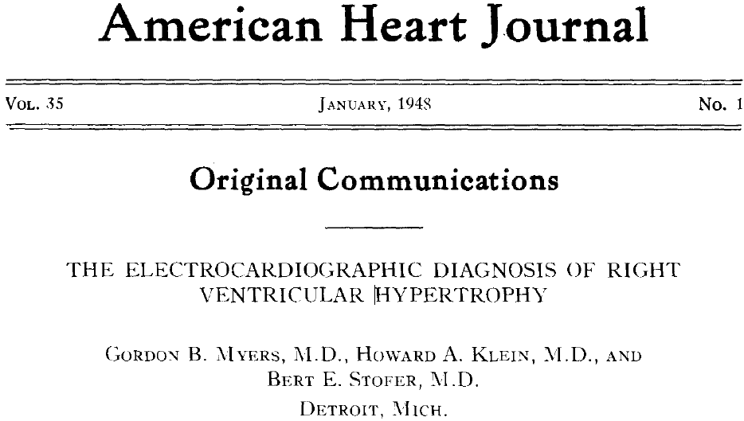
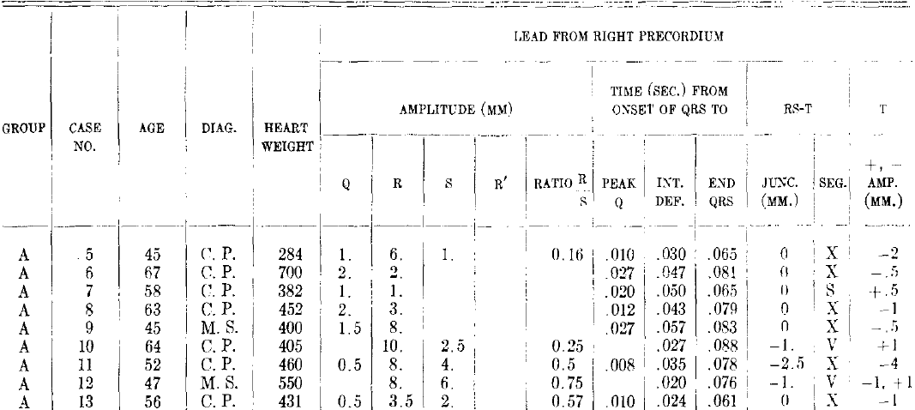
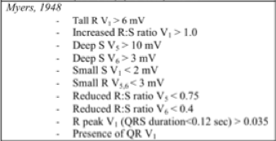
Myers, 1948
10 of 15 screening criteria for RVH were from a single study of 40 patients
Etiologies: CP (24), MS (13), ToF (2), or “arteriovenous aneurysm”. Patients with LVH were excluded.
While specificity was high, measured criteria were insensitive (7 of 40 patients with RVH had no evidence of RVH on ECG).

Slide 28
Lewis, 1914
Sir Thomas Lewis performed an autopsy study of 33 patients with mitral stenosis (including 17 with concomitant aortic valve disease)
50% demonstrated the “Einthoven’s Sign”
[(RI + SIII) – (SI + RIII) < 15mV].
Findings are not generalizable
preponderance of mitral stenosis and aortic valve lesions
NPV of this sign was poor
(RI + SIII)
I
(SI + RIII)
III
Notes:
Thomas Lewis, MBBS. Coined the term “clinical science”, and in the early 1900’s, took an interest and corresponded with Dr. Einthoven, who invented electrocardiography. Lewis then pioneered its use in clinical medicine – “The Father of Clinical Cardiac Electrophysiology”. He had an MI at 45, and smoked more than 3 packs per day. He ultimately died of coronary disease.

Slide 29
Butler, 1986
50 patients with RVH and 500 healthy controls
All subjects with mitral stenosis, mean age 45 years, 88% female
Examined the anterior, rightward, and posterolateral forces in RVH
specificity of 94% and sensitivity of 66%
A more recent study: 28 subjects with PAH, using cMRI
high specificity, sensitivities of ~65%
Sv₁
aVL
I
Rv₁/v₂ + SI/aVL
v₁
v₂
Blyth, et al. Pulmonary Circulation, 2012.

Slide 30
Other Studies using cMRI
More recent studies have examined the ECG in the diagnosis of RVH as measured by cMRI or elevated pulmonary arterial pressures.
Study sizes: n=23 to n=38
Also in patients with known RVH, or were high risk for pulmonary hypertension.
Criteria for RVH:
low sensitivity and insufficient specificity to be useful
There may be a relationship between ventricular gradient (difference in averaged QRS integral and T-wave integral) and pulmonary arterial systolic pressures
RVH not examined
Blyth KG, et al. Pulmonary Circulation, 2012.
Kopec G, et al. Circ J, 2012.
Scherptong RW, et al. J Electrocardiol 2012.
Notes:
Maybe there is a place for ECG in evaluating pHTN/RVH!

Slide 31
Filling a Gap
No prior large cohort studies have examined the utility of ECG in screening for RVH.
MESA provided an opportunity.

Slide 32
Lewis, 1914 | (R I + S III) – (S I + R III) < 15 mV
Myers, 1948 | Tall R V₁ > 6 mV Increased R:S ratio V₁ > 1.0 Deep S V₅ > 10 mV Deep S V₆ > 3 mV Small S V₁ < 2 mV Small R V_{5,6} < 3 mV Reduced R:S ratio V₅ < 0.75 Reduced R:S ratio V₆ < 0.4 R peak V₁ (QRS > 0.12 sec) > 0.035 sec Presence of QR V₁
Sokolow, 1949 | Tall R aVR > 4 mV Reduced R:S V₅ to R:S V₁ < 0.04 R V₁ + S V_{5,6} > 10 mV
Butler, 1986 | Max R V_{1,2} + max S I, aVL – S V₁ > 6 mV
Myers, 1948
n = 40, with CP (24), mitral stenosis (13), ToF (2), or “AV aneurysm”
specificity was high, but not sensitivity
Lewis, 1914
n = 33 with mitral stenosis
50% with Einthoven’s Sign, but poor NPV
Sokolow, 1949
n = 60, 44 with cyanotic congenital heart disease
R-wave > 4 mV in aVR with PPV of > 30%
Butler, 1986
n = 50, all with MS vs 500 healthy controls
specificity of 94% and sensitivity of 66%
(RI + SIII)
I
(SI + RIII)
III
“Einthoven’s Sign”
Sv₁
aVL
I
Rv₁/v₂ + SI/aVL
v₁
v₂
Butler
Notes:
The recommended criteria are derived from 4 specific studies.
Most criteria are derived from a study by Myer’s. These patients…..
I want to highlight “Einthoven’s Sign”, named after the father of electrocardiography. His mentee, Sir Thomas Lewis, attempted to demonstrate his theory of anterior forces predominating on the surface ECG in 33 patients with MS. Both sensitivity and NPV were poor.
This posed an opportunity to improve the understanding of how well these criteria may perform in a larger, healthier population.
Sokolow looked at a group, the majority of which had cyanotic congenital heart disease. The PPV of a tall R in aVR was 30%.
Butler demonstrated a poor sensitivity to predominant rightward, anterior forces in 50 patients with MS.
You can see that these criteria for the screening of RVH lack validation.

