Slide 1
Long-term air pollution exposure and ventricular conduction & repolarization abnormalities in MESA
Victor Van Hee, Adam Szpiro, Ronald Prineas, Jon Neyer, Karol Watson, David Siscovick, Sung Kyun Park, Joel Kaufman
MESA SC Meeting
March 8, 2011

Slide 2
Background
Well established relation between PM_{2.5} & CVD (Brook et al 2010), mechanisms incompletely understood
Surface ECG ventricular repolarization and conduction abnormalities suggest potential mechanisms
Prior studies (Henneberger 2005; Lux 2009; Liao 2010; Baja 2010) have shown repolarization changes related to PM, but weaknesses:
  Short-term, relatively imprecise exposure estimates
  Continuous measures
  Inability to distinguish mechanisms
  Most in patients with known CVD
Notes:
involving altered autonomic function, changes in cardiac structure / electrical function, possibly atherosclerosis

Slide 3
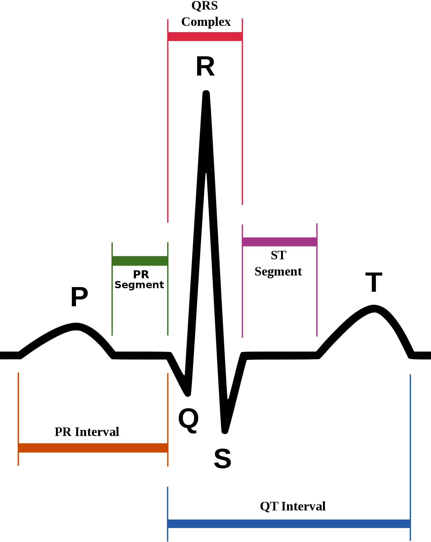
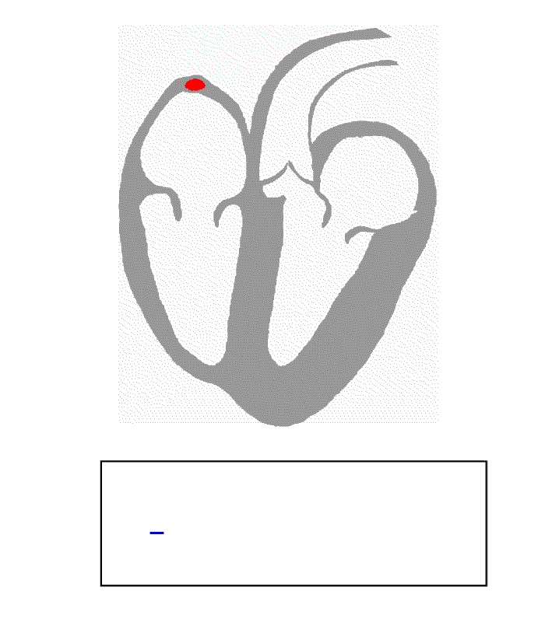
Ventricular Conduction & Repolarization Abnormalities
Image: Anthony Atkielski
Animated GIF: Kalumet (Wikipedia)

Slide 4
Ventricular Conduction & Repolarization Abnormalities
Prolonged QT and wide QRS are important predictors of CVD death and arrhythmia (Desai 2006; Schouten 1991)
Several potential known causes (drugs, genes, atherosclerosis)
Image: Anthony Atkielski
Notes:
Desai – 45000 general medical patients in the palo alto VA
Dekker – 28 year follow up of 3000 healthy Dutch civil servants

Slide 5
Objectives
Examine the relationship between long-term air pollution exposure and ventricular conduction / repolarization using ECG
Primary hypothesis:
  Long-term PM_{2.5} exposure (and traffic proximity) are associated with prevalent ventricular conduction and repolarization abnormalities in MESA
Secondary:
  Associations are not mediated by subclinical atherosclerosis (CAC)
Notes:
HRV under investigation elsewhere

Slide 6

MESA, the Multi-Ethnic Study of Atherosclerosis
Cohort designed to investigate progression of CVD in adults free of disease at baseline
~6800 multi-ethnic adults in 6 U.S. cities
Well-characterized risk factors, high tech measures of subclinical disease, ECG

Slide 7
Methods
Cross-sectional, logistic regression
Outcomes: Prolonged QT, QRS widening (IVCD)
Exposures: Annual PM_{2.5}, traffic proximity
Potential confounders: age, gender, race, BMI, income, education, smoking, EtOH, BP, DM, LDL/HDL, medications, site
Potential mediator: atherosclerosis (Agatston score)
Sensitivity analyses: interactions, additional confounders (QT in QRS analysis & vice versa), other forms of QT and QRS
Notes:
alpha1c alphad1c amlod1c anar* dig1c edd1c iprtr1c maoi1c sympth1c tca1c tcap1c

Slide 8
Primary Outcomes
Prolonged QT: QTrr > 95th %tile race-specific cutoffs for heart rate-adjusted QT
Intraventricular Conduction Delay (QRS > 120ms): Novacode criteria 3.1, 3.2, or 3.3
Notes:
LVM Minnesota Code: hi ampliitude R waves, primarily Sokolow-Lyon-type criteria
LVH Novacode: Cornell voltage for LVH criteria
IVCD QRS>120 ms

Slide 9
Exposures
Predictions of long-term PM_{2.5} concentrations
  MESA Air pragmatic spatiotemporal modeling estimates
  Relies on data from EPA AQS monitors, MESA Air fixed sites, MESA Air home sampling
  Average during 1 year prior to each person’s exam
Indicator of long-term traffic-related pollution
  Residential proximity <100 meters of an Interstate or State Hwy (CFCC A1 or A2) or <50 meters of a major arterial road (CFCC A3)

Slide 10
Participants
6,765 participants had 12-lead ECG at Exam 1
5,245 of 6,765 (78%) had address information and consent
4,970 of the 5,245 (95%) had complete covariate information
4,783 of the 4,970 (96%) had no lead connection interchange (n=33) or poor ECG quality (n=154)
71% of total Exam 1 cohort is evaluated in this analysis
Notes:
Read at a central site
Grade 4 or 5 poor quality

Slide 11
Participant Characteristics
Variable | % or mean (SD) | Variable | % or mean (SD)
Male | 46 | LA | 19
Age (years) | 61.5 (10.0) | NY | 18
African-American | 26 | Winston-Salem | 14
Caucasian | 40 | Chicago | 19
Chinese | 12 | Baltimore | 14
Hispanic | 22 | St. Paul | 17
BMI | 28.3 (5.4) | Nonzero CAC | 48
Hypertensive | 42
Diabetic | 11
Former smoker | 37 | Prolonged QT | 14
Current smoker | 12 | Ventric Cond Delay | 4
Total n=4783

Slide 12
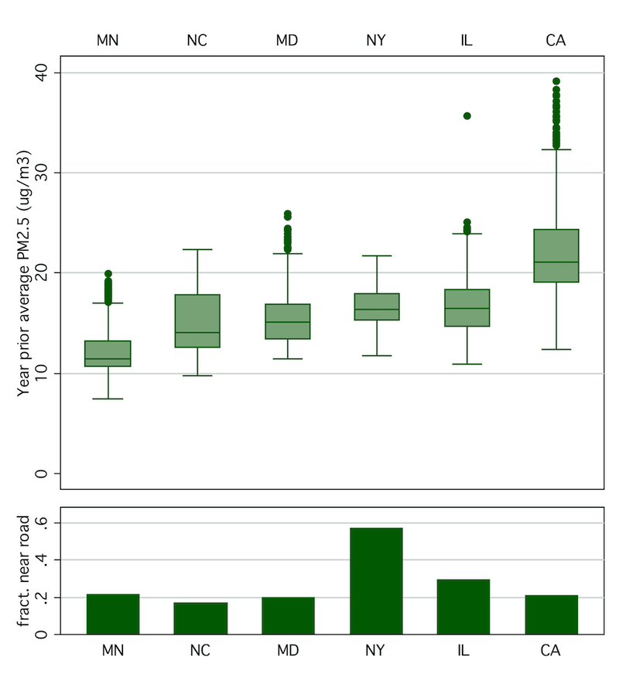
Exposures

Slide 13
Models
Model 1: Age, gender, race, BMI, income, education, cigarette use, EtOH use, SBP, DBP, HTN, DM, LDL, HDL
Model 2: Above + site
Model 3: Above + beta blockers, alpha blockers, calcium channel blockers, anti-arrhythmics, digoxin, sympathomimetics, tricyclics, erectile dysfunction drugs
Model 4: Above + coronary artery calcium score

Slide 14
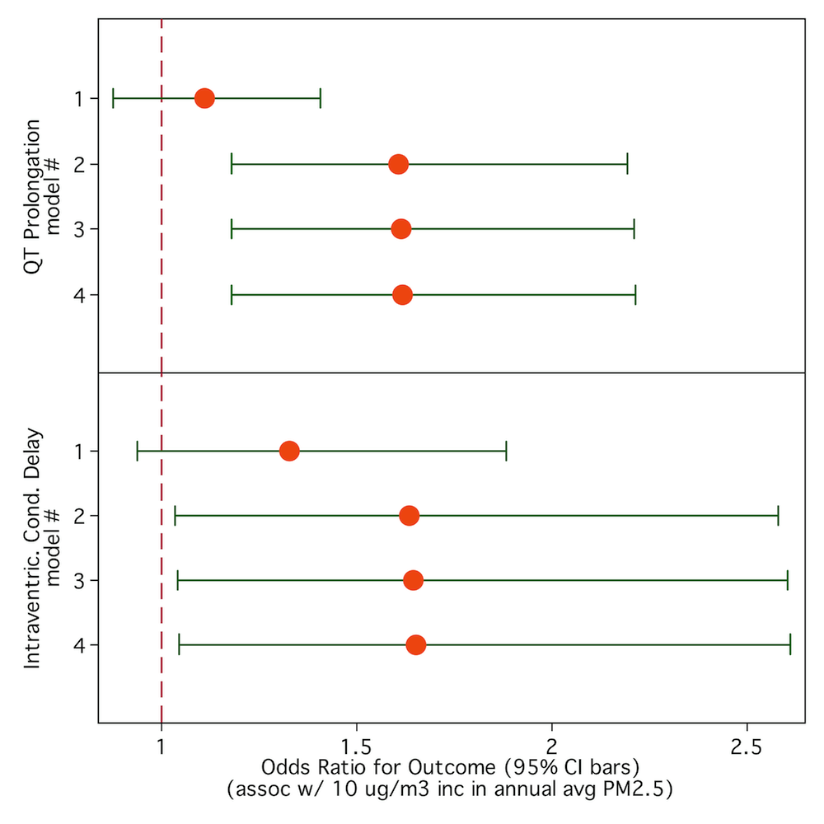
PM_{2.5} and ECG Abnormalities

Slide 15
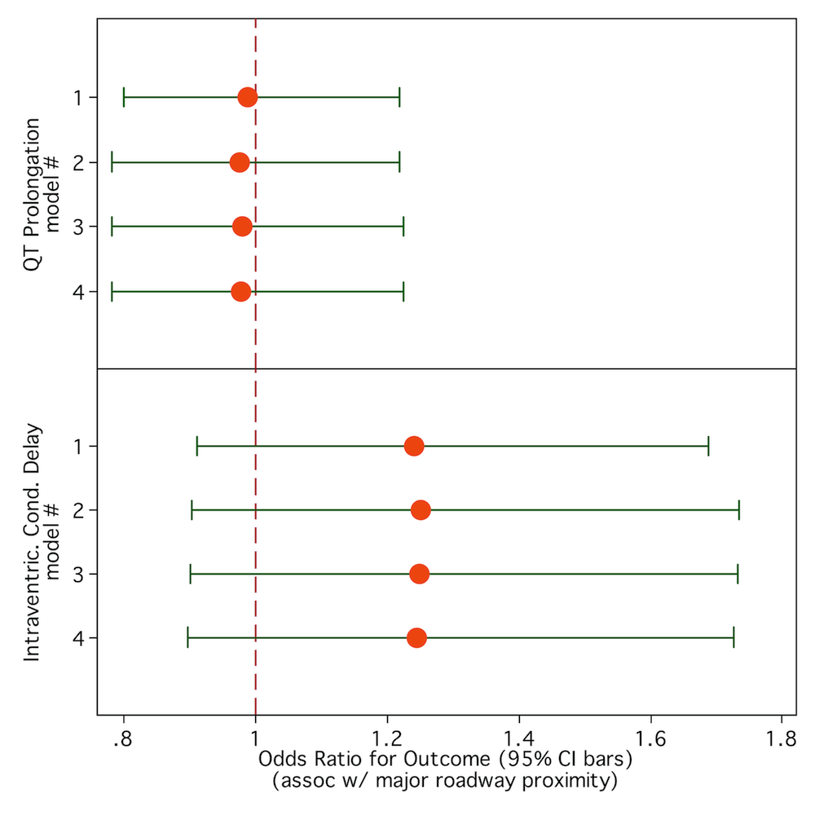
Roadway Proximity and ECG Abnormalities

Slide 16
Sensitivity Analyses
Additional control for other smoking indicators, roadway proximity in PM_{2.5} models, did not alter effect estimates
No evidence of effect modification
Repolarization analyses adjusted for conduction (and vice versa) suggest primary association with repolarization
No apparent linear relationship between PM_{2.5} and durations

Slide 17
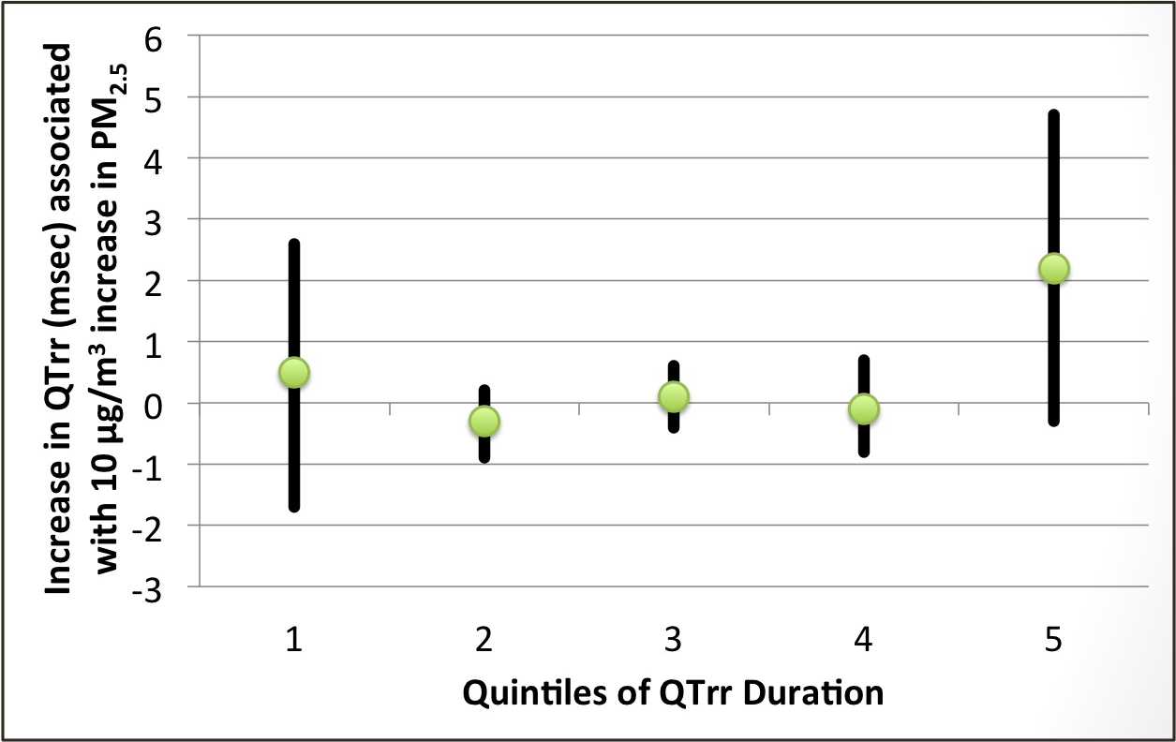
Association Between PM_{2.5} and QTrr, by QTrr Quintiles

Slide 18
Summary
Long-term PM_{2.5} exposure associated with important ECG abnormalities (QT prolongation > wide QRS).
Prolonged QT (and wide QRS) are important predictors of CVD death and arrhythmia.
Associations unaltered by adjustment for CAC – suggests lack of mediation by atherosclerosis
Effect of site adj suggests either confounding or within-city > between-city effects (as in Miller et al 2007)
QT prolongation effect most clear in upper quintiles of QT duration
Notes:
QTc prolongation is associated with a 2-3x higher risk of arrhythmia and cardiac death (and as much as 8x higher risk in individuals < 68 years old) (Straus 2006, Algra 1991)
IVCD also associated with poor CVD outcomes including left ventricular dysfunction (Lee 2003) and death (Hesse 2001)

Slide 19
Strengths & Limitations
Large, well-characterized cohort
CAC
Excellent long-term exposure data
Data on under-represented ethnicities
Focus on prognostically-relevant ECG measures
Cross-sectional
Roadway proximity measure limited
~6 second ECG

Slide 20
Acknowledgements
Adam Szpiro
Ronald Prineas
Jon Neyer
Karol Watson
David Siscovick
Sung Kyun Park
Joel Kaufman
Many others

Slide 21
References
Baja ES, et al. Traffic-related air pollution and QT interval: modification by diabetes, obesity, and oxidative stress gene polymorphisms in the normative aging study. Environ Health Perspect. 2010;118:840-846.
Brook RD, et al. Particulate Matter Air Pollution and Cardiovascular Disease. An Update to the Scientific Statement From the American Heart Association. Circulation. 2010;121:2331-2378.
Desai AD, et al. Prognostic Significance of Quantitative QRS Duration. Am J Med. 2006;119:600-606.
Henneberger A, et al. Repolarization changes induced by air pollution in ischemic heart disease patients. Environ Health Perspect. 2005;113:440-446.
Liao D, et al. Acute Adverse Effects of Fine Particulate Air Pollution on Ventricular Repolarization. Environ Health Perspect. 2010;118:1010-1015.
Lux RL, Pope CA. Air pollution effects on ventricular repolarization. Res Rep Health Eff Inst. 2009;Research Report 141:3-28.
Miller KA, et al. Long-term exposure to air pollution and incidence of cardiovascular events in women. N Engl J Med. 2007;356:447-458.
Schouten EG, et al. QT interval prolongation predicts cardiovascular mortality in an apparently healthy population. Circulation. 1991;84:1516-1523.

Slide 22
Thank you. Questions?

Slide 23
Supplemental slides

Slide 24
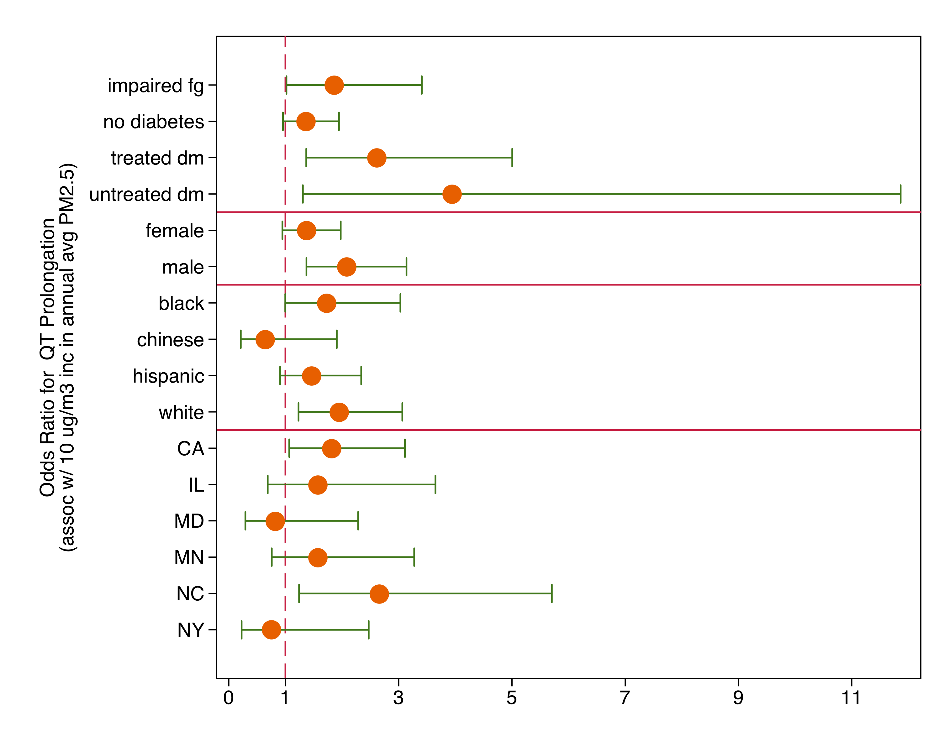
Association Between PM_{2.5} Exposure & QT prolongation (Full Model) – Interactions

Slide 25
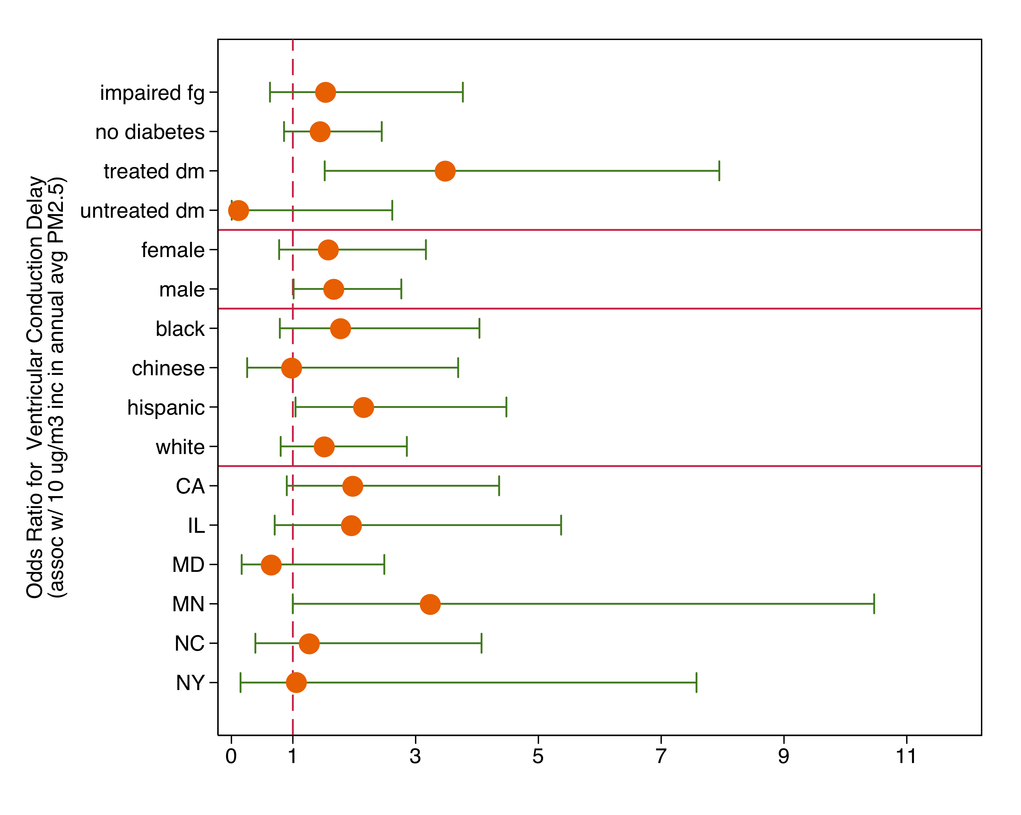
Association Between PM_{2.5} Exposure & VCD (Full Model) – Interactions

Slide 26
Bivariate Analyses
Age, race, gender, HTN, BMI, medication use, diabetes, HDL, income, education strongly associated with ECG abnormalities. Site also associated with some ECG abnormalities.
Participants in the lowest quartile of PM_{2.5} exposures:
  Increased: age, men, former smokers, higher BMI, higher income, high school or some college educational attainment, and Caucasian race, Q wave abnormalities.
  Less: ECG signs of increased LV mass or early repolarization.
Hispanics and African Americans nearer to major roadways than other racial groups, also individuals with lower income and ECG criteria for high LV mass and early repolarization.
Notes:
# abn
AA>Hisp>Chinese>Caucasian, men, older
>>>MD>MN>NC
QTc
Women longer, DM longer, age longer, on any meds longer, HTN longer, CAU > CHN > AA > HISP, IL > MN > NC > MD > NY > CA
Cigs shorter

