Slide 1
MESA Steering Committee Meeting
Seattle 4-25-13
The Adaptive Immune System in Non-Immune Chronic Diseases and Aging
A MESA-Inflammation Update
Tracy, Doyle, Huber, Jenny, Olson, Sallam: UVM
Psaty, Kronmal, De Boer: UW

Slide 2
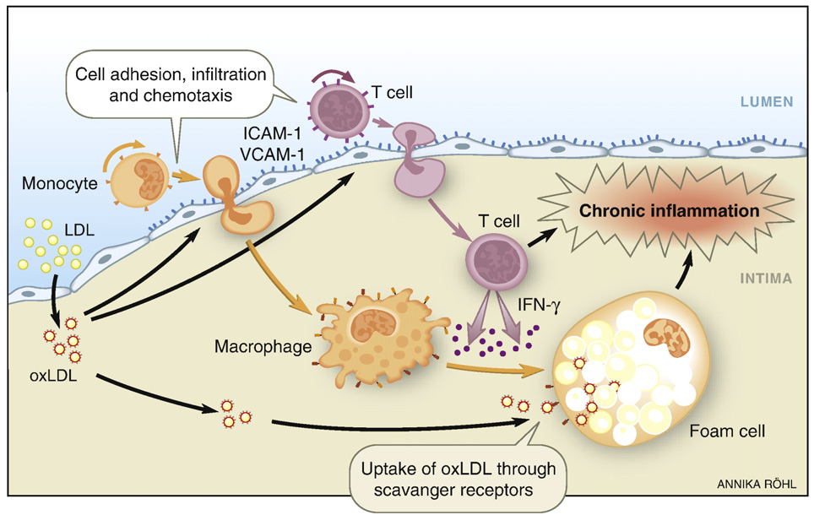
Atherosclerosis is Characterized by Innate and Adaptive Immune Responses
Andersson et al. Clinical Immunology. 2010.

Slide 3
Distribution of white cell populations in humans
Laboratory for Clinical Biochemistry Research
University of Vermont

Slide 4
Distribution of Lymphocyte Subpopulations
Distribution of Lymphocyte Subpopulations
CD4⁺ Subpopulations
~18% of
Lymphocytes
Naive: Antigen-inexperienced
B Cells
~7% of
Lymphocytes
NK Cells
CD4⁺ α:β
55% of T cells
Th1
Th2
Th17
Treg
δ:γ CD4⁻CD8⁻
Effector:
~10% of T cells
CD8⁺ α:β
35% of T cells
Memory: Long-lived
Antigen-specific
T cells: ~75% of
Lymphocytes

Slide 5
The Multi-Ethnic Study of Atherosclerosis: MESA
2000 - 2002, n = 6814 men and women in 4 ethnicities Caucasian, African American, Hispanic, and Chinese
1000 individuals randomly selected
  57% women, 46% Caucasian, 10% Asian American, 21% African American, and 23% Hispanic
Cellular epidemiology done in exam 4, 2006-2007
  Flow cytometry-based, focused on Adaptive Immunity
  CD4⁺ T cells; Th1, Th2 cells
  NK cells; γ−δ T cells
  Memory & Naïve T cells
Laboratory for Clinical Biochemistry Research
University of Vermont

Slide 6
Immunosenescence
The progressive loss of adaptive immune function with age and use; associated with thymic involution
Biomarkers include:
Loss of Naïve CD4⁺ and/or CD8⁺ T cells
Increased Effector/Memory CD4⁺ and/or CD8⁺ T cells
CD28^{null} CD4⁺ and/or CD8⁺ T cells
Loss of DNA T cell Excision Circles (TRECs)
  “footprint” of gene rearrangement for T cell receptors

Slide 7
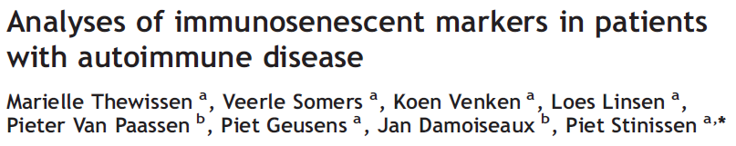
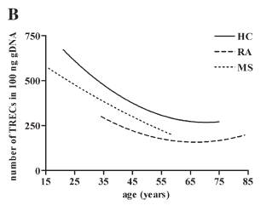
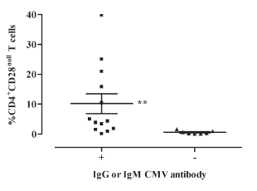

Slide 8
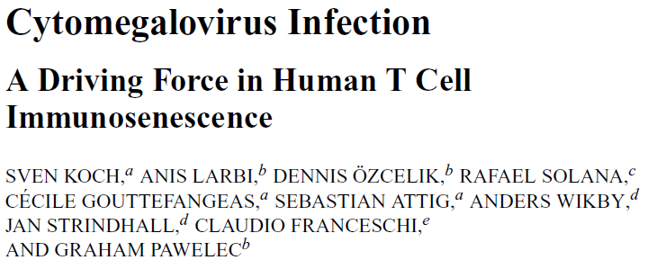
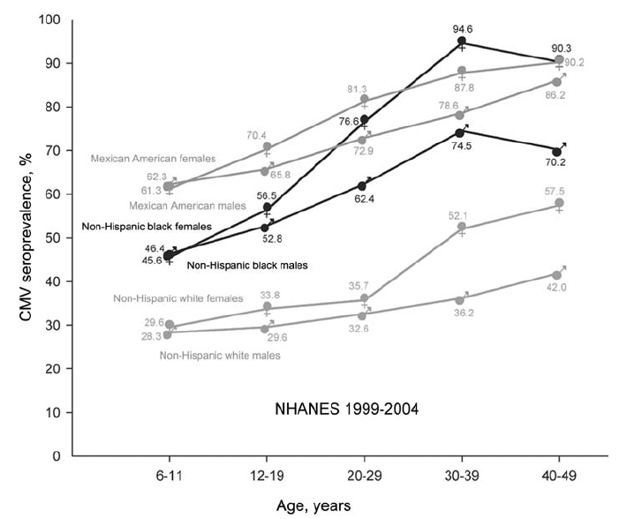

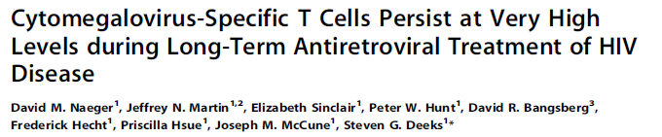
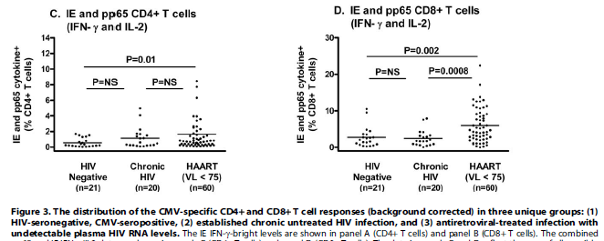
Naeger et al. PLoS One. 5:e8886, 2010
The T cell response to CMV was ~6% during long-term therapy, which was over twice that seen in HIV-seronegative persons.

Slide 9
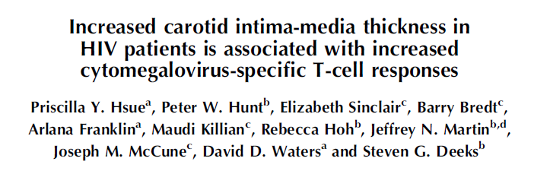
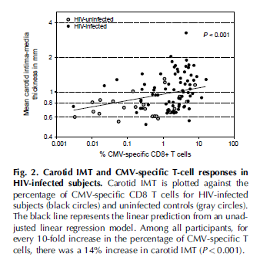
Inflammation, Atherosclerosis, and Aging
Hsue et al. AIDS 2006, 20:2275–2283
Laboratory for Clinical Biochemistry Research
University of Vermont

Slide 10


Rationale & Hypothesis
Antigen-specific T cells are abundant in human atherosclerotic lesions.
Th1 bias drives increased atherosclerosis in mice; attenuating Th1-differentiation results in reduced lesion development.
Th1 bias is associated with atherosclerosis in humans (Tracy et al., manuscript submitted)
Information from population-based epidemiological studies is lacking.
H_{o}: Increased proportions of circulating effector/memory cells and decreased proportions of naive cells will be associated with subclinical atherosclerosis.
Antigen Exposure
(e.g. oxLDL, CMV)
Adaptive Immune Activation
(↑ Effector/Memory/↓Naive)
Atherosclerosis
CD4⁺
CD45RA⁺
CD4⁺
CD45RO⁺
oxLDL
CMV
Naive Cell
Effector-Memory Cell

Slide 11
Distributions of Naive and EM Cells in MESA-Inflammation
Flow cytometry used to phenotype CD4⁺ T-cell subsets: naive, effector/memory (EM) in n=917 participants during Exam 4
Naïve, EM expressed as a % of CD4⁺ cells

Slide 12
Associations of CD4⁺ Naive and Effector/Memory Cells with Demographic Variables
*
*
56%
58%
*
51%
30%
26%
31%
*
31%
*
*
24%
26%
25%

Slide 13
CMV and H.pylori are Main Correlates of Adaptive Immune Activation
Variable (increment) | %Naive |  | %Effector/Memory
 | β Coef. | P value | β Coef. | P value
Age (10 yr increase) | -1.25 | <0.05 | -0.47 | ns
Gender (male vs female) | -4.2 | <0.0001 | 2.81 | <0.05
Race (vs EA)
Chinese-American | 1.91 | ns | 1.11 | ns
African-American | -1.97 | ns | 2.61 | ns
Hispanic-American | -1.69 | ns | 4.33 | <0.005
Season (vs Winter)
Spring | 2.11 | ns | 0.01 | ns
Summer | 4.07 | <0.05 | 3.26 | ns
Fall | 7.21 | <0.0001 | 0.76 | ns
BMI (5.6 kg/m²) | -1.26 | <0.05 | 0.54 | ns
IL-6 (1.2 pg/ml) | -1.49 | <0.05 | 2.26 | <0.0001
CMV (vs 0.0 EU/ml)
0.1 – 99.9 EU/ml | -2.91 | <0.05 | 4.71 | <0.005
100 – 199.9 EU/ml | -6.15 | <0.0001 | 8.11 | <0.0001
200 – 299.9 EU/ml | -7.05 | <0.005 | 7.29 | <0.005
H. pylori (vs <0.9)
0.9-6.9 | -3.44 | <0.005 | 2.68 | <0.05
6.9-13.9 | -6.60 | <0.05 | 3.99 | <0.05
Model R² | 0.15 |  | 0.12

Slide 14
CD4⁺ Effector/Memory Cells are Associated with Subclinical Atherosclerosis
Independent Variable (increment) lnCAC
 | Coefficient |  | P value
Model 1: Age, sex, race/ethnicity, effector/memory or naive cells.
Age (10 yr increase) |  | 0.92 | ≤0.0001
Sex (vs female) |  | 0.37 | ≤0.005
CD4⁺ Effector/Memory (15.2%) |  | 0.19 | <0.05
CD4⁺ Naive (14.2%) |  | -0.16 | 0.13
Model R² |  | 0.22
Model 2: Model 1 + IL-6, CMV and H. pylori titers.
CD4⁺ Effector/Memory (15.2%) |  | 0.21 | <0.05
Model R² |  | 0.22
Model 3: Model 2 + BMI, Sys-BP, BP lowering medication, smoking status, total-chol, LDL-chol, lipid lowering medication,and diabetes status.
Age (10 yr increase) |  | 0.82
Sex (vs female) |  | 0.70
Lipid-lowering medication |  | 0.65 | ≤0.0001
Diabetes Status (vs normal)
Impaired glucose tolerance |  | 0.46 | ≤0.005
CD4⁺ Effector/Memory (15.2%) |  | 0.20 | <0.05
Model R² |  | 0.24

Slide 15
CD4⁺ Effector/Memory Cells are Associated with Subclinical Atherosclerosis
Independent Variable (increment) lnCAC
 | Coefficient |  | P value
Model 1: Age, sex, race/ethnicity, effector/memory or naive cells.
Age (10 yr increase) |  | 0.92 | ≤0.0001
Sex (vs female) |  | 0.37 | ≤0.005
CD4⁺ Effector/Memory (15.2%) |  | 0.19 | <0.05
CD4⁺ Naive (14.2%) |  | -0.16 | 0.08
Model R² |  | 0.22
Model 2: Model 1 + IL-6, CMV and H. pylori titers.
CD4⁺ Effector/Memory (15.2%) |  | 0.21 | <0.05
Model R² |  | 0.22
Model 3: Model 2 + BMI, Sys-BP, BP lowering medication, smoking status, total-chol, LDL-chol, lipid lowering medication,and diabetes status.
Age (10 yr increase) |  | 0.82
Sex (vs female) |  | 0.70
Lipid-lowering medication |  | 0.65 | ≤0.0001
Diabetes Status (vs normal)
Impaired glucose tolerance |  | 0.46 | ≤0.005
CD4⁺ Effector/Memory (15.2%) |  | 0.20 | <0.05
Model R² |  | 0.24

Slide 16
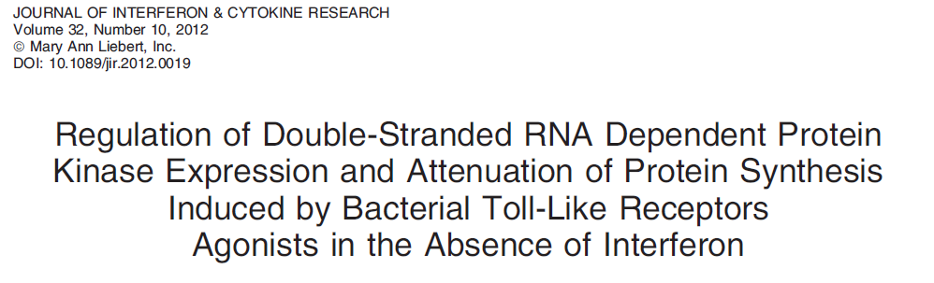
Viral replication → PKR → decreased protein synthesis

Slide 17
Coagulation Factors Measured in HIV⁺ Individuals Before and After Therapy Show Decreased Hepatocyte Protein Production
Made principally by hepatocytes
Baker, Brummel-Ziedins, Tracy et al, submitted, 2013

Slide 18
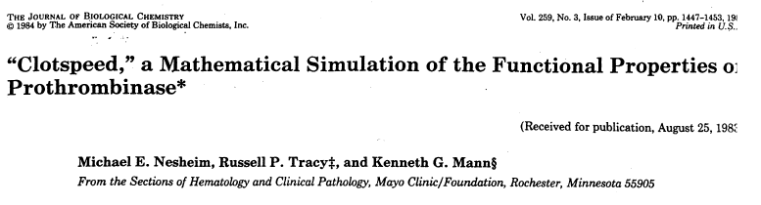
Modeling the Coagulation System

Slide 19
Computational modeling indicates that viral replication is associated with decreased hepatocyte protein production and increased thrombin generation
Baker, Brummel-Ziedins, Tracy et al, submitted, 2013

Slide 20
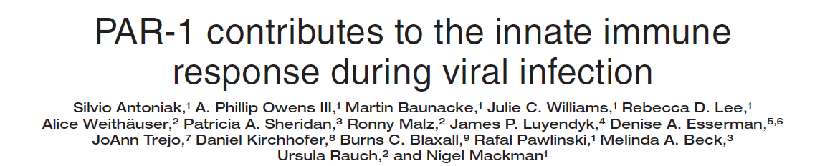
Viral replication → PKR → decreased protein synthesis
“…Our results indicate that the tissue factor/thrombin/PAR-1 pathway enhances IFN-β expression and contributes to the innate immune response during single-stranded RNA viral infection…”

Slide 21
Model for Coagulopathy in viral infections: thrombin is both “good” and “bad”
Viral replication
Interferon production
Thrombosis risk
PAR-1 – mediated
effects
IRPs (n >2,000)
Including
PKR upregulation
& activation
Antiviral benefit
Procoagulant state
& increased thrombin
Reduced Protein
Synthesis
Altered Coagulome

Slide 22
Conceptual Model of How Immune Function Interacts with Atherosclerosis & Aging
Coagulation; also part of “inflammation”
(e.g., MΦ activation, IL-6, etc)
Non-immune stimulators:
Wound healing
Dental carries
Alcoholic liver damage
Smoke-related lung damage
etc
Innate Immunity; “inflammation”
(e.g., MΦ activation, IL-6, etc)
?
?
IFN-γ
Immune stimulators:
Natural:
  Viruses (e.g. CMV, HIV);
  Bacteria
  Autoimmune disorders
    RA, SLE
IFN-γ
When there is sufficient OXLDL:
ATHEROSCLEROTIC
PLAQUE
Th1
Increasing immunosenescence
Th2
?
Naive
T cells
Memory
T cells
Adaptive Immunity
(e.g. CD4⁺ cells, CD8⁺ cells, B cells)
Increasing immunosenescence leads to increased inflammation:
puts increasing burden on innate immunity
Increases infectious burden due to inefficient immune response
Increases cancer risk due to loss of immune surveillance.
Can we substitute all chronic diseases for atherosclerosis ?

Slide 23
Lower Naive Cells are Associated with T2D
T2D (n=151) | %naive OR (95% CI) | %EM OR (95% CI) | %Th1 OR (95% CI) | %Th2 OR (95% CI)
Model A: | 0.76 (0.61, 0.93) | 1.23 (1.01, 1.50) | 1.08 (0.89, 1.31) | 0.99 (0.81, 1.21)
Model B: | 0.80 (0.64, 0.99) | 1.18 (0.96, 1.45) | 0.99 (0.79, 1.24) | 0.95 (0.75, 1.19)
Model C: | 0.75 (0.59, 0.96) | 1.18 (0.94, 1.49) | 1.16 (0.92, 1.45) | 0.98 (0.77, 1.26)
Models were analyzed by logistic regression with T2D as the outcome variable. T cell subpopulations were analyzed per SD increase in separate models. Model A: Age, gender, race/ethnicity; Model B: Model A + BMI; Model C: Model B + systolic BP, use of BP lowering medication, smoking status, IL-6, CRP. T2D was defined by usage of diabetes medication.

Slide 24
Manuscripts
Tracy et al.: T Helper Type 1 Bias in Healthy People is Associated with Cytomegalovirus Serology and Atherosclerosis: the Multi-Ethnic Study of Atherosclerosis. Good review at Circ, but not accepted; Re-sub to JAHA, accepted.
Olson et al.: Decreased Naive and Increased Effector/Memory CD4+ T cells are associated with Subclinical Atherosclerosis: the Multi-Ethnic Study of Atherosclerosis. Good review at PLoS Med, but not accepted; re-sub to PLoS One, under review.
Olson et al.: Associations of CD4+ T lymphocyte subpopulations with Type 2 Diabetes in MESA. In preparation.
Jenny et al.: Associations of Natural Killer Cells with atherosclerosis in MESA. In preparation.

