Slide 1
MESA Inflammation: Update
Progress on main analyses (Tracy)
Preliminary GWAS results (Durda)
Results on surrogate Th panel (Doyle)
Preliminary look at Memory/Naïve cells (Olson)
Two concepts to consider:
  Immune Landscape
  Cellular senescence
Laboratory for Clinical Biochemistry Research
University of Vermont

Slide 2
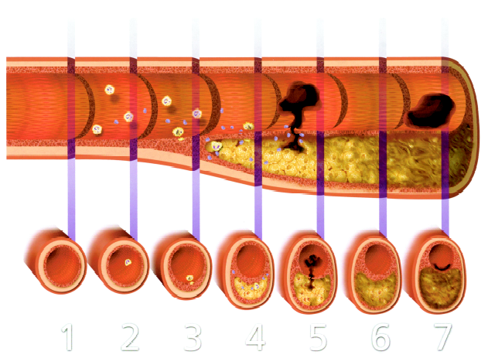
Vascular Cell Biology
FIBROUS CAP
NEOVASCULARIZATION
(outlined in black)
INFLAMMATORY CELLS
(round nuclei)
CALCIFICATION
LIPID CORE
Libby P. Circ 104:365-72, 2001
Kotran, Kumar, Collins. Robbins Pathologic Basis of Disease. 6th edition. Saunders, 1999
Atherosclerosis, thrombosis and calcification
C-reactive protein (CRP)
Fibrinogen
Inflammation
(Interleukin-6; IL-6)

Slide 3
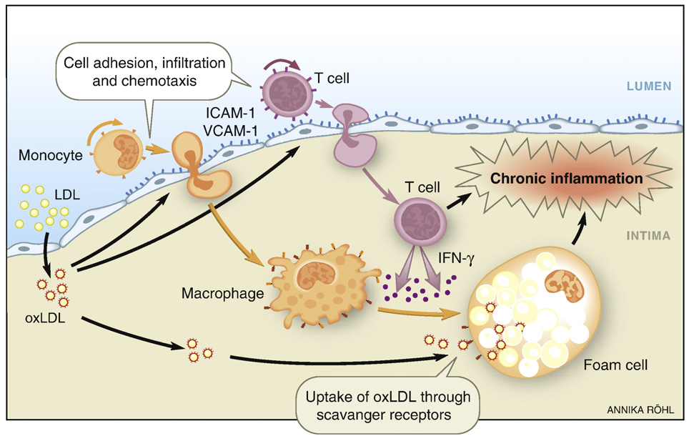
Atherosclerosis: initial stages
Laboratory for Clinical Biochemistry Research
University of Vermont

Slide 4
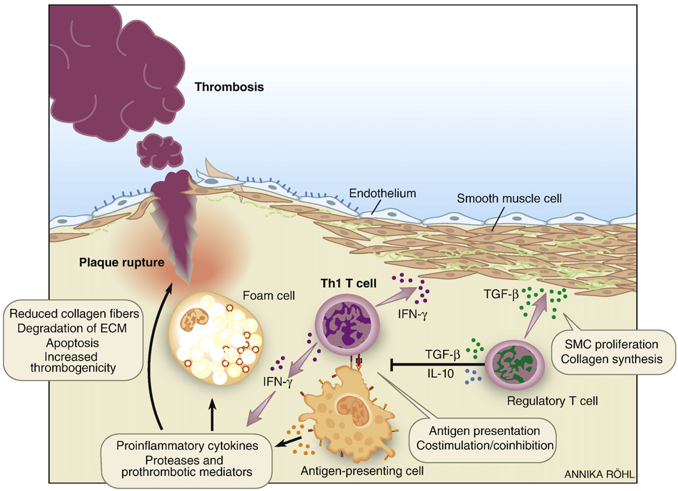
Atherosclerosis: role of T cells
Laboratory for Clinical Biochemistry Research
University of Vermont

Slide 5
Inflammation, Atherosclerosis, and HIV
To a large extent INFLAMMATION is both the cause and the response to dead cells and/or damaged tissue; some forms include:
  Homeostatic tissue remodeling: inflammatory cells may participate in destroying tissue, then slowly rebuild it; quality declines with age;
  Bacterial defense: inflammatory cells kill bacteria, then clean up the residue; immunosenescence leads to increased vulnerability with age;
  Wound repair: in some ways similar to remodeling, but done in an accelerated manner; the rebuilt tissue is not of the same quality as the starting tissue – often fibrotic.
    Chronic low-level “wound repair”: many examples (atherosclerosis, cirrhosis, chronic kidney disease, chronic obstructive pulmonary disease (COPD), etc) ; the rebuilt tissue is fibrotic and not as functional contributing to loss of organ function
Laboratory for Clinical Biochemistry Research
University of Vermont

Slide 6
The Multi-Ethnic Study of Atherosclerosis: MESA
2000 - 2002, n = 6814 men and women in 4 ethnicities Caucasian, African American, Hispanic, and Chinese
1000 individuals randomly selected
  57% women, 46% Caucasian, 10% Asian American, 21% African American, and 23% Hispanic
Cellular epidemiology done in exam 4, 2006-2007
  CD4⁺ T cells; Th1, Th2 cells
  NK cells; γ−δ T cells
  Memory & Naïve T cells
Laboratory for Clinical Biochemistry Research
University of Vermont

Slide 7
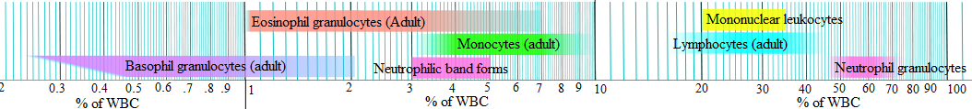
Distribution of white cell populations in humans
Laboratory for Clinical Biochemistry Research
University of Vermont

Slide 8
Distribution of lymphocyte subpopulations in humans
We express our indices:
CD4+ as % of lymphocytes
Th1 as % of CD4+ cells
Th2 as % of CD4+ cells
Memory as % of CD4+
Naïve as % of CD4+ cells
~18% of Lymphocytes
~7% of
Lymphocytes
10% of T Cells
55% of T Cells
35% of T Cells
~75% of Lymphocytes
From Immuno Biology, The Immune System in Health and Disease,
Janeway, Travers, Walport, Capra, 4th edition
Laboratory for Clinical Biochemistry Research
University of Vermont

Slide 9
MESA Inflammation: Prediction of T Cell Indices
 | %CD4 |  | %Th1 |  | %Th2
Variable (increment) | Coef. | P value | Coef. | P value | Coef. | P value
Age (10 yr increase) |  | ns | -0.86 | <0.005 |  | ns
Sex (male vs female) | -3.17 | <0.005 | 1.12 | <0.05 |  | ns
Race (vs European American)
Asian American | -7.73 | <0.001 | 0.09 | ns | 0.31 | <0.01
African American | -9.01 | <0.001 | 1.08 | ns | 0.33 | <0.001
Hispanic American | -4.34 | <0.001 | 0.78 | ns | 0.10 | ns
Season (vs Winter)
Spring | 0.16 | ns | 1.44 | <0.05 |  | ns
Summer | -7.39 | <0.001 | 3.03 | <0.01 | 0.53 | <0.001
Fall | -0.23 | ns | 0.35 | ns | 0.25 | <0.001
CMV (vs 0.0 EU/ml)
0.1 – 99.9 EU/ml | -4.84 | <0.001 | 4.02 | <0.001 |  | ns
100 – 199.9 EU/ml | -4.48 | <0.005 | 7.94 | <0.001 |  | ns
200 – 299.9 EU/ml | -7.35 | <0.001 | 9.30 | <0.001 |  | ns
IL-6 (pg/ml) | -1.19 | <0.01 | 0.50 | <0.05 |  | ns
Model R² | 0.15 |  | 0.21 |  | 0.06
Median (SD) | 40 (10) |  | 16 (8) |  | 0.85 (0.8)

Slide 10
MESA Inflammation: Prediction of Atherosclerosis
 | Ln CAC (n=552) |  | cIMT-common (n=905)
Variable (increment) | Coef. | P value | Coef. | P value
Age (10 yr increase) | 0.71 | <0.001 | 0.08 | <0.001
Sex (male vs female) | 0.81 | <0.001 | 0.06 | <0.001
Race (vs European American
Asian American |  | ns |  | ns
African American |  | ns |  | ns
Hispanic American |  | ns | -0.03 | <0.05
Blood Pressure
sys blood pressure (10 mmHg) |  | ns | 0.02 | <0.001
dia blood pressure (10 mmHg) |  | ns | -0.02 | <0.05
BMI (5 kg/m²) |  | ns | 0.01 | <0.01
Smoking (vs never smoker)
Former | 0.39 | <0.05 |  | ns
Current | 0.61 | ­< 0.05 |  | ns
Cell-based analytes
%Th1 (10%) | 0.25 | <0.01 | 0.02 | <0.05
%Th2 (1%) |  | ns | -0.02 | <0.01
Model R² | 0.17 |  | 0.33
Laboratory for Clinical Biochemistry Research
University of Vermont
Notes:
These are biovariability data showing the % of CD4+ cells that are Th1 cells in 14 apparently healthy volunteers over18 months. Each individual has a reasonably stable phenotype and we can easily differentiate among individuals based on their %Th1 count. The analytical coefficient of variation of this particular assay is approximately 9%. We have biovariability data on the other T cell measurements and natural killer cell subsets as well.

Slide 11
Cohort, Variables, GWAS
MESA 1000 (MESA Inflammation)
EA – 375 AA – 170
Hispanic – 216 Chinese - 94
Variables
Log %Th1 Log %Th2 %CD4
GWAS
Only genotyped SNPs; ~750k

Slide 12
Acknowledgements
University of Vermont:
Peter Durda
Peggy Doyle
University of Virginia:
Joe Mychaleckyj
Ani Manichaikul
Steve Rich
University of Washington
Bruce Psaty
Dick Kronmal
MESA and the MESA Participants

Slide 13
Important Features
Important biological phenotype in cardiovascular and other diseases
Unique, never been looked at before
Small sample size
Difficult/expensive phenotype
Difficult for replication

Slide 14
Overall Analytical Strategy
 | %CD4 | Log%Th1 | Log%Th2
EA | Genotyped/imputed Unadj/adj | Genotyped/imputed Unadj/adj | Genotyped/imputed Unadj/adj
AA | Genotyped/imputed Unadj/adj | Genotyped/imputed Unadj/adj | Genotyped/imputed Unadj/adj
HA | Genotyped/imputed Unadj/adj | Genotyped/imputed Unadj/adj | Genotyped/imputed Unadj/adj
CA | Genotyped/imputed Unadj/adj | Genotyped/imputed Unadj/adj | Genotyped/imputed Unadj/adj
Meta | Genotyped/imputed Unadj/adj | Genotyped/imputed Unadj/adj | Genotyped/imputed Unadj/adj

Slide 15
Log Percent Th1
Results

Slide 16
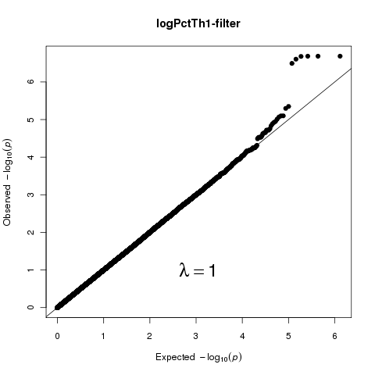
Log Percent Th1 EA

Slide 17
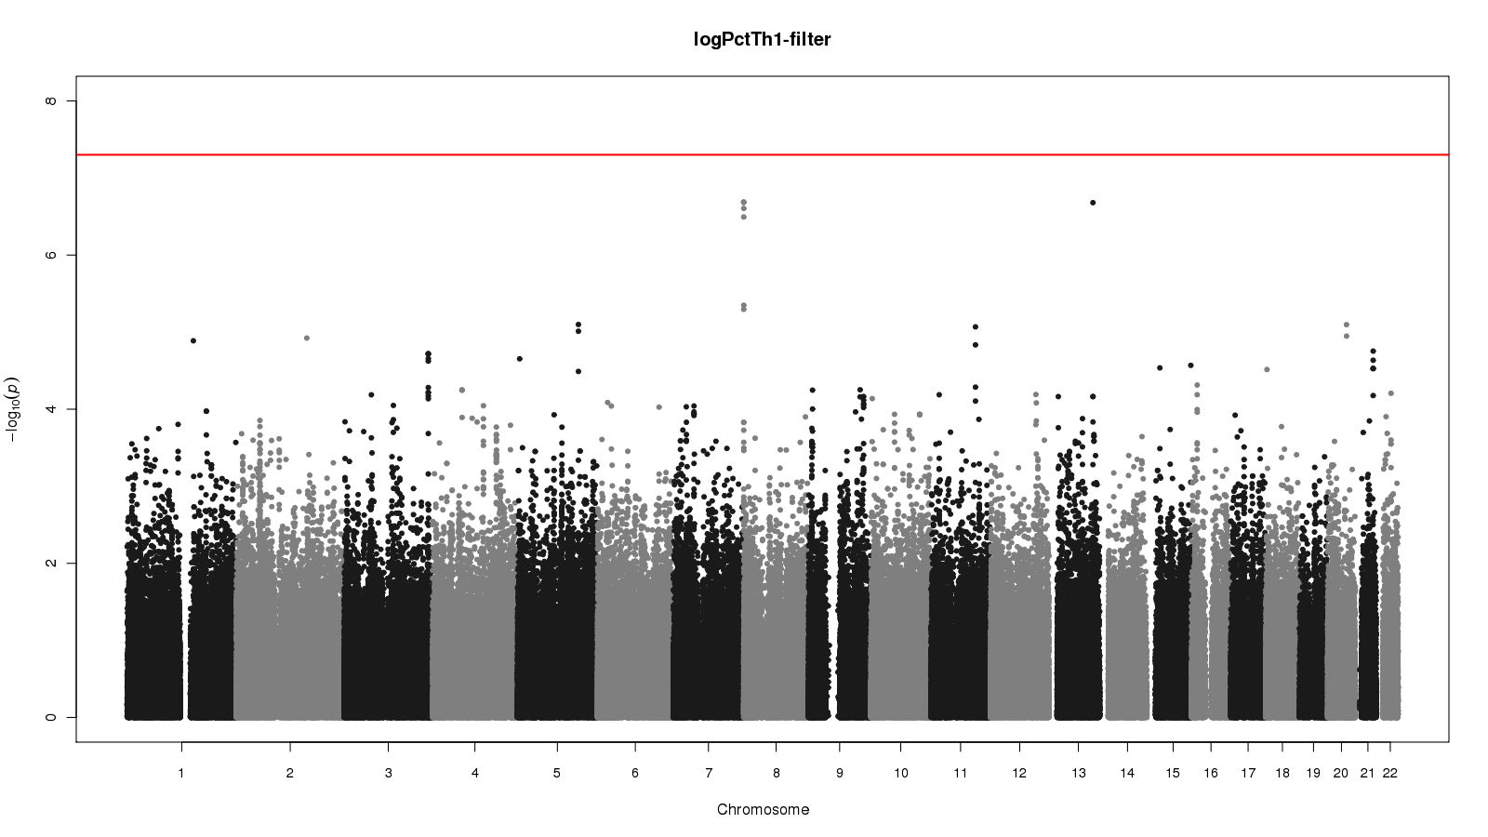
Log Percent Th1 EA

Slide 18
Local Plot Log Pct Th1 EA
2.06E−7

Slide 19
Top Hits for EA Log Pct Th1
SNPID | Chr | Position | Beta | SE | pval | AF_coded_all | HWE_pval
rs11782267 | 8 | 201877 | -0.189 | 0.035694 | 2.06E-07 | 0.4492 | 1
rs7820395 | 8 | 202894 | -0.189 | 0.035694 | 2.06E-07 | 0.4492 | 1
rs7831661 | 8 | 202995 | -0.189 | 0.035694 | 2.06E-07 | 0.4492 | 1
rs7325697 | 13 | 98915794 | -0.2627 | 0.049641 | 2.09E-07 | 0.135 | 0.372
rs10435671 | 8 | 202498 | -0.1884 | 0.035824 | 2.48E-07 | 0.4504 | 0.9171
rs4045956 | 8 | 209677 | -0.1849 | 0.035503 | 3.2E-07 | 0.3971 | 0.5178
rs2906334 | 8 | 189547 | -0.1664 | 0.035716 | 4.47E-06 | 0.4799 | 0.8366
rs2906337 | 8 | 190898 | -0.1656 | 0.035759 | 5.07E-06 | 0.4866 | 0.836
Notes:
Rs7325697 chrm 13 between genes, miRNA

Slide 20
Top Hits for EA Log Percent Th1
5 hits with p value 3E-07 on Chrm 8 downstream from ZNF 596 and upstream from FBXO25
1 hit with a p value of 2E-07 on Chrm 13 in a micro RNA coding region

Slide 21
ZNF596 and FBXO25
Some Zinc Finger Proteins are regulators of deubiquination; some are transcription factors
FBXO25 – specificity factor for ubiquitin ligases and ubiquination
Nature. 2011 Mar 31;471(7340):591-6.
Linear ubiquitination prevents inflammation and regulates immune signalling.
Gerlach B, et al.

Slide 22
META Analysis Log PCt Th1
1.06E−7
Notes:
Effect 0.1411 Direction +++-
Sorry no Manhattan plot.

Slide 23
META Analysis Log PCt Th1
rs12517410 chr 5 lysine (K) – specific demethylase 3B (KDM3B) intron
    P value 1.06E-07
Notes:
Not much known about KDM3B possible tumor necrosis stimulating gene

Slide 24
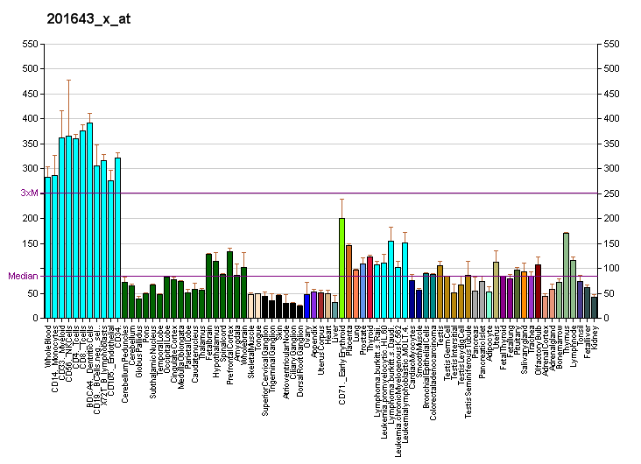
KDM3B
Diagram created by AndrewGNF based on data from Su AI, Wiltshire T, Batalov S, et al (2004). "A gene atlas of the mouse and human protein-encoding transcriptomes".
Proc. Natl. Acad. Sci. U.S.A. 101 (16): 6062–7. doi:10.1073/pnas.0400782101. PMID 15075390.
Creation supported by the Genomics Institute of the Novartis Research Foundation.

Slide 25
Log Percent Th2
Results
Analyses of the four ethnicities did not show any statistically
significant hits
The meta analysis did find a statistically significant hit with
a p value of 3.33E-08 on Chr 1

Slide 26
META Analysis Log PCt Th2
3.33E−8
Notes:
Effect 0.2629 Direction ??++
Sorry no Manhattan plot

Slide 27
rs2275837 Chr 1
Coiled-coil domain containing 27 (CCDC27)
Function unknown
PubMed references for this gene include:
Personalized smoking cessation; quit success genotype score
Low bone mineral density

Slide 28
Percent CD4 Cells Results

Slide 29
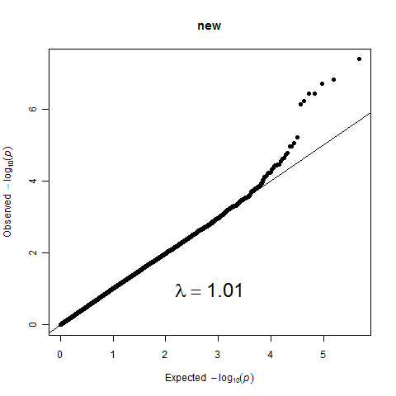
Percent CD4 Cells EA

Slide 30
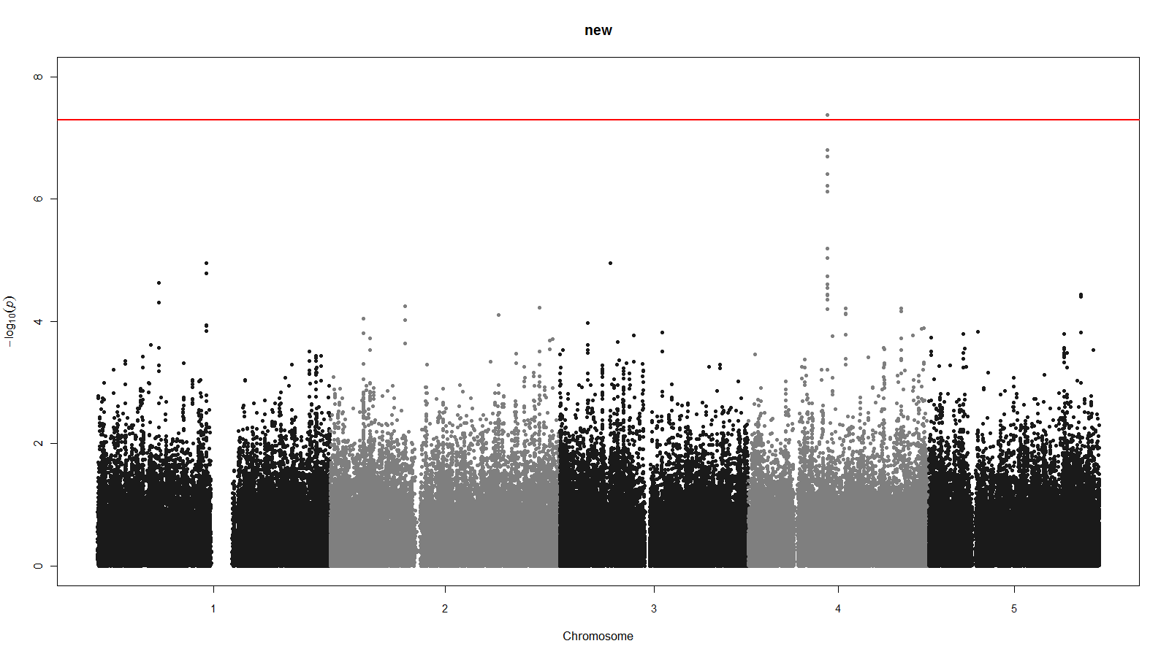
Percent CD4 Cells EA
4.18E-08

Slide 31
EA Pct CD4
4.18E−8
Notes:
Beta 3.769

Slide 32
Top Hits for EA Percent CD4 Cells
SNPID | Chr | Position | Beta | SE | pval | AF_coded_all | HWE_pval
rs4693051 | 4 | 83870158 | 3.769 | 0.672675 | 4.18E-08 | 0.4303 | 0.8333
rs1358056 | 4 | 83867553 | 3.798 | 0.709774 | 1.55E-07 | 0.3449 | 0.9091
rs4693498 | 4 | 83859356 | 3.608 | 0.680626 | 2E-07 | 0.4772 | 0.9174
rs6535382 | 4 | 83857571 | 3.543 | 0.685167 | 3.85E-07 | 0.4759 | 0.7566
rs6535384 | 4 | 83858517 | 3.543 | 0.685167 | 3.85E-07 | 0.4759 | 0.7566
rs11836187 | 12 | 4029435 | 7.56 | 1.485265 | 5.75E-07 | 0.05615 | 0.3227
rs6535395 | 4 | 83860850 | 3.456 | 0.680181 | 6.02E-07 | 0.4693 | 1
rs4693497 | 4 | 83857644 | 3.462 | 0.687177 | 7.45E-07 | 0.4745 | 0.7554

Slide 33
Top Hit for EA Percent CD4 Cells
rs4693051 is in an intron on the Chrm 4 gene Stearoyl-CoA desaturase 5 (SCD5)
SCD5 has been associated with two pathways
    Biosynthesis of unsaturated fatty acids
      T cells have unique FA metabolism among lymphocytes
    PPAR signaling pathway
      PPAR-gamma signaling is critical in T cells

Slide 34
Summary
Log Pct Th1
EA multiple hits on chr 8 not quite reaching genome wide significance; ZNF596 and FBXO25
Meta analysis hit on chr 5 not quite reaching genome wide significance; KDM3B
Log Pct Th2
Meta analysis rs2275837 on chr 1;
p value = 3.33E-08; CCDC27
Percent CD4 Cells
EA rs4693051 on chr 4;
p value = 4.18E-08; SCD5

Slide 35
Next Steps
(where do we go from here?)
Larger sample size – biomarker panel for “Th-ness” ??
  Genotype-Guided Phenotyping: selection of samples based on genotype, then phenotype these samples from frozen samples or new blood draws
Analyses: adjust for seasonality and cmv titer; imputed SNPs
Follow-up hits with possible functional studies

Slide 36
Update on developing a panel as a surrogate measure of “Th-ness”
N=132 samples from GEMINI (Lenore Launer, Jeff Williamson & colleagues)
  Cellular phenotyping, plasma measures
  Concern: all elderly
Use regression modeling of plasma measures to obtain best estimate of cellular phenotypes

Slide 37
Variables entered
CMV IgG2 IL10
Gender IgG3 IL12p70
Age IgG4 IL13
IL-6 IL1b IFNγ
IP-10 IL2 TNFα
CMV IL4 Seasonality
IgE IL5
IgG1 IL8

Slide 38
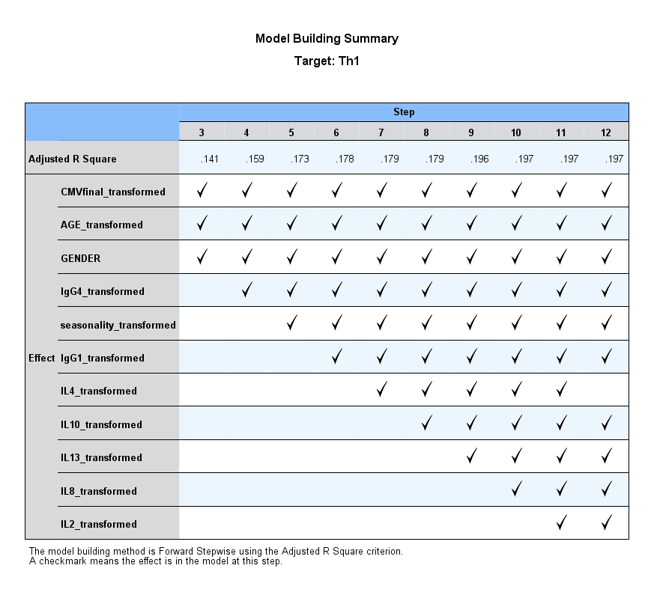

Slide 39
Preliminary look at CD4+ and CD8+ Memory and Naïve T Cells
Initial analyses done by Nels Olson, UVM post-doc;
Need to connect to Dick Kronmol
Therefore, this is a VERY preliminary look
Laboratory for Clinical Biochemistry Research
University of Vermont
Notes:
These are biovariability data showing the % of CD4+ cells that are Th1 cells in 14 apparently healthy volunteers over18 months. Each individual has a reasonably stable phenotype and we can easily differentiate among individuals based on their %Th1 count. The analytical coefficient of variation of this particular assay is approximately 9%. We have biovariability data on the other T cell measurements and natural killer cell subsets as well.

Slide 40
Associations of CD4+ and CD8+ Memory and Naïve T Cells
Variable | CD4⁺ Memory (%) Naïve (%) Memory/Naive | CD8⁺ Memory (%) Naïve (%) Memory/Naive
Age† | 0.80 < 0.0001 0.0008 | 0.25 0.29 0.39
Gender* | 0.12 < 0.0001 0.28 | 0.003 0.12 0.03
Smoking | 0.61 0.26 0.61 | 0.61 0.004 0.07
Hypertension | 0.06 0.02 0.10 | 0.65 0.54 0.42
Student’s T-Test (gender, hypertension) and ANOVA (age, smoking, clinic) to test for differences among groups.
†: Age Categories are defined as 45-54 yrs; 55-64 yrs; 65-74 yrs; 75-84 yrs.
 | Men | Woman
CD4⁺ Naïve Cells | 26.3 (0.67) | 30.0 (0.65)
CD8⁺ Memory Cells | 7.8 (0.27) | 6.8 (0.22)
CD8⁺ Memory/Naïve ratio | 0.23 (0.04) | 0.20 (0.03)
Laboratory for Clinical Biochemistry Research
University of Vermont
Notes:
These are biovariability data showing the % of CD4+ cells that are Th1 cells in 14 apparently healthy volunteers over18 months. Each individual has a reasonably stable phenotype and we can easily differentiate among individuals based on their %Th1 count. The analytical coefficient of variation of this particular assay is approximately 9%. We have biovariability data on the other T cell measurements and natural killer cell subsets as well.

Slide 41
Associations of Memory & Naïve cells with Serologies
 | CD4⁺ Memory (%)
Pathogen | n | Pos Exposure | n | Neg Exposure | p-value
C. pneumoniae | 672 | 54.2 (xxx) | 242 | 53.0 (xxx) | 0.30
H. pylori | 305 | 56.1 (xxx) | 389 | 52.2 (xxx) | 0.0011
Herpes simplex | 594 | 54.2 (xxx) | 109 | 51.7 (xxx) | 0.34
Hepatitis A | 389 | 54.8 (xx) | 316 | 52.3 (xxx) | 0.077
Cytomegalovirus | 528 | 55.0 (xxx) | 175 | 46.9 (xxx) | <0.0001
 | CD4⁺ Naïve (%)
Pathogen | n | Pos Exposure | n | Neg Exposure | p-value
C. pneumoniae | 672 | 28.1 (xxx) | 242 | 28.4 (xxx) | 0.75
H. pylori | 305 | 25.7 (xxx) | 389 | 29.5 (xxx) | 0.0009
Herpes simplex | 594 | 27.4 (xxx) | 109 | 30.7 (xxx) | 0.068
Hepatitis A | 389 | 26.5 (xxx) | 315 | 30.4 (xxx) | 0.0047
Cytomegalovirus | 528 | 27.0 (xxx) | 175 | 33.0 (xxx) | 0.0001
Laboratory for Clinical Biochemistry Research
University of Vermont
Notes:
These are biovariability data showing the % of CD4+ cells that are Th1 cells in 14 apparently healthy volunteers over18 months. Each individual has a reasonably stable phenotype and we can easily differentiate among individuals based on their %Th1 count. The analytical coefficient of variation of this particular assay is approximately 9%. We have biovariability data on the other T cell measurements and natural killer cell subsets as well.

Slide 42
Associations of Memory & Naïve cells: Spearman Correlations (adj age, sex, race)
Variable | CD4⁺ Memory | CD4⁺ Naive
 | r (p) | r (p)
Demographics
Age | 0.03 (0.4) | -0.13 (0.0001)
Obesity
BMI (kg/m²) | 0.10 (0.002) | -0.13 (<0.0001)
Waist (cm) | 0.11 (0.001) | -0.13 (<0.0001)
Hip (cm) | 0.06 (0.07) | -0.08 (0.02)
Lipids
Total cholesterol (mg/dl) | - 0.04 (0.3) | 0.04 (0.3)
LDL cholesterol (mg/dl) | - 0.04 (0.2) | 0.04 (0.2)
HDL cholesterol (mg/dl) | - 0.07 (0.04) | 0.07 (0.03)
Triglycerides (mg/dl) | 0.04 (0.2) | -0.04 (0.2)
Laboratory for Clinical Biochemistry Research
University of Vermont
Notes:
These are biovariability data showing the % of CD4+ cells that are Th1 cells in 14 apparently healthy volunteers over18 months. Each individual has a reasonably stable phenotype and we can easily differentiate among individuals based on their %Th1 count. The analytical coefficient of variation of this particular assay is approximately 9%. We have biovariability data on the other T cell measurements and natural killer cell subsets as well.

Slide 43
Associations of Memory & Naïve cells: Spearman Correlations (adj age, sex, race)
Variable | CD4⁺ Memory | CD4⁺ Naive
 | r (p) | r (p)
Inflammation and Coagulation
CRP*§ (mg/l) | 0.09 (0.007) | - 0.08 (0.02)
IL-6*§ (pg/ml) | 0.15 (<0.0001) | - 0.12 (0.0005)
sIcam-1 (ng/ml) | 0.06 (0.09) | - 0.02 (0.6)
e-selectin (ng/ml) | 0.13 (0.0004) | - 0.08 (0.03)
IL-2sr (pg/ml) | - 0.004 (0.9) | 0.02 (0.5)
HSP-60 (μg/ml) | 0.03 (0.5) | 0.02 (0.5)
PAI-1 (ng/ml) | 0.07 (0.08) | - 0.12 (0.002)
d-dimer (μg/ml) | 0.07 (0.04) | - 0.03 (0.4)
Fibrinogen (mg/dl) | 0.04 (0.3) | -0.04 (0.3)
Laboratory for Clinical Biochemistry Research
University of Vermont
Notes:
These are biovariability data showing the % of CD4+ cells that are Th1 cells in 14 apparently healthy volunteers over18 months. Each individual has a reasonably stable phenotype and we can easily differentiate among individuals based on their %Th1 count. The analytical coefficient of variation of this particular assay is approximately 9%. We have biovariability data on the other T cell measurements and natural killer cell subsets as well.

Slide 44
Associations of Memory & Naïve cells: Spearman Correlations (adj age, sex, race)
Variable | CD4⁺ Memory | CD4⁺ Naive
 | r (p) | r (p)
Cardiovascular
ABI§ | - 0.28 (0.4) | - 0.26 (0.4)
Common carotid IMT§(mm) | 0.03 (0.4) | - 0.06 (0.08)
Internal carotid IMT§ (mm) | - 0.03 (0.3) | 0.05 (0.13)
Positive Agatston score§ | 0.10 (0.04) | - 0.11 (0.02)
CAC§ | 0.11 (0.04) | -0.05 (0.32)
CAC Arterial mass§ | 0.11 (0.03) | - 0.14 (0.003)
Laboratory for Clinical Biochemistry Research
University of Vermont
Notes:
These are biovariability data showing the % of CD4+ cells that are Th1 cells in 14 apparently healthy volunteers over18 months. Each individual has a reasonably stable phenotype and we can easily differentiate among individuals based on their %Th1 count. The analytical coefficient of variation of this particular assay is approximately 9%. We have biovariability data on the other T cell measurements and natural killer cell subsets as well.

Slide 45
Two Concepts
Immune Landscape
Cellular Senescence
Laboratory for Clinical Biochemistry Research
University of Vermont
Notes:
These are biovariability data showing the % of CD4+ cells that are Th1 cells in 14 apparently healthy volunteers over18 months. Each individual has a reasonably stable phenotype and we can easily differentiate among individuals based on their %Th1 count. The analytical coefficient of variation of this particular assay is approximately 9%. We have biovariability data on the other T cell measurements and natural killer cell subsets as well.

Slide 46
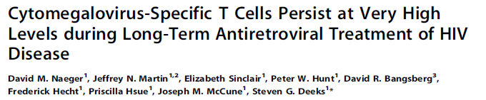
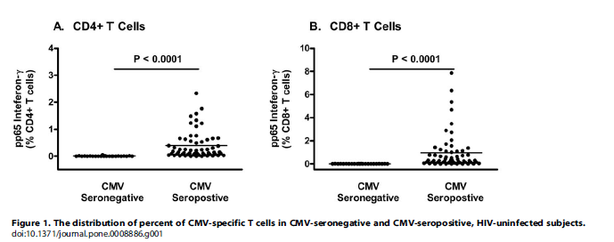
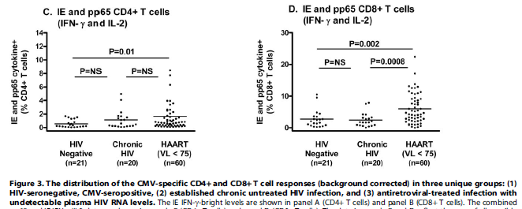
The CD8⁺ T cell response to just two CMV proteins (pp65 and IE) was approximately 6% during long-term therapy, which was over twice that seen in HIV-seronegative persons.
CMV-specific CD4⁺ T cell responses followed the same trends, but the magnitude of the effect was smaller.
Conclusions/Significance: Long-term successfully treated HIV infected patients have remarkably high levels of CMV-specific effector cells. These levels are similar to that observed in the elderly, but occur at much younger ages.
Laboratory for Clinical Biochemistry Research
University of Vermont
Naeger et al. PLoS One. 5:e8886, 2010

Slide 47
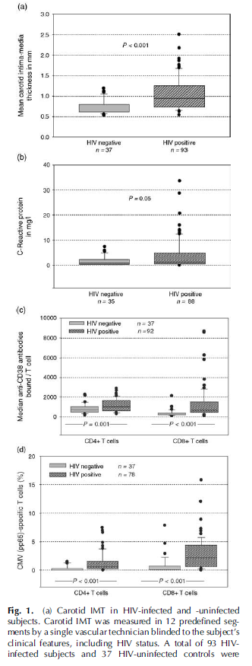
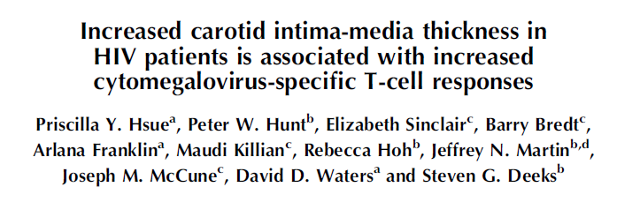
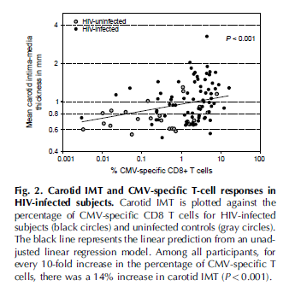
Inflammation, Atherosclerosis, and Aging
Hsue et al. AIDS 2006, 20:2275–2283
Laboratory for Clinical Biochemistry Research
University of Vermont

Slide 48
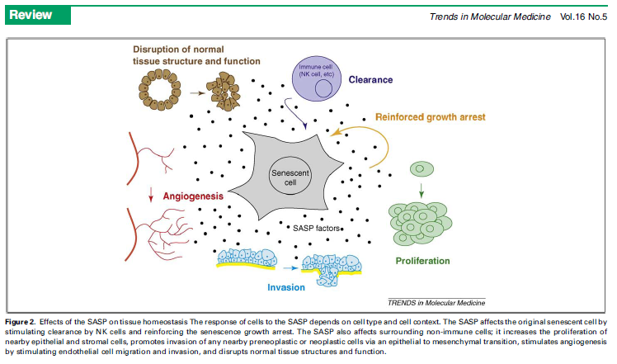
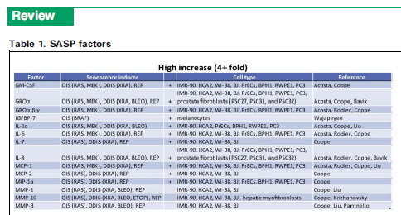
In Immune Biology:
J Gen Virol. 2011 Aug 3. [in press]
Infection with cytomegalovirus but not herpes simplex virus induces the accumulation of late differentiated CD4+ and CD8+ T-cells (CD-28-) in humans. Derhovanessian E, et al.
In general: SASP-Senescence-Associated Secretory Phenotype. Judy Campisi and colleagues; e.g., Freund et al. Trends Mol Med 16:238, 2010
Laboratory for Clinical Biochemistry Research
University of Vermont
Notes:
These are biovariability data showing the % of CD4+ cells that are Th1 cells in 14 apparently healthy volunteers over18 months. Each individual has a reasonably stable phenotype and we can easily differentiate among individuals based on their %Th1 count. The analytical coefficient of variation of this particular assay is approximately 9%. We have biovariability data on the other T cell measurements and natural killer cell subsets as well.

Slide 49
Downward Spirals….
Lower SES
Higher environmental stress
  Smoking,
  Air pollution
Adiposity
Adaptive Side
Innate Side
Chronic Inflammation
Chronic Infection
e.g., CMV, HIV
Th1 Biasing
Genes
Genes
Chronic Diseases
Aging
Occupation of
“immunologic landscape”
Large fraction of
TCR repertoire
Large fraction of CD28⁻ cells
Apoptotic-resistant
Non-proliferative
“Senescent”
Surrogates:
IMT, CAC, etc
Increased cancer, infectious disease
Laboratory for Clinical Biochemistry Research
University of Vermont

Slide 50
Laboratory for Clinical Biochemistry Research
University of Vermont
Notes:
These are biovariability data showing the % of CD4+ cells that are Th1 cells in 14 apparently healthy volunteers over18 months. Each individual has a reasonably stable phenotype and we can easily differentiate among individuals based on their %Th1 count. The analytical coefficient of variation of this particular assay is approximately 9%. We have biovariability data on the other T cell measurements and natural killer cell subsets as well.

Slide 51
Laboratory for Clinical Biochemistry Research
University of Vermont
Notes:
These are biovariability data showing the % of CD4+ cells that are Th1 cells in 14 apparently healthy volunteers over18 months. Each individual has a reasonably stable phenotype and we can easily differentiate among individuals based on their %Th1 count. The analytical coefficient of variation of this particular assay is approximately 9%. We have biovariability data on the other T cell measurements and natural killer cell subsets as well.

Slide 52
Laboratory for Clinical Biochemistry Research
University of Vermont
Notes:
These are biovariability data showing the % of CD4+ cells that are Th1 cells in 14 apparently healthy volunteers over18 months. Each individual has a reasonably stable phenotype and we can easily differentiate among individuals based on their %Th1 count. The analytical coefficient of variation of this particular assay is approximately 9%. We have biovariability data on the other T cell measurements and natural killer cell subsets as well.

Slide 53
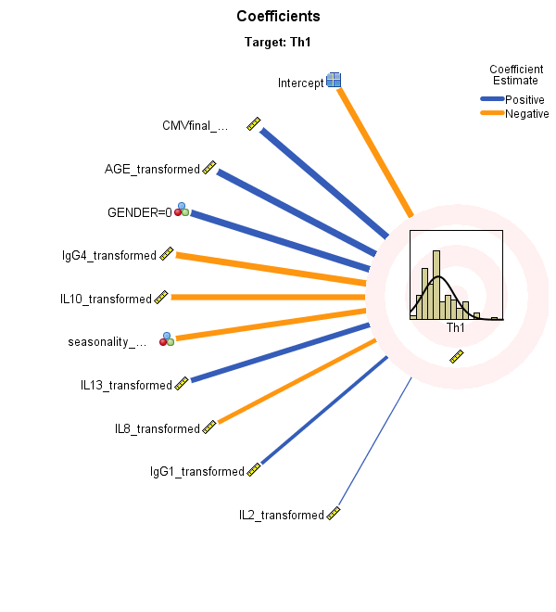

Slide 54
Variable | Coefficient | Significance | Importance
CMV | 0.016 | 0.004 | 0.103
Age | 0.667 | 0.006 | 0.103
Gender | 4.459 | 0.008 | 0.103
IgG4 | -4.244 | 0.021 | .101
IL10 | -2.028 | 0.048 | 0.099
Seasonality | -4.099 | 0.059 | 0.099
IL13 | 1.948 | 0.063 | 0.099
IL8 | -0.375 | 0.103 | 0.098
IgG1 | 0.760 | .143 | 0.098
IL2 | 10.064 | .240 | 0.097

Slide 55
ZNF596 and FBXO25
FBXO25
  FBXO25 is one of the 68 human F-box proteins that serve as specificity factors for a family of ubiquitin ligases composed of s-phase-kinase associated protein 1, really interesting new gene-box 1, Cullin 1, and F-box protein (SCF1) that are involved in targeting proteins for destruction across the ubiquitin proteasome system
    Ubiquination is the process by which proteins are targeted for degradation intracellularly, in a proteosome
  Ubiquination is key to immune function (Bhoj & Chen. Nature 458: 430, 2009)
  Th cell differentiation requires the transcription factor ThPOK, which is stabilized in CD4+ cells but rapidly degraded in CD8+ cells by ubiquination (Zhang, et al. Journal of Immunology, 2010, 185: 3960–3969)
  ThPOK is not only expressed in T cells destined to become Th cells, but also expressed in Th cells once they have become CD4⁺; by extrapolation, therefore, it may play a role in further differentiation into Th1 or Th2.
  a polymorphism in the mechanism of ubiquination might affect the half-life of ThPOK and tilt differentiation first for or against CD4 vs CD8, then (by extrapolation) Th1 vs Th2.
ZNF596
  Zinc Finger Protein 596: no known function

Slide 56
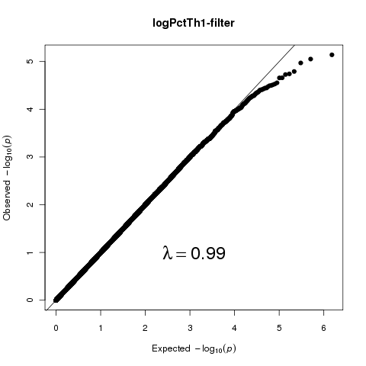
Log Percent Th1 AA

Slide 57
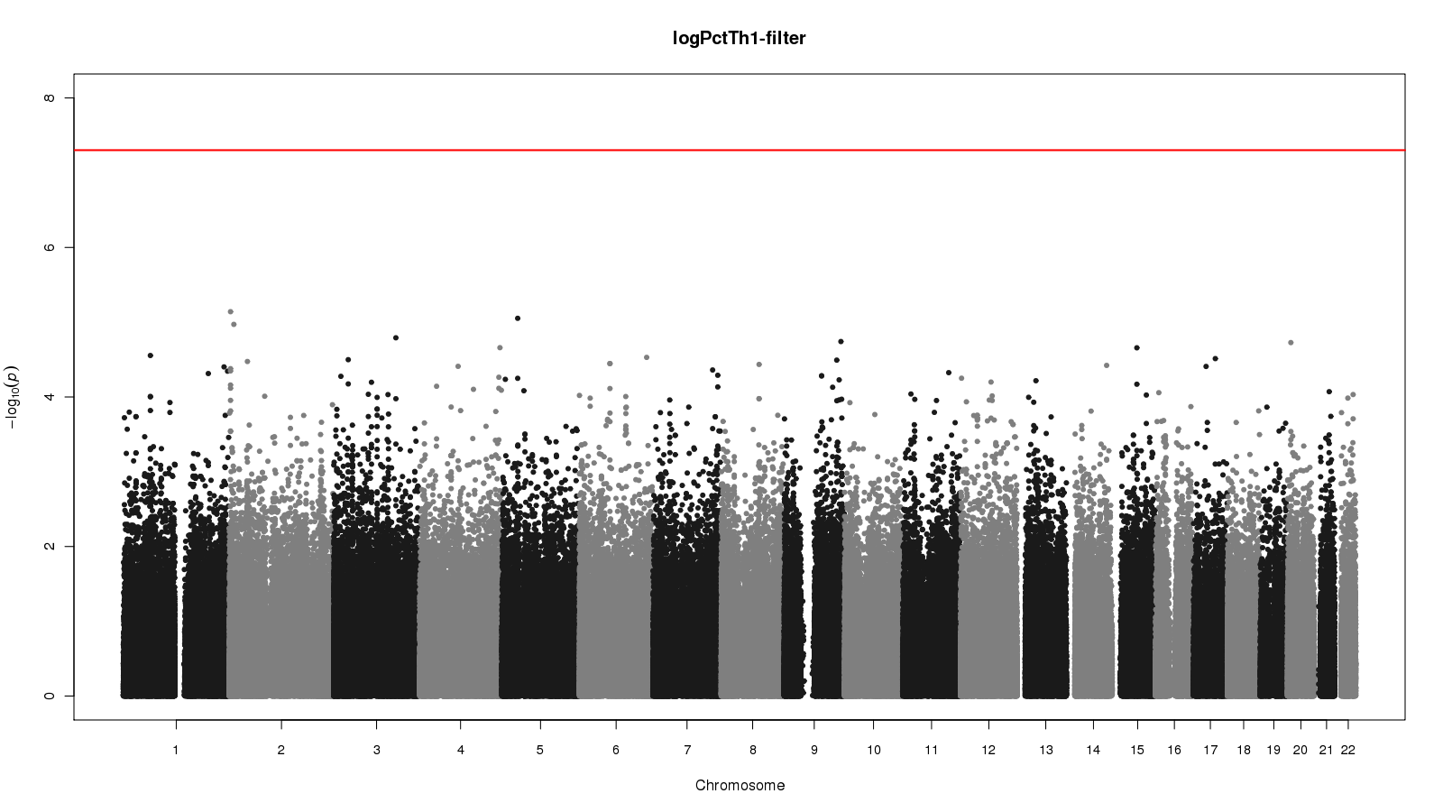
Log Percent Th1 AA

