Slide 1
Recently submitted to Nat Gen:
Rare and low frequency coding variants are associated with LDL cholesterol levels: findings from the NHLBI Exome Sequencing Project
Author list:
Leslie A. Lange*¹, Youna Hu*², Chenyi Xue³, Zhengzheng Tang⁴, Chris Bizon⁵, Ethan M. Lange^{1,4}, Joshua D. Smith⁶, Emily H. Turner⁶, Goo Jun², Hyun Min Kang², Kuo-ping Li⁴, Gina Peloso^{7,8}, Jacy Crosby⁹, Christina L. Wassel¹⁰, Ron Do^{7,8}, Nora Franceschini¹¹, Lisa W. Martin¹², Jennifer G. Robinson¹³, Themistocles L. Assimes¹⁴, David R. Crosslin^{15,16}, Elizabeth A. Rosenthal¹⁵, Michael Tsai¹⁷, Mark J. Rieder⁶, Deborah N. Farlow⁸, Aaron R. Folsom¹⁷, Thomas Lumley¹⁶, Ervin R. Fox¹⁸, Christie M. Ballantyne¹⁹, Stacey B. Gabriel⁸, David Altshuler^{7,8,20,21}, Christopher J. O’Donnell^{22, 23}, Wendy S. Post²⁴, Alexander P. Reiner²⁵, Eric Boerwinkle⁹, Bruce M. Psaty^{25,26,27}, Sekar Kathiresan^{7,8,23}, Kari E. North¹¹, Dan-yu Lin⁴, Gail Jarvik¹⁵, L. Adrienne Cupples^{22,28}, Charles Kooperberg²⁹, James G. Wilson³⁰, Deborah A. Nickerson#⁶, Goncalo R. Abecasis²#, Stephen S. Rich³¹#, Russell P. Tracy³²#, Cristen J. Willer^{3,33}#, on behalf of the NHLBI Exome Sequencing Project¥

Slide 2
Purpose: To determine whether rare and/or low frequency coding variants are associated with LDL-C levels, we performed exome sequencing and analysis of 412 individuals ascertained from population-based cohorts with extreme LDL-C (< 2nd percentile and > 98th percentile) and 1593 individuals ascertained for other phenotypes.
Results:
Analysis of the LDL extreme groups (n=412) did not identify exome-wide significant associations (p < 1x10⁻⁶).
However, in the total sample (n=2005), we observed exome-wide significant evidence for association between LDL-C and:
  rare nonsynonymous and splice variants in LDLR (p=3x10⁻⁹)
  low frequency nonsynonymous variants in PCSK9 (p = 2x10⁻⁸)
  singleton loss-of-function variants in APOB (p=8x10⁻⁸)
Of six additional genes known to cause Mendelian LDL-C disorders, two genes (NPC1L1 and ABCG5) had suggestive evidence for association (p < 4x10⁻⁴) with LDL-C
Conclusion:
Our results indicate that no single association test is ideal for detecting all relevant genes, as the genetic architecture underlying association at each gene differed, based on variant frequency and effect on protein function.

Slide 3
Results:
In burden tests of aggregated rare (MAF < 1%) and/or low frequency variants (MAF 1-5%), three genes, APOB, LDLR and PCSK9, reached exome-wide significance (p < 1x10⁻⁶)
LDLR:
  3 novel putatively pathological variants; nonsynonymous variants did not cluster in any specific exon or functional domain of LDLR.
  Although LDLR is one of the most re-sequenced genes, with over 1122 variants previously identified , exome sequencing 211 individuals with extremely high LDL-C identified, including one novel splice mutation.
PCSK9
  7novel variants; 6missense variants and 1nonsense variant; 6 of these were identified exclusively in individuals with extreme LDL-C, either as singletons or doubletons.
  One singleton and one doubleton were observed in individuals with high LDL-C; remaining variants were seen in those with extremely low LDL-C.
APOB:
  examining only variants predicted to result in loss of protein function and with frequency < 5%: 8 novel variants; 5 singleton nonsense variants and 3 singleton splice variants. These variants were jointly associated with low LDL-C (p=8x10-8).

Slide 5
Bean plot showing medication adjusted LDL-C values by LDLR variant class in ESP participant samples (N=2005).
Green lines represent individuals;
gray shading denotes probability density;
black line indicates the mean medication adjusted LDL-C value within LDLR variant class;
light gray dotted line represents the overall mean.

Slide 8
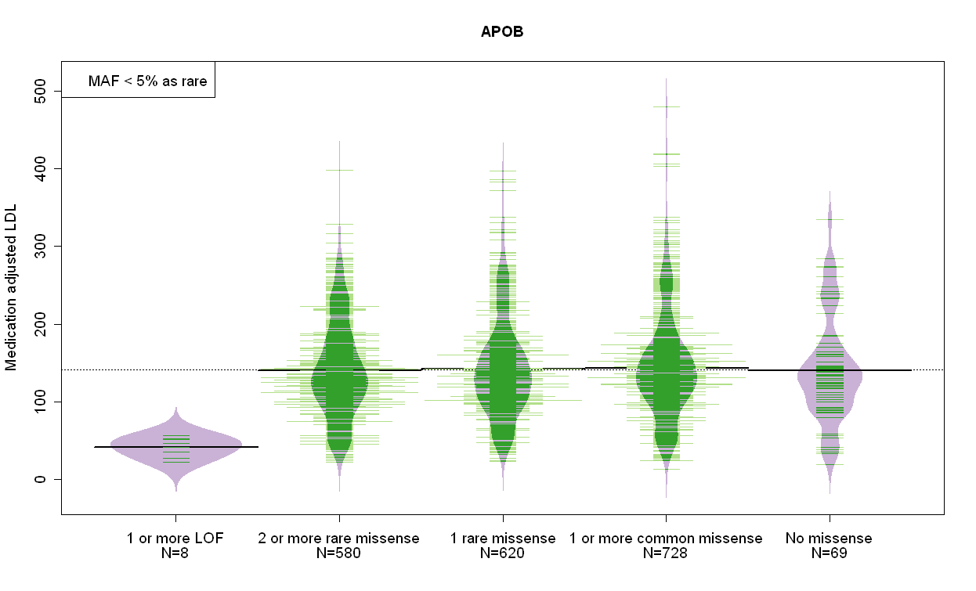

Slide 10
ESP Hemostatic Factors
QC and Analysis
Alanna Morrison
August 27, 2012

Slide 11
Data Description
ESP6800 Studies | N
Broad: EOMI | 743
HeartGO | 2709
LungGO | 986
LungGO_CF | 431
WHISP | 1954
Total | 6823
ESP6800
  Contains 6823 samples
  Phenotype data from the
  ESP6800_Phenotype_Update_061212_final update
HeartGO (2709) + WHISP (1954) = 4663
Remove 30 individuals with missing esp_race_selfreport
4633
Remove 59 individuals due to sample QC
(66 – 7 with missing race accounted for in previous step)
4574
2649 EA
1925 AA

Slide 12
VCF Summary
Variant Statistics
Metrics | 4574 Individuals
N Variants | 1,861,464
Monomorphic | 351,249
Singletons | 774,265
Doubletons | 180,502
Variant sites nalt ≥3 | 555,448
Ti/Tv | 2.86
Ti/Tv Singletons | 2.80
Average MAF | 0.011
1,510,215
Autosomes only

Slide 13
Variant summary
4574 individuals after sample-level QC
  1925 AA
  2649 EA
Annotated by SeattleSeq (RefSeq), hg19
Ethnic Group | Total # Variants | MAF<0.01 | 0.01 ≥ MAF ≥ 0.05 | MAF>0.05
EA (N=2649) | 852,715 | 746,003 | 36,913 | 69,799
AA (N=1925) | 962,734 | 779,029 | 88,490 | 95,215
EA: Of the 1,861,464 variants in the VCF, 4 are missing for all individuals.
Of the remaining 1,861,460 variants, 423 variants are excluded for HWE <1e-100 and 1,008,322 are monomorphic in EA.
AA: Of the 1,861,464 variants in the VCF, 3 are missing for all individuals.
Of the remaining 1,861,461 variants, 288 variants are excluded for HWE <1e-100 and 898,439 are monomorphic in AA.

Slide 14
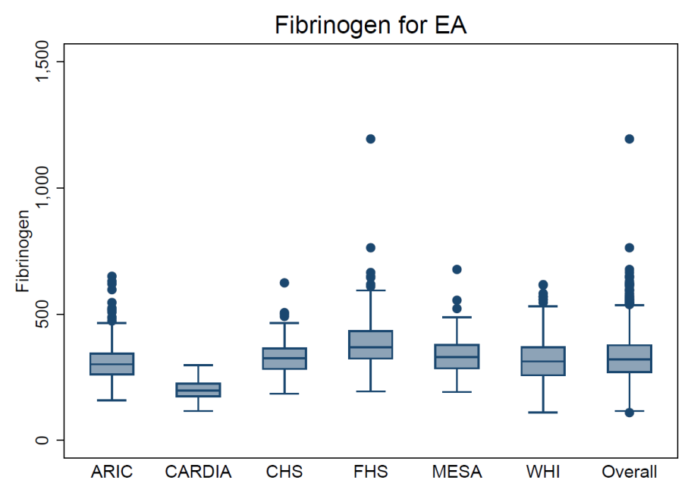
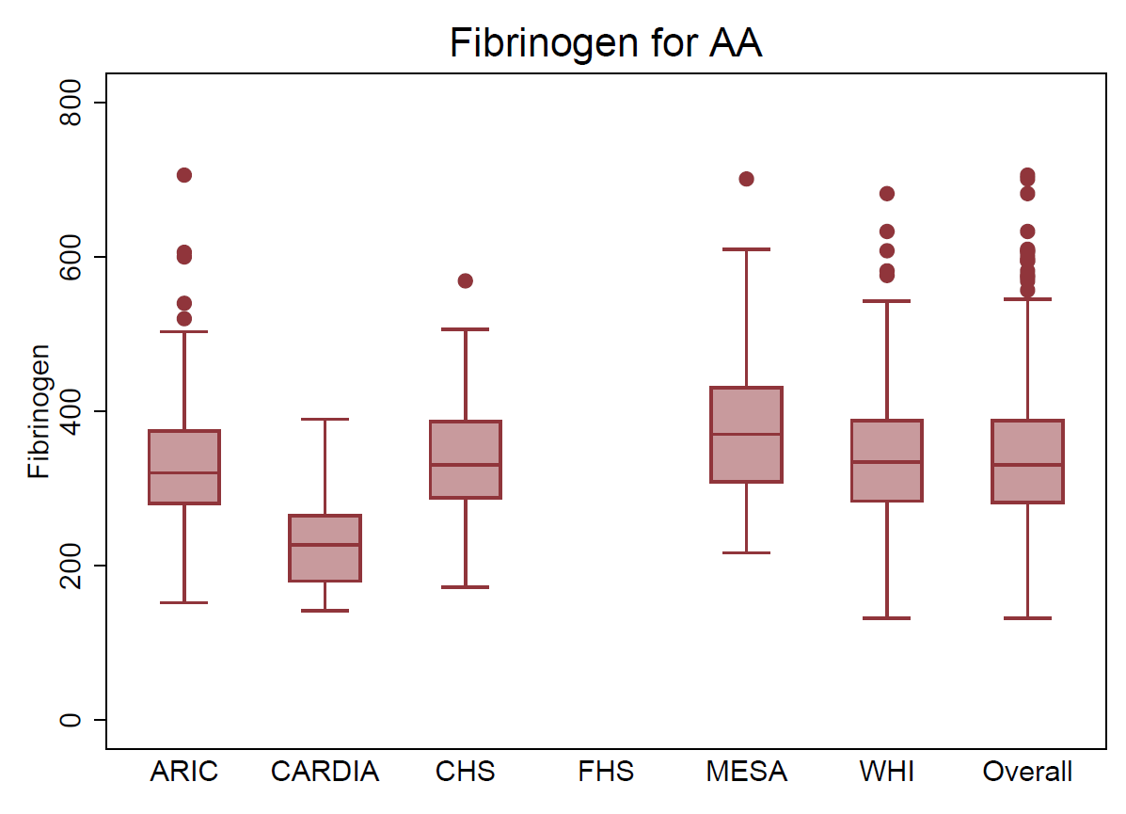
Fibrinogen
 | N | Mean | SD | Min | Max
EA | 2013 | 328.9 | 85.8 | 110 | 1194
AA | 872 | 338.8 | 84.7 | 132 | 706
No outliers removed
513 54 144 436 247 619
320 30 61 150 311
Notes:
In the 5400 we had 1494 EA and 675 AA

Slide 15
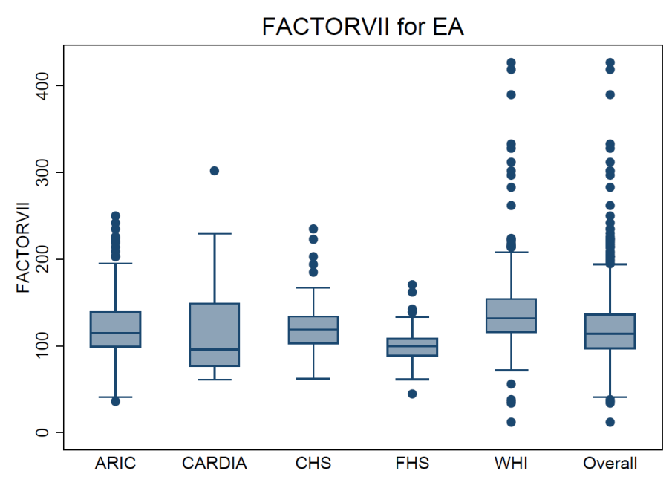
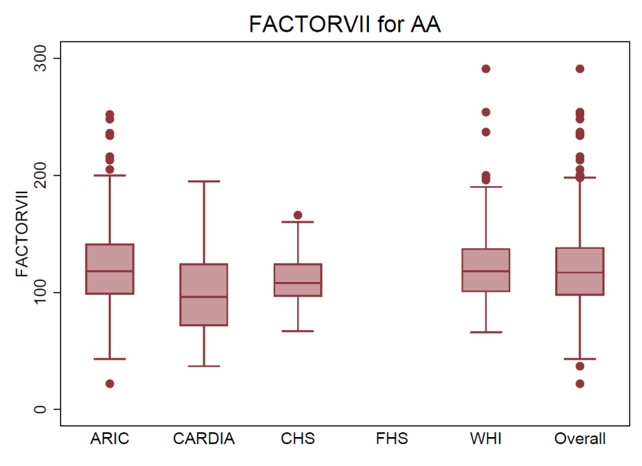
Factor VII
Outliers Removed (>450)
 | N | Mean | SD | Min | Max
EA | 1222 | 120.7 | 38.8 | 12 | 427
AA | 651 | 119.7 | 32.9 | 22 | 291
Outliers with >450 (N=26)
WHI 4 AA 1237-1977
WHI 22 EA 497-3007
505 53 141 248 275
317 30 63 241
Notes:
In the 5400 we had 944 EA and 542 AA
Exclude individuals with values >300% normal = approximately 450

Slide 16
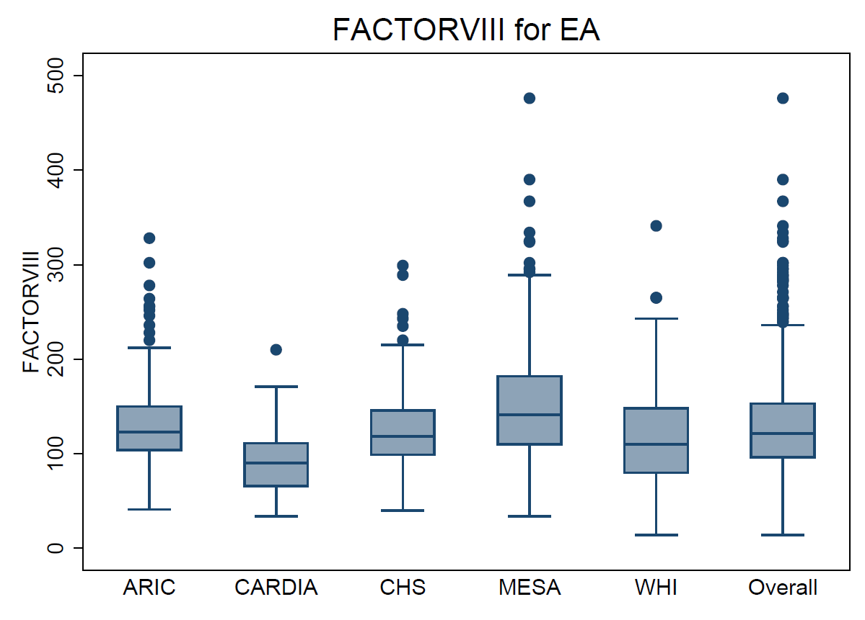
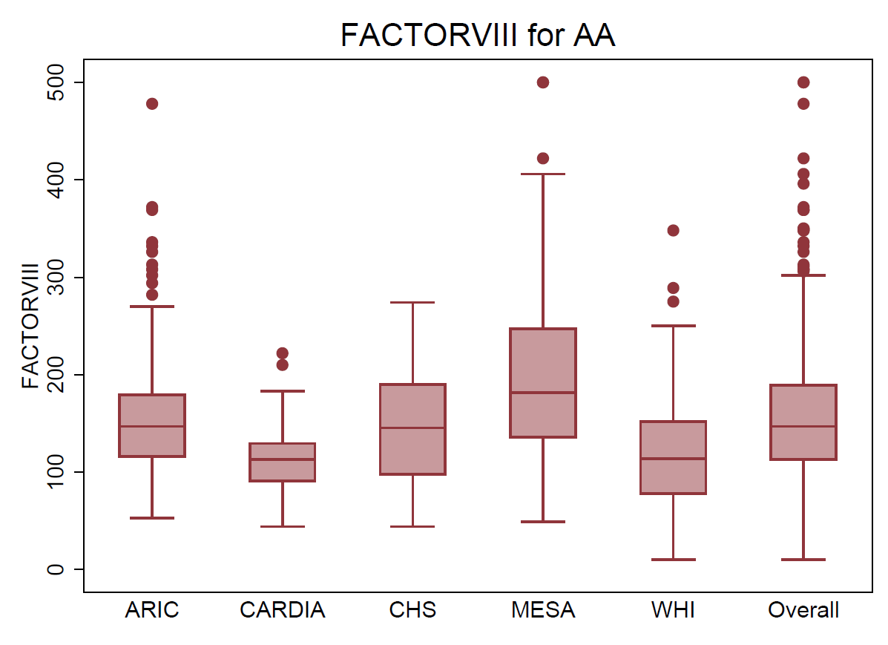
Factor VIII
 | N | Mean | SD | Min | Max
EA | 1296 | 128.3 | 50.1 | 14 | 476
AA | 603 | 159.2 | 68.4 | 10 | 500
513 53 142 247 341
320 36 18 150 79
Notes:
In the 5400 we had 918 EA and 443 AA

Slide 17
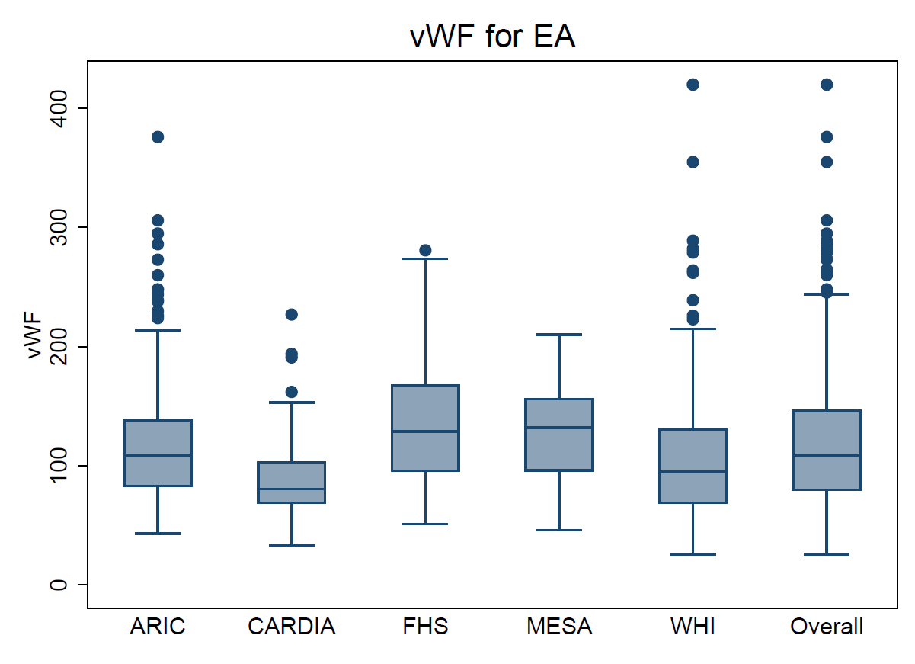
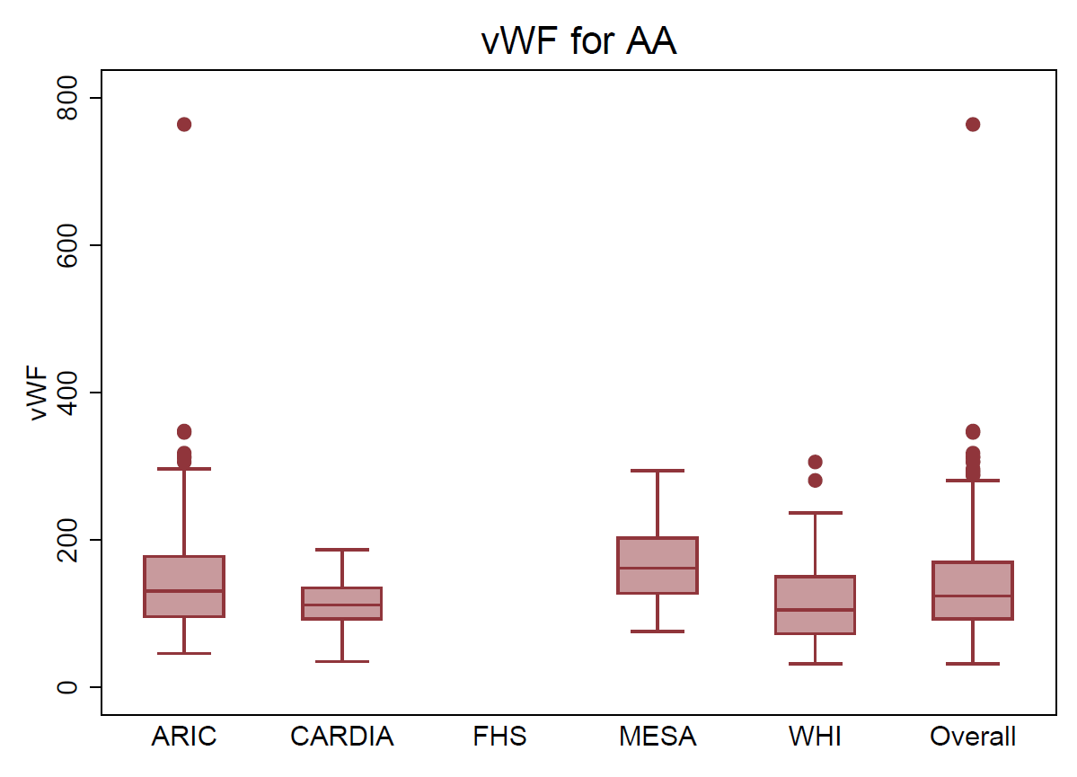
vWF
 | N | Mean | SD | Min | Max
EA | 1185 | 117.2 | 49.8 | 26 | 420
AA | 441 | 137.1 | 65.6 | 32 | 764
513 54 248 41 329
320 29 17 75
Notes:
In the 5400 we had 902 EA and 358 AA

Slide 18
Association analyses
I. Common variant linear regression
  Combines HeartGO and WHISP
  Stratify by EA and AA
  MAF > 5%
  Covariates: age at measurement, gender, rsPC1, rsPC2
II. Common variant meta-analysis with CHARGE-S EAs
  using inverse-variance weighted meta analysis
  CHARGE-S: 2245 EAs (991 ARIC, 633 CHS, 621 FHS)
    Only SNVs common in both studies
    Common annotation (ANNOVAR)

Slide 19
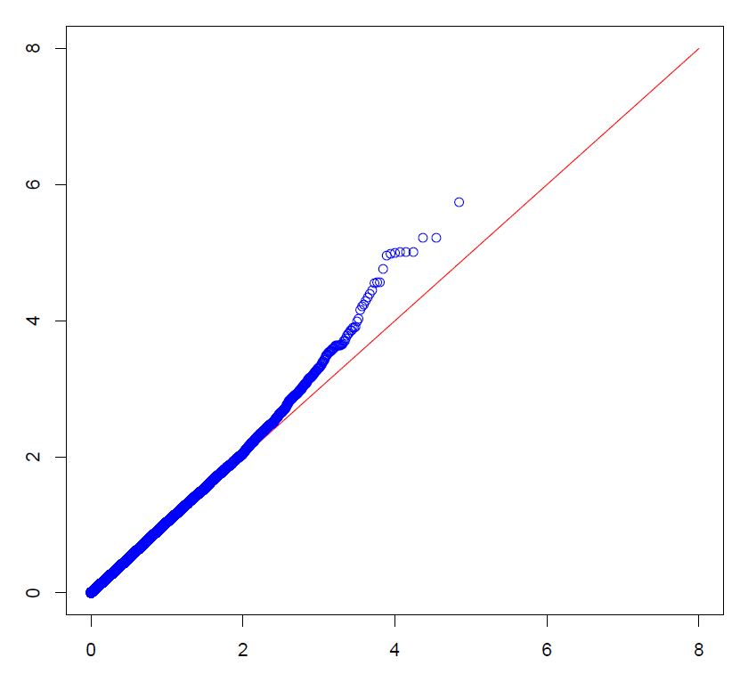
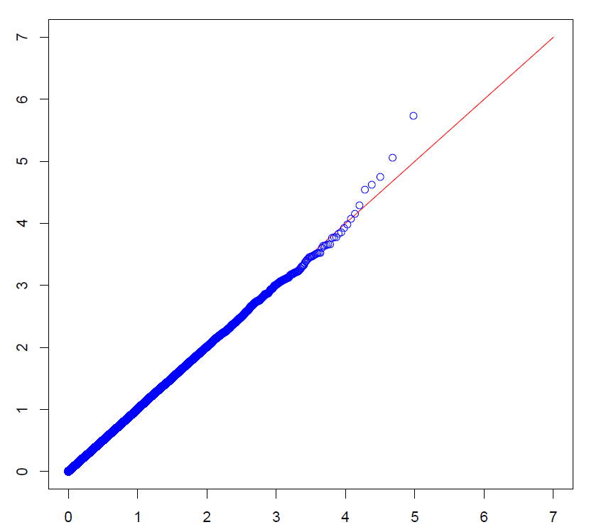
Fibrinogen QQ-Plots
EA
AA
EA: 0.05 / 69,782 SNVs = 7.2e-07
AA: 0.05 / 95,420 SNVs = 5.2e-07

Slide 20
Fibrinogen Top Hits: EA
Chr:Pos | P-value | GVS | rs# | Amino acid | PolyPhen | Gene
chr12_123342633 | 1.84E-06 | intron | NA | none | unknown | FAM101A
chr3_122277160 | 6.19E-06 | intron | 9289198 | none | unknown | PARP9
chr3_122277172 | 6.19E-06 | intron | 9289199 | none | unknown | PARP9
chr19_15276919 | 9.80E-06 | intron | 2074619 | none | unknown | NOTCH3
chr19_15276923 | 9.80E-06 | intron | 10416777 | none | unknown | NOTCH3
chr19_15278057 | 9.80E-06 | intron | 1548555 | none | unknown | NOTCH3
chr19_9002519 | 1.03E-05 | missense | 150783178 | HIS,ASP | unknown | MUC16
chr19_15273381 | 1.07E-05 | intron | 4809030 | none | unknown | NOTCH3
chr19_15276143 | 1.13E-05 | intron | 2074618 | none | unknown | NOTCH3
chr19_15273248 | 1.76E-05 | intron | 4809029 | none | unknown | NOTCH3
EA: 0.05 / 69,782 SNVs = 7.2e-07
Notes:
Merge with GWAS and any novel findings here
add MAF

Slide 21
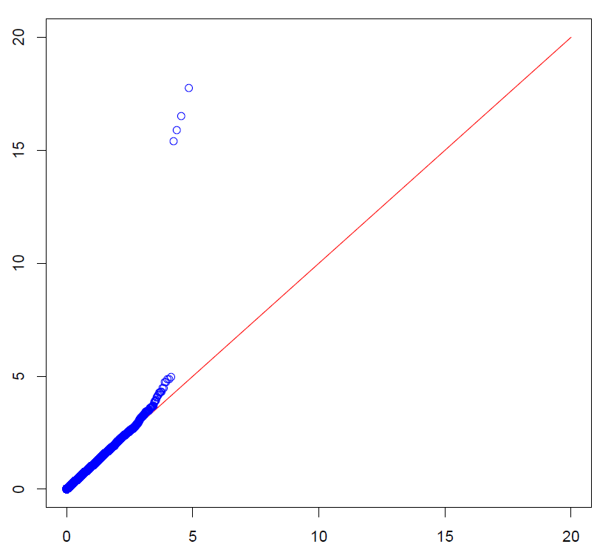
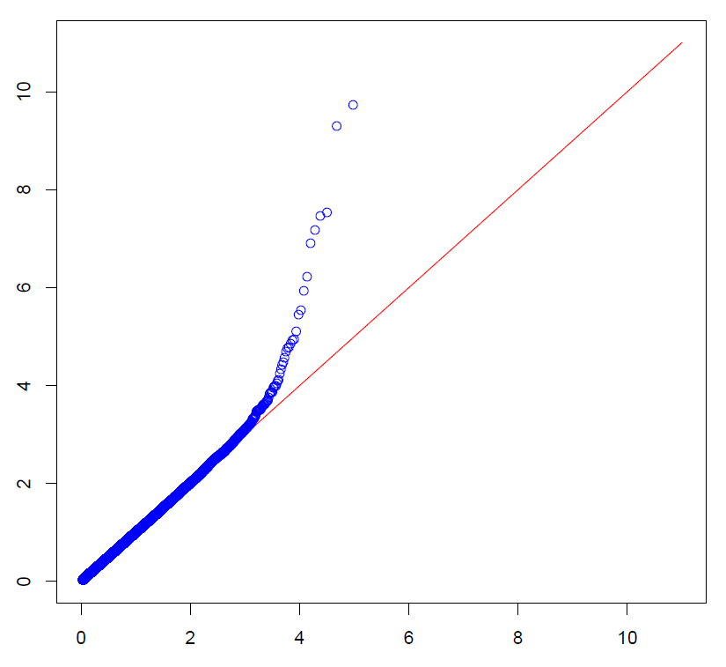
Factor VII QQ-Plots
EA
AA
EA: 0.05 / 69,746 SNVs = 7.2e-07
AA: 0.05 / 95,220 SNVs = 5.25e-07

Slide 22
Factor VII Top Hits: EA
Chr:Pos | P-value | GVS | rs# | Amino acid | PolyPhen | Gene
chr13_113770068 | 1.85E-18 | coding-synonymous | 6042 | none | unknown | F7
chr13_113760228 | 3.16E-17 | intron | 6039 | none | unknown | F7
chr13_113773159 | 1.36E-16 | missense | 6046 | ARG,GLN | benign | F7
chr13_113772707 | 3.94E-16 | intron | 6041 | none | unknown | F7
chr3_189547697 | 1.11E-05 | intron | 73199745 | none | unknown | TP63
chr8_145066004 | 1.41E-05 | intron | 67714660 | none | unknown | GRINA
chr4_57883175 | 1.43E-05 | intron | 1718866 | none | unknown | POLR2B
chr8_145059425 | 1.82E-05 | missense | 11136344 | ILE,VAL | benign | PARP10
chr2_99232873 | 0.0000184 | intron | 6711099 | none | unknown | UNC50
chr15_31267123 | 0.0000335 | intron | 77719498 | none | unknown | MTMR10
EA: 0.05 / 69,746 SNVs = 7.2e-07

Slide 23
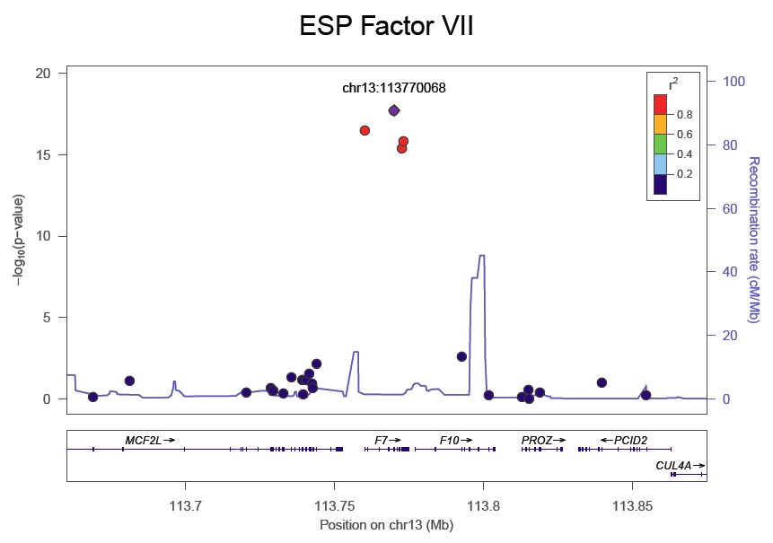
Regional Plot F7 in EAs

Slide 24
Factor VII Top Hits: AA
Chr:Pos | P-value | GVS | rs# | Amino acid | PolyPhen | Gene
chr13_113773159 | 1.88E-10 | missense | 6046 | ARG,GLN | benign | F7
chr13_113772707 | 5.07E-10 | intron | 6041 | none | unknown | F7
chr7_6449496 | 2.91E-08 | missense | 2303361 | GLN,ARG | benign | DAGLB
chr13_113760228 | 3.42E-08 | intron | 6039 | none | unknown | F7
chr13_113770068 | 6.68E-08 | coding-synonymous | 6042 | none | unknown | F7
chr2_179577870 | 1.28E-07 | coding-synonymous | 61232800 | none | unknown | TTN
chr7_6456347 | 5.97E-07 | coding-synonymous | 1055428 | none | unknown | DAGLB
chr11_64535357 | 1.18E-06 | intron | 575375 | none | unknown | SF1
chr7_6426954 | 2.96E-06 | intron | 3729790 | none | unknown | RAC1
chr2_179586779 | 3.64E-06 | intron | 16866469 | none | unknown | TTN
AA: 0.05 / 95,220 SNVs = 5.25e-07

Slide 25
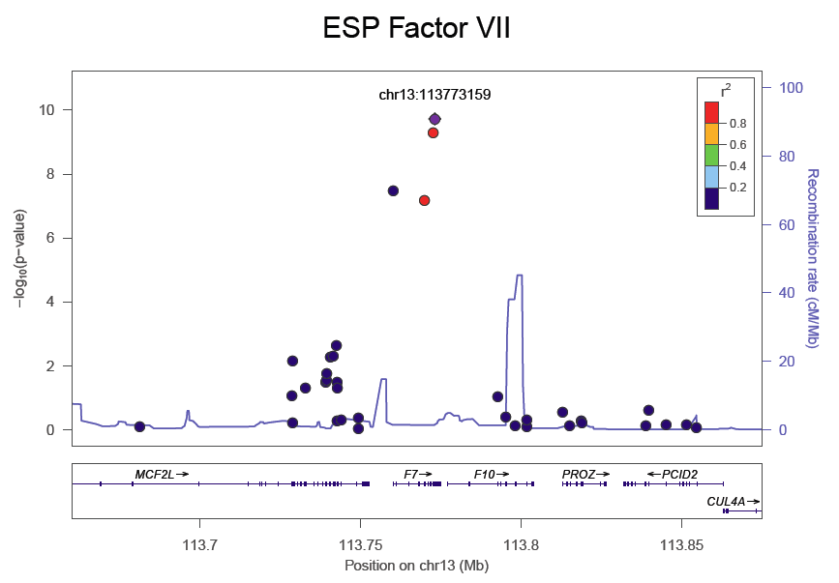
Regional Plot F7 in AAs

Slide 26
4 F7 variants in EA and AA
Chr:Pos | P-value EA | P-value AA | GVS | rs# | Amino acid | PolyPhen | Gene
chr13_113770068 | 1.85E-18 | 6.68E-08 | coding-synonymous | 6042 | none | unknown | F7
chr13_113760228 | 3.16E-17 | 3.42E-08 | intron | 6039 | none | unknown | F7
chr13_113773159 | 1.36E-16 | 1.88E-10 | missense | 6046 | ARG,GLN | benign | F7
chr13_113772707 | 3.94E-16 | 5.07E-10 | intron | 6041 | none | unknown | F7

Slide 27
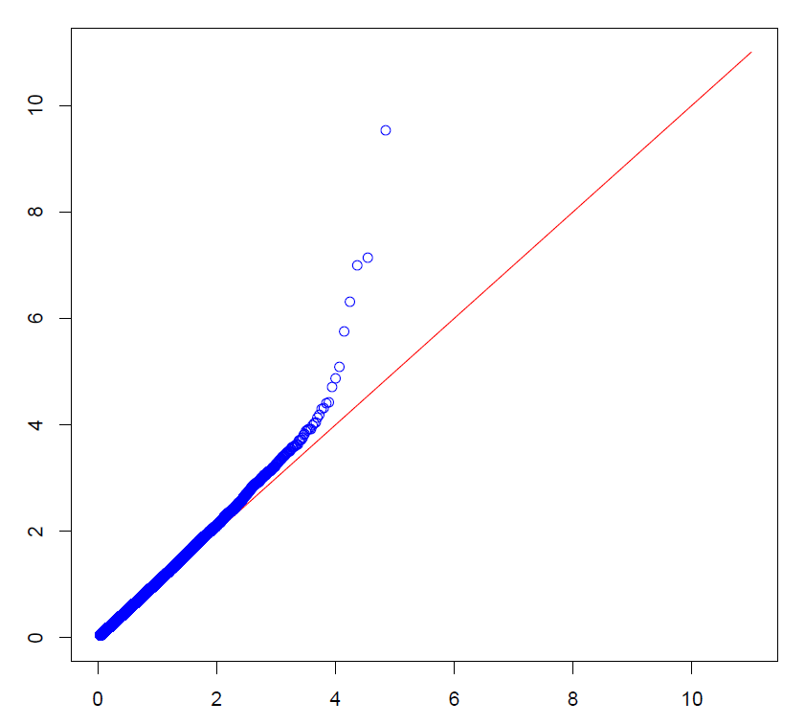
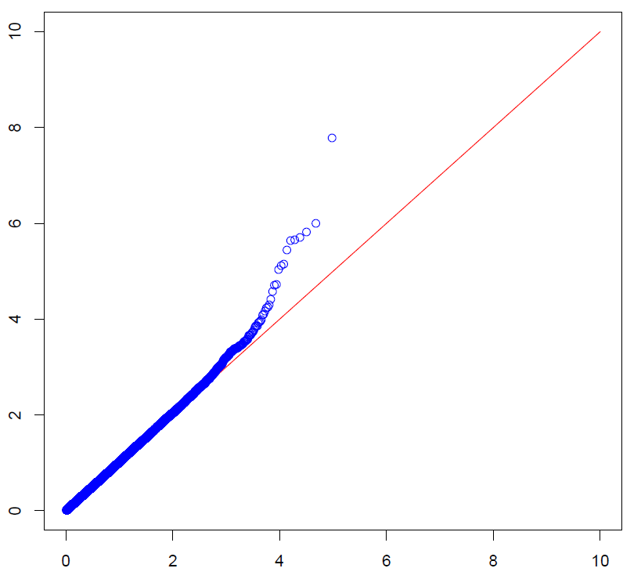
Factor VIII QQ-Plots
EA
AA
EA: 0.05 / 69,832 SNVs = 7.2e-07
AA: 0.05 / 95,746 SNVs = 5.2e-07

Slide 28
Factor VIII Top Hits: EA
Chr:Pos | P-value | GVS | rs# | Amino acid | PolyPhen | Gene
chr9_136081319 | 3.04E-10 | missense | 11244035 | VAL,ILE | benign | OBP2B
chr9_136270538 | 7.48E-08 | missense | 41302673 | LEU,ARG | possibly-damaging | C9orf96
chr9_136328657 | 1.03E-07 | coding-synonymous | 3124765 | none | unknown | C9orf7
chr9_136330428 | 4.96E-07 | intron | 41302667 | none | unknown | C9orf7
chr9_136081829 | 1.78E-06 | intron | 11244037 | none | unknown | OBP2B
chr9_136133531 | 8.29E-06 | intron | 4962040 | none | unknown | ABO
chr16_1827836 | 1.35E-05 | coding-synonymous | 1178432 | none | unknown | SPSB3
chr8_27779811 | 1.95E-05 | intron | 4732613 | none | unknown | SCARA5
chr15_42185439 | 3.76E-05 | intron | 1672459 | none | unknown | SPTBN5
chr6_32122386 | 4.05E-05 | missense | 3134604 | CYS,TRP | probably-damaging | PPT2
EA: 0.05 / 69,832 SNVs = 7.2e-07

Slide 29
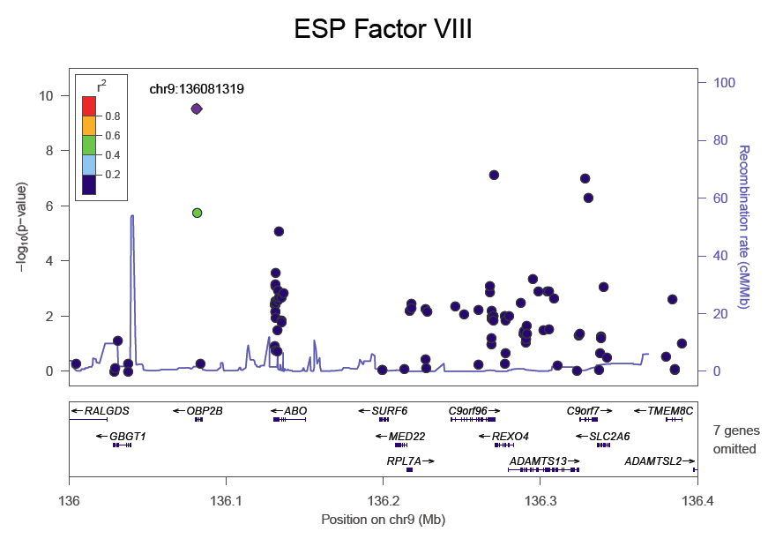
Regional Plot ABO region in EAs

Slide 30
Factor VIII Top Hits: AA
Chr:Pos | P-value | GVS | rs# | Amino acid | PolyPhen | Gene
chr9_136132754 | 1.68E-08 | intron | 8176722 | none | unknown | ABO
chr4_25674906 | 9.95E-07 | intron | 62409431 | none | unknown | SLC34A2
chr9_136131188 | 1.54E-06 | coding-synonymous | 8176749 | none | unknown | ABO
chr9_136131315 | 2.01E-06 | missense | 8176747 | GLY,ALA | probably-damaging | ABO
chr9_136131415 | 2.27E-06 | missense | 8176743 | GLY,SER | unknown | ABO
chr9_136131461 | 2.36E-06 | coding-synonymous | 8176741 | none | unknown | ABO
chr9_136131322 | 3.71E-06 | missense | 8176746 | LEU,MET | unknown | ABO
chr2_121744225 | 7.27E-06 | intron | 2276553 | none | unknown | GLI2
chr9_140147152 | 7.67E-06 | coding-synonymous | 28376526 | none | unknown | C9orf173
chr9_136131592 | 9.21E-06 | missense | 7853989 | ARG,GLY | unknown | ABO
AA: 0.05 / 95,746 SNVs = 5.2e-07

Slide 31
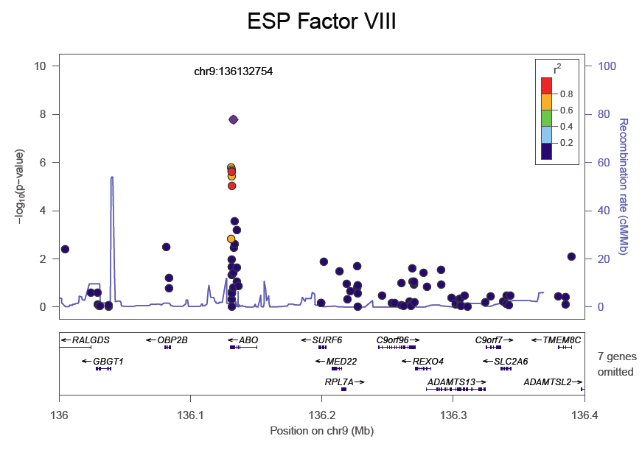
Regional Plot ABO region in AAs

Slide 32
25 ABO variants in EA and AA
Chr:Pos | P-value EA | P-value AA | GVS | rs# | Amino acid | PolyPhen | Gene
chr9_136131022 | 0.1171 | 0.001465 | utr-3 | 8176751 | none | unknown | ABO
chr9_136131188 | 0.003802 | 1.54E-06 | coding-synonymous | 8176749 | none | unknown | ABO
chr9_136131289 | 0.000792 | 0.01068 | missense | 8176748 | VAL,MET | unknown | ABO
chr9_136131315 | 0.003365 | 2.01E-06 | missense | 8176747 | GLY,ALA | probably-damaging | ABO
chr9_136131322 | 0.003802 | 3.71E-06 | missense | 8176746 | LEU,MET | unknown | ABO
chr9_136131347 | 0.000706 | 0.02123 | coding-synonymous | 8176745 | none | unknown | ABO
chr9_136131415 | 0.00665 | 2.27E-06 | missense | 8176743 | GLY,SER | unknown | ABO
chr9_136131437 | 0.00352 | 0.4807 | coding-synonymous | 8176742 | none | unknown | ABO
chr9_136131461 | 0.006832 | 2.36E-06 | coding-synonymous | 8176741 | none | unknown | ABO
chr9_136131472 | 0.002881 | 0.04707 | missense | 8176740 | PHE,ILE | unknown | ABO
chr9_136131592 | 0.1762 | 9.21E-06 | missense | 7853989 | ARG,GLY | unknown | ABO
chr9_136131651 | 0.000262 | 0.9168 | missense | 1053878 | PRO,LEU | unknown | ABO
chr9_136131783 | 0.01168 | 0.225 | intron | 8176737 | none | unknown | ABO
chr9_136131785 | 0.003361 | 0.2671 | intron | 8176736 | none | unknown | ABO
chr9_136132754 | 0.1836 | 1.68E-08 | intron | 8176722 | none | unknown | ABO
chr9_136132852 | NA | 0.1501 | coding-synonymous | 8176721 | none | unknown | ABO
chr9_136132873 | 0.03301 | 0.03707 | coding-synonymous | 8176720 | none | unknown | ABO
chr9_136132954 | 0.002514 | NA | intron | 75179845 | none | unknown | ABO
chr9_136132957 | 0.001171 | 0.003387 | intron | 8176718 | none | unknown | ABO
chr9_136133506 | 0.002088 | 0.002315 | missense | 512770 | SER,PRO | benign | ABO
chr9_136133531 | 8.29E-06 | 0.000279 | intron | 4962040 | none | unknown | ABO
chr9_136135195 | 0.002067 | 0.08369 | intron | 549331 | none | unknown | ABO
chr9_136135237 | 0.01468 | 0.000642 | coding-notMod3 | 549443 | none | unknown | ABO
chr9_136135238 | 0.01644 | 0.02341 | missense | 549446 | HIS,ARG | benign | ABO
chr9_136136770 | 0.001447 | 0.1314 | missense | 688976 | PHE,VAL | benign | ABO

Slide 33
Burden tests
Definition: Rare variants are those that are not classified as common. This approach will avoid testing the same SNPs in both common and rare variant models
  Include all variants MAF ≤ 5% in either ESP or CHARGE-S
  Missing rate < 20% (follow CHARGE-s QC)
  Only functional variants according to SeattleSeq annotation (or annotation consistent with CHARGE-S): missense, splice-5, missense-near-splice, stop-gained, splice-3, stop-gained-near-splice, stop-lost, stop-lost-near-splice
Unit of analysis: gene
  A variant can be assigned to multiple genes
List of tests
  T5 (counts of variants with an alternate allele)
  Weighted-Sum
  SKAT
Run separately for EA and AA
Covariates (same as common variant analysis): age at measurement, gender, rsPC1, rsPC2

Slide 34
Sample sizes and #genes
Race_trait (sample size) | # genes with >=5 variants | Significance Threshold
aa_factor8 (603) | 11,334 | 4.41e-06
ea_factor8 (1,296) | 12,424 | 4.02e-06
aa_vwf (441) | 10,214 | 4.90e-06
ea_vwf (1,185) | 12,234 | 4.09e-06
aa_factor7 (651) | 11,654 | 4.29e-06
ea_factor7 (1,222) | 12,344 | 4.05e-06
aa_fibri (872) | 12,649 | 3.95e-06
ea_fibri (2,013) | 14,091 | 3.55e-06

Slide 35
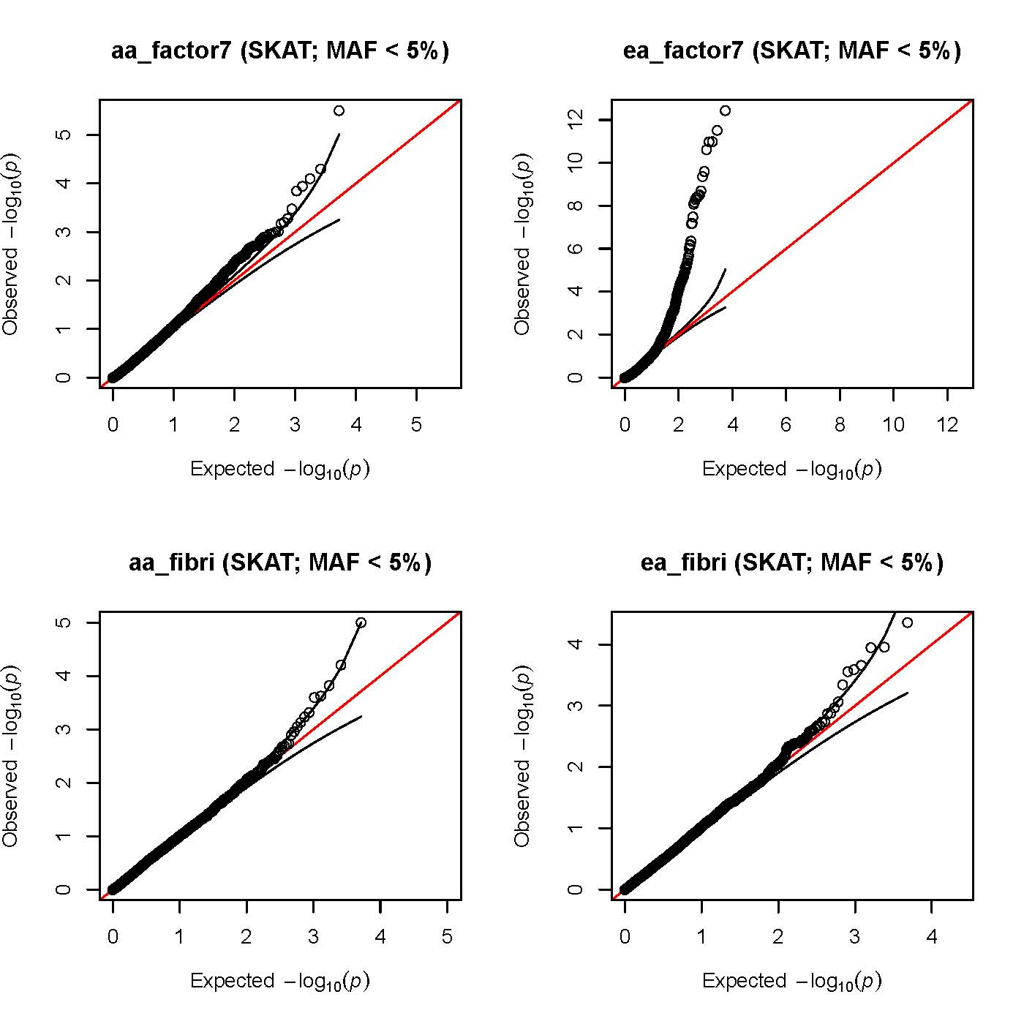
SKAT results

Slide 36
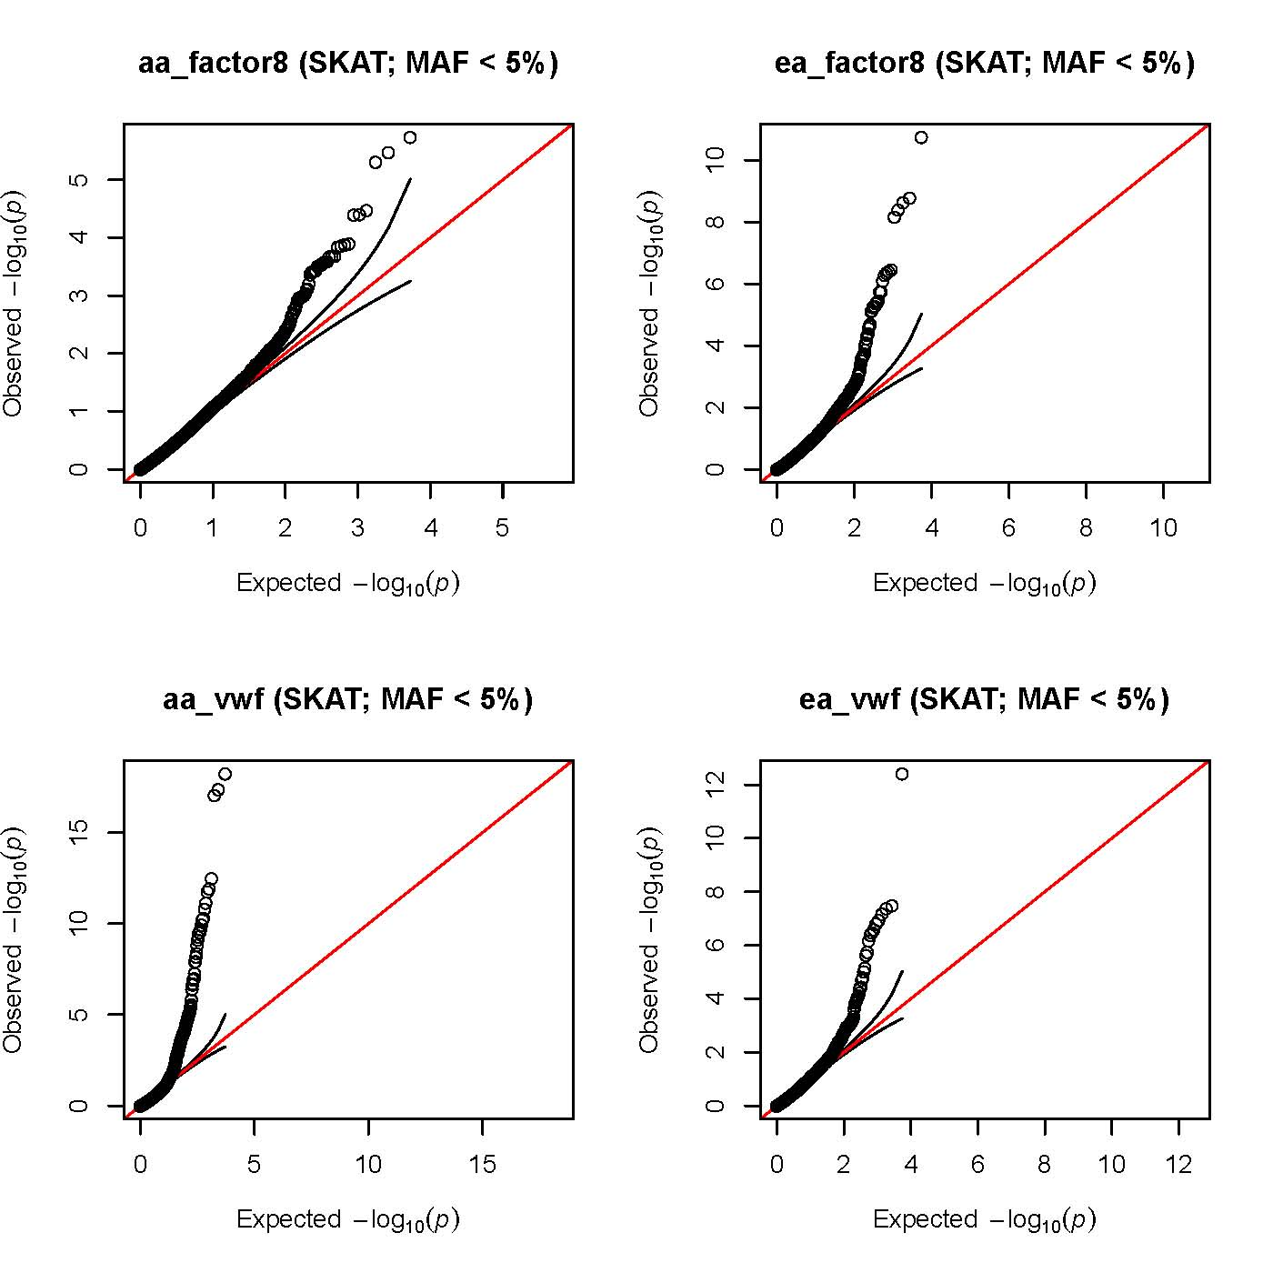
SKAT results

