Slide 1
exome meets microbiome:
CLEC7A & ulcerative colitis
Taylor, Underhill, Illiev, Funari,
Becker, Brown, Nguyen, Reyes, Strom, Wang
Dubinsky, Fleshner, McGovern, Rotter
Notes:
As you all know, we humans carry a large assortment of microbes in our guts, mouths, and on our skin.
The importance of these is being appreciated
This evening I want to give you some ideas to apply to future MESA studies by a brief review of the tools being used to study these microbes and by a study that we recently published on the interaction between gut fungi and the severity of ulcerative colitis

Slide 2
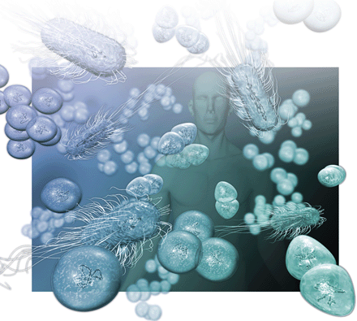
Review
Notes:
Microbiome refers to the organisms that live with and within our bodies
the organisms in a particular place in our bodies act as an ecological community
Metagenome refers to the genes of those organisms in the aggregate—genes acting in addition to the human genome
First, a review of the tools

Slide 3
Tools to Study Microbiome
Sequence 16srRNA to identify species
  Relative abundance of different taxonomic groups
Assign shotgun sequence to clusters of orthologous groups (genes) in databases
  Identify genes present & assign function in entire microbial community
  Changes in gene abundance
Systems approach (pathways)
  Looks at connections between enzymes through the same intermediate molecule
  Make conclusions about metabolic capacity
  Gene groups set in context of their pathways
Notes:
With primers for the appropriate region we can sequence all of the 16sRNA’s present in a sample
we compare the sequence with known sequences and count the number of each type to measure abundance

Slide 4
Large-Scale Microbiome Studies
Metagenomics of Human Intestinal Tract (MetaHIT)
  Qin et al 2010. Nature 464: 59-65
  Metagenomic approach
  Fecal samples
  124 adults: normal, overweight, obese, & IBD
Human Microbiome Project
  242 adults:
  Sampled at 18 or 15 sites: nose, mouth, skin, & fecal samples
  Both 16S profiling and metagenomic sequencing
Ongoing sequencing of organisms when isolated
Notes:
Tools, continued
And, just as there have been large scale efforts to provide data for use by all investigators,

Slide 5
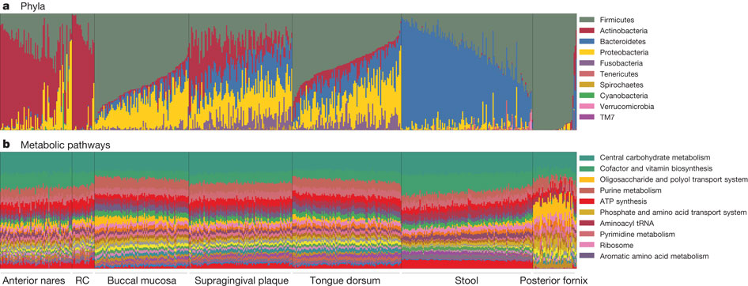

Carriage of microbial taxa varies while metabolic pathways
remain stable within a healthy population.
Nose
Mouth
Stool
C Huttenhower et al. Nature 486, 207-214 (2012) doi:10.1038/nature11234
Notes:
Vertical bars are individual samples, by body habitat This comes from the human microbiome project
Colors are relative abundances
Species
Metabolic modules/pathways

Slide 6
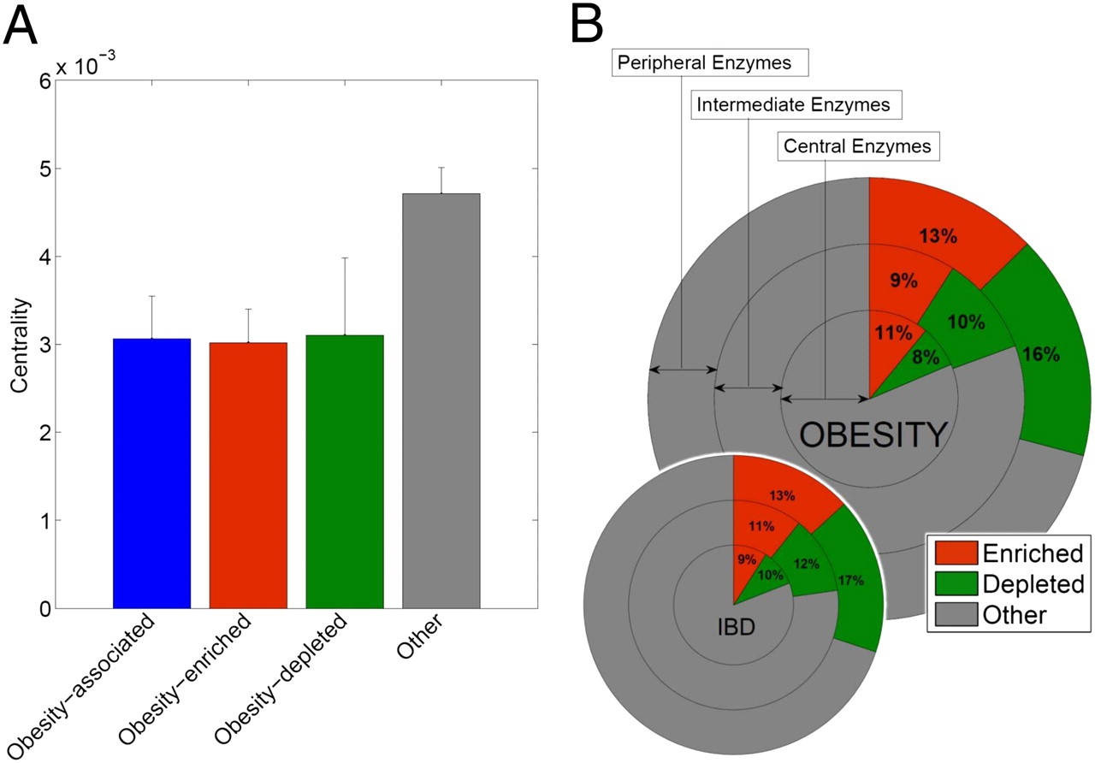
Notes:
Differences in enzymes, both up and down, comparing IBD and obese subjects.
These differences are greater in “peripheral” enzymes of pathways.

Slide 7
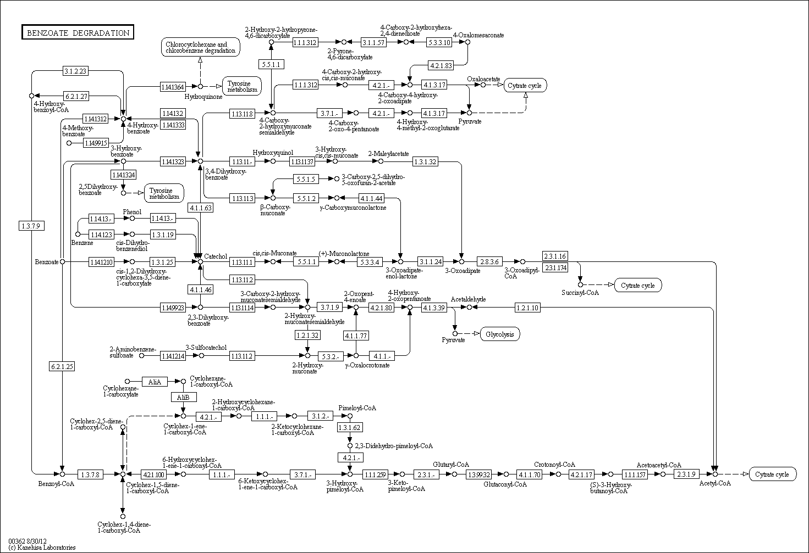
Example of central vs peripheral
Citrate Cycle
Citrate Cycle
glycolysis
Citrate Cycle
Notes:
Here I want to give you the feel for central, intermediate, periphery

Slide 8
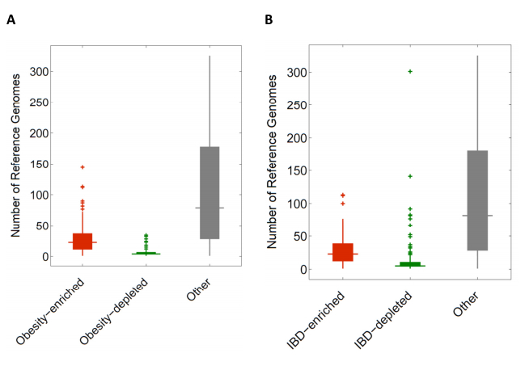
Disease conditions favor less-characterized organisms
Notes:
Fig. S7. Boxplots of the number of reference genomes (n=326) associated with enzymes of different classes in (A) obese and (B) IBD microbiomes. Enzymes associated with either obesity or IBD are present in far fewer reference genomes (p<2.0x10-55 [obese]; p<2.410-57 [IBD]; Wilcoxon rank-sum test).

Slide 9
Possibilities
Disease states favor peripheral metabolic pathways and poorly characterized organisms
Host genes may perturb the microbial communities
This all provides the greatest opportunity for study of gene/environmental
  microbiome may interact with environmental exposure

Slide 10
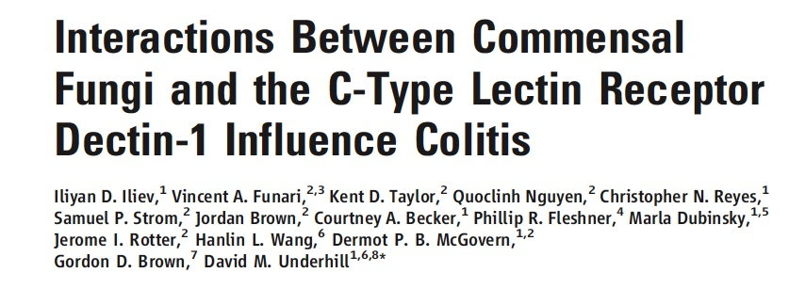
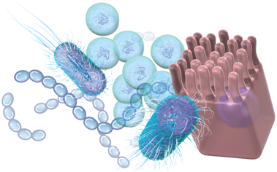
Science 336:1314-1317, 2012.
Notes:
With all of these studies

Slide 11
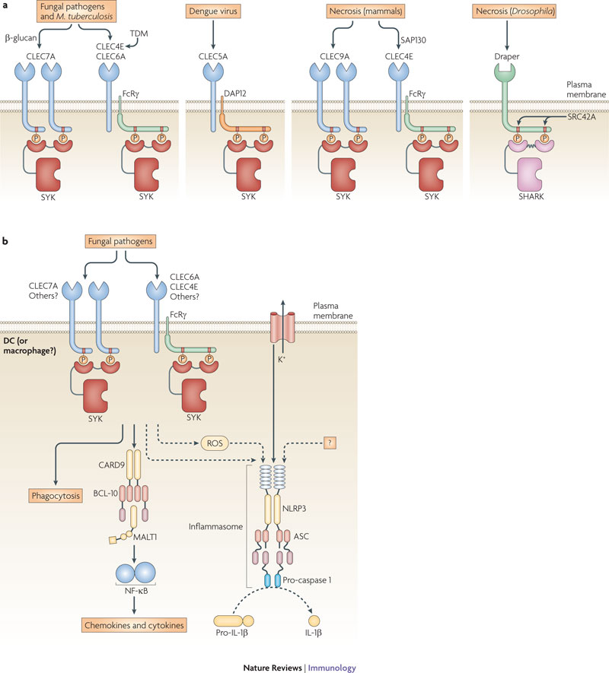
Dectin-1 (CLEC7A):
innate immune receptor for fungi
Expressed by Macrophages, Dendritic cells, Neutrophils
Recognizes Fungal Cell Wall β-glucan
Dectin-1 deficient mice are highly susceptible to a variety of pathogenic fungi
Dectin-1 deficient people are similarly susceptible to fungal infections
Notes:
Second
the primary interaction receptor for the immune system to recognize fungi is CLEC7A/Dectin-1

Slide 12
CLEC7A & UC
SYK & UC
CLEC7A & SYK are not known to be genes for ulcerative colitis but CARD9 is known to be a UC risk gene
CARD9 & UC
Nature, 2012, in press.
Notes:
Third
CLEC7A and SYK are not known to be genes for UC
But CARD9 is

Slide 13
AIM
Investigate the interaction between
intestinal fungi,
the innate immune system
(Dectin-1 or CLEC7A receptor), and
intestinal inflammation in mouse (DSS colitis) &
human (severe ulcerative colitis)
Notes:
The aim of our study was to study the three-way interaction between intestinal fungi, the innate immune system, and intestinal inflammation

Slide 14
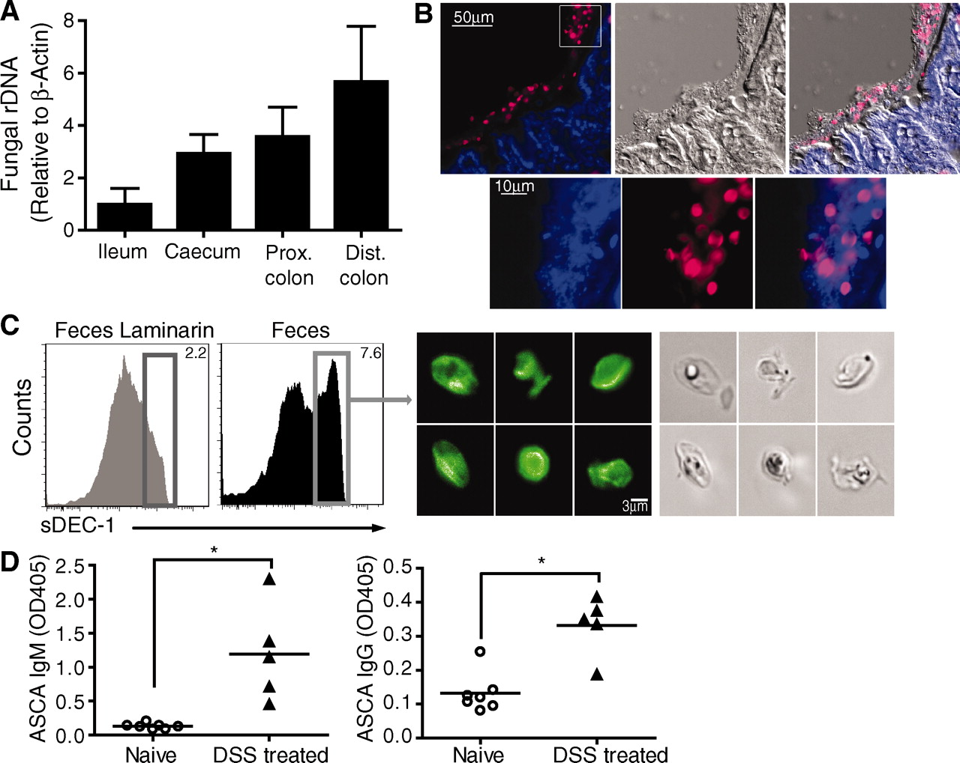
CLEC7A recognizes fungi in the gut
Notes:
Commensal fungi are present in the intestine and are recognized by Dectin-1. (In mouse)
the number of fungal rRNA molecules increases
CLEC7A recognizes the fungi in the gut
unicellular forms can be isolated from feces
(A) Prevalence of fungi in mucosa isolated from ileum, cecum, proximal (prox) and distal (dist) colon of C57BL/6J mice. ITS1-2 rDNA level was analyzed by quantitative polymerase chain reaction and normalized to β-actin DNA. (B) Visualization of commensal fungi in the intestine. Colon sections were stained with a soluble Dectin-1 probe (sDEC-1) and counterstained with 4′,6′-diamidino-2-phenylindole (DAPI). The DAPI signal has been amplified in (B, bottom) to show that DAPI-stained bacteria and fungi are in close proximity to each other. (C) Intestinal fungi are recognized by Dectin-1. Fecal pellets were homogenized and labeled with sDEC-1 in the presence (gray histogram) or absence (black histogram) of laminarin (a soluble β-glucan) to block specific binding. Binding was assessed by flow cytometry (left panels). Dectin-1–binding fungi were sorted (right) and visualized by confocal microscopy. (D) ASCA generation after DSS colitis. Mice were exposed twice to 2.5% DSS-supplemented water for 7 days each separated by 2 weeks of recovery. Serum samples were collected before DSS treatment (day 0) and 2 weeks after the last DSS cycle (42 days total), and ASCA IgM and IgG were measured by enzyme-linked immunosorbent assay (ELISA). Each symbol represents a mouse, all error bars indicate the SD; unpaired t test, *P < 0.05. All data are representative of at least two independent experiments with similar results.

Slide 15
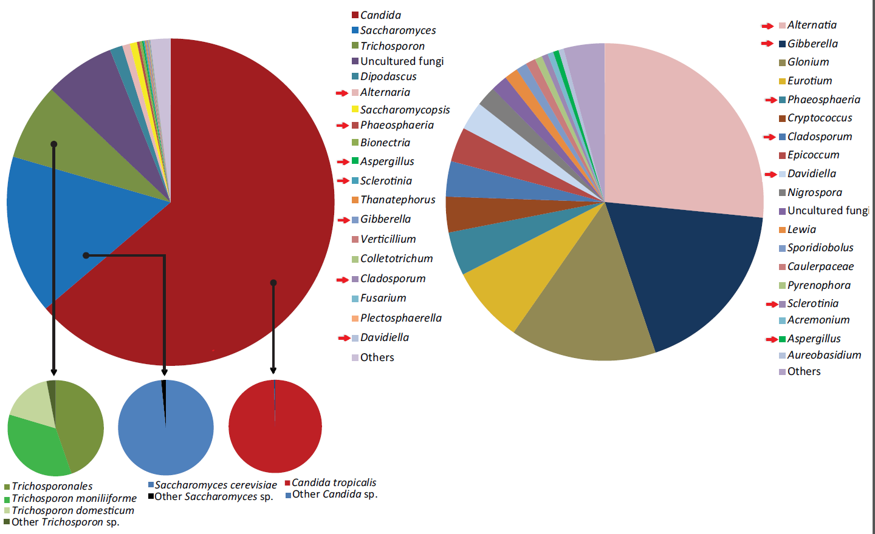
What Fungi are in a mouse gut?
Feces
Food
Commensal fungi include over 200 species representing over 50 genera
Iliev et al. 2012. Science. 2012
Notes:
four major groups are
candida (dark red)
saccharomyces (blue)
trichosporon (green)
unclutured (purple)

Slide 16
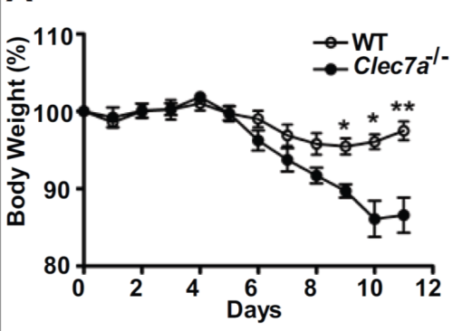
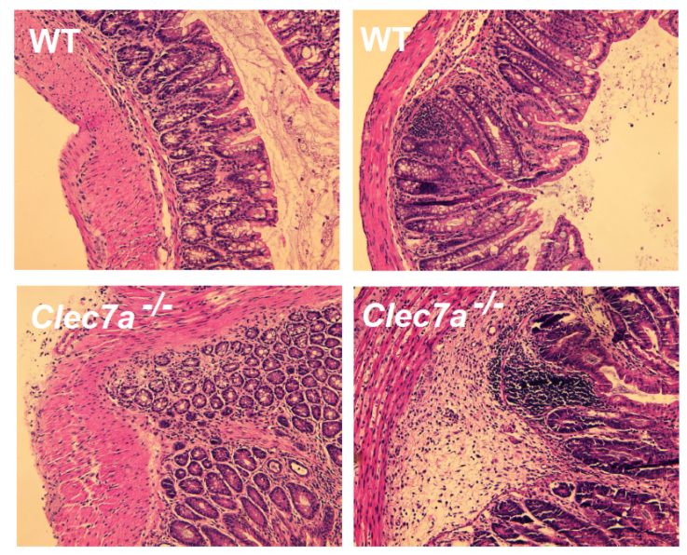
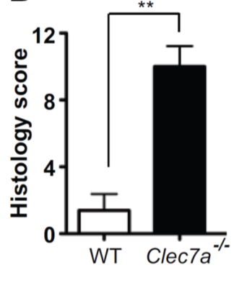
CLEC7A -/- increases severity of colonic inflammation in DSS mouse model
Iliev et al. Science. 2012
Littermate controls
Notes:
Mouse model of intestinal inflammation
dextran sulfate treatment

Slide 17
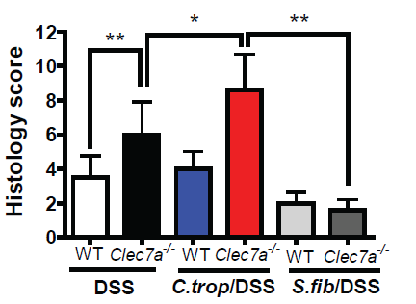
Specific Fungi Alter Colonic Inflammation

Slide 18
Medically refractive ulcerative colitis
(MRUC)
Ulcerative colitis is a superficial inflammation of the large intestine
Some patients require colectomy because they do not respond to medical therapy
  iv corticosteroids
  cyclosporin
  biological therapies such as anti-TNF
And so require surgery to control symptoms
Haritunians et al 2010. Inflammatory Bowel Disease 16:1830.
Notes:
So since CLEC7A was interacting with fungi and the CLEC7A knockout had a more severe colitis
We looked at the association between CLEC7A and severity in our MRUC cohort

Slide 19
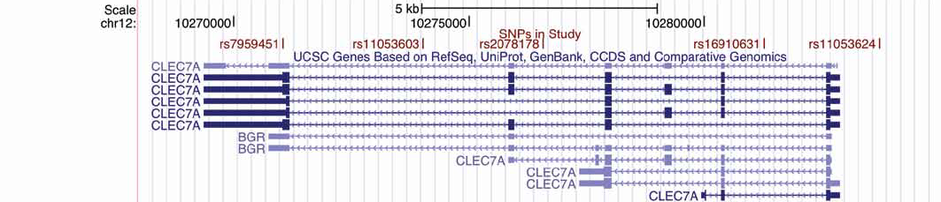
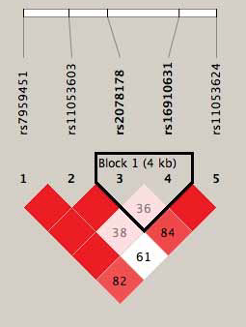
Dectin-1 Association with MR-UC
5 common SNPs in human Dectin-1 gene (CLEC7A) genotyped in the cohort
SNP | Allele | OR | 95% CI | P logistic
rs7959451 | A | 1.40 | 1.09-1.82 | 0.0096
rs11053603 | A | 1.47 | 1.02-2.10 | 0.037
rs2078178 | A | 1.52 | 1.22-1.89 | 0.00018
rs16910631 | A | 0.83 | 0.56-1.26
rs11053624 | G | 1.52 | 1.09-2.14 | 0.015
Iliev et al. Science. 2012

Slide 20
With CLEC7A GA haplotype
PROPORTION REMAINING (without surgery)
Without CLEC7A GA haplotype
DURATION (mo)

Slide 21
Association of CLEC7A haplotypes with medically-refractive ulcerative colitis
Combined dataset from exome chip, immunochip, and custom genotyping chips
(Haplotypes assigned by PHASE 2.1 using the
entire dataset n=3100)
Haplotype | rs7137840 | exm983338 | rs2078178 | rs3901533 | rs3901532 | exm983342 S->L | rs11053617 | rs16910631 | Frequency
1 | A | G | A | A | G | G | G | G | 0.050
2 | A | G | A | A | G | G | G | A | 0.041
3 | A | G | A | A | G | A | G | G | 0.0021
4 | A | G | A | C | G | G | G | G | 0.0005
5 | G | G | A | A | G | G | G | G | 0.0001
6 | G | G | A | A | G | G | A | G | 0.151
7 | G | G | A | A | G | G | A | A | 0.0019
8 | G | G | A | C | G | G | A | G | 0.0004
9 | G | G | G | A | G | G | A | G | 0.0001
10 | G | G | G | C | G | G | A | G | 0.0031
11 | G | G | G | C | A | G | A | G | 0.717
12 | G | G | G | C | A | G | A | A | 0.027
13 | G | A | G | C | A | G | A | G | 0.004
Notes:
Now then more recently we have completed genotyping for both the immuno-chip and exome chip plus custom content
Giving us a large dataset for CLEC7A, SYK, and CARD9 genes

Slide 22
Association of CLEC7A haplotypes with medically-refractive ulcerative colitis
Combined dataset from exome chip, immunochip, and custom genotyping chips
(Haplotypes assigned by PHASE 2.1 using the
entire dataset n=3100)
Haplotype | rs7137840 | exm983338 | rs2078178 | rs3901533 | rs3901532 | exm983342 S->L | rs11053617 | rs16910631 | Frequency
1 | A | G | A | A | G | G | G | G | 0.050
2 | A | G | A | A | G | G | G | A | 0.041
3 | A | G | A | A | G | A | G | G | 0.0021
4 | A | G | A | C | G | G | G | G | 0.0005
5 | G | G | A | A | G | G | G | G | 0.0001
6 | G | G | A | A | G | G | A | G | 0.151
7 | G | G | A | A | G | G | A | A | 0.0019
8 | G | G | A | C | G | G | A | G | 0.0004
9 | G | G | G | A | G | G | A | G | 0.0001
10 | G | G | G | C | G | G | A | G | 0.0031
11 | G | G | G | C | A | G | A | G | 0.717
12 | G | G | G | C | A | G | A | A | 0.027
13 | G | A | G | C | A | G | A | G | 0.004
Associations

Slide 23
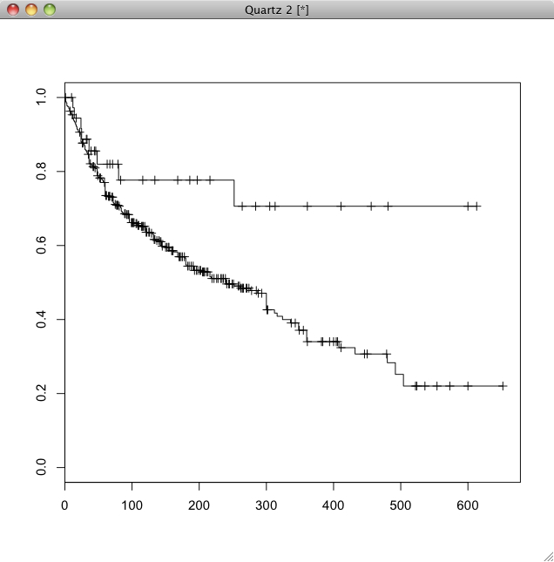
Association of CLEC7A haplotype 12
P _{likelihood ratio test} =0.007
With CLEC7A Hap12
PROPORTION REMAINING (without surgery)
mruc | hap12
 | no | yes
no | 394 | 32 | 0.075
yes | 259 | 12 | 0.033
OR=0.43; p_{fisher}=0.03 p _{logistic} = 0.027
Without CLEC7A Hap12
Duration (months)

Slide 24
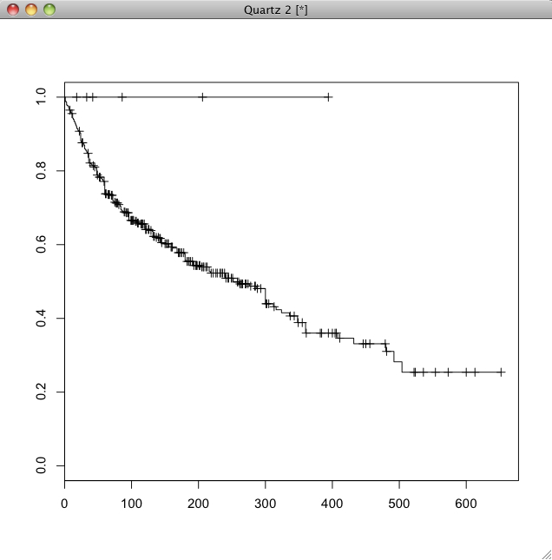
Association of CLEC7A haplotype 13
Hap13 yes
P _{likelihood ratio test} =0.027
mruc | hap13
 | no | yes
no | 420 | 6 | 0.075
yes | 268 | 0 | 0.033
p_{fisher}=0.09
PROPORTION REMAINING (without surgery)
Hap13 no
DURATION (mo)

Slide 25
SYK
79 SNPs on the iChip
323 MRUC, 533 non-MRUC
SNP |  | MRUC | Non-MRUC | beta | P logistic
rs290212 | G | 0.337 | 0.247 | 0.10 | 5.4x10⁻⁵
rs290213 | A | 0.865 | 0.801 | 0.10 | 0.00082

Slide 26
rs290212
P _{likelihood ratio test} = 0.00031
PROPORTION REMAINING (without surgery)
AA
GG, GA
DURATION (mo)
Notes:
There was no association with CARD9

Slide 27
Summary
Disease severity in a mouse model of intestinal inflammation is increased by knockout of an innate-immunity fungal receptor (CLEC7A) and by manipulation of fungal species in the gut
Disease severity in a human model of intestinal inflammation is associated with variants in genes related to innate immune response to fungi: CLEC7A and SYK

Slide 28
Conclusions
The microbiome includes fungal species
Disease states favor as yet uncharacterized microbes and peripheral metabolic pathways
Gene variation affects the “ecology” of the microbiome
Variation in genes related to the microbiome are associated with disease states related to the microbiome

