Slide 1
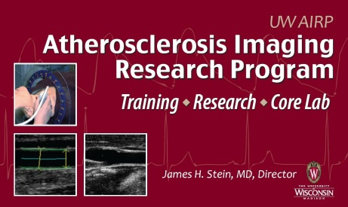
Predictors of Common Carotid Artery Intima-Media Thickness and Carotid Artery Plaque Score Progression in the Multi-Ethnic Study of Atherosclerosis (MESA)
Matthew C. Tattersall, Amanda Gassett, Claudia E. Korcarz, Joel D. Kaufman, Kiang J. Liu, Lianne Sheppard, Richard A. Kronmal, Brad C. Astor, James H. Stein

Slide 2
Background
Carotid intima-media thickness (IMT) is a non-invasive measure of subclinical arterial injury
IMT represents early arterial injury that in later stages is manifested as plaque formation
Stein JH, et al. J Am Soc Echocardiogr 2008;21:93

Slide 3
High CCA IMT Independently Predicts Future CVD Events
Study | N | Age | Yrs | CV Event | Cutpoint | Adjusted RR (95% CI)
ARIC | 12,841 | 45-64 | 5 | MI, CHD death | tertile | W: 2.53 (1.02-6.26) M: 2.02 (1.32-3.09)
 | 14,214 | 45-64 | 7 | stroke | tertile | W: 2.32 (1.09-4.94) M: 2.24 (1.26-4.00)
CAPS | 5,056 | 19-90 | 4 | MI, stroke, death | quartile | 1.85 (1.09-3.15)
CHS | 4,476 | >65 | 6 | MI | quintile | 3.61 (2.13-6.11)
 |  |  |  | stroke | quintile | 2.57 (1.64-4.02)
KIHD | 1,257 | 42-60 | 3 | MI | >1.0 mm | 2.1 (0.8-5.2)
MDCS | 5,163 | 46-68 | 7 | MI, CHD death | tertile | 1.50 (0.81-2.59)
MESA | 6,698 | 45-84 | 4 | CHD, CHD death | quartile | 2.3 (1.4-3.8)
Rotterdam | 6,389 | >55 | 7-10 | MI | quartile | 1.95 (1.19-3.19)
San Danielle | 1,348 | 18-99 | 12 | Stroke, TIA, vascular death | >1.0 mm | 5.6 (3.2-10.1)
Tromsø | 6,226 | 25-84 | 5 | MI | quartile | W: 2.86 (1.07-7.65) M: 1.73 (0.98-3.06)
Yao City | 1,289 | 60-74 | 5 | stroke | quartile | 4.9 (1.9-12.0)
Modified from Johnson HM, et al. J Nuc Cardiol 2011;18:153
Notes:
This slide shows a subset of large observational studies demonstrating that increased common carotid artery IMT – in the highest teritle or quartile – is indep. assocaited with increased risk of future MI, coronary death, and death

Slide 4
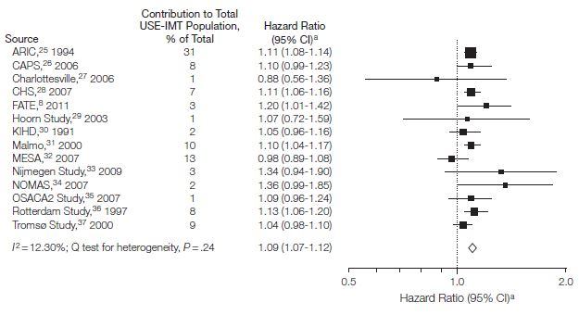
Increasing CCA IMT Predicts Future CVD Events
USE-IMT Meta-analysis
14 population-based cohorts; 45,828 subjects
Median 11 year f/up; 4,007 incident MI/stroke
CCA IMT (per 0.1 mm increase)
MI: 1.08 (1.05-1.10); Stroke: 1.12 (1.10-1.15)
Den Ruiter HM, et al. JAMA 2012;308:796
Notes:
Even as a continuous variable, higher IMTpredicts future CVD events. In the USE-IMT ,eta-analysis of …

Slide 5
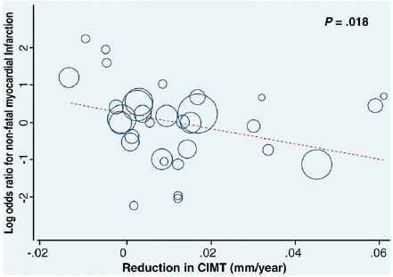
Carotid IMT Progression in Clinical Trials
28 RCTs, N = 15,598 subjects
For each 0.01 mm/year slower rate of ΔCIMT, OR for MI = 0.82 (0.69 - 0.96; p = 0.018)
Goldberger ZD, et al. Am Heart J 2010; 160:701
Notes:
What about progression of IMT? It was first used in clinical trials – primarily of lipid-lowering and antihypertensive therapy – as a surrogate endpoint of CVD risk, and indeed, in this met-anaysis from Goldberg the OR for MI was significantly decreased for each 0.01 mm/year of slowed progression – though the limits of meta-regression are well known, and this relationship was not seen in some importna subgroups

Slide 6
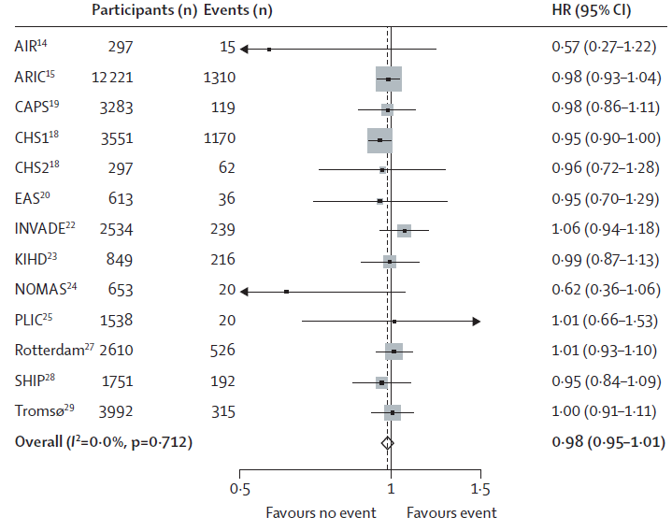
Carotid IMT Progression in Epidemiological Studies
PROG-IMT: 16 studies, N = 36,984 subjects
Mean CCA IMT progression: HR 0.98 (0.95-1.01) for MI/stroke
MESA: ΔCCA CIMT over 32 months predicted stroke risk, but did not affect PROG-IMT
Polak JF, et al. Stroke 2011; 42:317
Lorenz MW, et al. Lancet 2012;379:2053
Notes:
More recently, IMT progression has been investigated epidemiological studies, though with less success. In PROG-IMT, progression of CCA IMT was not associated with risk fo MI or stroke. Indeed, none of the studies in the meta-analysis showed a strong, significant association between IMT progression and CVD risk. However a report from MESA in 2011, showed that change in CCSA predicted stroke risk, though in a small # of participants which when in include din PROG-IMT did not affect its results.

Slide 7
Traditional CVD Risk Factors and Cross-Sectional Carotid IMT
Study | Risk Factors | Multivariate Model R²
Framingham Offspring Study | Age, Gender, Systolic BP, Total cholesterol, HDL-C, Smoking, Diabetes, HTN Meds | 0.29
Northern Manhattan Study | Age, Gender, LDL-C, Smoking, Glucose | 0.11
Cardiovascular Health Study | Age, Gender, Smoking, HTN, Diabetes | 0.17
Tromsø Study | Age, Gender, TC, HDL-C, Systolic BP, BMI, Smoking, Lipid-lowering Medications, Diabetes, CVD | 0.21
Polak JF, et al. J Ultrasound Med 2010; 29:1759
Rundek T, et al. Stroke. 2013 44: 2101
O’Leary DH, et al. Stroke. 1996; 27: 224
Herder M, et al. Stroke 2012; 43 1818
Notes:
Indeed, in large, heterogeneous populations, traditional risk factors do not explain much of the variability in carotid IMT. In a clinical trial of more homogenous patients with high BP or high cholesterol, looking at the effect of a powerful intervention like an ACE-I or a statin, carotid IMT change may be a good surrogate. But given the variability of IMT measures and the weak associations between risk factors and IMT, detecting effects of changes in risk factors on changes in IMT may be difficult.

Slide 8
Carotid IMT Progression in Tromsø Study
N=2743 subjects; mean right CCA IMT
Baseline and mean 13.2 years later
IMT progression rate = 0.01 mm/year
Multivariable model R² = 0.01
Age, gender, HDL-C, BMI, total cholesterol, systolic BP, CVD, smoking, lipid-lowering drugs, diabetes mellitus
Risk Factor | Beta Coefficient | P value
Male Gender | 0.067 | 0.0002
Total Cholesterol | 0.05 | 0.0002
Systolic Blood Pressure | -0.076 | 0.002
Notes:
For example, in the Tromso study of … for mean right CCA IMT progression the R=squared is very low and associations even with well established RFs are weak, though statistically significant.

Slide 9
Carotid Plaque Presence Independently Predicts Future CVD Events
Study | N | Age | Yrs | Event | Adjusted HR
ARIC | 12,375 | 45-64 | 7 | MI, CHD death | 2.96 (1.54-3.30)
KIHD | 1,288 | 42-60 | ≤2 | MI | 4.15 (1.5-11.47)
MDCS | 5,163 | 46-68 | 7 | MI, CHD death | 1.81 (1.14-2.87)
Northern Manhattan | 1,939 | >40 | 6 | Stroke | 3.1 (1.1-8.5)
Rotterdam | 6,389 | >55 | 7-10 | MI | 1.83 (1.27-2.62)
San Danielle | 1,348 | 18-99 | 12 | Stroke, TIA, vascular death | 10.4 (6.4-17.1)
Yao City | 1,289 | 60-74 | 5 | Stroke | 3.2 (1.4-7.1)
Modified from Johnson HM, et al. J Nuc Cardiol 2011;18:153
Notes:
More recently, attention has focused on carotid plaque as a more powerful predictor of CVD events than high IMT – as shown on this slide, where several large studies show a HR of 2-3 for plaque presence and predicting MI, coronary death, and stroke. Less is known about progression of carotid plaque, which we’ll revisit later.

Slide 10
Hypotheses
Baseline traditional CVD risk factors and socio-demographic markers are major predictors of longitudinal changes in:
CCA IMT
New carotid plaque formation

Slide 11
Methods
Subjects: participants with baseline and exam 5 carotid IMT studies
CCA IMT measurement
Mean far wall distal CCA IMT from right and left sides
All segments included regardless of “matching”
Carotid plaque score (0-12)

Slide 12
Plaque Formation
Plaque score change = E5 – E1 plaque score
New plaque: plaque score change of 0 vs. ≥1
De novo plaque
Baseline initial plaque score = 0
Plaque score change of 0 vs. ≥1

Slide 13
Statistical Methods
Multivariate regression model
Scaled change: progression in microns/yr
Mean of mean right and mean left CCA
Those with only one side excluded
Mixed effects model
Accounts random and fixed effects
Baseline IMT is modeled
Notes:
Our analyses used two models …

Slide 14
Components of Mixed Effects Model
Fixed Effects | Random Effects
Age | Time
Gender | Subject
Ethnicity
Systolic blood pressure
Total cholesterol
HDL-C
Family history
Diabetes mellitus
Income
Smoking
Education
Use of statin medications
Use of anti-hypertensive Rx
BMI
Fasting glucose

Slide 15
Outcome Variables
Outcome Variable | Units | Measure | Sides
Scaled longitudinal IMT change (multivariable model) | Microns/year | Continuous | Mean of the right and left at exam 1 and exam 5. If missing right or left, subject excluded.
Absolute longitudinal IMT change (mixed model) | Microns | Continuous | If baseline and exam 5 present for any side, included in the analysis.
New plaque (multivariable logistic regression model) | Δ Plaque score | Binary | Both included.
De novo plaque (multivariable logistic regression model) | Δ Plaque score (initial plaque score = 0) | Binary | Both included.

Slide 16
Results: Descriptive Statistics
Variable |  | Exam 1 | Exam 5
N |  | 3409 | 3409
Age (years) |  | 60.3 | 69.8
Male Gender |  | 46.9% | N/A
Ethnicity | African-American | 26.4%
 | Chinese | 12.8%
 | Hispanic | 21.5%
 | Caucasian | 39.3%
Notes:
Fast – state N, mean age, % male, % white

Slide 17
Results: Descriptive Statistics
Variable |  | Exam 1 | Exam 5 | P Value
SBP (mmHg) |  | 124.3 | 124.2 | 0.78
HDL-C (mg/dL) |  | 51.0 | 56.0 | <0.0001
Total cholesterol (mg/dL) |  | 194.0 | 182.8 | <0.0001
Fasting glucose (mg/dL) |  | 95.1 | 102.1 | <0.0001
BMI (kg/m²) |  | 28.3 | 28.5 | <0.0001
Smoking | Current | 11.4% | 7.3% | <0.0001
 | Former | 36.8% | 47.2%
 | Never | 51.8% | 45.5%
Anti-HTN medications |  | 34.8% | 55.6% | <0.0001
Statin medications |  | 15.1% | 37.3% | <0.0001
Notes:
Fast normal BP, Lipids, and glucose – stayed pretty stable over 10 years
Number of current smokers decreased
Marked increase in # on antiHTn and statin meds

Slide 18
Anti-HTN Medication Use in MESA
P<0.0001
P=0.0003
P<0.0001
P<0.0001

Slide 19
Statin Medication Use in MESA
P<0.0001
P=0.004
P<0.0001

Slide 20
Results: Descriptive Statistics
Variable | Exam 1 | Exam 5 | P Value
Mean mean CCA IMT (microns) | 752.5 | 865.2 | <0.0001
Right CCA Progression | 12.1 microns/year |  | 0.35
Left CCA Progression | 11.6 microns/year
New plaque formation | 55.6% (N=1753) |  | N/A
De novo plaque formation | 40.1% (N=676) |  | N/A
Notes:
Fast -

Slide 21
MESA: Exam 1 CVD RF Correlations for Mean CCA IMT
 | TNEMC | UW AIRP
 | N=6536 | N=2969
Age | 0.40 | 0.50
Gender | 0.13 | 0.13
Systolic BP | 0.30 | 0.34
HDL-C | -0.09 | -0.08
LDL-C | 0.05 | 0.06
BMI | 0.14 | 0.14
Glucose | 0.12 | 0.15
Similar associations for diabetes, smoking and antihypertensive medications
Notes:
As you know, MESA had two carotid IMT reading centers. We put these risk factor correlations with mean CCA IMT up for your reference. The Tufts center read over 6500 studies. University of Wisconsin - UW - re-read about 45% of them and found similar and for some variables, stronger correlations, for example with age, systolic BP, and glucose.

Slide 22
Carotid IMT Reader Reproducibility
4 readers read 24 scans
Blinded
4 per field center; 1/2 each from E1 and E5
Intra-reader reproducibility was excellent for mean CCA IMT (TEM 2.6-3.3%, ICCs 0.97-0.99) and mean ICA IMT (TEM 2.9-4.9%; ICC 0.98-0.99)
Inter-reader reproducibility was excellent mean CCA-IMT (TEM 2.6-4.8%, ICC 0.99) and very good for mean ICA-IMT (TEM 5.5-7.4%, ICC 0.98)

Slide 23
Carotid IMT Scan-Rescan Reproducibility
44 repeated scans from 3 sonographers; single reader
Pearson correlations for unmatched and matched segments ranged from 0.94-0.98
Mean (SD) differences were 0.006 (0.036-0.076) mm for matched and unmatched segments
No outliers on limit of agreement (Bland-Altman) analysis for matched segments

Slide 24
Carotid Plaque Reproducibility
Intra-reader reproducibility was excellent (per reader Kappa = 0.82-1.0, overall Kappa = 0.83, 95% CI 0.70-0.96)
Inter-reader reproducibility also was excellent (Kappa = 0.89; 95% CI 0.72-1.00)

Slide 25
MESA Exam 1 Multivariable Model for Mean CCA IMT
Study | Risk Factors | Multivariate Model R²
Exam 1: TNEMC N=5862 | Age, Gender, Ethnicity, BMI, Smoking, Systolic BP, Glucose, HTN Meds, Statin use, TC, HDL, Family Hx, Diabetes, Education, Income | 0.22
Exam 1: UW AIRP N=2761 | Same as above | 0.29
Exam 5: UW AIRP N=2716 | Same as above | 0.23
Notes:
The multivariate model for exam 1 CCA IMT was somewhat stronger of UW re-reads, despite having less than half the number of scans, and was as higher than almost every study in the literature and the same as Framingham. Click – the R2 for Exam 5 was a little lower, as expected, possibly due to a survivor bias.

Slide 26
CCA IMT Progression*: Multivariate Model 1
Multivariate model with use of anti-HTN and statin medications at baseline
Predictor | Parameter estimate | Standard error | P value
Chinese (c/w white) | -2.846 | 0.88 | 0.001
Hispanic (c/w white) | -1.803 | 0.76 | 0.02
HDL-C (mg/dL) | -0.044 | 0.02 | 0.02
Anti-HTN medications (baseline) | -2.049 | 0.58 | 0.0004
Statin medications (baseline) | 1.303 | 0.73 | 0.07
Adjusted R² = 0.01
*microns/year

Slide 27
CCA IMT Progression*: Mixed Effects Model 1
Mixed model with use of anti-HTN and statin medications at baseline
Predictor | Parameter estimate | Standard error | P value
Chinese | -2.279 | 0.90 | 0.01
Anti-HTN medications (baseline) | -2.111 | 0.60 | 0.0004
Statin medications (baseline) | 1.589 | 0.75 | 0.03
Previously significant variables in multivariate model
Hispanic | -1.389 | 0.79 | 0.08
HDL-C (mg/dL) | -0.036 | 0.02 | 0.07
*microns
Notes:
Emphasize very similar results

Slide 28
CCA IMT Progression*: Multivariate Model 2
Multivariate model with time on anti-HTN and statin medications
Predictor | Parameter estimate | Standard error | P value
Chinese | -2.899 | 0.88 | 0.001
Hispanic | -2.079 | 0.76 | 0.006
HDL-C (mg/dL) | -0.048 | 0.02 | 0.01
Diabetes mellitus | 2.863 | 1.23 | 0.02
Time on anti-HTN medications (years) | -0.292 | 0.08 | <0.0001
Time on statin medications (years) | -0.161 | 0.08 | 0.04
Adjusted R² = 0.01
*microns/year

Slide 29
CCA IMT Progression*: Mixed Effects Model 2
Mixed model with time on anti-HTN and statin medications
Predictor | Parameter estimate | Standard error | P value
Chinese | -2.333 | 0.90 | 0.001
Hispanic | -1.572 | 0.79 | 0.05
Time on anti-HTN medications (years) | -2.040 | 0.72 | 0.005
Previously significant variables in multivariate model
HDL-C (mg/dL) | -0.039 | 0.02 | 0.06
Diabetes mellitus | 1.892 | 1.23 | 0.12
Time on statin medications (years) | -0.961 | 0.74 | 0.19
*microns
Notes:
Note – very similar results when modeled for “ever on” statins and antihypertensive medications

Slide 30
Summary: IMT Progression
Mixed effect and scaled multivariate models yielded very similar findings
Similar parameter estimates
Consistent predictors of IMT progression
Protective effects of Hispanic and Chinese ethnicity, HDL-C, anti-HTN medications
Statin effect weaker
Protective when modeled as “time on” or “ever on,” seen in multivariate models only
Low R² values (similar to Tromsø)

Slide 31
New Carotid Plaque: Logistic Model 1
Logistic model with use of anti-HTN and statin medications at baseline
Variable |  | Odds Ratio | P value
Age |  | 1.10 (1.04-1.06) | <0.001
Hispanic |  | 0.75 (0.59-0.95) | 0.02
Chinese |  | 0.70 (0.53-0.90) | 0.008
African-American |  | 0.67 (0.54-0.81) | <0.0001
Systolic BP |  | 1.01 (1.005-1.01) | <0.0001
Glucose |  | 1.01 (1.01-1.01) | 0.02
HDL-C |  | 0.99 (0.99-0.99) | 0.01
Total cholesterol |  | 1.00 (1.00-1.01) | 0.001
Tobacco use | Current | 2.34 (1.81-3.02) | <0.0001
 | Former | 1.28 (1.08-1.50) | 0.004
Rescaled R² = 0.15; AUC = 0.69

Slide 32
New Carotid Plaque: Logistic Model 2
Logistic model with time on anti-HTN and statin medications
Variable |  | Odds Ratio | P value
Age |  | 1.10 (1.04-1.06) | <0.001
Hispanic |  | 0.75 (0.60-0.95) | 0.02
Chinese |  | 0.70 (0.53-0.90) | 0.008
African-American |  | 0.67 (0.54-0.82) | 0.0001
Systolic BP |  | 1.01 (1.01-1.01) | <0.0001
Glucose |  | 1.01 (1.01-1.01) | 0.02
HDL-C |  | 0.99 (0.99-0.99) | 0.02
Total cholesterol |  | 1.00 (1.00-1.01) | 0.005
Tobacco use | Current | 2.31 (1.79-2.99) | <0.0001
 | Former | 1.27 (1.08-1.50) | 0.004
Rescaled R² = 0.15; AUC = 0.69

Slide 33
De Novo Plaque: Logistic Model 2
Logistic Model with time on anti-HTN and statin medications
(those without initial plaque N = 1685)
Variable | Odds Ratio | P value
Age | 1.10 (1.03-1.05) | <0.001
African-American | 0.67 (0.50-0.89) | 0.01
Total cholesterol | 1.00 (1.00-1.01) | 0.03
Tobacco use (current) | 1.75 (1.23-2.50) | 0.002
Rescaled R² = 0.08, AUC = 0.64

Slide 34
Summary: New Plaque
Strong effects of several traditional risk factors identified
Did not see effect of anti-HTN or statin meds
Especially strong effect for current smoking
Protective effect of African-American race (?)
Model R² and AUCs reasonably strong
Change in carotid plaque score had similar predictors (not shown)
Difficult to model since so many zeroes
ZIP models

Slide 35
Discussion?
Thank you!

Slide 37
Plaque Formation by Ethnicity
Ethnicity | New Plaque | Total Subjects
African-American | 54% (N=431) | 803
Hispanic | 55% (N=379) | 692
Chinese | 49% (N=198) | 405
Caucasian | 37% (N=745) | 1257

Slide 38
Traditional Risk Factors
Risk Factor | Measure | Exam
Age | Continuous (years) | Baseline Exam 1
Gender | Categorical (Binary) | Baseline Exam 1
Ethnicity | Categorical (dichotomized variables) Caucasian Hispanic African-American Chinese | Baseline Exam 1
Smoking Status | Categorical (dichotomized variables) Never Smoker Current Smoker Former Smoker | Baseline Exam 1
Total Cholesterol | Continuous (mg/dL) | Baseline Exam 1
High Density Lipoprotein | Continuous (mg/dL) | Baseline Exam 1
Systolic Blood Pressure | Continuous (mmHG) | Baseline Exam 1
Diabetes Diagnosis | Categorical (binary) based on ADA guidelines | Baseline Exam 1

Slide 39
Traditional Risk Factors
Risk Factor | Measure | Exam
Income | Categorical (dichotomized variables) $0-$15,999/year $16,000-$34,999/year $35,000-$99,999/year ≥$100,000 | Baseline Exam 1
Education Level | Categorical (dichotomized variables) Completed High School Completed College Completed Professional degree | Baseline Exam 1
Family History | Categorical (Binary) defined as CVD in: First degree Male relative < 55 years First degree Female relative <65 years | Baseline Exam 1
Body Mass Index | Continuous (kg/m²) | Baseline Exam 1
Fasting Glucose | Continuous (mg/dL)
Use of statin medications | Continuous (total time on Rx) Binary (ever on, baseline) | E1-E5
Use of Anti-hypertensive medications | Continuous (total time on Rx) Binary (ever on, baseline) | E1-E5

Slide 40
Descriptive Statistics
Variable |  | Exam 1 | Exam 5 | P Value
Diabetes |  | 10.6% (321)
Family History |  | 43.5% | N/A
Education | HS | 86.2 % (2935) | N/A
 | College | 39.8% (1356)
 | Professional | 21.4% (728)
Income | $0-$15,999/year | 14.1% (403) | 15.2 % (434)
 | $16,000-$34,999/year | 24.4% (696) | 24.1% (687)
 | $35,000-$99,999/year | 44.9% (1280) | 42.2% (1205)
 | ≥$100,000 | 16.6% (474) | 18.5% (527)

Slide 41
CCA IMT Progression: Multivariate Model 3
Multivariate Model with “Ever on” Hypertensive and Statin Medications
Predictor | Parameter estimate | Standard error | P value
HDL-C (mg/dL) | -0.05 | 0.02 | 0.013
Chinese | -2.922 | 0.88 | 0.0009
Hispanic | -2.047 | 0.762 | 0.007
Ever on Hypertensive meds | -1.923 | 0.606 | 0.002
Ever on Statin Medications | -1.27 | 0.547 | 0.02
Diabetes | 2.863 | 1.23 | 0.02
Adjusted R² = 0.001

Slide 42
CCA IMT Progression: Mixed Effect Model 3
Mixed Model with “Ever on” Hypertensive and Statin Medications
Predictor | Parameter estimate | Standard error | P value
Chinese | -2.318 | 0.901 | 0.01
Hispanic | -1.527 | 0.79 | 0.05
Ever on Hypertensive meds | -1.504 | 0.616 | 0.015
Previously significant variables with multivariate model
Ever on Statin Medications | -0.543 | 0.554 | 0.33
Diabetes | 1.683 | 1.23 | 0.17
HDL-C (mg/dL) | -0.039 | 0.02 | 0.059

Slide 43
New Carotid Plaque: Logistic Model 3
Logistic Model with “Ever on” Hypertensive and Statin Medications
Variable |  | Odds Ratio | P value
Age |  | 1.1 (1.04-1.06) | <0.001
Systolic BP |  | 1.01 (1.01-1.02) | <0.0001
Glucose (serum) |  | 1.01 (1.0-1.01) | 0.02
HDL-C |  | 0.99 (0.99-0.99) | 0.03
Cholesterol |  | 1.003 (1.0-1.01) | 0.009
African-American |  | 0.67 (0.55-0.82) | 0.0001
Hispanic |  | 0.75 (0.60-0.95) | 0.02
Chinese |  | 0.70 (0.53-0.90) | 0.008
Tobacco use | Current | 2.31 (1.79-2.99) | <0.0001
 | Former | 1.27 (1.08-1.50) | 0.005
Rescaled R² = 0.15, AUC= 0.69

Slide 44
SAS Code for Mixed Models
Proc Mixed data = Mixed order=data noclprint=10;
Class idno side WFU COL NWU UCLA JHU;
Model IMT = age1c gender1 bmi1c sbp1c glucos1c hdl1 chol1 sttn1c htnmed1c chinese AfricanAmerican hispanic tobformer tobcurrent diabetes famhx CompletedHS College _015999
_3599999 _1634999K side TIME age1c*time HTNMIXED STATINMIXED side *time gender1*time bmi1c*time sbp1c*time glucos1c*time hdl1*time chol1*time chinese*time AfricanAmerican*time hispanic*time tobformer*time tobcurrent*time diabetes*time famHx*time CompletedHS*time College*time _015999*time _3599999*time _1634999K*time
/solution
;
Random int time /subject=idno type = UN;
run;

