Slide 1
Proteomics & Metabolomics
Pothur Srinivas
Program Director
National Heart, Lung, and Blood Institute
National Institutes of Health
U.S.A
MESA Science Symposium
September 22, 2011

Slide 2
Billions of cells
100s of different and parallel processes
specialized
housekeeping
~20, 000 genes in each cell
Closest entities to the phenotype!
Biology
Therapy

Slide 3
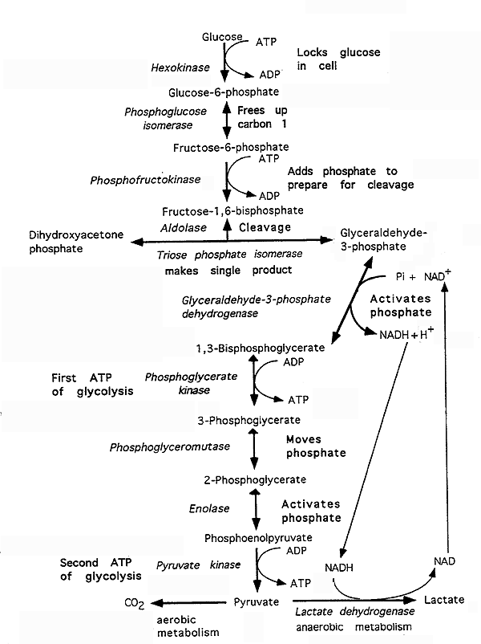
Proteins & Metabolites

Slide 4
Proteins & Phenotype
Functional components of cells
Displays more complexity but offers more
specificity
Interaction with environment reflected in this domain
The most commonly affected domain in disease, response and therapy
Notes:
Of all the molecular domains, the Proteomic domain is most tightly correlated with the expressed phenotype of an organism
Proteins are workhorses of an organism-they are the enzymes that carry out biological catalysis, they help transport chemicals in and out of cells , they help in energy production, and facilitate all important cellular functions for growth and survival.
Regulation of cellular processes requires precisely controlled intermolecular interactions that alter the location and/or activity of effector proteins (Scott and Pawson, 2009), typically driven by protein modules that recognize specific features of proteins.

Slide 5
‘Omic’ Domains’
What Can Happen
Genes/Genome
Genomics
What Appears to Happen
RNA/Transcriptome
Transcriptomics
The study of the expression, quantity, and function of proteins, including their dynamics, interactions, and modifications
What Makes it Happen
Proteins/Proteome
Proteomics
What Has Happened
Metabolites/Metabolome
Metabolomics
Notes:
Anyone who has worked with cell culture will tell you how amazed they are with the intricate regulation of cell function but also surprised at the adaptive capacity of the cell to continue its specialized function as a myocyte, adipocyte in the face of external stimuli and insults. Many of these decisions are made at the non-genome level which is why it is important to integrate information from all levels possible.

Slide 6
Health to Disease Continuum
Insult
Symptoms
Diagnosis
Treatment
Positive Outcome
Adverse Outcome
Clinical Phase
Preclinical Phase
Notes:
Change in underlying physiology predominantly by functional protein changes

Slide 7
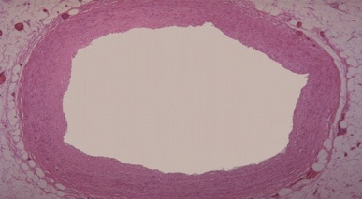
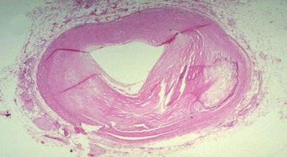
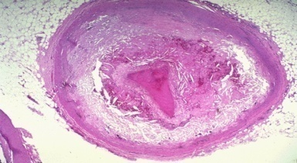
Health to Disease Continuum
Atherosclerosis
Healthy Vessel
Diseased Vessel
Molecular Processes
PROTEOME
Notes:
Change in underlying physiology is predominantly through functional protein changes. Let us take the example of atherosclerosis which is the underlying cause of CHD and stroke that we saw are the leading cause of death worldwide. When an atherosclerotic plaque ruptures and results in the in thrombosis it occludes the host vessel-when this happens in the coronary arteries, it results in a myocardial infarction or heart attack. When this happens in the carotid arteries, it results in stroke and when it occurs in the peripheral arteries such as those found in the leg, it causes peripheral arterial disease. Briefly, the atherosclerotic lesion develops from a fatty streak or lesion through an atheroma to a fibrous plaque to one that either become stable by forming a thick cap or a vulnerable plaque (often due to a thin cap fibrous atheroma) that is prone to rupture.

Slide 8
Protein markers used successfully in clinical cardiology
Troponin
Diagnosis of heart attack
Benefit derived from antithrombotic therapy
Notes:
A rapid assay for B-type natriuretic
peptide (BNP) not only can be used to
diagnose heart failure, it can help the
clinician evaluate effectiveness of
therapy, determine when discharge from
the hospital is appropriate, and estimate
prognosis.

Slide 9
Protein Markers and clinical Utility
Troponin
Diagnosis
NSTEACS
Cardiotoxicity
Myocardial Infarction/Heart Attack
Prognosis
Pharmaco-
therapeutics
Intervention
Adverse Outcomes/Mortality
Tailor Treatment
Notes:
The biggest successes for using protein based markers for patient care and in the clinic, in my mind, can be seen in the CVD arena, especially clinical cardiology. Since the 1990s troponin measurement has been an integral component of the clinical algorithm for the diagnosis of myocardial infarction. The cardiac troponins T and I are integral parts of the heart muscle’s contractile system and following myocardial necrosis are released into the blood stream. They are detectable 4-6 hrs after an MI and generally peak at about 24 h
In Non ST elevation ACS-patients not exhibiting a typical pattern of acute myocardial injury, elevated troponin levels has been shown to be predictive of adverse outcomes especially increased mortality
Further levels are predictive of benefit derived from antithrombotic therapy especially with glycoprotein IIb /IIIa inhibitor-abciximab
A recent analysis of about 19,000 patient data across seven studies (randomized clinical trials) has demonstrated increased intermediate and long term risk of mortality in those individuals demonstrating elevated levels of troponin or troponin 24 h post a coronary artery bypass surgery
Morrow and Cannon as early as 2001 showed that troponin levels can been used to select subsets of NSTEACS patients likely to benefit from early cardiac catheterization. In fact they observed a 40% decrease in death, MI and rehospitalization relative to the group that did not undergo the early intervention.
Recent guidelines from the ACC and AHA recommend routine measurement of tropoonin levels to guide therapy
Even more recently, troponin is starting to be used to screen for cardiotoxic effects of drugs being developed for other diseases especially cancer

Slide 10
Protein Markers
BNP
Diagnosis of congestive heart failure
MPO
Diagnosis of acute coronary syndromes/future risk of coronary artery disease
Notes:
A rapid assay for B-type natriuretic peptide (BNP) not only can be used to diagnose heart failure, it can help the clinician evaluate effectiveness of therapy, determine when discharge from the hospital is appropriate, and estimate
prognosis

Slide 11
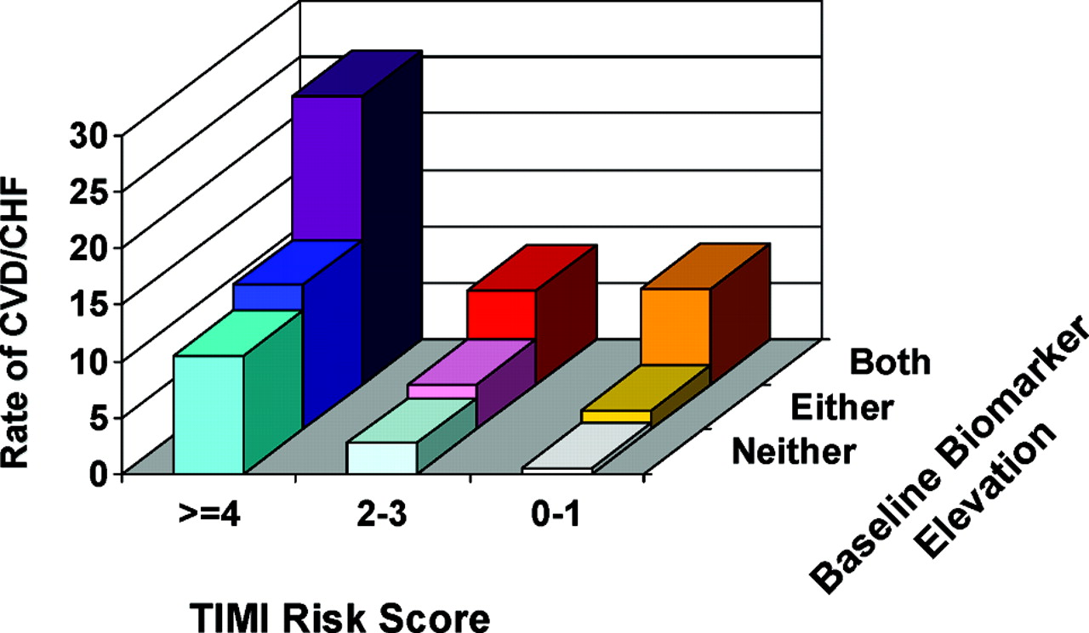
Multimarkers
Protein Markers in CVD
Sabatine, M. S. et al. Circulation 2008;117:1936-1944
Notes:
ST2 complements BNP in predicting adverse cardiovascular outcomes including CHF in STEMI patients-studies by other groups have identified the IL33-ST2 system promotes intramyocardial communication between fibroblasts and cardiomyocytes
TIMI-clinical risk assessment tool for ST elevation MI-DM, Hypertension,systolic blood pressure,heart rate, age,Killip class and time to treatment
Demonstration that in a multimarker panel including TnI, hsCRP, and BNP, the thrombus precursor protein, TpP, predicts increased risk for death, MI or recurrent ischemia (ACS patients)
Demonstration in stable CAD patients that elevated levels of Lp-PLA2 predicts an increased risk of CV death, MI, coronary revascularization, unstable angina, or stroke independent of traditional CV risk factors
Sabatine, M. S. et al. Circulation 2008;117:1936

Slide 12
Prediction
Uppsala Longitudinal Study
Community based cohort of elderly men
Myocardial damage
Left ventricular dysfunction
Renal failure
Inflammation
Better risk prediction than traditional risk factors
Zethelius et al, 2008
Notes:
Increased C-statistic from .688 to .748
1135 participants-mean followup over 10 years

Slide 13
Proteome Proteomics& Phenotype
Diet
Environment
Health
Disease
Functional changes in the Proteome
Quantitative
Concentrations/levels
Qualitative
PTMS
Interactions
Fluxes

Slide 14
Clinical Retrospective Prospective Large
assay longitudinal longitudinal scale
Development validation validation application
Discovery
Phase 1 Phase 2 Phase 3 Phase 4 Phase 5
Analytical Validation
Clinical Validation
Pre-analytical issues
Platform Variability
Reagents
Assays
Define protein heterogeneity
Clinical assay validation
Standard operating Protocols
Define thresholds of normal variation
Differentially modified
Define heterogeneity in different disease states
Adapted from Pepe et al, 2005
Notes:
Heterogeneity and variation of sample collection
Just because a protein is present at different concentration between two conditions or states does not make it a biomarker

Slide 15
Challenges
Blood
Plasma
Wide dynamic range
Magnitude of difference
Top ten proteins make up 90% of the plasma protein concentrations
Reagents
Notes:
Albumin~50%, Globulin~35%, Fibrinogen~4%

Slide 16
Metabolomics
The comprehensive characterization of low molecular weight biochemicals or metabolites
lipids, sugars, and aminoacids

Slide 17
Metabolomics
Metabolites participate in almost all aspects of cellular function
Relfect phenotypes that are the net result of genomic, transcriptomic and proteomic variability
represent one of the most integrated indices of biological status
offer snapshots into the biomolecular space not possible with other approaches

Slide 18
Metabolomics
~20,000 genes
~100,000 transcripts
~1,000,000 proteins
~4,000-6,000 metabolites

Slide 19
Diabetes risk assessment
Nested case control study in the Framingham Offspring Study
210 of ~2,000 participants of a routine exam developed diabetes – 12 year follow-up period
A group of five metabolites predict the risk for diabetes
Obesity
Human observations recapitulated in animal modes
Atherosclerosis
Interaction of gut microbiota with diet to produce pro-atherogenic metabolites
Gerszten et al, 2011; Newgard et al; Hazen et al, 2011
Notes:
Recent studies-many cross sectional in nature, reveal distinct differences in metabolomic profiles after glucose loading-indicating impaired glucose tolerance
Differences between lean and obese individuals
Framingham Offspring study-2
5- 7 fold higher risk in logistic regression models

Slide 20
Normal Physiology
PROTEOME/ METABOLOME
Pathology
Detection
Diagnosis
Therapeutic Intervention
Prognosis
Notes:
Unifying thread that provides understanding at the basic and clinical level to help translate to the population level. It provides understanding, therapuetic or targets for intervention and markers for assessment of status

Slide 21
A successful marker
Easy to measure, reproducible
Provide incremental information/value added
Help guide clinical decision making
Morrow and de Lemos, 2007

Slide 22
Opportunities
Opportunities
Enhance current understanding of cardiovascular disease biology
Causes of heart disease that cannot be explained by known risk factors
Insights into disease mechanisms
Development of novel drug targets
Preventive therapies irrespective of their ability to enhance risk stratification

