Slide 1
Residual Lung Volume and Left Ventricular Mass
Benjamin Smith MD MS
Columbia University Medical Center
USA
September 13 2012

Slide 2
Background
Left ventricular (LV) mass predicts incident cardiovascular events
Per 10% increase in LV mass there is:
14% greater risk of all-cause mortality
18% greater risk of cardiovascular death
40% greater risk of incident heart failure
Levy D, et al. N Engl J Med 1990;322:1561-6.
Haider, et al. J Am Coll Cardiol 1998;32:1454-9.
Bluemke DA, et al. J Am Coll Cardiol 2008;52:2148-55.

Slide 3
Background
LV mass is determined by LV wall stress
LV wall stress∝ LV transmural pressure
P_{outside}
P_{inside}
Fessler and Permutt. The Thorax Part B 1995.

Slide 4
Background
Cardiovascular disease and COPD co-exist
COPD may increase LV wall stress
AIRFLOW OBSTRUCTION
HYPERINFLATION
MORE NEGATIVE INSPIRATORY PLEURAL PRESSURE
↑ LV TRANSMURAL PRESSURE
↑ WALLSTRESS
↑LV MASS

Slide 5
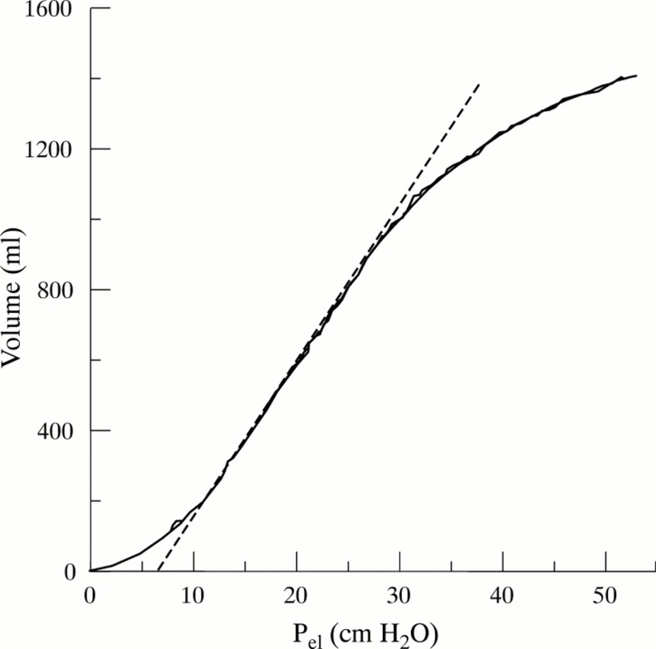
Background
∆P
Hyperinflation
∆P
Lung Volume (mL)
Normal lung volume
- Pleural Pressure (cm H₂O)
Tidal breathing | Controls at rest | COPD at rest | COPD on exercise
Inspiratory ∆ in pleural pressure | -2 mmHg | -4 to -10 mmHg | -13 to -16 mmHg
Potter WA, et al. J Clin Invest 1971;50:910-9.
O'Connell JM, Campbell AH. Thorax 1976;31:669-77.
Montes de Oca M, et al. Am J Respir Crit Care Med 1996;154:1284-9.

Slide 6
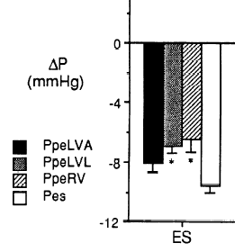
Background
Inspiratory pleural pressures alter juxtacardiac pressures
Mueller Maneuver
Anterior LV
Lateral LV
Right Ventricle
P_{esophageal}
Takata M, et al. J Appl Physiol 1990;68:1640-50

Slide 7
Hypothesis
Hyperinflation, as measured by residual lung volume, is associated with greater LV mass, independent of blood pressure, body size and other traditional cardiac risk factors

Slide 8
Methods
MESA COPD Study at Columbia University
Inclusion: 50-79 yrs, ≥ 10 pack-years
Exclusion: clinical cardiovascular disease, cancer, other chronic lung disease, >300lbs
Participants recruited from a population-based cohort study (Emphysema and Cancer Action Project)
Additional participants with COPD were recruited from the outpatient community

Slide 9
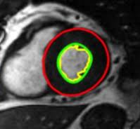
Methods
Outcome variable
Primary: LV mass quantified by cardiac MR
Secondary: LV mass to LV end-diastolic volume ratio
Exposure variable
Residual lung volume

Slide 10
Methods
Co-variates
Model 1
Age, gender, race-ethnicity, level of education attained
Height, weight, body-size indexing term specific to LV mass†
CT emphysema (% lung volume <-950HU) and post-bronchodilator FEV₁
Model 2
Model 1 co-variates +
Smoking status (by serum cotinine), pack-years
Systolic BP (resting, seated, measured 3 times), hypertension
Cholesterol level, lipid lowering med use
Fasting glucose and diabetes status
†: (height^{0.561}*weight^{0.608}) Brumback LC et al. Int J Cardiovasc Imaging 2010;26:459-68.

Slide 11
Methods
Analysis:
Multiple linear regression
Participants were weighted by the inverse ratio of sample prevalence to source study prevalence of COPD

Slide 12
Anthropometrics
Characteristic | Quartiles of Percent Predicted Residual Volume
Residual lung volume No. | 1.33 L N=29 | 1.73 L N=30 | 2.09 L N=30 | 2.89 L N=30
Age – years | 69±5 | 69±6 | 69±8 | 68±6
Male sex – % | 59 | 53 | 50 | 60
Race or ethnic group – %
Caucasian | 66 | 77 | 80 | 77
African American | 17 | 13 | 17 | 23
Other | 17 | 10 | 3 | 0
Height – cm | 169±11 | 168±9 | 167±10 | 169±9
Weight – kg | 77±16 | 79±17 | 75±18 | 76±19
Body-surface area – m² | 1.9±0.2 | 1.9±0.2 | 1.9±0.3 | 1.9±0.3
* Plus-minus values are means ± standard deviation.

Slide 13
Risk factors
Characteristic | Quartiles of Percent Predicted Residual Volume
Residual lung volume No. | 1.33 L N=29 | 1.73 L N=30 | 2.09 L N=30 | 2.89 L N=30
Current smoker – % | 28 | 40 | 33 | 50
Pack-years – median (IQR) | 36 (27) | 32 (26) | 40 (30) | 50 (34)
Systolic blood pressure – mmHg | 119±15 | 119±16 | 126±18 | 123±13
Hypertension – % | 24 | 40 | 57 | 53
Glucose mg/dl – median (IQR) | 96 (19) | 104 (22) | 102 (20) | 98 (17)
Diabetes mellitus – % | 7 | 13 | 20 | 20
Total Cholesterol – mg/dl | 183±36 | 197±45 | 187±41 | 178±37
Lipid lowering med use – % | 52 | 27 | 50 | 37
* Plus-minus values are means ± standard deviation.

Slide 14
Cardiopulmonary measures
Characteristic | Quartiles of Percent Predicted Residual Volume
Residual lung volume No. | 1.33 L N=29 | 1.73 L N=30 | 2.09 L N=30 | 2.89 L N=30
COPD – % | 45 | 53 | 70 | 90
COPD Severity – %
Mild | 31 | 23 | 37 | 7
Moderate | 14 | 30 | 27 | 43
Severe/Very severe | 0 | 0 | 27 | 40
Emphysema
% -950 HU – median (IQR) | 1.2 (2.4) | 1.4 (2.4) | 1.7 (3.9) | 7.7 (16)
LV Mass – grams | 122±29 | 131±39 | 129±34 | 131±35
LV EDV – mL | 121±26 | 116±26 | 114±23 | 112±36
LV Mass : LV EDV ratio | 1.03±0.18 | 1.13±0.26 | 1.13±0.17 | 1.20±0.22
LV Ejection fraction – % | 59±6 | 62±7 | 60±7 | 60±8
* Plus-minus values are means ± standard deviation.

Slide 15
Primary hypothesis
Residual lung volume (1 SD = 0.71 L) | Mean change in grams of LV mass per standard deviation increase In residual lung volume (95% CI) | P Value
Model 1 | 7.2 grams (2.4 to 12 grams) | 0.004
* Model 1 adjusted for age, gender, race or ethnic group, height, weight, body-size indexing term, education level, percent emphysema_{-950 HU} and FEV₁. Model 2 additionally adjusted for smoking status, pack-years, systolic blood pressure, hypertension, fasting plasma glucose level, diabetes, total cholesterol level and lipid lowering medication use.

Slide 16
Primary hypothesis
Residual lung volume (1 SD = 0.71 L) | Mean change in grams of LV mass per standard deviation increase In residual lung volume (95% CI) | P Value
Model 1 | 7.2 grams (2.4 to 12 grams) | 0.004
Model 2 | 6.6 grams (2.3 to 11 grams) | 0.003
* Model 1 adjusted for age, gender, race or ethnic group, height, weight, body-size indexing term, education level, percent emphysema_{-950 HU} and FEV₁. Model 2 additionally adjusted for smoking status, pack-years, systolic blood pressure, hypertension, fasting plasma glucose level, diabetes, total cholesterol level and lipid lowering medication use.
Systolic blood pressure
7.4 grams
<0.001
(1 SD = 16 mmHg)
(4.1 to 11 grams)

Slide 17
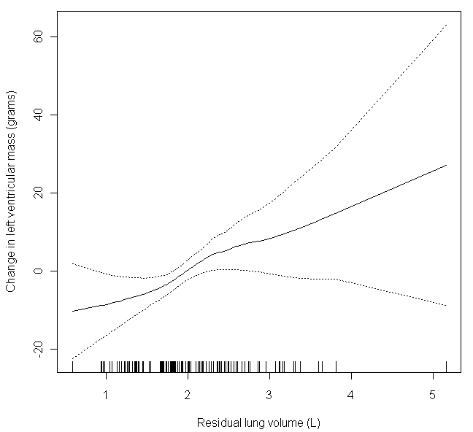
Primary hypothesis
190
P=0.01
170
150
Predicted left ventricular mass (grams)
130
110
Residual lung volume (L)
* GAM model adjusted for age, gender, race or ethnic group, height, weight, body-size indexing term, education level, percent emphysema_{-950 HU}, FEV_{1,} smoking status, pack-years, systolic blood pressure, hypertension, fasting glucose level, diabetes, total cholesterol level and lipid lowering medication use. Test for non-linearity: p=0.23.

Slide 18
Sensitivity analyses
Predicted change in LV mass (grams)
per SD increase in residual volume
* Original model adjusted for age, gender, race or ethnic group, height, weight, body-size indexing term, education level, percent emphysema_{-950 HU}, FEV_{1,} smoking status, pack-years, systolic blood pressure, hypertension, fasting glucose level, diabetes, total cholesterol level and lipid lowering medication use.

Slide 19
Secondary analyses
Residual lung volume (1 SD = 0.71 L) | Mean change in LV mass : LV EDV ratio per standard deviation increase In residual lung volume (95% CI) | P Value
Model 1 | 0.08 (0.02 to 0.15) | 0.02
Model 2 | 0.06 (0.01 to 0.12) | 0.03
* Model 1 adjusted for age, gender, race or ethnic group, height, weight, body-size indexing term, education level, percent emphysema_{-950 HU} and FEV₁. Model 2 additionally adjusted for smoking status, pack-years, systolic blood pressure, hypertension, fasting plasma glucose level, diabetes, total cholesterol level and lipid lowering medication use.

Slide 20
Limitations
Cross-sectional design
Residual confounding
Underlying mechanism not assessed
HYPERINFLATION
↑LV MASS

Slide 21
Hypothesis
Hyperinflation, as measured by residual lung volume, is associated with greater inspiratory changes in intra-thoracic pressure

Slide 22
Methods
Consecutive patients undergoing cardiac catheterization and lung volume measurement at CUMC (2009-2011)
Inclusion: >45 yrs
Exclusion:
Prior CABG, heart/lung transplant, lobectomy
LV EF < 50%, valve disease, congenital heart disease
Acute MI, arrhythmia, PCI or mechanical ventilation

Slide 23
Methods
Pressure-time waveforms stored digitally (GE Hemodynamic recording system)
LV pressure
Pulmonary artery occlusion (PAO) pressure
Aortic root pressure

Slide 24
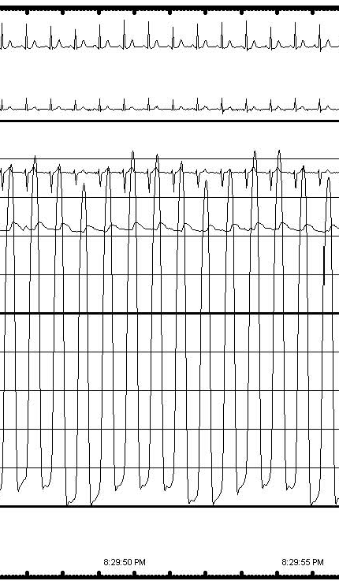
Methods
Pressure-time waveform analysis:
Inspiratory pressure change:
P_{expiration} – P_{inspiration}
= 10 mmHg
200
Exp.
Exp.
Insp.
Insp.
LV pressure waveform (mmHg)
100
Coefficient of variation:
LV: 5.6%
PAO: 7.6%
Aortic root: 7.7%
0
Time (s)
Notes:
RR 17
HR 80

Slide 25
Methods
Outcome variable
Primary: Inspiratory change in LV diastolic pressure
Secondary: Inspiratory change in PAO and aortic root pressures
Exposure variable
Residual lung volume

Slide 26
Methods
Analysis:
GEE for repeated measures
Robust standard errors
Co-variates:
Age, gender, height, weight, body-surface area

Slide 27
Results
N=72 | With acceptable waveforms†
Age – years | 61±9
Male sex - no. (%) | 32 (44)
Height – cm | 167±15
Weight – kg | 76±21
Body-surface area – m² | 1.8±0.3
COPD – no. (%) | 60 (83)
Residual lung volume – L | 2.6±1.4
†Unacceptable waveforms (n=3): arrhythmia (2) and less than 2 breaths on waveform (1).

Slide 28
Results
N=72 | With acceptable waveforms
Indication for catheterization – no. (%)
Pre lung transplant evaluation | 37 (51)
Abnormal stress test / dyspnea evaluation | 19 (26)
Pre operative evaluation | 8 (11)
Pulmonary hypertension evaluation | 8 (11)
Aortic root catheterization: | N=42
Aortic root systolic pressure – mmHg | 123±25
Aortic root diastolic pressure – mmHg | 74±12
Pulmonary artery catheterization: | N=60
PAO pressure – mmHg | 10±5.0
LV catheterization: | N=32
LV diastolic pressure – mmHg | 3.0±4.5
* Plus-minus values are means ± standard deviation.

Slide 29
Results
 | Mean change in the magnitude of inspiratory pressure variation (mmHg) per standard deviation increase in residual volume (95% CI)
 | LV diastolic pressure N=32
Residual volume | 2.1 (0.9 to 3.4) P=0.001
* Predicted mean changes in all models adjusted for age, gender, height, weight and body surface area and lung volume indicated.

Slide 30
Results
 | Mean change in the magnitude of inspiratory pressure variation (mmHg) per standard deviation increase in residual volume (95% CI)
 | LV diastolic pressure N=32 | PAO pressure N=60 | Aortic root systolic pressure N=42 | Aortic root diastolic pressure N=42
Residual volume | 2.1 (0.9 to 3.4) P=0.001 | 2.1 (0.8 to 3.5) P=0.002 | 3.6 (1.7 to 5.5) P<0.001 | 1.5 (0.9 to 2.2) P<0.001
* Predicted mean changes in all models adjusted for age, gender, height, weight and body surface area and lung volume indicated.

Slide 31
Limitations
Cross-sectional design
Not population-based
Emphysema not assessed
Effect of exercise not assessed

Slide 32
Summary
In a population with predominantly mild-to-moderate COPD, higher residual volume was independently associated with greater LV mass
The magnitude of association was similar to that of systolic blood pressure
Residual volume is also associated with greater inspiratory change in intrathoracic pressure

Slide 33
Implications
Hyperinflation, as measured by residual volume, may represent:
a novel risk factor for cardiovascular disease
an unmeasured form of ‘hypertension’
a novel therapeutic target for cardiovascular disease

Slide 34
Acknowledgements
Columbia University:
R. Graham Barr (PI)
Robert C Basner
Daniel Rabinowitz
Steven Shea
Martin R Prince
LeRoy Rabbani
Daichi Shimbo
National Institutes of Health:
David A Bluemke
University of California Los Angeles:
Antoinette S Gomes
University of Iowa:
Eric Hoffman
University of Pennsylvania:
Steven Kawut
Northwestern University:
Ravi Kalhan
Johns Hopkins University:
João A Lima
Chia-Ying Liu
Erin D Michos
Funding:
NIH/NHLBI R01-HL093081
R01-HL077612
R01-HL075476
N01-HC95159-HC95169
Fonds de la recherche en santé Québec

Slide 35
References
Murphy SL, et al. National Center for Health Statistics; 2012 April 2, 2012.
Levy D, et al. N Engl J Med 1990;322:1561-6.
Bluemke DA, et al. J Am Coll Cardiol 2008;52:2148-55.
Oparil S. J Am Coll Cardiol 1985;5:57B-65B.
Rutten FH, et al. Eur Heart J 2005;26:1887-94.
Curkendall SM, et al. Ann Epidemiol 2006;16:63-70.
Leith DE, et al. Eur Respir J 1999;13:468-72.
Brumback LC et al. Int J Cardiovasc Imaging 2010;26:459-68.
Fessler and Permutt. The Thorax Part B 1995.

Slide 36
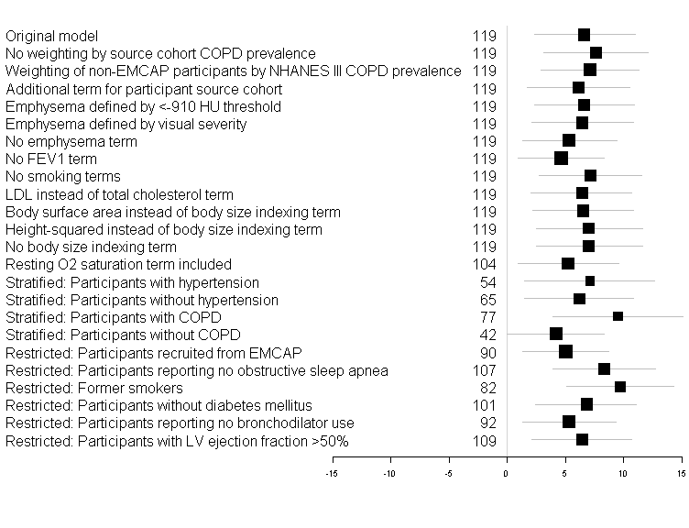
Additional Sensitivity Analyses
n
Predicted mean change in left ventricular mass (grams)
per standard deviation change in residual lung volume

Slide 37
Standard errors
Standard errors were computed by first summing empirical estimates of the covariance matrices of COPD-stratum specific contributions to the gradient of the weighted sum of squares, and pre- and post- multiplying by the matrices of mixed partial derivatives of the gradient weighted sum of squares evaluated at the weighted least squares solutions (analogous to generalized estimated equation estimator)

Slide 38
Methods
Outcome variable
Primary: LV mass quantified by cardiac MR
Secondary: LV mass to LV end-diastolic volume ratio
Exposure variable
Primary: Residual lung volume
Secondary:
Residual volume to total lung capacity ratio (RV/TLC)
Functional residual capacity (FRC)
Total lung capacity (TLC)

Slide 39
Other lung volumes
Hyperinflation Metric | Mean change in grams of LV mass per standard deviation increase In hyperinflation metric (95% CI) | P Value
RV/TLC | 5.0 grams (1.1 to 8.8 grams) | 0.01
Functional residual capacity | 2.6 grams (-3.0 to 8.1 grams) | 0.36
Total lung capacity | 5.3 grams (-1.6 to 12 grams) | 0.13
* Results presented use model 2 co-variates. Predicted mean changes adjusted for age, gender, race or ethnic group, height, weight, body-size indexing term, education level attained, percent emphysema_{-950 HU}, FEV₁ smoking status (current versus former), pack-years of smoking history, systolic blood pressure, hypertension, fasting plasma glucose level, diabetes, total cholesterol level and lipid lowering medication use. Predicted mean change, along with 95% CI for the linear term of the variable specified were estimated using regression models. Abbreviations: LV denotes left ventricle, CI confidence interval, HU Hounsfield units, and FEV₁ forced expired volume in the first second.
Notes:
Mention FRC, TLC in secondary analyses.

Slide 40
Other lung volumes
 | Mean change in the magnitude of inspiratory pressure variation (mmHg) per standard deviation increase in variable indicated (95% CI)
 | LV diastolic pressure N=32 | PAO pressure N=60 | Aortic root systolic pressure N=42 | Aortic root diastolic pressure N=42
Residual volume | 2.1 (0.9 to 3.4) | 2.1 (0.8 to 3.5) | 3.6 (1.7 to 5.5) | 1.5 (0.9 to 2.2)
Residual volume to TLC ratio | 2.1 (0.7 to 3.5) | 2.6 (1.5 to 3.6) | 2.7 (0.8 to 4.5) | 1.0 (0.3 to 1.7)
* Predicted mean changes in all models adjusted for age, gender, height, weight and body surface area and lung volume indicated.

