Slide 1
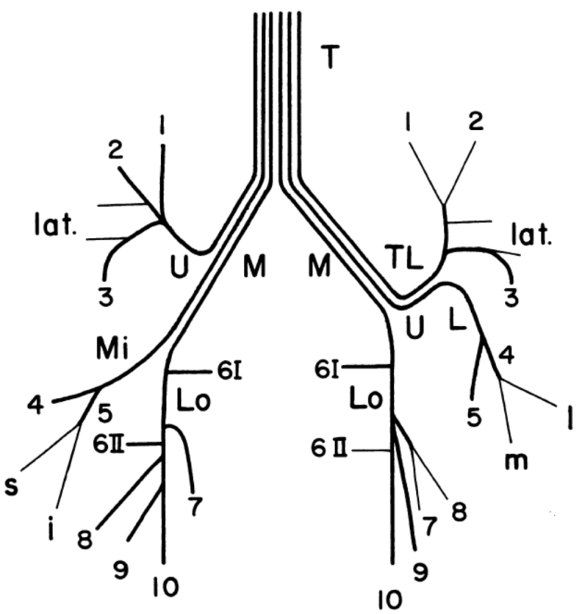
Common Airway Variants, COPD and Asthma in a Multi-Ethnic Sample: the MESA Lung Study
Benjamin Smith MD MS
Columbia University
Dezso Kassay. Diseases of the Chest. 1961

Slide 2
Background
Chronic obstructive pulmonary disease (COPD):
A leading cause of death in US and globally
Defined by irreversible airflow limitation
Caused largely by inhaled particulate matter
Asthma:
Affects 300 million globally
Defined by intermittent airflow limitation
Reversible with anti-inflammatory therapy

Slide 3
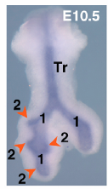
Repapi E, et al. Nat Gen 2010:1(42).
Hedgehog interacting protein:
SNP associated with 0.5% change in lung function
Retinoic acid receptor B:
SNP associated with 0.4% change in lung function
Artigas MS, et al. Nat Gen 2010:1(42).
Cardosa WV. Regulation of early lung morphogensis. Development 2006:133.
Notes:
1. SpiroMeta and CHARGE consortia, and Health 2000 Survey (20K, 32K, and 800 participants).
2. 23 studies (48K), follow up in 16 studies (46K)
All European ancestry.
HHIP, RARB both implicated in branching morphogenesis.

Slide 4
Background
The tracheobronchial tree is a conduit for gas exchange and a filter of particulate matter
The 3-D structure of the tracheobronchial tree determines airflow resistance and influences the pattern particle deposition

Slide 5
Human Tracheobronchial Anatomy:
Lungs: 2
3
4
Lobes: 5
Segments: “18”
2
5
4

Slide 6
Background
Lower lobe segmental variants are common:
Accessory right subsuperior bronchus: 28-62%
Accessory left subsuperior bronchus: 27-30%
Accessory left medial basal segment: 7-14%
Absence of right medial basal segment: 8-14%
The relationship between common variants of the lower lobe anatomy and disorders of airflow limitation is unknown
Boyden (USA) 1949 N=60 autopsy specimens
Yamashita (Japan) 1972 N=180 autopsy specimens

Slide 7
Objectives
1. Determine relationship between variant lower lobe anatomy and COPD
2. Determine relationship between variant lower lobe anatomy and asthma

Slide 8
Methods
Nested case-controls within MESA Lung E5:
Objective 1: COPD vs controls
Inclusion:
MESA Lung exam 5 participants
≥10 pack-years of smoking
Exclusion:
Self-reported asthma onset before 45 years old
Cases: All COPD cases
Defined by post-bronchodilator spirometry (FEV₁/FVC<0.7)
Controls: No COPD
2 for each case (unmatched)

Slide 9
Methods
Nested case-controls within MESA Lung E5:
Objective 2: Asthma vs controls
Inclusion:
MESA Lung exam 5 participants
<10 pack-years of smoking
Exclusion:
Self-reported COPD or emphysema
Cases: All asthma cases
Defined by self-reported asthma onset before age 45 years
Controls: No asthma
2 for each case (matched: age, gender, race, smoking status)

Slide 10
Methods
Nested case-controls within MESA Lung E5:
Objective 1: COPD vs controls
Inclusion:
MESA participant
≥10 pack-years of smoking
Exclusion:
Self-reported asthma onset before age 45 years
Cases: All COPD cases
defined by post-bronchodilator spirometry
Controls: No COPD
2 for each case (unmatched)
Objective 2: Asthma vs controls
Inclusion:
MESA participant
<10 pack-years of smoking
Exclusion:
Self-reported COPD or emphysema
Cases: All asthma cases
Self-reported onset before 45 years old
Controls: No asthma
2 for each case (matched on age, gender, race-ethnicity and smoking status)

Slide 11
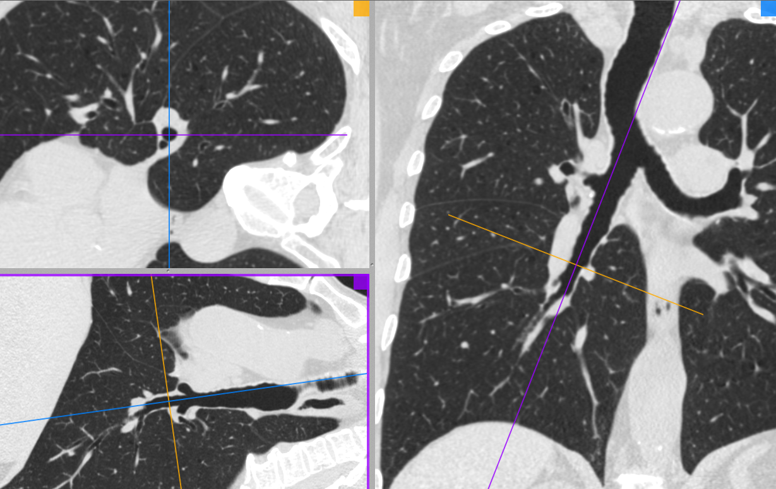
Methods
Lower lobe anatomy mapping:
Visual mapping:

Slide 12
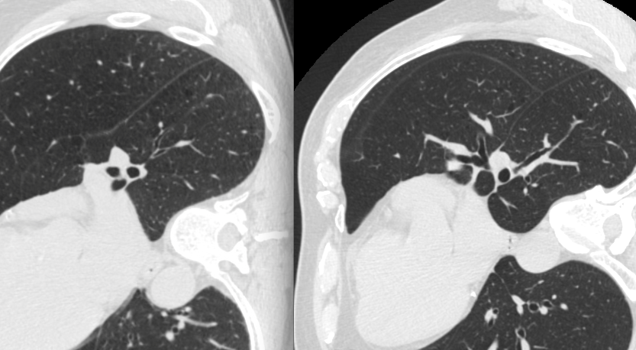
Methods
Lower lobe anatomy mapping:
Visual mapping:
Participant A
Participant B

Slide 13
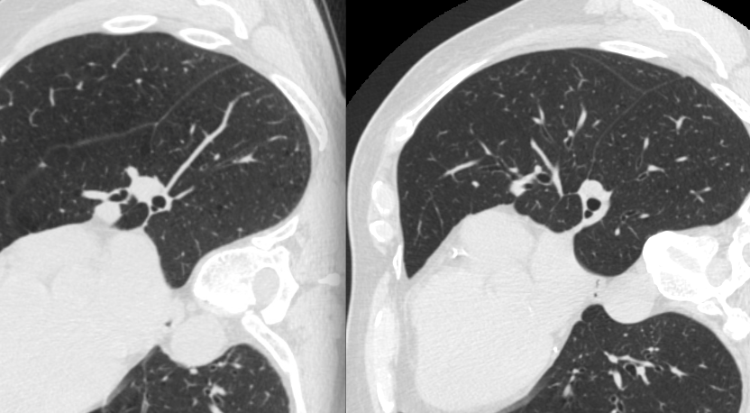
Methods
Lower lobe anatomy mapping:
Visual mapping:
Participant A
Participant B

Slide 14
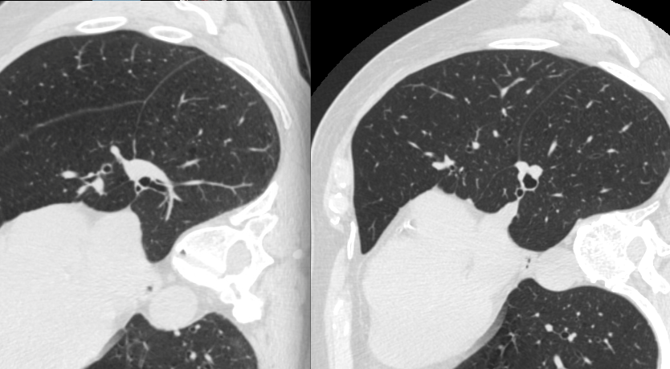
Methods
Lower lobe anatomy mapping:
Visual mapping:
Participant A
Participant B

Slide 15
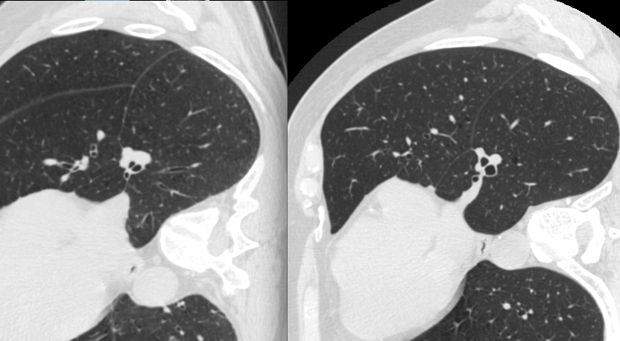
Methods
Lower lobe anatomy mapping:
Visual mapping:
Participant A
Participant B

Slide 16
Methods
Analysis:
Lower lobe segmental anatomy classification:
Normal anatomy:
9 segments
Variant anatomy:
Any variant
8 segments, 10 segments, 11 segments, 12 segments
Prevalence ratio for COPD by variant anatomy status
Prevalence ratio for asthma by variant anatomy status
Adjusted for age, gender, height, weight, race-ethnicity and smoking status

Slide 17
Results: COPD vs Controls
 | COPD N=133 | No COPD N=266
Age – year | 72±8 | 68±8
Male – % | 68 | 62
Race-ethnicity – %
Caucasian | 53 | 40
African American | 29 | 29
Hispanic | 12 | 21
Asian | 5 | 9
Height – cm | 170±9 | 168±10
Weight – kg | 82±18 | 83±17
Current smoker – % | 14 | 11
Pack-years | 42±27 | 29±20
Excessive motion artifact – n | 3 | 2

Slide 18
Results: COPD vs Controls
Lower Lobe Segmental Anatomy | Prevalence by COPD status |  | Prevalence ratio for COPD
 | COPD N=130 | No COPD N=264 | Unadjusted (95% CI) | Model 1 (95% CI) | Model 1 + race-ethnicity (95% CI)
Normal anatomy:
9 segments | 51% | 64% | Reference | Reference | Reference
Variant anatomy:
Any variant | 49% | 36% | 1.43 (1.08 to 1.89) | 1.41 (1.09 to 1.83) | 1.34 (1.03 to 1.73)
8 segments | 8.5% | 3.4% | 1.96 (1.25 to 3.06) | 1.99 (1.34 to 2.93) | 1.81 (1.19 to 2.74)
10 segments | 34% | 23% | 1.49 (1.07 to 2.07) | 1.48 (1.12 to 1.96) | 1.39 (1.05 to 1.85)
11 segments | 6.2% | 8.7% | 0.71 (0.32 to 1.54) | 0.98 (0.55 to 1.76) | 0.96 (0.54 to 1.69)
12 segments | 0.8% | 1.1% | 0.68 (0.07 to 6.44) | 0.70 (0.12 to 3.98) | 0.66 (0.13 to 3.38)
Model 1 adjusted for age, gender, height, weight, and smoking status.

Slide 19
Results: COPD vs Controls
Lower Lobe Segmental Anatomy | Prevalence by COPD status |  | Prevalence ratio for COPD
 | COPD N=130 | No COPD N=264 | Unadjusted (95% CI) | Model 1 (95% CI) | Model 1 + race-ethnicity (95% CI)
Normal anatomy:
9 segments | 51% | 64% | Reference | Reference | Reference
Variant anatomy:
Any variant | 49% | 36% | 1.43 (1.08 to 1.89) | 1.41 (1.09 to 1.83) | 1.34 (1.03 to 1.73)
8 segments | 8.5% | 3.4% | 1.96 (1.25 to 3.06) | 1.99 (1.34 to 2.93) | 1.81 (1.19 to 2.74)
10 segments | 34% | 23% | 1.49 (1.07 to 2.07) | 1.48 (1.12 to 1.96) | 1.39 (1.05 to 1.85)
11 segments | 6.2% | 8.7% | 0.71 (0.32 to 1.54) | 0.98 (0.55 to 1.76) | 0.96 (0.54 to 1.69)
12 segments | 0.8% | 1.1% | 0.68 (0.07 to 6.44) | 0.70 (0.12 to 3.98) | 0.66 (0.13 to 3.38)
Model 1 adjusted for age, gender, height, weight, and smoking status.

Slide 20
Results: COPD vs Controls
Lower Lobe Segmental Anatomy | Prevalence by COPD status |  | Prevalence ratio for COPD
 | COPD N=130 | No COPD N=264 | Unadjusted (95% CI) | Model 1 (95% CI) | Model 1 + race-ethnicity (95% CI)
Normal anatomy:
9 segments | 51% | 64% | Reference | Reference | Reference
Variant anatomy:
Any variant | 49% | 36% | 1.43 (1.08 to 1.89) | 1.41 (1.09 to 1.83) | 1.34 (1.03 to 1.73)
8 segments | 8.5% | 3.4% | 1.96 (1.25 to 3.06) | 1.99 (1.34 to 2.93) | 1.81 (1.19 to 2.74)
10 segments | 34% | 23% | 1.49 (1.07 to 2.07) | 1.48 (1.12 to 1.96) | 1.39 (1.05 to 1.85)
11 segments | 6.2% | 8.7% | 0.71 (0.32 to 1.54) | 0.98 (0.55 to 1.76) | 0.96 (0.54 to 1.69)
12 segments | 0.8% | 1.1% | 0.68 (0.07 to 6.44) | 0.70 (0.12 to 3.98) | 0.66 (0.13 to 3.38)
Model 1 adjusted for age, gender, height, weight, and smoking status.

Slide 21
Results: COPD vs Controls
Lower Lobe Segmental Anatomy | Prevalence by COPD status |  | Prevalence ratio for COPD
 | COPD N=130 | No COPD N=264 | Unadjusted (95% CI) | Model 1 (95% CI) | Model 1 + race-ethnicity (95% CI)
Normal anatomy:
9 segments | 51% | 64% | Reference | Reference | Reference
Variant anatomy:
Any variant | 49% | 36% | 1.43 (1.08 to 1.89) | 1.41 (1.09 to 1.83) | 1.34 (1.03 to 1.73)
8 segments | 8.5% | 3.4% | 1.96 (1.25 to 3.06) | 1.99 (1.34 to 2.93) | 1.81 (1.19 to 2.74)
10 segments | 34% | 23% | 1.49 (1.07 to 2.07) | 1.48 (1.12 to 1.96) | 1.39 (1.05 to 1.85)
11 segments | 6.2% | 8.7% | 0.71 (0.32 to 1.54) | 0.98 (0.55 to 1.76) | 0.96 (0.54 to 1.69)
12 segments | 0.8% | 1.1% | 0.68 (0.07 to 6.44) | 0.70 (0.12 to 3.98) | 0.66 (0.13 to 3.38)
Model 1 adjusted for age, gender, height, weight, and smoking status.

Slide 22
Results: Variant Anatomy by COPD Severity
*
*
:χ² p<0.05
*
Prevalence (%)
*
Any
Lower Lobe
Variant
8
Segment
Variant
10
Segment
Variant
11
Segment
Variant
12
Segment
Variant

Slide 23
Results: Variant Anatomy by Race-Ethnicity
*
*
:χ² p<0.05
Prevalence (%)
Any
Lower Lobe
Variant
8
Segment
Variant
10
Segment
Variant
11
Segment
Variant
12
Segment
Variant

Slide 24
Results: Asthma vs Controls
 | Asthma N=108 | No Asthma N=216
Age – year | 66±8 | 66±8
Male – % | 33 | 33
Race-ethnicity – %
Caucasian | 32 | 32
African American | 31 | 31
Hispanic | 29 | 29
Asian | 9 | 9
Height – cm | 164±9 | 163±9
Weight – kg | 81±18 | 77±15
Former smoker – % | 33 | 33
Pack-years | 1.0±2.5 | 0.8±2.2
Excessive motion artifact – n | 1 | 1

Slide 25
Results: Asthma vs Controls
Lower Lobe Segmental Anatomy | Prevalence by Asthma status |  | Prevalence ratio for Asthma
 | Asthma N=106 | No Asthma N=215 | Unadjusted (95% CI) | Model 1 (95% CI) | Model 1 + race-ethnicity (95% CI)
Normal anatomy:
9 segments | 59% | 56% | Reference | Reference | Reference
Variant anatomy:
Any variant | 41% | 44% | 0.91 (0.66 to 1.24) | 0.85 (0.62 to 1.16) | 0.84 (0.62 to 1.15)
8 segments | 3.8% | 5.1% | 0.79 (0.33 to 1.88) | 0.85 (0.37 to 1.94) | 0.78 (0.32 to 1.88)
10 segments | 29% | 31% | 0.94 (0.66 to 1.34) | 0.87 (0.61 to 1.23) | 0.87 (0.62 to 1.23)
11 segments | 7.6% | 6.1% | 1.13 (0.63 to 2.02) | 1.06 (0.60 to 1.87) | 1.10 (0.64 to 1.91)
Model 1 adjusted for age, gender, height, weight, and smoking status.

Slide 26
Results: Asthma vs Controls
Lower Lobe Segmental Anatomy | Prevalence by Asthma status |  | Prevalence ratio for Asthma
 | Asthma N=106 | No Asthma N=215 | Unadjusted (95% CI) | Model 1 (95% CI) | Model 1 + race-ethnicity (95% CI)
Normal anatomy:
9 segments | 59% | 56% | Reference | Reference | Reference
Variant anatomy:
Any variant | 41% | 44% | 0.91 (0.66 to 1.24) | 0.85 (0.62 to 1.16) | 0.84 (0.62 to 1.15)
8 segments | 3.8% | 5.1% | 0.79 (0.33 to 1.88) | 0.85 (0.37 to 1.94) | 0.78 (0.32 to 1.88)
10 segments | 29% | 31% | 0.94 (0.66 to 1.34) | 0.87 (0.61 to 1.23) | 0.87 (0.62 to 1.23)
11 segments | 7.6% | 6.1% | 1.13 (0.63 to 2.02) | 1.06 (0.60 to 1.87) | 1.10 (0.64 to 1.91)
Model 1 adjusted for age, gender, height, weight, and smoking status.

Slide 27
Results: Variant Anatomy by COPD Severity
*
:χ² p<0.05
Prevalence (%)
Any
Lower Lobe
Variant
8
Segment
Variant
10
Segment
Variant
11
Segment
Variant

Slide 28
Summary
The prevalence ratio for COPD is significantly higher with common variants of lower lobe segmental anatomy
The prevalence ratio for asthma is not associated with these variants
Variant lower lobe segmental anatomy differs by race-ethnicity

Slide 29
Interpretation
The association between COPD and common lower lobe variants may be due to anatomy-environment interactions (e.g., particulate matter deposition)
Race-ethnic differences in COPD prevalence may be related in part to variant lower lobe anatomy

Slide 30
Limitations
Cross-sectional analysis
Modest number of cases
Asthma defined by self-report
Anatomy assessment “unblinded”

Slide 31
Future directions
Determine if anatomic variants are associated with developmental gene variants
Determine particle deposition behavior with computational or fabricated 3D models of variant anatomy
Determine if segmental anatomy varies over the lifespan

Slide 32
Thanks / Questions
R. Graham Barr
Eric A. Hoffman
Matt Budoff
Karen Hansen
Karen Hinckley Stukovsky
Dan Rabinowitz
MESA Collaborators
NIH/NHLBI: N01-HC-95159 through N01-HC-95165 and N01-HC-95169 and grants R01 HL-077612, R01 HL-075476 and RC1-HL100543

Slide 33
Results: COPD (<10 pack-years) vs Controls
 | COPD N=96 | No COPD N=192
Age – year | 72±10 | 66±9
Male – % | 56 | 46
Race-ethnicity – %
Caucasian | 44 | 16
African American | 23 | 20
Hispanic | 10 | 44
Asian | 23 | 20
Height – cm | 167±10 | 164±9
Weight – kg | 76±17 | 75±16
Former smoker – % | 31 | 23
Pack-years | 0.8±2.2 | 0.4±1.6
Excessive motion artifact – n | 0 | 2

Slide 34
Results: COPD (<10 pack-years) vs Controls
Lower Lobe Segmental Anatomy | Prevalence by COPD status |  | Prevalence ratio for COPD
 | COPD N=106 | No COPD N=215 | Unadjusted (95% CI)
Normal anatomy:
9 segments | 57% | 58% | Reference
Variant anatomy:
Any variant | 43% | 42% | 1.02 (0.73 to 1.43)
Model 1 adjusted for age, gender, height, weight, and smoking status.

