Slide 1
MESA Repository Report
March, 2011

Slide 2
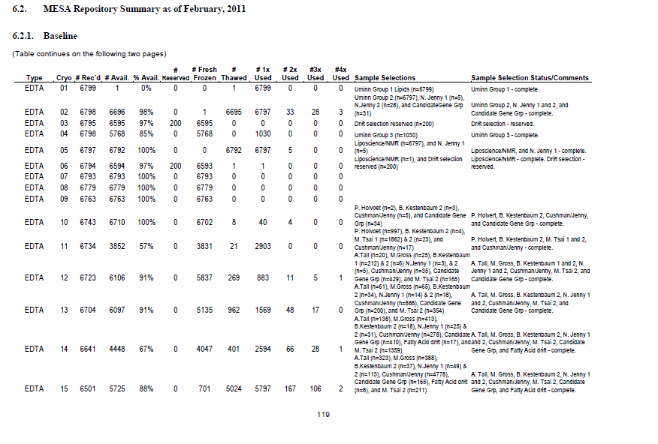
The MESA Repository Report
Example of a page from the Steering Committee Report, first section: details of sample utilization

Slide 3
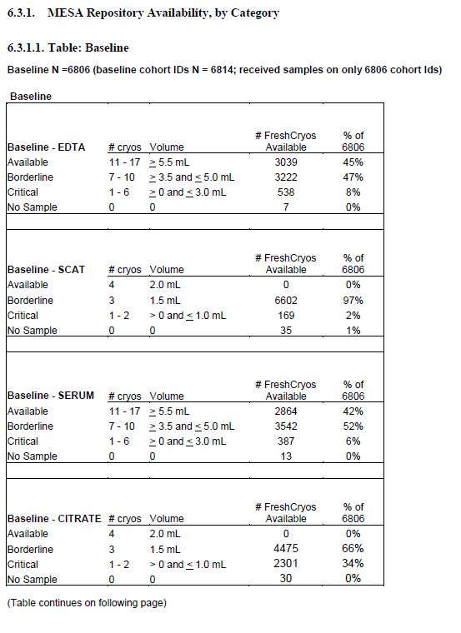
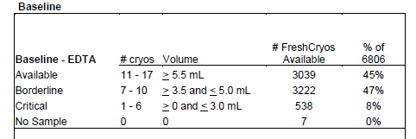
The MESA Repository Report
Example of a page from the Steering Committee Report, second section: details of sample availability

Slide 4
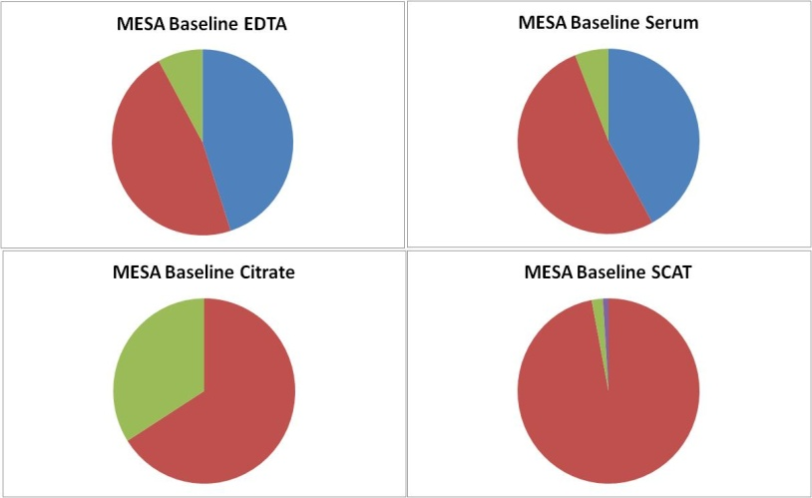
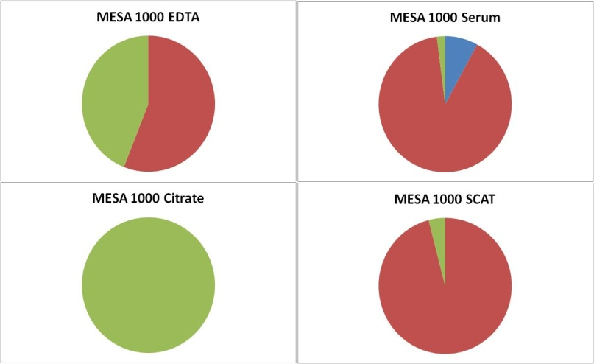
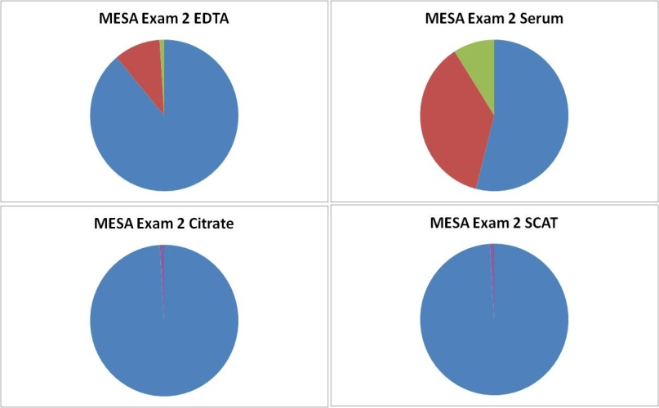
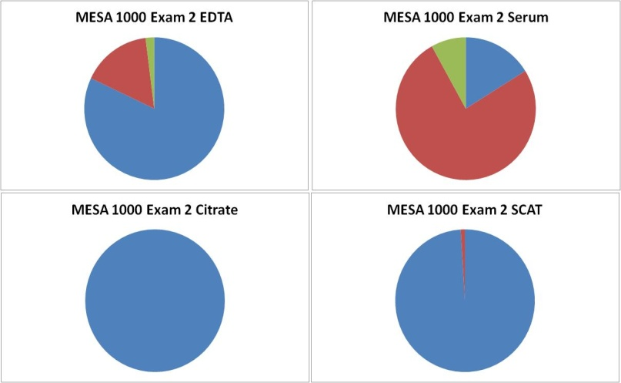
Sample Availability Dashboard
Available (definition = # Cryovials: EDTA & Serum, 11-17; Citrate & SCAT, 4 )
Borderline (definition = # Cryovials: EDTA & Serum, 7-10; Citrate & SCAT, 3 )
Critical (definition = # Cryovials: EDTA & Serum, 1-6; Citrate & SCAT, 1-2 )
None

