Slide 1

MINERAL METABOLISM
AND CARDIOVASCULAR HEALTH
Bryan Kestenbaum, MD MS
Ian H. de Boer, MD MS
Associate Professors
Division of Nephrology
Kidney Research Institute
University of Washington, Seattle

Slide 2
RATIONALE FOR STUDYING VITAMIN D IN MESA
Deficiency is common in the western world
Complex metabolism varies by race/ethnicity
Biologic links with metabolic disorders
Epidemiologic links with chronic diseases

Slide 3
VITAMIN D DEFICIENCY IS COMMON AND VARIES BY RACE
12-20 ng/ml
<12 ng/ml
25-OHD <20 ng/ml ”deficient” by current definitions
NHANES 2004

Slide 4
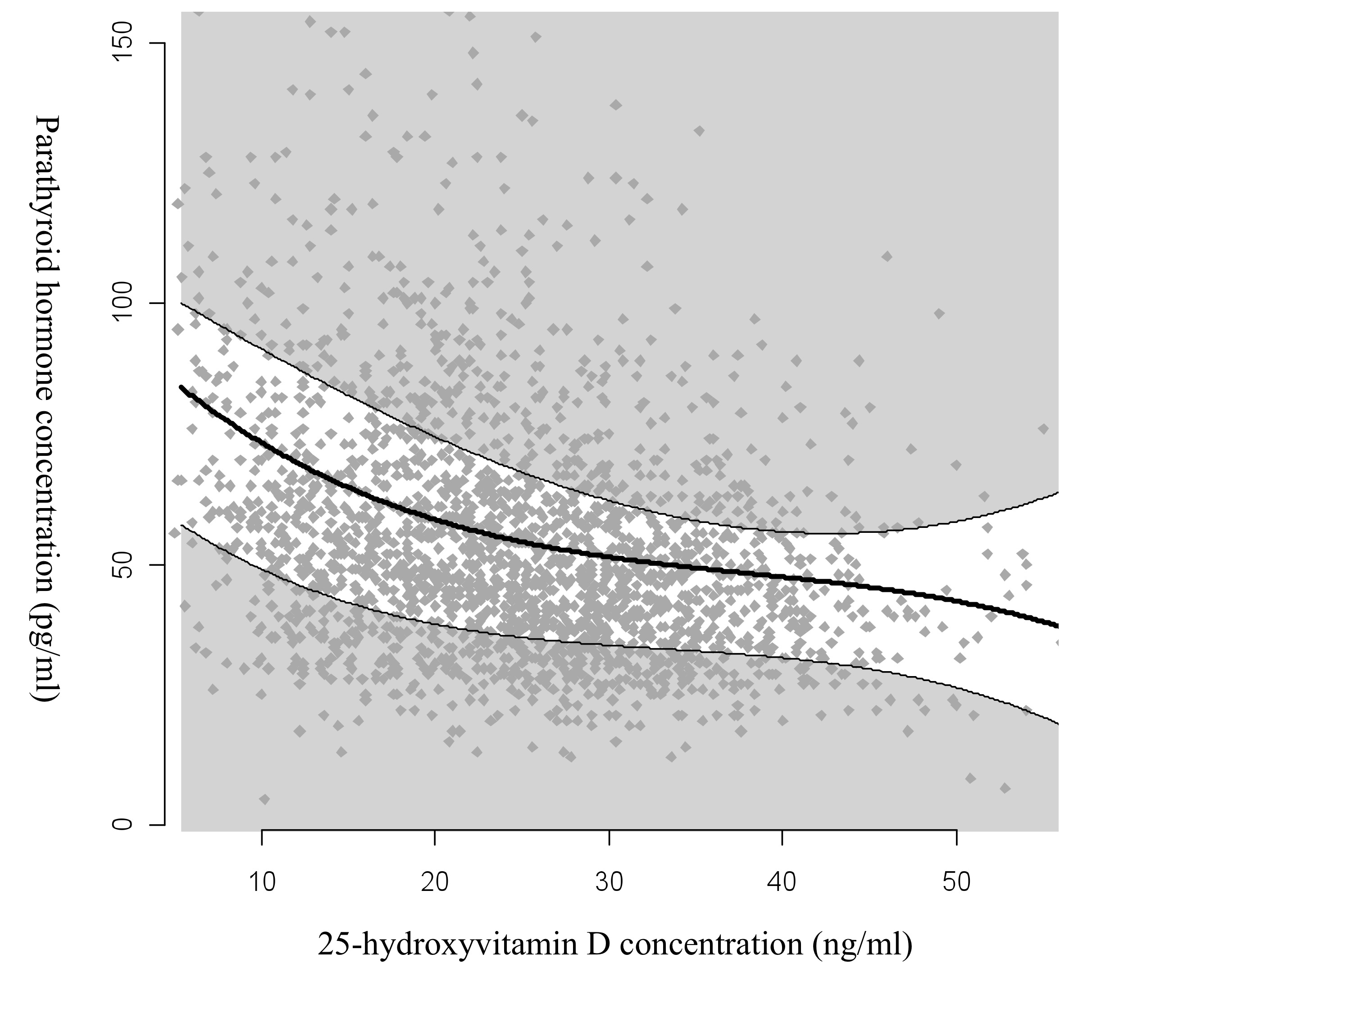
DEFINING “FUNTIONAL” VITAMIN D DEFICIENCY
Cardiovascular
Health Study
N=2,312
PTH (pg/mL)
25-hydroxyvitamin D (ng/mL)

Slide 5

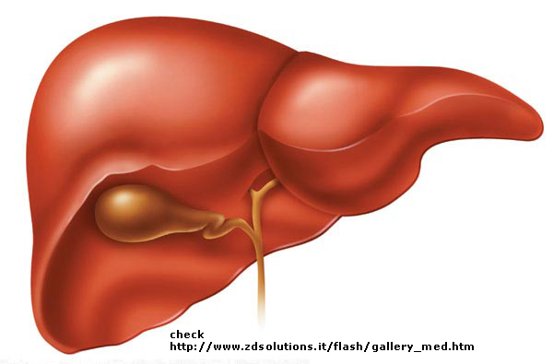
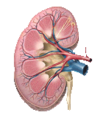
VITAMIN D METABOLISM IS COMPLEX
7-dehydro-
cholesterol
VITAMIN D3
Cholecalciferol
25-HYDROXYVITAMIN D
Supplements
1,25-DIHYDROXYVITAMIN D
VDR
24,25-DIHYDROXYVITAMIN D
metabolite
Vitamin D receptor

Slide 6
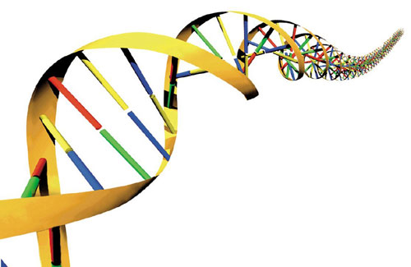
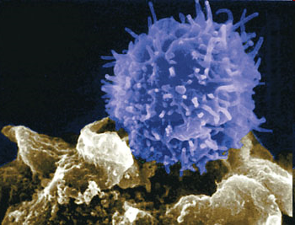
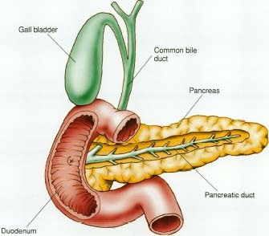
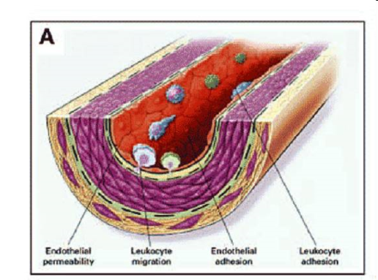
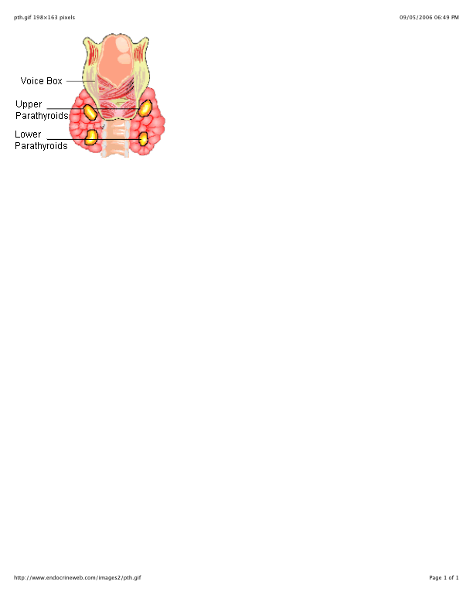
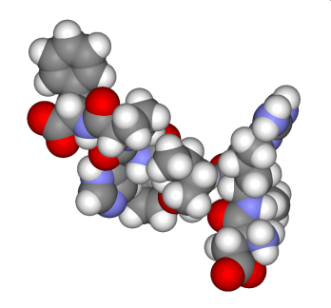
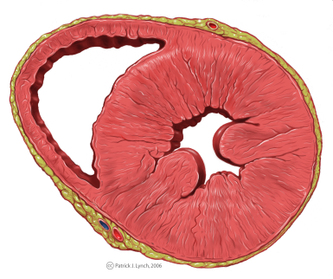
VITAMIN D AFFECTS MUTIPLE TARGET TISSUES
VDR
Vitamin D receptor
VRE
Vitamin D response element
Immune
Glucose
VSMC
Parathyroid
⁭ RAAS
Myocytes

Slide 7
INCIDENT EVENTS IN CARDIOVASCULAR HEALTH STUDY
1,662 CHS participants free of CVD, cancer, and fracture at baseline
 |  | ADJUSTED HR¹ | ADJUSTED HR²
 | EVENTS | 95% CI | 95% CI
MI | 230 | 1.52 (1.10, 2.09) | 1.34 (0.95, 1.89)
CANCER | 372 | 1.26 (0.97, 1.63) | 1.15 (0.88, 1.50)
HIP FRACTURE | 196 | 1.29 (0.93, 1.79) | 1.27 (0.90, 1.79)
DEATH | 847 | 1.36 (1.16, 1.60) | 1.25 (1.06, 1.47)
COMPOSITE | 808 | 1.29 (1.11, 1.51) | 1.18 (1.01, 1.38)
¹ Adjusted for age, sex, and clinic site
² Adds smoking, alcohol, BMI, physical activity, diabetes, hypertension, and eGFR
Low 25-OHD: <14 ng/ml winter; <18 ng/ml spring-fall; <22 ng/ml summer

Slide 8
RATIONALE FOR STUDYING PHOSPHORUS IN MESA
PO₄ homeostasis: balance between intake and excretion
Dietary phosphorus consumption increasing
Kidney function declining (older age)
Altered PO4 balance associated with cardiovascular disease

Slide 9


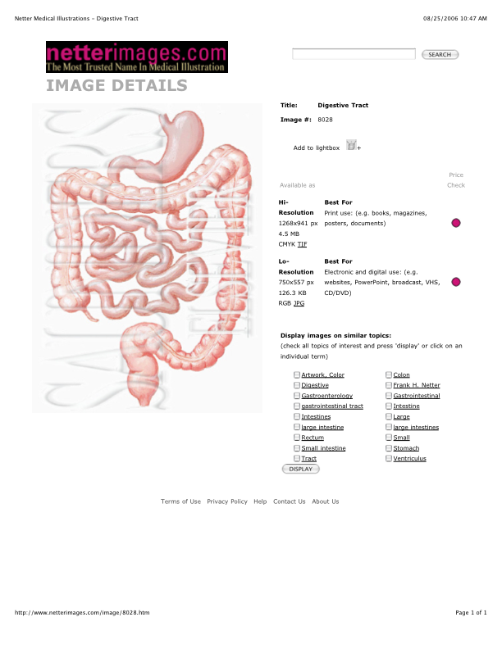
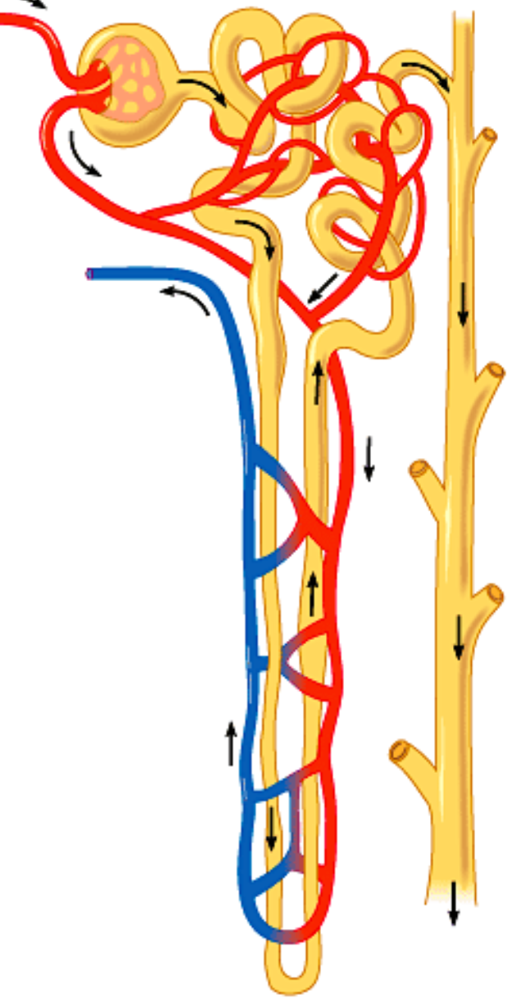
PHOSPHATURIC HORMONES FGF-23 AND PTH
INCREASE PO₄ EXCRETION THROUGH THE KIDNEY
PO₄
DAMAGED NEPHRONS
FGF-23
+++
PTH
URINE PO₄

Slide 10
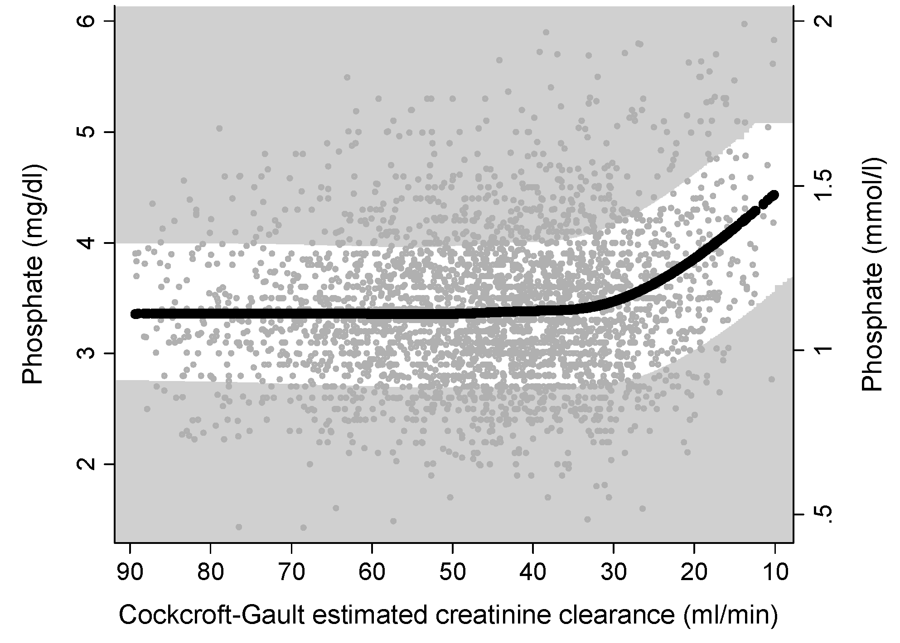
PHOSPHORUS BALANCE ALTERED IN EARLY KIDNEY DISEASE
SERUM PHOSPHORUS CONCENTRATIONS MAINTAINED
PTH
FGF-23
Kestenbaum et al, JASN 2005

Slide 11
PHOSPHORUS BALANCE ALTERED IN EARLY KIDNEY DISEASE
PHOSPHATURIC HORMONES ELEVATED
MESA DATA; N=2,739

Slide 12
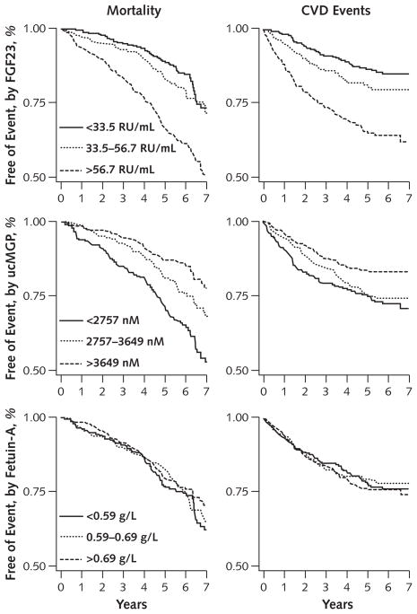
PHOSPHORUS HORMONES ASSOCIATED CV EVENTS
FGF-23
863 subjects with established CAD in Heart and Soul study
Parker et al, Ann Int Med 2010
Notes:
Heart and Soul data yet?

Slide 13
MESA MINERAL METABOLISM WORKING GROUP
Matt Budoff, UCLA
Bryan Kestenbaum, U Washington
Ian de Boer, U Washington
Nancy Jenny, U. Vermont
Michael Criqui, UCSD
Matt Allison, UCSD
Joe Ix, UCSD
Carmen Peralta, UCSF
Russ Tracy, U. Vermont
Christine Wassel, UCSD
Erin Michos, Johns Hopkins
Pallav Bhatnaggar, Johns Hopkins
Dan Arking, Johns Hopkins
Ronit Katz, U. Washington
Sylvia Rosas, U. Pennsylvania
David Siscovick, U Washington
Jennifer Nettleton, U. Texas

Slide 15
MESA MINERAL METABOLISM STUDY
Limitations of current knowledge
Available biomarkers (25-OHD, serum phosphorus)
Pathophysiology and molecular mechanisms unclear

Slide 16
MESA MINERAL METABOLISM STUDY
Measure 6 biomarkers of PO₄ and vitamin D metabolism
Serum PO₄, serum intact FGF-23, urine FePO₄
Serum 25-OHD*, serum 24,25-OH2D, serum PTH
in the complete MESA classic at visit 1
*25-OHD to be repeated on 400 participants at exam 2

Slide 17
MESA MINERAL METABOLISM STUDY
Test associations with subclinical disease, such as
Change in left ventricular mass
Change in coronary artery calcification
Arterial pulse wave velocity

Slide 18
MESA MINERAL METABOLISM STUDY
Test associations with clinical disease, such as
Incident cardiovascular events
Incident hypertension
Incident diabetes
Incident chronic kidney disease

Slide 19
MESA MINERAL METABOLISM STUDY
Progress
3800/6814 (56%) completed to date
Expected completion January 1, 2012

Slide 20
FUTURE DIRECTIONS
NOVEL DETERMINANTS OF MINERAL METABOLISM
Genetic variants and mineral metabolism markers
Mineral metabolism markers and gene expression
Epigenetics (DNA methylation)
Novel dietary assessment and nutritional databases
Novel molecular markers from animal studies (klotho?)

Slide 21
FUTURE DIRECTIONS
ADDITIONAL OUTCOMES
Vascular structure / function at other anatomic sites
Bone phenotypes (qCT, DEXA of hip and spine)
Vitamin D and biology of adiposity
Progression of kidney disease

