Slide 1
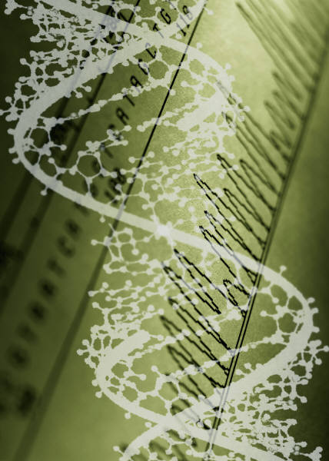
MESA Genetics Committee Report
April 25, 2014
Jerome I. Rotter

Slide 2
Genetics in MESA
MESA Candidate Genes/MESA Family
MESA CARe
MESA SHARe
MESA CNV
MESA HeartGO/ESP
MESA Epigenetics
MESA Exome Chip
MESA Metabochip
?MESA Microbiome?

Slide 3
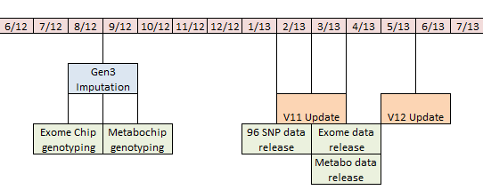
MESA SNP Health Association Resource (SHARe) Progress Report
Study Timeline
Funding Ended
Working Groups continue to be supported where analysts are available
dbGaP period of exclusivity may be reduced to 6 months sometime in 2013.

Slide 4
MESA SHARe Data
dbGaP Update Schedule:
Version 11 MESA SHARe Update (Released March 2013)
Version 12 MESA SHARe Update (Planned release June 2013).
- Exam 5
- A1AT Lung Data
- Atrial Fib Events Update
- Mineral Metabolism update
- Consent type changes
- Abdominal Body Composition
MESA Eye
MRI update
Rennin activity, aldosterone
MESA Sleep
- MESA Kidney
- 96 SNP Panel
- Exome Chip
- APOE1 and ApoA1
- HDL Subfractions

Slide 5
19 MESA SHARe Approved Analytic Sites
Cedars-Sinai Medical Center (PI: Jerome Rotter, MD)
University of Virginia (PI: Stephen Rich, PhD)
University of Washington (PI: Richard Kronmal, PhD)
Wake Forest University (PI: Gregory Burke, MD, MSc)
Johns Hopkins University (PI: Wendy Post, MD, MS)
University of California, San Diego (PI: Christina Wassel, PhD)
Emory University (PI: Yan Sun, PhD, MS)
University of Texas (PI: Jennifer Nettleton, PhD)
Loyola University (PI: Holly Kramer, MD, MPH)
University of North Carolina (PI: Leslie Lange)
University of Vermont (PI: Russell Tracy, PhD)
University of Pennsylvania (PI: Steven Kawut, MD)
Northwestern University (PI: Laura J. Rasmussen-Torvik, PhD, MD)
University of Michigan at Ann Arbor (PI: Sharon Kardia, PhD)
University of Alabama (PI: Donna Arnett, PhD)
University of Minnesota (PI: Mike Tsai, MD, PhD)
University of California San Francisco (Gregory Marcus, MD)
Harvard University (PI: Susan Redline, MD)
Harvard University (PI: Lucia Sobrin, MD)
120 additional investigators outside of MESA have applied for and gained access to MESA SHARe data.
Soon to be
LA BioMed Harbor UCLA (PI: Xiuqing Guo, PhD)

Slide 6
MESA SHARe Phenotype Working Groups
21 MESA SHARe Phenotype Working Groups actively meet.
Since April 2010, 164 publication proposals were submitted from 19 different Phenotype Working Groups and SHARe Committees
36 proposals use standard analysis plan developed by MESA SHARe Analysis Committee, 83 follow analysis outlined by consortia, and 45 use non-standard analysis as defined by the Working Group
27 published papers
Includes collaborations with CHARGE, ICBP, MACAD, PRIMA, GENEVA, CARe, NOMAS, Type 2 DM Consortium, CARDIA, SPIROMETA, HealthABC, SUNLIGHT, CKDGen, FIND, WHI, Family Heart Study, Genestar, Diabetic Heart Study, Framingham, CHS, ARIC, AGES, Rotterdam, Jackson Heart, Family Heart Study

Slide 7
MESA SHARe Phenotype Working Groups
Working Group | # Paper Proposals
NUTRITION | 17
ADIPOSITY | 15
BLOOD PRESSURE | 13
FATTY ACIDS | 13
LUNG | 12
PSYCHOSOCIAL FACTORS | 10
AF/ECG | 9
BIOMARKERS | 9
LIPIDS | 8
SUBCLINICAL AND CLINICAL CVD | 8
DIABETES/METABOLIC SYNDROME | 7
EYE | 7
LV FUNCTION/STRUCTURE | 5
RENAL | 5
MINERAL METABOLISM | 5
INFLAMMATION | 4
PHARMACOGENETICS | 3
ANALYSIS COMMITTEE | 2
EXOME CHIP | 1

Slide 8
MESA Genetics Publications

Slide 9
MESA Genetics P&P Committee Members
Wendy Post – Chair
Christina Wassel
Ken Rice
Xiuqing Guo
Stephen Rich
Nancy Jenny
Yongmei Liu
Kaeleen Drummey (Genetics P&P Coordinator)

Slide 10
MESA SHARe Published Papers: Recent
Shah SA et al. | Standard | Published Ann Noninvasive Electrocardiol Jan 2013
Associations Between NOS1AP Single Nucleotide Polymorphisms (SNPs) and QT Interval Duration in Four Racial/Ethnic Groups in the Multi-Ethnic Study of Atherosclerosis (MESA)
Richard A. Jensen et al. | Meta-analysis | Published PLoS One Feb 2013
Genome-Wide Association Study of Retinopathy in Individuals without Diabetes
Katie Kerr et al. | Meta-analysis | Published Nature Genetics April 2013
Identification of heart rate–associated loci and their effects on cardiac conduction and rhythm disorders

Slide 11
MESA SHARe Published Papers: Recent
(Mychaleckyj ) Huang et al. | Standard | Published Blood Dec 2012
Genome-wide association study for circulating levels of PAI-1 provides novel insights into its regulation
Jason H.Y. Wu et al. | Meta-analysis | Published Circ Cardiovasc Genet Jan 2013
Genome-Wide Association Study Identifies Novel Loci Associated With Concentrations of Four Plasma Phospholipid Fatty Acids in the De Novo Lipogenesis Pathway: Results from the CHARGE Consortium

Slide 12
MESA SHARe Published Papers : Recent
Smith CE et al. | Meta-analysis | Published Int J Obes (Lond) Jan 2013
Lipoprotein receptor-related protein 1 variants and dietary fatty acids: meta-analysis of European origin and African American studies.
(McKeown) Hruby A et al. | Meta-analysis | Published J Nutr Mar 2013
Higher Magnesium Intake Is Associated with Lower Fasting Glucose and Insulin, with No Evidence of Interaction with Select Genetic Loci, in a Meta-Analysis of 15 CHARGE Consortium Studies.
(Campbell) Thanassoulis et al. | Standard | Published N Engl J Med Feb 2013
Genetic Associations with Valvular Calcification and Aortic Stenosis

Slide 13
MESA SHARe Published Papers : Recent
Nettleton et al. | Meta-analysis | Published Am. Journal of Epi. Jan 2013
Meta-analysis investigating associations between healthy diet and fasting glucose and insulin levels and modification by loci associated with glucose homeostasis in data from 15 cohorts.
(Bakshis) Hek et al. | Meta-analysis | Published Biol Psychiatry Apr 2013
A Genome-Wide Association Study of Depressive Symptoms
Subramanyam et al. | Standard | Published PLoS One Jan 2013
Social factors and leukocyte DNA methylation of repetitive sequences: the multi-ethnic study of atherosclerosis

Slide 14
MESA SHARe Published Papers: Recent
(Richardson) Subramanyam et al. | Meta-analysis | Published Am J Hum Genet Jan 2013
Gain-of-function Lipoprotein Lipase variant rs13702 modulates lipid traits through disruption of a microRNA-410 seed site
Divers et al. | Non-Standard | Published Circ Cardiovasc Genet Feb 2013
Admixture mapping of coronary artery calcified plaque in African Americans with type 2 diabetes
Liang et al. | Standard | Epub Atherosclerosis Feb 2013
APOE genotype modifies the association between plasma omega-3 fatty acids and plasma lipids in the Multi-Ethnic Study of Atherosclerosis (MESA)

Slide 15
MESA SHARe Published Papers: Recent
Frazier-Wood et al. | Meta- analysis | Published Hum Genet Apr 2013.
Genetic variants associated with VLDL, LDL and HDL particle size differ with race/ethnicity
(Manichaikul) Wilk et al. | Meta-analysis | Published Am. J. Respir. and Crit. Care Med. Oct 2012
Genome-wide association studies identify CHRNA5/3 and HTR4 in the development of airflow obstruction

Slide 16
Journal Club: “Genetic Associations with Valvular Calcification and Aortic Stenosis” Thanassoulis, et.al., NEJM 2013; 368: 503-512 (February 7, 2013)
Medical Genetics Seminar Series
Michael A. Nasiak, M.D.
April 18, 2013

Slide 17
…What we’ll be talking about…
Normal Aortic Valve
Stenotic Calcified Aortic Valve

Slide 18
…and this is how the aortic valve behaves…

Slide 19
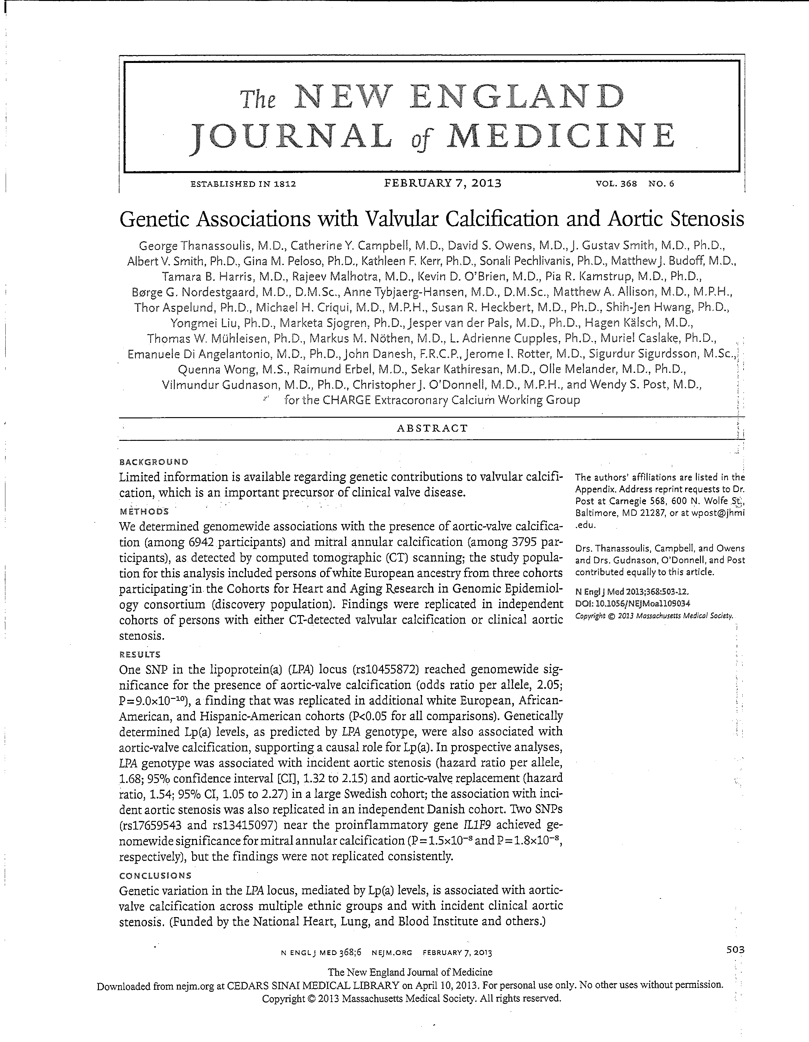
Let’s now look at this article…
Thanassoulis, et.al., NEJM 2013; 368: 503-512 , February 7, 2013

Slide 20
Purpose
Assess for any genetic contributions to valvular calcification/sclerosis (as presumed precursor to valvular stenosis)
…or, as the authors put it…
“To identify common genetic variants associ-ated with aortic valve calcium (AVC), mitral annular calcium (MAC), and clinical valve disease”

Slide 21
Purpose
Assess for any genetic contributions to valvular calcification/sclerosis (as presumed precursor to valvular stenosis)
…or, as the authors put it…
“To identify common genetic variants associ-ated with aortic valve calcium (AVC), mitral annular calcium (MAC), and clinical valve disease”
…i.e. Let’s do a GWAS!

Slide 22
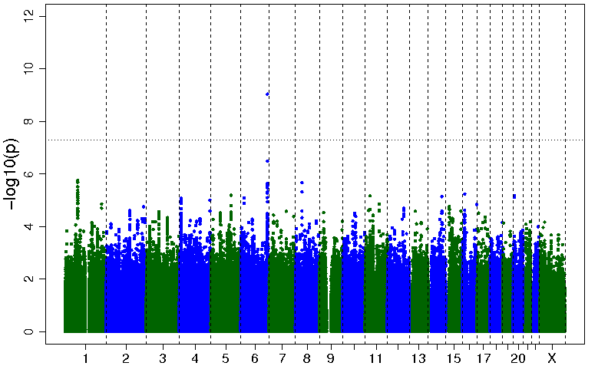
Aortic Valve Calcium Manhattan Plot
LPA
Chromosomal Position

Slide 23
Results from Discovery and Replication Stages for SNP rs10455872 in LPA in White Europeans
Study | MAF | N | OR (95% CI) | P-value
Discovery Cohort Results
FHS | 0.07 | 1298 | 2.33 (1.42-3.81) | 7.9 x 10⁻⁴
AGES-RS | 0.06 | 3117 | 2.04 (1.52-2.74) | 1.9 x 10⁻⁶
MESA | 0.06 | 2527 | 1.80 (1.09-2.97) | 0.022
Discovery Meta-analysis (FHS, AGES-RS, and MESA)* | 0.07 | 6942 | 2.05 (1.63-2.57) | 9.0 x 10⁻¹⁰
Replication (HNR) | 0.06 | 745 | 2.04 (1.13-3.67) | 0.018
Combined Meta-analysis (Replication) (FHS, AGES-RS, MESA, and HNR)† | 0.07 | 7687 | 2.05 (1.66-2.53) | 2.8 x 10⁻¹¹
*Genomic control correction †No genomic control correction

Slide 24
Cross-ethnicity Replication in MESA of rs10455872 and Aortic Valve Calcium
Ethnicity (cohort) | N | MAF | OR (95% CI) | P-value
African-American | 2497 | 0.02 | 3.57 (1.42-8.99) | 0.0068
Hispanic-American | 2026 | 0.02 | 2.75 (1.39-5.45) | 0.0037
Chinese-American | 774 | 0.005 | 1.13 | 0.96
0.005*774=4
Notes:
.005*774=4

Slide 25
Mendelian Randomization: How it was applied:
If all of the effect of rs10455872 on AVC is through Lp(a), then can estimate causal effect of Lp(a) on AVC by the ratio of co-efficients for regression of AVC on rs10455872 and Lp(a) on rs10455872
Associations between AVC, plasma Lp(a), and rs10455872 were performed in FHS and AGES, separately
Instrumental variable analysis performed
Results were meta-analyzed using random effects meta-analysis
SNP
A
Lp(a)
B
C (causal effect of Lp(a) on AVC) = B / A
C
AVC
Notes:
To support the hypothesis of a causal association between our LPA SNP and AVC, an instrumental variable analysis was performed.
In our analyses, genetically elevated Lp(a) concentrations (predicted by SNP data) were regressed against AVC presence.
[A 2-stage Murphy-Topel variance estimator was used to compute 95% confidence intervals (CI). Individual study results were then combined using a random effects meta-analysis with inverse variance weighting, due to heterogeneity across cohorts.]

Slide 26
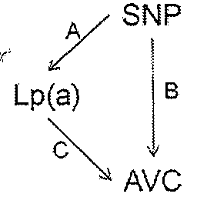
Instrumental Variable Analysis of Lp(a) and Presence of Aortic Valve Calcium
Condensed Table 4 | Meta-analysis
Association with plasma Lp(a)* | OR (95% CI) | p-value
rs10455872 | 1.58 (1.21-1.94) | <0.0001
Associations with AVC | OR (95% CI) | p-value
rs10455872 | 2.17 (1.66-2.83) | <0.0001
Plasma Lp(a)* | 1.29 (1.18-1.42) | <0.0001
Genetically-elevated Lp(a) | 1.62 (1.27-2.06) | <0.0001
rs10455872, adjusted for Lp(a) | 1.62 (0.94-2.81) | 0.085
* Plasma Lp(a) levels were non-normally distributed and log-transformed.
Notes:
This table shows the results of our instrumental variable analysis of lipoprotein a and presence of aortic valve calcium.
In FHS and AGES-RS, where Lp(a) concentrations were available, our top SNP was strongly associated with Lp(a) levels and Lp(a) was associated with presence of AVC . After adjustment for Lp(a), the association between rs10455872 SNP and AVC was attenuated in both cohorts and became non-significant when cohorts were pooled (meta-analytic p=0.085). Genetically elevated Lp(a) levels are the plasma Lp(a) levels predicted based on the genotype. Based on pooled data across both cohorts, the “causal” effect of genetically elevated Lp(a) levels was estimated as a 62% increase in the prevalence of AVC per log-unit increase in plasma Lp(a) (p=1x10⁻⁴; meta-analytic OR, 1.62).

Slide 27
Instrumental Variable Analysis of Lp(a) and Presence of Aortic Valve Calcium
Condensed Table 4 | Meta-analysis
Association with plasma Lp(a)* | OR (95% CI) | p-value
rs10455872 | 1.58 (1.21-1.94) | <0.0001
Associations with AVC | OR (95% CI) | p-value
rs10455872 | 2.17 (1.66-2.83) | <0.0001
Plasma Lp(a)* | 1.29 (1.18-1.42) | <0.0001
Genetically-elevated Lp(a) | 1.62 (1.27-2.06) | <0.0001
rs10455872, adjusted for Lp(a) | 1.62 (0.94-2.81) | 0.085
* Plasma Lp(a) levels were non-normally distributed and log-transformed.
Notes:
This table shows the results of our instrumental variable analysis of lipoprotein a and presence of aortic valve calcium.
In FHS and AGES-RS, where Lp(a) concentrations were available, our top SNP was strongly associated with Lp(a) levels and Lp(a) was associated with presence of AVC . After adjustment for Lp(a), the association between rs10455872 SNP and AVC was attenuated in both cohorts and became non-significant when cohorts were pooled (meta-analytic p=0.085). Genetically elevated Lp(a) levels are the plasma Lp(a) levels predicted based on the genotype. Based on pooled data across both cohorts, the “causal” effect of genetically elevated Lp(a) levels was estimated as a 62% increase in the prevalence of AVC per log-unit increase in plasma Lp(a) (p=1x10⁻⁴; meta-analytic OR, 1.62).

Slide 28
Instrumental Variable Analysis of Lp(a) and Presence of Aortic Valve Calcium
Condensed Table 4 | Meta-analysis
Association with plasma Lp(a)* | OR (95% CI) | p-value
rs10455872 | 1.58 (1.21-1.94) | <0.0001
Associations with AVC | OR (95% CI) | p-value
rs10455872 | 2.17 (1.66-2.83) | <0.0001
Plasma Lp(a)* | 1.29 (1.18-1.42) | <0.0001
Genetically-elevated Lp(a) | 1.62 (1.27-2.06) | <0.0001
rs10455872, adjusted for Lp(a) | 1.62 (0.94-2.81) | 0.085
* Plasma Lp(a) levels were non-normally distributed and log-transformed.
Notes:
This table shows the results of our instrumental variable analysis of lipoprotein a and presence of aortic valve calcium.
In FHS and AGES-RS, where Lp(a) concentrations were available, our top SNP was strongly associated with Lp(a) levels and Lp(a) was associated with presence of AVC . After adjustment for Lp(a), the association between rs10455872 SNP and AVC was attenuated in both cohorts and became non-significant when cohorts were pooled (meta-analytic p=0.085). Genetically elevated Lp(a) levels are the plasma Lp(a) levels predicted based on the genotype. Based on pooled data across both cohorts, the “causal” effect of genetically elevated Lp(a) levels was estimated as a 62% increase in the prevalence of AVC per log-unit increase in plasma Lp(a) (p=1x10⁻⁴; meta-analytic OR, 1.62).

Slide 29
Instrumental Variable Analysis of Lp(a) and Presence of Aortic Valve Calcium
Condensed Table 4 | Meta-analysis
Association with plasma Lp(a)* | OR (95% CI) | p-value
rs10455872 | 1.58 (1.21-1.94) | <0.0001
Associations with AVC | OR (95% CI) | p-value
rs10455872 | 2.17 (1.66-2.83) | <0.0001
Plasma Lp(a)* | 1.29 (1.18-1.42) | <0.0001
Genetically-elevated Lp(a) | 1.62 (1.27-2.06) | <0.0001
rs10455872, adjusted for Lp(a) | 1.62 (0.94-2.81) | 0.085
* Plasma Lp(a) levels were non-normally distributed and log-transformed.
Notes:
This table shows the results of our instrumental variable analysis of lipoprotein a and presence of aortic valve calcium.
In FHS and AGES-RS, where Lp(a) concentrations were available, our top SNP was strongly associated with Lp(a) levels and Lp(a) was associated with presence of AVC . After adjustment for Lp(a), the association between rs10455872 SNP and AVC was attenuated in both cohorts and became non-significant when cohorts were pooled (meta-analytic p=0.085). Genetically elevated Lp(a) levels are the plasma Lp(a) levels predicted based on the genotype. Based on pooled data across both cohorts, the “causal” effect of genetically elevated Lp(a) levels was estimated as a 62% increase in the prevalence of AVC per log-unit increase in plasma Lp(a) (p=1x10⁻⁴; meta-analytic OR, 1.62).

Slide 30
Instrumental Variable Analysis of Lp(a) and Presence of Aortic Valve Calcium
Condensed Table 4 | Meta-analysis
Association with plasma Lp(a)* | OR (95% CI) | p-value
rs10455872 | 1.58 (1.21-1.94) | <0.0001
Associations with AVC | OR (95% CI) | p-value
rs10455872 | 2.17 (1.66-2.83) | <0.0001
Plasma Lp(a)* | 1.29 (1.18-1.42) | <0.0001
Genetically-elevated Lp(a) | 1.62 (1.27-2.06) | <0.0001
rs10455872, adjusted for Lp(a) | 1.62 (0.94-2.81) | 0.085
* Plasma Lp(a) levels were non-normally distributed and log-transformed.
Notes:
This table shows the results of our instrumental variable analysis of lipoprotein a and presence of aortic valve calcium.
In FHS and AGES-RS, where Lp(a) concentrations were available, our top SNP was strongly associated with Lp(a) levels and Lp(a) was associated with presence of AVC . After adjustment for Lp(a), the association between rs10455872 SNP and AVC was attenuated in both cohorts and became non-significant when cohorts were pooled (meta-analytic p=0.085). Genetically elevated Lp(a) levels are the plasma Lp(a) levels predicted based on the genotype. Based on pooled data across both cohorts, the “causal” effect of genetically elevated Lp(a) levels was estimated as a 62% increase in the prevalence of AVC per log-unit increase in plasma Lp(a) (p=1x10⁻⁴; meta-analytic OR, 1.62).

Slide 31
Conclusions
Using Mendelian Randomization, the genetically determined Lp(a) values were causally associated with a 62% increase in the odds of AVC per log-unit increment in Lp(a) levels
This data suggests that lifelong elevations in Lp(a) levels lead to a markedly increased prevalence of AVC in adulthood, and implicate Lp(a) in the development of aortic stenosis

Slide 32
Comments
This is why we do GWAS
The study’s results are firm…and Important!
That’s Good! Finally, there is some direction to go in terms of addressing aortic stenosis
If AVC is the precursor of AS, and Lp(a) levels are causally associated with the risk of both (through established LPA gene expression), then focused therapy can be delivered presumably during the latent period…once one exists…
Treatment against Lp(a) can be direct or indirect

Slide 33
NHLBI-ESP Study Design
Samples Selected from Large Studies
HeartGO
N>60,000
LungGO
N>19,000
WHISP
N>142,000
ARIC, CARDIA, CHS,
FHS, JHS, MESA
e.g., Lung Health Study, Acute Lung Injury
Women’s Health Initiative
Sequencing Performed at the Broad & University of Washington
Multi-Sample Variant Calling
European Americans
N=4420
African Americans
N=2312
6800 Exomes

Slide 34
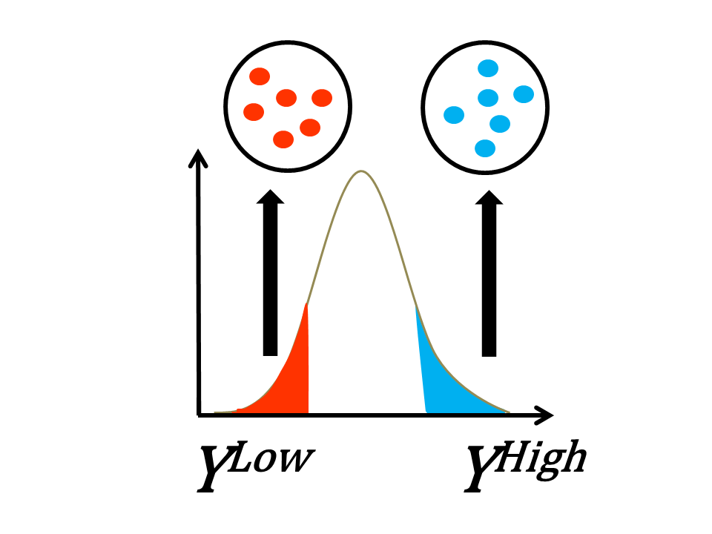
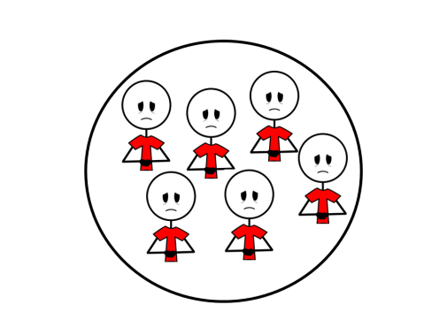
Samples Selected for a Variety of Traits from ~220,000 Individuals
Traits with extreme quantitative values
Low-density lipoprotein (N=657)
Blood pressure (N=812)
Disease endpoints
Stroke (N=551)
Chronic obstructive pulmonary disease (N=500)
Early onset myocardial infarction (N=1007)
Deeply phenotyped individuals
Randomly selected to be used as controls (N=964)
Notes:
Bullet 2 has cases only. The total number of cases AND controls:
COPD (N=626)
EOMI (N=1718)

Slide 35
Extensive Secondary Phenotypic Data
C-reactive protein (N=3379)
EKG measurements(N_{EKG-QT}= 3442)
Fasting Blood Glucose (N=2470)
Fibrinogen (N=2915)
High-density lipoprotein (N=3770)
Intima-Media Thickness (N=2079 )
Low-density lipoprotein (N=2685)
Red blood cell count (N=1103)
Systolic Blood Pressure (N=4423)
Triglycerides (N=3728)
Uric Acid (N=2169)
Waist-to-hip ratio (N=3853)
White blood cell count (N=3792)
von Willebrand Factor (N=1587)
>80 Traits Available for Analysis
Notes:
Disease Traits counted both cases and controls

Slide 36
LDL Study: Statistical Analysis LDL ESP Working Group courtesy of Russ Tracy
Exome Sequencing performed at Broad Institute and University of Washington
Read mapping, variant filtering, sample QC done at the University of Michigan
Single variant association test
Several different burden tests
Aggregate evidence for variants that meet thresholds to select ‘functional’ coding variants
Frequency
Loss-of-function (nonsense, splice, read-through) vs missense
Prediction of deleteriousness
Selected 17 genes with most promising burden tests in stage 1 (P < 5 x 10⁻⁴)
Examined these genes in additional 1302 samples

Slide 37
Exome Sequencing Project LDL Extremes Sample Selection
Unselected for LDL
< 2nd pctile
mean 52mg/dL
> 98th pctile
mean 250 mg/dL
Low LDL Unselected High LDL Total
Stage 1 247 1451 307 2005 (43% AA)
Stage 2 144 1001 157 1336 (66% AA)
Total 391 2452 464 3341 (53% AA)
Samples are from ARIC, Cardiovascular Health Study, Framingham Heart Study, Jackson Heart Study, Coronary Artery Risk Development in Young Adults (CARDIA) study, Multi-Ethnic Study of Atherosclerosis (MESA), Women’s Health Initiative (WHI)

Slide 38
Stages 1+2: Four genes reach significance (N = 3341, P < 1x10⁻⁶)
Gene | Variants included in burden test | Stage 1 (N = 2005) |  | Stage 2 (N = 1302) |  | Stage 1+ 2 (N = 3307)
 |  | P | BF | P | BF | P | Effect size (mg/dl)
PCSK9 | LOF < 5% Nonsyn+splice <5% | 5x10⁻¹⁰ 2x10⁻⁸ | 0.9 11.9 | 6x10⁻¹⁰ 3x10⁻¹⁰ | 1.8 25.0 | 3x10⁻¹⁸ 7x10⁻¹⁷ | -70 -25
LDLR | Nonsyn + splice < 0.1% | 3x10⁻⁹ | 2.5 | 2x10⁻⁵ | 2.1 | 3x10⁻¹³ | 52
APOB | LOF < 5% | 8x10⁻⁸ | 0.25 | 5x10⁻⁴ | 0.31 | 2x10⁻¹⁰ | -98
PNPLA5 | Nonsyn + splice MAF < 0.1% | 5x10⁻⁵ | 1.2 | 2x10⁻³ | 1.6 | 3x10⁻⁷ | 44
Burden frequency (BF) = % of individuals that carry at least one rare allele in that gene

Slide 39
PNPLA5
9 Members of PNPLA family, share short motif found in potato tuber protein
PNPLA members were found to serve critical roles in diverse aspects of lipid metabolism and signaling
PNPLA2 variants increase risk of T2D
PNPLA3 variants (adjacent gene to PNPl5) increase risk of NAFLD
No diseases listed in OMIM or knock-out mouse for PNPLA5
Function mostly unknown

Slide 40
Conclusions from searching for rare and low frequency LDL variants
1 novel gene reaches exome-wide significance
PNPLA5
3 known Mendelian dyslipidemia genes detected (p < 1 x 10⁻⁶)
PCSK9, LDLR, APOB
Novel variants even in heavily sequenced genes
Genetic architecture quite different at associated genes
Very rare missense variants in LDLR and PNPLA5 cause high LDL
Very rare loss-of-function variants in APOB reduce LDL
Mix of 1-2% and rare missense and nonsense variants in PCSK9 reduce LDL
Common variants in APOE
LOF of these 4 genes can result in higher LDL (LDLR, PNPLA5) or lower LDL (PCSK9, APOB)
Larger sample sizes needed to find more novel genes

Slide 41
HumanExome BeadChip
Key features:
Exonic variants (+rare)
Selected from over 12,000 individual exome and whole genome sequences, representing diverse population sets: European, African, Hispanic and Asian individuals
Contains AIMs
At a fraction cost of sequencing
Marker Categories | Values
Total markers | > 250,000
Nonsynonymous SNPs (NCBI) | 232,125
SNPs in coding regions (including UTR) | 246,139
SNPs in exon splice regions | 55,376
source: http://www.illumina.com
http://genome.sph.umich.edu/wiki/Exome_Chip_Design
MESA investigators, through their participation in the HeartGO project of the NHLBI Exome sequencing project, participated in the generation of data that contribute to this chip.

Slide 42
Exome Chip Data - Plans and Availability
10 Cohorts and 6 Genotyping Centers involved, all using common set of Coriell controls.
Cohort | Genotyping Center
CHS, MESA, and Family Health Study | Cedars-Sinai
ARIC, CARDIA, AGES | University of Texas - Houston
Health ABC | Wake Forest
Framingham | Illumina Core Lab
Jackson Heart | Broad
Rotterdam | Rotterdam

Slide 43
Exome Chip Data - Plans and Availability
Exome data now available from CC with idno.
CC will distribute to MESA investigators with approved MESA Genetics P&P Proposal. Like SHARe, Exome analyses will be led by working groups.
Data will be posted to dbGaP June 2013 to link with GWAS data.

Slide 44
Exome Chip Data – Paper Proposals
Author | FullTitle
Alexander P Reiner MD | Common and Exonic Variants Associated with Biomarkers of Inflammation
Charles R Farber PhD | BICC1 SNP associations with bone mineral density (BMD) in the Multi-Ethnic Study of Atherosclerosis (MESA)
Talin Haritunians PhD | CHARGE Consortium Meta-Analysis for Anthropometric Traits: The Multi-Ethnic Study of Atherosclerosis
Christina Wassel PhD, FAHA | Association of Rare and Low Frequency Variants with Subclinical Atherosclerosis in the CHARGE Consortium: An Exome Chip Analysis
Ani Manichaikul PhD | Participation of MESA in the CHARGE Lipids Exome Chip Project
Nicholette D Allred PhD | Analysis of Adiponectin (ADIPOQ) Low Frequency Variants including Coding variants from the Exome Chip in the Multi-Ethnic Study of Atherosclerosis SHARe
Brian Edmand Cade PhD | Genetic analyses of obstructive sleep apnea and related traits in The Multi-Ethnic Study of Atherosclerosis (MESA)
Mark O Goodarzi MD, PhD | CHARGE Consortium Meta-Analysis for Type 2 Diabetes-Related Quantitative Traits: The Multi-Ethnic Study of Atherosclerosis
Michael W Cammarata MD | DNA Methylation and Gene Expression of P2Y12 ADP Receptor: The Multi-Ethnic Study of Atherosclerosis.
Holly Kramer MD, MPH | MESA SHARe Exome Project: ESP-GO Renal Working Group Manuscript Proposal
Dr. Walter Palmas MD | Exome Chip and Blood Pressure Phenotypes: Participation of MESA in a CHARGE Consortium Meta-Analysis

Slide 46
Genetic variants associated with VLDL, LDL and HDL particle size differ with race/ethnicity.
We conducted 3 GWAS on VLDL, LDL and HDL lipoprotein diameters in the participants of GOLDN, and sought replication of findings P<1.0^{*10-5} in the Caucasian participants of MESA.
Significant associations in both Caucasian populations were tested for association in the non Caucasian MESA participants.
APOB variants were associated with mean VLDL diameter in both Caucasian populations, and in the Hispanic population of MESA. Hepatic lipase (LIPC) variants were associated with mean HDL diameter in the Caucasians populations only.
This suggests that the genetic underpinnings of mean lipoprotein diameter differ by race/ethnicity. This may indicate that strategies to modify lipoprotein profiles must be sensitive to race/ethnicity.
Frazier-Wood et al, Hum Genet, 2013; 132(4):405-13.

Slide 47
Smith CE et. al. Lipoprotein receptor-related protein 1 variants and dietary fatty acids : meta-analysis of European origin and African American Studies. Int J Obes advance online publication, 29 January 2013; doi:10.1038/ijo.2012.215.
LRP1 - a multi-functional endocytic receptor and signaling molecule expressed in adipose and the hypothalamus.
Evidence for a role of LRP1 in adiposity is accumulating from animal and in vitro models, but data from human studies are limited
Meta-analysis of 14 studies of US and European whites and 4 of African Americans to evaluate associations of dietary fatty acids and LRP1 genotypes with adiposity, and interactions between dietary fatty acids and LRP1 genotypes
Seven LRP1 SNPs evaluated in whites (N up to 42 000) and twelve SNPs in African Americans (N up to 5800)
Dietary saturated fatty acids and LRP1 genotype at rs2306692 may interactively influence anthropometric traits

Slide 48
Heartrate heritability estimates range from 55% to 77%
GWAS of heartrate in up to 181,171 individuals
Confirmed all 7 previously established loci
Identified 14 new loci
234 genes within 500 kb of these 21 loci
Various experimental and bioinformatic approaches identified a set of 49 candidate genes for heartrate regulation
Follow-up on 31 of these candidate genes:
RNAi in D. melanogaster
Downregulation of candidates in D. rerio
Results support a role for 20 of 31 candidate genes in regulating heartrate
most compelling results for MFN1 and PLD1
den Hoed, M NatGen epub 3/21/2013

Slide 49
Genome-Wide Association Study Identifies Novel Loci Associated With Concentrations of Four Plasma Phospholipid Fatty Acids in the De Novo Lipogenesis Pathway. Results From the CHARGE Consortium.
Jason H.Y. Wu, Rozenn N. Lemaitre, Ani Manichaikul, Weihua Guan, Toshiko Tanaka, Millennia Foy, Edmond K. Kabagambe, Luc Djousse, David Siscovick, Amanda M. Fretts, Catherine Johnson, Irena B. King, Bruce M. Psaty, Barbara McKnight, Stephen S. Rich, Yii-Der I. Chen, Jennifer A. Nettleton, Weihong Tang, MD, Stefania Bandinelli, David R. Jacobs, Jr, Brian L. Browning, Cathy C. Laurie, Xiangjun Gu, Michael Y. Tsai, Lyn M. Steffen, Luigi Ferrucci, Myriam Fornage, Dariush Mozaffarian
Circ Cardiovasc Genet.2013; 6:171-83.

Slide 50
Fatty Acids of Interest
Palmitic acid (16:0)
Stearic acid (18:0)
Palmitoleic acid (16:1n7)
Oleic acid (18:1n9)

Slide 51
De Novo Lipogenesis (DNL)

Slide 52
DNL Fatty Acids and Heart Disease
Circulating levels of DNL fatty acids (in RBC phospholipids and plasma phospholipids) are associated with diabetes and heart disease.
DNL fatty acids, heart disease and sudden cardiac death:
Jason et al. AJCN (2011)
Lemaitre et al. Metabolism (2010)

Slide 53
Participating Cohorts
Cohort | N | Age | Men, %
ARIC | 3269 | 54 | 49
CARDIA | 1507 | 46 | 47
CHS | 2404 | 72 | 38
InCHIANTI | 1075 | 68 | 45
MESA | 706 | 62 | 47
Total N = 8961 Whites

Slide 54
Meta-analysis Results

Slide 55
Summary of Results

Slide 56
Conclusions
Common variations in genes with diverse functions, including protein-glycosylation, PUFA metabolism, phospholipid metabolism, and glucose and oxygen-sensing pathways, are associated with fatty acids in the DNL pathway
Additional studies are needed to explore if these molecular mechanisms influence fatty acid synthesis and metabolism.

