Slide 1
MESA “Sequencing” Update
September 22, 2011
Stephen S. Rich

Slide 2
MESA Genetics Activities
MESA Genetics Committee
MESA Family
Early SNP genotyping
Candidate gene efforts funded by MESA Family
Other candidate gene projects
Large Scale Genotyping
CARe
SEA: SNPs and the Extent of Atherosclerosis
MESA-SHARe
ExomeChip (future)
Other Genetic Initiatives
MESA CNV (Rich)
Exome Sequencing Project (Rich)
Epigenomics (Liu)

Slide 3
MESA SNP Health Association Resource (SHARe) Progress Report
MESA SHARe extends genome wide SNP genotyping to non-AFA MESA Classic, MESA Family, and MESA Air New Recruits using Affymetrix Genome-Wide Human SNP Array 6.0 (1M SNPs plus CNVs)
8399 participants consented to genotyping, 8293 passed QC filters and are available on dbGaP (note: 3 dropped at V6 Update).
Study Timeline

Slide 4
MESA Genetics Overview
We have integrated MESA into a large number of consortia, collaborating with the following studies and consortia: CHARGE, ICBP, GIANT, Global Lipids, MACAD, PRIMA, GENEVA, CARe, NOMAS, CARDIA, SPIROMETA, HealthABC, SUNLIGHT, CKDGen, FIND, WHI, Family Heart Study, Genestar, Diabetic Heart Study, Framingham, AGES, ARIC, MEDIA, IRAS Family, GUARDIAN, Jackson Heart Study, African-American Coronary Calcium, African-American Quantitative T2D Traits.
MESA continues its contributions to the NHLBI Exome Sequencing project, as part of the HeartGO effort, which includes 6 NHLBI cohorts. Over 2500 of the planned 7500 exomes have been sequenced, and data analysis is now proceeding.
ExomeChip genotyping process underway
Illumina chip
Delivery Dec 1, 2011
Content heavy in rare/infrequent variants

Slide 5
MESA Genetics Overview
There are now 7 updates of MESA SHARe phenotypes, and we have added the CARe IBC candidate gene data as well.
MESA SHARe Newsletter was distributed to participants
We have now expanded to 13 MESA SHARe analytic sites
The third in-person MESA SHARe meeting was held on 2/9/11 in Boston, preceding the meeting of the CHARGE (Cohorts for Heart and Aging Research in Genetic Epidemiology consortium). The focus was on the “Multi-ethnic in MESA.”
151 MESA Genetics proposals have submitted with 21 papers published, and 17 pen drafts submitted.
Fourth in-person meeting was held yesterday, preceding MESA Steering Committee, focusing on phenotypes in MESA

Slide 6
MESA SHARe Phenotype Working Groups
20 MESA SHARe Phenotype Working Groups actively meet.
Since April 2010, 75 publication proposals, and 16 pen drafts were submitted from 17 different Phenotype Working Groups and SHARe Committees
19 proposals use standard analysis plan developed by MESA SHARe Analysis Committee, 52 follow analysis outlined by consortia, and 4 use non-standard analysis as defined by the Working Group
7 published papers

Slide 7
MESA SHARe Published Papers
(Goodarzi) Song et al. | Replication | Published Nature Dec 2010
CRTC3 links catecholamine signaling to energy balance
(Palmas) Ehret et al. | Replication | Published Nature Sept 2011
Common polymorphisms impacting blood pressure and cardiovascular disease in diverse populations highlight novel biological pathways
(Palmas) Wain et al. | Replication | Accepted Nature Genetics Aug 2011
Genome wide association study identifies six new loci influencing pulse pressure and mean arterial pressure
Manichaikul et al. | Methods | Accepted Human Genetics July 2011
Analysis of Family- and Population-Based Samples in Cohort Genome-Wide Association Studies

Slide 8
MESA SHARe Published Papers
Lemaitre et al. | Meta-analysis | Accepted PLOS Genetics, July 2011
Genetic loci associated with plasma phospholipid n-3 fatty acids. A meta-analysis of Genome-wide Associations from the CHARGE Consortium
(Herrington) O’Donnell et al. | Replication | In Press Circulation July 2011
Genome-wide association study for coronary artery calcification with follow up in myocardial infarction.
(Manichaikul) Artigas et al. | Meta-analysis | Accepted Nature Genetics July 2011
Genome wide Association and large scale follow up identifies 16 novel loci for lung function.

Slide 9
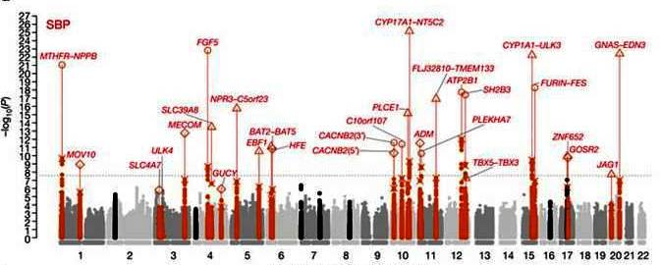
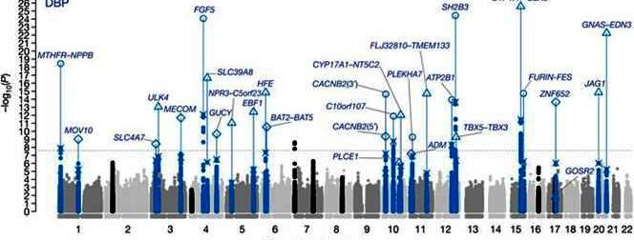
Genetic variants in novel pathways influence blood pressure and cardiovascular disease risk The International Consortium for Blood Pressure Genome-Wide Association Studies. Ehret G et al., Nature (Published online September 11, 2011; MESA authors: Palmas, Raffel, Yao, Guo)
Genome-wide association meta-analysis, n=200,000 Caucasians.
Twenty-nine independent SNPs at 28 loci were significantly associated with SBP, DBP, or both (all p<5E-09).
Of them, 16 loci were novel; 6 contain genes previously known or suspected to regulate blood pressure (GUCY1A3–GUCY1B3, NPR3–C5orf23, ADM, FURIN–FES, GOSR2, GNAS–EDN3); the other 10 may provide new clues to blood pressure physiology.
A genetic risk score based on 29 genome-wide significant variants was associated with hypertension, left ventricular wall thickness, stroke and coronary artery disease. That score was also associated with BP levels in East Asian, South Asian, and African ancestry populations.

Slide 10
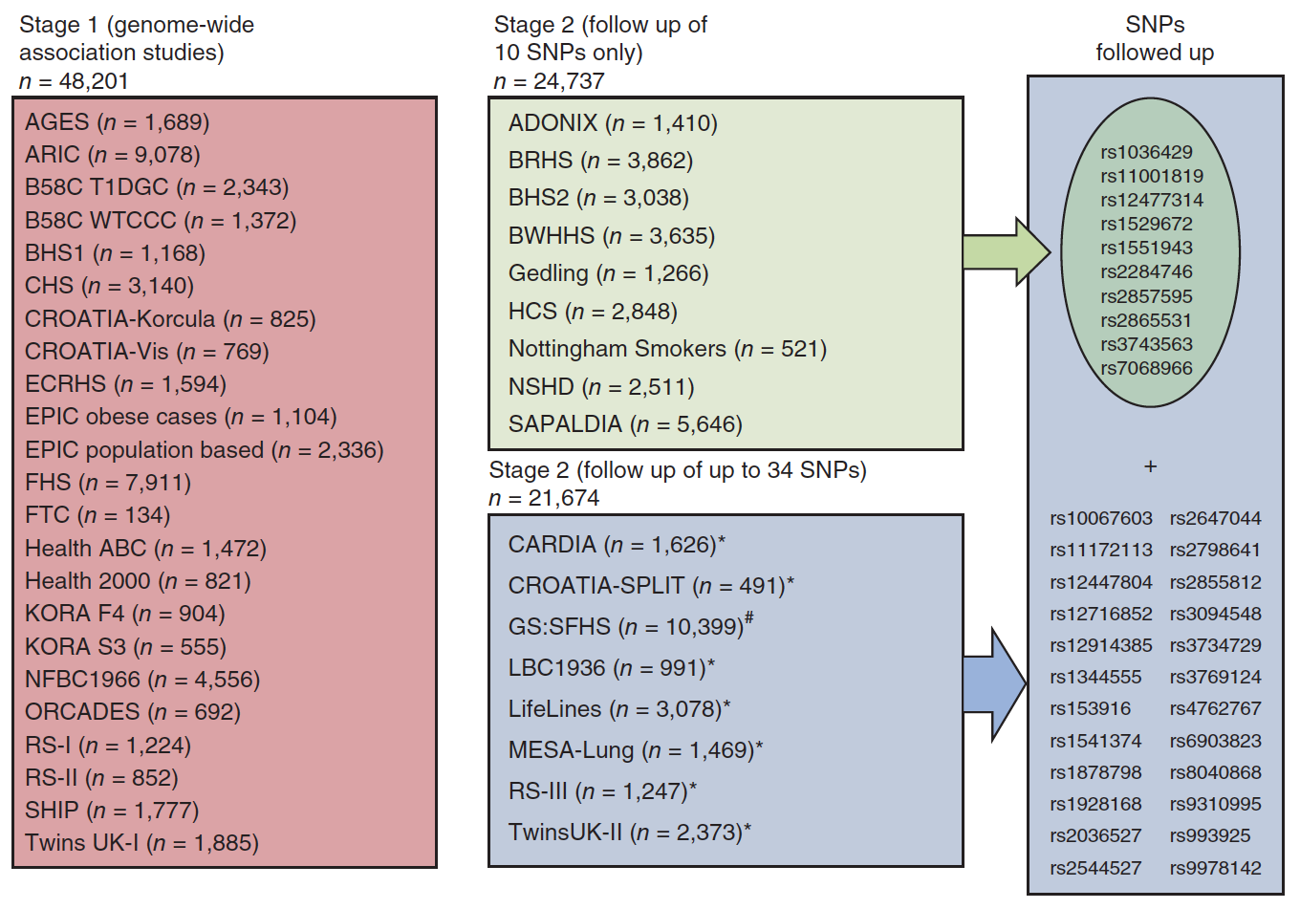
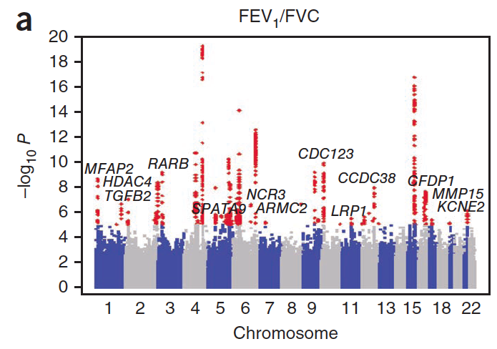
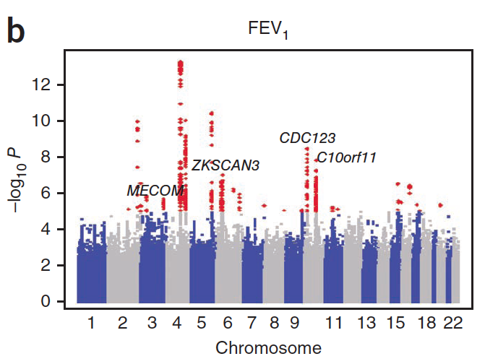
Genome-wide association and large-scale follow up identifies 16 new loci influencing lung function.
Soler Artigas M, …, Manichaikul A, …, Liu Y, …, Barr RG, …, Rich SS, …, Rotter JI, …, Tobin MD. Nature Genetics, in press.
Stage 1: GWAS in a total of n=48,201 individuals
Stage 2: Follow-up of selected SNPs in 17 cohorts, including 34 SNPs in MESA (n=1,469)

Slide 11
A Genome Wide Association Study of Valvular Calcium Implicates LPA in the Development of Aortic Stenosis
George Thanassoulis, MD, MSc*; Catherine Y. Campbell, MD*; David S. Owens, MD*; J. Gustav Smith, MD; Albert V. Smith, PhD; Gina M. Peloso, PhD; Kathleen F. Kerr, PhD; Sonali Pechlivanis, PhD; Matthew J. Budoff, MD; Tamara B. Harris, MD, MS; Rajeev Malhotra, MD; Kevin D. O’Brien, MD; Matthew A. Allison, MD, MPH; Thor Aspelund, PhD; Michael H. Criqui, MD, MPH; Susan R. Heckbert, MD, PhD; Shih-Jen Hwang, PhD; Yongmei Liu, PhD; Marketa Sjogren, PhD; Jesper van der Pals, MD, PhD; Hagen Kälsch, MD; Thomas W. Mühleisen, PhD; Markus M. Nöthen, MD; L. Adrienne Cupples, PhD; Muriel Caslake, PhD; Emanuele Di Angelantonio, MD, PhD; John Danesh, FRCP; Jerome I. Rotter, MD; Sigurdur Sigurdsson, MSc; Quenna Wong; Raimund Erbel, MD; Sekar Kathiresan, MD; Olle Melander, MD, PhD, Villi Gudnason, MD, PhD*, Christopher J. O’Donnell, MD, MPH*, Wendy S. Post, MD, MS* for the CHARGE Extracoronary Calcium Working Group
Framingham Heart Study (FHS); Age, Gene-Environment Susceptibility (AGES)-Reykjavik Study; Multi-Ethnic Study of Atherosclerosis (MESA), Heinz Nixdorf Recall Study, Malmo Diet and Cancer Study (MDCS)

Slide 13
HeartGO Structure
HeartGO Coordination
University of Virginia (S Rich, PI)
ARIC
E Boerwinkle
A Morrison
CARDIA
M Gross
A Reiner
CHS
B Psaty
R Tracy
FHS
L Atwood
C O’Donnell
JHS
H Taylor
J Wilson
MESA
J Rotter
W Post
Requirements: IRB APPROVAL, 5ug DNA, GWAS guidelines
HeartGO supports Labs, Coordinating Centers, and Genetic Counseling

Slide 14
MESA Contributions (Sample & Data)
Seq Ctr | Trait | Samples Rec’d | Passed Q/C |  | Passed Seq (%)
Broad | BP | 46 | 46 |  | 44 (96%)
Broad | DPR | 50 | 50 |  | 50 (100%)
UWash | Stroke | 12 | 12 |  | 12 (100%)
UWash | DPR1+2 | 51+112 | 51+112 |  | 48 + ?? (94%)
UWash | LDL | 99 | ?? |  | ??

Slide 15
100 in each tail x 2 ethnic groups
LOW LDL
HIGH LDL
LOW BP
HIGH BP

Slide 16
Exome Variant Server
A server of the allele frequencies for the first ESP data freeze.
The first set in is highly filtered, so based on the common exome capture target (28 Mb) and data from ~ 2275 individuals
More data being loaded (ESP5500) and populations (EA and AA) will be selectable
This MS2500P data was submitted to dbSNP
http://snp.gs.washington.edu/evs

Slide 17
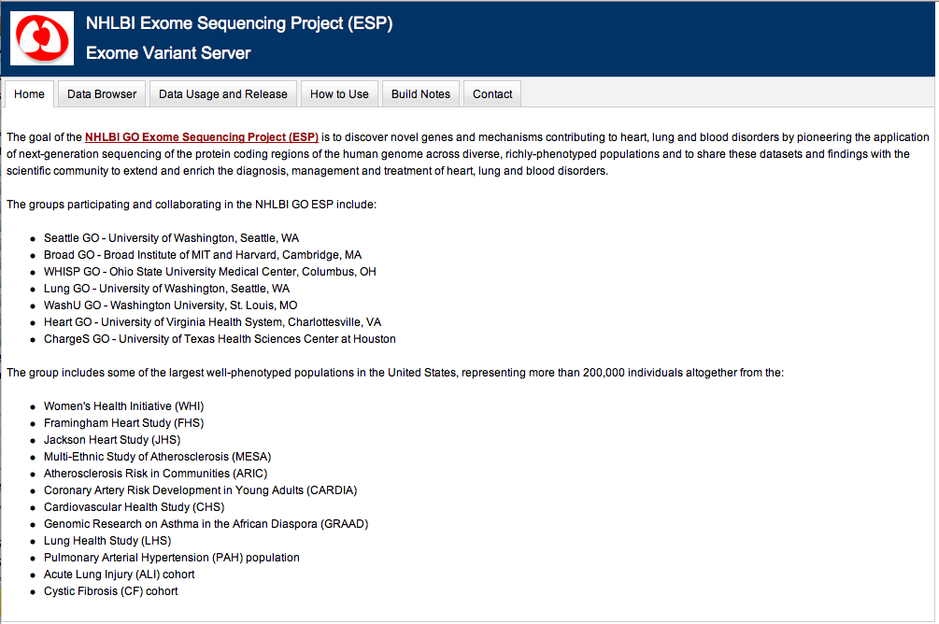
EVS is an interactive version of dbSNP with ESP sites and associated genotypes
http://snp.gs.washington.edu/EVS/

Slide 18
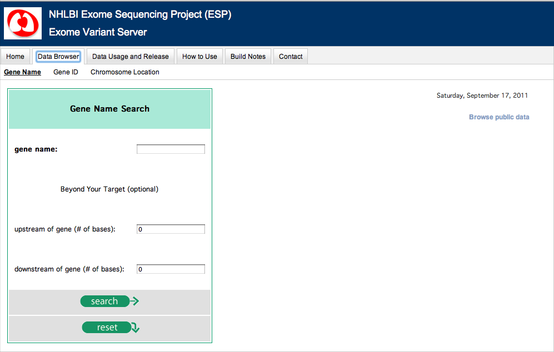

Slide 19
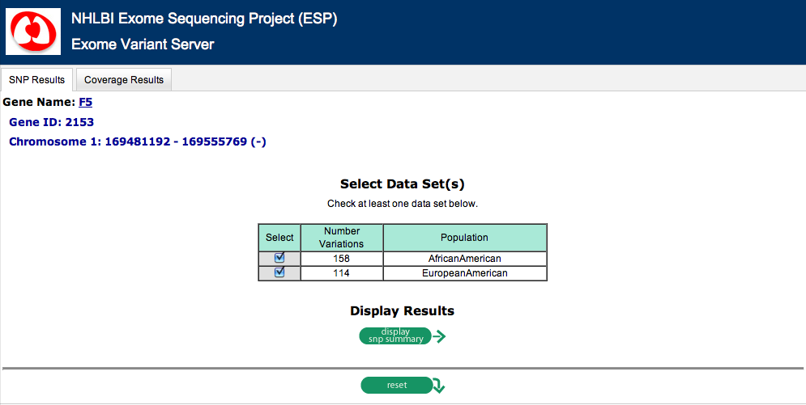

Slide 20
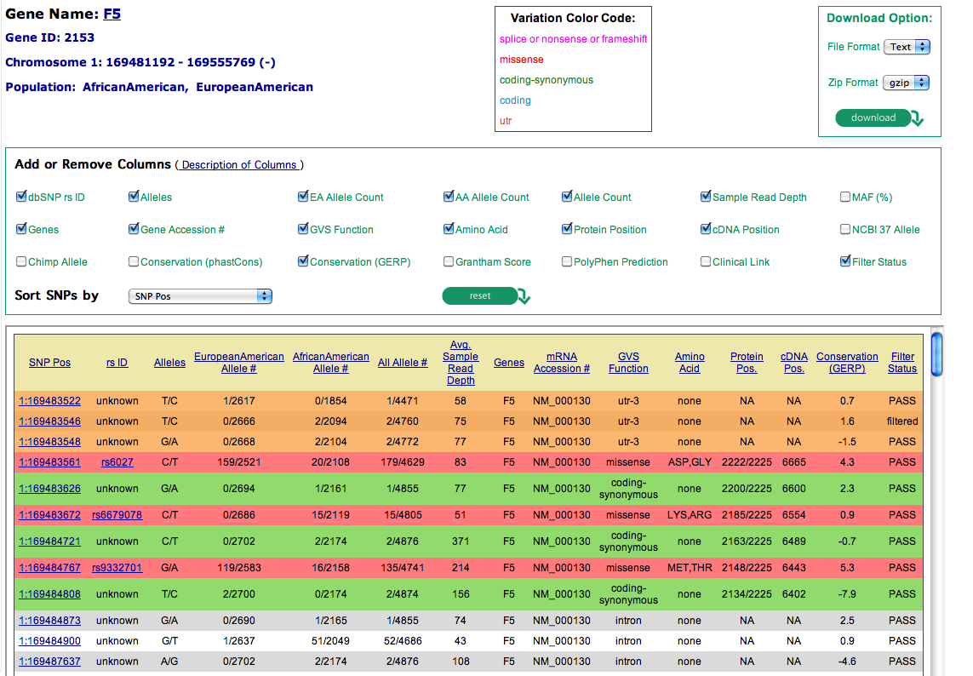

Slide 21
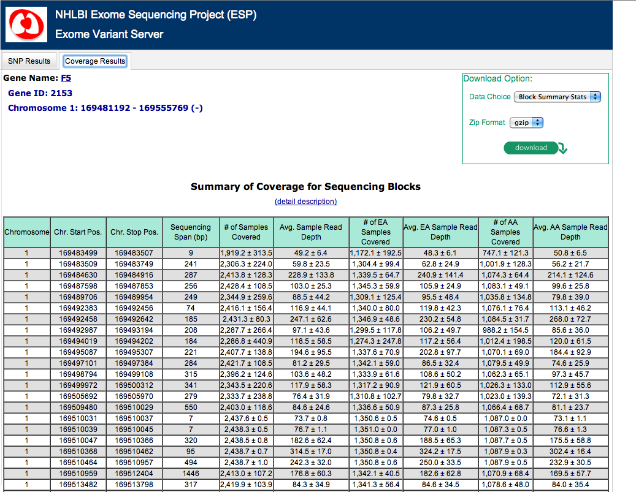

Slide 22
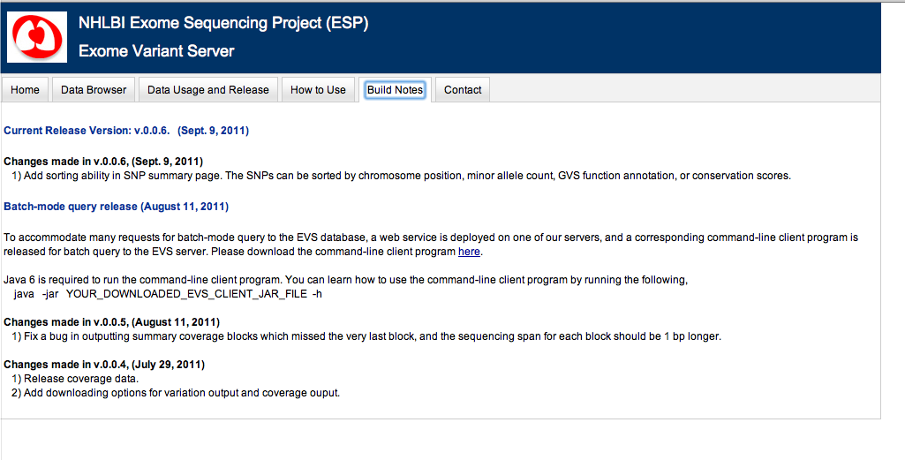

Slide 23
Exome Chip
Current exome sequencing studies are well powered to discover functional variation
Current exome sequencing studies are less well powered to establish association
Genotyping assays provide a cost effective way to examine large numbers of samples
An exome genotyping array will only reach ~80% of the variation that might be captured by sequencing
An exome genotyping array will not be effective for loci where private mutations drive association

Slide 24
Exome Chip Design Strategy
Collate list of sites and frequency information among a coalition of the willing (12,031 samples; ~9,000 European, ~2,000 African, ~500 Hispanic, ~500 Han Chinese)
Contributed site lists constitute preliminary, interim analyses of unpublished data
Selection criteria designed to achieve broad representation, avoid technical artifacts Non-synonymous variants seen >3 times and in at least 2 call sets
Splice and stop variants seen >2 times and in at least 2 call sets
Diversity enhancing variants added as filler
Sites must pass study specific filters, HWE P > 10⁻⁶ (except on X)

Slide 25
Coding Content (RefSeq Genes)
1,107,051 nonsynonymous variants
646,888 with allele counts = 1
163,044 with allele counts = 2
297,119 with allele counts > 2
260,054 seen in at least 2 studies
44,529 splice variants
27,265 with allele counts = 1
17,264 with allele counts > 1
12,662 seen in at least 2 studies
31,003 stop gain/loss variants
20,637 with allele counts = 1
10,366 with allele counts > 1
7,137 seen in at least 2 studies

Slide 26
Implementation of the Exome Chip
Illumina allocated budget of ~300,000 beadtypes
Most SNPs require one bead
A/T and G/C SNPs require 2 beads
Tri-allelic SNPs require 4 beads for full determination
Illumina design considerations
Exclude sites with design score < 0.5
Avoided primers with multiple hits in the genome
Favored primers extending into mRNA (versus intron)
Excluded sites within 5 bp of site with 100+ counts
Affymetrix allocating budget of ~350,000 probes
Affymetrix design based upon Axiom platform
Plan to favor sites extending into the exon
Plan to exclude “close” sites
Plan to query 10,000s of indels

