Slide 1
MESA Genetics Report Stephen S. Rich, PhD
October 3, 2013

Slide 2
MESA Genetics Committee Agenda
5:00pm Welcome
5:05pm Introductions
5:10pm Overview of meeting
5:15pm P&P Report (W Post)
5:30pm Rare Variants & LDL, BMI (L Lange)
6:00pm Genetic Variants & Lipid Particle Size (A Frazer-Wood)
6:20pm MESA, PAGE & MetaboChip (C Wassel)
6:45pm Future Directions for MESA (Genetics)

Slide 3
MESA Genetics P&P

Slide 4
MESA SHARe Phenotype Working Groups
21 MESA SHARe Phenotype Working Groups actively meet
Since April 2010, 194 publication proposals, and 53 pen drafts were submitted from 19 different Phenotype Working Groups and SHARe Committees
42 proposals use standard analysis plan developed by MESA SHARe Analysis Committee, 94 follow analysis outlined by consortia, and 44 use non-standard analysis as defined by the Working Group
37 published papers
Includes collaborations with CHARGE, ICBP, MACAD, PRIMA, GENEVA, CARe, NOMAS, Type 2 DM Consortium, CARDIA, SPIROMETA, HealthABC, SUNLIGHT, CKDGen, FIND, WHI, Family Heart Study, Genestar, Diabetic Heart Study, Framingham, CHS, ARIC, AGES, Rotterdam, Jackson Heart, Family Heart Study

Slide 5
MESA SHARe Published Papers: Recent
Monda et al. (Rassmussen-Torvik) | Meta-analysis | Published Nature Genetics June 2013
G 107: Genome-wide association of body fat distribution in african ancestry populations suggests new Loci.
Tanaka et al. (Nettleton) | Meta-analysis | Published Am J Clin Nutr June 2013
G 076: Genome-wide meta-analysis of observational studies shows common genetic variants associated with macronutrient intake.
Liu et al. (Haritunians) | Meta-analysis | Published PLoS Gen Aug 2013
G 105: A meta-analysis identifies new loci associated with body mass index in individuals of African ancestry.

Slide 6
MESA SHARe Published Papers: Recent
Sim et al. | Meta-analysis | Published PLoS One June 2013
G 073: Genetic loci for retinal arteriolar microcirculation
Stambolian et al. (Li) | Meta-analysis | Published Hum Mol Genet Jul 2013
G 219: Meta-analysis of genome-wide association studies in five cohorts reveals common variants in RBFOX1, a regulator of tissue-specific splicing, associated with refractive error
Klein et al. | Other | Am J Ophthalmol Aug 2013
G 194: Associations of Candidate Genes to Age-Related Macular Degeneration Among Racial/Ethnic Groups in the Multi-Ethnic Study of Atherosclerosis.

Slide 7
MESA SHARe Published Papers : Recent
Grove et al. (Haritunians) | Other | Published PLoS One July 2013
G 212: Best practices and joint calling of the HumanExome BeadChip: the CHARGE Consortium
Avery et al. (Li) | Standard | Published Pharmacogenomics 2013
G 170: Drug-gene interactions and the search for missing heritability: a cross-sectional pharmacogenomics study of the QT interval.

Slide 8
MESA SHARe Pen Drafts
Title | Lead Author | Approval Date
G 280: GWAS Analysis of Refractive Error: The AREDS, KORA, MESA and Sardinia | Li | Sept 2013
G 127: GWAS of Caffeine Intake | Cornelis | Sept 2013
G 218: BICC1 SNP associations with bone mineral density (BMD) in the Multi-Ethnic Study of Atherosclerosis (MESA) | Farber | Sept 2013
G 180: Participation of MESA in a CHARGE Genome-Wide Association Study of Forced Vital Capacity | Manichaikul | Aug 2013
G 242: Association of ADORA2B SNPs with subclinical atherosclerosis and inflammatory markers in The Multi-Ethnic Study of Atherosclerosis (MESA) | Manichaikul | Aug 2013

Slide 9
MESA SHARe Pen Drafts
Title | Lead Author | Approval Date
G 186: Association of scavenger receptor class B type I (SCARB1) rs4238001 and rs2278986 variants with incident cardiovascular disease: Multi-Ethnic Study of Atherosclerosis. | Manichaikul | July 2013
G 224: ID3 SNP rs11574 Associated with Atherosclerosis in the Multi-Ethnic Study of Atherosclerosis (MESA) | Manichaikul | May 2013
G 118: Meta-analysis of the relations among FTO and MC4R genes, Dietary Intakes and Obesity | Qi | April 2013
G 258: Identification of shared genes underlying airway obstruction and emphysema: replication in MESA Caucasians | Manichaikul | April 2013
G 104: GWAS of plasma phospholipid n-6 fatty acids with CHARGE | Tsai | Feb 2013

Slide 10
MESA SHARe Pen Drafts
Title | Lead Author | Approval Date
G 151: Meta-analysis of genome-wide association studies in African Americans provides insights into the genetic architecture of type 2 diabetes | Ng | Feb 2013
G 182: Meta-analysis of obesity-related traits in the Asia Diabetes and Obesity Consortium | Guo | Jan 2013
G 201: Methylomics of Gene Expression in Human Monocytes: the Multi-Ethnic Study of Atherosclerosis (MESA) | Liu | Aug 2012
G 177: A GWAS and Linkage Study of Pulmonary Emphysema on CT Scan | Manichaikul | Jul 2012
G 158: Cardiovascular Candidate Genes, HDL, Lung Function and Percent Emphysema: the Candidate-gene Association Resource and MESA Lung/SHARe Studies | Burkart | Dec 2011

Slide 11
MESA Genetics P&P Committee Members
Wendy Post (Chair)
Xiuqing Guo
Spencer Huang
Nancy Jenny
Yongmei Liu
Jim Pankow
Steve Rich
Christina Wassel

Slide 12
Research Updates
Leslie Lange (UNC-Chapel Hill)
NHLBI ESP: LDL & BMI
Lekki Frazer-Wood (U Texas SPH)
Christina Wassel (U Pitt)

Slide 13
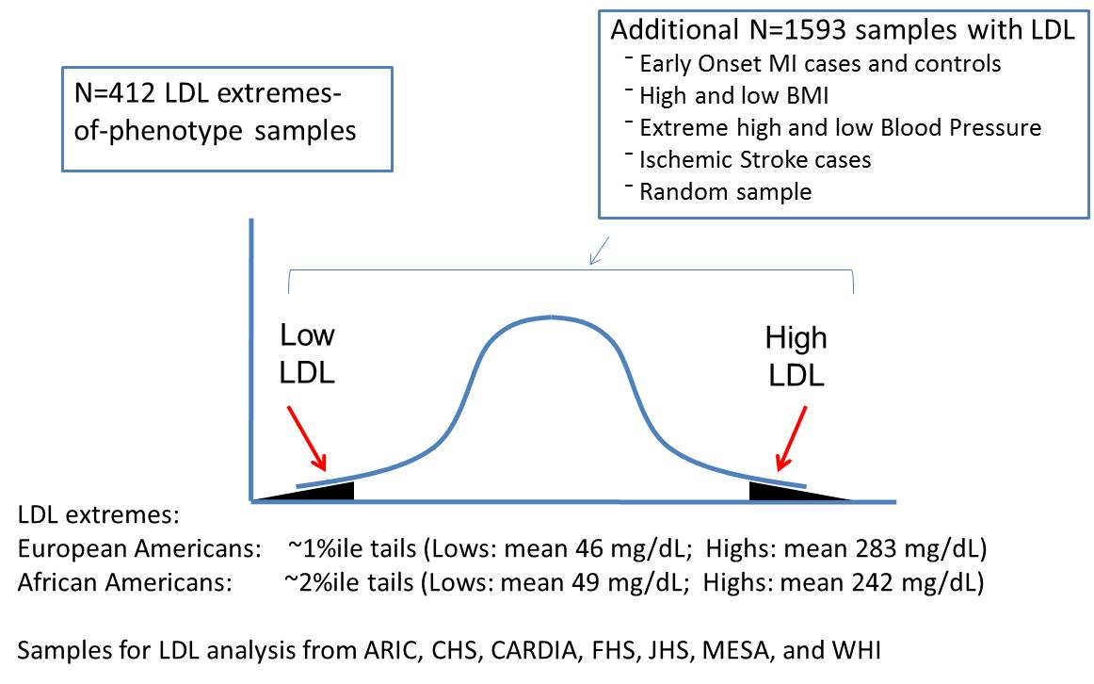
ESP LDL stage 1 sample

Slide 14
Results
Significant evidence for:
TOMM40 (single variant; tags APOE haplotype)
PCSK9, LDLR, APOB, PNPLA5 (gene-based)
Suggestive evidence for:
ABCG5, NPC1L1 (gene-based)
Follow-up of PNPLA5 in GO-T2D (EA’s only): P=0.04 (consistent direction of effect; N=11)

Slide 15
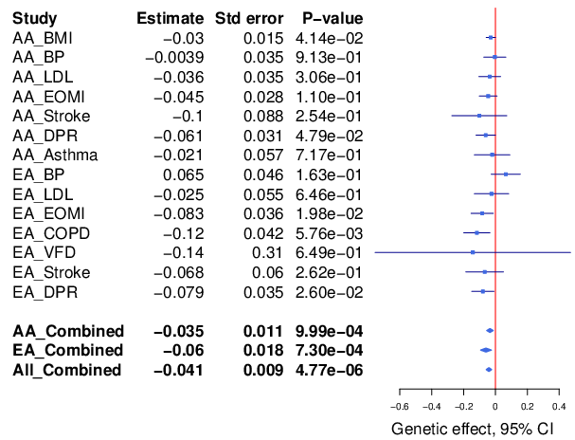
Forest Plot for ATF4 (BMI)

Slide 16
Animal model evidence for ATF4
"ATF4 regulates obesity, glucose homeostasis, and energy expenditure“ (Seo J et al., Diabetes 2009):
Flies with insertions at the Atf4 locus have reduced fat content, increased starvation sensitivity, and lower levels of circulating carbohydrate. Atf4 null mice are also lean, and they resist age-related and diet-induced obesity. Atf4 null mice have increased energy expenditure potentially accounting for the lean phenotype. Atf4 null mice are hypoglycemic, even before substantial changes in fat content, indicating that Atf4 regulates mammalian carbohydrate metabolism. In addition, the Atf4 mutation blunts diet-induced diabetes as well as hyperlipidemia and hepatosteatosis. Several aspects of the Atf4 mutant phenotype resemble mice with mutations in components of the target of rapamycin (TOR) pathway. Consistent with the phenotypic similarities, Atf4 null mice have reduced expression of genes that regulate intracellular amino acid concentrations and lower intracellular concentration of amino acids, a key TOR input. Further, Atf4 mutants have reduced S6K activity in liver and adipose tissues.”

Slide 17
Ethnic differences in lipoprotein size and distribution
Lekki Wood, PhD
Assistant Professor, Human Genetics Center, School of Public Health

Slide 18
Lipoproteins as a biomarker of metabolic dysfunction
Frazier-Wood et al, 2011, Lipids in Health and Disease
Notes:
Introduce concept of diameter

Slide 19
Genetics Of Lipid-lowering Drug Network
ApoB
Bub3
GALTNT7
Frazier-Wood et al, 2013, Human Genetics

Slide 20
Replicated SNPs
VLDL diameter: ApoB (GOLDN P=2*10⁻⁸; MESA P=.001; combined P=1*10⁻⁷)
HDL diameter: LIPC (GOLDN P=1*10-5; MESA P=9*10⁻⁵; combined P=2*10⁻⁹)
ApoB: Hispanics: P=.001; African-Americans: P=.50; Chinese-Americans = .20)
LIPC: Hispanics: P=.10; African-Americans: P=.10)

Slide 21
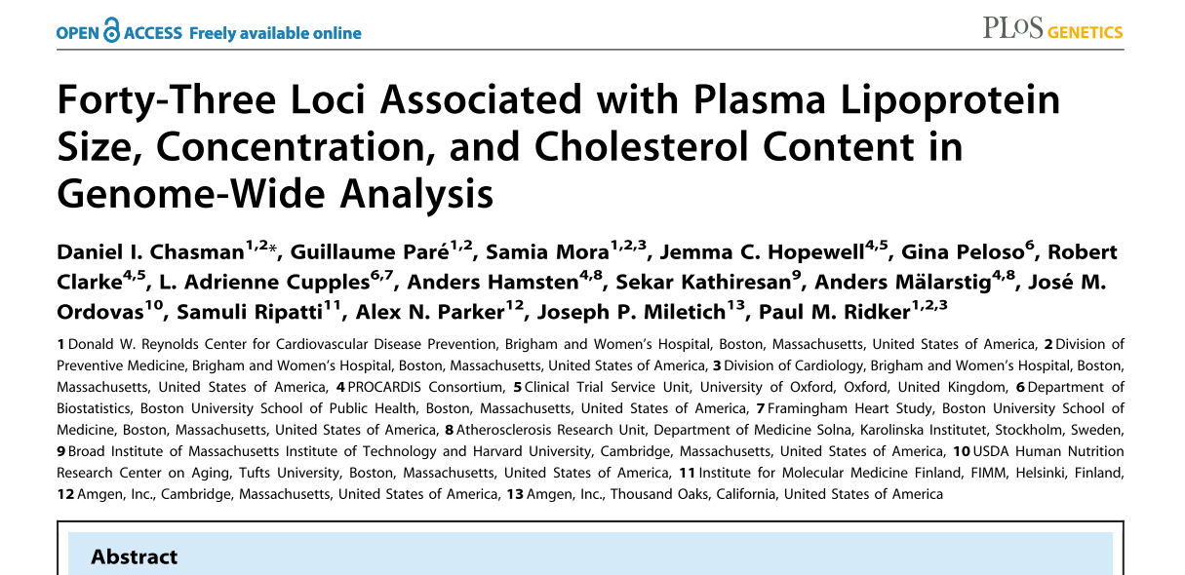

Slide 22
Analysis of replicated loci in MESA
120 SNP-phenotype associations; 68 (56%) showed nominal replication (P<.05; uncorrected for multiple testing), 10 (8%) were unavailable and 43 (36%) did not replicate in the MESA dataset.
Genetic Risk Score (GRS)

Slide 23
PAGE I Participants
White | African American | Hispanic/ Latino | Asian/ Pacific Islander | American Indian
57,385 | 23,893 | 21,788 | 16,975 | 7,671
128K Total Participants

Slide 24
MESA Metabochip
Ancillary funded by Sue Bielinski, Joel Kaufman, Jerry Rotter and Sverre Vedal
8169 total MESA participants (Family + Air + Classic) after cleaning/QC by Jerry’s shop
279 excluded participants
156,664 SNPs passed QC
143,539 SNPs, MAF>0.005
Forward and top strand notations available

Slide 25
How do I get Metabochip data?
MESA investigators w/ approved proposal
Steps for proposal submission:
Metabochip WG by a MESA representative, give at least 1 week for approval
Metabochip WG will suggest MESA phenotype experts + genotyping + ancillary PIs as co-authors
Next, Genetics P&P submission by a MESA representative, standard rules and timing applies
Kayleen et al at CC can provide access to the U Wash ftp site
Notes:
Can get the mailing list from either me or Kayleen for the Metabochip WG

Slide 26
A-A Results Ln(ACR), with MESA*
Chr | SNP | Gene | MAF | Beta | P-value
8 | rs17399841 | GRHL2 | 0.01 | -0.480 | 9.84E-07
5 | rs153914 | SPATA9/RHOBTB3 | 0.01 | -0.413 | 1.98E-05
4 | rs17439845 | LEF1 | 0.02 | -0.461 | 1.75E-08
12 | rs11836243 | ZNF641/ANP32D | 0.12 | 0.140 | 1.32E-04
*MAF≥0.01, results with MESA for original top/significant SNPs
Directionality for SNPs consistent between MESA and other studies, MESA specific p-value was 0.03.

Slide 27
LEF1 Gene
LEF1: lymphoid enhancer-binding factor 1
Aka TCF10, TCF7L3, TCF1ALPHA
Mediator in the Wnt signaling pathway
rs17439845 located in one of LEF1 introns
SNPs in LEF1 have been implicated in lupus and osteoporosis
Also associated with waist circumference, C-reactive protein, blood count traits, bone mineral density, echocardiographic traits

Slide 28
MESA Genetics Opportunities (in this crappy funding environment)
Russ Tracy and Bruce Psaty led the Discussion

Slide 29
The NHLBI Exome Sequencing Project (presentation to OSMB) Stephen S. Rich, PhD
September 30, 2013

Slide 30
NHLBI Exome Sequencing Project (ESP)
Three cohort-based groups
Heart disease (HeartGO, S Rich)
Lung disease (LungGO, M Bamshad)
Women’s Health Initiative (WHISP, R Jackson)
Two sequencing centers
Broad Institute (BroadGO, S Gabriel/D Altshuler)
University of Washington (SeattleGO, D Nickerson)
Two additional GO components
CHARGE-S (E Boerwinkle, targeted & exome sequencing)
WashUGO (T Graubert, cancer focus, whole genome seq)

Slide 31
NHLBI Exome Sequencing Project
Established with ARRA funding
Extremes of cardiovascular and lung phenotypes to be analyzed to enrich for genetic effects
Early Onset Disease
“Mendel-ize” Traits-Compare
extremes of trait distribution
Rare, higher penetrant variants
Example of extreme
High FRS
no MI
Early-onset MI

Slide 32
Relatively small numbers in each tail x 2 ethnic groups
LOW LDL
HIGH LDL
LOW BP
HIGH BP

Slide 33
HeartGO
N>60,000
LungGO
N>19,000
WHISP
N>142,000
12 Primary Traits
Extremes of Quantitative Traits: BP, BMI & LDL
Disease Outcomes: EOMI, PAH & Stroke and Controls for EOMI & PAH
Severity of Disease: Asthma, COPD, ALI and Pseudomonas Infection and Pulmonary Function in CF patients
Deeply Phenotyped Reference Group
Secondary Traits
48 Quantitative & 11 Qualitative
~6700 exomes
sequenced at the Broad & University of Washington
European Americans
N=4420
African Americans
N=2312

Slide 34
HeartGO Structure
HeartGO Coordination
University of Virginia (S Rich, PI)
ARIC
E Boerwinkle
A Morrison
CARDIA
M Gross
A Reiner
CHS
B Psaty
R Tracy
FHS
L Atwood
C O’Donnell
JHS
H Taylor
J Wilson
MESA
J Rotter
W Post
Requirements: IRB APPROVAL, 5ug DNA, GWAS guidelines
HeartGO supports Labs, Coordinating Centers, and Genetic Counseling

Slide 35
MESA Contributions (Sample & Data)
Seq Ctr | Trait | Samples Rec’d | Passed Q/C | Passed Seq(%) | dbGaP Release
Broad | BP | 46 | 46 | 44 (96%) | 3 (5400)
Broad | DPR | 50 | 50 | 50 (100%) | 4 (7000)
UW | Stroke | 12 | 12 | 12 (100%) | 3 (5400)
UW | DPR1/2 | 51/112 | 51/112 | 48/112 (94%/100%) | 4 (5400) 5 (7000)
UW | LDL | 124 | 124 | 117 (94%) | 5 (7000)
395 Samples Received
100% passed Sequencing Center Q/C (!!!)
383 (97%) passed sequencing

Slide 36
A Few Publications from ESP
Tennessen JA, Bigham AW, O’Connor TD, Fu W, Kenny EE, Gravel S et al. Evolution and functional impact of rare coding variation from deep sequencing of human exomes. Science 2012 Jul 6;337(6090) 64-9
Emond MJ, Louie T, Emerson J, Zhao W, Mathias RA, Knowles MR et al. Exome sequencing of extreme phenotypes identifies DCTN4 as a modifier of chronic Pseudomonas aeruginosa infection in cystic fibrosis. Nat Genet 2012 Jul 8;44(8):886-9
Auer PL, Johnsen JM, Johnson AD, Logsdon BA, Lange LA, Nalls MA et al. Imputation of exome sequence variants into population-based samples and blood-cell-trait-associated loci in African-Americans: NHLBI GO Exome Sequencing Project. Am J Hum Genet 2012 Nov 2;91(5):794-808
Fu W, O’Connor TD, Jun G, Kang HM, Abecasis GR, Leal SM et al. Analysis of 6,515 exomes reveals the recent origin of most human protein-coding variants. Nature 2013 Jan 10;493(7431):216-20
Johnsen JM, Auer PL, Morrison AC, Jiao S, Wei P, Haessler J et al. Common and rare von Willebrand factor (vWF) coding variants, VWF levels, and factor VIII levels in African Americans: the NHLBI Exome Sequencing Project. Blood 2103 Jul 25;122(4):590-7

Slide 37
Snippets of ESP Results - 1
EOMI
Led by Sek Kathiresan and Chris O’Donnell
Exome sequencing of
1,207 cases of MI with early age at onset
946 ‘controls’ with older age, high FRS, no MI
Strongest single variant results in 9p21, LDLR, APOE, …
Rare variants contribute to burden of risk in APOA5 (novel)
Validation by re-sequencing 11,414 additional participants
APOA5 carriers of rare variants had
higher triglycerides than non-carriers
Lower HDL levels than non-carriers
Under review, N Engl J Med

Slide 39
Snippets of ESP Results - 2
LDL cholesterol levels
Led by Cristen Willer and Leslie Lange
Exome sequencing of 2,005 participants, including 554 selected for extremes of LDL (>98th or <2nd percentile)
Strongest single variant results in APOE
Rare variants contribute to burden of risk in PCSK9, LDLR, APOB and PNPLA5 (novel)
Validation in GOT2D sequencing study of 2,084 participants
Different genes exhibited different genetic architecture
PCSK9 – loss of function variants (MAF < 5%)
LDLR – rare missense, loss of function variants (MAF<0.1%)
Under review, Am J Hum Genet (after a long tortuous path with Nat Genet)

Slide 44
Snippets of ESP Results - 3
Pharmacogenomics
Led by Adam Gordon (Nickerson lab)
Exome sequencing of 2,203 African Americans and 4,300 Caucasians
Survey of coding variation in 12 CYP450 genes
Discovered 1,006 unique variants (275 known, 731 novel); 486 missense variants and 42 nonsense/splice or frameshift
CYP2A6, CYP2B6, CYP2D6 contain most nonsynonymous variation (and are in the top 20% exome-wide)
Predicted function -> drug metabolism?
11.7% AA and 7.6% EA carry a predicted functional variant
21.8% AA and 14.1% EA have variants in one of 12 CYP genes
Under review, Hum Mol Genet

Slide 46
MESA ESP data in dbGaP

Slide 47
MESA ESP dbGaP access

Slide 48
The ExomeChip
Exome sequencing studies are likely well-powered to discover shared (MAF > 0.1%) variants that contribute to diseases of interest
Exome sequencing studies of (non-Mendelian) traits may be underpowered to demonstrate association to those variants
Array-based genotyping is less expensive per sample than exome sequencing

Slide 49
Samples Contributed to ExomeChip
Samples | # Samples | Phenotype | Samples | # Samples | Phenotype
Baylor Autism | 902 | Autism | Finn BMI | 46 | BMI
Broad Autism + DILI | 993 | Autism* | ESP BP | 613 | BP
STARD | 50 | Depression | Lipid extremes | 131 | Lipids
Broad SCZ | 525 | Schizophrenia | ESP AA | 1143 | Metabolic
Cancer Genome Atlas | 422 | Cancer | ESP EA | 1377 | Metabolic
HIV | 121 | HIV | Sardinia | 505 | Metabolic
Lausanne Sanger | 456 | Population | ESP AA (UW) | 144 | Metabolic
1KG Solid | 306 | Population | ESP EA (UW) | 983 | Metabolic
1KG Illumina | 822 | Population | GO T2D Genome | 602 | T2D
Chinese Exomes | 327 | Population | Pfizer T2D | 182 | T2D
 |  |  | GO T2D Exome | 1016 | T2D
 |  |  | T2D Exome | 362 | T2D
 | 4924 |  |  | 7104
Total: 12,028 samples

Slide 50
Coding Content (RefSeq Genes)
1,107,051 nonsynonymous variants
646,888 with allele counts = 1
163,044 with allele counts = 2
297,119 with allele counts > 2
260,054 seen in at least 2 studies
44,529 splice variants
27,265 with allele counts = 1
17,264 with allele counts > 1
12,662 seen in at least 2 studies
31,003 stop gain/loss variants
20,637 with allele counts = 1
10,366 with allele counts > 1
7,137 seen in at least 2 studies

Slide 51
MESA ExomeChip data
Genotyping of MESA (and MESA ancillary) samples conducted at CSMC (n=8,304)
Quality Control conducted at UVA
SNP-level call rate (missing > 5%); 37 SNPs removed (1 Y SNP)
Sample-level call rate (missing > 5%); 5 subjects (1m, 4f)
Sample-level heterozygosity (1m, 7f)
Sex mismatch (47 subjects removed)
Cryptic relationships (23 pairs flagged as errors; 16 pairs of unintended first-degree relatives)
Concordance with GWAS (3,064 overlapping SNPs); 78 samples do not match MESA SHARe GWAS data
ExomeChip-GWAS concordance; reassign 79 ID, drop 6 ID
Data released March 2013 (v12 MESA SHARe update, June 2013)(n=8,239)

Slide 52
MESA ExomeChip activity
Take advantage of multi-ethnic structure and diverse phenotypes that would otherwise not be considered in large consortia
Phenotypes
Lipids (levels and subfractions)
Lung (PFT and CT measures of volume, COPD, emphysema)
Hematology and blood count factors
Inflammatory and endothelial biomarkers
Imaging of the heart (cardiac MRI, LV/RV parameters)
Fatty acid and lipid metabolism
Develop active collaboration with basic scientists

Slide 53
CHARGE-MESA ExomeChip activity
“best practices” manuscript
Grove et al., Best practices and joint calling of the HumanExome BeadChip: the CHARGE Consortium. PLoS One 2013 Jul 12;8(7):e68095. PMID: 23874508
Lipids
CHARGE (~60,000 participants [3/4 white, 1/4 black] with Total Cholesterol, LDL, HDL, triglycerides); Gina Peloso lead
Lung
Pulmonary function tests (FEV1, FVC, FEV1/FVC)
Stephanie London, CHARGE; Graham Barr, MESA
Ischemic Stroke
116 MESA participants with stroke diagnosis
Myriam Fornage, CHARGE; Stephen Rich, MESA

Slide 54
Future Directions
Exome Sequence Project
MESA/HeartGO ESP with CHARGE-S
Translating candidate genes with burden of rare variants into mechanisms of pathology
ExomeChip
Leverage MESA ethnic-diversity and phenotypes into MESA-centric studies
Continue MESA collaborations with CHARGE
Initiate MESA as discovery cohort with PAGE (NHGRI)
Utilizing MESA expression/methylation data with genomic data into Systems Genetics
MESA serving as a foundation for functional studies with basic scientists

