Slide 1



MESA-Sleep
An Update
April 26, 2013
Multi-Ethnic Study of Atherosclerosis, Steering Committee Meeting, Seattle Washington

Slide 2

Thank You Team-MESA!!!
All Field Sites, Coordinating Center, Reading Centers,
NHLBI
February 2013:
2166 15 channel PSGs (2060 passed; 95%)
2251 Multi-day Actigraphy Studies (2150 passed; 96%)

Slide 3
Sleep Disorders: Altered Metabolic/Inflammatory Pathways
Sleep deprivation and misalignment
  Increased cortisol
  Inflammatory cytokines
  Altered glucose tolerance
  Sympathetic nervous system overactivity
  Decreased leptin; increased ghrelin
Sleep Apnea/Hypoxemia
  Inflammatory cytokines (TNFal; IL6)
  Oxidative metabolites
  Dyslipidemia
  Insulin resistance
Each associated with diabetes, HTN, CHD, stroke

Slide 4
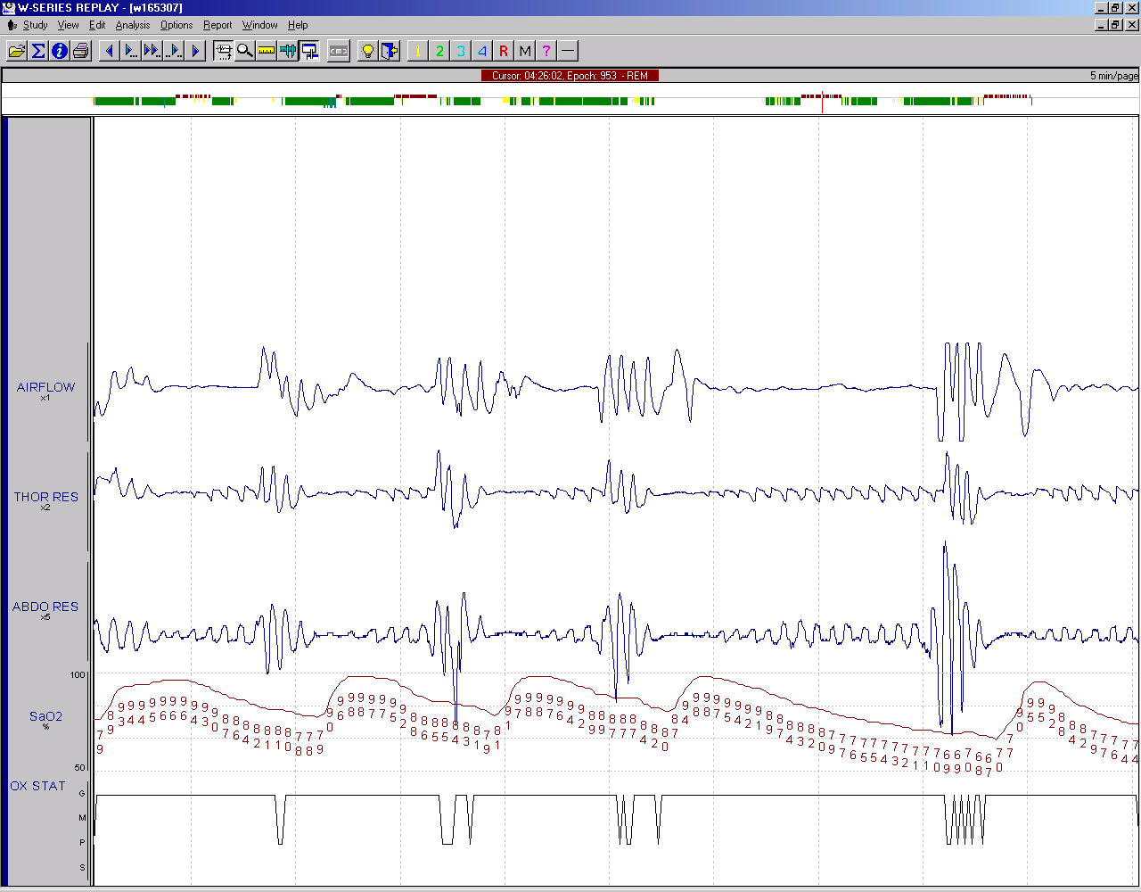
Physiological Consequences
Intrathoracic Pressure Changes
  Preload, afterload and transmural pressure
  Trigger baroreceptors
Hypoxemia, hypercapnia, and arousal
  SNS overdrive
  Systemic and Pulmonary Vasoconstriction
  Abnormal HRV and increased HR
  Inflammation and oxidative stress

Slide 5
Cardiac Structural Remodeling In Sleep Apnea
Surges in BP/Sustained Hypertension
    Arterial Stiffness, Increased Afterload, Diastolic Dysfunction, Atrial distention
Cyclical Intrathoracic Pressure Swings
  Changes in Atrial Volume Orban AJC 2008:102
Myocyte Injury
  Catecholamine Excess, Inflammation, Oxidative Stress and Pro-thrombosis
  Hypoxemia/Ischemia

Slide 6
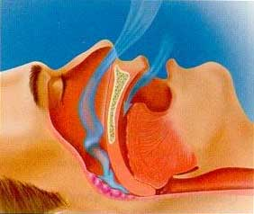
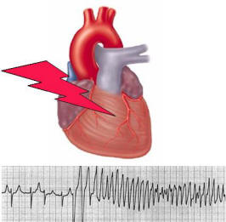
PHYSIOLOGIC PERTURBATIONS
INTERMEDIATE MECHANISMS
CLINICAL OUTCOMES
Chronic Intermittent Hypoxia
Ventilatory Overshoot Hyperoxia
Increased Sympathetic Nervous System Activity
Intrathoracic Pressure Swings
Hypercapnia
Increased Arousals
Reduced Sleep Duration
Increased Inflammation
Increased Oxidative Stress
Metabolic Dysfunction/
Insulin Resistance
Hyper-coaguability
Endothelial Dysfunction
Autonomic Dysfunction
Systemic Hypertension
Atherosclerosis
Diastolic Dysfunction
Congestive Heart Failure
Stroke
Increased Mortality and Sudden Death
CARDIAC ARRHYTHMIAS
SLEEP-Apnea
Mehra R Curr Resp Med Rev 2007

Slide 7
Sleep Apnea and CVD
SDB and CVD co-aggregate
  A majority of CVD patients have (unrecognized) SDB
    75% MESA participants have mild or more severe SDB
Strong biological plausibility of SDB in pathogenesis of CVD and diabetes
Strongest associations
    HTN, stroke, atrial fibrillation, diabetes, HF
SDB treatment may
    Insulin sensitivity
    Reduce BP and incident HTN
    Improve LV function
    Prevent incident and recurrent atrial fibrillation
    Reduce rate of CVD events

Slide 8
Knowledge Gaps
Epidemiological studies of white individuals, with BP or CVD endpoints
  Intermediate pathways/subclinical disease?
  Generalizability across racial/ethnic groups?
Contributions of specific sleep traits
  Sleep apnea, sleep duration, sleep timing, insomnia, PLMs
    Ethnic/gender variation accounting for variation in CVD
Genetic susceptibility
Intervention effects

Slide 9





MESA-Sleep Aims
Sleep Apnea
(AHI, Hypoxemia)
CVD Risk
Factors
(obesity, glucose impairment, dyslipidemia)
Racial/Ethnic
And
Gender Variation
Sleep As An Explanatory
Variable (race/gender
associations)
Independent Effects
Of Given Sleep Traits
Power of Quantitative
Sleep Metrics
Overnight ECG
Integrate with Genetics
Information
Extreme
Sleep Duration
Sleep Architecture
(SWS, REM, Spindles, SWA, Efficiency)
Subclinical Disease
CAC, cIMT, ABI, LVM, EF, RVM
Periodic Limb
Movements
Sleep
Misalignment
Clinical CVD
Insomnia

Slide 10
MESA-Sleep Exam
Invited all Exam-5 attendees
    Oct/Nov 2010-> Feb 2013
15 channel in-home polysomnograph (Somte)
  256 Hz overnight ECG collection
  Central, occipital and frontal EEG
  Routine scoring plus spectral analysis of ECG and EEG
7 day wrist actigraphy (Spectrum)
  Light, activity, on/off
  Day and night activity patterns
Standardized questionnaire and diary
  Insomnia, sleepiness, chronotype, SDB, sleep habits, RLS, shift work

Slide 11


PSG Receipts – 2,166
As of 4/1/2013
2010 2011 2012 2013
56 PSGs 1,041 PSGs 1,016 PSGs 53 PSGs

Slide 12
Total PSGs Received=2166
Total Actigraphy Received = 2251

Slide 13
Overall Quality PSG
Site | N-2166 | % Failed | N-2060 Passed | % V Good Excellent | % Good | % Fair
3-WFU | 316 | 5.1% | 300 | 84% | 10.3% | 5.7%
4-COL | 384 | 3.9% | 369 | 75.3% | 14.6% | 10%
5-JHU | 313 | 2.2% | 306 | 83.7% | 9.5% | 6.8%
6-UMN | 371 | 3.5% | 358 | 82.4% | 12.6% | 5%
7-NWU | 392 | 2.0% | 384 | 84.4% | 11.9% | 3.7%
8-UCLA | 390 | 12.1% | 343 | 70.8% | 20.4% | 8.7%
Totals | 2166 | 4.9% | 2060 | 80% | 13.3% | 6.7%
Increased failure rates associated with staff turnover
Notes:
A

Slide 14
Target Each Site - 383

Slide 15
Final 2240 Participants
1976 Participants w/PSG & Actigraphy
43 Participants w/PSG–Failed Actigraphy
72 Participants w/Actigraphy–Failed PSG
41 Participants w/PSG–no Actigraphy
108 Participants w/Actigraphy–no PSG
Total of 95 failed Actigraphy and 106 failed PSG

Slide 16
Urgent/Abnormal/Potential
Referral Summary
Description n=TotRcpts | Total 2166 | WFU 316 | COL 384 | JHU 313 | UMN 371 | NWU 392 | UCLA 390
Urg - 2nd/3rd degree block | 8 | 4 | 2 | 0 | 0 | 1 | 1
Urg – NSVT | 27 | 6 | 2 | 9 | 6 | 2 | 2
Urg - SaO2 <85% for >10% TST | 21 | 4 | 3 | 6 | 2 | 1 | 5
Total Urgents | 55 2.5% | 14 4.4% | 7 1.8% | 14 4.5% | 8 2.2% | 4 1% | 8 2.1%
Potential Urg A-fib | 24 | 4 | 6 | 4 | 3 | 1 | 6
Abnormal AHI >50 | 175 | 26 | 28 | 25 | 31 | 25 | 40
Actual Participant #s* | 231 | 40 | 37 | 38 | 38 | 29 | 49
*Actual # of Participants with Urgent/Abnormal/Potential Referrals = 231
Many of the participants had more than one referral type – For example 16 of the 21 Urgent SaO2 also had Abnormal AHI >50.

Slide 17
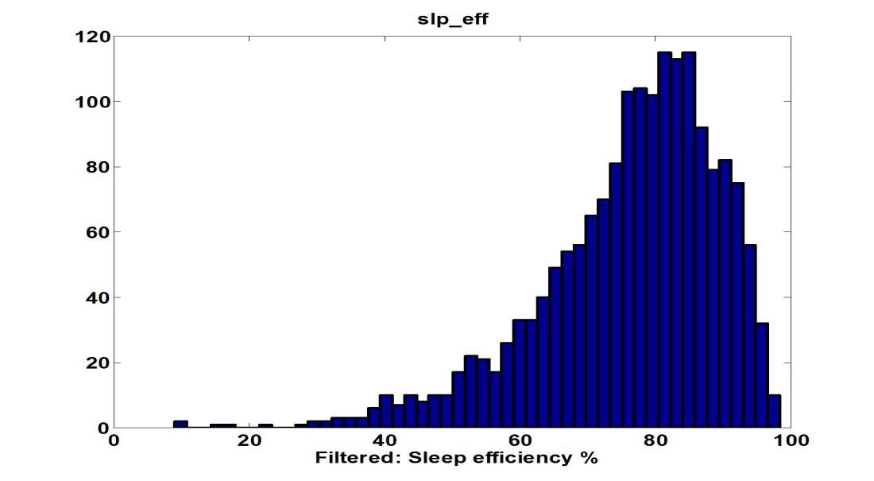
MESA-Sleep Data
Sleep Efficiency
Oxygen Saturation
Arousal Index
Apnea Hypopnea Index
21.6 ± 11.6
19.7 ± 18.5
13.5

Slide 18
Sleep Apnea Prevalence
By Gender

Slide 19
Sleep Duration and Gender
Avg Duration: 6.5 ± 1.4 hrs
410
304
284
252
Percentage (%)
204
159
137
122
66
60
42
41
10
24
17
9
3
0
7
3
2
0

Slide 20
Short Sleep and PLMD
By Gender

Slide 21
Sleep Apnea Prevalence
By Race/Ethnicity

Slide 22
Short and Long Sleep
By Race/Ethnicity
Sleep > 9 hrs

Slide 23
Initial Observations
High quality sleep data: PSG + actigraphy
Very high prevalence of SDB
  Male predominance
  Across racial/ethnic groups, possibly increased in Hispanics
High prevalence of “short” sleep
  Lowest prevalence in whites
  First US data in Chinese
  Higher in men vs women
Long sleep most common in Hispanics

Slide 24
Let the fun begin!
Sleep
Stress
Air
Genetics
MRI
Elasticity
Cognition
Sleep Working Groups
Phenotype
Genotype
5 calls already
Over 25 participants

Slide 25
Approved Papers
PSG Predictors of Elevated Blood Pressure (Dean)
Sleep Duration and the HPA axis (Castro-Diehl)
Sleep Apnea and Retinal Disease (Chew; used self report only)
Sleep Apnea and Mortality-Yebohah (self report only; published)
Genetic Variants/Genes Associated with Sleep Apnea and Related Sleep Phenotypes (Cade)

Slide 26
Papers Proposals Under Development
Trainee proposals
  Brian Cade (BWH)
  Dennis Dean (BWH)
  Jessie Baker (BWH)
  Mako Nagayohi (UM)
  Young Kwon (UM)
  Ceclia Castro (Col)
  Carmela Alcantra (Col)

Slide 27
Papers Proposals Under Development
Racial/ethnic/ socioeconomic predictors and prevalence of SDB
SDB and glycemic control
SDB and PAD
Activity (actigraphy) and PAD
SDB and arterial elasticity (SAE, LAE)
SDB and aortic distensibility (AD)
SDB and A Fib (A Fib subtypes)
Racial/ethnic differences in the association of sleep duration and health risk behaviors/habits (physical activity, substance use, smoking).
Inflammation and racial/ethnic differences in the association of sleep duration with incident CHD.

Slide 28
Papers Proposals Under Development
SDB (nocturnal hypoxemia) and cognitive functioning
SDB and LV mass and function
SDB and RV mass and function/PAP
Prevalence and risk factors for periodic limb movement disorder/RLS
Association of PLMs and subclinical CVD
Air pollutants and SDB and mediating role in CVD
Heart rate entropy and SDB

Slide 29
Papers Proposals Under Development
Circadian sleep/wake timing
  CVD risk factors, subclinical and clinical CVD
Sleep EEG signatures of CVD risk factors
- Slow wave activity and dissipation
- sex and ethnic differences
Circadian chronotype , clock genes, CVD risk
Spindle density, SWS dissipation and cognition

Slide 30

Papers Proposals Under Development
Functional genetic networks and sleep traits
Genetics of Sleep Duration and Architecture
Sleep traits epigenetic changes
Sleep traits and expression changes
Epigenetics of genetics
Genetics of epigenetics

Slide 31
In Progress
Matrix showing time interval and (n) between exam components and sleep exam
Analysis tip sheet
Participant/missing data bias
Access to the Sleep Portal-direct access to raw physiological data and query tools
Completion of ECG and EEG spectral analysis
Final editing of daytime naps

Slide 32
Related Grants/Projects
Minority training supplement (Dean)
Life after Linkage
  GWAS plus family data
  Common plus rare variants for sleep apnea
  Begun with exome chip data
RV and Sleep (Kawut)
National Sleep Research Resource
  Portal for community access to sleep data

Slide 33
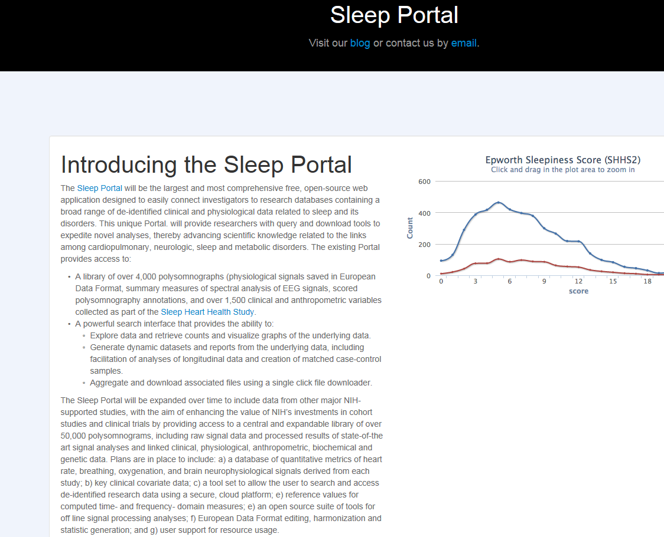
Sleep Portal
http://sleepepi.github.io/hybrid

Slide 34
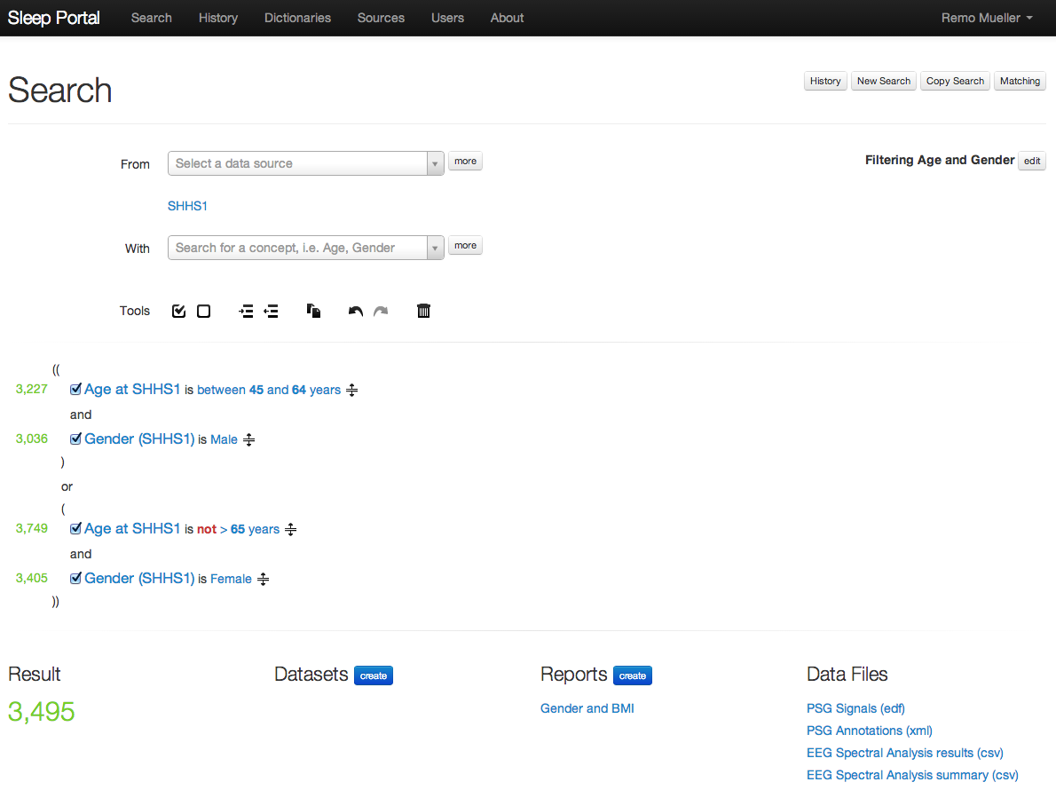
Searching in the Sleep Portal
An example search against the Sleep Heart Health Study (SHHS1) Dataset that finds men between the age of 45 and 64, and women under the age of 65.

Slide 35
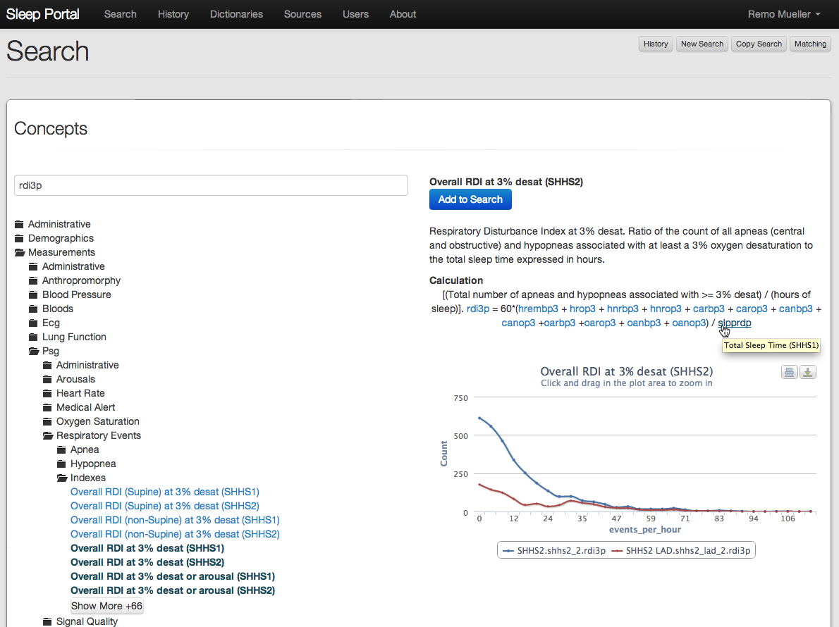
Searching Available Data
Exploring data provides interactive graphs, calculations for derived variables, links to related concepts, and links to PDFs of data capture instruments.

Slide 36
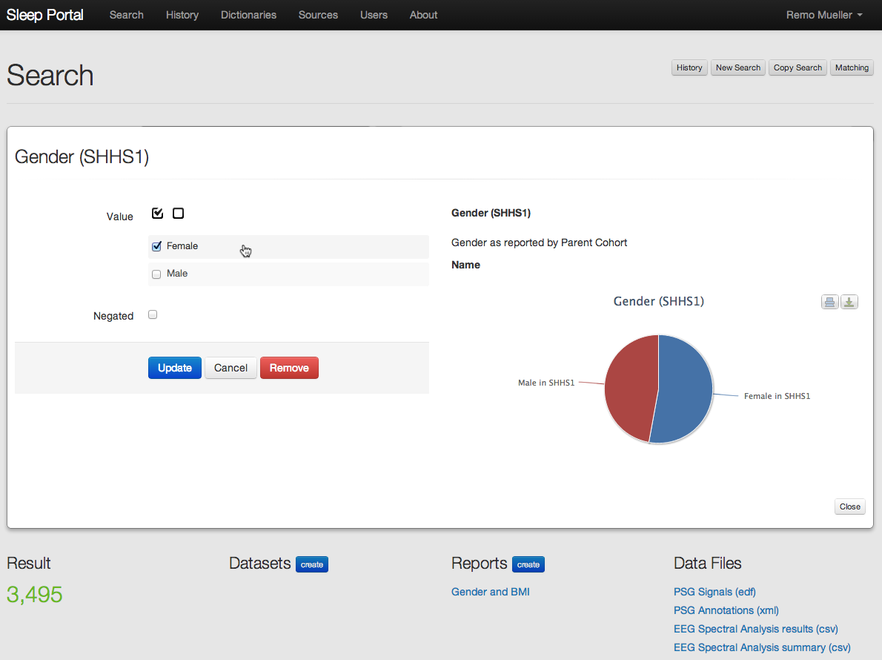
Setting Search Criteria (Categorical)
Search concepts provide graphs of the underlying data and let the user specify the value constraints without knowledge of how the data is stored in the connected data source(s).

Slide 37
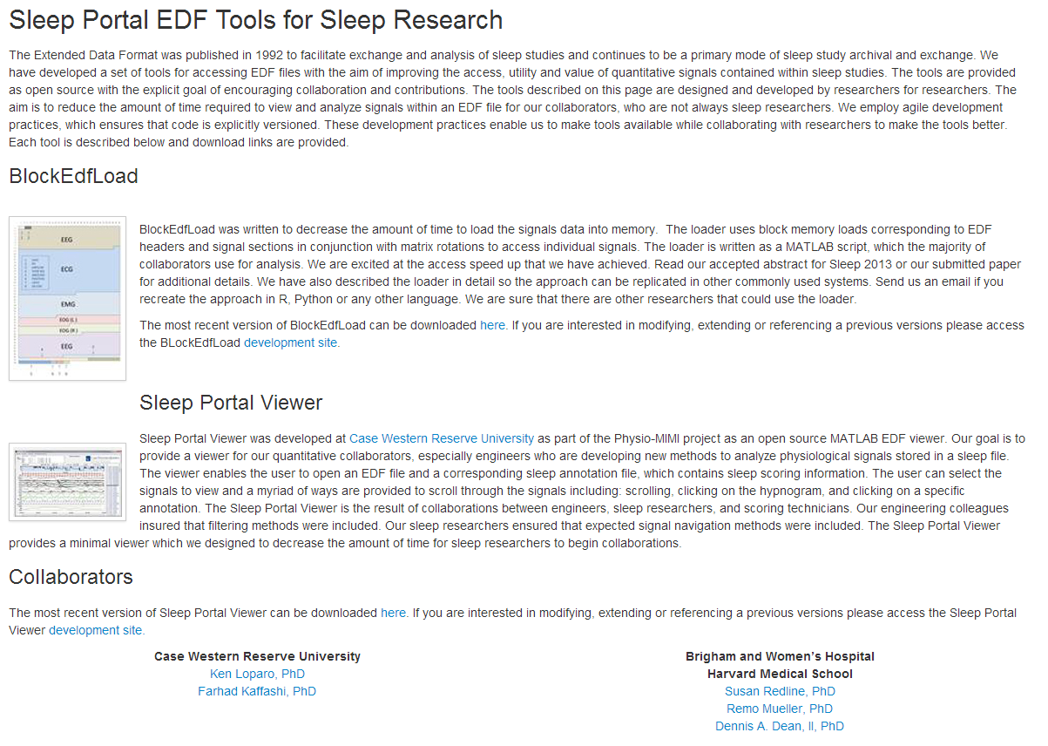
New tools are required to extract dynamic signals from sleep data

Slide 38
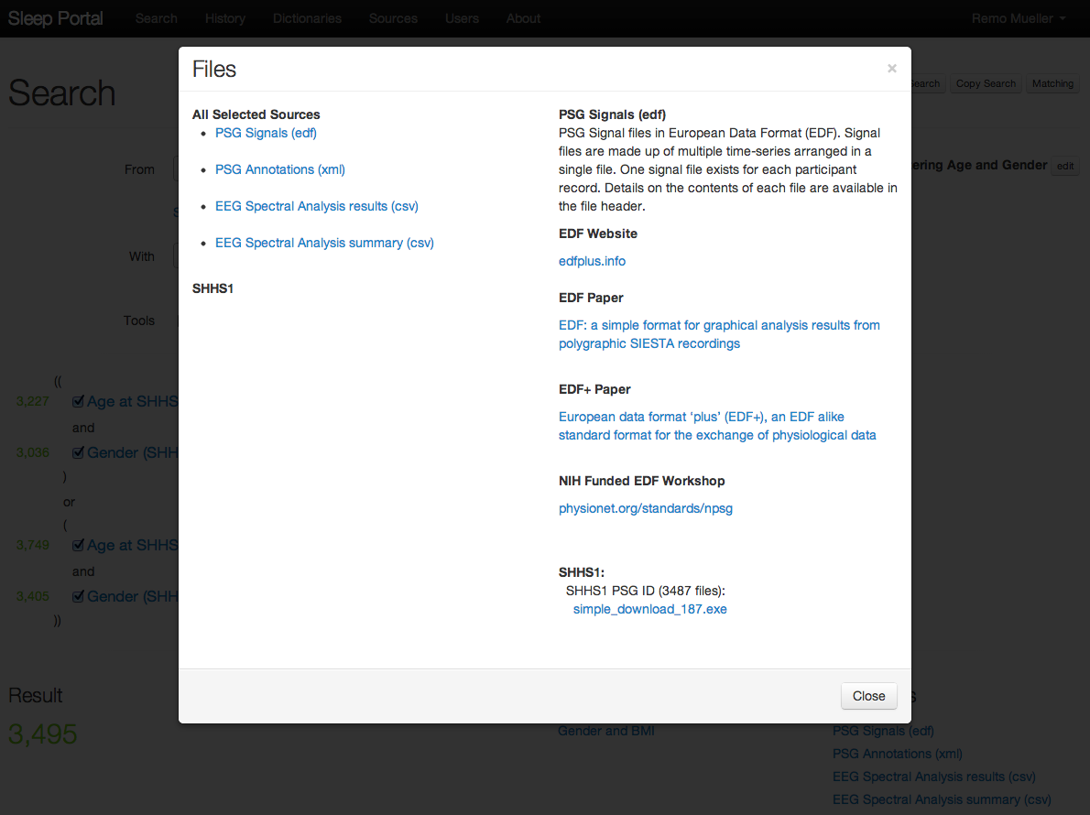
Download Files
Download multiple files associated with the search in one easy executable. The simple downloader can be stopped and will resume where it left off when restarted.

Slide 39
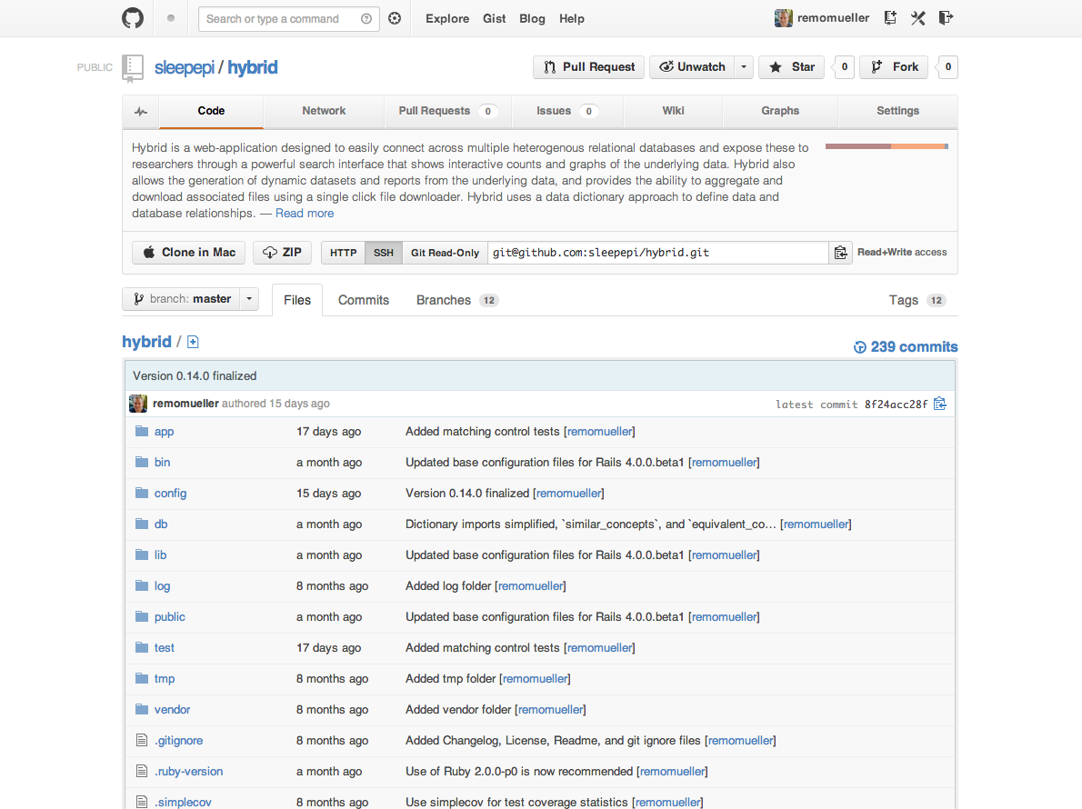
Open Source
The Sleep Portal code is open source available at github.com. Community contributions are welcome, and institutions may create forks to fit their individual requirements.

