Slide 1
MESA Sleep
Steering Committee Update
Oct 2013
Multi-Ethnic Study of Atherosclerosis, Steering Committee Meeting, Silver Springs, MD

Slide 2
Final 2240 Participants
1976 Participants w/PSG & Actigraphy
43 Participants w/PSG–Failed Actigraphy
72 Participants w/Actigraphy–Failed PSG
41 Participants w/PSG–no Actigraphy
108 Participants w/Actigraphy–no PSG
Total of 95 failed Actigraphy and 106 failed PSG

Slide 3
Overall Quality PSG
Site | N-2166 | % Failed | N-2060 Passed | % VGood Excellent | % Good | % Fair
3-WFU | 316 | 5.1% | 300 | 84% | 10.3% | 5.7%
4-COL | 384 | 3.9% | 369 | 75.3% | 14.6% | 10%
5-JHU | 313 | 2.2% | 306 | 83.7% | 9.5% | 6.8%
6-UMN | 371 | 3.5% | 358 | 82.4% | 12.6% | 5%
7-NWU | 392 | 2.0% | 384 | 84.4% | 11.9% | 3.7%
8-UCLA | 390 | 12.1% | 343 | 70.8% | 20.4% | 8.7%
Totals | 2166 | 4.9% | 2060 | 80% | 13.3% | 6.7%
Notes:
All sites improved quality with exception of UCLA. In 2012 UCLA responsible for ½ of all failures.

Slide 4
MESA-Sleep Activities
Produce a final “clean” dataset and documentation
Limited set of variables
PSG variables finalized 2/13
Actigraphy data (naps) expected 10/13
EEG Spectral analyses expected 1/14
ECG Holter analyses expected 3/14
Web Portal (NSRR)

Slide 5
MESA-Sleep Activities
Monthly WG calls to catalyze manuscripts
MESA-Sleep Genetics group
Exome and Metabochip analyses
Upload core sleep variables to dbGAP
Outreach to young investigators, collaborators, and link Sleep to other MESA ancillaries
Stress, Lung, AIR, Elasticity, Vitamin D, Epigenetics

Slide 6
MESA-Sleep Activities
Create a crisp “users guide” to sleep data
Document Protocol, montage, summary of reliability
Explore use of HTN imputation approaches-sleep analyses
Compare participants in MESA-Sleep to other MESA participants
Recommended first tier variables
Cluster analyses + clinical input
Thresholds and transformations
Post on web portal

Slide 8
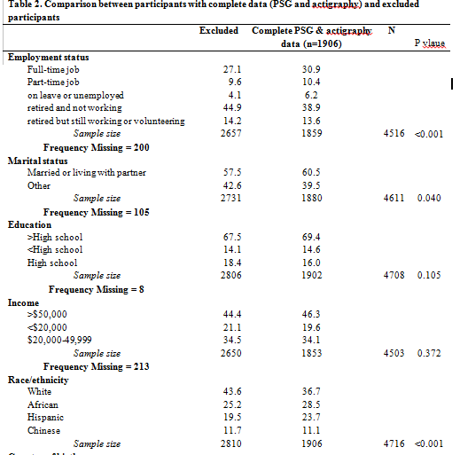

Slide 9
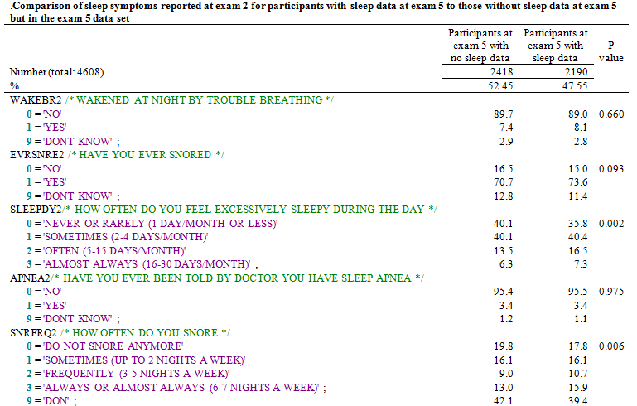

Slide 10
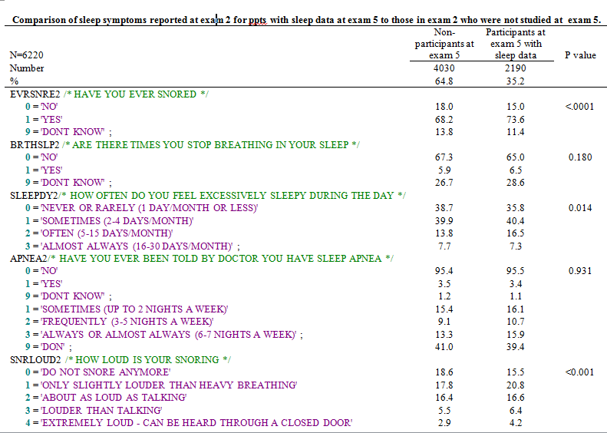

Slide 11
PSG Candidate Variable Set
Breathing Disturbance Index
OSAH3P* Obstructive Sleep Apnea Hypopnea Index
Rdinr3p Respiratory Disturbance Index (centrals/obstructives with 3% desat/in NREM)
Rdirem4p Respiratory Disturbance Index (centrals/obstructives with 4% desat/in REM)
Cai0p Central Apnea Index (all central events)
Overnight Hypoxemia
Pctlt90 Percentage sleep time <90% saturation
Sleep Architecture
Times34p* Percentage time in slow wave sleep
Timest2p Percentage time in stage 2 sleep
Sleep fragmentation
slp_eff Sleep Efficiency (%time asleep during sleep period)
ai_all Arousal Index
Periodic Limb Movements
Avgplma* Periodic Limb Movements/hr
AVGPLM Periodic Limb Movements with arousals/hr
* Selected “clinically”; all others selected via variable cluster analysis

Slide 12
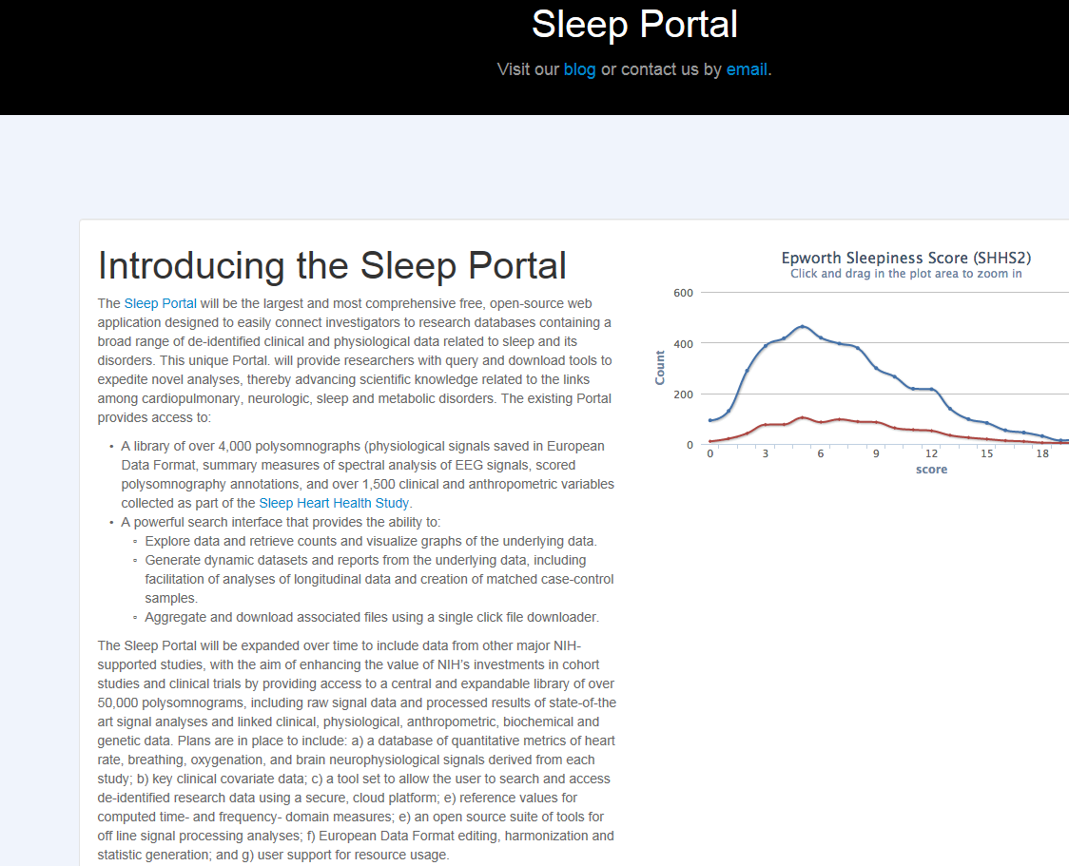

Slide 13
: https://github.com/sleepepi/mesa-documentation

Slide 14
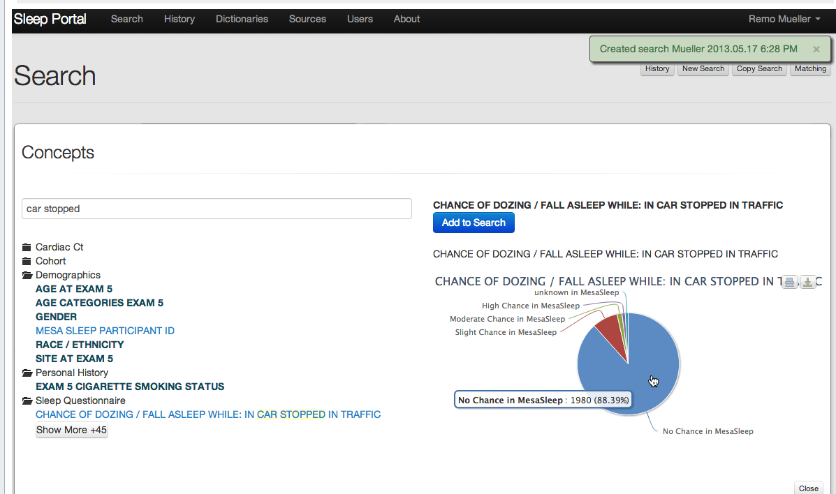

Slide 15
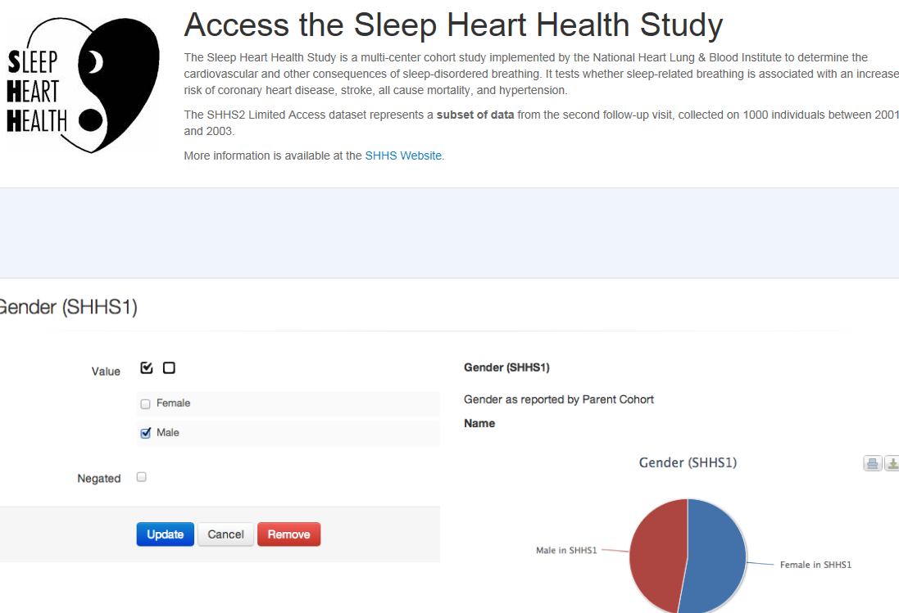
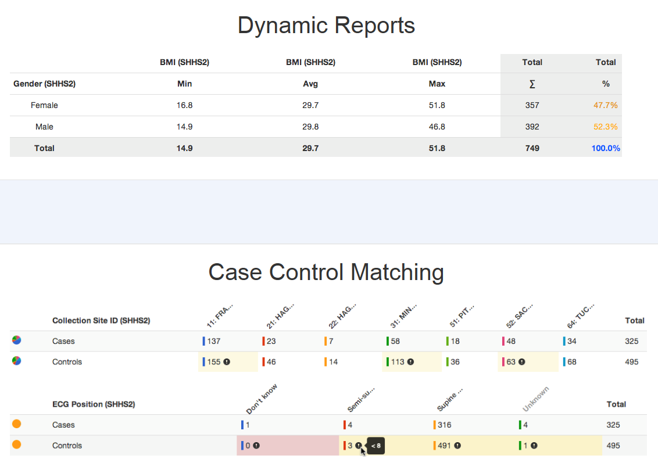

Slide 16
Sleep Manuscripts
15 Approved Proposals
8 Proposal Under Review (or almost)
7 Proposals Under Development

Slide 17
Approved Manuscripts
Variation by Race, Gender, SES (Redline)
Hypertension (Redline)
CAC (Lutsey)
PAD (Lutsey)
Glycemic Control (Redline)
Arterial Elasticity (Duprez)*
Aortic Stiffness (Lutsey)*
Cardiac MRI (Redline)
Circadian Rhythm (K Liu)
OSA & Interstitial Lung Disease (Barr)*
Sleep Duration and HPA Axis (Shea)*
Sleep Duration and SNS Activation (Shea)*
Genetics of OSA (Redline)
RLS and CVD (Redline)
Sleep and Telomere Length (Seeman)*
*Indicates Sleep X a 2nd ancillary

Slide 18
Papers Proposals Under Review
Sleep Disturbances and Depression (Davidson)
Sleep and Inflammation (Tracey)
Dynamic Non Linear ECG and Sleep (Post)
Air Pollution (Kauffman)
Vitamin D (Redline)
Carotid Ultrasound (Redline
Clock Genes and Diabetes (Redline)
OSA and COPD

Slide 19
Papers Proposals Under Development
Sleep and Cognition
Sleep EEG signatures and CVD and Cognition
- slow wave activity and dissipation
- sex and ethnic differences
Circadian genes, sleep and glucose control
Epigenetic changes/expression:
SDB; Sleep Duration
HRV and Sleep
A Fib and Sleep

Slide 20
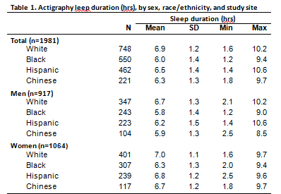

Slide 21
Sleep Duration By Site & Race

Slide 22
Selected Demographic Associations Adjusted Odds Ratios (95% CI)
Low Sleep Efficiency
Black Race 1.76 (1.32, 2.36)
Short Sleep (<6 hrs)
Female 0.35 (0.28., 0.45)
Not married 1.69 (1.30, 2.20)
Retired 0.53 (0.39, 0.71)
Race
Black 4.70 (3.45,6.42)
Hispanic 1.69 (1.14, 2.51)
Chinese 2.31 (1.39, 3.85)
Foreign Born 1.78 (1.24, 2.56)
Obese 1.96 (1.41, 2.72)

Slide 23
AHI and Race/Ethnicity
Percentage (%)

Slide 24
Sleep Apnea and Sleepiness Adjusted Odds Ratios (95% CI)
Sleep Apnea
Unadjusted -Adjusted
Black 1.38 (1.06, 1.80) 0.81 (0.61, 1.08)
Chinese 1.37 (0.99,1.91) 1.90 (1.18, 3.04)
Sleepiness
Unadjusted -Adjusted
Black 1.70 (1.31, 2.20) 1.72 (1.30, 2.27)

Slide 25
Sleep and Glucose Impairment (Bakker et al)

Slide 26
Thank you and stayed tuned!

