Slide 1
MESA – Sleep Updates
Steering Committee
September 13, 2012
September 2012 MESA Steering Committee Meeting, Silver Springs, MD

Slide 2
PSG Receipts – 1,916 As of 9/7/12

Slide 3
Overall Quality
Site | N-2011 | % Failed 2011 | % VGood Excellent | N-2012 | % Failed 2012 | % VGood Excellent
3-WFU | 153 | 6.5% | 75% | 129 | 3.9% | 87%
4-COL | 216 | 4.6% | 67% | 129 | 3.1% | 80%
5-JHU | 204 | 2.9% | 79% | 89 | 1.1% | 84%
6-UMN | 212 | 2.8% | 77% | 119 | 4.2% | 81%
7-NWU | 161 | 3.7% | 83% | 170 | .6% | 88%
8-UCLA | 160 | 11.9% | 67% | 120 | 12.5% | 61%
Totals | 1106 | 5.2% | 75% | 756 | 4.1% | 80%
Notes:
All sites improved quality with exception of UCLA. In 2012 UCLA responsible for ½ of all failures.

Slide 4
Failed Studies 88 of 1918 PSGs Received
 | Failed % | Oxi | EEG | Short <3 | No Data* | Ppt
3-WFU | 15 (5.2%) | 6 (2.1%) | 4 (1.4%) | 0 | 4 (1.4%) | 1 (.3%)
4-COL | 14 (3.9%) | 5 (1.4%) | 8 (2.2%) | 1 (.3%) | 0 | 0
5-JHU | 7 (2.3%) | 3 (1.0%) | 2 (.7%) | 2 (.7%) | 0 | 0
6-UMN | 11 3.3%) | 1 (.3%) | 6 (1.8%) | 1 (.3%) | 2 (.6%) | 1 (.3%)
7-NWU | 7 (2.0%) | 5 (1.4%) | 0 | 1 (.3%) | 1 (.3%) | 0
8-UCLA | 34 (11.8%) | 19 (6.6%) | 4 (1.4%) | 1 (.3%) | 7 (2.4%) | 3 (1%)
Totals | 88 (4.6%) | 39 (2%) | 24 (1.3%) | 6 (.3%) | 14 (.7%) | 5 (.3%)
*No Data includes - missing files , Somte did not record, and possible ppt issues
Site Failed percentages based on # PSGs received from Site - Totals based on total PSGs received at RC.
20 Participants agreed to a Redo – 18 of these were successful
6 at WFU; 4 at JHU; 4 at UMN; 4 at NWU

Slide 5
Urgent/Abnormal/Potential Referral Summary
Description n=TotRcpts | Total 1918 | WFU 286 | COL 359 | JHU 302 | UMN 336 | NWU 346 | UCLA 289
Urg - 2nd/3rd degree block | 7 | 4 | 2 | 0 | 0 | 1 | 0
Urg – NSVT | 20 | 4 | 2 | 8 | 4 | 1 | 1
Urg - SaO2 <85% for >10% TST | 20 | 4 | 3 | 6 | 2 | 1 | 4
Total Urgents | 47 2.4% | 12 4.2% | 7 1.9% | 13 4.3% | 6 1.8% | 3 .9% | 5 1.7%
Potential Urg A-fib | 20 | 4 | 6 | 3 | 3 | 1 | 3
Abnormal AHI >50 | 146 | 22 | 24 | 24 | 27 | 20 | 29
Actual Participant #s* | 191 | 34 | 33 | 35 | 33 | 24 | 32
*Actual # of Participants with Urgent/Abnormal/Potential Referrals = 191
Many of the participants had more than one referral type – For example 16 of the 20 Urgent SaO2 also had Abnormal AHI >50.

Slide 6
Actigraphy 1867 Receipts as of 9/10/11 1803 Passed – 64 Failed

Slide 7
Enrollment Status
Mesa Sleep Target: 2300 - Remaining to Reach Target: 380

Slide 8
Enrollment Status Target for Each Site – 383 by 11/30/12
WFU-92 to complete UMN-52 to complete
COL-23 to complete NWU-47 to complete
JHU-80 to complete UCLA-85 to complete

Slide 9
Enrollment Strategies
Opened recruitment window to include all
WFU and NW added hotel option
Contacting refusals to offer hotel
JHU exploring techs using hotel to reach out of area ppts
Contacting refusals to offer actigraphy only
Allowing CPAP users to do actigraphy only (sites to obtain lists from CC)

Slide 10
Enrollment – Other Issues
UCLA loss of key tech
Incentives for techs to stay until collection completed

Slide 11
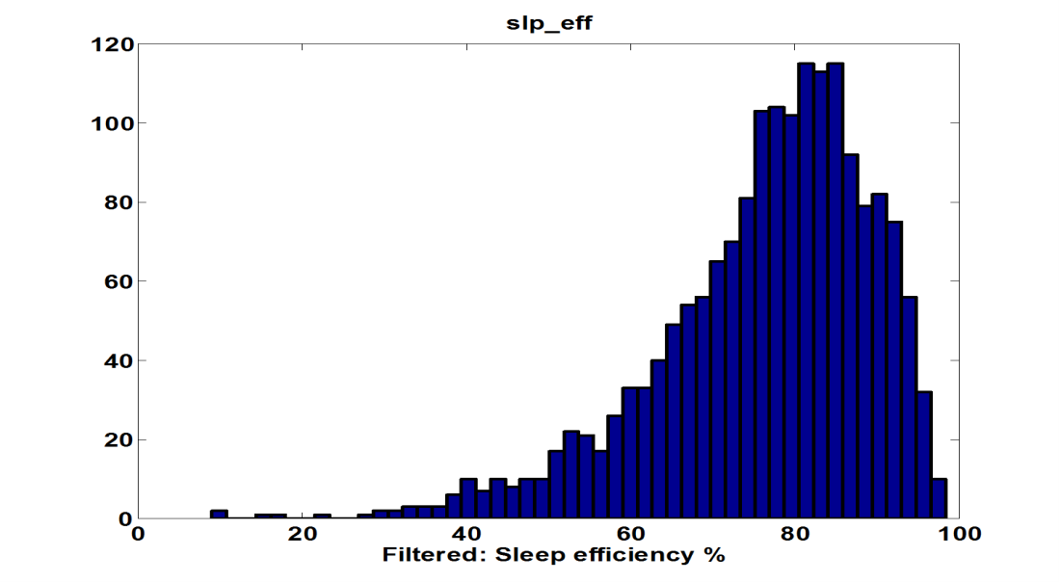
MESA-Sleep Data
Sleep Efficiency
Oxygen Saturation
Arousal Index
Apnea Hypopnea Index
21.6 ± 11.6
19.7 ± 18.5
13.5

Slide 12
AHI and Gender
AHI Categories
328
261
250
219
217
Percentage (%)
186
165
170

Slide 13
OSA (mild or more)
by gender
793
617
Percentage (%)
78.5%
219
165

Slide 14
OSA (moderate)
by gender
545
467
426
356
Percentage (%)
46%
22% with AHI > 30

Slide 15
AHI and Age
Age < 75
980
Percentage (%)
430
259
125

Slide 16
AHI and Race
Categories
225
220
197
158
161
138
141
150
Percentage (%)
89
169
76
68
1
1
0
0

Slide 17
Sleep Duration and Gender
Avg Duration: 6.5 ± 1.4 hrs
342
262
245
204
Percentage (%)
181
127
113
104
53
46
10
36
28
16
24
2
1
5
4
2
0
1

Slide 18
Sleep Duration < 7 hrs
607
512
405
Percentage (%)
282

Slide 19
Sleep Duration <= 6 hrs
Sleep Duration < = 6
723
536
Percentage (%)
289
258
30%

Slide 20
MESA Minority Supplement Dennis Dean PhD
Dynamic Physiological Indices
Functional Assays Collaborators - MESA Elasticity
Health Outcomes (MESA Core Measures)
PSG Signals from MESA-Sleep
SA-1
Respiratory Cycle-Related EEG Change (RCREC)
Arousals
Predictive
Explanatory
SA-1
SA-2A
AHI
High BP
EEG
MESA-Sleep
SA-2
Predictive
Breathing
SA-2B
Signal Source
Derived Measures
SA-3
Pulse Oximetry
Pleth Waveform
Derive
Predictive
SA-3A
Elasticity Estimate
SA-3B
Dr. Redline
MESA-Sleep
Night
Night/Day Relationship
Day
Arterial Elasticity
CV Disease
Drs. D. Duprez and Jacobs
MESA-Elasticity
B. Analytical and Software Toolset (Translational Outcome)
Aquire
Parse
Filter
Mine
Represent
Refine
Interact
Dr. R. Mueller, Mr. Rueschman
PSG Analysis Program, motivated by Visualizing Data, Ben Fry
Stats
Dr. R. Wang

Slide 21
Supplement Progress Overview
Research
Paper Proposal Accepted – April 13, 2013
Association of Sleep Exposures with Hypertension: The Multi-Ethnic Study of Atherosclerosis
Association of Sleep Exposures with Hypertension analysis is in progress
Collaboration with the MESA-Elasticity is in progress
IRB for collecting simultaneous tonometry and plethysmography in progress
Training
Completed year long applied statistics certificate offered by the Harvard Catalyst

Slide 22
Sleep-Hypertension Analysis
Primary Effects
Sleep Disordered Breathing
Oxygen Desaturation |  |  | continuous | avgsat, minsat, pctlt90
% Slow Wave Sleep |  |  | continuous | times34p
Apnea Hypoxia Index |  |  | continuous | rdi3p, rdirem3p, rdinr3p, rdi4p, rdirem4p, rdinr4p, rdi3pa, rdi4pa
Sleep Fragmentation
Sleep Efficiency |  |  | continuous | slp_eff
Arousal Index |  |  | continuous | ai_all, ai_rem, ai_nrem
Periodic Leg Movement Disorder
Periodic Leg Movement | continuous |  |  | plmaslp, plmanrem
Covariates
Age |  |  | continuous, polychotomous |  | age5c, agecat5
Race |  |  | polychotomous |  | race1
Gender |  |  | dichotomous |  | gender1
Body Mass Index |  |  | continuous, polychotomous |  | bmi5c, bmicat5c
Waist |  |  | continuous |  | waistcm5
Alcohol Use |  |  | dichotomous |  | curalc5
Tobacco |  |  | polychotomous |  | smkstat5, lvsmk5, cig5c
Medications |  |  | Continuous, dichotomous |  | totmed5, htnmed5c, diur5c
Environment |  |  | polychotomous |  | nscrime5, ntrash5 nnoise5
Psychological and Behavioral State |  |  | continuous |  | cesd5c
Marital Status |  |  | polychotomous |  | marital5
Personal Control |  |  | polychotomous |  | ucontrl5
Income |  |  | polychotomous |  | income5
Outcomes
Hypertension |  | dichotomous |  |  | htn5c
Systolic Blood Pressure |  | continuous |  |  | sbp5c
Diastolic Blood Pressure |  | continuous |  |  | dbp5c
Pulse Pressure |  | continuous |  |  | spp5c
Hypertension |  | polychotomous |  |  | htnstg5c
Resistant Hypertension, conservative |  | dichotomous |  |  | htnresistc
Resistant Hypertension |  | dichotomous |  |  | Htnresist
Hypertension Analysis Summary
Outcome class
Dichotomous | Continuous | Categorical
no-HTN | SBP continuous | HTN Stage
HTN | DBP continuous | Medication Resistant
Analysis Methods
Dichotomous | Continuous | Categorical
Logistic Regression | Regression with blood pressure (SBP and DBP) treated as right censored data | Polychotomous Regression
Resampling (e.g. Bootstrapping), and MESA developed imputation techniques for adjusting for medication use
Definitions
Hypertension (HTN)
SBP ≥ 140 or DBP ≥ 90 or anti-HTN medication
Hypertension Stage
1: Optimal SBP < 120 & DPB <80 2: Normal 120 <= SBP < 130 | 80<=DPB <85 3: High Normal 130 <= SBP < 140 | 85<=DPB <90 4: Stage 1 Hypertension 140 <= SBP < 160 | 90<=DPB <100 5: Stage 2 Hypertension 160 <= SBP < 180 | 100<=DPB <110 6: Stage 3 Hypertension SBP >= 180 | DPB <= 110
Medication Resistant (Hypertension)
Elevated BP despite treatment with three or more medications

Slide 23
Exposure and Outcome Correlations
Exposure and Outcome Correlations - RHO
Exposure and Outcome Correlations – p values
Saturation
Breathing
PLM
Saturation
Breathing
PLM
Sleep Structure
Arousals
Outcomes
Sleep Structure
Arousals
Outcomes
MESA CORE - Exam 5 AND MESA-SLEEP data (N=1823)

Slide 24
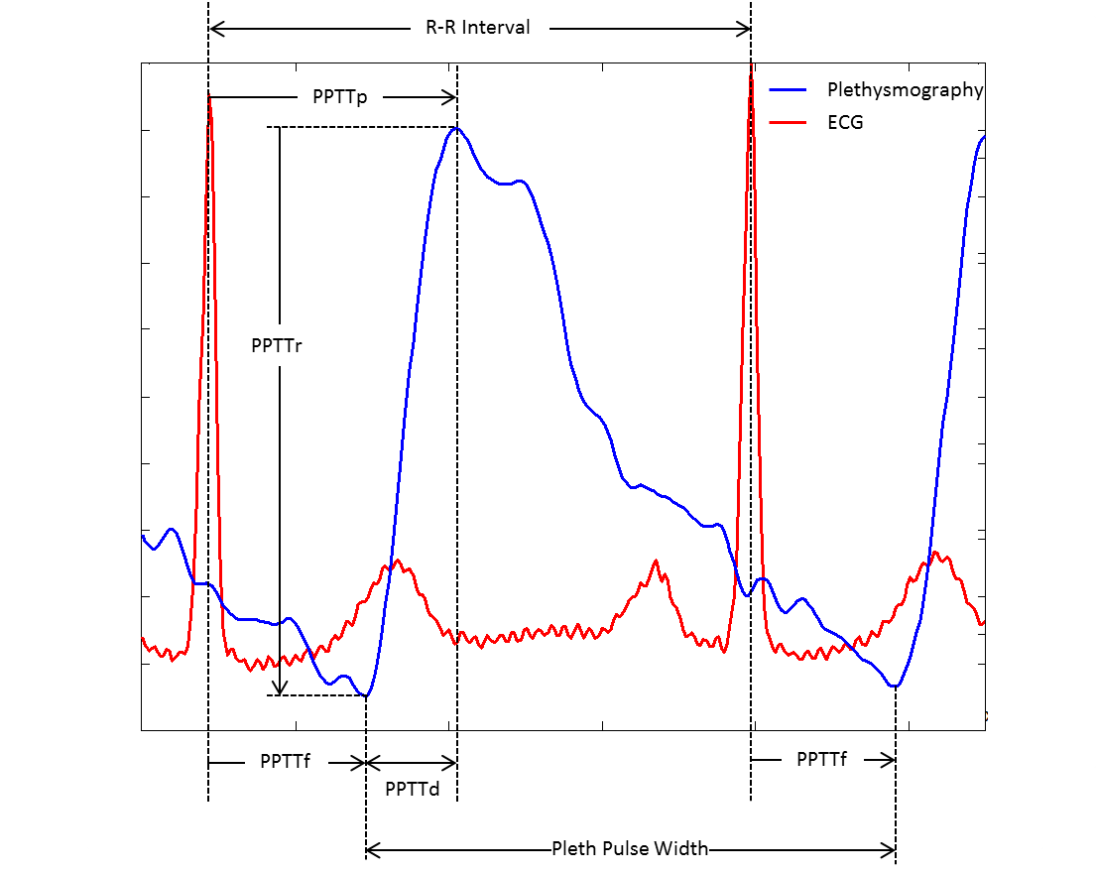
Plethysmography and Tonometry
Definition
Plethysmography records blood oxygen saturation levels, is commonly recorded during sleep studies, and is noninvasive to collect
Observation
Arterial tonometry (MESA-Elasticity) and plethysmography are visually similar
Research Motivation
Association of Small Artery Elasticity with Incident Cardiovascular Disease in Older Adults: The Multi-Ethnic Study of Atherosclerosis (Duprez et. al, 2011)
Hypothesis
Small artery elasticity estimated from Plethysmography are predictive of cardiovascular disease and could be used as a non-invasive health meter

Slide 25
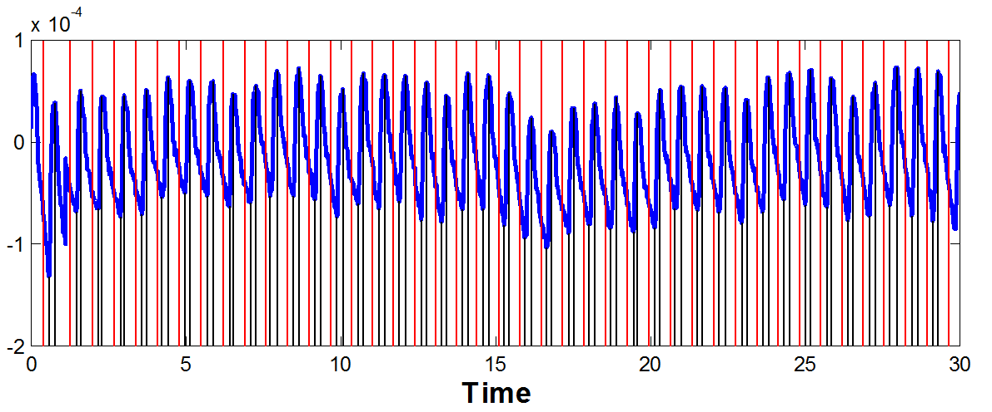
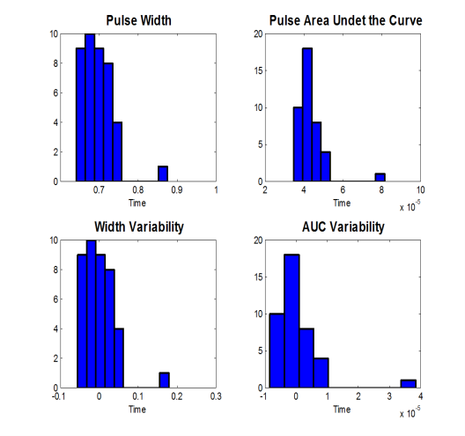
Automated Analysis and Summary
A Plethysmograph with R-wave timing
C Pulse Features
Pleth Pulses
Width
AUC
30 Second Wake Epoch
Amplitude
Width
AUC
B Automated Pulse Identification
Time
D Transit Time (Electro-Mechanical Delay) Features
PPTTf
PPTTp
PPTTf - PPTTp - PPTTd - PPTTr
PPTTd
PPTTr
* Hundreds of thousands of 30 second epochs available for analysis

Slide 26
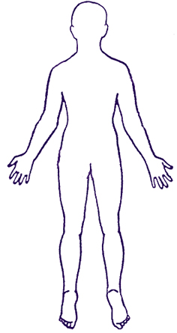
Estimating Peripheral Vascular Resistance and Compliance from Plethysmography (IRB)
Hypothesis: Plethysmography and tonometry pulse features are highly correlated, which is due to related cardiovascular input at the respective measuring point. This suggests that plethysmography could be used as a non-invasive measure of arterial health.
Hardware
Recording Sites
Specific Aim I: To test the hypothesis that the plethysmography derived indices of pulse transit times and indices of pulse magnitude are significantly correlated with corresponding tonometry indices.
Millar Tonometry (MESA)
Carotic
Radial
SphygmoCor Tonometry
Digit
Plethysmography
Specific Aim II: To test the hypothesis that arterial elasticity and compliance parameters computed from plethysmography with the Windkessel model are correlated with corresponding parameters estimated from tonometry.
Femoral
Electrocardiogram
* Plan to recruit 40 participants from new and existing subjects.

Slide 27
Summary and Plans
Data Collection
Sleep (PSG) data collection is resulting in high quality signals
Sleep (PSG) Data collection to be completed in Fall 2012
Begin Writing Group: N Punjabi, P Zee….others!
Research Supplement
Two Specific aims started
Plan to submit ATS abstract on the association of sleep exposures with hypertension
Plethysmography and tonometry data collection

