Slide 1
Atrial Fibrillation and NT pro-BNP: What can MESA tell us?
Kristen Patton, MD
University of Washington

Slide 2
AF is common
Incidence rises with age
Lifetime burden 1:4
Prevalence of Diagnosed AF Stratified by Age and Sex
Go, A. S. et al. JAMA 2001;285:2370-2375.

Slide 3
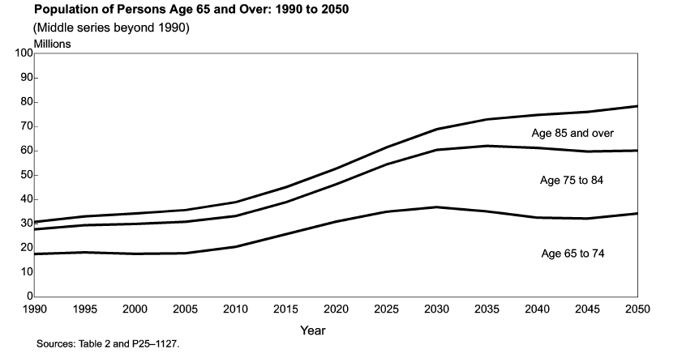
US Census Population growth
Day, Jennifer Cheeseman, Population Projections of the United States by Age, Sex, Race, and Hispanic Origin: 1995 to 2050, U.S. Bureau of the Census, Current Population Reports, P25-1130, U.S. Government Printing Office, Washington, DC, 1996

Slide 4
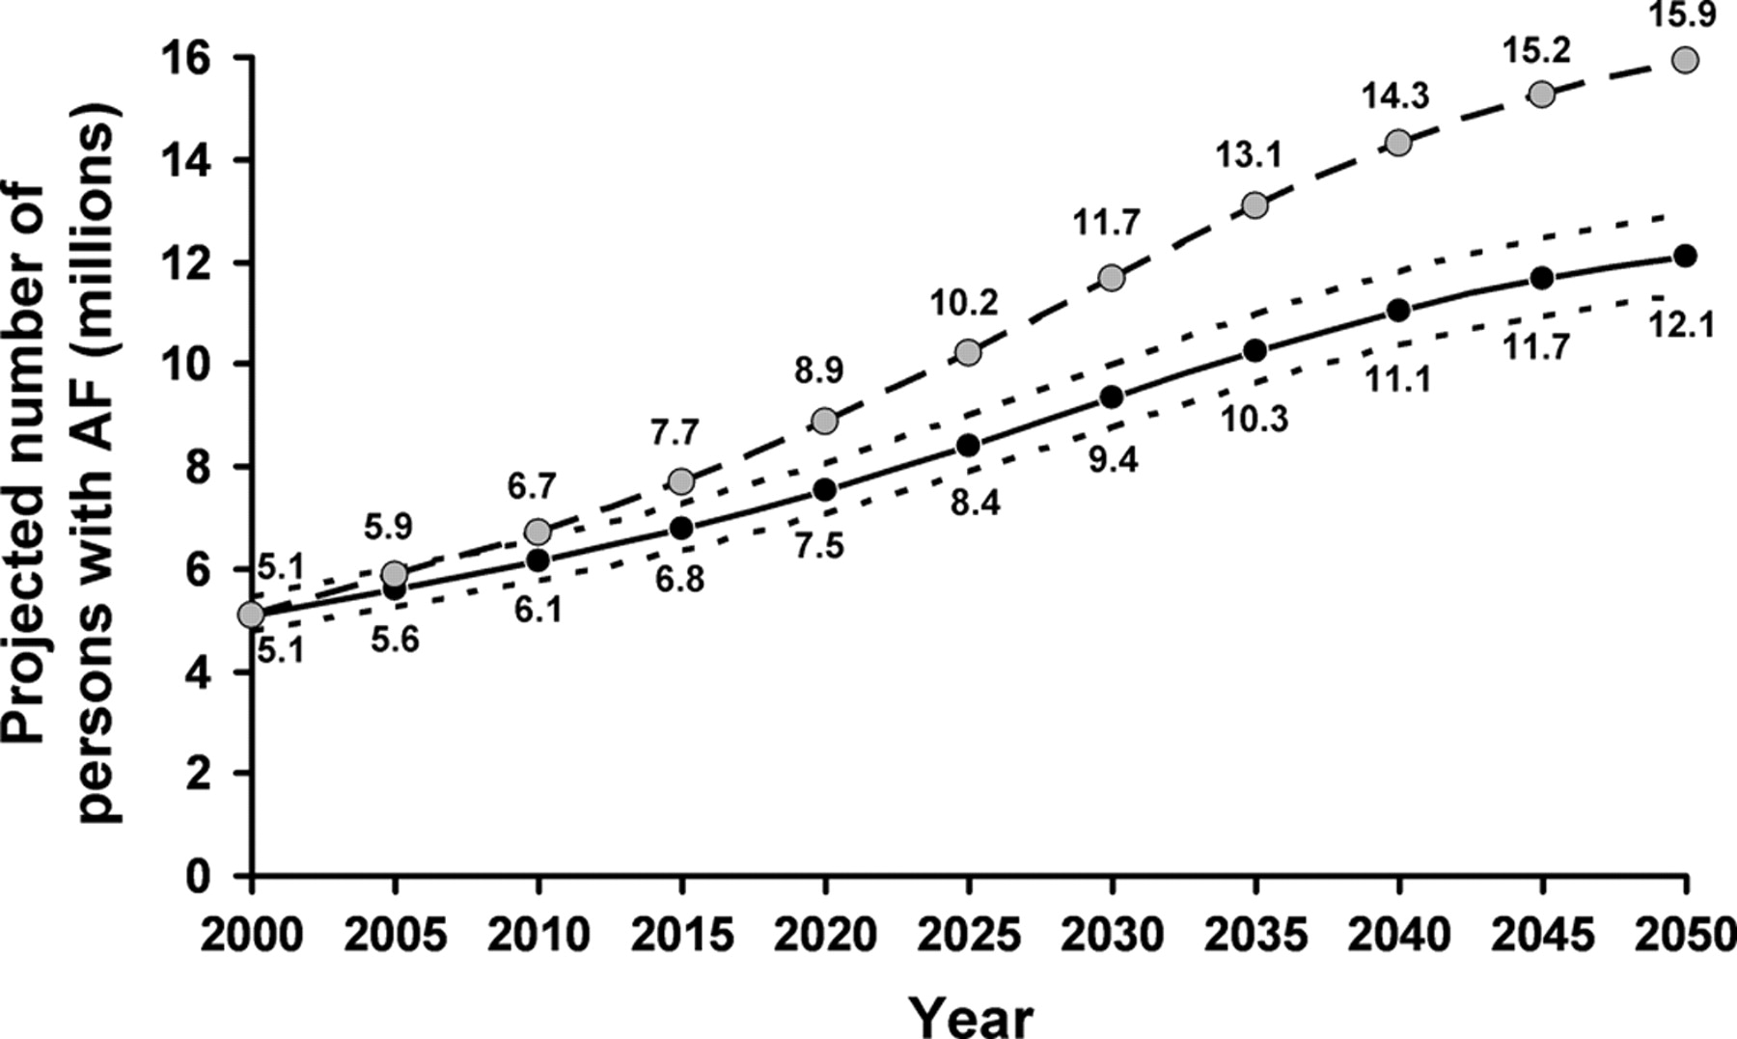
AF epidemic: Projected number of persons with AF in the United States between 2000 and 2050
Miyasaka Y et al. Circulation 2006;114:119-125

Slide 5
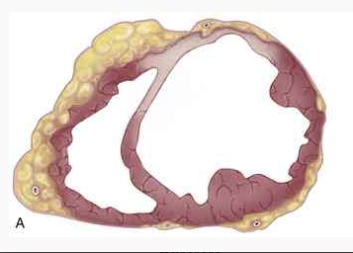
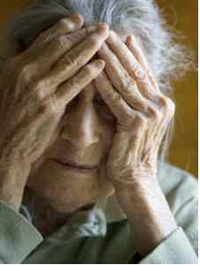
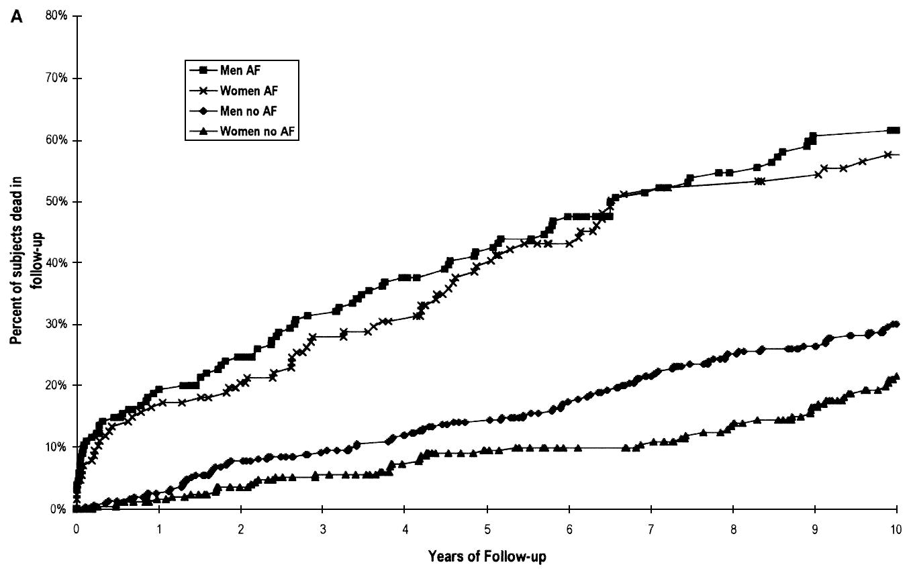
Why do we care: consequences of AF

Slide 6
Problem of AF
Clinical trials have primarily focused on treatment of AF
Goals:
Reduction of symptoms
Prevention of thromboembolic events
Prevention of heart failure
Reduction in mortality
Acceptance of AF as an unavoidable evil
No antiarrhythmic drug studies have shown improvement in outcomes

Slide 7
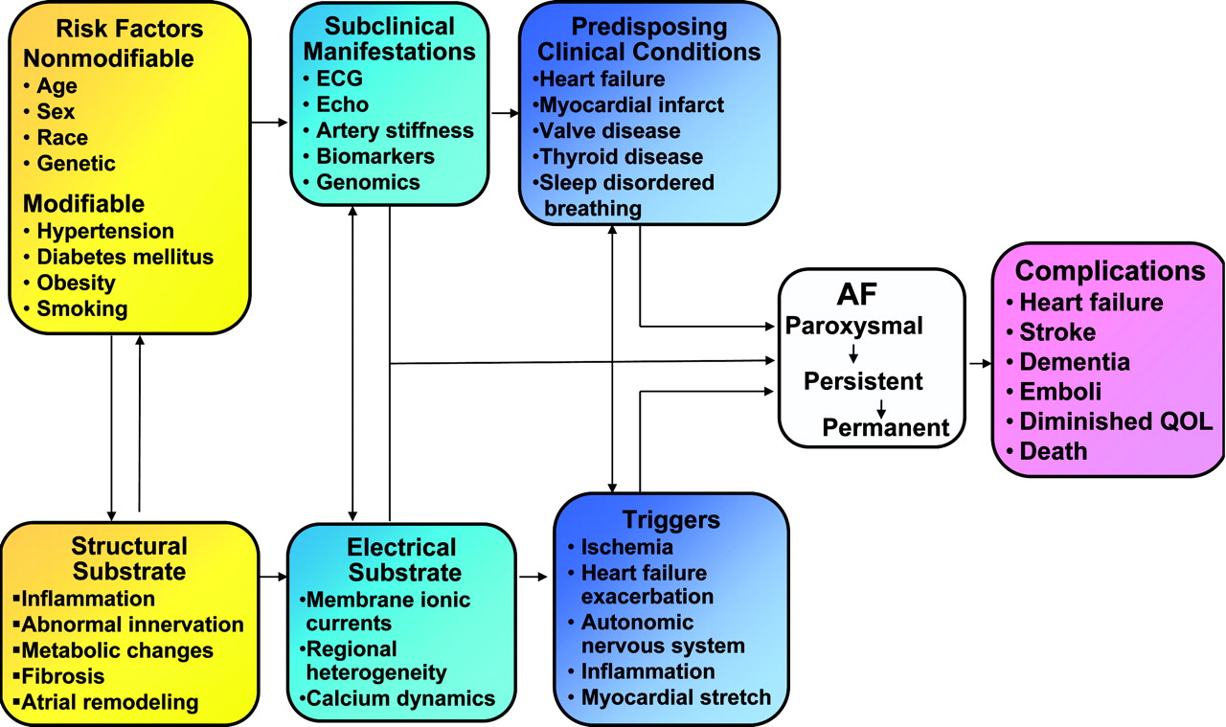
Shift to paradigm of prevention
Benjamin E J et al. Circulation 2009;119:606-618

Slide 8
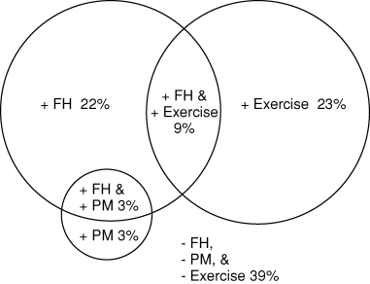
Barriers to understanding AF: how can we identify risk?
Clinical, biological and epidemiology studies limited by:
Ability to identify/diagnose AF
Sporadic
Often asymptomatic
Variably progressive
Inadequate surveillance tools
Phenotypic and genotypic heterogeneity
LAF, HF, post-op, vagal, HTN, thyroid, myocarditis, valvular, HCM, WPW, SCN5a, Lamin A/C…
Patton et. al. PACE2005;28;630

Slide 9
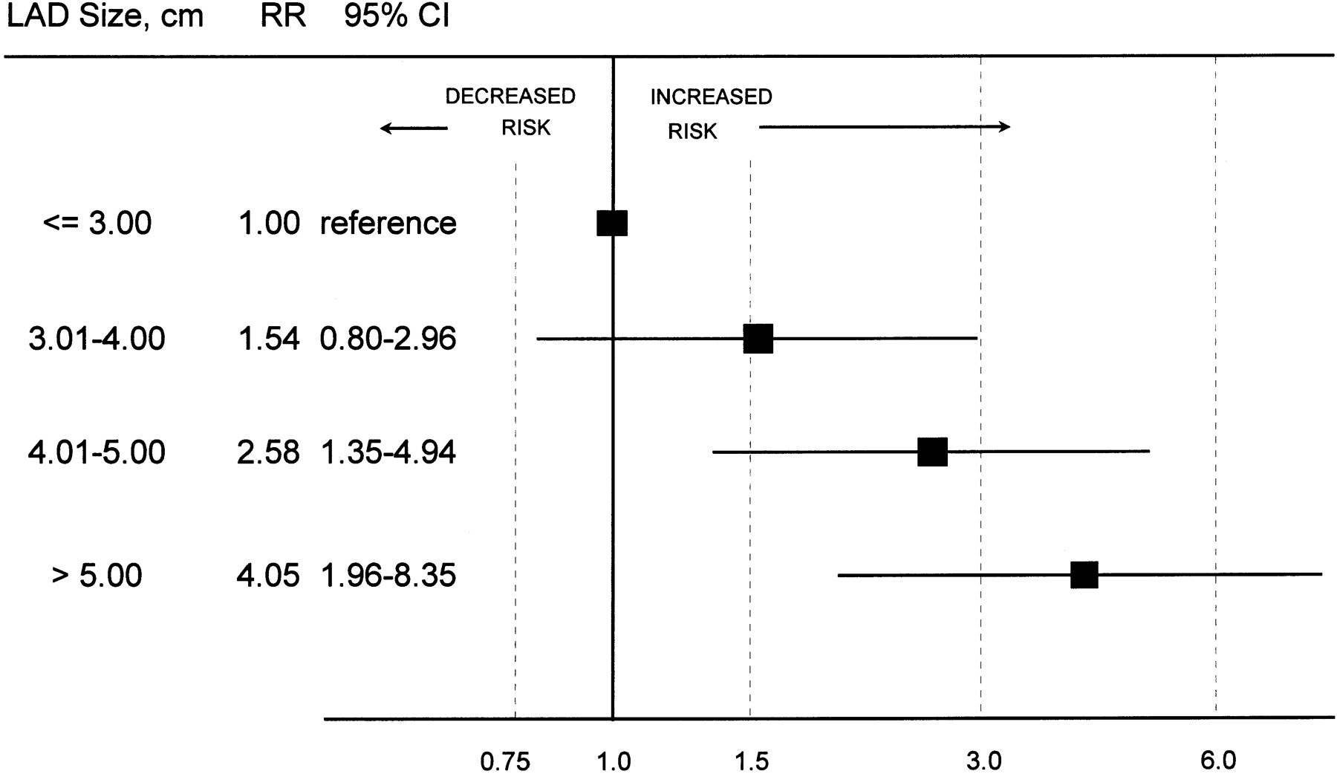
Epidemiologic established risk factors/associations
Age
Male sex
Heart failure
Diabetes
Hypertension
Myocardial infarction
Smoking
Myo & pericarditis
Valvular heart disease
Alcohol
Post-cardiac surgery
LA size
Psaty B M et al. Circulation 1997;96:2455-2461

Slide 10
AF – an epi success story
?
The population-attributable risk of atrial fibrillation in men and women determined from FHS.
Magnani J W et al. Circulation 2011;124:1982-1993

Slide 11
Novel risk factors/associations
Inflammatory biomarkers
Neurohormonal biomarkers
Genetics
Sleep apnea
Obesity and metabolic syndrome
Athletes
Increased pulse pressure

Slide 12
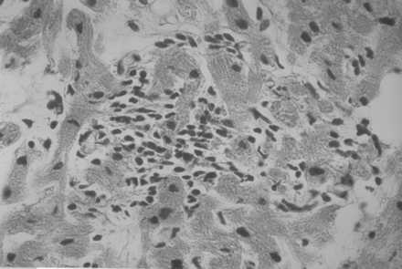
Inflammation and AF
High incidence of AF post-op
Time course of AF parallels IL-6, CRP and complement activation
Elevated inflammatory activity at the atrial tissue level in subjects with AF
Atrial “myocarditis”
Greater circulating inflammatory marker concentrations in pts with AF
CRP, BNP, IL-6
Frustaci et al. Circulation. 1997;96:1180
Atrial transport dysfunction in pts with elevated CRP and no AF
Inflammation alone impacts atrial function

Slide 13
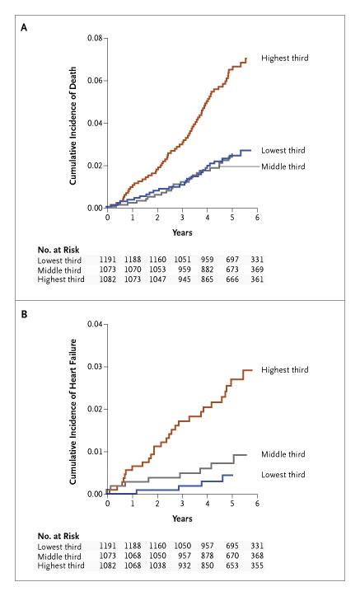
B-type Natriuretic peptide
Pleotropic peptide
Diuretic, natriuretic, vasorelaxant, antifibrotic, immune system modulator
Marker of increased atrial or ventricular wall strain, typically from pressure or volume overload
Correlates with LV mass and systolic dysfunction
Provides prognostic information before onset of clinically apparent cv disease, prognosis in many CV diseases, and death
Predicted AF and stroke, but very small number of cases
Wang TJ et al. N Engl J Med 2004;350:655-663.
Patton et. al Circulation 2009

Slide 14
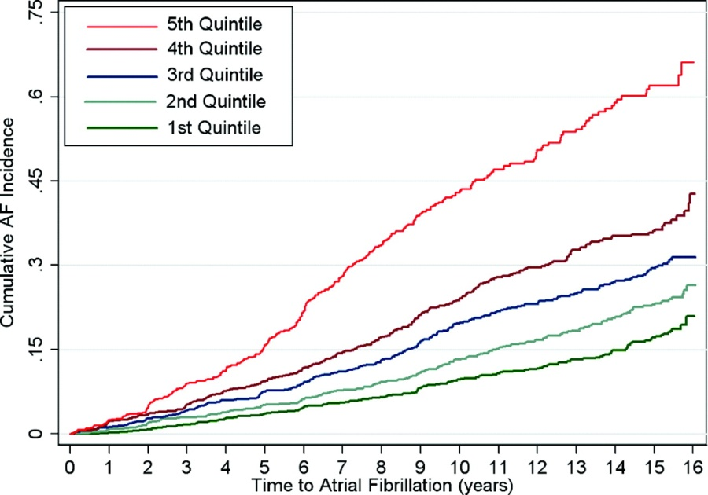
B-type Natriuretic peptide
Elevated in lone AF, independent of HF
CHS: baseline BNP predicts AF
HR 4 in highest quintile after adjustment for clinical and echo covariates
Ellinor et al. J Am Coll Cardiol, 2005; 45:82
Patton et. al Circulation 2009

Slide 15
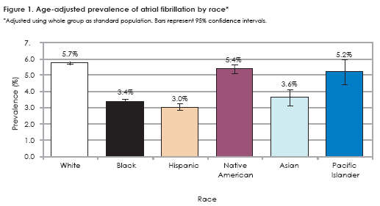
Problems with AF epidemiology
Current understanding based on predominantly white cohorts
Paradox: despite the greater burden of cardiovascular disease risk factors, blacks and Hispanic Americans have a lower incidence of AF
Borzecki et al. J Nat Med Assoc 2008:237

Slide 16
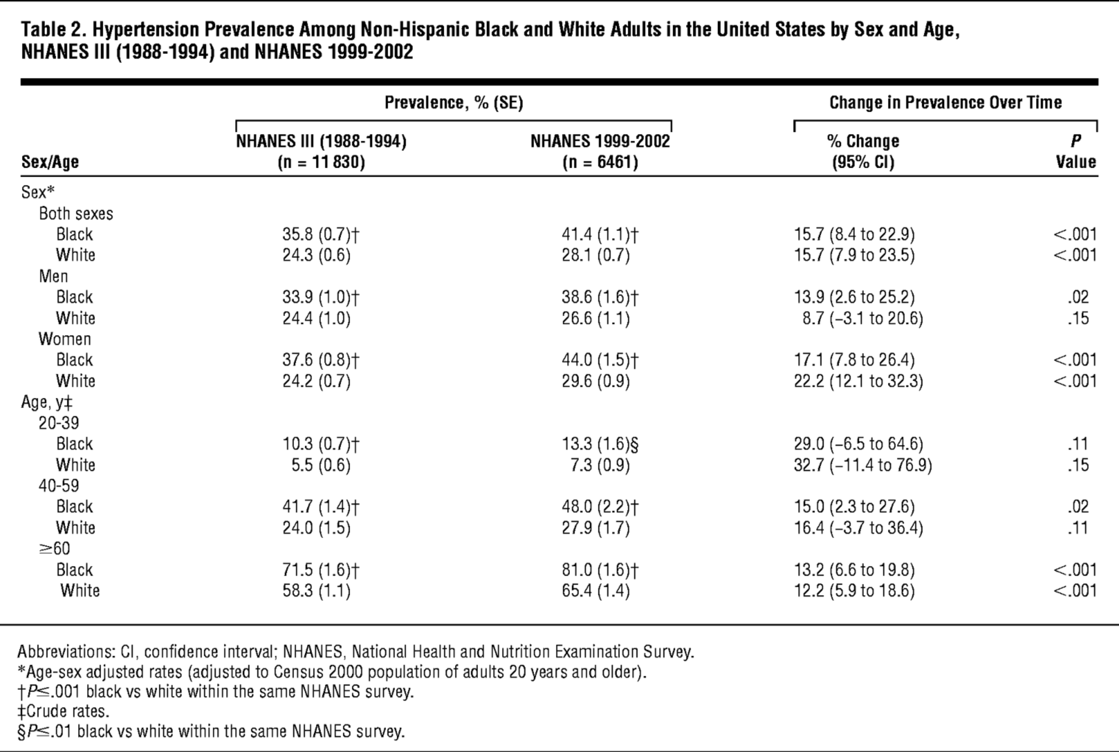
We know little about AF in non-white races, and what we know is paradoxical
AF sratified by PR interval < > 200 ms
Hypertension prevalence whites and blacks
Magnani J W et al. Circ Arrhythm Electrophysiol 2013;6:84-90
Arch Intern Med. 2005;165(18):2098-2104.

Slide 17
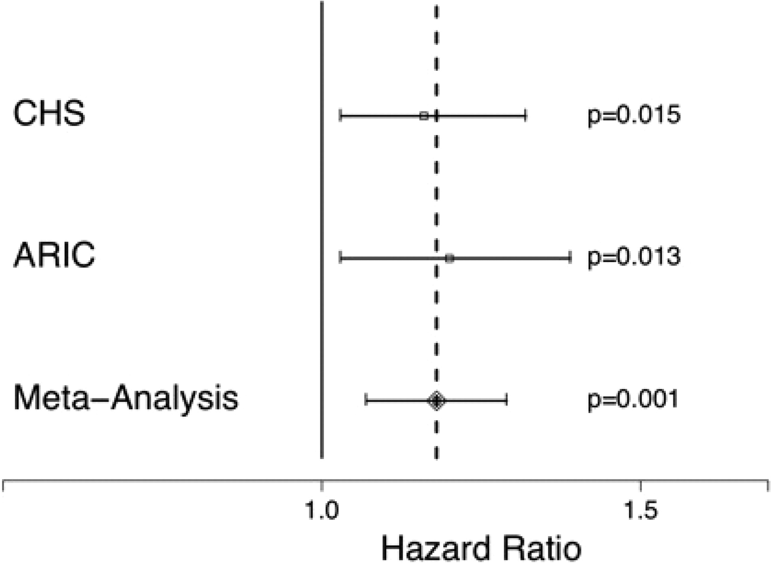
HRs of AF for each 10% increase in European ancestry after adjustment for clinical risk factors
Marcus G M et al. Circulation 2010;122:2009-2015

Slide 18
What is the relationship between NTp-BNP and AF in other ethnicities/races?

Slide 19
Methods: Data
5518 MESA subjects had baseline NT-pBNP measured
CV data from usual sources (enrollment, f/u, CMS records)
NT pBNP range 5 pg/ml-> 35,000 pg/ml
cMRI for LV structure, function

Slide 20
Methods: Determination of incident AF
Excluded self-reported AF
Hospital discharge diagnoses (ICD-9 codes 427.31 and 427.32), MESA events detection protocol, or CMS hospital billing
Validation substudy reviewing 45/185 MESA participants with hospital discharge diagnosis for AF showed AF was confirmed in 93% of cases.

Slide 21
Methods: Analysis
Cox model regressions to estimate HR of developing AF as a function of NT pBNP
Tested for interactions with age, gender, race/ethnicity
NT pBNP analyzed as continuous variable (ln), and as categories as quintiles
Failure time was baseline exam date and first hospitalization for AF or baseline exam and last known f/u
Adjusted for significant predictors from backwards selection: age, sex, r/e, ln NTpBNP, BMI, height, tobacco, HTN, BP, HTN meds, DM
cMRI data: LV mass, LV eDV, EF

Slide 22
Results: incident AF
Of 5518 subjects, over a median of 7.6 years of f/u (99% < 8.25 years f/u)
267 developed AF
No huge epidemiologic surprises
Older age (72 yrs vs. 62 yrs)
Male, white
Higher SBP, HTN dx, HTN meds
BMI and DM did not differ
EF same, LV mass higher in AF group
Avg NT pBNP level higher

Slide 23
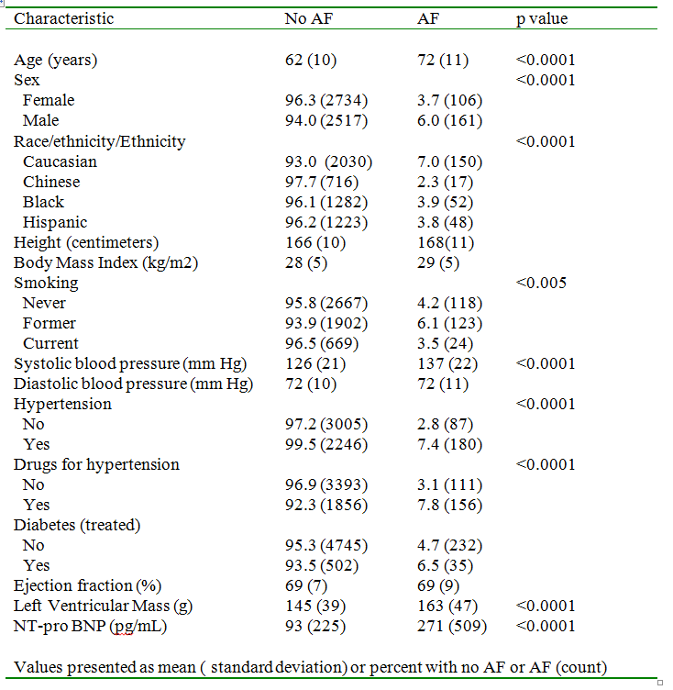

Slide 24
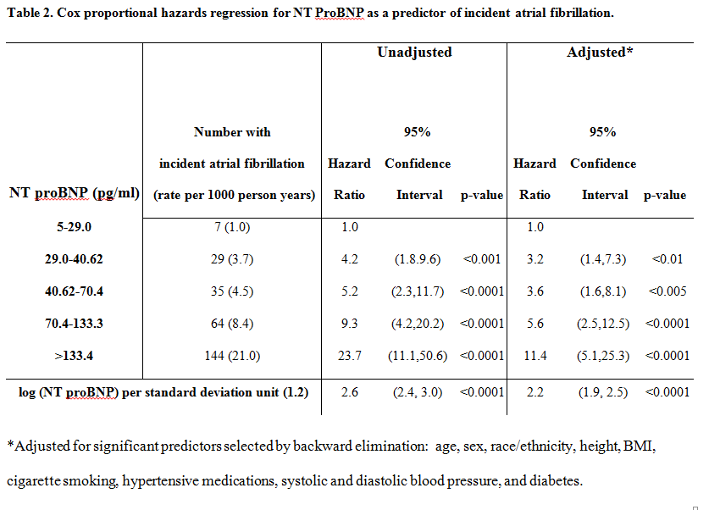
BNP associated with incident AF

Slide 25
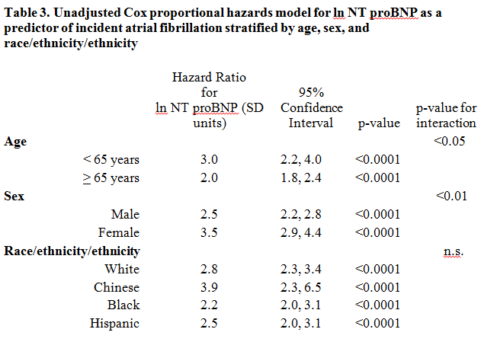
BNP strongly associated in young/old, women/men, non-white/white

Slide 26
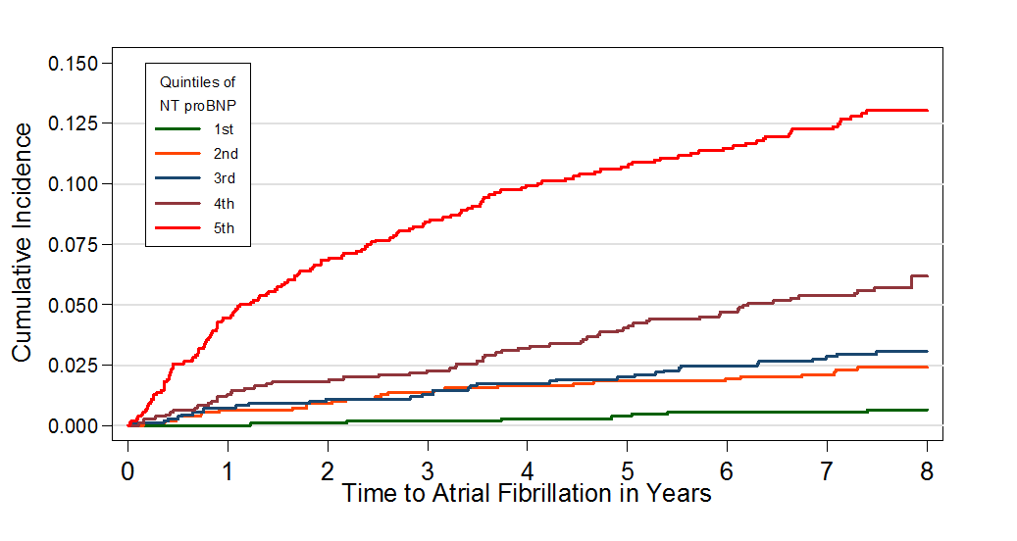
Cumulative incidence curve by quintile – entire cohort

Slide 27
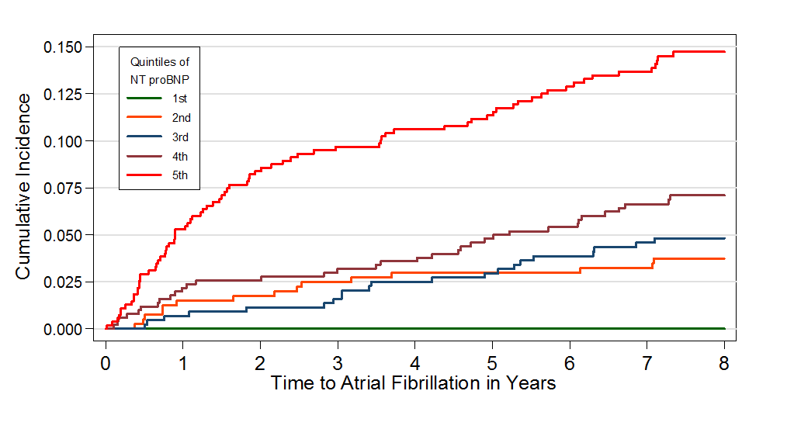
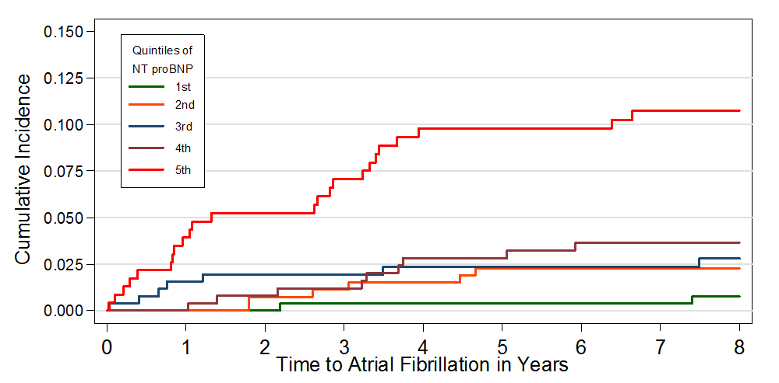
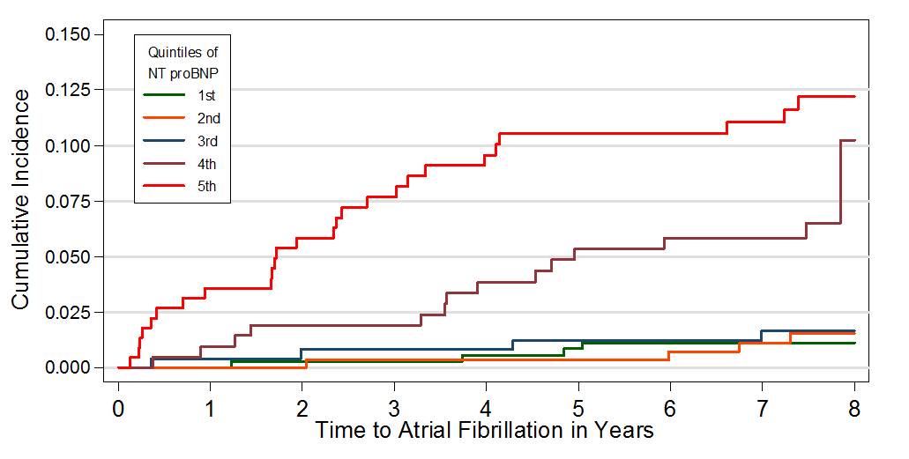
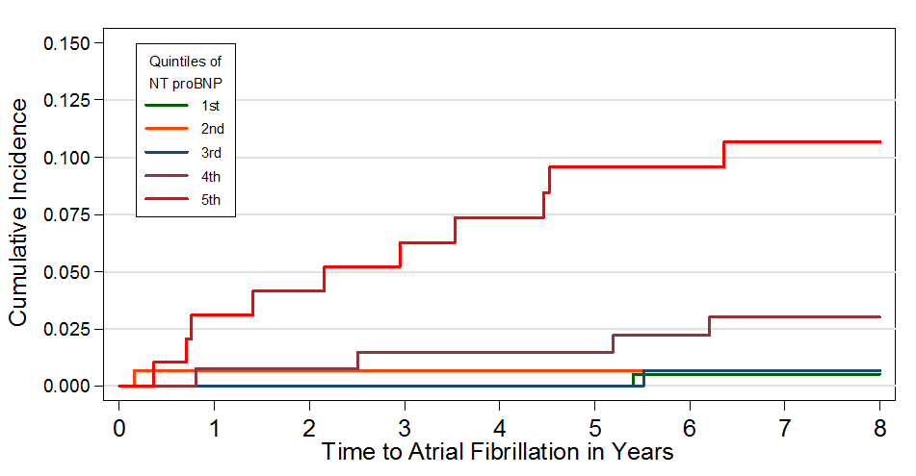
Incidence curves by race
White
Hispanic
Black
Asian/Chinese

Slide 28
NT pro-BNP is a strong and robust predictor of incident AF
Prognostic value is even greater in the young and women compared with older subjects and men
Robustly predictive in Blacks, Hispanics, and Asian/Chinese as Whites, despite lower incidence of AF
NT pBNP may be useful to distinguish a high risk group to target for prevention

Slide 29
Thank you!
Dick Kronmal
Susan Heckbert
Alvaro Alonso
Hossein Bahrami
Joao Lima
Gregory Burke

