Slide 1

Percent emphysema on computed tomography is associated with all-cause mortality
The Multi-Ethnic Study of Atherosclerosis (MESA) Lung Study
Lizzy Oelsner, MD
Post-doctoral fellow
Columbia University
Division of General Medicine
- Lung

Slide 2
Chronic lower respiratory disease
3rd leading cause of death in the US
4th leading cause of death globally
5th leading cause of years lived with disability
Minino AM, CDC, 2011.
Decramer et al, Lancet, 2012.
Vos T et al, Lancet, 2012.
Notes:
CDC / WHO / Global burden of disease
Also, per global burden, COPD is 2nd leading cause of disability-adjusted life years lost in US

Slide 3
Chronic lower respiratory disease
Chronic Bronchitis
Emphysema
Chronic obstructive pulmonary disease
Asthma
Adapted from AJRCCM, 1996
Notes:
COPD defined on spirometry as airflow obstruction that does not fully reverse with bronchodilators
Asthma as intermittent airway obstruction.
Chronic bronchitis as cough, mucous hypersecretion.
Emphysema as anatomical destruction of lung parenchyma

Slide 4
Chronic lower respiratory disease
Chronic Bronchitis
Emphysema
Chronic obstructive pulmonary disease
Most clinical research
Asthma
Adapted from AJRCCM, 1996
Notes:
COPD defined on spirometry as airflow obstruction that does not fully reverse with bronchodilators
Asthma as intermittent airway obstruction.
Chronic bronchitis as cough, mucous hypersecretion.
Emphysema as anatomical destruction of lung parenchyma

Slide 5
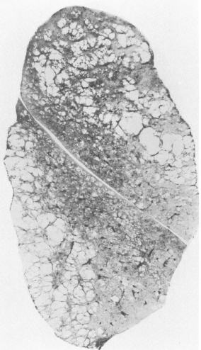
Emphysema knowledge gaps
Significance in absence of COPD unclear
Lung volume reduction surgery one of the few specific therapies
No successful medical clinical trials
Auerbach et al, NEJM 1972. Criner et al AJRCCM 2011 [NETT]. Stolk J et al, ERJ 2012 [REPAIR].

Slide 6
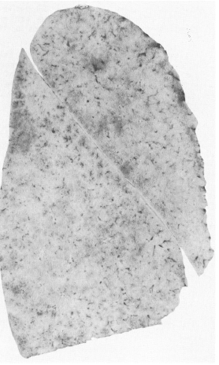
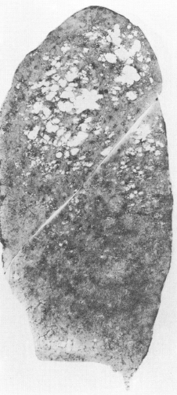
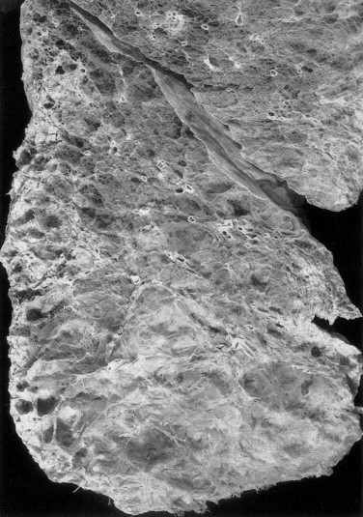
Emphysema subtypes
Normal lung
Centrilobular
Panlobular
Anderson et al, Science 1964. Auerbach et al, NEJM 1972. Tomashefski et al, Hum Path 2004. Takahashi et al, Int J Chron Obstruct Pulmon Dis, 2008
Notes:
Only 3 out of 71 autopsies in Anderson had no emphysema at all

Slide 7
Studying emphysema
Normal lung
Centrilobular
Panlobular
90% of never smokers
14% of smokers
Anderson et al, Science 1964. Auerbach et al, NEJM 1972. Tomashefski et al, Hum Path 2004. Takahashi et al, Int J Chron Obstruct Pulmon Dis, 2008
Notes:
Only 3 out of 71 autopsies in Anderson had no emphysema at all

Slide 8
Studying emphysema
Normal lung
Centrilobular
Panlobular
90% of never smokers
14% of smokers
98% smokers
Anderson et al, Science 1964. Auerbach et al, NEJM 1972. Tomashefski et al, Hum Path 2004. Takahashi et al, Int J Chron Obstruct Pulmon Dis, 2008
Notes:
Only 3 out of 71 autopsies in Anderson had no emphysema at all

Slide 9
Studying emphysema
Normal lung
Centrilobular
Panlobular
90% of never smokers
14% of smokers
98% smokers
47% never-smokers
Alpha-1 Antitrypsin
Anderson et al, Science 1964. Auerbach et al, NEJM 1972. Tomashefski et al, Hum Path 2004. Takahashi et al, Int J Chron Obstruct Pulmon Dis, 2008
Notes:
Only 3 out of 71 autopsies in Anderson had no emphysema at all

Slide 10
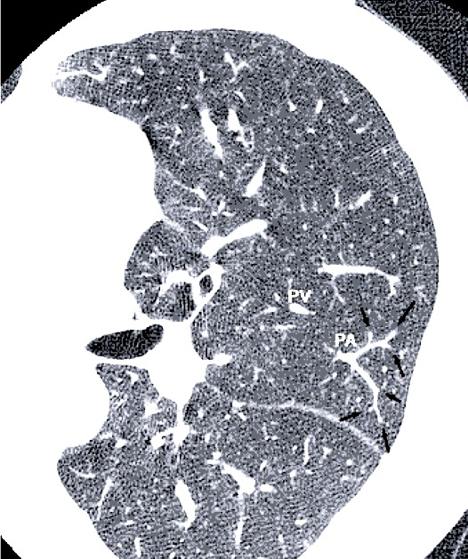
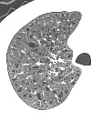
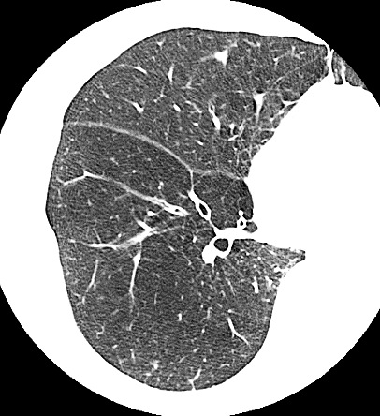
Studying emphysema
Normal lung
Centrilobular
Panlobular
Anderson et al, Science 1964. Auerbach et al, NEJM 1972. Tomashefski et al, Hum Path 2004. Takahashi et al, Int J Chron Obstruct Pulmon Dis, 2008
Notes:
Only 3 out of 71 autopsies in Anderson had no emphysema at all

Slide 11
CT emphysema and mortality
Predicts mortality | Does NOT predict mortality
256 alpha-1 antitrypsin patients (2003) | 609 patients with severe emphysema (2006)
251 stable COPD patients in Japan (2010) | 1,100 heavy smokers in Italy (2012)
900 ever-smokers (49% COPD) in Norway (2013)
Dawkins PA et al, Thorax, 2003.
Martinez FJ et al, AJRCCM, 2006.
Haruna A et al, Chest, 2010.
Sverzellati N et al, Radiology, 2012.
Johannessen A et al, AJRCCM, 2013.

Slide 12
Hypotheses
Percent emphysema and upper-lobe emphysema on CT are associated with increased all-cause mortality independent of other major risk factors

Slide 13
Multi-Ethnic Study of Atherosclerosis
Prospective, population-based NHLBI cohort
6,814 subjects recruited in 2000-02
  White, Chinese, African-American, and Hispanic
  Age 45-84 years
  Free of clinical cardiovascular disease at baseline
All subjects underwent baseline cardiac CT
Subset (N=3,849) with spirometry in 2004-06

Slide 14
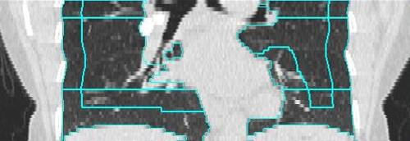
Percent emphysema
% emphysema = voxels < -950 HU / total voxels
% high attenuation areas (HAA) = voxels -600 to -250 HU / total voxels
Upper lobe
Hoffman EA et al, Acad Rad, 2009
Notes:
HAA as potential marker for interstitial lung disease and thus a radiologic confounder
Upper lobe defined as cephalad 1/8th on the z-axis of the cardiac CT scan as defined by PASS software

Slide 15
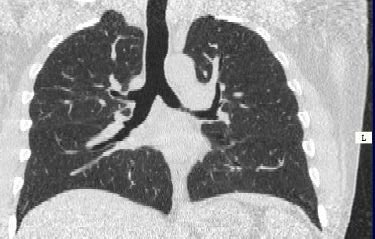
Correlations with full-lung scans
r=0.99
% Emphysema – Partial-lung
% Emphysema – Full-lung
500 current and former smokers (NLST)
Reddy, ATS, 2005
Hoffman, Acad Radiol, 2009

Slide 16
Correlations with full-lung scans
r=0.99
% Emphysema – Partial-lung
% Emphysema – Full-lung
500 current and former smokers (NLST)
Reddy, ATS, 2005
Hoffman, Acad Radiol, 2009

Slide 17
Events follow-up
Subject/family interviews every 9-12 months
Death surveillance supplemented by National Death Index (NDI)
4% lost to follow-up
Notes:
Investigated by death cert, med records, interviews
Loss to follow up at fu 10

Slide 18
Covariates
Questionnaires regarding behaviors, medical history, and medication use
Smoking status confirmed by urinary cotinine in ~4,000
Anthropometry and blood pressure measured by standardized protocols
Fasting blood samples for C-reactive protein, D-Dimer, cholesterol, creatinine, and glucose measurement
Coronary artery calcium by cardiac CT

Slide 19
Statistical Analysis
Percent emphysema square-root transformed
Percent emphysema dichotomized at top decile
Time-to-event modeled as time since baseline
Cox proportional hazards regression
  Hazard ratios (HRs) expressed per standard deviation
Generalized additive models to assess linearity
Kaplan-Meier survival curves

Slide 20
Statistical Analysis
Sequential adjustment for potential confounders and precision variables:
  Crude

Slide 21
Statistical Analysis
Sequential adjustment for potential confounders and precision variables:
  Crude
  Adjusted: age, sex, race, education, height, weight, weight > 220 lbs, scanner type, percent HAA (or, for upper-lobe emphysema, percent basilar emphysema)

Slide 22
Statistical Analysis
Sequential adjustment for potential confounders and precision variables:
  Crude
  Adjusted: age, sex, race, education, height, weight, weight > 220 lbs, scanner type, percent HAA (or, for upper-lobe emphysema, percent basilar emphysema)
  Fully adjusted: smoking status, pack-years, exercise, alcohol, cancer, hypertension, diabetes, hyperlipidemia, creatinine, coronary artery calcium score, CRP, d-dimer

Slide 23
Results: MESA participants
 | Top decile for percent emphysema | Total sample
N | 681 | 6810
Deaths | 81 | 517
Follow-up | 8.6 | 8.6
Percent male | 82 | 47
Age | 66 | 62
Percent never smokers | 29 | 45
Percent former smokers | 59 | 41
Percent current smokers | 12 | 14
FEV1/FVC | 0.70 | 0.76
Number with spirometry is 3,849, of which 407 are in the top decile.
Median values or percent.

Slide 24
Percent emphysema and mortality
Model | Deaths / At Risk | HR (95% CI) | P-value
Crude | 517/6805 | 1.20 (1.11, 1.30) | <0.001

Slide 25
Percent emphysema and mortality
Model | Deaths / At Risk | HR (95% CI) | P-value
Crude | 517/6805 | 1.20 (1.11, 1.30) | <0.001
Adjusted | 516/6782 | 1.20 (1.08, 1.33) | <0.001
  Adjusted for age, sex, race, education, height, weight, weight > 220 lbs, scanner type, percent HAA

Slide 26
Percent emphysema and mortality
Model | Deaths / At Risk | HR (95% CI) | P-value
Crude | 517/6805 | 1.20 (1.11, 1.30) | <0.001
Adjusted | 516/6782 | 1.20 (1.08, 1.33) | <0.001
Fully adjusted | 508/6662 | 1.19 (1.07, 1.32) | 0.001
  Adjusted for age, sex, race, education, height, weight, weight > 220 lbs, scanner type, percent HAA
  Fully adjusted for smoking status, pack-years, exercise, alcohol use, cancer, hypertension, diabetes, hyperlipidemia, creatinine, coronary artery calcium score, C-reactive protein, d-dimer

Slide 27
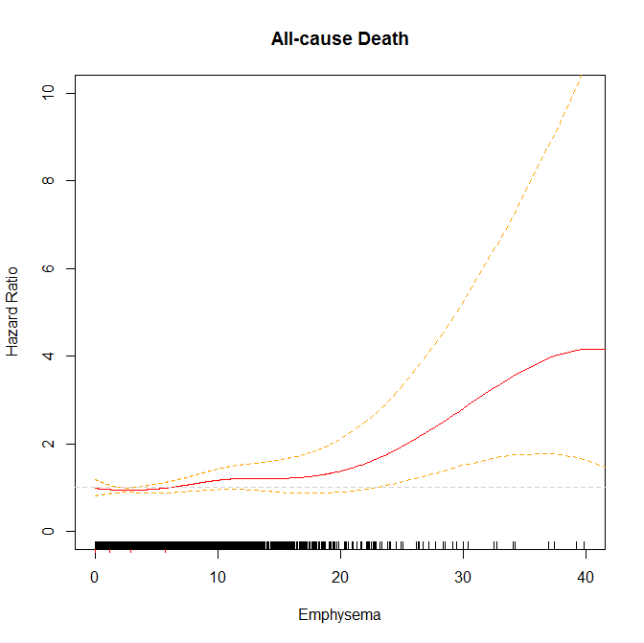
Percent emphysema and mortality
All-cause death
P = 2 x 10⁻⁴
Fully adjusted
Hazard Ratio
Percent emphysema
Notes:
No evidence for significant non-linearity
Fewer subjects at the tail end of the distribution; most clustered between 0-10

Slide 28
Upper-lobe emphysema and mortality
Model | Deaths / At Risk | HR (95% CI) | P-value
Crude | 516/6799 | 1.25 (1.15, 1.35) | <0.001
Adjusted | 515/6778 | 1.29 (1.11, 1.48) | <0.001
Fully adjusted | 507/6657 | 1.32 (1.15, 1.51) | <0.001
  Adjusted for age, sex, race, education, height, weight, weight > 220 lbs, scanner type, percent basilar emphysema
  Fully adjusted for smoking status, pack-years, exercise, alcohol use, cancer, hypertension, diabetes, hyperlipidemia, creatinine, coronary artery calcium score, C-reactive protein, d-dimer

Slide 29
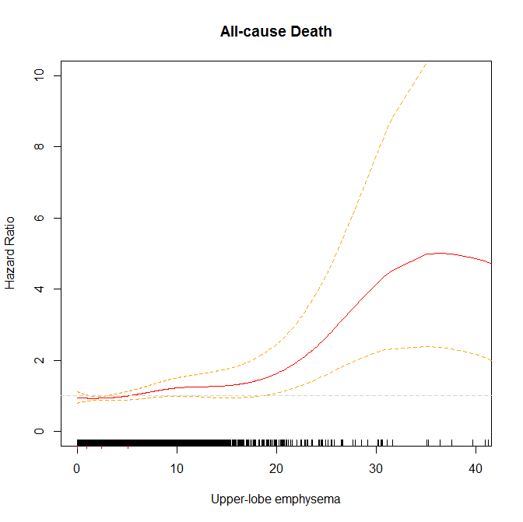
Upper lobe emphysema and mortality
All-cause death
P = 5 x 10⁻⁷
Fully adjusted
Hazard Ratio
Upper lobe emphysema

Slide 30
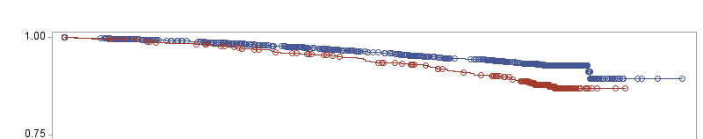
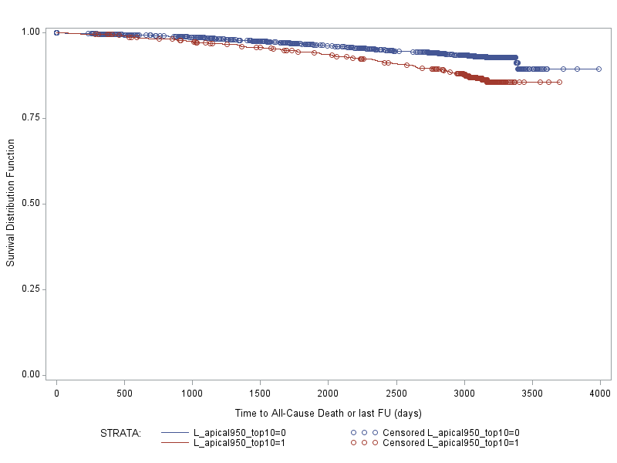
Survival for top 1/10th of emphysema
Percent emphysema
Top decile
Upper-lobe emphysema
Survival distribution function
Top decile
Time to all-cause death or last follow-up (days)
Log-rank test p<0.0001
Notes:
40-50% increased rate of death in the top decile (numbers in supplementary slide)

Slide 31
Stratification by smoking
Stratum (Deaths / At Risk) | Percent emphysema HR (95% CI) | Upper-lobe emphysema HR (95% CI)
Never smokers (179 / 3011) | 1.12 (0.93, 1.34) | 1.17 (0.95, 1.43)
  Fully adjusted for age, sex, race, education, height, weight, weight > 220 lbs, scanner type, pack-years, exercise, alcohol use, cancer, hypertension, diabetes, hyperlipidemia, creatinine, coronary artery calcium score, C-reactive protein, d-dimer
Notes:
Question of effect modification by smoking
P(int) for percent emphyema = 0.26
P(int) for upper-lobe emphysema = 0.08

Slide 32
Stratification by smoking
Stratum (Deaths / At Risk) | Percent emphysema HR (95% CI) | Upper-lobe emphysema HR (95% CI)
Never smokers (179 / 3011) | 1.12 (0.93, 1.34) | 1.17 (0.95, 1.43)
Former smokers (231 / 2707) | 1.15 (1.02, 1.31) | 1.28 (1.10, 1.50)
  Fully adjusted for age, sex, race, education, height, weight, weight > 220 lbs, scanner type, pack-years, exercise, alcohol use, cancer, hypertension, diabetes, hyperlipidemia, creatinine, coronary artery calcium score, C-reactive protein, d-dimer
Notes:
Question of effect modification by smoking

Slide 33
Stratification by smoking
Stratum (Deaths / At Risk) | Percent emphysema HR (95% CI) | Upper-lobe emphysema HR (95% CI)
Never smokers (179 / 3011) | 1.12 (0.93, 1.34) | 1.17 (0.95, 1.43)
Former smokers (231 / 2707) | 1.15 (1.02, 1.31) | 1.28 (1.10, 1.50)
Current smokers (98 / 944) | 1.33 (1.12, 1.59) | 1.52 (1.26, 1.83)
  Fully adjusted for age, sex, race, education, height, weight, weight > 220 lbs, scanner type, pack-years, exercise, alcohol use, cancer, hypertension, diabetes, hyperlipidemia, creatinine, coronary artery calcium score, C-reactive protein, d-dimer
Notes:
Question of effect modification by smoking

Slide 34
Adjustment for FEV1
  Substantially fewer deaths in spirometry subset: 134 deaths / 3470 at risk
Stratum (Deaths / At Risk) | Percent emphysema HR (95% CI) | Upper-lobe emphysema HR (95% CI)
Fully adjusted | 1.20 (0.97, 1.49) | 1.36 (1.03, 1.81)
  Fully adjusted for age, sex, race, education, height, weight, weight > 220 lbs, scanner type, smoking status, pack-years, exercise, alcohol use, cancer, hypertension, diabetes, hyperlipidemia, creatinine, coronary artery calcium score, C-reactive protein, d-dimer
  Excluding subjects with restrictive ventilatory defects (n=322)

Slide 35
Adjustment for FEV1
  Substantially fewer deaths in spirometry subset: 134 deaths / 3470 at risk
Stratum (Deaths / At Risk) | Percent emphysema HR (95% CI) | Upper-lobe emphysema HR (95% CI)
Fully adjusted | 1.20 (0.97, 1.49) | 1.36 (1.03, 1.81)
+ FEV₁ | 1.16 (0.94, 1.45) | 1.35 (1.02, 1.79)
  Fully adjusted for age, sex, race, education, height, weight, weight > 220 lbs, scanner type, smoking status, pack-years, exercise, alcohol use, cancer, hypertension, diabetes, hyperlipidemia, creatinine, coronary artery calcium score, C-reactive protein, d-dimer
  Excluding subjects with restrictive ventilatory defects (n=322)

Slide 36
Sensitivity analyses
Results were similar regardless of:
  Age
  Gender
  Race/ethnicity
  Exclusion of baseline emphysema and asthma
  FEV₁/FVC ratio < 0.7
  Restriction to non-cardiovascular deaths

Slide 37
Limitations
Cardiac CT scans did not image lung apices limiting measurement of upper lobes
Spirometry only available on a selected subset surviving to 2004-06

Slide 38
Conclusions
Emphysema on CT, especially upper-lobe emphysema, is associated with increased all-cause mortality independent of major risk factors
Effect estimates were similar after adjustment for FEV₁

Slide 39
Acknowledgements
Special Thanks to:
R Graham Barr, Steven Shea, Eric Hoffman, Aaron R. Folsom, Jeff Carr, Paul Enright, Nishant Verma, Steven Kawut, Richard Kronmal, David Lederer, Joao Lima, Gina Lovasi
Funding:
NHLBI N01-HC065226, RC1-HL100543, R01-HL077612, HRSA D55 HP05154

Slide 40
Additional slides

Slide 41
Mortality in top 1/10th of emphysema
Model | Percent emphysema HR (95% CI) | Upper-lobe emphysema HR (95% CI)
Crude | 1.70 (1.34, 2.16) | 1.85 (1.47, 2.33)
Adjusted | 1.47 (1.13, 1.90) | 1.64 (1.21, 2.21)
Fully adjusted | 1.38 (1.06, 1.80) | 1.55 (1.14, 2.09)
  Fully adjusted for age, sex, race, education, height, weight, weight > 220 lbs, site, scanner type, percent HAA (or, for upper-lobe emphysema, percent lower lobe emphysema), smoking status, pack-years, exercise, alcohol use, cancer, hypertension, diabetes, hyperlipidemia, coronary artery calcium score, C-reactive protein, d-dimer

Slide 42
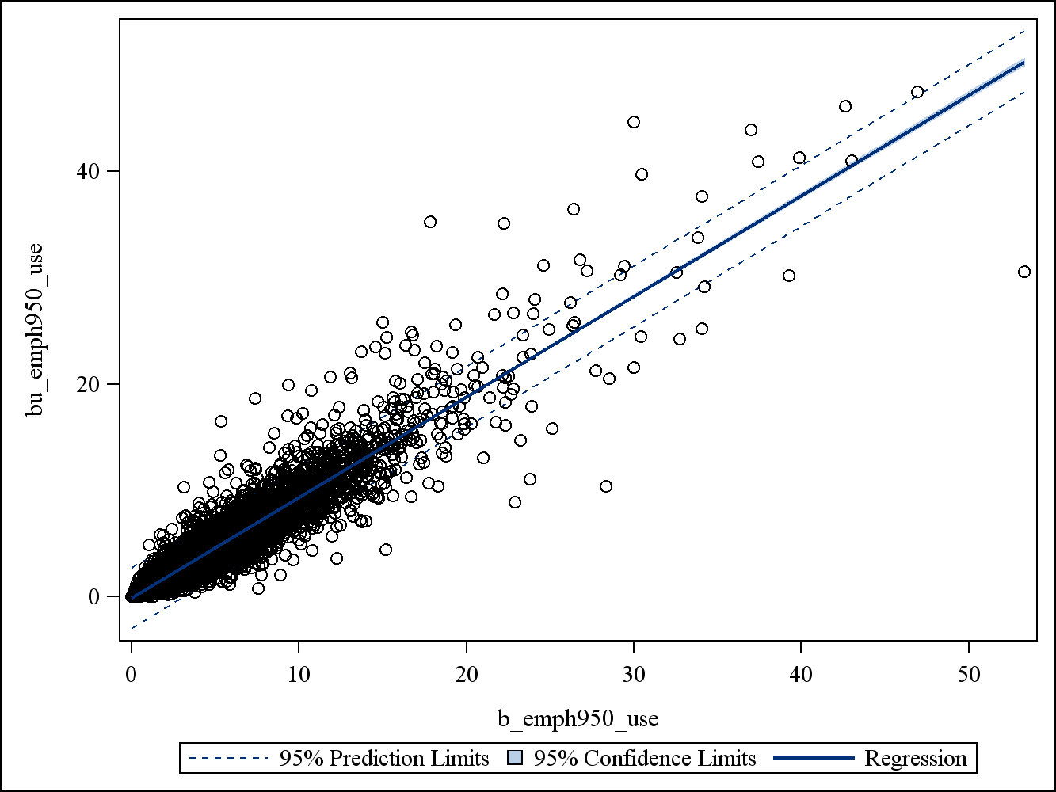
Correlation of percent emphysema and upper-lobe emphysema

Slide 43
Correlations of emphysema variables
Pearson Correlation Coefficients Prob > |r| under H0: Rho=0 Number of Observations
 | sqr_b_emph950 | sqr_bu_emph950 | sqr_bl_emph950 | sqr_pct_haa
sqr_b_emph950 | 1.00000 6810 | 0.95321 <.0001 6804 | 0.94670 <.0001 6804 | -0.55555 <.0001 6810
sqr_bu_emph950 | 0.95321 <.0001 6804 | 1.00000 6804 | 0.84577 <.0001 6804 | -0.50998 <.0001 6804
sqr_bl_emph950 | 0.94670 <.0001 6804 | 0.84577 <.0001 6804 | 1.00000 6804 | -0.55814 <.0001 6804
sqr_pct_haa | -0.55555 <.0001 6810 | -0.50998 <.0001 6804 | -0.55814 <.0001 6804 | 1.00000 6810

Slide 44
Full covariate list (30)
Age1c
Htcm1
Wtlb1
Educ1 (x5)
Gender1
Race1c
EBT vs MDCT
>220 lbs (MDCT)
Ever-smoking
Current-smoking
Pack-years
Missing smoking status
Missing pack years
Creatin1
Exercm1c
Crp1
Ddimer1
Agatpm1c
Sbp1c
Dbp1c
Glucos1c
Chol1
Hdl1
Alc1c
Htn1c
Htnmed1c
Diabhx1
Insln1c
Cholmed1
cancer

Slide 45
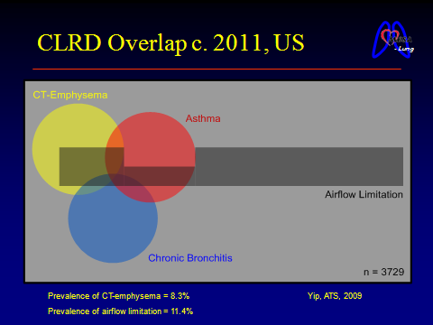
Overlap of COPD and emphysema
Yip, N

Slide 46
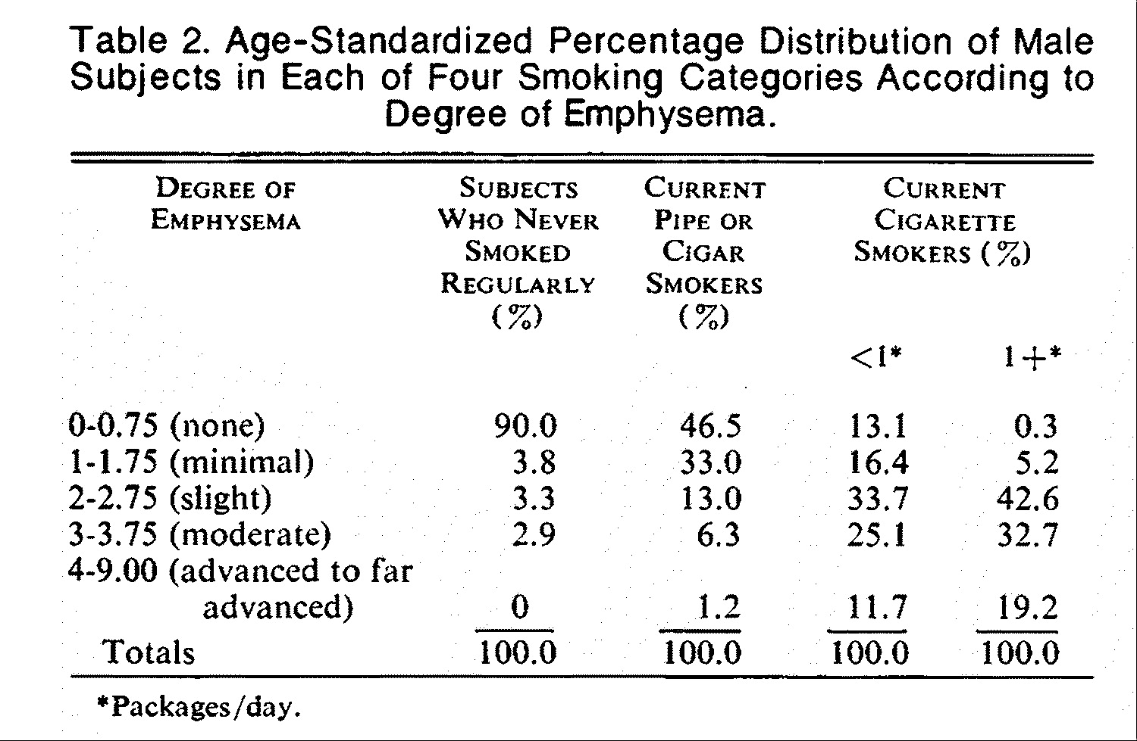
Emphysema and smoking
Auerbach et al, NEJM 1972
Notes:
Over 1,800 autopsies between 1963-1970 (NJ, NY) with smoking histories obtained from interviews of relatives.
One intact lung from each subject.

Slide 47
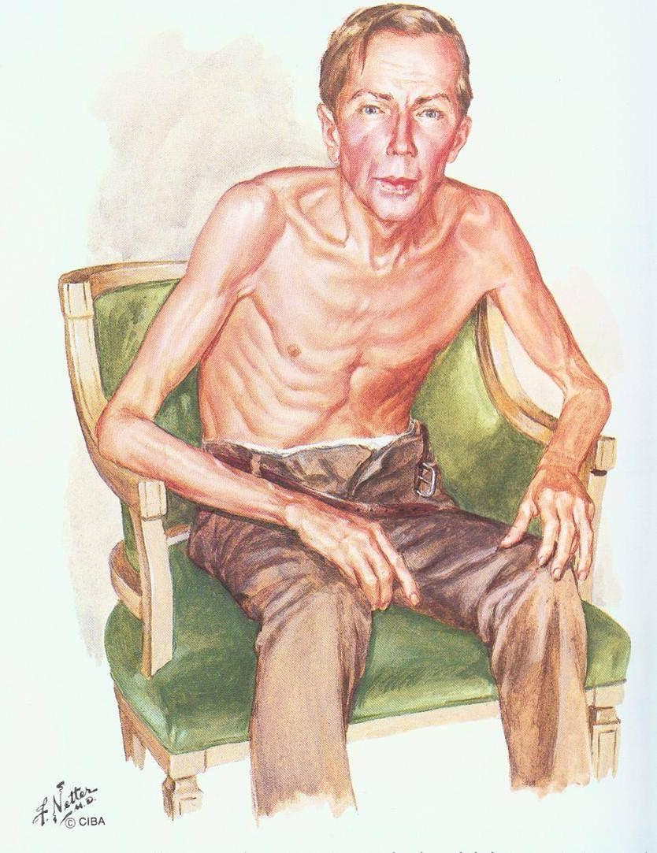
Mechanisms linking emphysema to morbidity and mortality
Hypoxemia
Airflow obstruction
Right heart failure
Left heart compromise
Systemic inflammation
Endothelial dysfunction
Martinez CH et al, Thorax 2012
Barr RG et al, NEJM 2010
Barr RG et al, AJRCCM 2007
Netter

Slide 48
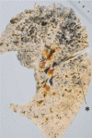
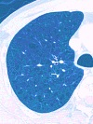
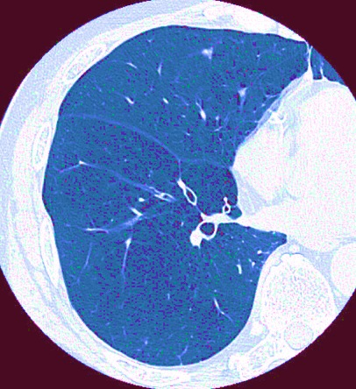

Emphysema
Centrilobular
Panlobular
Smoking-associated
Upper lobe
Alpha-1 Anti-Trypsin
Lower lobe
Anderson EA et al, Science, 1964
Adapted from Takahashi et al, Int J Chron Obstruct Pulmon Dis, 2008
Notes:
Centrilobular emphysema was associated with smoking in 1964, when it was found predominantly on autopsies of former or current smokers… Note parenchymal destruction nearest the terminal bronchioles at the center of the acini with anthracosis. However you don’t need autopsy: lung CT also demonstrates characteristic centriacinar low attenuation area, especially in the upper lobes.
Panlobular emphysema, by contrast, is classically associated with A1AT, the genetic disease that grounded the protease theories of emphysema pathogenesis. Here there is destruction throughout the lung, and more so in the lower lobes, that may be less apparent to the human eye on CT but can be identified systematically by software that analyzes regional attenuation.

