Slide 1
Cardiovascular disease and disability in older adults
Anne B. Newman, MD, MPH
Professor of Epidemiology and Medicine
University of Pittsburgh

Slide 2
Cardiovascular disease is disabling
Disability (Ettinger 1993)
Heart disease = 15% of men and 10% of women
Stroke = 4% men and 2% women Population Attributable Risk
Population Attributable Risk (Landrum MB, 2008)
Heart disease 11%
Stroke 9%
PAD 6%
Women have more disability from their CVD than men (Whitson HE, 2010)

Slide 3
Selected Causes of Disability
Percentage of persons reporting specific disease as the cause of difficulty with IADL or ADL
Ettinger WH Jr, Fried LP, Harris T, Shemanski L, Schulz R, Robbins J. Self-reported causes of physical disability in older people: the Cardiovascular Health Study. J Am Geriatr Soc. 1994;42(10):1035-1044.

Slide 4
Attributable risk for mobility disability Arthritis, infection, dementia, heart failure, diabetes and stroke each contribute 10% or more to total.
Landrum MB, Stewart KA, Cutler DM. Pathways to disability: Clinical pathways to disability. In: Health at older ages: the causes and consequences of declining disability among the elderly. Editors: Cutler DM, Wise DA. National Bureau of Economic Research; Chicago. 2008:169.
Notes:
Use of Attributable Risk to Target conditions that should be addressed to improve active life expectancy.
Thus we used the aggregation of tasks employed by Fried et al. (1994) to summarize our fourteen ADL and IADL measures into three major types of disability: (1) mobility disability (getting out of bed, walking inside and walking outside the home). (2) disability in complex tasks (cooking, laundry, light housework, grocery shopping, managing money, and using the telephone) and (3) disability in self-care tasks (eating dressing toileting, and bathing). Following theoretical and empirical work suggesting hierarchies in the disablement process, we consider disability in basic self-care tasks to represent the most severe type of disability, and mobility disability to represent early manifestations of loss of functional abilities.
Respondents were classified as disabled on an ADL task if they reported that someone helped them perform the task, if someone stayed nearby in case they needed help, or if they used special equipment to perform the task. Respondents were classified as disabled on an IADL task if they report that they cannot do the task because of disability or health problems.

Slide 5
Comparing the Effects of Medical Conditions on the Rate of Disability in Men and Women
 | Regression Coefficient
Condition | Men | Women | p Value†
Arthritis | .04** | .10** | <.001
Obesity | .17** | .17** | NS
Fracture | .06** | .06** | NS
Vision problems | .11** | .11** | NS
Hearing problems | .03 | .14** | <.001
Diabetes | .05** | .05** | NS
Claudication | .05* | .21** | <.001
Stroke | .07** | .18** | <.001
Congestive heart failure | .07** | .21** | <.001
Coronary heart disease | .02 | .08** | <.001
Bronchitis | .05** | .05** | NS
Emphysema | .09** | .09** | NS
Cognitive impairment | .02* | .02* | NS
Notes: All models included age, race, education, and marital status. Coefficients indicate regression effects on the rate of disability. NS = nonsignificant.
† These p values indicate whether a sex by condition interaction is present. p values >.05 are NS, indicating that the medical condition is associated with a similar disability rate in men and women.
**p < .01; * p < .05. These p values indicate whether a sex-specific coefficient is significantly different from zero. .
Whitson HE, Landerman LR, Newman AB, Fried LP, Pieper CF, Cohen HJ. Chronic medical conditions and the sex-based disparity in disability: The Cardiovascular Health Study. J Gerontol A Biol Sci Med Sci. 2010; 65A(12):M1325-M1331.PMCID: PMC2990264. doi:10.1093/gerona/glq139

Slide 6
Questions about CVD, Disability and Aging
How does subclinical CVD impact older adults?
How can we define the key components of healthy aging?
Do systems change together with age?
Future questions

Slide 7
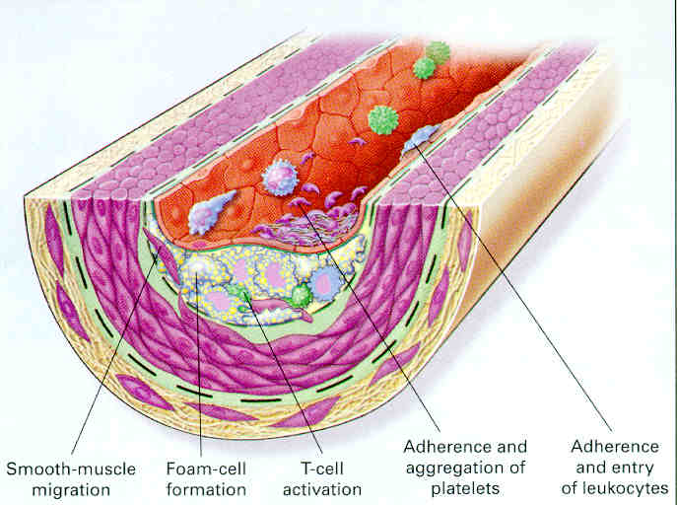
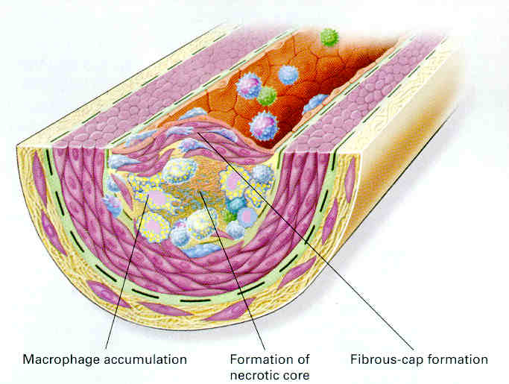
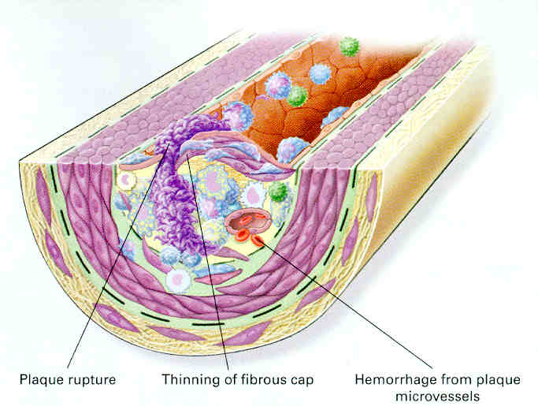
Progression of the inflammatory lesion in atherosclerosis
Ross R. Atherosclerosis--an inflammatory disease. New England Journal of Medicine. 340(2):115-26, 1999.

Slide 8
Framework for the study of subclinical cardiovascular disease
Traditional CVD
Risk Factors
Age
Sex
Hypertension
Diabetes
Smoking
high LDL-C
Low HDL-C
Subclinical CVD
US – carotid artery wall thickness
Echo – carotid stenosis; LV wall motion abnormalities
Ankle-arm index
ECG
Brain MRI
Coronary Artery Calcification
Clinical
events
MI
Angina
CHF
PAD
Stroke
Geriatric Syndromes
Cognitive decline
Frailty
Successful aging
Disability
“Novel” Risk Factors
Fibrinogen
CRP
Mortality
CVD death
All cause
Notes:
Let me now briefly mention the methods use din CHS to study SCVD.
This was the basic conceptual framework used.
Non-invasive tests such as carotid USG, echocardiogram, ankle and arm blood pressure measurement, ECG, brain MRI, coronary calcification, and others were collected through standardized procedures.
The ability of these measures to predict incident CVD events and mortality, which were confirmed by a panel of experts review actual medical records, was assessed. Information on self-reported and performance-based physical and cognitive function was also collected.
Data were available on traditional risk factors. Blood was also stored assessment of novel risk factors in the future.

Slide 9
Framework for the study of subclinical cardiovascular disease and aging
Traditional CVD
Risk Factors
Age
Sex
Hypertension
Diabetes
Smoking
high LDL-C
Low HDL-C
Subclinical CVD
US – carotid artery wall thickness
Echo – carotid stenosis; LV wall motion abnormalities
Ankle-arm index
ECG
Brain MRI
Coronary Artery Calcification
Clinical
events
MI
Angina
CHF
PAD
Stroke
Geriatric Syndromes
Cognitive decline
Frailty
Successful aging
Disability
“Novel” Risk Factors
Fibrinogen
CRP
Mortality
CVD death
All cause
Notes:
Let me now briefly mention the methods use din CHS to study SCVD.
This was the basic conceptual framework used.
Non-invasive tests such as carotid USG, echocardiogram, ankle and arm blood pressure measurement, ECG, brain MRI, coronary calcification, and others were collected through standardized procedures.
The ability of these measures to predict incident CVD events and mortality, which were confirmed by a panel of experts review actual medical records, was assessed. Information on self-reported and performance-based physical and cognitive function was also collected.
Data were available on traditional risk factors. Blood was also stored assessment of novel risk factors in the future.

Slide 10
Potential mechanisms of CVD affecting function
Clinical disease
Subclinical end organ damage
Diffuse chronic inflammation

Slide 11
PAD impact on function
Direct (McDermott)
Lower muscle strength
Lower muscle mass
Poorer peripheral nerve function
Indirect
Other prevalent CVD
Incident CVD
Vascular dementia

Slide 12
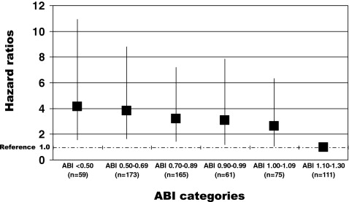
Figure 1 Adjusted Associations of ABI and Mobility Loss Adjusted associations of baseline ankle-brachial index (ABI) and mobility loss at 5-year follow-up among persons age 55 years and older (n = 644). Results are adjusted for age, sex, race, comorbidities, body mass index, smoking, and physical activity levels. The y-axis shows the hazard ratio representing the risk of mobility loss at 5-year follow-up.
Number of events per ABI category: ABI <0.50, n = 12; ABI 0.50 to 0.69, n = 30; ABI 0.70 to 0.89, n = 30; ABI 0.90 to 0.99, n = 11; ABI 1.00 to 1.09, n = 16; and ABI 1.10 to 1.30, n = 8. Number of deaths per ABI category: ABI <0.50, n = 20; ABI 0.50 to 0.69, n = 39; ABI 0.70 to 0.89, n = 28; ABI 0.90 to 0.99, n = 8; ABI 1.00 to 1.09, n = 9; and ABI 1.10 to 1.30, n = 10.
McDermott MM, Guralnick JM, Tian L, et al. Associations of Borderline and Low Normal Ankle-Brachial Index Values With Functional Decline at 5-Year Follow-Up : The WALCS (Walking and Leg Circulation Study) Journal of the American College of Cardiology Volume 53, Issue 12 2009 1056 – 1062. http://dx.doi.org/10.1016/j.jacc.2008.09.063

Slide 13
Table 3. Attenuation of the Relationship Between Ankle Arm Index (AAI) and Activity of Daily Living and Instrumental Activity of Daily Living Disability (Brach J, JAGS, 2008)
 | Incidence Rate (per 100 Person-Years) | Model 1* | Model 2† | Model 3‡
 |  | Hazard Ratio (95% Confidence Interval)
AAI
1.0 | 10.1 | Reference | Reference | Reference
0.9–<1.0 | 13.9 | 1.42 (1.18–1.71) | 1.13 (0.92–1.39) | 1.09 (0.89–1.34)
0.8–<0.9 | 17.6 | 1.79 (1.39–2.31) | 1.33 (1.01–1.76) | 1.36 (1.03–1.79)
<0.8 | 17.4 | 1.84 (1.49–2.28) | 1.17 (0.91–1.51) | 1.11 (0.86–1.4)
Age | — | — | 1.07 (1.06–1.09) | 1.07 (1.06–1.09)
Male | — | — | 0.67 (0.58–0.76) | 0.65 (0.57–0.74)
Black | — | — | 1.35 (1.15–1.57) | 1.34 (1.14–1.57)
>High school education | — | — | 1.24 (1.09–1.40) | 1.22 (1.08–1.39)
IC according to Rose Questionnaire | — | — | 1.21 (0.73–2.01) | 1.11 (0.97–1.85)
Prevalent CVD | — | — | 1.49 (1.29–1.72) | 1.39 (1.20–1.61)
Arthritis | — | — | 1.34 (1.18–1.51) | 1.35 (1.19–1.52)
Diabetes mellitus status
Impaired fasting glucose | — | — | 0.98 (0.81–1.20) | 0.97 (0.80–1.19)
Diabetes mellitus | — | — | 1.43 (1.20–1.70) | 1.36 (1.14–1.62)
Depression | — | — | 1.04 (1.03–1.06) | 1.04 (1.03–1.06)
Pack-years | — | — | 1.00 (1.00–1.00) | 1.00 (1.00–1.00)
Smoking status
Quit >1 year before | — | — | 1.17 (1.00–1.37) | 1.18 (1.01–1.38)
Quit <1 year before | — | — | 1.42 (1.03–1.96) | 1.46 (1.06–2.01)
Current | — | — | 1.29 (0.98–1.70) | 1.32 (1.00–1.74)
Alcohol, drinks/week | — | — | 1.00 (0.99–1.01) | 1.00 (0.99–1.02)
BMI, kg/m² | — | — | 1.03 (1.01–1.04) | 1.03 (1.01–1.04)
Interim CVD | — | — | — | 1.89 (1.61–2.24)
Likelihood-ratio test |  |  |  | P<.001
* Unadjusted.
† † Adjusted for age, sex, race, education, intermittent claudication (IC) according to Rose Questionnaire, prevalence of cardiovascular disease (CVD), arthritis status, diabetes mellitus status, pack-years of smoking, smoking status, alcohol use, and body mass index (BMI).
‡ ‡ Adjusted for all factors in Model 2 plus interim CVD.

Slide 14
Dementia incidence by ankle-arm index (AAI) level adjusted by age, gender and race at entry (p = 0.002) Cox Survival plot
AAI>1.0
AAI 0.9-1.00
AAI 0.8-0.9
AAI<0.8
Newman, AB, Fitzpatrick AL, Lopez O, et al. Dementia and Alzheimer’s Disease Incidence in Relationship to Cardiovascular Disease in the Cardiovascular Health Study Cohort. In Press. J Am Geriatr Soc. 2005.

Slide 15
6 minute walk distance - contributions of age, race, disease and subclinical disease in men and women in CHS, mean age 77 years
Meters walked
Enright PL. McBurnie MA. Bittner V. Tracy RP. McNamara R. Arnold A. Newman AB. Cardiovascular Health Study. The 6-min walk test: a quick measure of functional status in elderly adults. Chest. 2003; 123(2):387-98.

Slide 16
Predictors of 400 meter walk time in Health ABC from multivariate model
Seconds
Age
Sex-Woman
Black Race
BMI Q4
PAD
Stroke
Knee Pain
Depression
AAI<0.9
FEV1/FVC<70%
Newman AB, Haggerty CL, Nevitt MC, Simonsick EM, for the Health ABC Research Group. Walking Performance and cardiovascular response: Associations with age and morbidity – The Health, Aging and Body Composition Study. J Gerontol Med Sci. 2003; 58: 715-720.

Slide 17
Hypothetical Trajectory for Physiologic Reserve in Relation to Health, Functional Limitation & Disability
Baseline
health status
Health
Functional
limitation
hip fracture
Disability
Physiologic Reserve
pneumonia
congestive
heart failure
Death
Younger age
Older age
Time

Slide 18
Multisystem Physiologic Aging – is there correspondence between systems? Which systems mark functional decline?
Overall Function
Vascular
Brain
Kidney
Lung
Metabolic
Musculoskeletal
Worse Better
Years

Slide 19
Pathways linking aging and age-related disease
Modifiable risk factors –
Smoking, inactivity, toxins, diet, radiation exposure
Disease phenotype – selective and preventable
Cellular damage and repair
Disability and vulnerability to mortality
Altered tissue function
Altered organ function
Time
Intrinsic factors –
oxidative damage, hormonal factors, inflammation, genetic predisposition
Aging phenotype – universal and inevitable

Slide 20
Pathways linking aging and age-related disease
Modifiable risk factors –
Smoking, inactivity, toxins, diet, radiation exposure
Disease phenotype – selective and preventable
Cellular damage and repair
Disability and vulnerability to mortality
Altered tissue function
Altered organ function
Time
Intrinsic factors –
oxidative damage, hormonal factors, inflammation, genetic predisposition
Aging phenotype – universal and inevitable

Slide 21
Cardiovascular Health Study: physiologic index of comorbidity
10-point scale: 0 = healthy, 10 = unhealthy
Graded: 0 (best tertile), 1 (middle tertile), 2 (worst tertile)
Explains 40% of age effect on mortality
System | Marker
Vascular | Carotid intima-media thickness
Pulmonary | Forced vital capacity
Brain | White matter grade
Metabolism | Serum fasting glucose
Renal | Serum cystatin-C
Newman AB, et al. J Gerontol A Biol Sci Med Sci. 2008;63:603-9.

Slide 22
Crude mortality rates by physiologic index of comorbidity versus comorbidity count
Comorbidity Count
Physiologic Index of Comorbidity
Newman AB, Boudreau RM, Naydeck BL, Fried LF, Harris TB. A Physiologic Index of Comorbidity - Relationship to Mortality and Disability. J Gerontol A Biol Sci Med Sci. 2008;63A:M603-609.

Slide 24
Cardiovascular Health Study: frailty scale
Frailty component | Marker | Score 0 vs. 1
Unintentional weight loss / sarcopenia | Weight loss | ≥10 lbs/5% unintentional weight loss in past year
Weakness | Grip strength | Lowest 20%
Exhaustion | CES-D, 2 items | Exhaustion/low energy ≥3 days/week
Physical activity | Questionnaire, kcal | Lowest 20%
Motor performance | Walk time/15 feet | Slowest 20%
Fried LP, et al. J Gerontol A Biol Sci Med Sci. 2001.

Slide 25
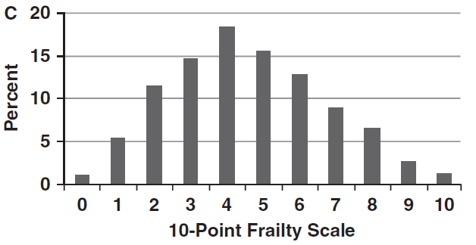
Cardiovascular Health Study: new 10-point frailty scale using tertile scoring for components
Vigorous
Frail
Sanders JL, et al. J Gerontol A Biol Sci Med Sci. 2011.

Slide 26
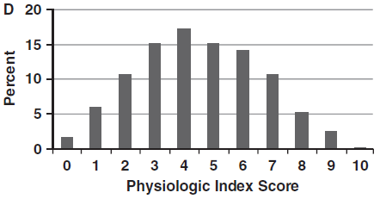
New CHS frailty scale mirrors physiologic index of comorbidity
Vigorous
Healthy
Sanders JL, et al. J Gerontol A Biol Sci Med Sci. 2011.

Slide 27
Pathways linking aging and age-related disease
Modifiable risk factors –
Smoking, inactivity, toxins, diet, radiation exposure
Disease phenotype – selective and preventable
Cellular damage and repair
Disability and vulnerability to mortality
Altered tissue function
Altered organ function
Time
Intrinsic factors –
oxidative damage, hormonal factors, inflammation, genetic predisposition
Aging phenotype – universal and inevitable

Slide 28
Hypothetical Trajectory for Physiologic Reserve in Relation to Health, Functional Limitation & Disability
Baseline
health status
Health
Functional
limitation
hip fracture
Disability
Physiologic Reserve
pneumonia
congestive
heart failure
Death
Younger age
Older age
Time

Slide 29
Biomarkers examined for correspondence between systems
DHEAS –adrenal androgen; major source of sex steroids in old age
IGF-1 and binding proteins – regulate growth and metabolism
Cholesterol – indicator of nutrition, inflammation
Adiponectin –promotes glucose regulation and fatty acid breakdown, paradoxical association with mortality and CHD in old age
IL-6 – marker of inflammation

Slide 30
CHS All Stars – Characteristics of year 18 survivors in 1996-1997 (year 9), stratified by gender
Variables | Women (N=585) | Men (N=316)
n (%) or mean (SD)
Year 9 Age (years) | 76.3 (3.6) | 76.5 (3.5)
Year 18 Age (years) | 85.3 (3.6) | 85.5 (3.5)
Baseline weight (lbs) | 152 (28) | 178 (26)
Number of chronic diseases | 1.24 (0.92) | 1.16 (0.96)
Black race | 93 (15.9%) | 42 (13.3%)
Currently married | 275 (47.8%) | 260 (83.6%)
Current smoker | 37 (6.5%) | 19 (6.1%)
Biomarkers
Baseline DHEAS (µg/mL) | 0.55 (0.4) | 0.85 (0.5)
Baseline adiponectin (ng/mL) | 15.4 (6.9) | 10.7 (5.4)
Baseline IGF-1 (ng/mL) | 158 (59.6) | 179 (59.4)
Baseline IGFBP-1 (ng/mL) | 42.8 (29.4) | 34.6 (26.8)
Baseline IGFBP-3 (mg/L) | 3556 (889) | 3033 (781)
Baseline IL-6 (pg/mL) | 2.95 (1.7) | 3.29 (2.0)
Baseline cholesterol (mg/dL) | 213 (36) | 193 (36)
Function, Mean (SD)
Grip strength (kg) | 23.1 (5.5) | 38.8 (7.4)
Gait speed (m/sec) | 0.95 (0.22) | 1.03 (0.22)
3MSE score | 95.2 (5.3) | 95.5 (4.4)
DSST score | 45.1 (11.8) | 41.9 (12.0)

Slide 31
Correlations between changes in biomarkers*
IGF-1 and IGF BP-3 r= 0.63
IGF-1 and IGF BP-1 r= - 0.29
IL-6 and IGF BP-1 r= 0.18
IL-6 and cholesterol r= - 0.15
Cholesterol and IGF BP-3 r= 0.29
Others r < 0.1
* All p < 0.001

Slide 32
CHS All Stars - Median (Q1, Q3) change in biomarkers from 1996-97 to 2005-06 by gender
 | Absolute change year 9-18 |  | Percent change year 9-18
 | Women | Men | Women | Men
Biomarker
DHEAS (µg/mL) | -0.06 (-0.19, 0.04) | -0.16 (-0.34, 0.05) | -14.7 (-36.4, 11.6) | -24.7 (-42.5, -8.0)
Adiponectin (ng/mL) | 2 (-0.3, 5.1) | 2.6 (0.5, 6) | 15 (-2.1, 40.1) | 29.2 (6.4, 63.2)
IGF-1 (ng/mL) | -6 (-37.5, 20.2) | -22.4 (-51.4, 5.6) | -4.7 (-23, 15.4) | -12.9 (-28.4, 3.8)
IGFBP-1 (ng/mL) | 9.5 (-4.5, 27.4) | 11.6 (-0.1, 25.4) | 29.9 (-10.3, 103.6) | 41.9 (-0.3, 115.8)
IGFBP-3 (mg/L) | -243 (-635, 170) | -314 (-624, -13.7) | -6.7 (-18.4, 5) | -11 (-21.6, -0.6)
IL-6 (pg/mL) | 0.5 (-0.3, 1.9) | 0.8 (-0.2, 2.2) | 22 (-11.1, 75.2) | 32.8 (-6.9, 84.2)
Cholesterol (mg/dL) | -17 (-45, 4) | -22 (-44, -3) | -8 (-21, 2) | -11 (-24, -2)
Increase – Adiponectin, IGF BP-1, Il-6
Decrease – DHEAS, IGF-1, IGF BP-3, Cholesterol

Slide 33
CHS All Stars - Median (Q1, Q3) change in functional measures from 1996-97 to 2005-06 by gender
 | Absolute change year 9-18 |  | Percent change year 9-18
 | Women | Men | Women | Men
Functional measure
Grip strength (kg) | -5.3 (-7.3, -2.3) | -8 (-12, -4.7) | -21.4 (-33.3, -11.4) | -21.4 (-30.4, -13.4)
Gait speed (m/sec) | -0.2 (-0.4, 0) | -0.2 (-0.4, 0) | -20 (-35.4, 0) | -20 (-33.3, 0)
3MSE score | -4 (-9, -1) | -4 (-9, -1) | -4 (-10, -1) | -4 (-9, -1)
DSST score | -10 (-15, -5) | -9 (-14, -5) | -21 (-35, -11) | -23 (-35, -12)

Slide 34
Association of change in biomarker level with change in grip strength and gait speed, with each biomarker change entered separately.
Δ Biomarker | SD Units | Δ Grip Strength (kg) | N=759 | Δ Gait speed (m/sec) | N=711
 |  | β (95% CI) | P | β (95% CI) | P
DHEAS | -0.29 µg/mL | 0.657 (0.238, 1.076) | 0.002 | 0.022 (0.001, 0.044) | 0.045
Adiponectin | 5.08 ng/mL | -0.029 (-0.401, 0.344) | 0.881 | 0.003 (-0.016, 0.022) | 0.737
IGF-1 | -46.8 ng/mL | -0.081 (-0.464, 0.301) | 0.677 | 0.014 (-0.005, 0.034) | 0.153
IGFBP-1 | 32.7 ng/mL | -0.303 (-0.691, 0.086) | 0.128 | -0.013 (-0.034, 0.008) | 0.214
IGFBP-3 | -609 mg/L | 0.037 (-0.332, 0.407) | 0.843 | 0.007 (-0.012, 0.025) | 0.494
IL-6 | 2.50 pg/mL | -0.702 (-1.087, -0.317) | <0.001 | -0.019 (-0.039, 0.001) | 0.059
Cholesterol | -40 mg/dL | W: -0.101 (-0.577, 0.375) M: 0.919 ( 0.241, 1.597) | 0.678 0.008 | 0.012 (-0.010, 0.033) - | 0.291
Notes:
Footnote: Models are adjusted for age, sex, black race (Y/N), current smoking status (Y/N), current marital status (Y/N), number of chronic diseases, change in weight during follow up, standard deviation (SD) unit of 1996-97 biomarker, and interaction of biomarker change with sex, if significant. When the sex interaction is significant, results for women (W) and men (M) are given separately.

Slide 35
Association of change in biomarker level with change in physical function, all markers in model
 |  | Δ Grip Strength (kg) | N=759 | Δ Gait speed (m/sec) | N=711
Δ Biomarker | SD Units | β (95% CI) | P | β (95% CI) | P
DHEAS | -0.29 µg/mL | 0.594 (0.171, 1.018) | 0.006 | 0.020 (-0.002, 0.042) | 0.081
Adiponectin | 5.08 ng/mL | 0.033 (-0.342, 0.407) | 0.865 | 0.001 (-0.018, 0.020) | 0.879
IGF-1 | -46.8 ng/mL | -0.319 (-0.868, 0.231) | 0.256 | 0.016 (-0.012, 0.045) | 0.262
IGFBP-1 | 32.7 ng/mL | -0.185 (-0.604, 0.235) | 0.388 | -0.004 (-0.026, 0.019) | 0.755
IGFBP-3 | -609 mg/L | 0.175 (-0.355 , 0.705) | 0.517 | -0.010 (-0.038, 0.017) | 0.471
IL-6 | 2.50 pg/mL | -0.685 (-1.081, -0.289) | 0.001 | -0.017 (-0.037, 0.004) | 0.105
Cholesterol | -40 mg/dL | W: -0.265 (-0.760, 0.231) M: 0.666 (-0.026, 1.357) | 0.295 0.059 | 0.007 (-0.016, 0.030) - | 0.540 -
Models are adjusted for age, sex, black race (Y/N), current smoking status (Y/N), current marital status (Y/N), number of chronic diseases, change in weight during follow up, standard deviation (SD) unit of 1996-97 biomarker, and interaction of biomarker change with sex if found to be significant when biomarkers were modeled separately .
Notes:
Footnote: Models are adjusted for age, sex, black race (Y/N), current smoking status (Y/N), current marital status (Y/N), number of chronic diseases, change in weight during follow up, standard deviation (SD) unit of 1996-97 biomarker, and interaction of biomarker change with sex if found to be significant when biomarkers are modeled separately (Table 3).

Slide 36
Association of change in biomarker level with change in cognitive function (3MSE and DSST), biomarker change entered separately.
Δ Biomarker | SD Units | Δ 3MSE | N=793 | Δ DSST | N=771
 |  | β (95% CI) | P | β (95% CI) | P
DHEAS | -0.29 µg/mL | 0.489 (-0.311, 1.288) | 0.231 | W: 1.458 (0.416, 2.500) M: -0.714 (-1.992, 0.563) | 0.006 0.273
Adiponectin | 5.08 ng/mL | W: -0.827 (-1.732, 0.077) M: 0.633 (-0.446, 1.712) | 0.073 0.250 | 0.396 (-0.383, 1.176) - | 0.319
IGF-1 | -46.8 ng/mL | 0.411 (-0.323, 1.145) | 0.273 | -0.151 (-0.942, 0.640) | 0.708
IGFBP-1 | 32.7 ng/mL | -0.109 (-0.861, 0.643) | 0.776 | -0.057 (-0.880, 0.766) | 0.892
IGFBP-3 | -609 mg/L | -0.215 (-0.926, 0.495) | 0.553 | 0.098 (-0.672, 0.869) | 0.803
IL-6 | 2.50 pg/mL | -0.859 (-1.594, -0.124) | 0.022 | -1.051 (-1.853, -0.248) | 0.010
Cholesterol | -40 mg/dL | -0.046 (-0.849, 0.757) | 0.911 | 0.930 (0.060, 1.800) | 0.036
Models are adjusted for age, sex, black race (Y/N), current smoking status (Y/N), current marital status (Y/N), number of chronic diseases, change in weight during follow up, standard deviation (SD) unit of 1996-97 biomarker, and interaction of biomarker change with sex, if significant. When the sex interaction is significant, results for women (W) and men (M) are given separately.
Notes:
Footnote: Models are adjusted for age, sex, black race (Y/N), current smoking status (Y/N), current marital status (Y/N), number of chronic diseases, change in weight during follow up, standard deviation (SD) unit of 1996-97 biomarker, and interaction of biomarker change with sex, if significant. When the sex interaction is significant, results for women (W) and men (M) are given separately.

Slide 37
Summary of results
Adiponectin, IL-6 and IGF BP-1 increased, while DHEAS, IGF-1 and IGF BP-3 decreased over 9 years
Concurrently, gait speed, grip strength and DSST all decreased by about 20%
Changes among biomarkers were weakly correlated except for IGF-1 and BP’s
Declining DHEAS and increasing IL-6 tracked with declines in grip strength (more than gait speed) and DSST (more than 3MSE)

Slide 38
Long Life Family Study: Healthy Aging Index (HAI)*
10-point scale: 0 = healthy, 10 = unhealthy
System | Marker
Vascular | Pulse pressure
Pulmonary | Forced vital capacity
Brain | Modified Mini Mental score
Metabolism | Serum fasting glucose
Renal | Serum creatinine
* Referent values from CHS age 65+, mean age 74

Slide 39
Mortality in CHS by physiologic index score vs. count of chronic conditions
Newman AB, et al. J Gerontol A Biol Sci Med Sci. 2008;63:603-9.

Slide 40
Healthy Aging Index (HAI; Sanders et al., 2012)
Heritability of the HAI, was calculated using maximum likelihood method.
Covariates: Age, Age^2, field center. Age and Age^2 were significant covariates.

Slide 41
CVD and Longevity in CHS Cohort < age 75 at baseline who have had opportunity to reach 90 years or older
 | <=80 N=427 n (%) | 81-89 N=782 n (%) | 90+ N=652 n (%)
Composite Score
0 (No CVD) | 12 (6.8) | 68 (48.9) | 490 (39.5)
1 | 63 (15.4) | 142 (34.6) | 205 (50.0)
2 or 3 | 122 (18.1) | 299 (44.4) | 253 (37.5)
4,5 or 6 | 56 (35.4) | 70 (44.3) | 32 (20.3)
Clinical CVD | 174 (36.3) | 212 (44.2) | 94 (19.6)

Slide 42
Longevity analysis plan
Evaluate for factors that protect individuals with high levels of vascular disease from disability
Role of physical activity
Markers of vascular adaptation

Slide 43
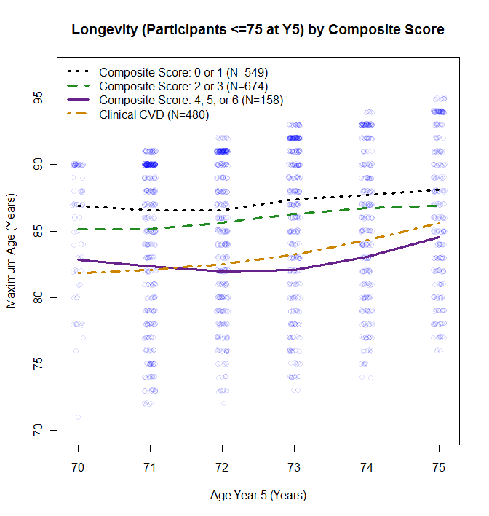
Figure 4b: Age at Y5 versus maximum age by composite sub-clinical CVD score (0/1, 2/3, 4/5/6, or CVD) for 1,861 CHS participants who were younger than or equal to 75 at CHS Y5.

Slide 44
Opportunities for MESA
Very well characterized for vascular and pulmonary disease
Potential to inform the relationship of CVD to understudied aspects of aging (with additional exams)
Brain and Cognition
Muscle and Nerve
Opportunities to better understand vascular adaptation

Slide 45
Acknowledgements
CHS (NHLBI) and CHS All Stars (NIA)
Health ABC (NIA)
LLFS (NIA)
CHARGE Aging and Longevity Working Group
CHS Geriatrics Working Group

